Slide 1


Frito Lay
Talent management
DDSANALYTICS

Slide 2

Employee Retention - Goals
It’s not just about keeping people; it’s about making them happy to come to work here.
DDSANALYTICS

Slide 3
Employee Retention - Goals
How much is attrition affected by satisfaction with:
Job Roles?
Work Environment?
Work-Life Balance?
Are there other factors contributing to employee attrition?
DDSANALYTICS

Slide 4
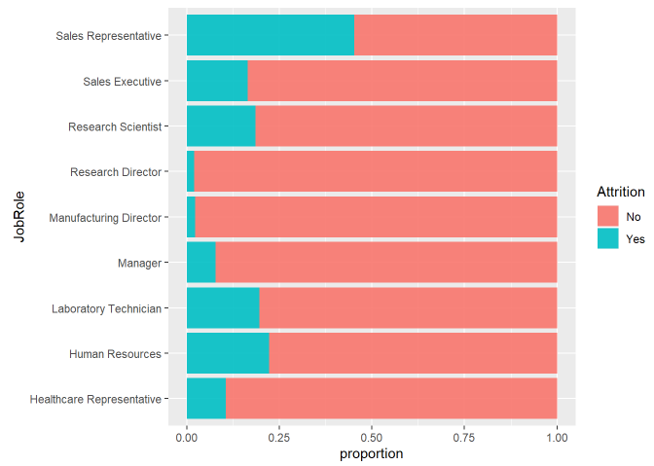
Employee Retention – Highest Attrition Jobs
45% of Sales Reps left the company
DDSANALYTICS

Slide 5
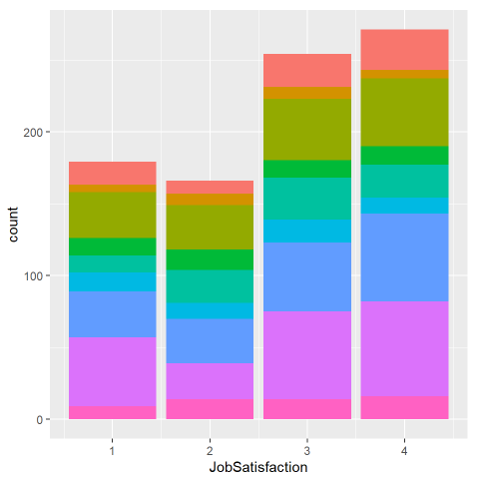
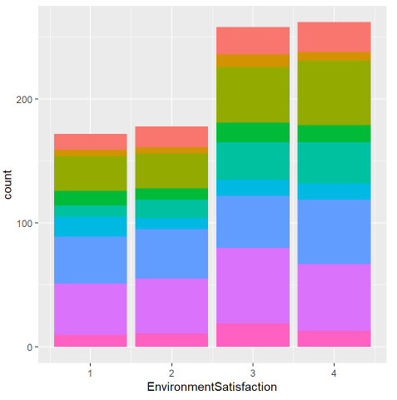
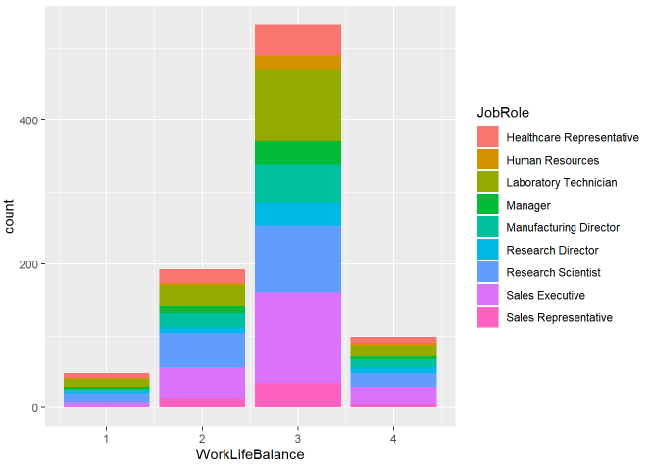
Satisfaction Scores and Issues with Subjective Metrics
DDSANALYTICS

Slide 6
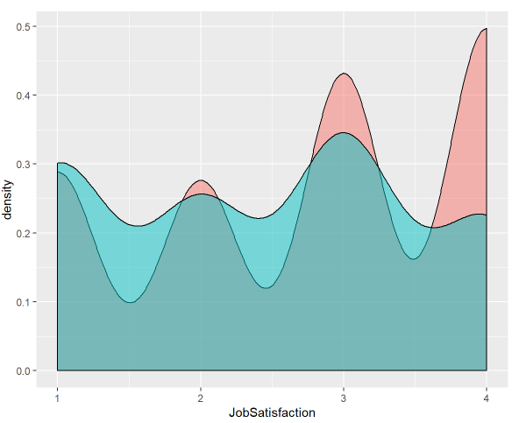
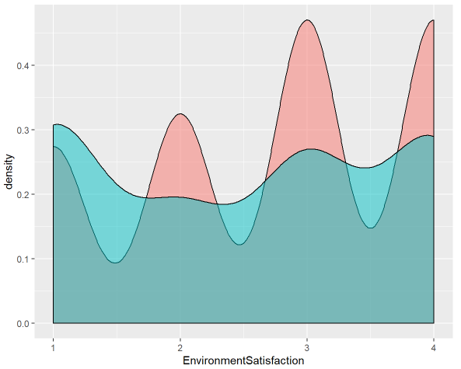
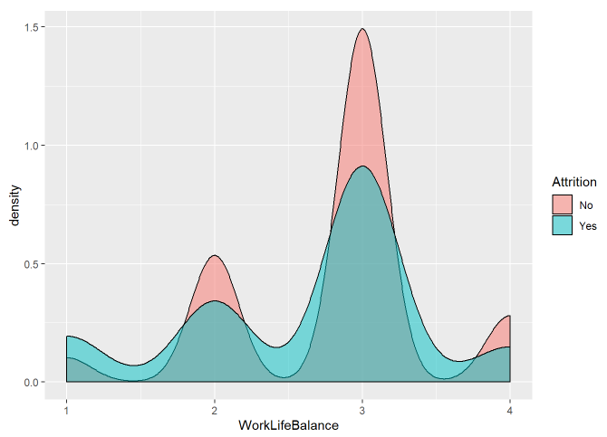
Satisfaction Scores
DDSANALYTICS

Slide 7
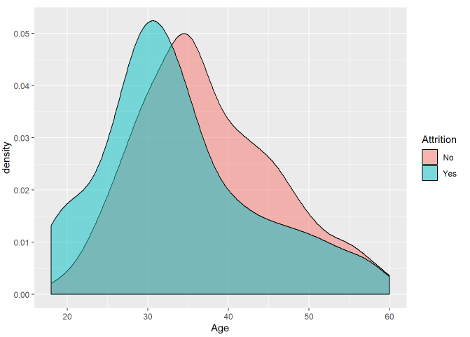
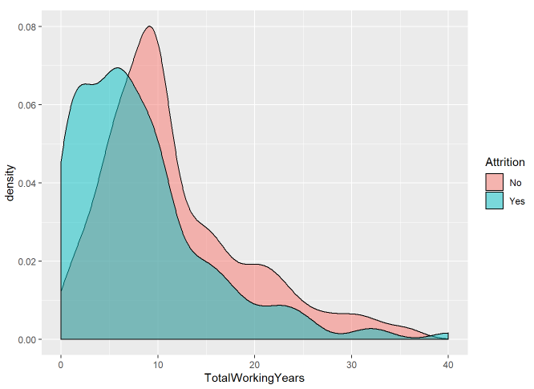
Employee Retention – Other Factors General Employee Info and History
DDSANALYTICS

Slide 8
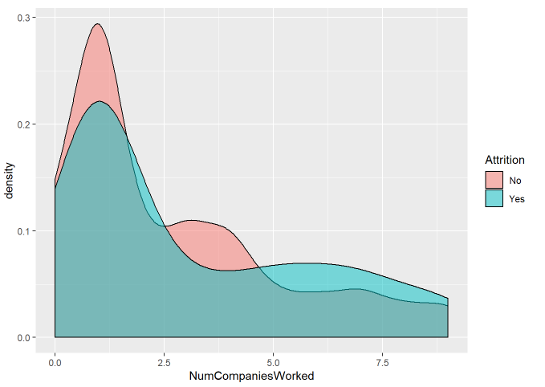
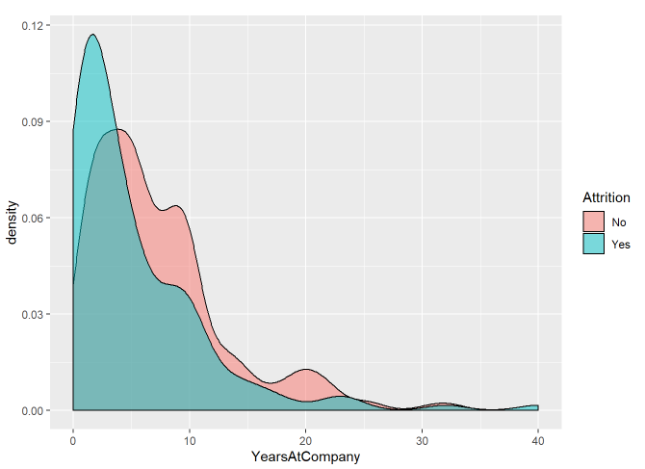
Employee Retention – Other Factors General Employee Info and History
DDSANALYTICS

Slide 9
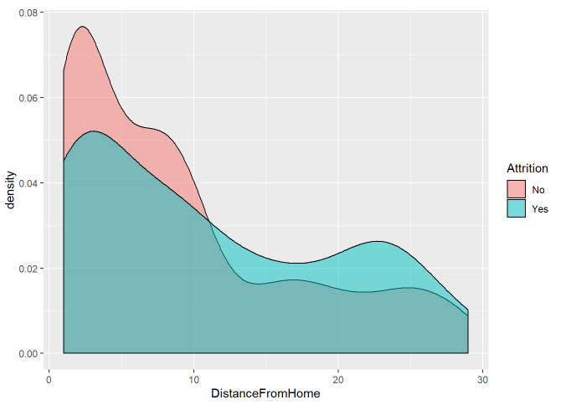
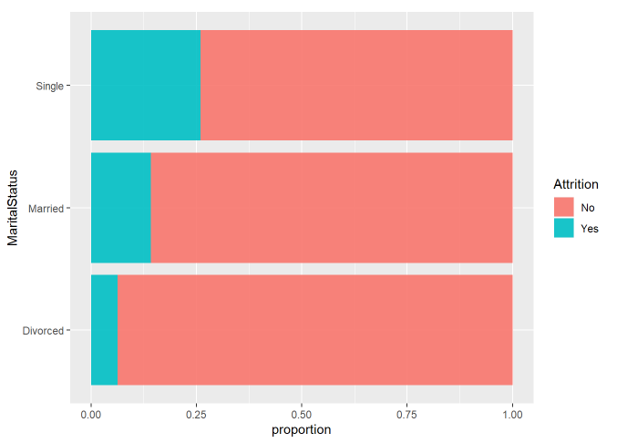
Employee Retention – Other Factors General Employee Info and History
DDSANALYTICS

Slide 10
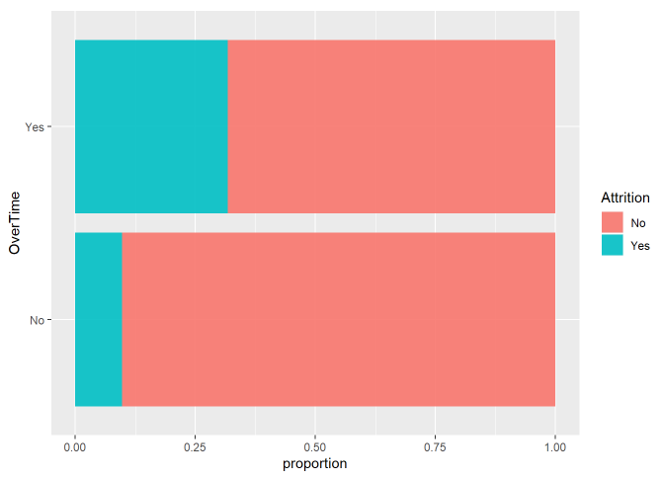
Employee Retention – Other Factors
DDSANALYTICS

Slide 11
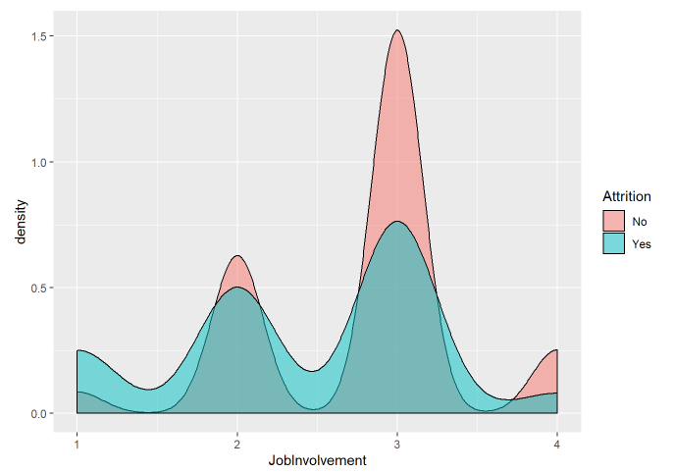
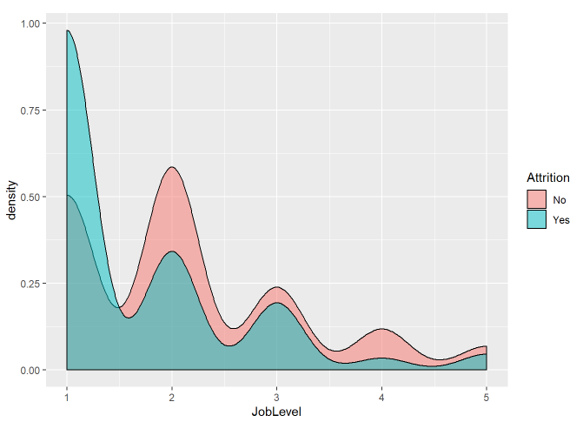
Employee Retention – Other Factors
DDSANALYTICS

Slide 12
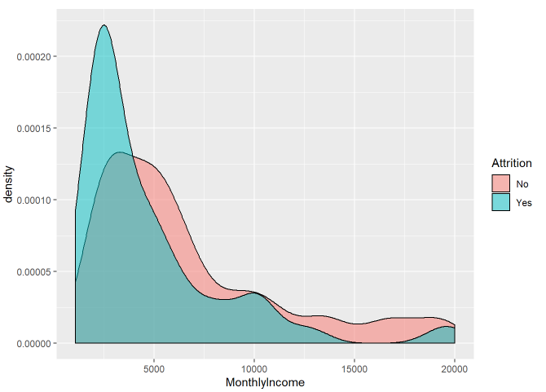
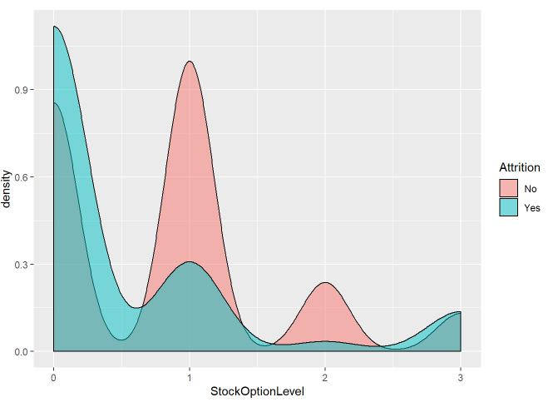
The Obvious One…
Salaries are important to employees.
DDSANALYTICS

Slide 13
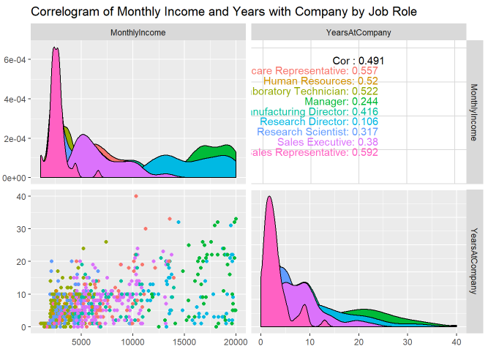
The Obvious One…
Salaries are important to employees.
Sales reps are paid the least, and last the shortest amount of time in their job roles
DDSANALYTICS

Slide 14
Prediction Model For Attrition
Two models tested to classify employees by attrition:
Naïve-Bayes
Logistic Regression
Model accuracy and sensitivity is initially high (the proportion of people who stay is much higher than those who leave) and specificity is low.
Adjust model for a balanced sensitivity and specificity (predicting both when employees will stay or leave)
Because the proportion of retention to attrition is high, balanced sens/spec will over-predict attrition.
DDSANALYTICS

Slide 15
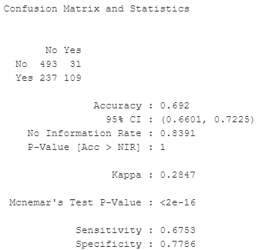
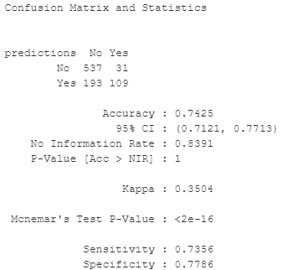
Prediction Model For Attrition
The logistic regression model produced better results
All Employees
Naïve Bayes Model
Logistic Regression Model
Talk with Employees most likely to leave
DDSANALYTICS

Slide 16
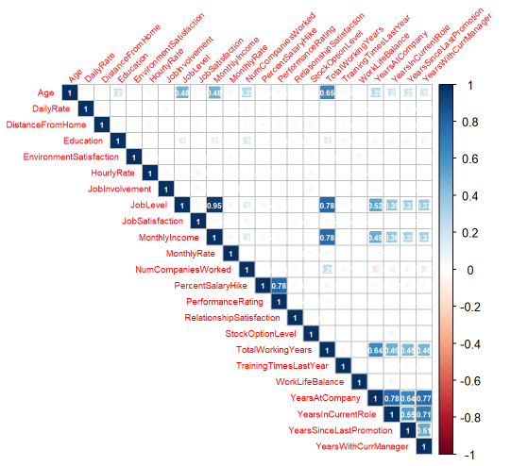
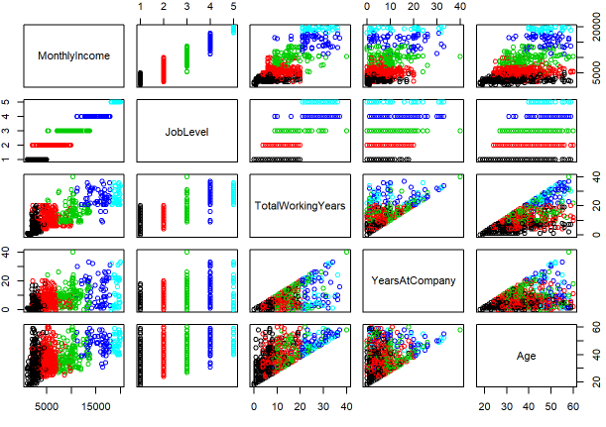
Prediction Model For Monthly Income
DDSANALYTICS

Slide 17
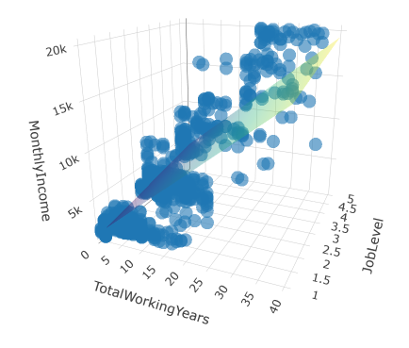
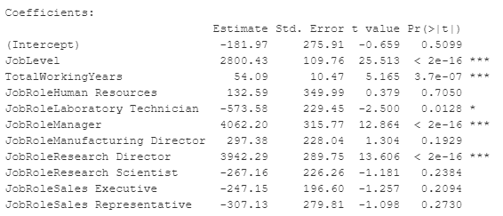

Prediction Model For Monthly Income
Final Model Parameters
Variable Selection Tool for categorical predictors
DDSANALYTICS

