Slide 1


Frito Lay
Talent management
DDSANALYTICS
Notes:
So today as part of our initial foray into talent management at Frito Lay we are going to be looking at some metrics that affect employee attrition as well as present the results of our predictive models for attrition and salaries.

Slide 2

Employee Retention - Goals
It’s not just about keeping people; it’s about making them happy to come to work here.
DDSANALYTICS
Notes:
A good point to summarize what we are going to see is this one: “It’s not just about keeping people; it’s about making them happy to come to work here.”
- and we have the data to back up why this isn’t just a cliché to toss aside.

Slide 3
Employee Retention - Goals
How much is attrition affected by satisfaction with:
Job Roles?
Work Environment?
Work-Life Balance?
Are there other factors contributing to employee attrition?
DDSANALYTICS
Notes:
We start with these 3 questions because they were asked of the employees in a survey so we could get a feel for their subjective sentiments about working here. We want to know: How much is attrition affected by satisfaction with * job roles, *work environments, and *work-life balance} Then we move on to some other categories that involve less subjective metrics. But before we dive into the “why” let’s look at where the most attrition is happening in the company.

Slide 4
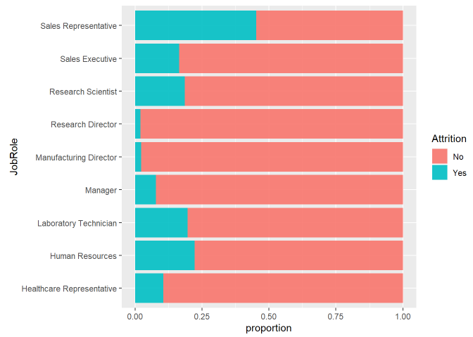
Employee Retention – Highest Attrition Jobs
45% of Sales Reps left the company
DDSANALYTICS
Notes:
This is a representation of all the company data we have on attrition by job role. More blue represents more attrition, and it clear that relative to other jobs, Sales reps have the highest attrition – nearly twice as much proportionately than any other job, with a 45% rate of attrition. Sales Execs, on the other hand, seem to want to stay. Generally speaking, managerial positions have better retention across the board, which is common.

Slide 5
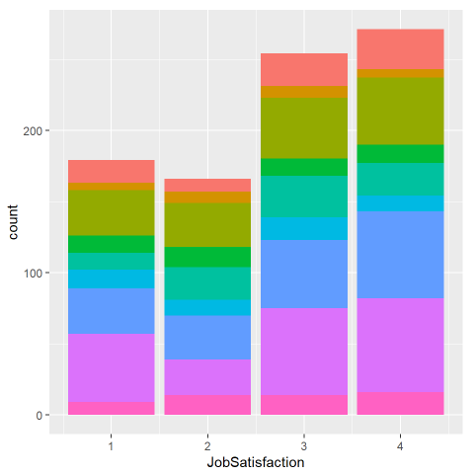
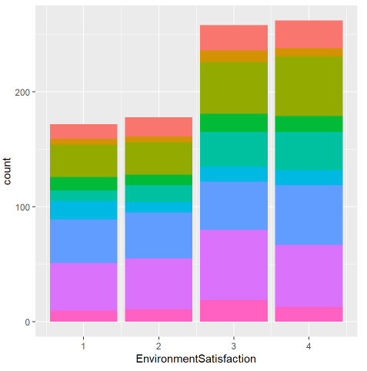
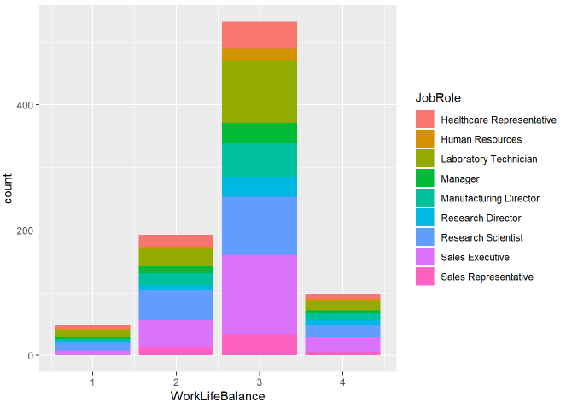
Satisfaction Scores and Issues with Subjective Metrics
DDSANALYTICS
Notes:
These are some bar plots of satisfaction scores from the surveys. These are mostly to give you an idea of the overall sentiments of company employees but it gives a little insight into the different scores by job role. It can be a bit hard to tell the individual changes between scores for each job role but our examination showed that the distributions were fairly similar for each job, so it didn’t shed much light on why sales reps had higher attrition. Employees often aren’t sure of what their responses are going to be used for, and newer employees tend to give higher scores for these questions regardless of position so they have to be taken with a grain of salt.

Slide 6
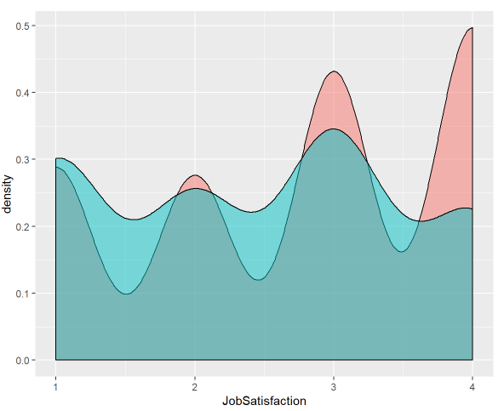
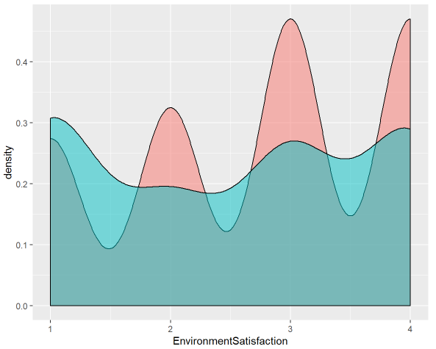
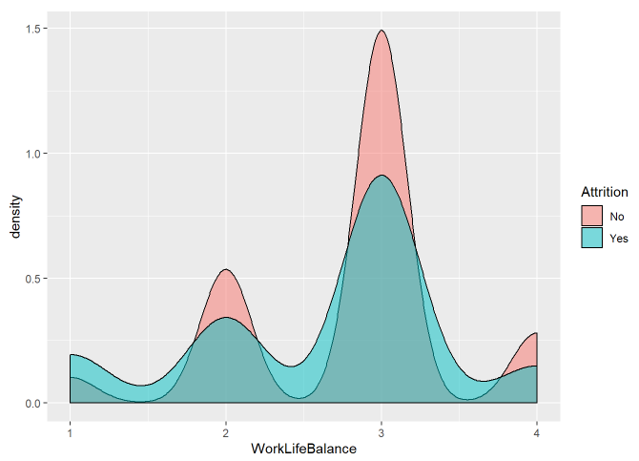
Satisfaction Scores
DDSANALYTICS
Notes:
However, if we look at how these scores affect attrition overall, there are some clear considerations to be taken into the responses. In these density plots, the blue again represents attrition, and you can clearly see that on the lower ends of each plot representing low satisfaction (or poor work-life balance) the proportion of employees that leave is higher than those that don’t. This demonstrates that taking these surveys periodically could give valuable insight needed to proactively find out what might be troubling employees before they leave.

Slide 7
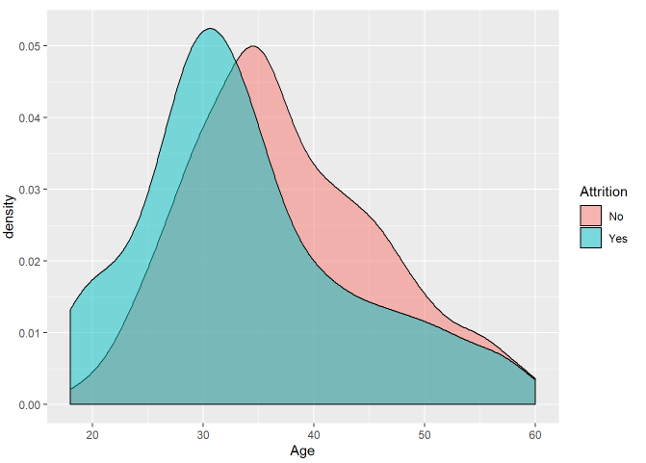
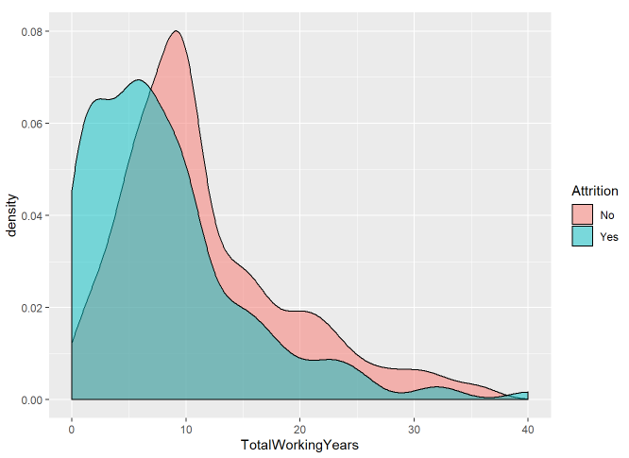
Employee Retention – Other Factors General Employee Info and History
DDSANALYTICS
Notes:
Let’s look at some other factors that can contribute to attrition, starting with those the company can’t necessarily control, but are useful for prediction based on some data exploration and our model that we’ll discuss in few moments. Remember for these plots we are seeing higher attrition where the blue is more prominent than red. So First we can see that older employees that have been in the workforce longer tend to have lower rates of attrition.

Slide 8
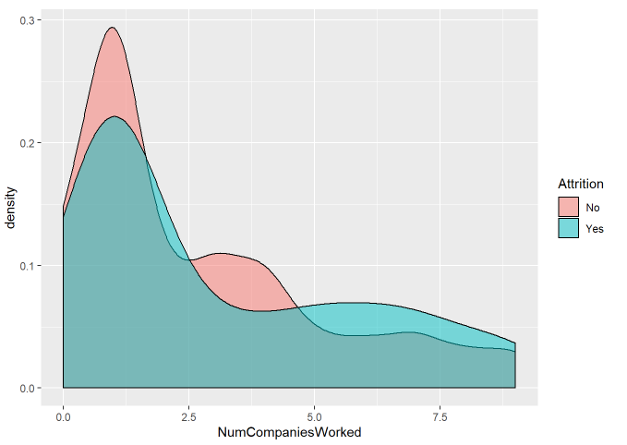
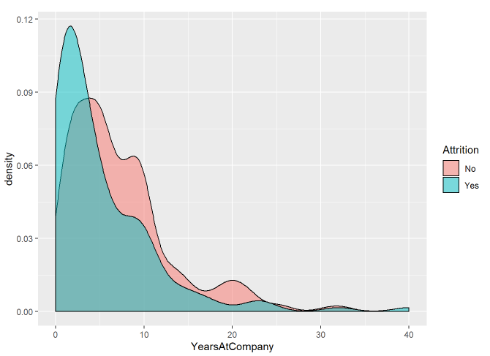
Employee Retention – Other Factors General Employee Info and History
DDSANALYTICS
Notes:
This can be compared to how many companies the employees have worked with previously and how long they’ve been with Frito Lay. You can see how you can predict that if someone has changed jobs a lot before, they are likely to again, and most of the attrition here happens in the first couple years.

Slide 9
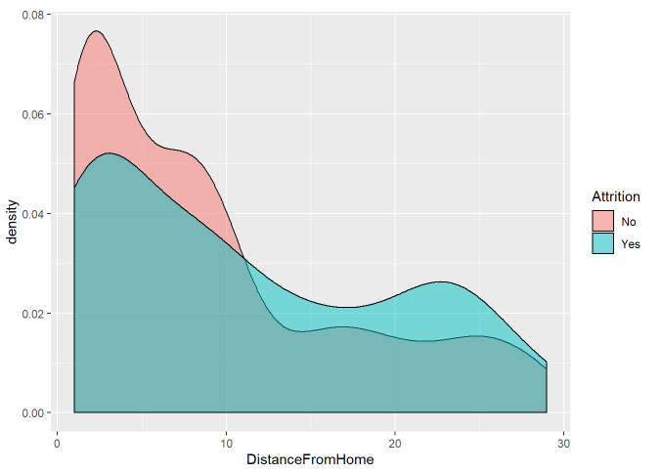
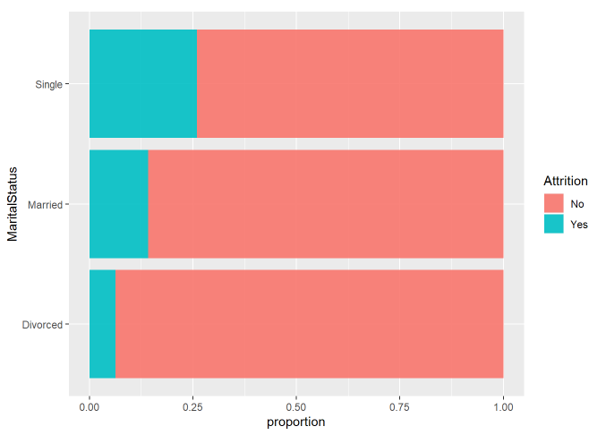
Employee Retention – Other Factors General Employee Info and History
DDSANALYTICS
Notes:
Commute time is another intuitive indicator of if employees are more likely to leave as indicated by the plot of distance from home. This might be an area of improvement with some company flexibility for certain positions for work-from-home opportunities or perhaps aid in covering transportation costs. Marital Status has high implications on attrition so it can be useful for prediction, but we certainly don’t want to encourage a marriage and subsequent divorce to decrease the chances of attrition. Its likely just correlated with life stage.

Slide 10
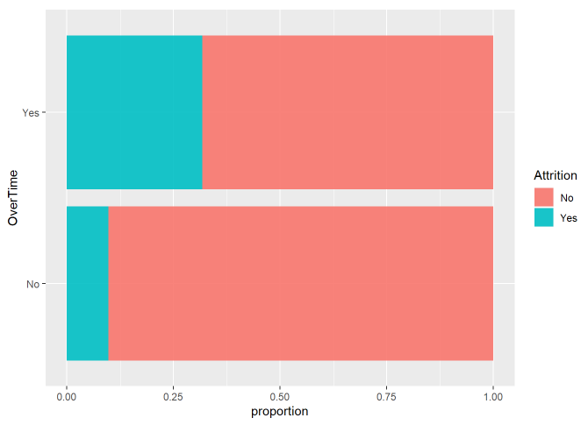
Employee Retention – Other Factors
DDSANALYTICS
Notes:
Now there is one area where the company may be to make some changes that could have big effects. The plot you see and our prediction model revealed this as the most important factor in determining attrition, and that’s overtime. Employees that have any amount of overtime are 3 times as likely to leave as those that dont. It would be worth the company’s time to explore this in more detail to see if there is anything that can be done to mitigate this effect.

Slide 11
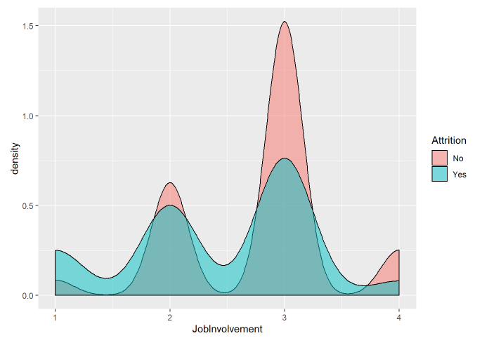
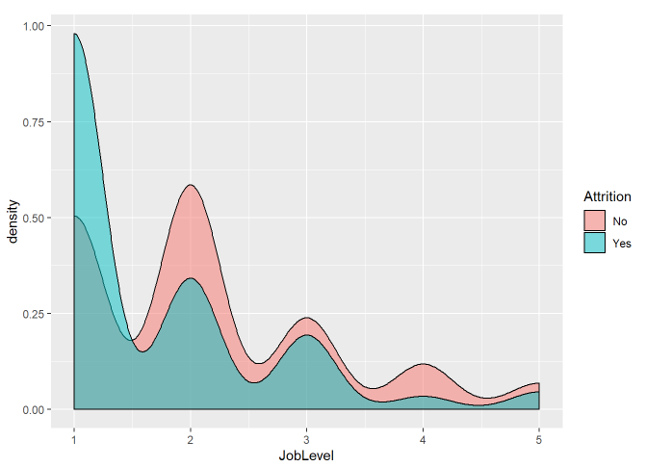
Employee Retention – Other Factors
DDSANALYTICS
Notes:
Job involvement is another subjective score that shows some level of improved retention for employees that believe they are more involved so it could be prudent for the company to make sure all employees feel that they are making a significant contribution. As job level likely increases with time spent in the job, it makes sense that attrition would decrease as job level increases. This variable was extremely important to our Salary model that we’ll go over, and leads us to our last observation on employee retention -

Slide 12
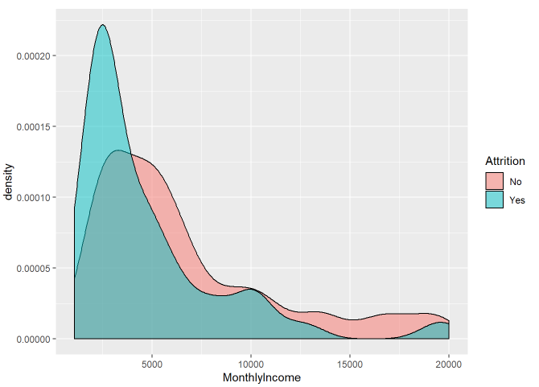
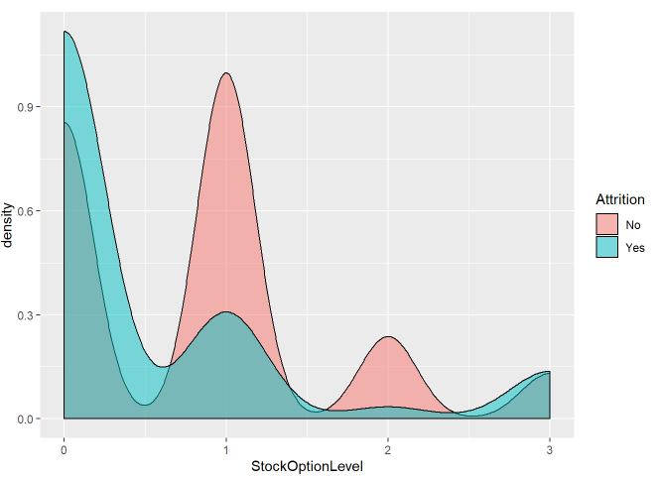
The Obvious One…
Salaries are important to employees.
DDSANALYTICS
Notes:
And that’s that money matters. The lowest paid workers are the most likely to leave, and you can also see the huge drop in attrition when employees have at least some level of stock options in Frito Lay. Offering that to more employees could be a good improvement.

Slide 13
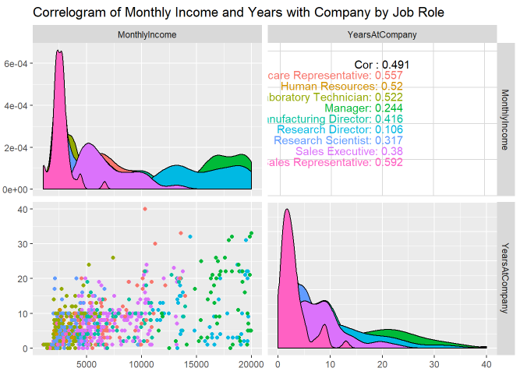
The Obvious One…
Salaries are important to employees.
Sales reps are paid the least, and last the shortest amount of time in their job roles
DDSANALYTICS
Notes:
And we can look back at sales reps (which are in pink on these plots) and see why they might have the highest attrition. Sales reps are paid the least, and last the shortest amount of time in their job roles
So Its no secret that money keeps employees and that shows here. But that gives us a good segway into a short discussion of the models you asked us to build for attrition and Salary determination…

Slide 14
Prediction Model For Attrition
Two models tested to classify employees by attrition:
Naïve-Bayes
Logistic Regression
Model accuracy and sensitivity is initially high (the proportion of people who stay is much higher than those who leave) and specificity is low.
Adjust model for a balanced sensitivity and specificity (predicting both when employees will stay or leave)
Because the proportion of retention to attrition is high, balanced sens/spec will over-predict attrition.
DDSANALYTICS
Notes:
I’m not going to go into much detail on how these models were built, but the whole arduous process is laid out in the rmd file that accompanies this presentation. But the important thing to note about our goal for the attrition model was to obtain a balanced sensitivity and specificity. Because our data (obviously) includes a number of employees that left the company that is much fewer than those that stayed, there is going to be a tendency for any model to be biased toward predicting that people are going to stay to raise overall accuracy of the model. But I believe the best model for this situation is one which sacrifices accuracy by decreasing sensitivity and shifting that bias toward over-predicting that employees will leave, so that maybe the company can do something about it. After all, There’s never anything wrong talking with an employee about what might improve their job satisfaction, but there’s little you can do about it if they’ve already left.

Slide 15
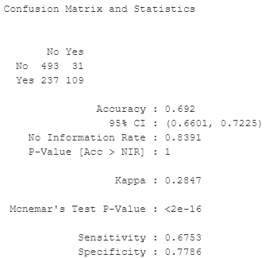
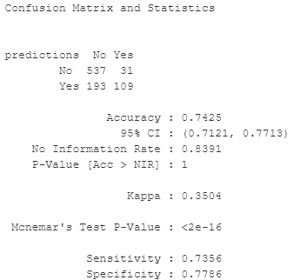
Prediction Model For Attrition
The logistic regression model produced better results
All Employees
Naïve Bayes Model
Logistic Regression Model
Talk with Employees most likely to leave
DDSANALYTICS
Notes:
The balance was achieved using a synthetic oversampling technique that produced a training set with an approx. equal number of attrition and retention responses to build the model. The variables used were selected based on the EDA (most of which we discussed) and some automated selection tools. The better model for our goal ended up being the logistic regression model. Note the balanced sensitivity and specificity from over-predicting a “yes” response. The overall model accuracy is actually less than the “no-information” rate which would mean predicting that no employees ever leave (which would be silly), and this highlights why model accuracy can be less important and less informative than the proportions of correctly identifying each of the outcomes.

Slide 16
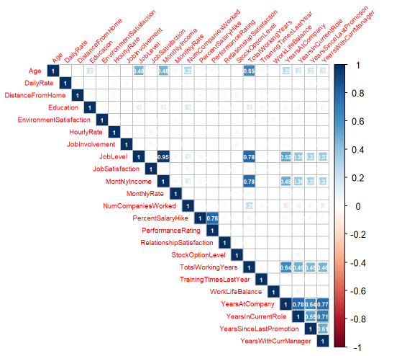
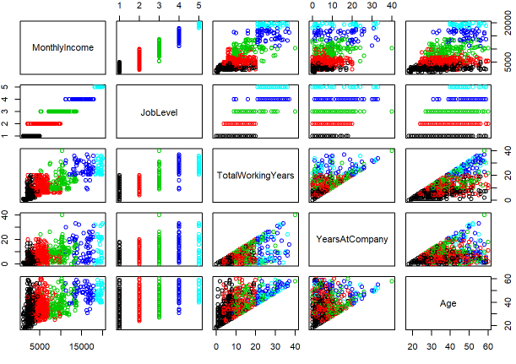
Prediction Model For Monthly Income
DDSANALYTICS
Notes:
Building the multiple linear regression model for predicting salary was relatively straightforward. We started with identifying which numeric variables were correlated with Monlthy income using a correlation chart, and then plotted those variables to observe the trends. Job level jumped out the most, so the plots were color coded by job level. We attempted some transformations for some variables like Age, but couldn’t improve their linearity much.

Slide 17
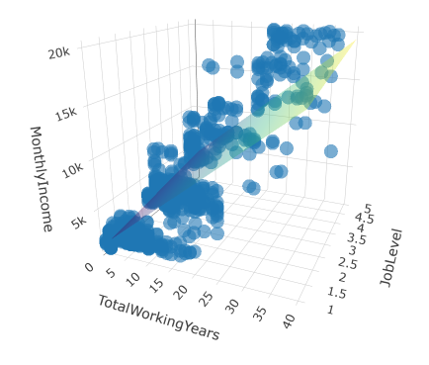
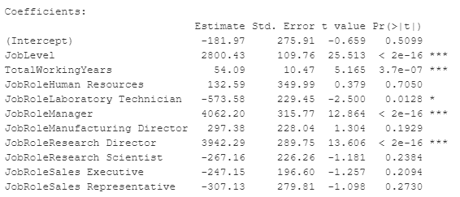

Prediction Model For Monthly Income
Final Model Parameters
Variable Selection Tool for categorical predictors
DDSANALYTICS
Notes:
Using only the numeric variables of Job level and Total Working years, we could get a pretty good model - represented by the 3d plot of them with the regression model plane. A variable selection tool was used to identify any categorical variables that might improve prediction and we finally settled on a model that achieved an adjusted R-squared of .957 by only adding the Job Role variable to what we had. All of this to mean that intuitively, Job Role and level along with the how long an employee has worked are the biggest determinants of salary.

