Slide 1
Progress Report
December 2024
Joshua Chapman

Slide 2
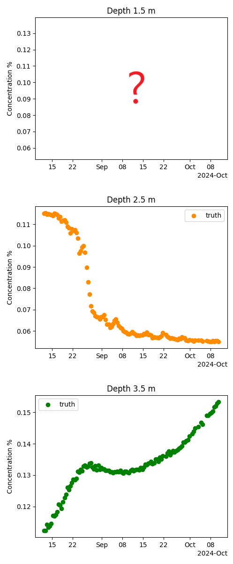
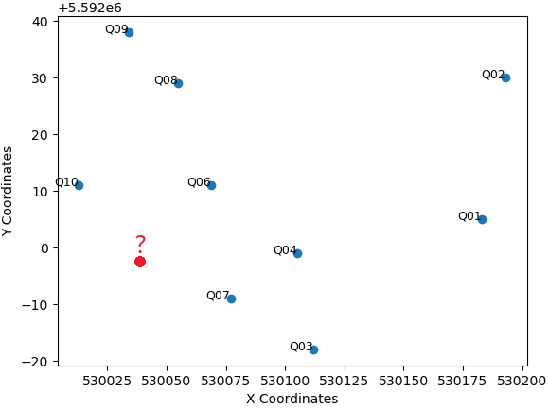
The Problem: Spatial Estimation
Hard Problem:
What is the concentration of PHC
at an unmeasured 3D location
Slightly Easier Problem:
What is the concentration at
an unmeasured depth?

Slide 3
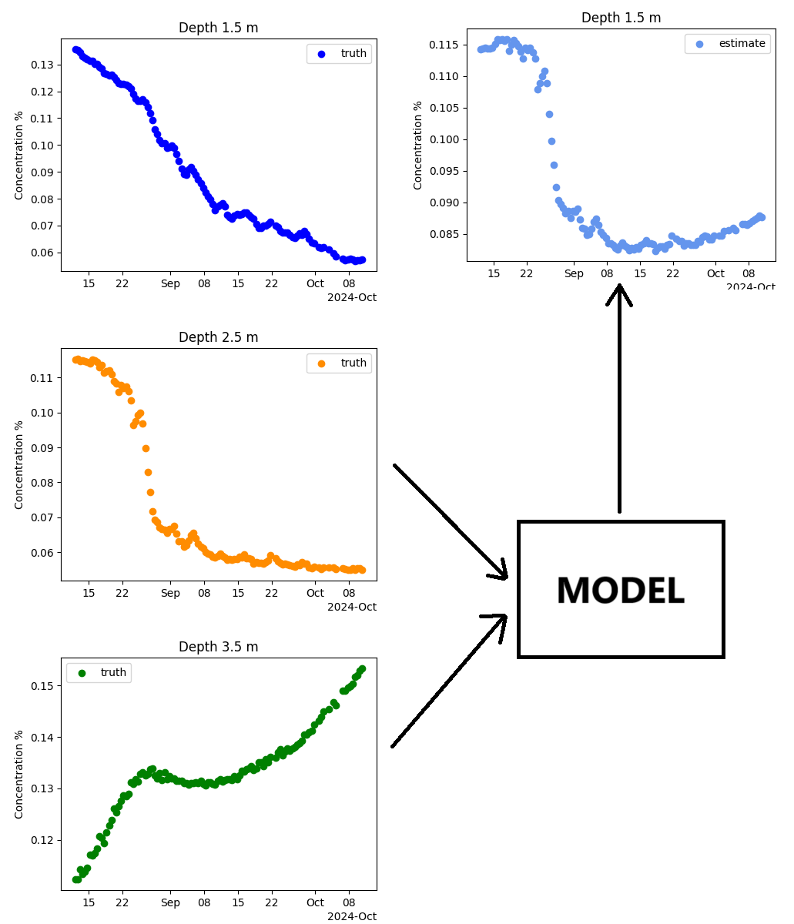
Outline for Testing Different Methods
Two sensors are inputs to a given model
The model produces an estimate of the sensor not included as an input

Slide 4
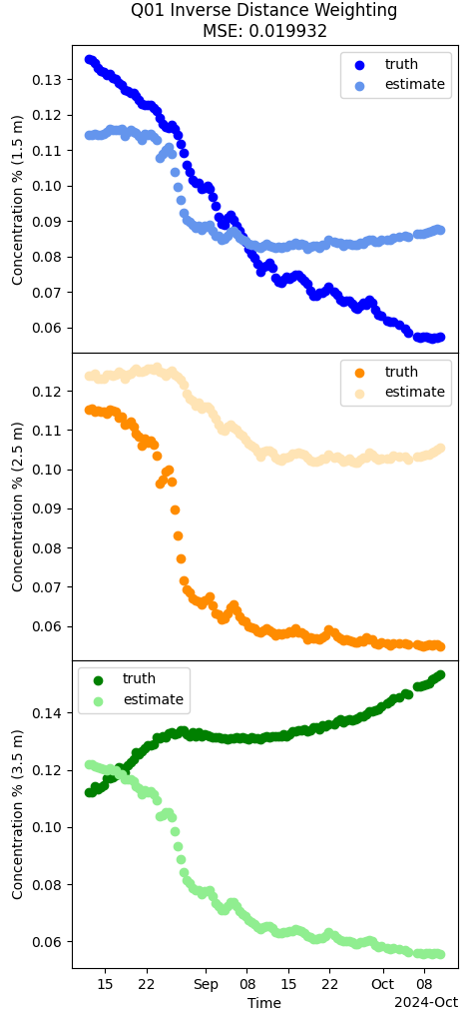
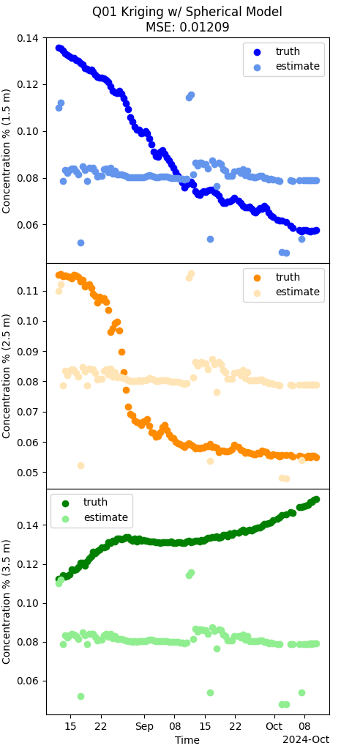
Simple Methods
Inverse Distance Weighting
The unknown sensor is estimated as a function of distance to the other sensors
Kriging
Also weighted as a function of distance, however the distance is determined as a function of a fitted curve

Slide 5
Physics-Based Estimation
The physics model takes two sensors for training. The remaining sensor is used for validation.
A gradient descent algorithm optimizes a grid-based simulation to fit to the training sensor data.
Once optimization is complete, the simulated data at the depth of the validation sensor is extracted for comparison with the test measurements.

Slide 6
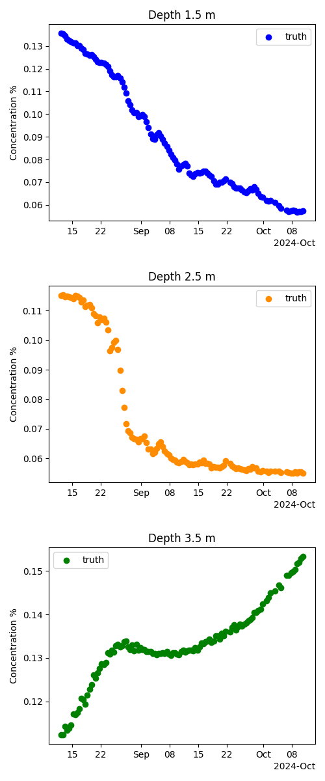
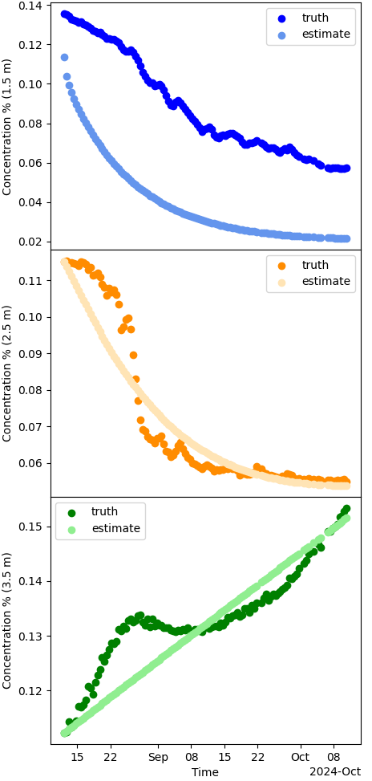
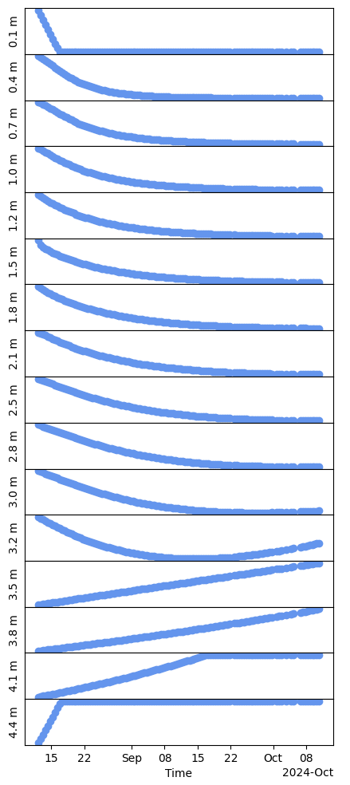
Our Approach – Physics-Based Estimation
Measurements
Comparison of measurements simulation
Results of multiple cells from the simulation
Simulation
Parameter Optimizer

Slide 7
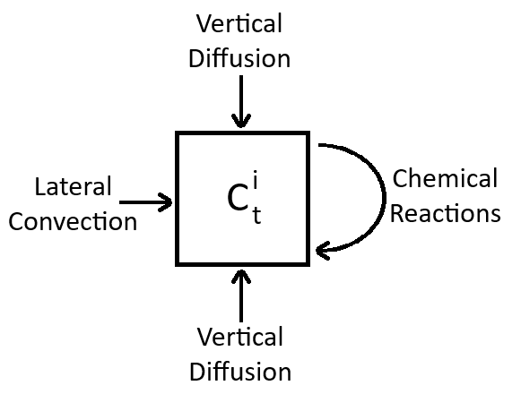

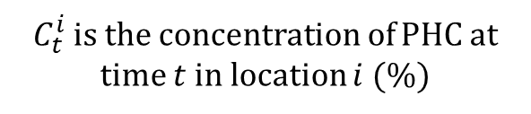
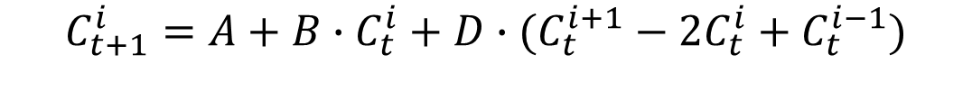
Physics Model
A: Lateral Advection (% per hour)
  ${10}^{−4}≤{A≤−10}^{−7}or {10}^{−7}≤A≤{10}^{−4}, A∈ℝ$
B: Chemical Reactions (unitless)
  ${−10}^{−3}≤{B≤−10}^{−6}or {10}^{−6}≤B≤{10}^{−3}, B∈ℝ$
D: Diffusion Coefficient ($m^{2}$ per hour)
  ${10}^{−12}≤D≤{10}^{−5}, D∈ℝ$
$C_{t}^{i}$ is the concentration of PHC at time $t$in location $i$(%)
$$C_{t+1}^{i}=A+B∙C_{t}^{i}+D∙(C_{t}^{i+1}−2C_{t}^{i}+C_{t}^{i−1})$$

Slide 8
Comparison
Mean-Squared Error (MSE)
 | Inverse Distance Weighting | Kriging | Physics-based
Q01 | 2.10E-02 | 1.21E-02 | 4.83E-02
Q02 | 4.97E-04 | 4.85E-03 | 9.46E-04
Q03 | 1.80E-02 | 2.90E-01 | 1.07E-02
Q04 | 3.34E-01 | 2.01E-01 | 2.46E-01
Q06 | 4.37E-01 | 1.04E-01 | 1.11E-01
Q07 | 4.64E-02 | 3.12E-01 | 1.45E-02
Q08 | 2.26E-01 | 9.35E-02 | 7.22E-02
Q09 | 1.23E-02 | 1.05E-01 | 1.27E-02
Q10 | 1.20E-01 | 3.55E-01 | 2.52E-02
Average MSE | 1.35E-01 | 1.64E-01 | 6.01E-02

Slide 9
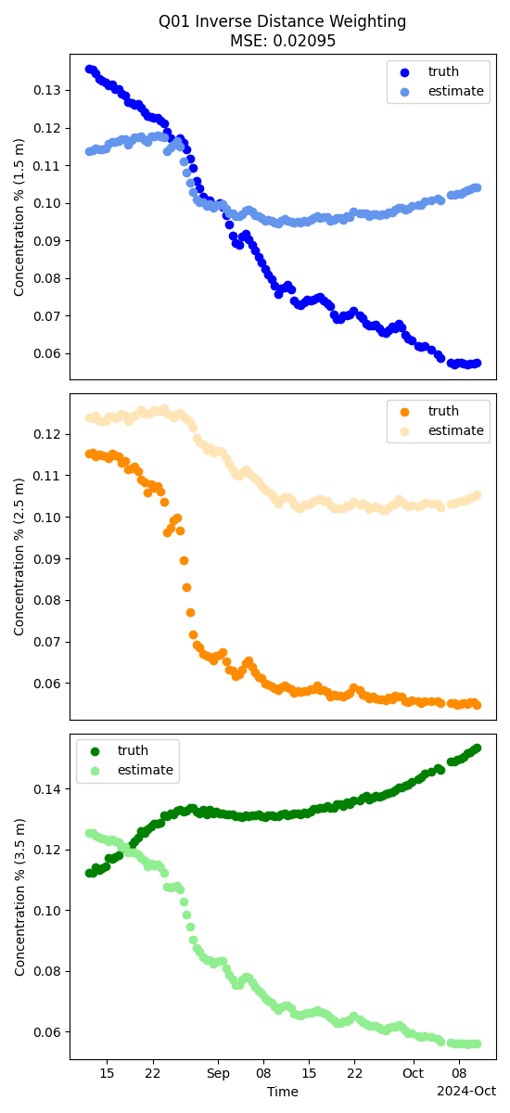
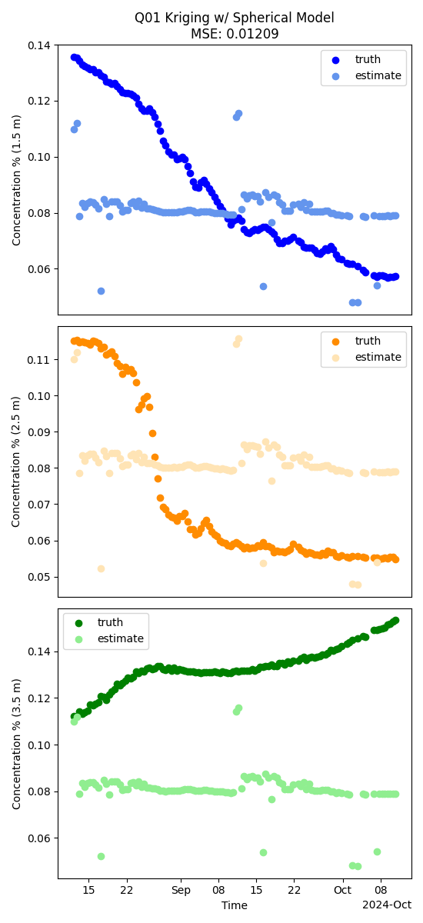
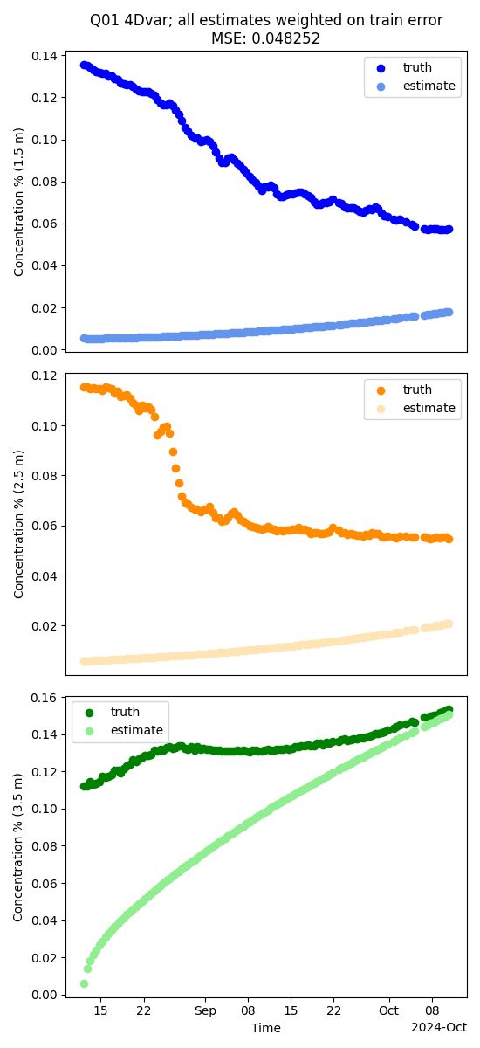
More comparison

Slide 10
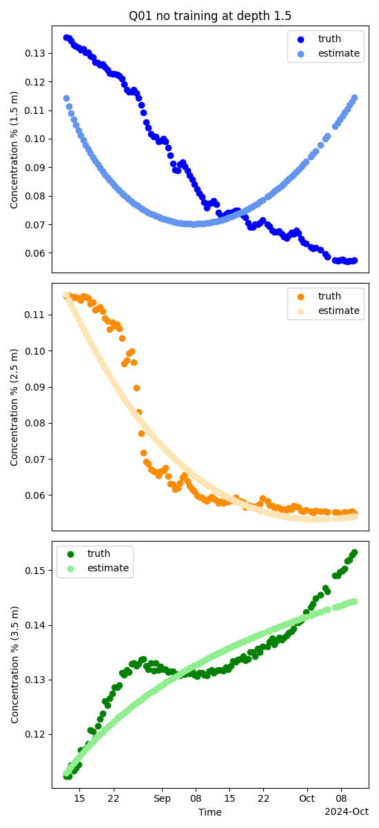
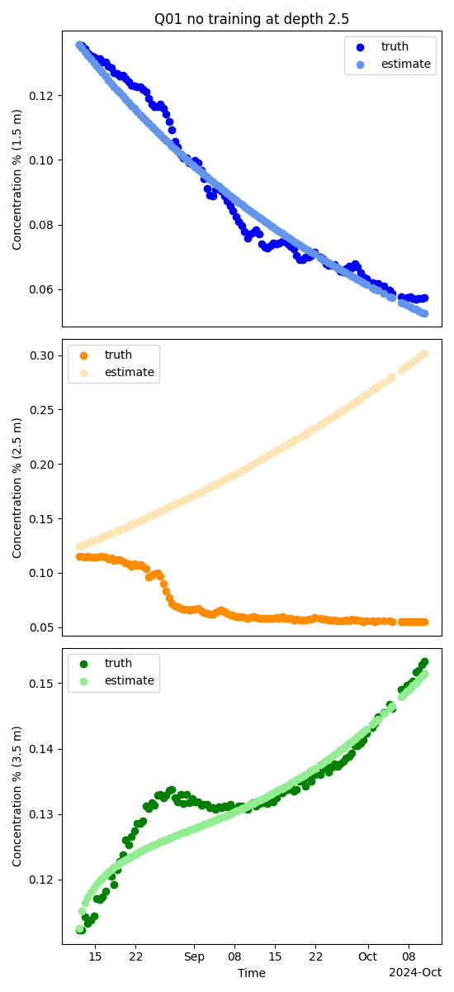
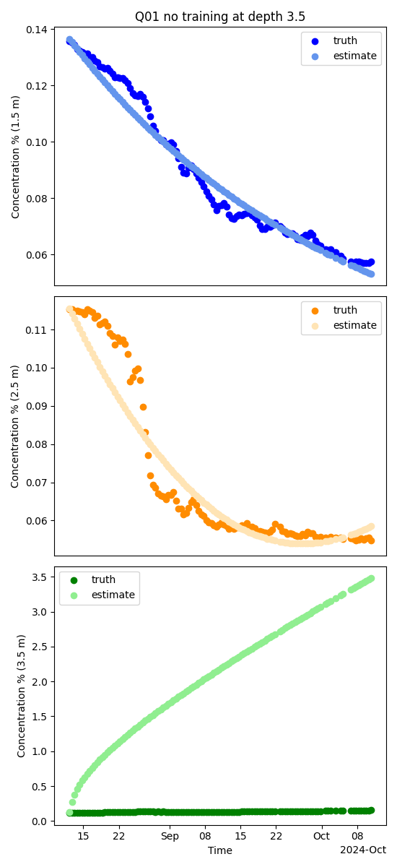
The Issues
Cells without training data trend towards extreme behavior to quickly fit the cells with training data
Difficult to estimate the initial concentration of PHC at the test depth
Steps for Improvement
Limiting the parameter space
Reducing the training time of parameter tuning
Taking weighted averages of multiple simulation estimates
Determining a better method for determining the initial concentration of the unknown sensor

Slide 11
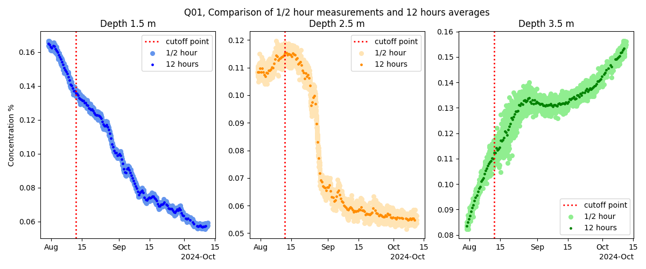
Pre-processing
Data averaged to 12 hours
Data selected from Aug 12-Oct 12
Notes:
Confirm those dates
Add plots outlining the process

Slide 12
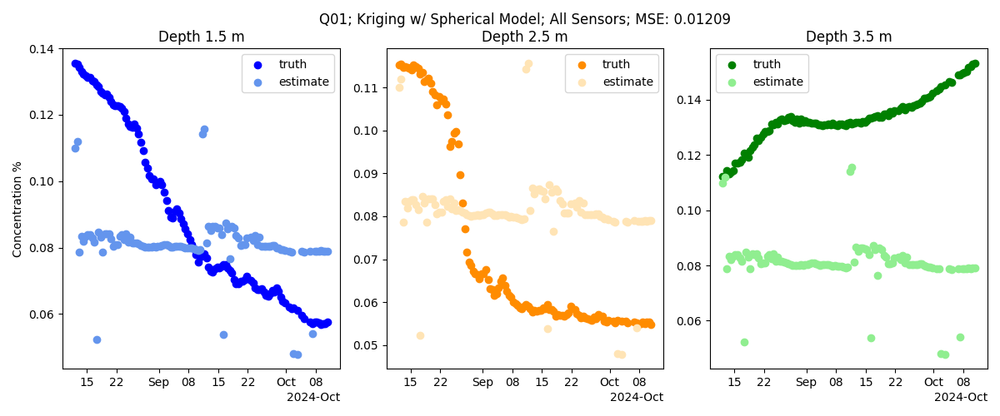
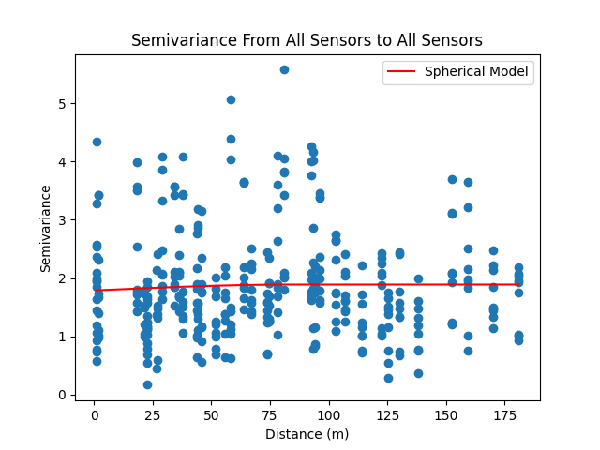
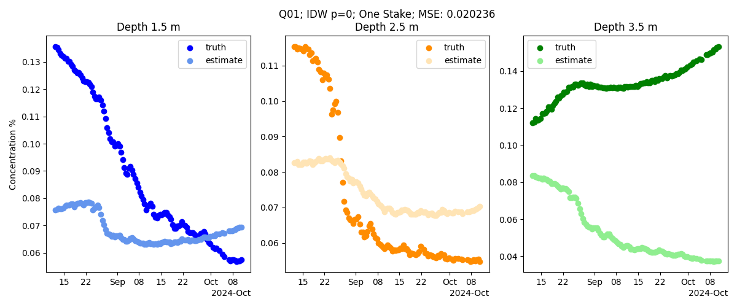
Spatial Estimation
Inverse Distance Weighting
Kriging using exponential, linear, spherical & gaussian models

Slide 13
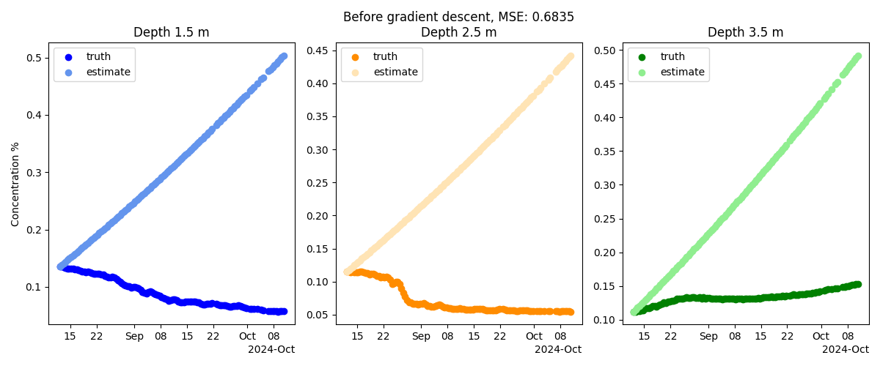
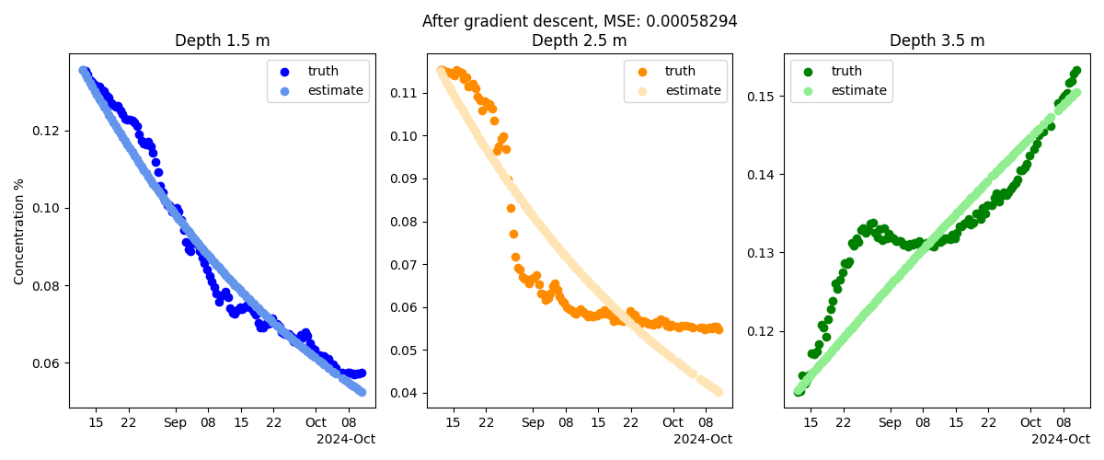
Parameter Estimation

Slide 14
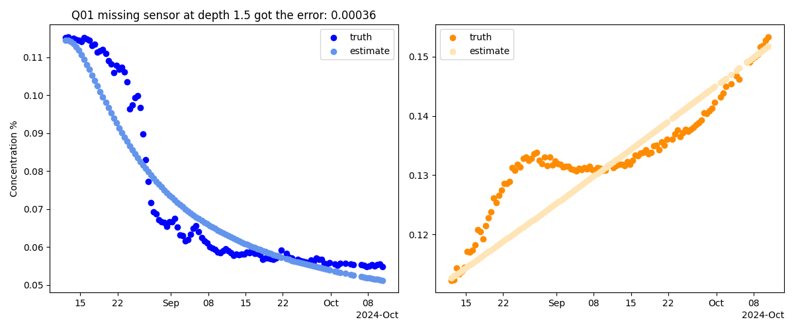
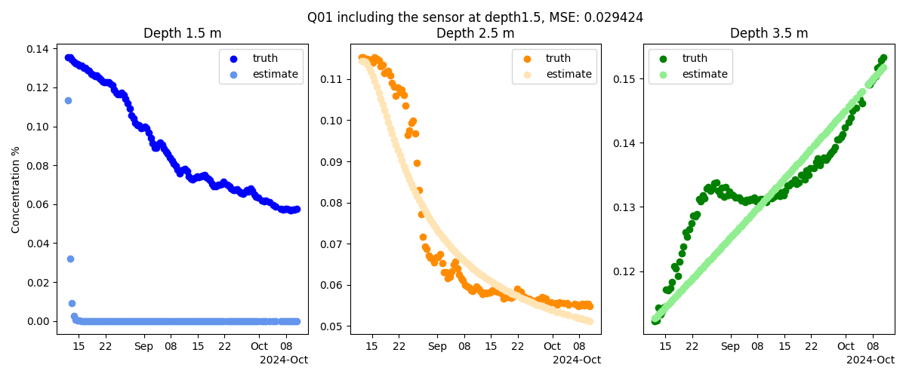
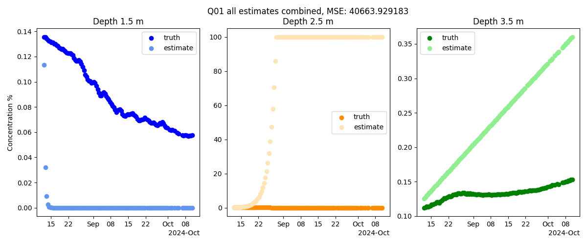
Performance on unseen data

