Slide 1
Analysis and Comparison of Spatial Interpolation Methods for Modelling the Movement and Remediation of Hydrocarbons in Soil
By Joshua Chapman
Supervised by Dr. Kevin Stanley

Slide 2
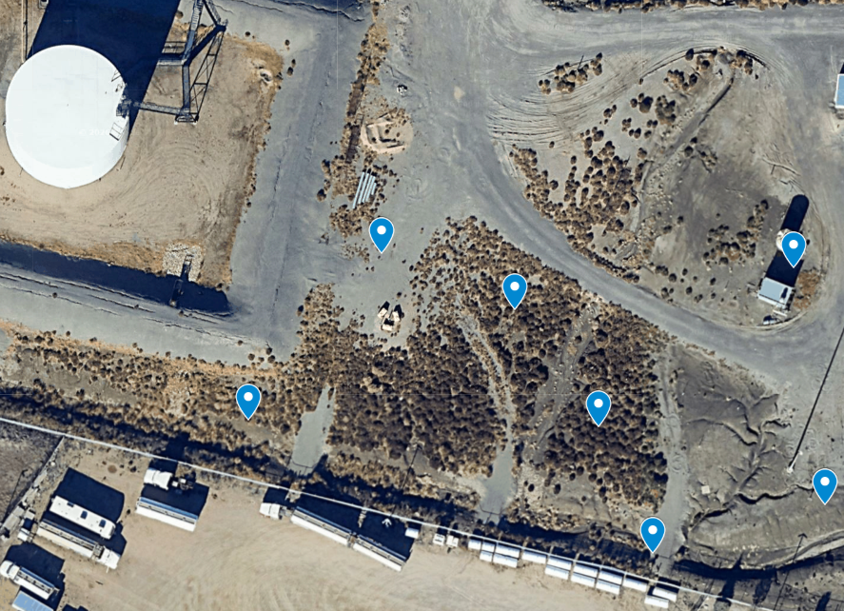

3D Interpolation of Petroleum Hydrocarbons (PHC)
Sensor Stake Location

Slide 3
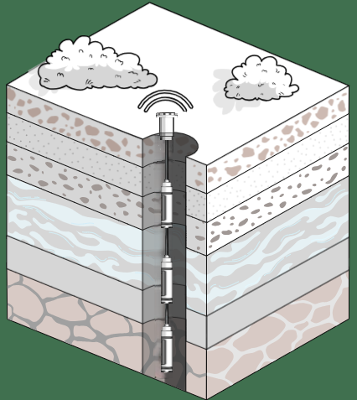
3D Interpolation of Petroleum Hydrocarbons (PHC)
3x PHC Sensors per Stake
1.5 m
2.5 m
3.5 m
Sensor Stake Location

Slide 4
1D Interpolation with Depth
1.5 m
2.5 m
3.5 m

Slide 5
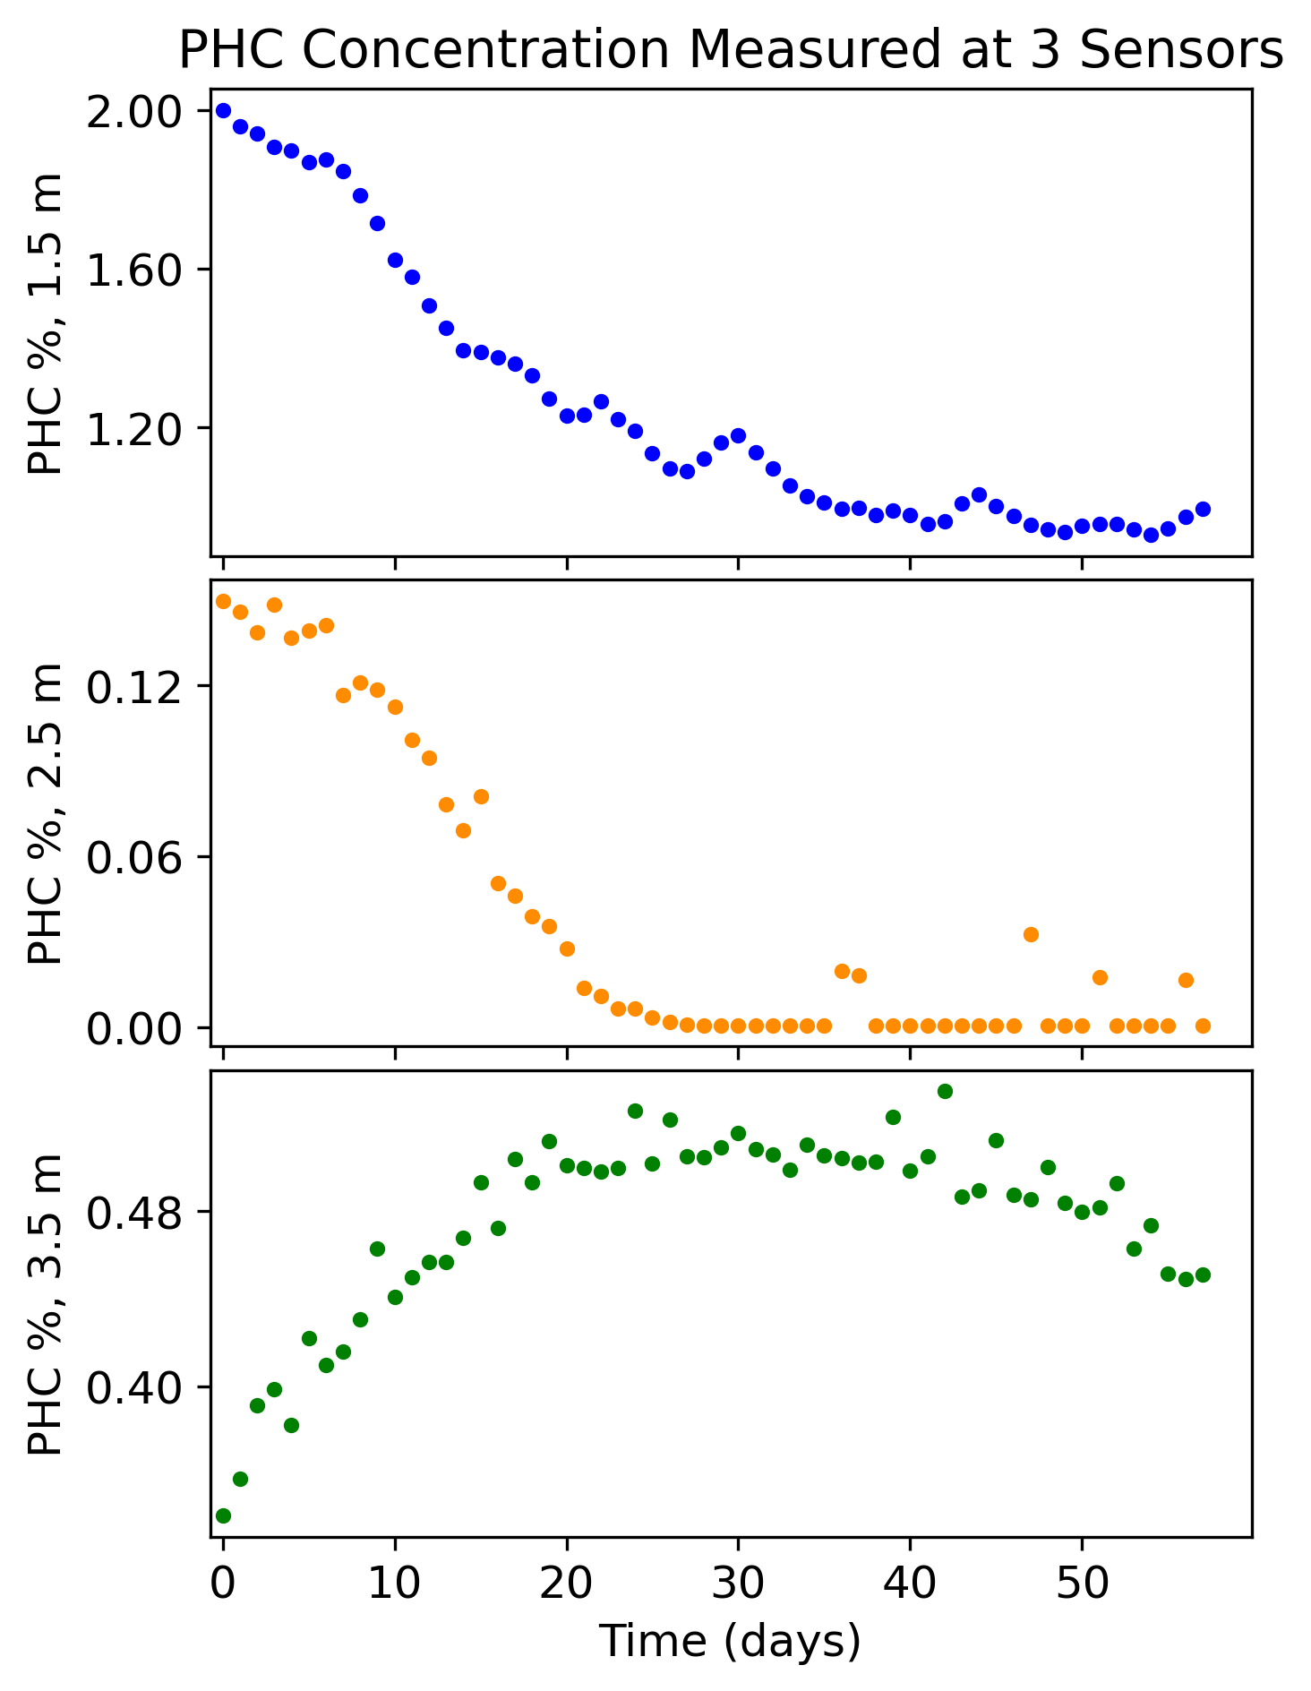
1D Interpolation (Depth)
Given
Sensors measure concentration (%) of PHC in the surrounding air
1.5 m
2.5 m
3.5 m

Slide 6
1D Interpolation (Depth)
Given
Given
Find
?
The PHC concentration (%) at all un-measured depths
1.5 m
?
2.5 m
?
3.5 m
?
Notes:
Add an explanation for % here

Slide 7
Spatial Interpolation Methods

Slide 8
Spatial Interpolation Methods
Distance-Based
Inverse Distance Weighting
Kriging
Notes:
Remove the other ones from this
We did these ones BECAUSE

Slide 9
Spatial Interpolation Methods
Distance-Based
Parameter Estimation
Inverse Distance Weighting
Kriging
4D-Var
Gauss-Levenberg-Marquadt
Iterative Ensemble Smoother
Notes:
Remove the other ones from this
We did these ones BECAUSE

Slide 10
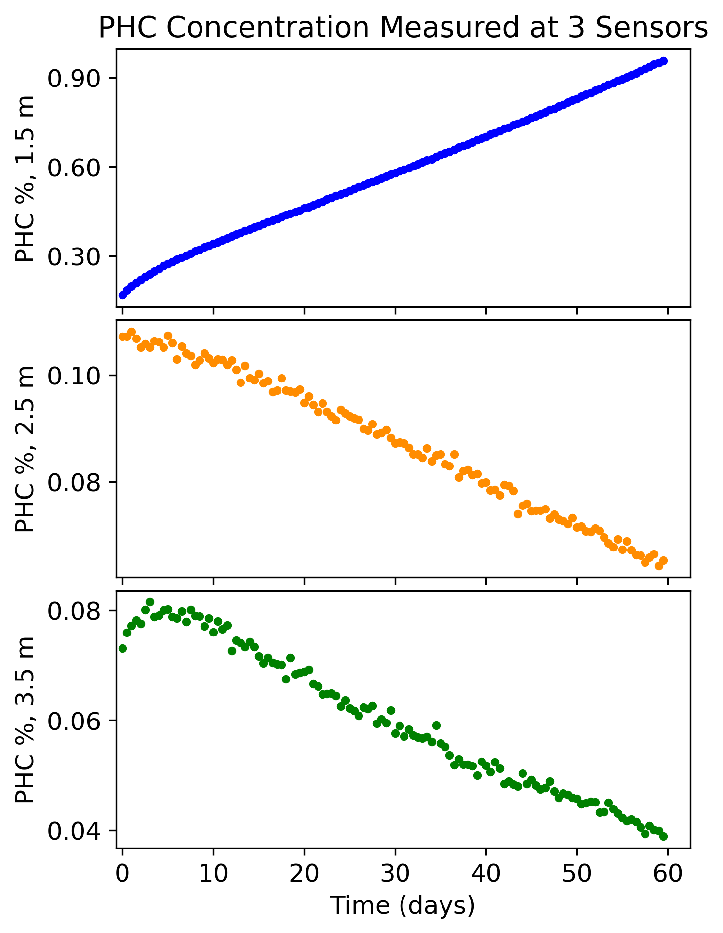
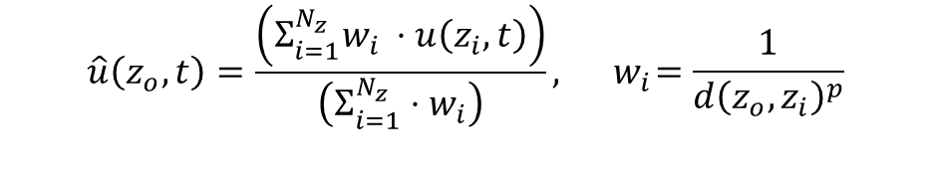
Inverse Distance Weighting (IDW)
$$\hat{u}\left(z_{o},t\right)=\frac{\left(Σ_{i=1}^{N_{z}}w_{i} ⋅u\left(z_{i},t\right)\right)}{\left(Σ_{i=1}^{N_{z}}⋅w_{i}\right)},{ w}_{i}=\frac{1}{d{\left(z_{o},z_{i}\right)}^{p}}$$

Slide 11
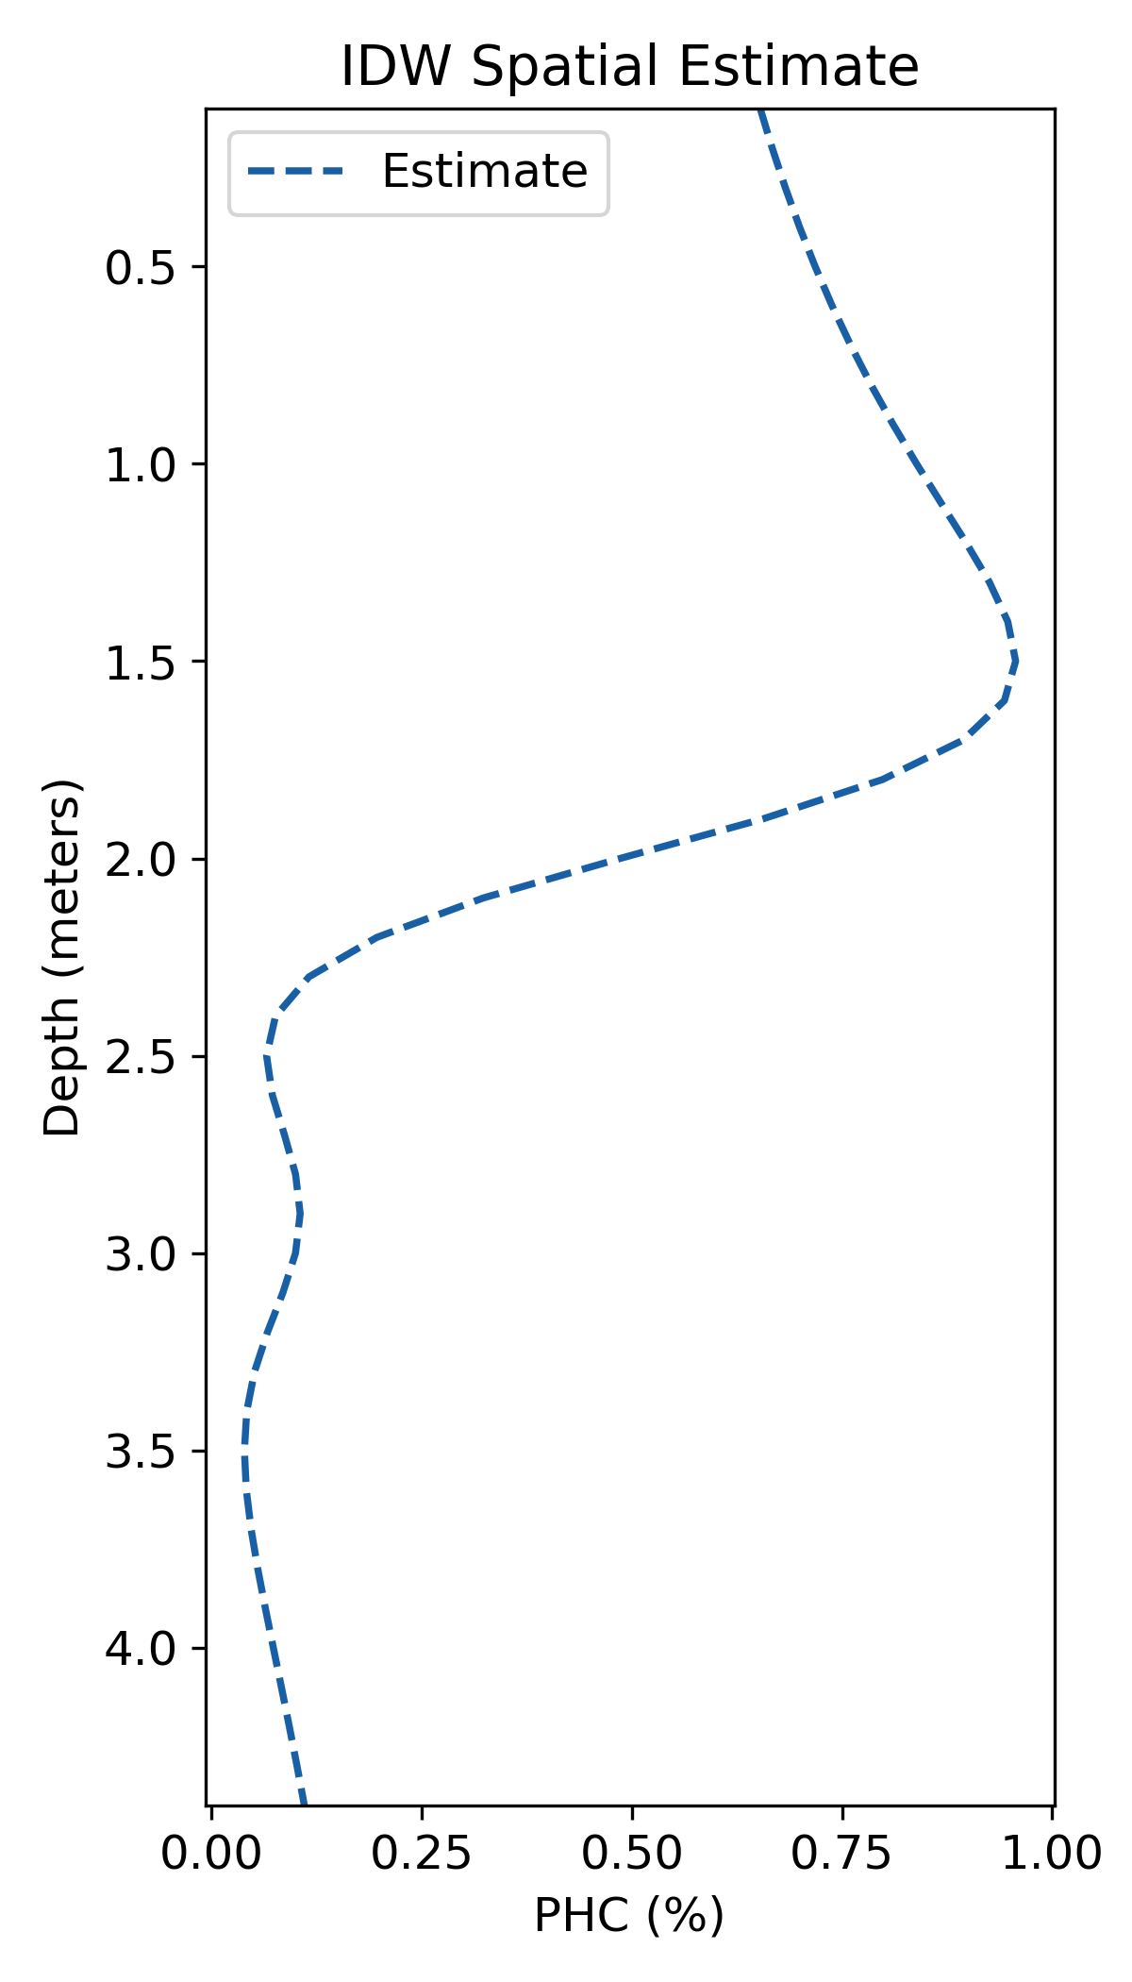
Inverse Distance Weighting (IDW)

Slide 12
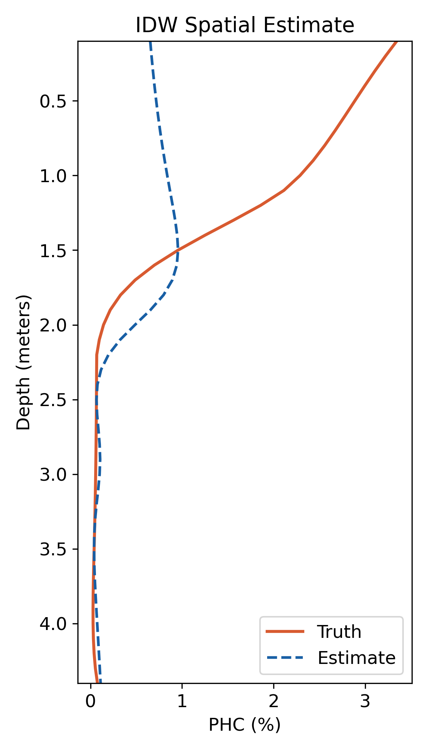
Inverse Distance Weighting (IDW)

Slide 13
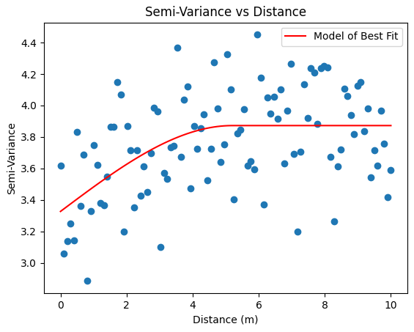

Kriging
$$γ\left(z_{i_{1}}−z_{i_{2}}\right)=\frac{1}{2}{\left(u\left(z_{i_{1}},t\right)−u\left(z_{i_{2}},t\right)\right)}^{2}$$
Models for Fitting
Linear
Gaussian
Spherical
Exponential
Notes:
Change this so that it is just “and there is Kriging” and move this to the end

Slide 14
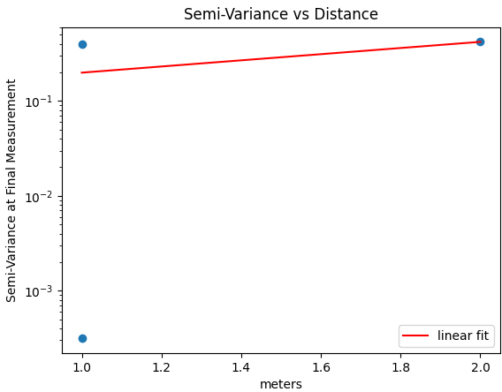
Kriging
$$γ\left(z_{i_{1}}−z_{i_{2}}\right)=\frac{1}{2}{\left(u\left(z_{i_{1}},t\right)−u\left(z_{i_{2}},t\right)\right)}^{2}$$
Models for Fitting
Linear
Gaussian
Spherical
Exponential

Slide 15
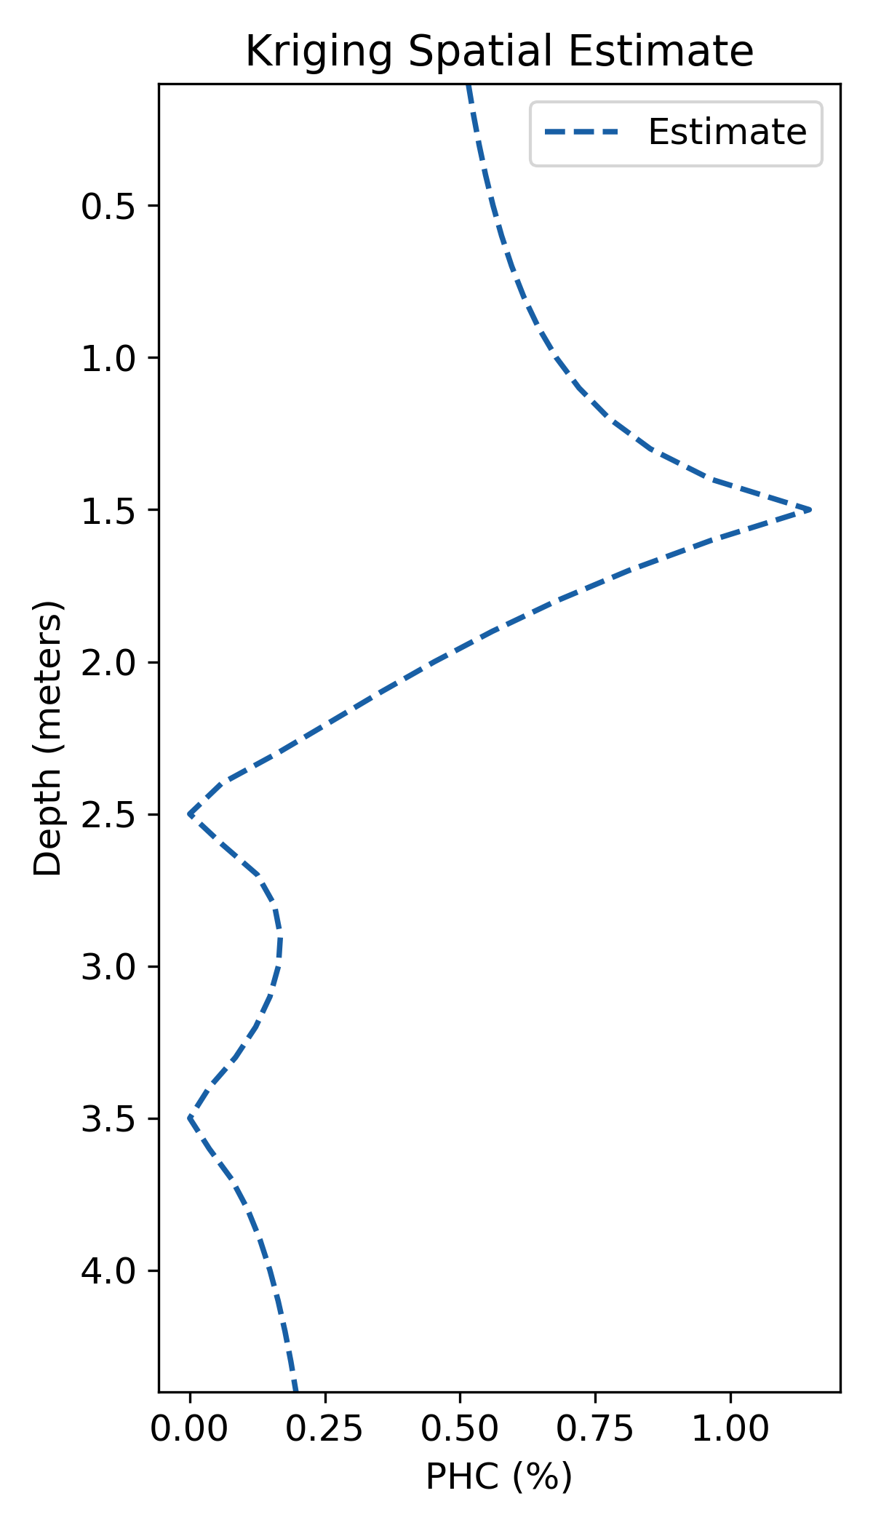
Kriging

Slide 16
Parameter Estimation
Given Measurements

Slide 17
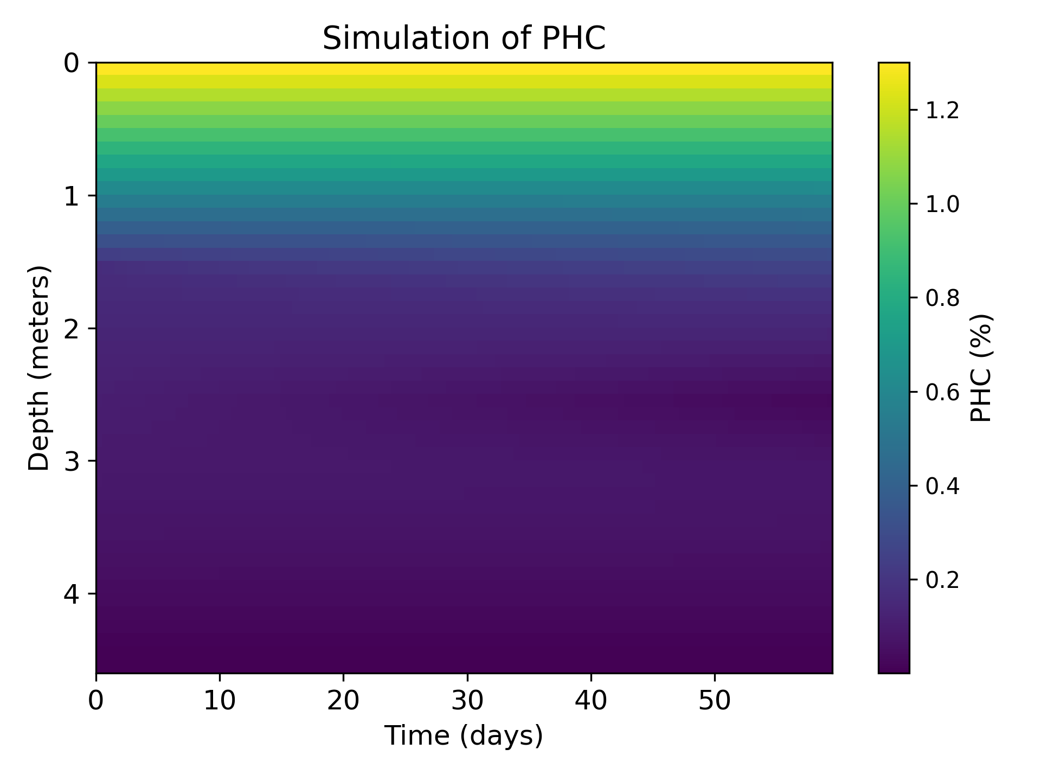
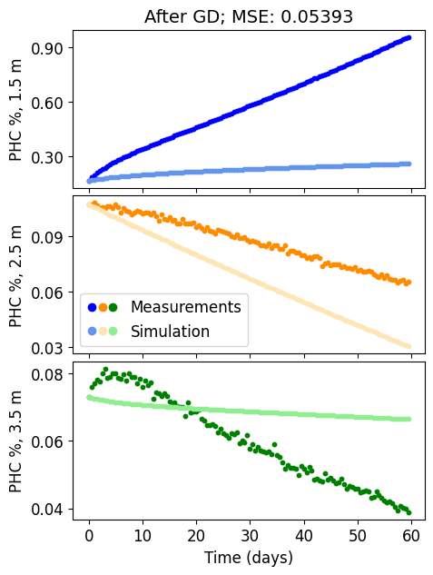
Parameter Estimation
Given Measurements
Run Simulation
Evaluate & Adjust

Slide 18
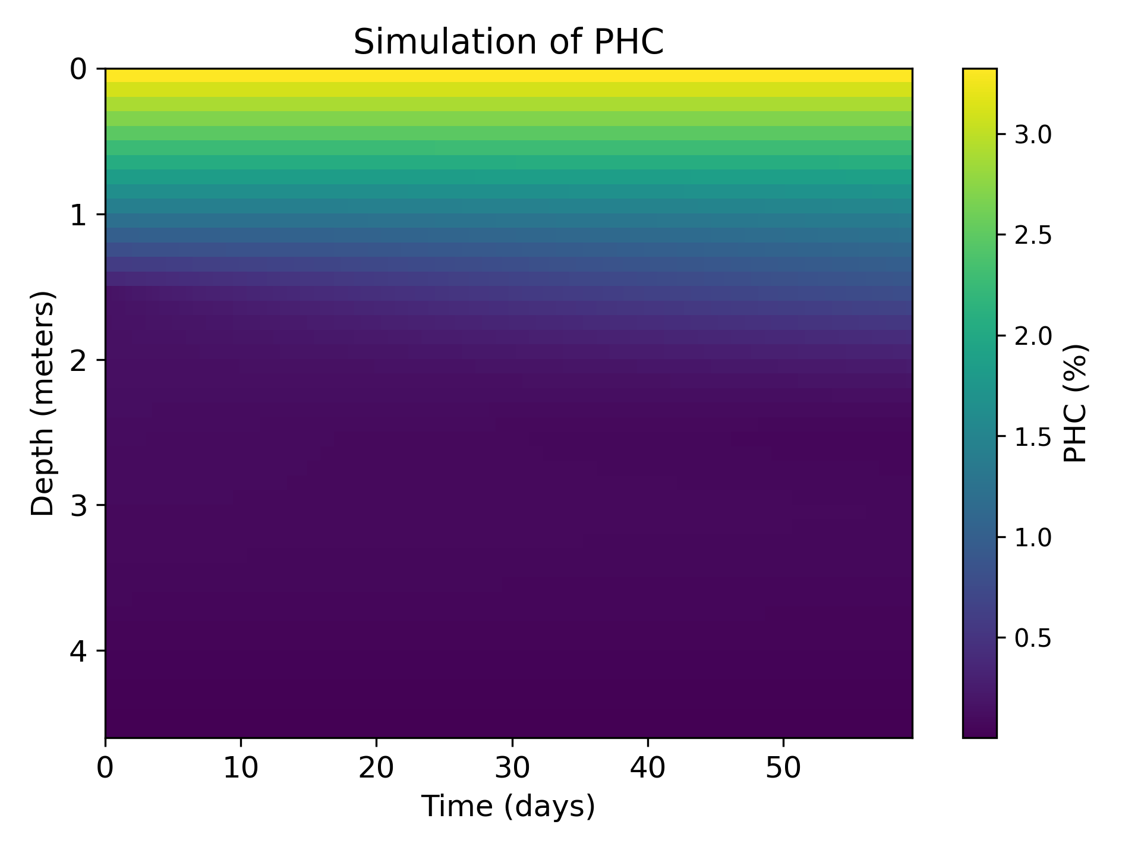
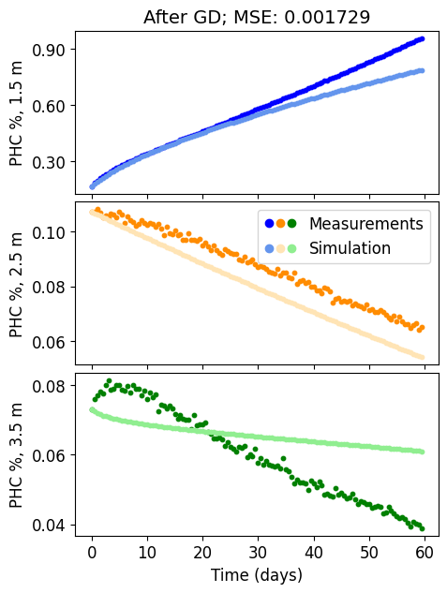
Parameter Estimation
Given Measurements
Run Simulation
Evaluate & Adjust

Slide 19

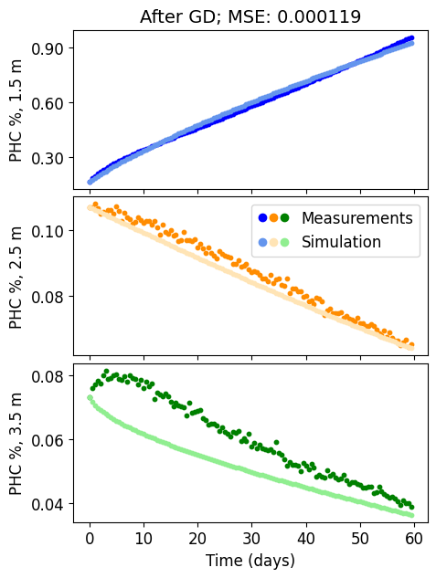
Parameter Estimation
Given Measurements
Run Simulation
Evaluate & Adjust

Slide 20
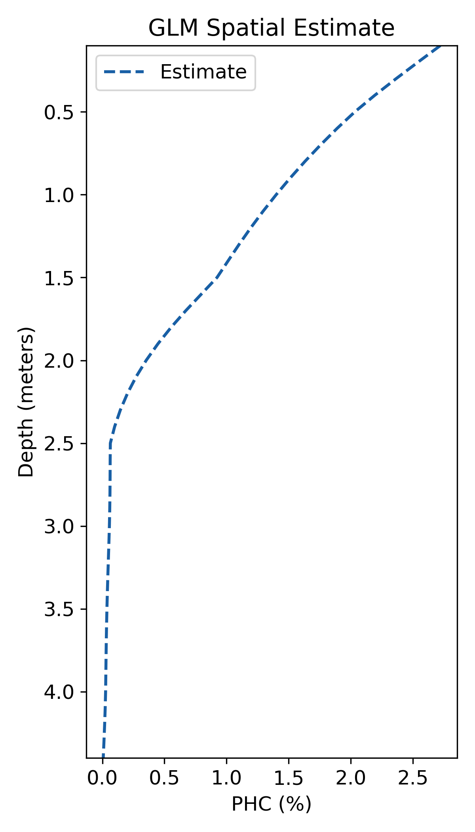
Parameter Estimation
Given Measurements
Run Simulation
Get Spatial Estimate

Slide 21
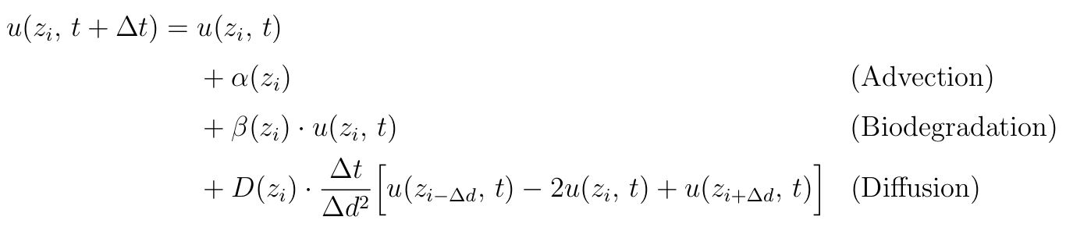
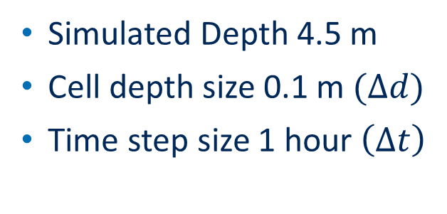
Soil Simulation
Simulated Depth 4.5 m
Cell depth size 0.1 m $(Δd)$
Time step size 1 hour $\left(Δt\right)$

Slide 22

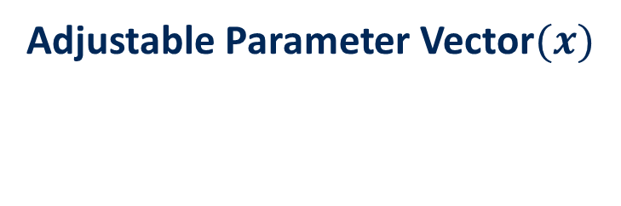
Parameter Estimation
Adjustable Parameter Vector$(x)$
$$α\left(z_{i}\right)$$
$$β\left(z_{i}\right)$$
$$D\left(z_{i}\right)$$
$$u\left(z_{0}\right)$$
$$u(z_{−1})$$
(Advection)
(Biodegradation)
(Diffusion)
(Top Boundary Condition)
(Bottom Boundary Condition

Slide 23
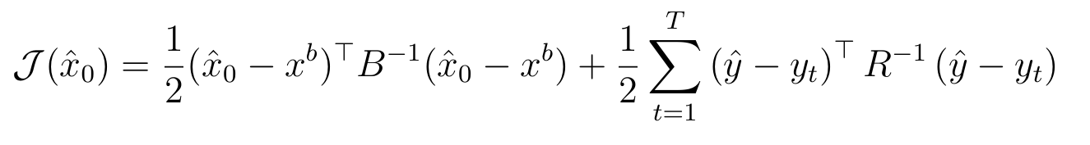
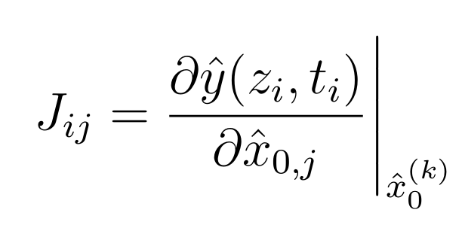
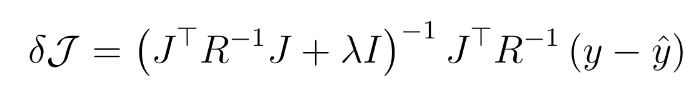
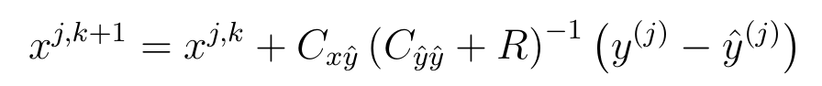

Parameter Estimation Methods
Parameter Vector$(x)$
4D-Var (explicit calculation of derivative)
Gauss-Levenberg-Marquadt (Newton’s Method for derivative)
Iterative Ensemble Smoother (Ensemble informs derivative)

Slide 24
Real World Dataset
27 samples from 11 measurement stakes
Sample length ranges from 30 to 250 days
Raw measurements every 30 minutes (averaged to every 12 hours)

Slide 25
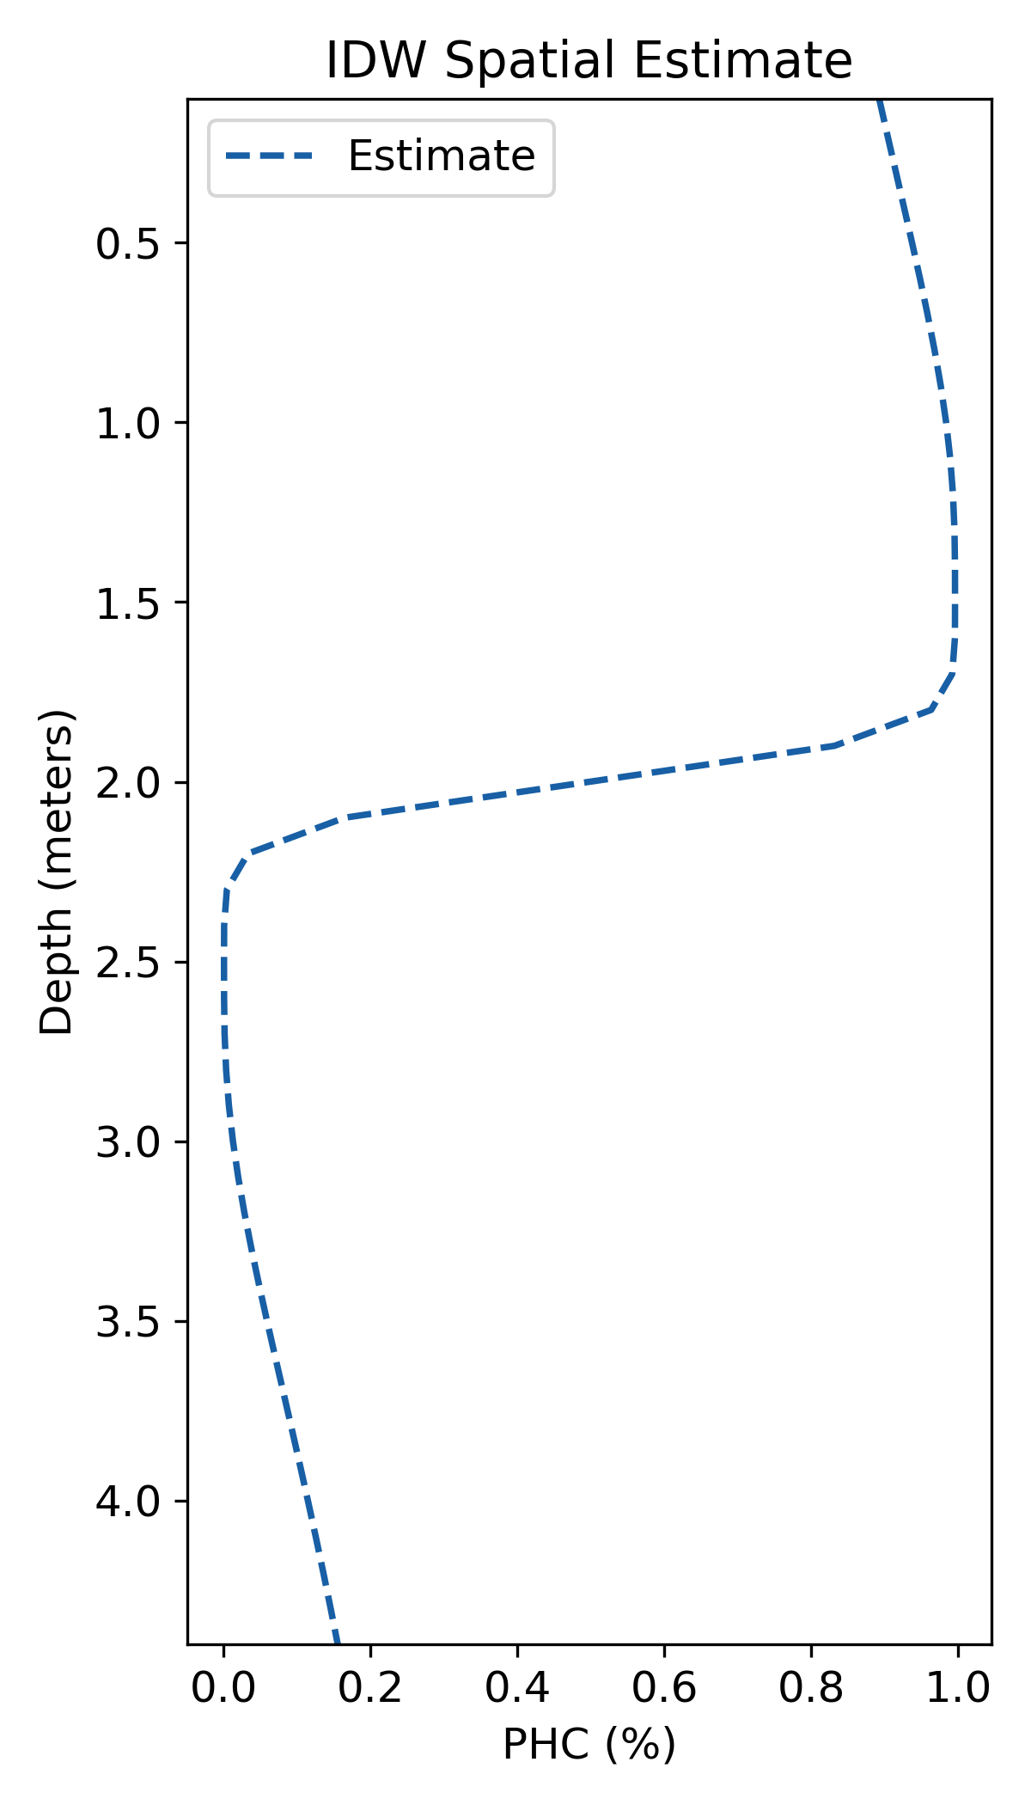
Evaluating the Real-World Samples

Slide 26
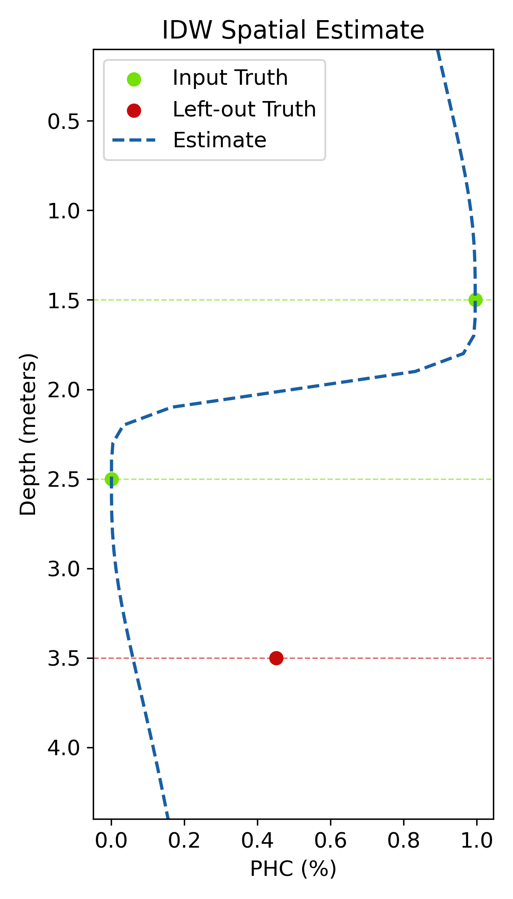
Evaluating the Real-World Samples

Slide 27
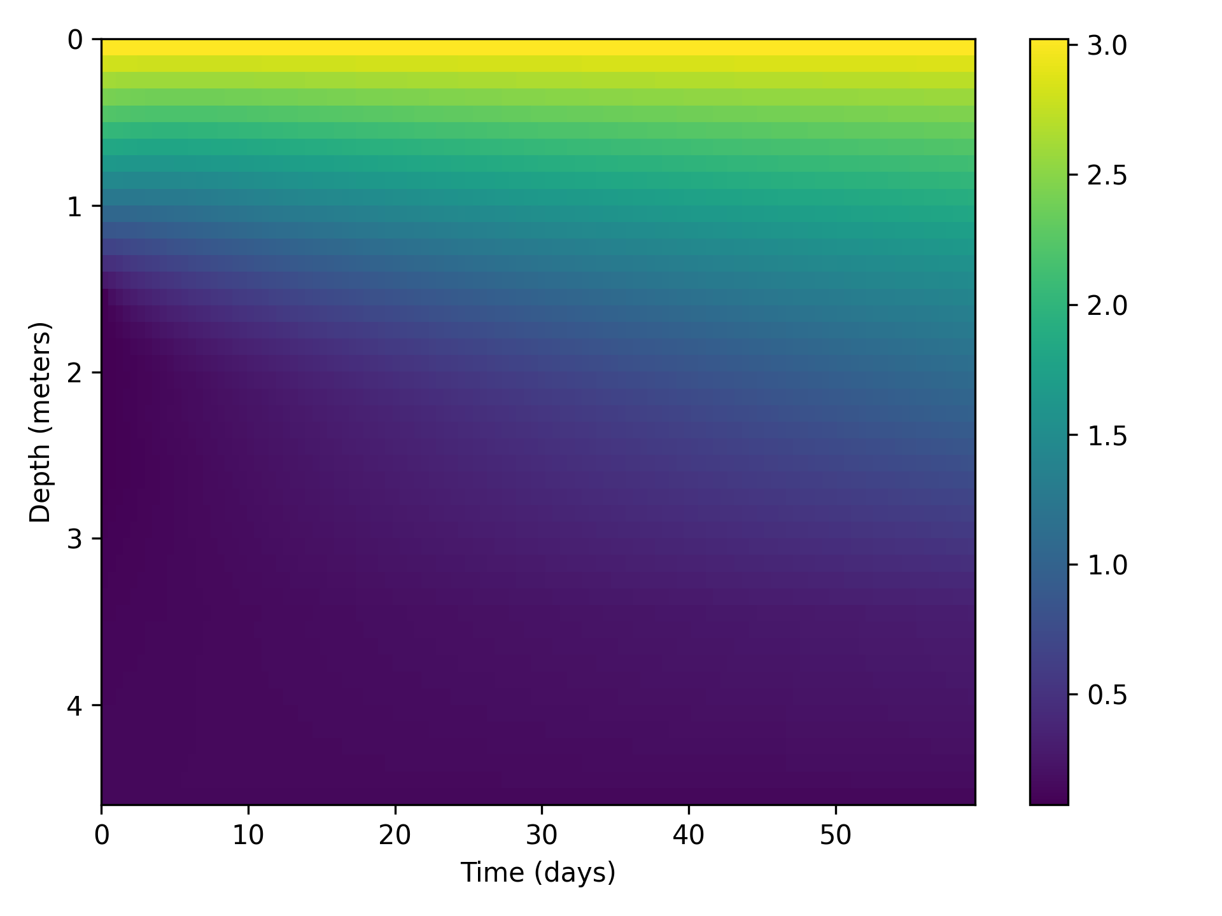
Synthetic Data
600 samples
Simulated Depth 4.5 m
Simulated time 60 days

Slide 28
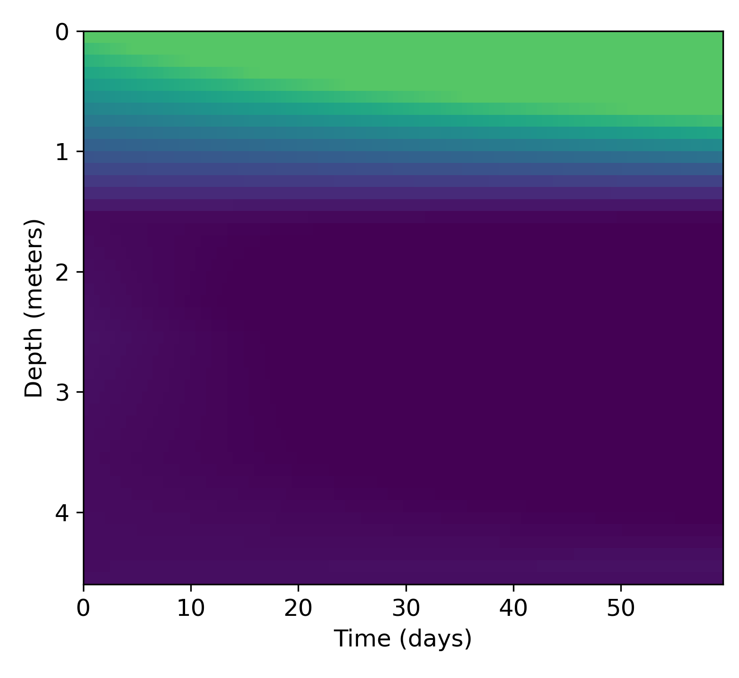
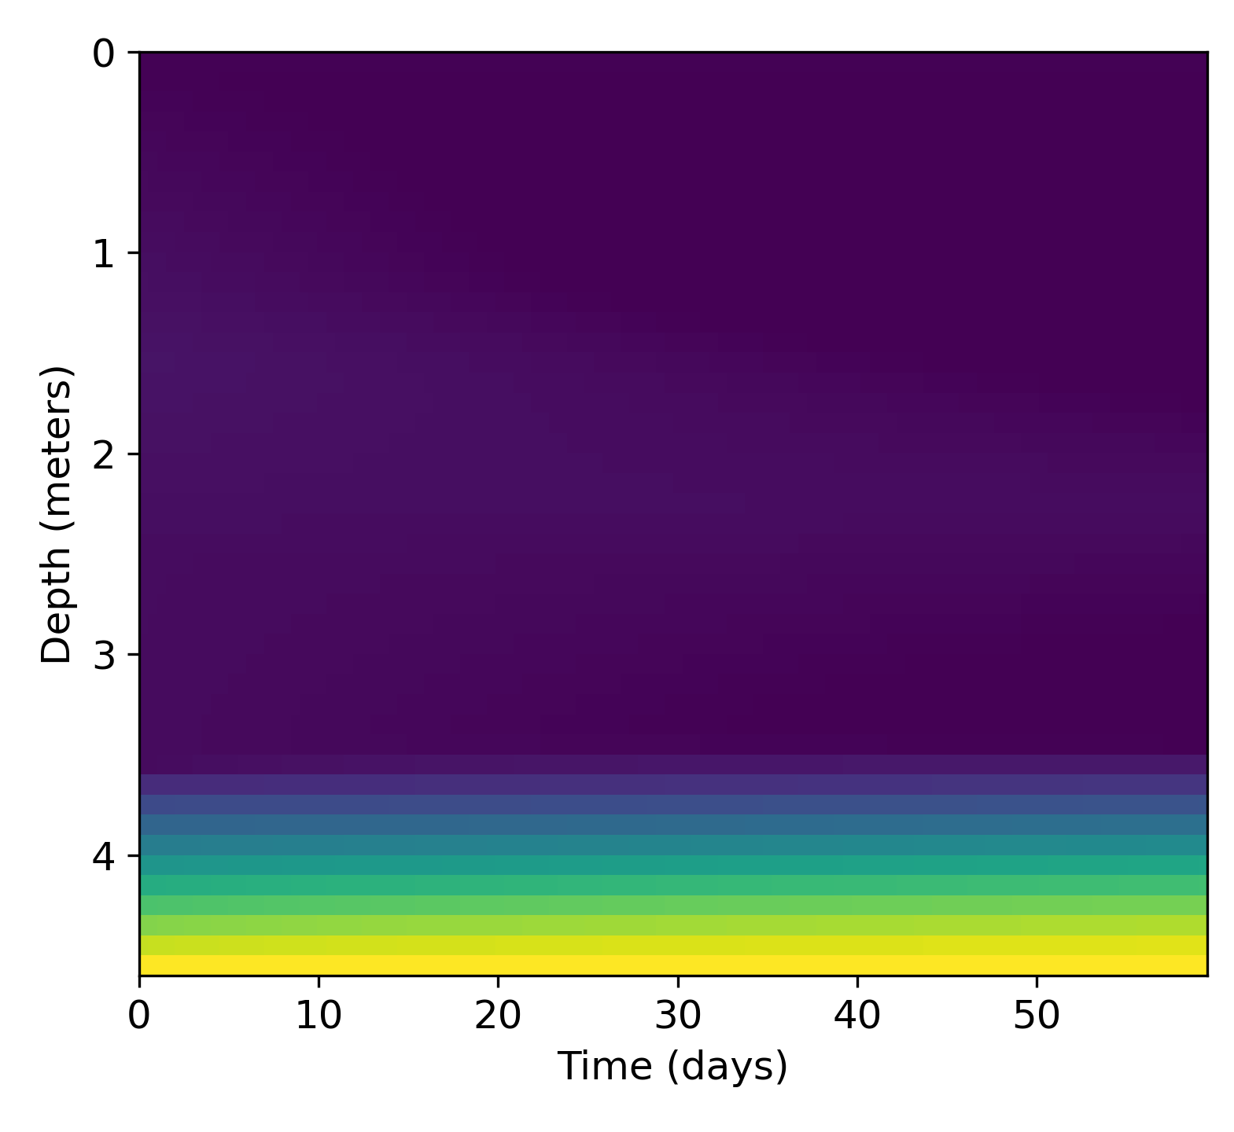
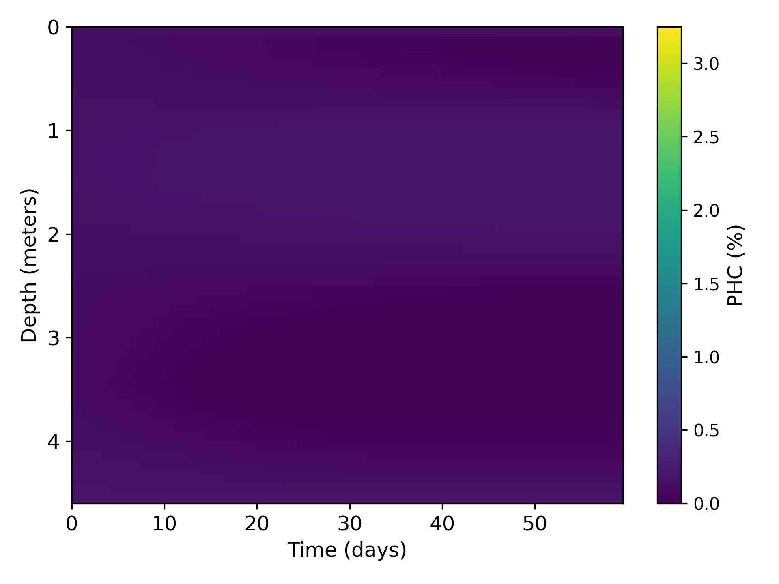
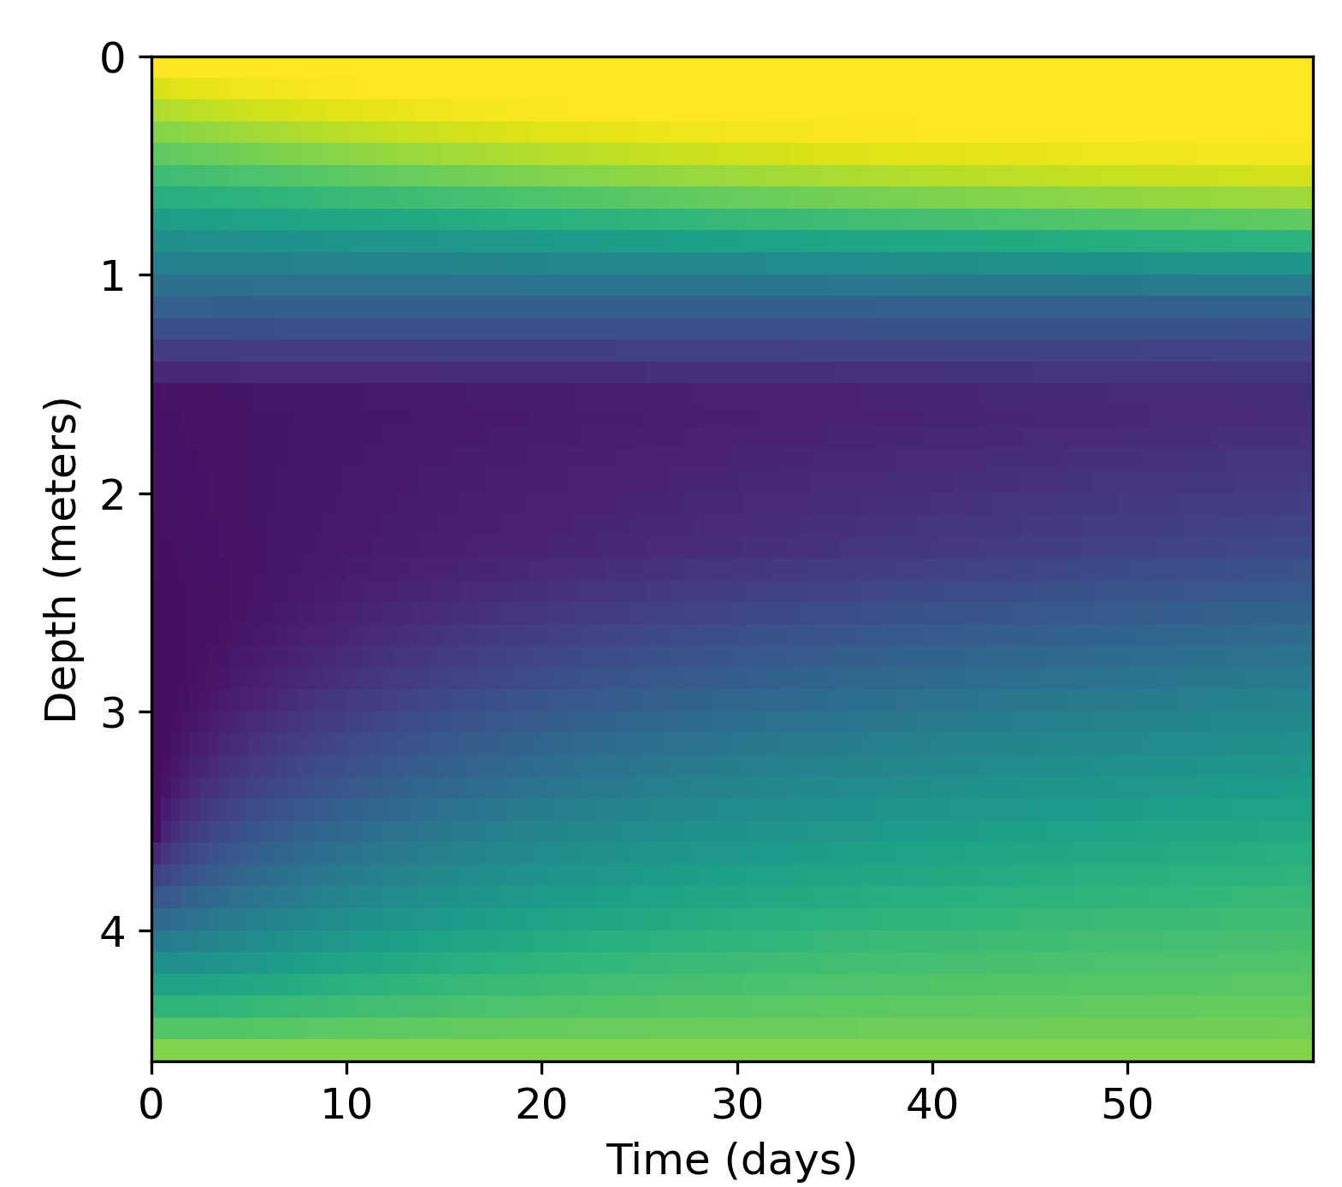
Synthetic Data
Top
Bottom
600 samples
Simulated Depth 4.5 m
Simulated time 60 days
4 types of boundary conditions (top, bottom, both and no source)
Both
Neither

Slide 29
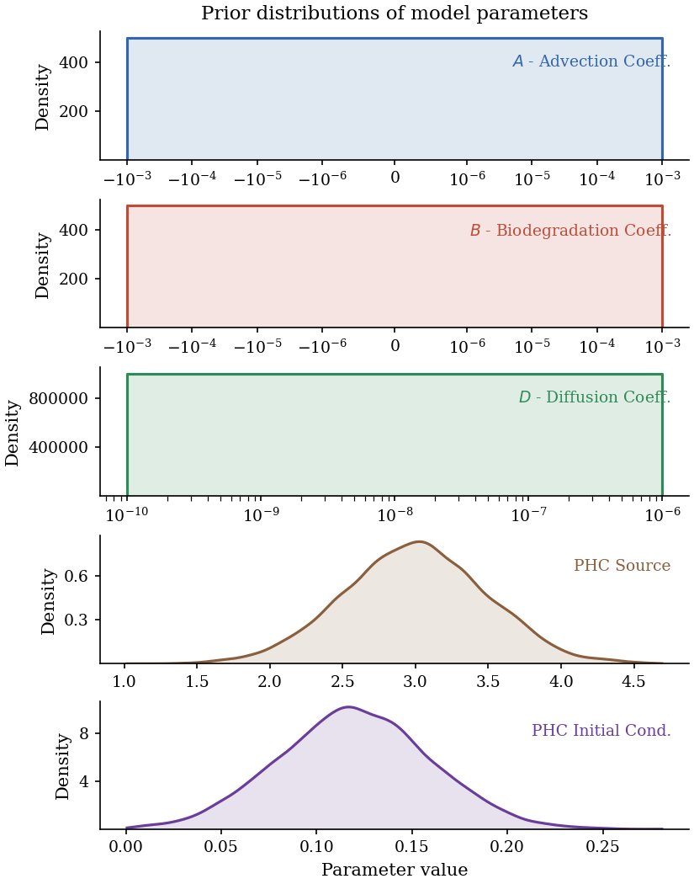
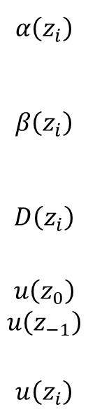
Synthetic Data
$$α\left(z_{i}\right)$$
$$β\left(z_{i}\right)$$
$$D\left(z_{i}\right)$$
$$u\left(z_{0}\right)$$
$$u\left(z_{−1}\right)$$
$$u\left(z_{i}\right)$$
600 samples
Simulated Depth 4.5 m
Simulated time 60 days
4 types of boundary conditions (top, bottom, both and no source)

Slide 30
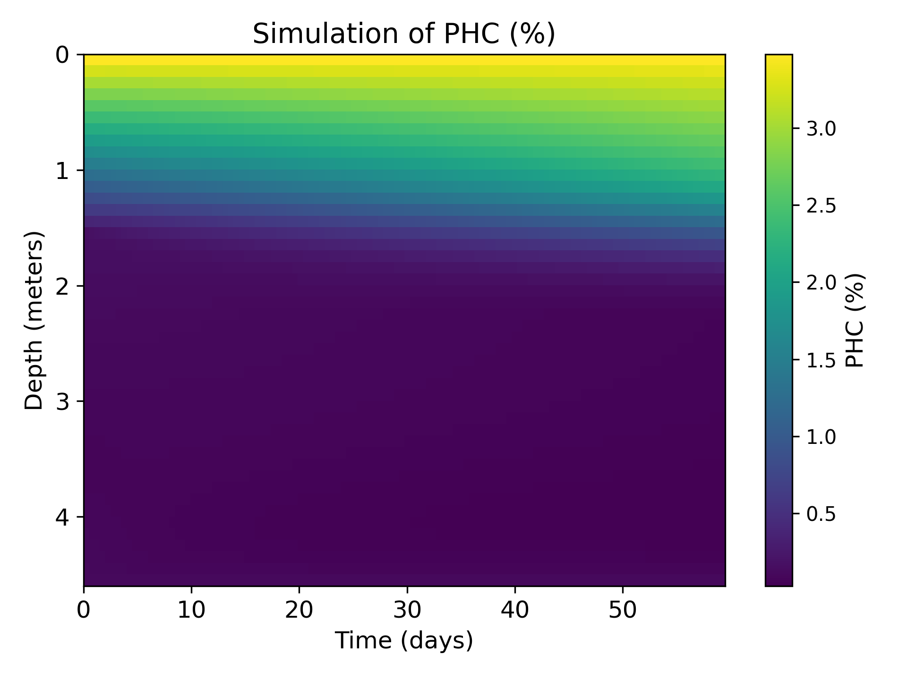
Synthetic Data Evaluation
Raw Simulation
Measurement Format

Slide 31

Synthetic Data Evaluation
Spatial Interpolation Method
Measurement Format
Estimate
Raw Simulation

Slide 32
Synthetic Data Evaluation
Spatial Interpolation Method
Measurement Format
Estimate & Evaluate
Raw Simulation

Slide 33
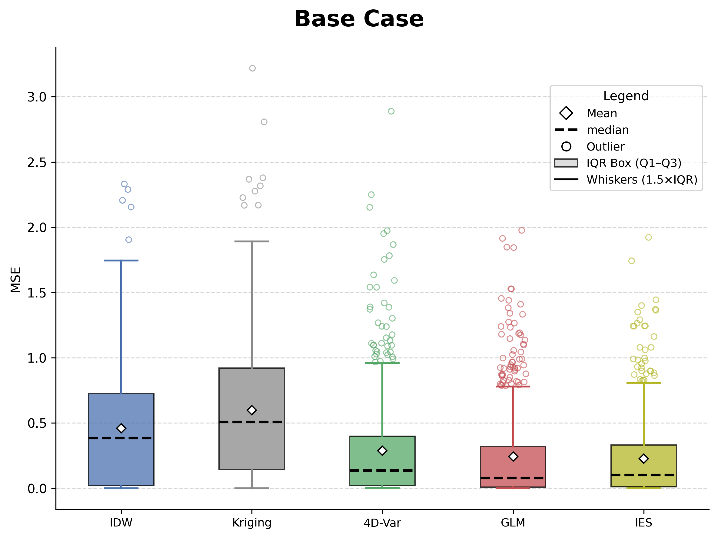
Synthetic Results

Slide 34
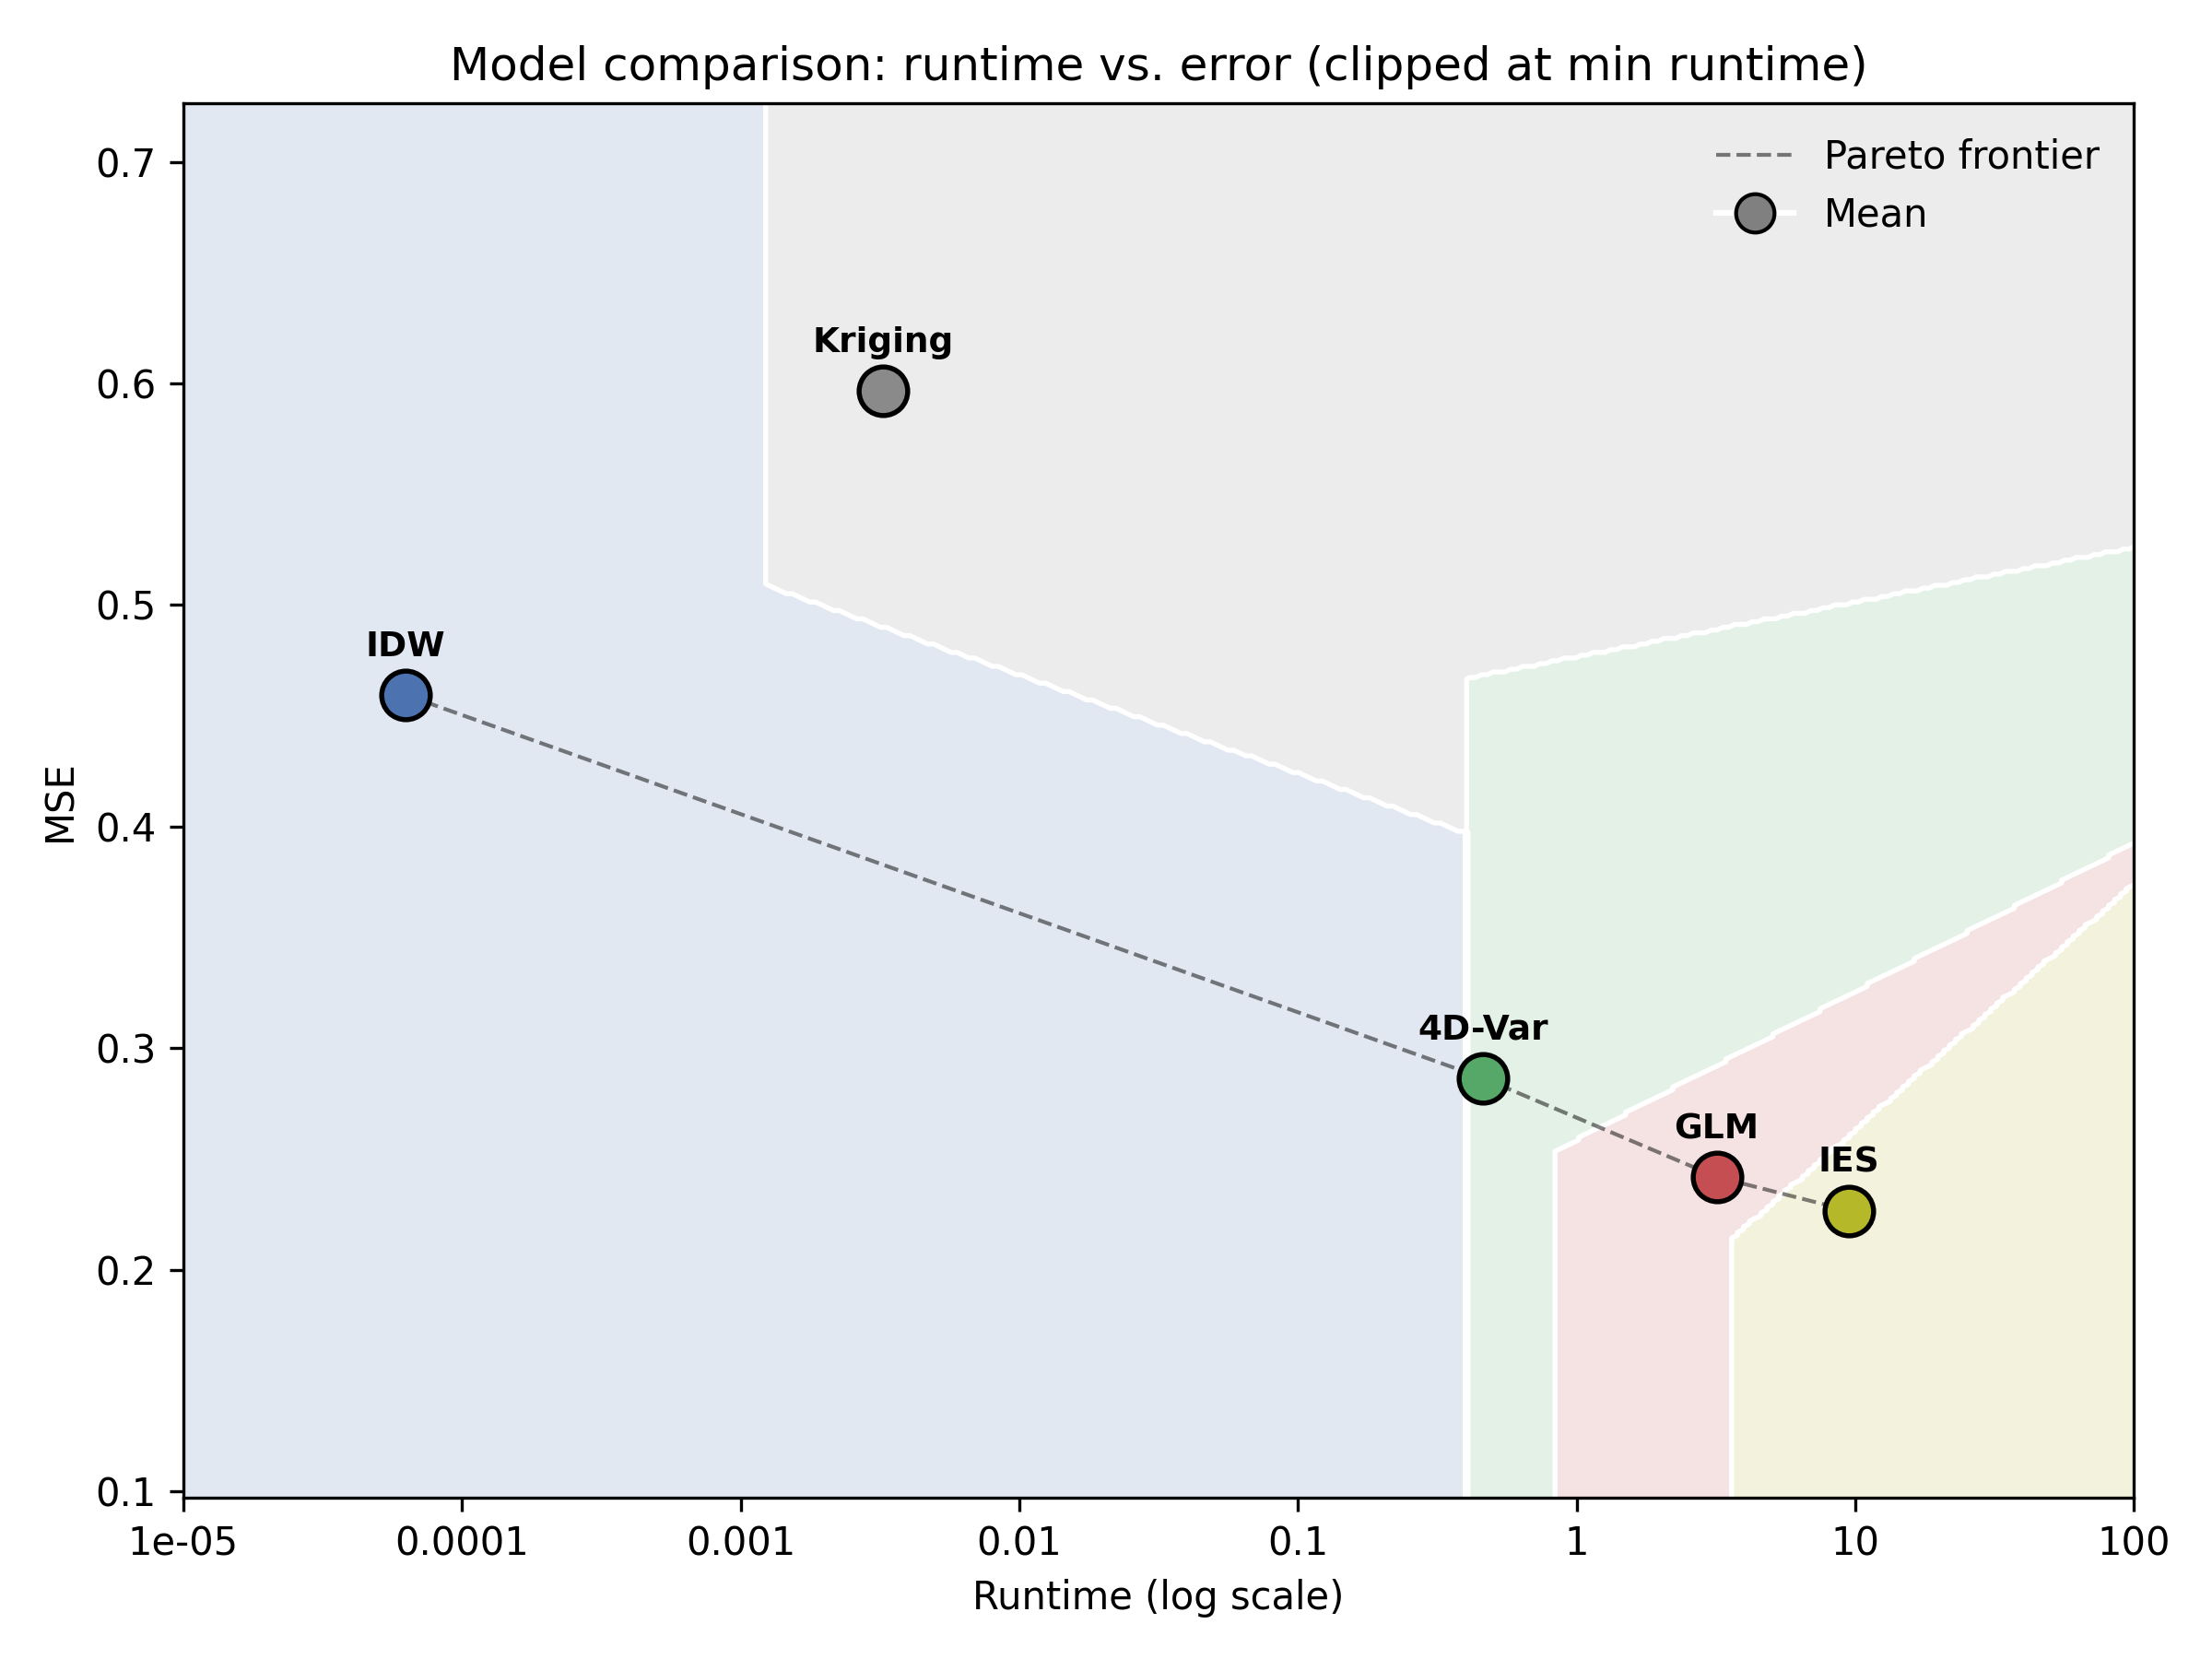
Synthetic Results

Slide 35
Synthetic Results Failure Modes
Notes:
Only one model for all of these
Talk about the box plots more.

Slide 36
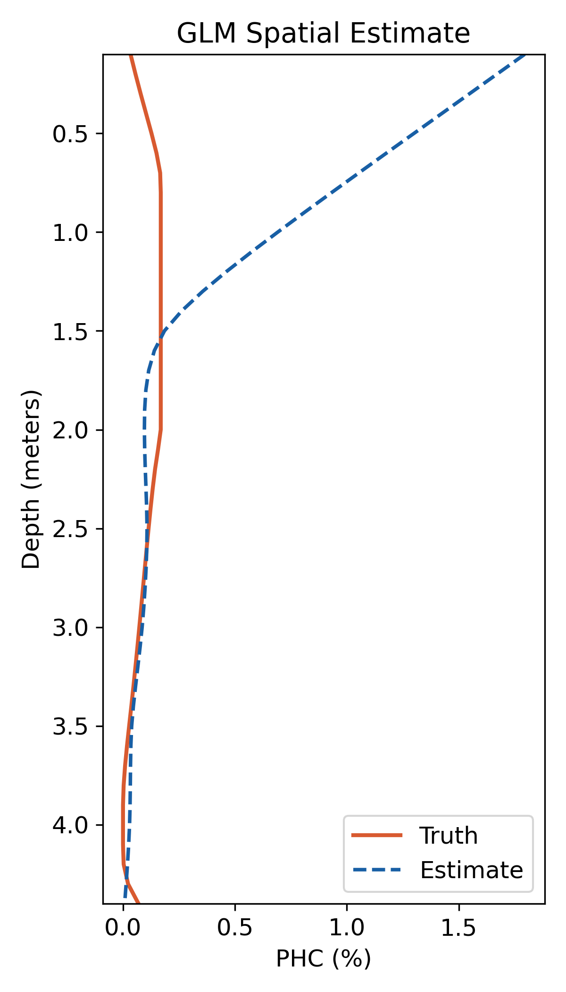
Synthetic Results Failure Modes
Notes:
Only one model for all of these
Talk about the box plots more.

Slide 37
Synthetic Data Variations
Measurement Noise
Number of Sensors
Measurement Frequency
Soil Parameter Noise
Sensor Dropout

Slide 38
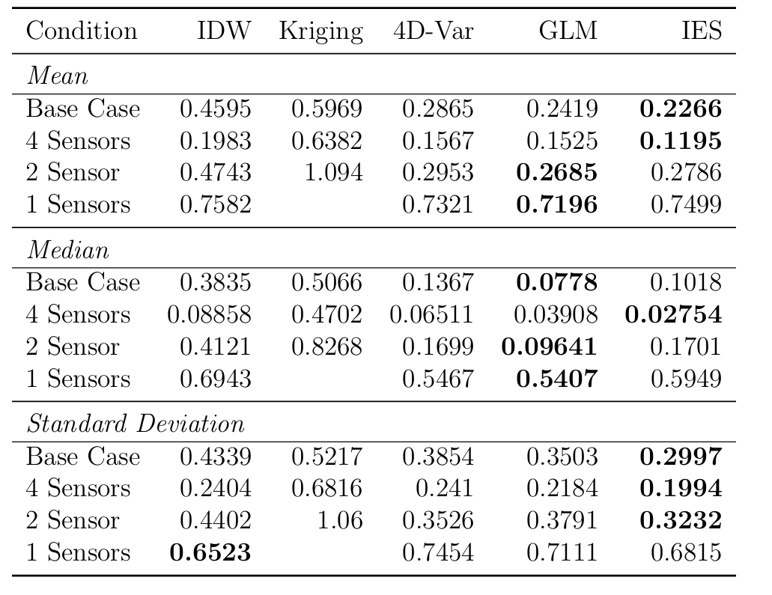
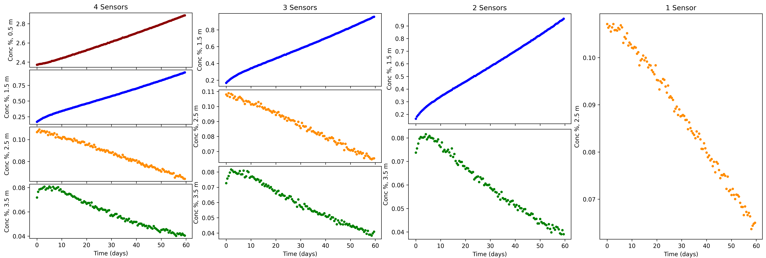
Synthetic Data Variations
Measurement Noise
Number of Sensors
Measurement Frequency
Soil Parameter Noise
Sensor Dropout
Notes:
Add the graphic at the start to show where the sensors are for each of these sensor count ones

Slide 39
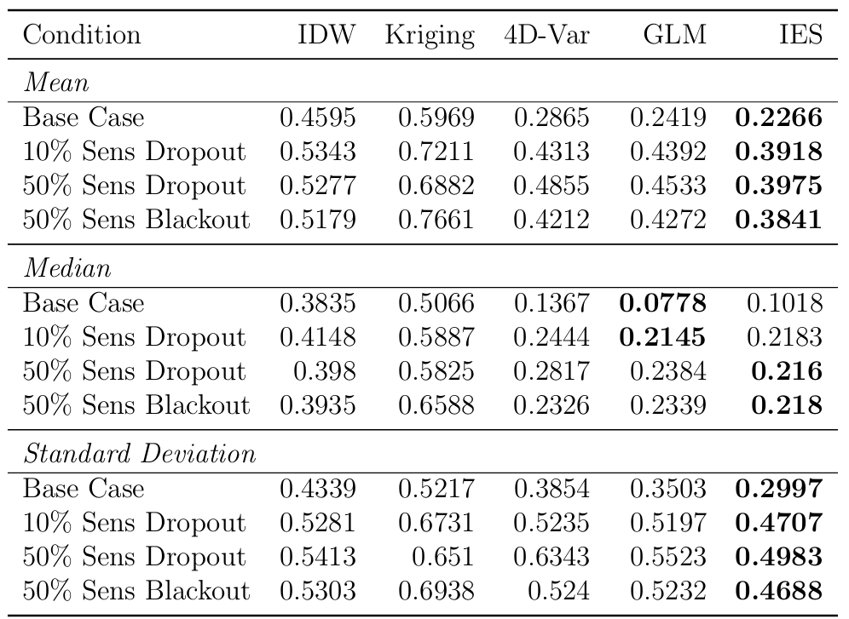
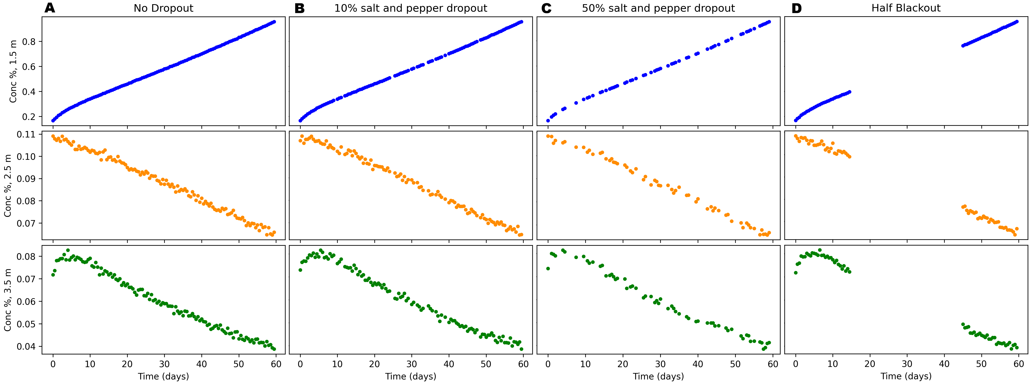
Synthetic Data Variations
Measurement Noise
Number of Sensors
Measurement Frequency
Soil Parameter Noise
Sensor Dropout

Slide 40
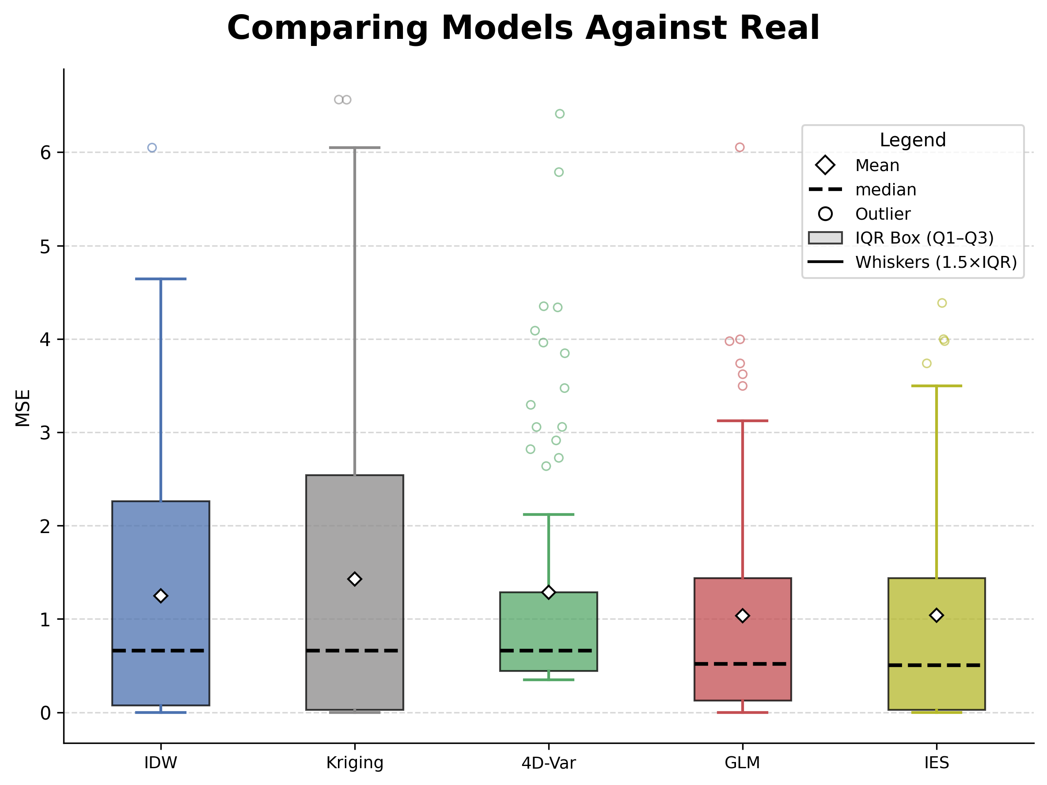
Real-World Results
Notes:
Real-World results explanation

Slide 41
Real-World Results
Synthetic
Real-World

Slide 42
Conclusions
IES is the best for max computational ability
IDW is best for real-time and edge-computing applications
Not as many sensors are needed on the same stake
Notes:
Name it finding
Try starting with this figure in the results

Slide 43
Limitations/Future Work
2D and 3D models needed for proper evaluation
Separate physics models for synthetic and parameter estimation
More extensive hyper parameter tuning

Slide 44
Thanks for your attention

Slide 45
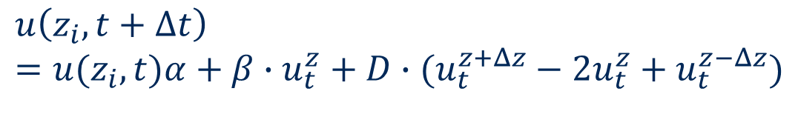
$$u\left(z_{i},t+Δt\right)=u(z_{i},t)α+β∙u_{t}^{z}+D∙(u_{t}^{z+Δz}−2u_{t}^{z}+u_{t}^{z−Δz})$$

Slide 46
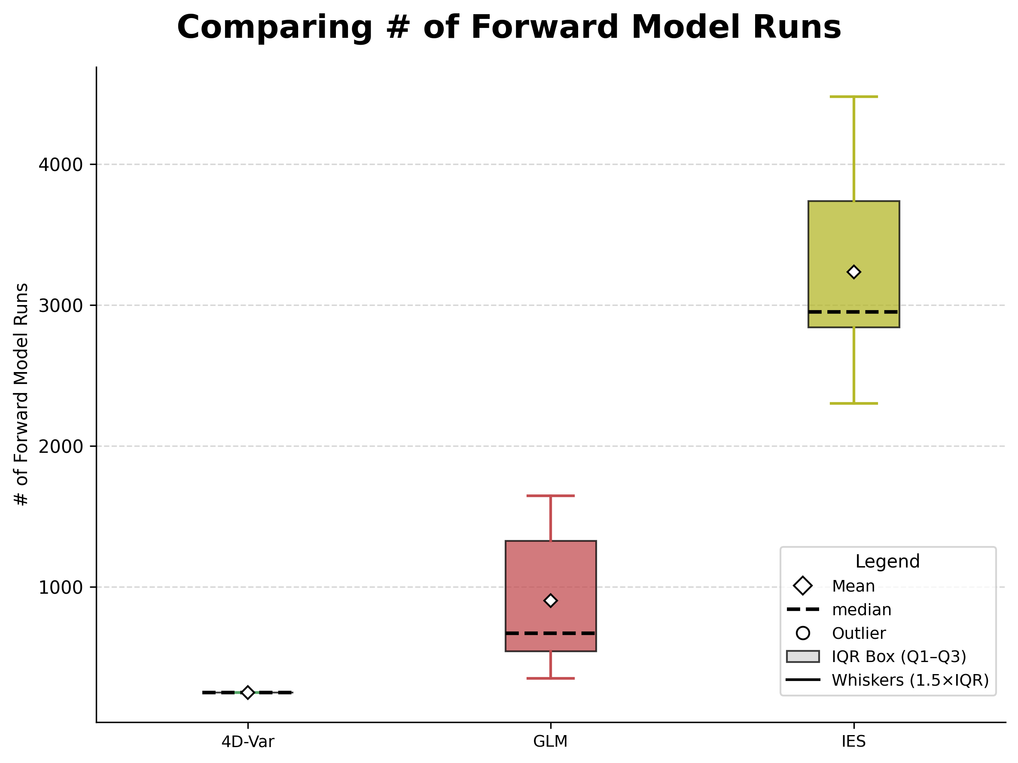
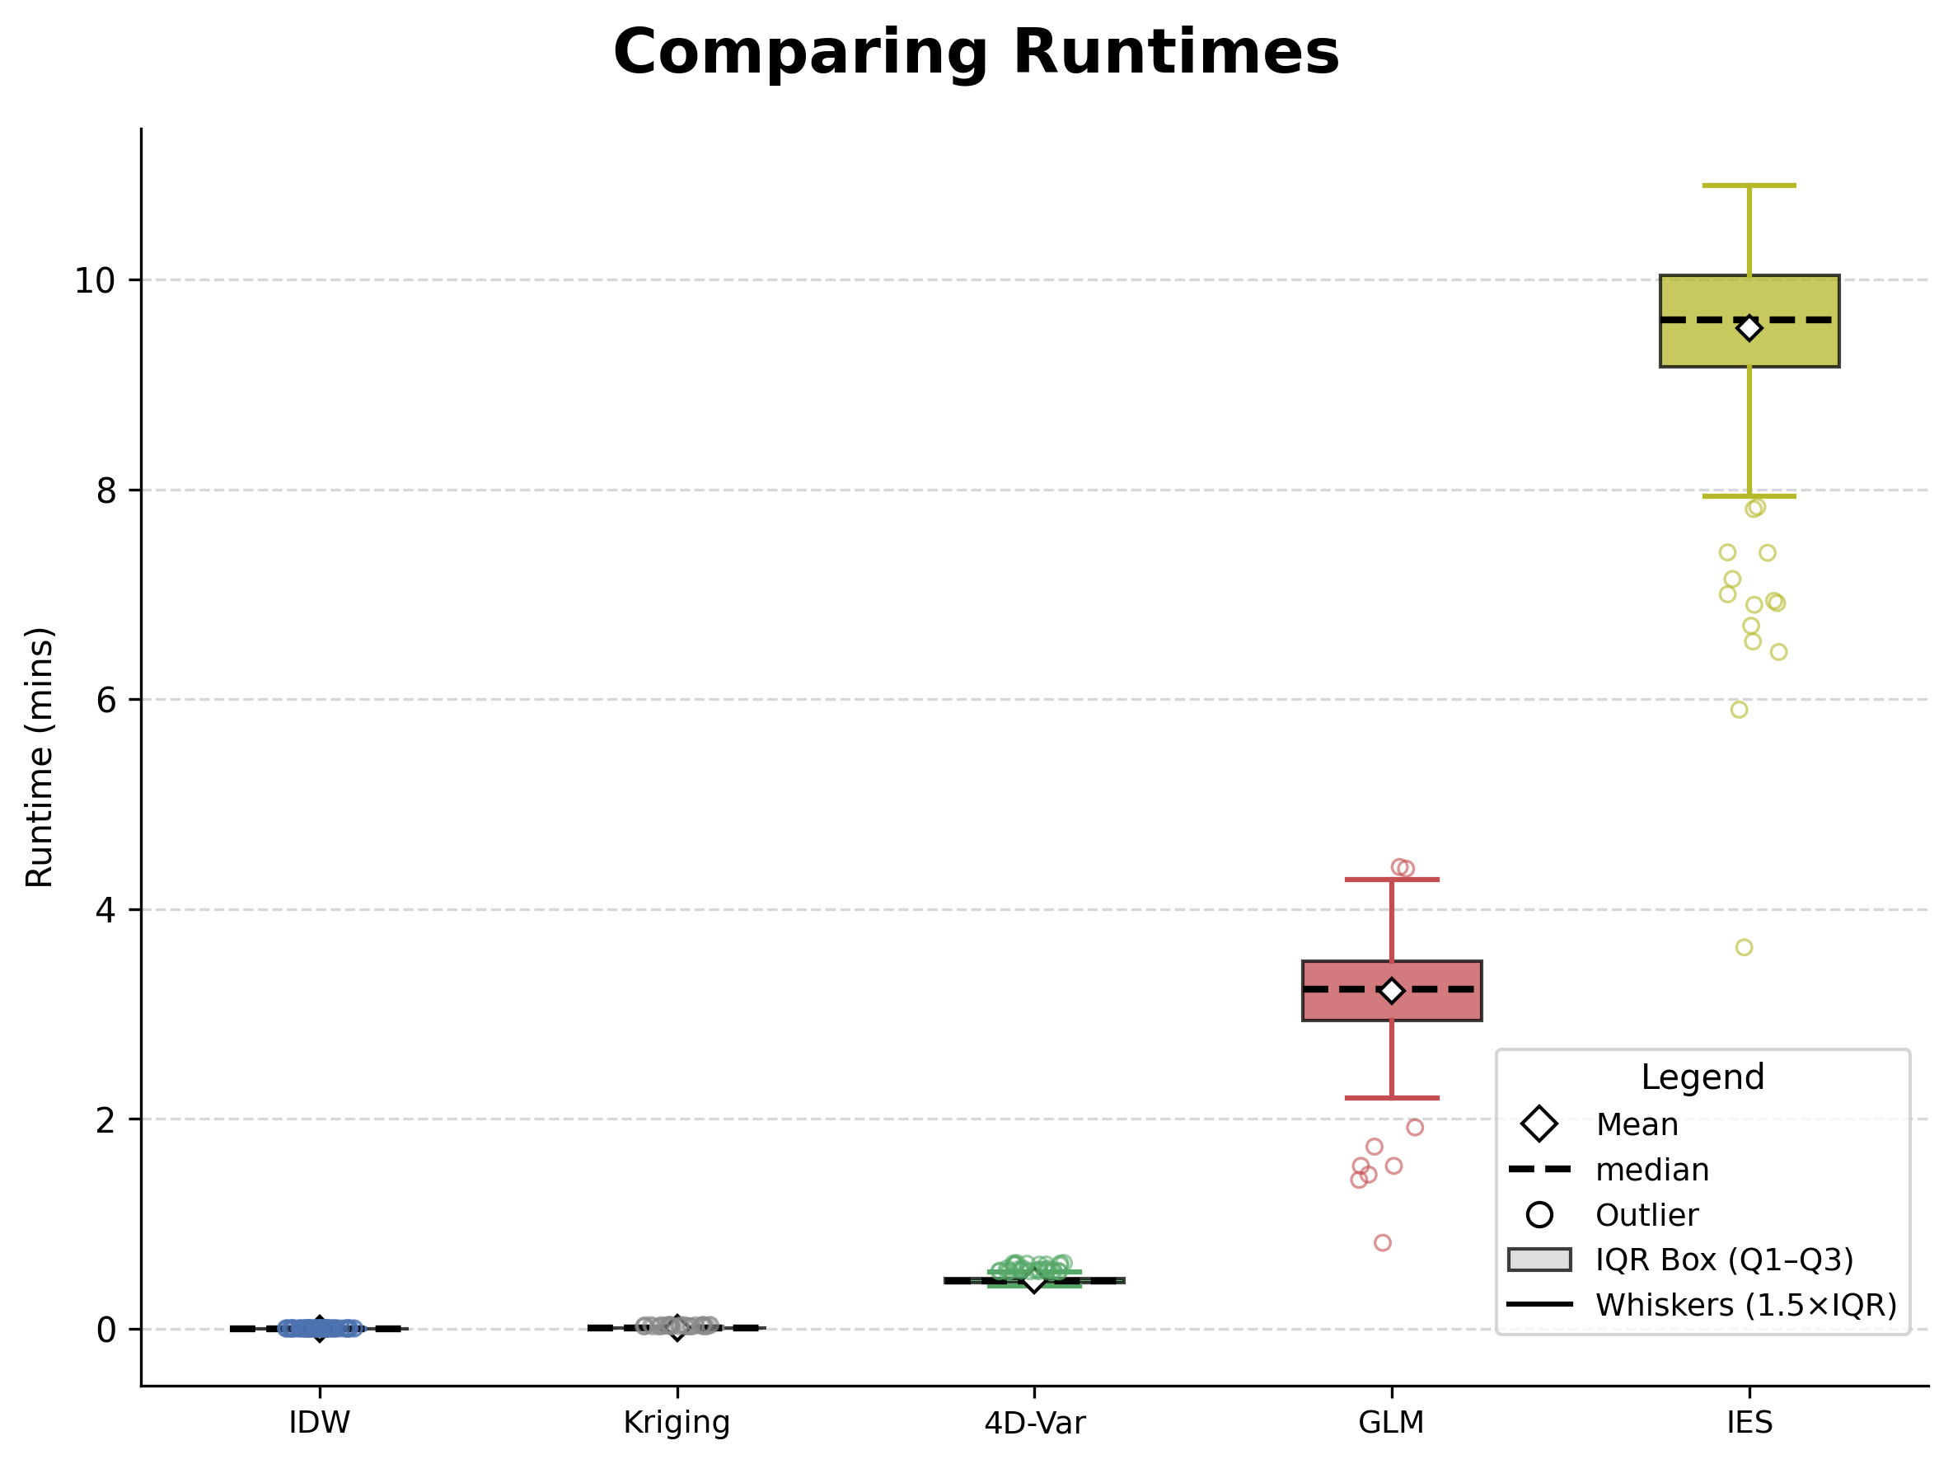
Synthetic Results

Slide 47
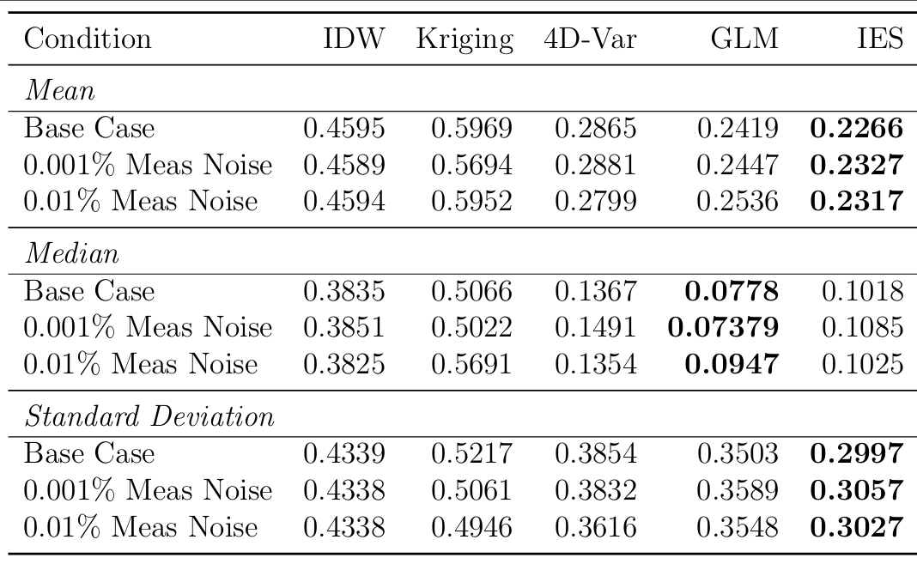
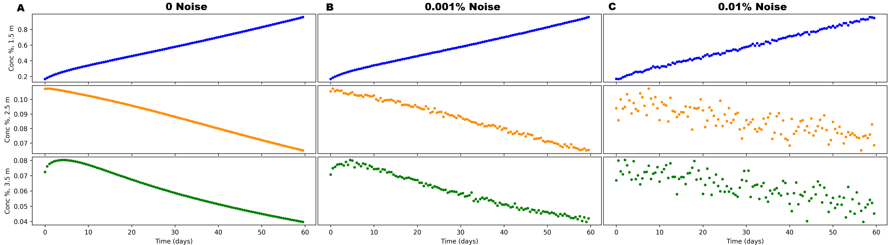
Synthetic Data Variations
Measurement Noise
Number of Sensors
Measurement Frequency
Soil Parameter Noise
Sensor Dropout

Slide 48
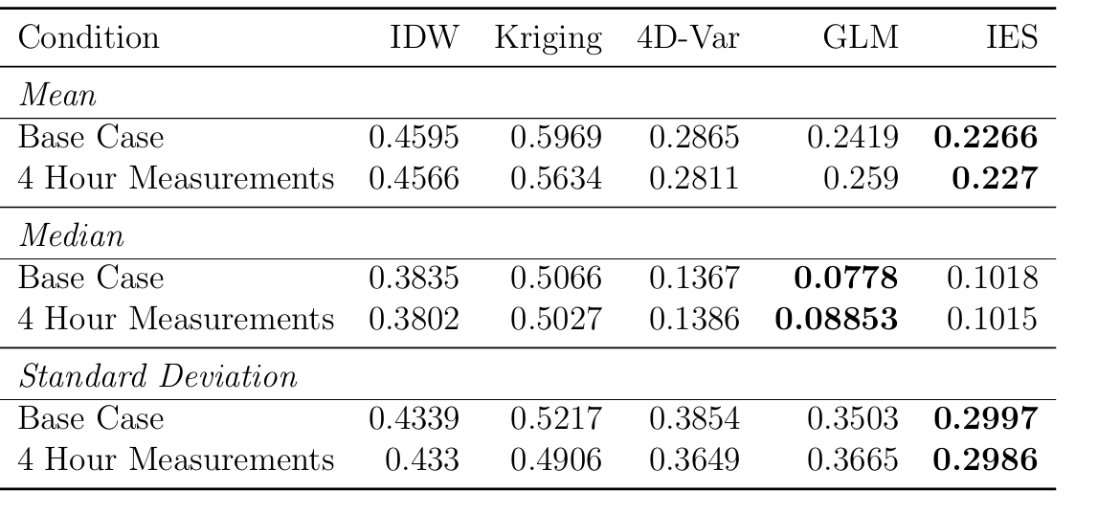
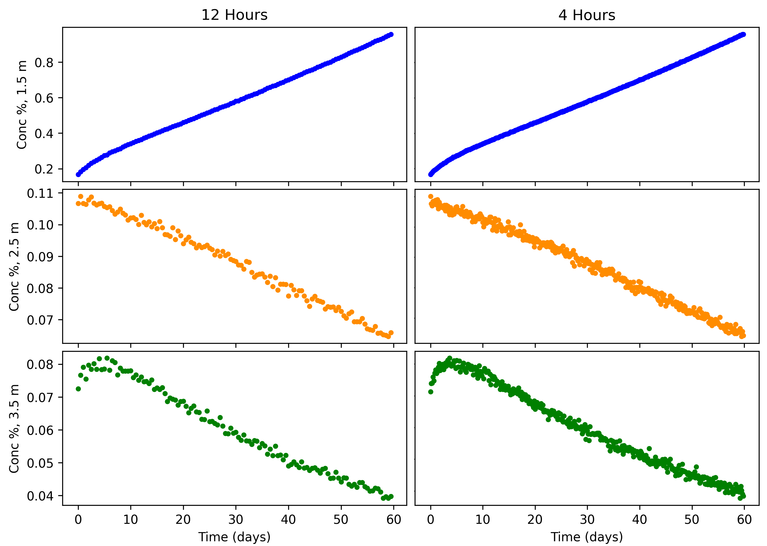
Synthetic Data Variations
Measurement Noise
Number of Sensors
Measurement Frequency
Soil Parameter Noise
Sensor Dropout

Slide 49


Synthetic Data Variations
Measurement Noise
Number of Sensors
Measurement Frequency
Soil Parameter Noise
Sensor Dropout
Notes:
Cut this slide

Slide 50

Sites Contaminated w/ Petroleum Hydrocarbons (PHC)

Slide 51

Distance-Based Spatial Interpolation
Inverse Distance Weighting
$$\hat{u}\left(z_{o},t\right)=\frac{\left(Σ_{i=1}^{N_{z}}w_{i} ⋅u\left(z_{i},t\right)\right)}{\left(Σ_{i=1}^{N_{z}}⋅w_{i}\right)},{ w}_{i}=\frac{1}{d{\left(z_{o},z_{i}\right)}^{p}}$$

Slide 52
Placing PHC Measurement Stakes
Sensor Stake Location

