Slide 1
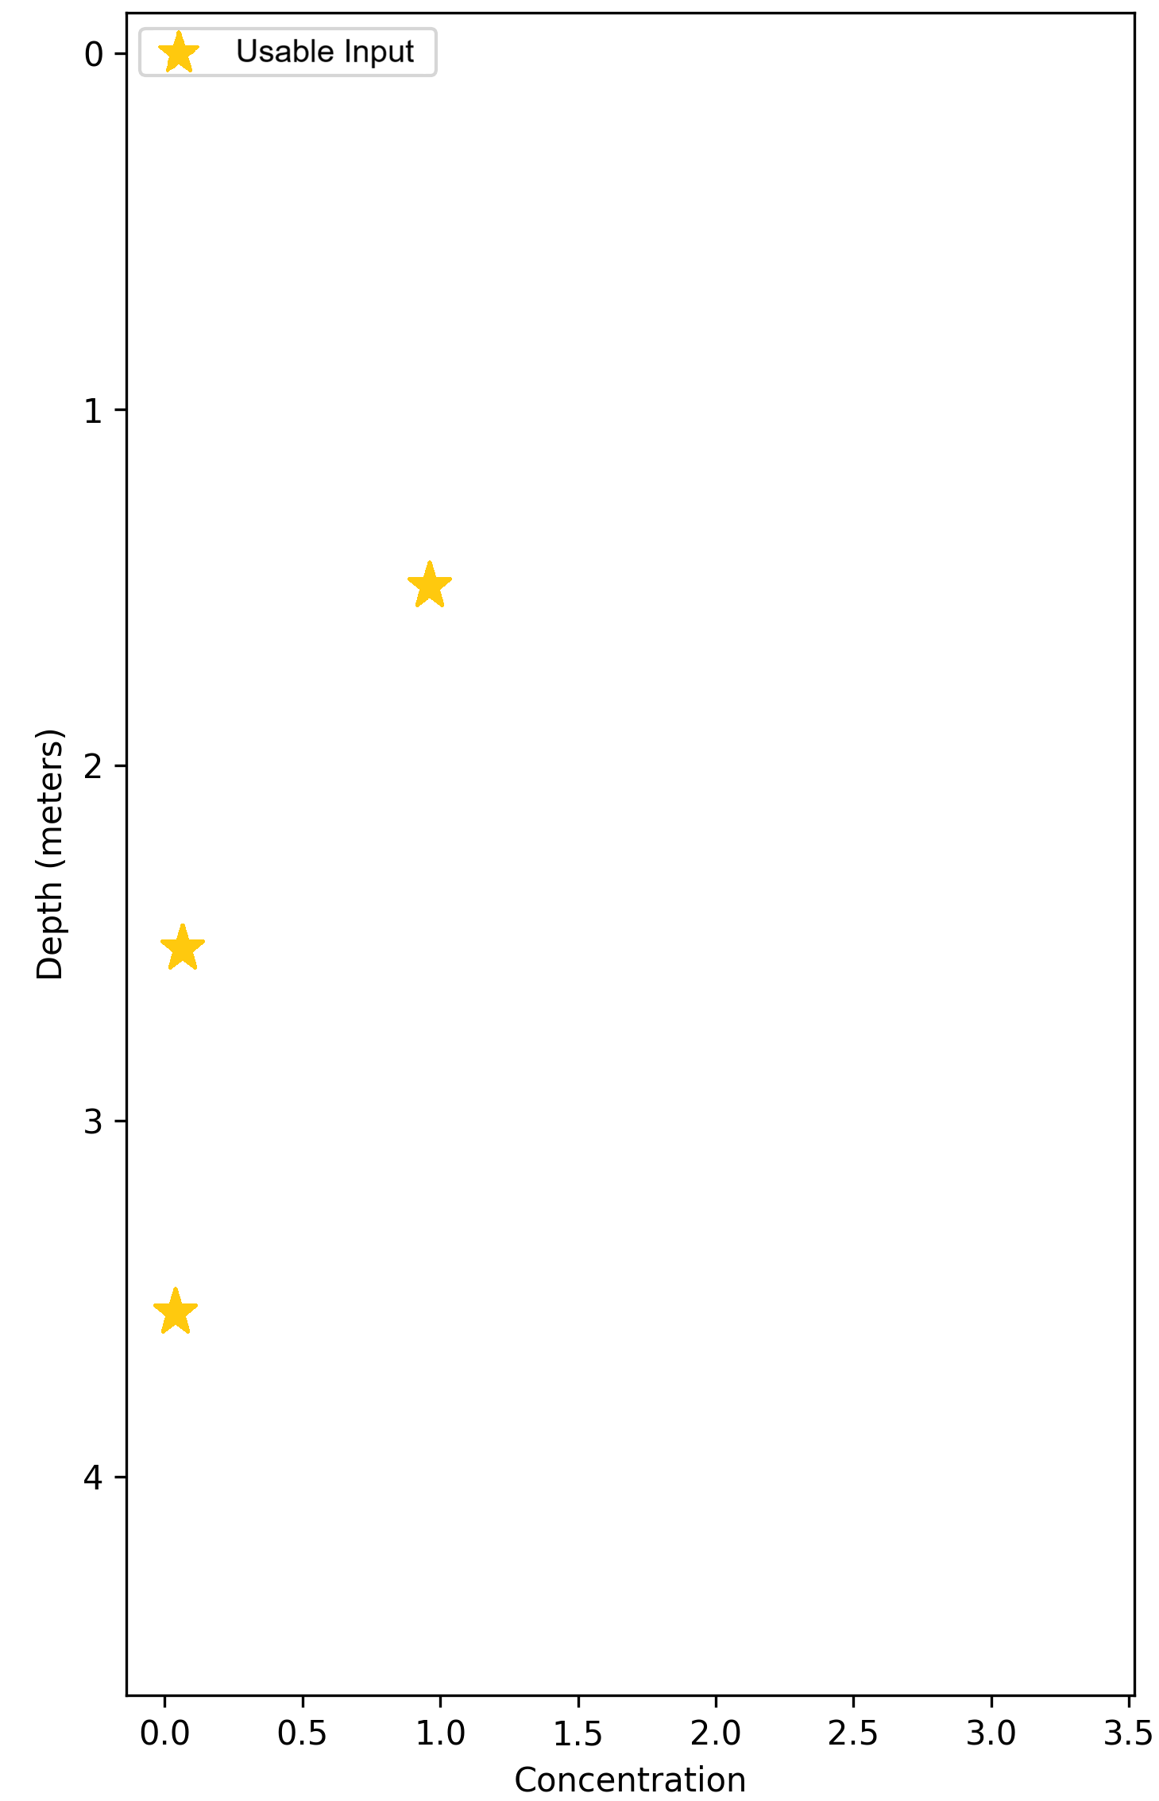
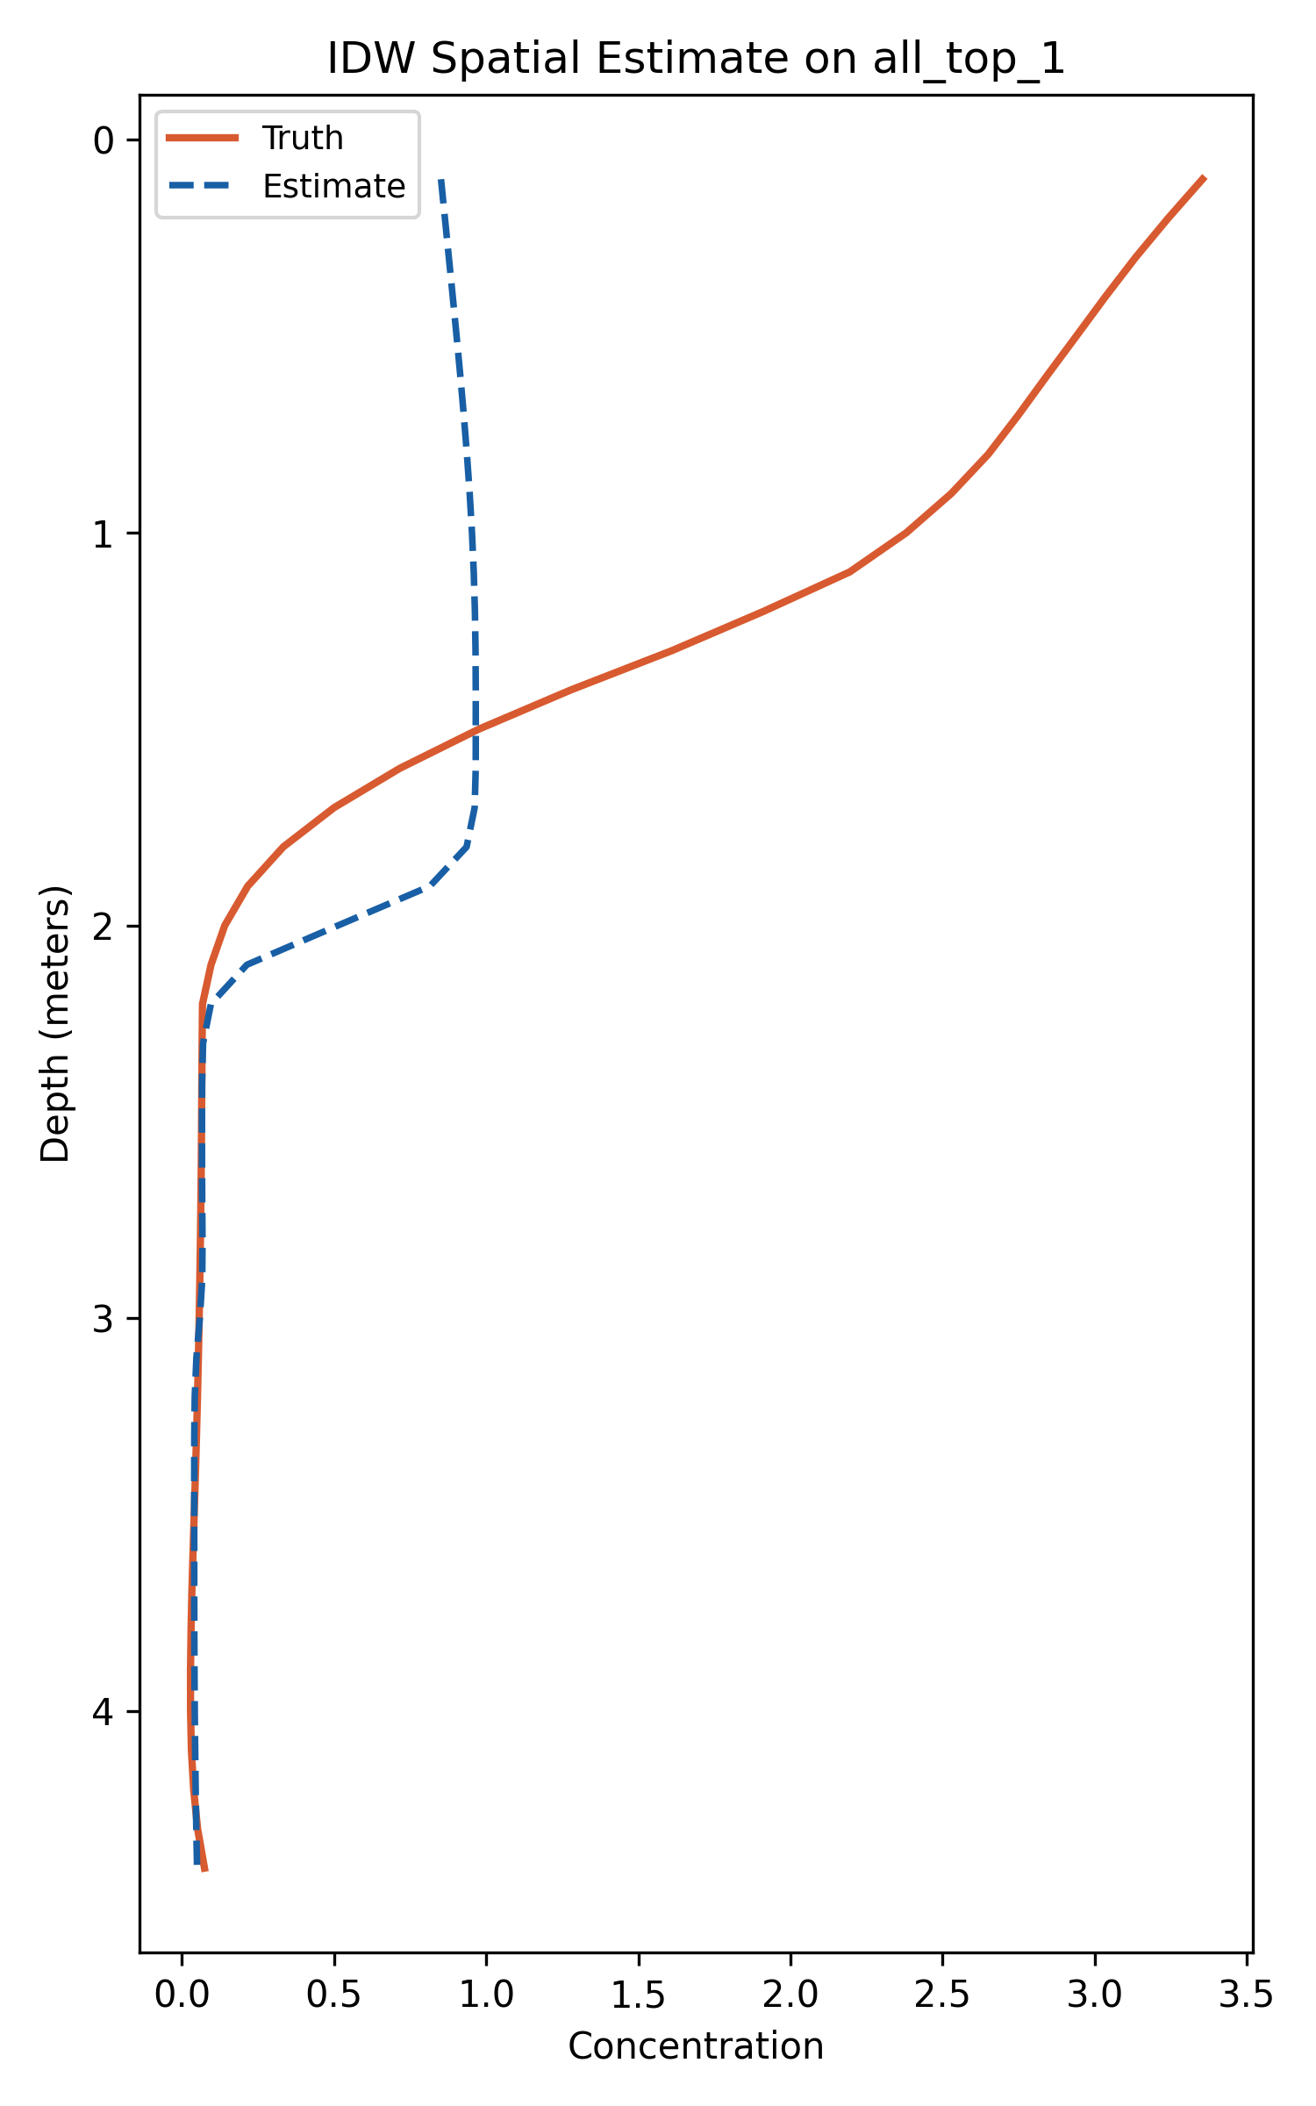
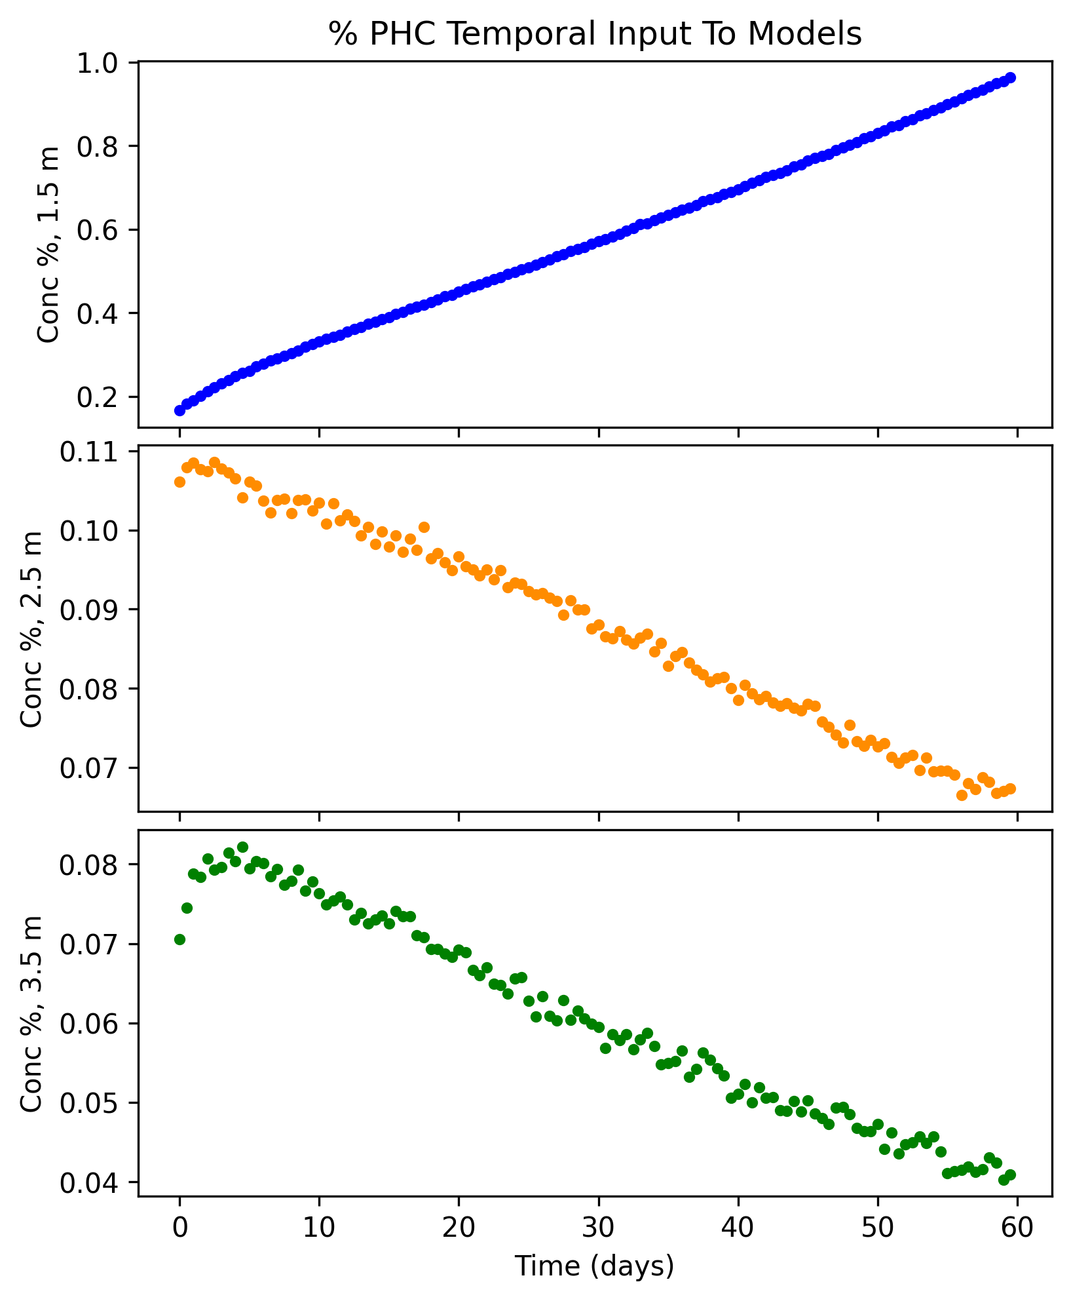
Distance-Based Interpolators
Usable Input
Produced Spatial Estimate
Evaluate The Estimate
Temporal Input to the Model
Distance-Based Interpolators
Produce Simulation
Sample
Compare Sample to Provided Input
Extract spatial Estimate
Evaluate Spatial Estimate
Initial Parameter
Estimate
Update Parameter Estimate

