Slide 1
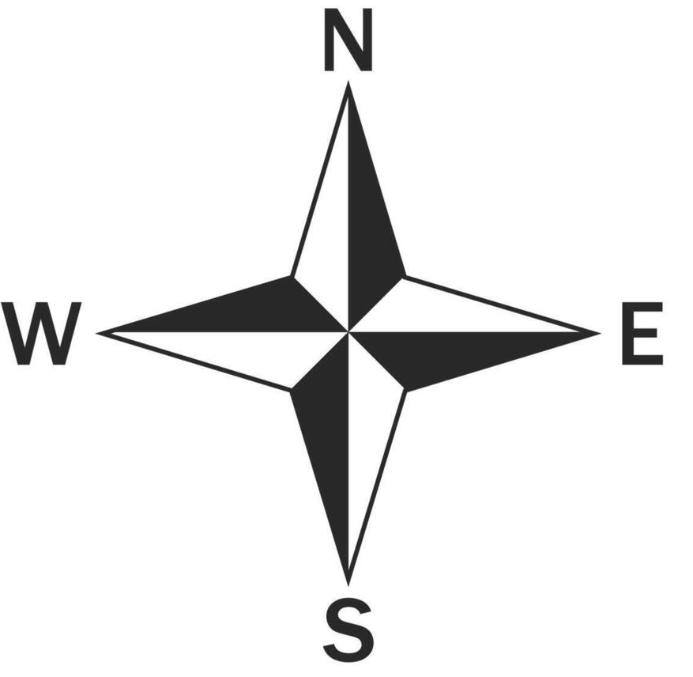
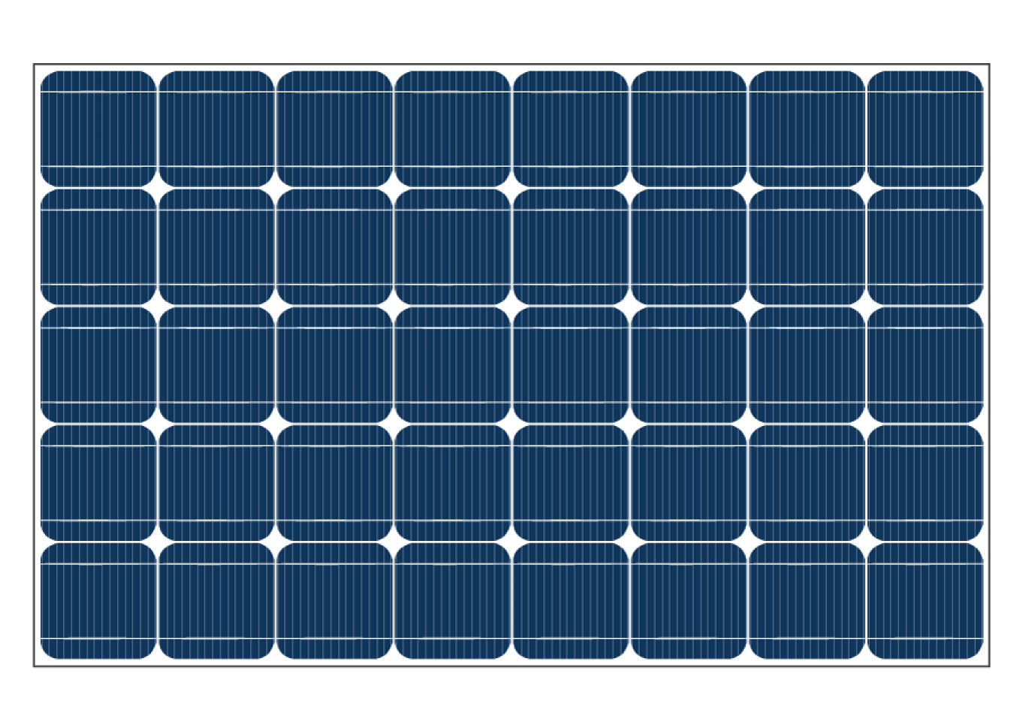


Obstacle
Obstacle
$$θ_{T0}$$
$$θ_{A0}$$
SWL

