Slide 1

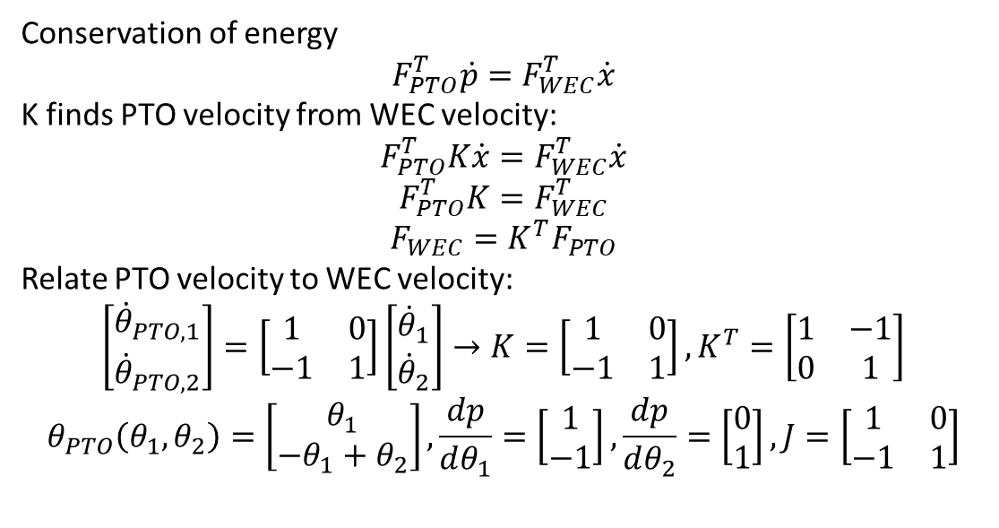





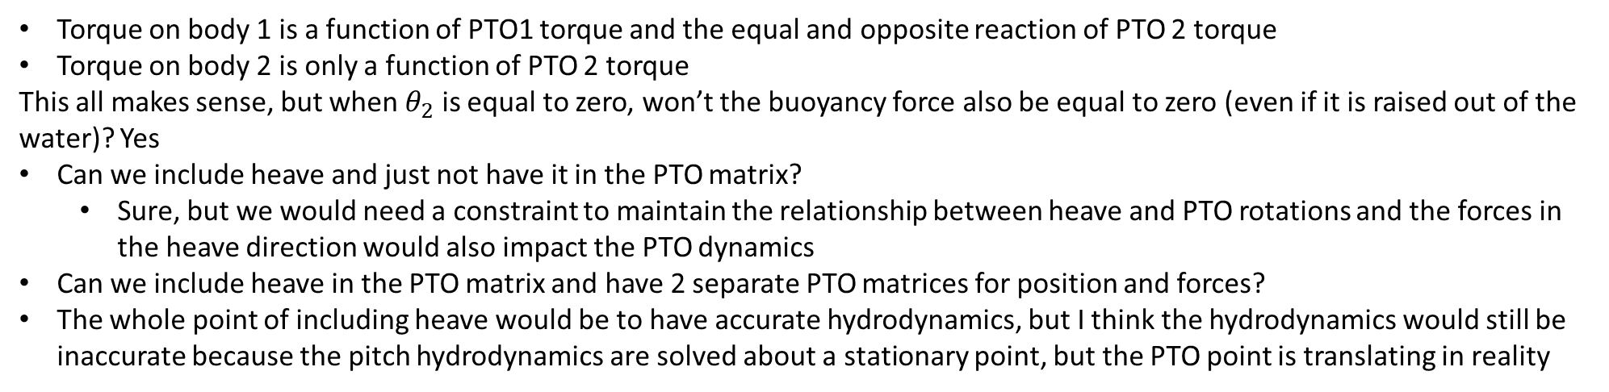

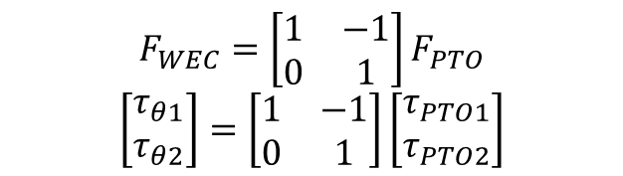
Conservation of energy
$$F_{PTO}^{T}\dot{p}=F_{WEC}^{T}\dot{x}$$
K finds PTO velocity from WEC velocity:
$$F_{PTO}^{T}K\dot{x}=F_{WEC}^{T}\dot{x}$$
$$F_{PTO}^{T}K=F_{WEC}^{T}$$
$$F_{WEC}=K^{T}F_{PTO}$$
Relate PTO velocity to WEC velocity:
$$\left[\begin{matrix}{\dot{θ}}_{PTO,1} \\ {\dot{θ}}_{PTO,2}\end{matrix}\right]=\left[\begin{matrix}1 & 0 \\ −1 & 1\end{matrix}\right]\left[\begin{matrix}{\dot{θ}}_{1} \\ {\dot{θ}}_{2}\end{matrix}\right]→K=\left[\begin{matrix}1 & 0 \\ −1 & 1\end{matrix}\right], K^{T}=\left[\begin{matrix}1 & −1 \\ 0 & 1\end{matrix}\right]$$
$$θ_{PTO}\left(θ_{1},θ_{2}\right)=\left[\begin{matrix}θ_{1} \\ −θ_{1}+θ_{2}\end{matrix}\right],\frac{dp}{dθ_{1}}=\left[\begin{matrix}1 \\ −1\end{matrix}\right],\frac{dp}{dθ_{2}}=\left[\begin{matrix}0 \\ 1\end{matrix}\right], J=\left[\begin{matrix}1 & 0 \\ −1 & 1\end{matrix}\right]$$
$$d$$
$$d$$
$$θ_{PTO,2}$$
$$θ_{PTO,1}$$
$$θ_{2}$$
$$θ_{1}$$
$$F_{WEC}=\left[\begin{matrix}1 & −1 \\ 0 & 1\end{matrix}\right]F_{PTO}$$
$$\left[\begin{matrix}τ_{θ1} \\ τ_{θ2}\end{matrix}\right]=\left[\begin{matrix}1 & −1 \\ 0 & 1\end{matrix}\right]\left[\begin{matrix}τ_{PTO1} \\ τ_{PTO2}\end{matrix}\right]$$
Torque on body 1 is a function of PTO1 torque and the equal and opposite reaction of PTO 2 torque
Torque on body 2 is only a function of PTO 2 torque
This all makes sense, but when $θ_{2}$ is equal to zero, won’t the buoyancy force also be equal to zero (even if it is raised out of the water)? Yes
Can we include heave and just not have it in the PTO matrix?
Sure, but we would need a constraint to maintain the relationship between heave and PTO rotations and the forces in the heave direction would also impact the PTO dynamics
Can we include heave in the PTO matrix and have 2 separate PTO matrices for position and forces?
The whole point of including heave would be to have accurate hydrodynamics, but I think the hydrodynamics would still be inaccurate because the pitch hydrodynamics are solved about a stationary point, but the PTO point is translating in reality

Slide 2
Including heave?
The whole point of including heave would be to have accurate hydrodynamics, but I think the hydrodynamics would still be inaccurate because the pitch hydrodynamics are solved about a stationary point, but the PTO point is translating in reality
Even if we include heave, the pitch hydrostatics are still based on a stationary PTO so are inaccurate.
How would WEC-Sim handle this problem?
Computes BEM about the center of gravity, then uses parallel axis theorem to translate forces to the point of rotation
Think about how to do this in WecOptTool

Slide 3
Hydrostatics
Do the hydrostatics take into account body position or just wave elevation?
In WEC-Sim it just uses displacement for linear hydrostatics
WecOptTool uses the transfer function defined as the hydrostatic stiffness from BEM to convert x_wec (wec position) to force in frequency domain
Also just uses the body displacement
But, this won’t be accurate if pitch is about a location that isn’t stationary

Slide 4
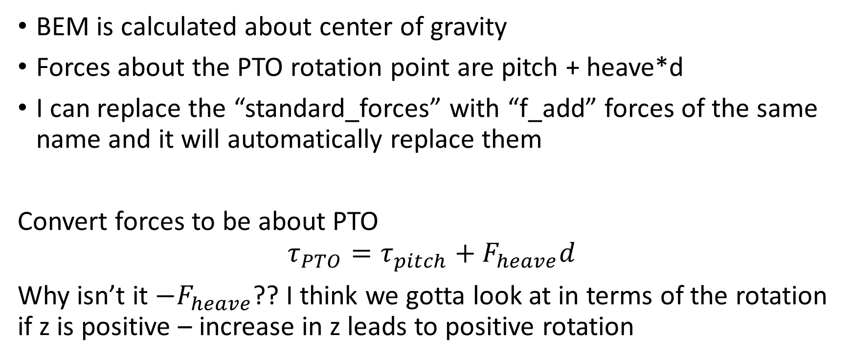
How to apply parallel axis theorem in WecOptTool
BEM is calculated about center of gravity
Forces about the PTO rotation point are pitch + heave*d
I can replace the “standard_forces” with “f_add” forces of the same name and it will automatically replace them
Convert forces to be about PTO
$$τ_{PTO}=τ_{pitch}+F_{heave}d$$
Why isn’t it $−F_{heave}$?? I think we gotta look at in terms of the rotation if z is positive – increase in z leads to positive rotation

Slide 5
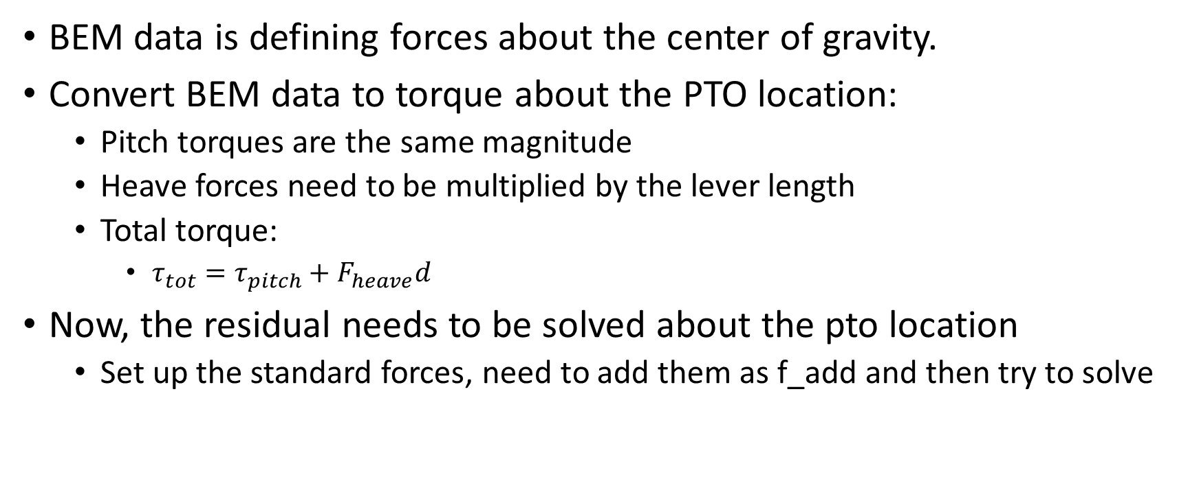
Applying parallel axis theorem
BEM data is defining forces about the center of gravity.
Convert BEM data to torque about the PTO location:
Pitch torques are the same magnitude
Heave forces need to be multiplied by the lever length
Total torque:
$τ_{tot}=τ_{pitch}+F_{heave}d$
Now, the residual needs to be solved about the pto location
Set up the standard forces, need to add them as f_add and then try to solve

Slide 6
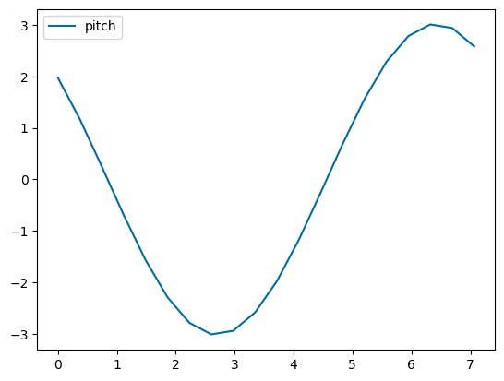
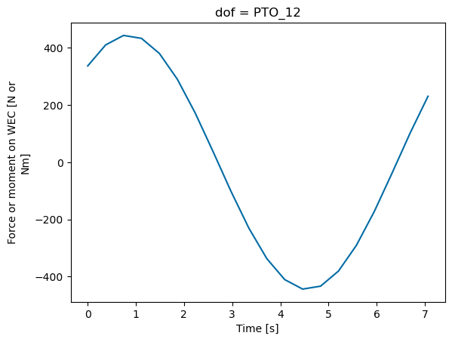
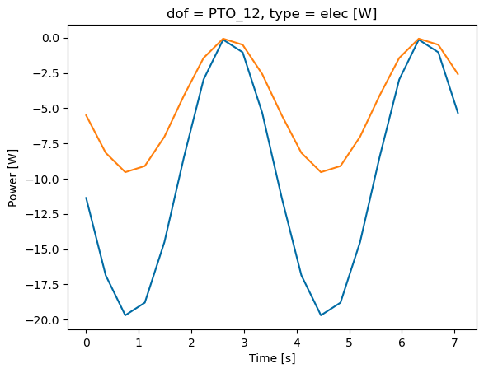
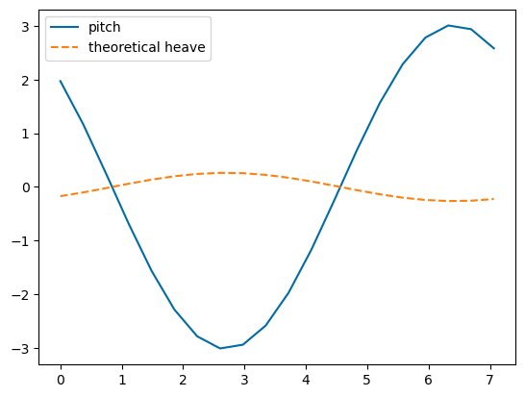


Compare pitch BEM vs. pitch manual
Fixed – inertia needed to be subtracted!

Slide 7

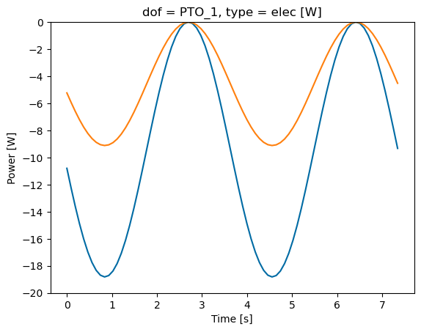
Compare to WEC-Sim
H = 0.5 m, T = 7.4371 s – so its found in WS frequency array
Kp = 1e4 – Matches WEC-Sim!
Why doesn’t 2 dof consolidated match?
Inertia fixed! It matches!
Why does 2 dof not match? Full 2 dof doesn’t make sense because were consolidating heave in pitch dof, then would be adding it back
WEC-Sim CIC case is slightly smaller

Slide 8
Why does WEC-Sim result have variation in the power peaks?
Coupling terms?
That doesn’t seem to be the issue (for 1 or 2) but I still don’t know what is…
Try removing all but pitch and heave terms – This worked!!
Why is the result slightly different? Compare all BEM terms
Hydrostatic stiffness is same
Added mass/rad/exc is same!
Got 1 body to match!!
All coefficients also match for 2 bod
Why does WEC-Sim PTO torque not match constraint torque?
Constraint torque equals pitch – heave*d
Why is there very small difference with and without inv_kin matrix?

Slide 9
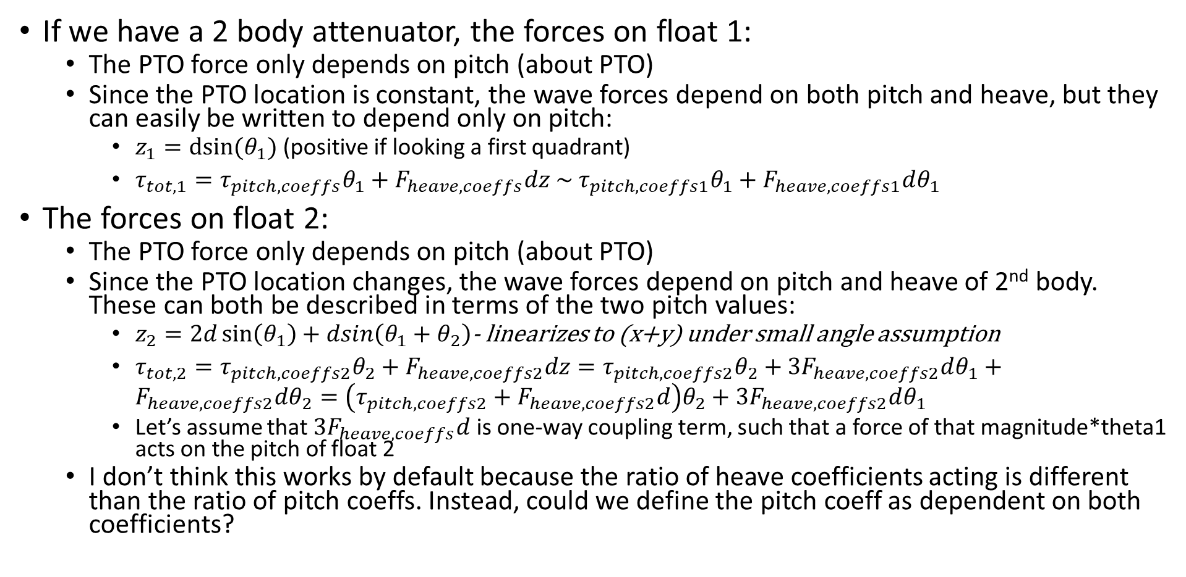
2 body – directly describe PTOs
If we have a 2 body attenuator, the forces on float 1:
The PTO force only depends on pitch (about PTO)
Since the PTO location is constant, the wave forces depend on both pitch and heave, but they can easily be written to depend only on pitch:
$z_{1}=dsin⁡(θ_{1})$ (positive if looking a first quadrant)
$τ_{tot,1}=τ_{pitch,coeffs}θ_{1}+F_{heave,coeffs}dz \sim τ_{pitch,coeffs1}θ_{1}+F_{heave,coeffs1}dθ_{1}$
The forces on float 2:
The PTO force only depends on pitch (about PTO)
Since the PTO location changes, the wave forces depend on pitch and heave of 2nd body. These can both be described in terms of the two pitch values:
$z_{2}=2d\sin\left(θ_{1}\right)+dsin\left(θ_{1}+θ_{2}\right)$- linearizes to (x+y) under small angle assumption
$τ_{tot,2}=τ_{pitch,coeffs2}θ_{2}+F_{heave,coeffs2}dz=τ_{pitch,coeffs2}θ_{2}+3F_{heave,coeffs2}dθ_{1}+F_{heave,coeffs2}dθ_{2}=\left(τ_{pitch,coeffs2}+F_{heave,coeffs2}d\right)θ_{2}+3F_{heave,coeffs2}dθ_{1}$
Let’s assume that $3F_{heave,coeffs}d$ is one-way coupling term, such that a force of that magnitude*theta1 acts on the pitch of float 2
I don’t think this works by default because the ratio of heave coefficients acting is different than the ratio of pitch coeffs. Instead, could we define the pitch coeff as dependent on both coefficients?

Slide 10

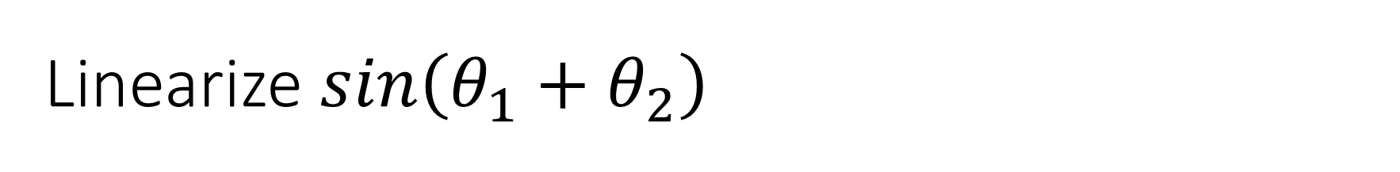
Linearize $sin\left(θ_{1}+θ_{2}\right)$
$$sin\left(θ_{1}+θ_{2}\right)=\sin\left(θ_{1}\right)\cos\left(θ_{2}\right)+\cos\left(θ_{1}\right)\sin\left(θ_{2}\right)$$
Linearized:
$θ_{1}+θ_{2}$ - based on Taylor expansion!

Slide 11
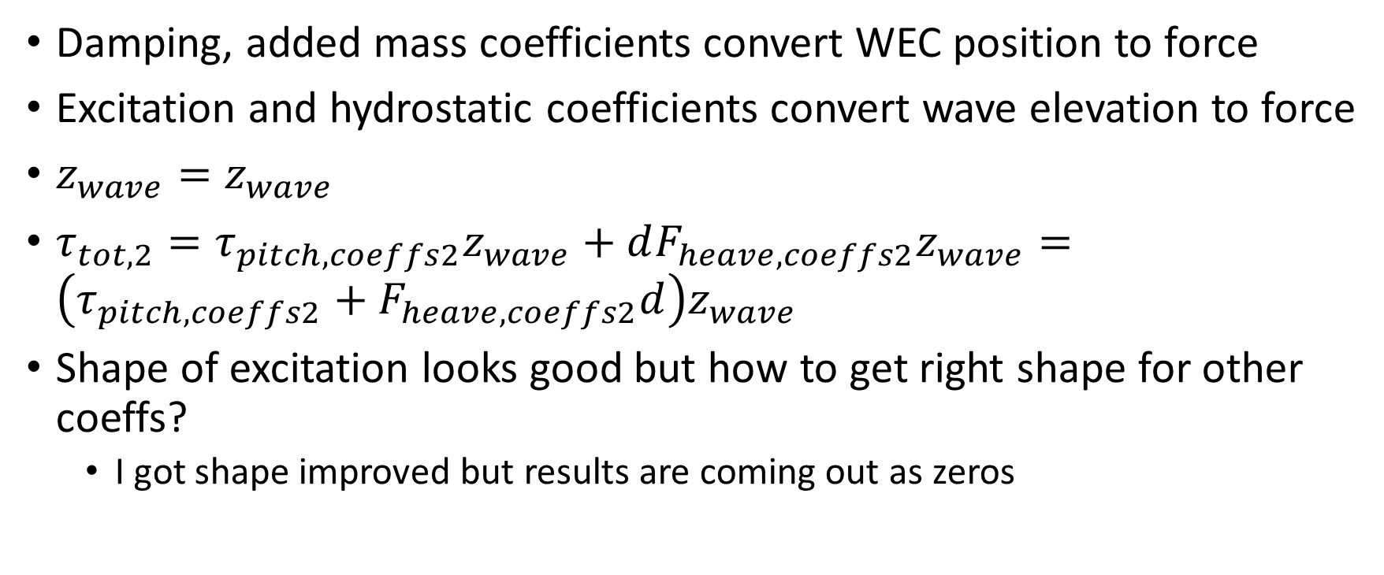
Excitation forces and hydrostatics
Damping, added mass coefficients convert WEC position to force
Excitation and hydrostatic coefficients convert wave elevation to force
$z_{wave}=z_{wave}$
$τ_{tot,2}=τ_{pitch,coeffs2}z_{wave}+dF_{heave,coeffs2}z_{wave}=\left(τ_{pitch,coeffs2}+F_{heave,coeffs2}d\right)z_{wave}$
Shape of excitation looks good but how to get right shape for other coeffs?
I got shape improved but results are coming out as zeros

Slide 12
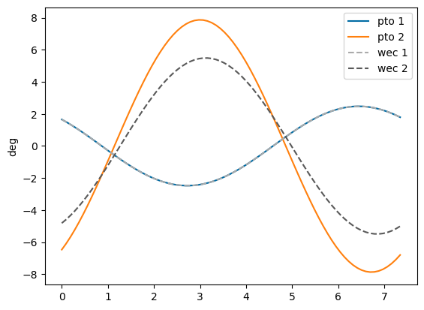
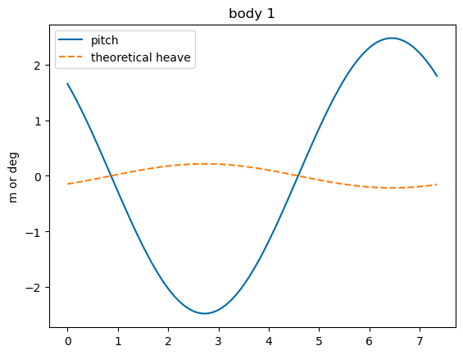
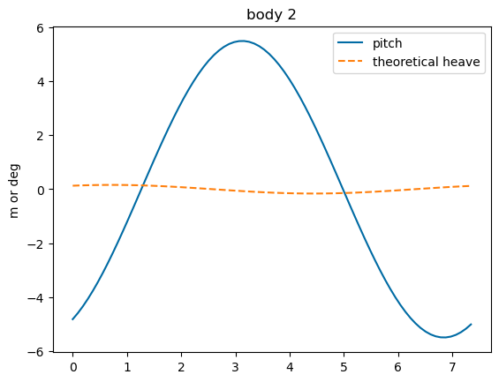
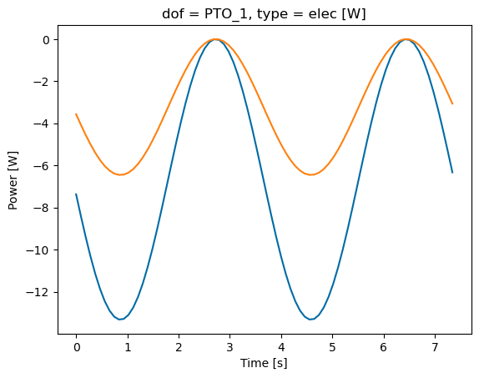
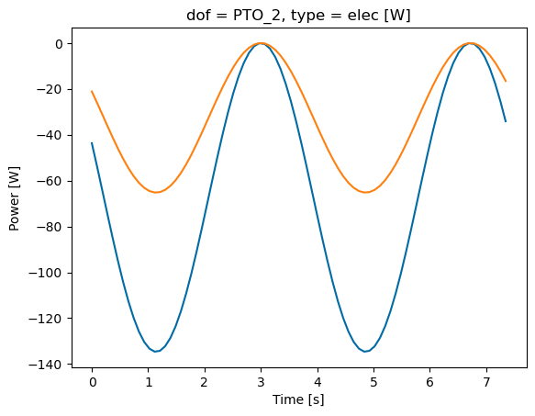
Compare 2 body
WecOptTool results are off but why?
For some reason, pitch sign is opposite in WS, but ignore for now

Slide 13
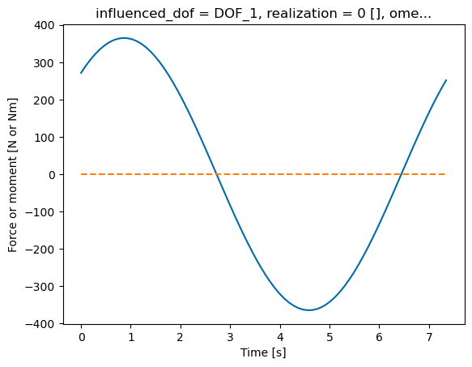
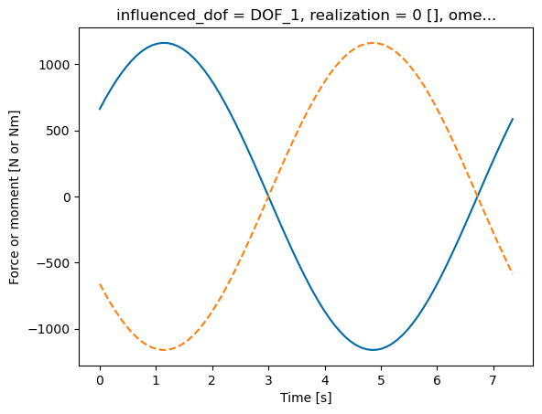
What could the reason be for WecOptTool having smaller pitch for body 1?
Too much force is being transferred onto body 1 from PTO 2?
Torque from/on body 1 is not being transferred to PTO 2?

Slide 14
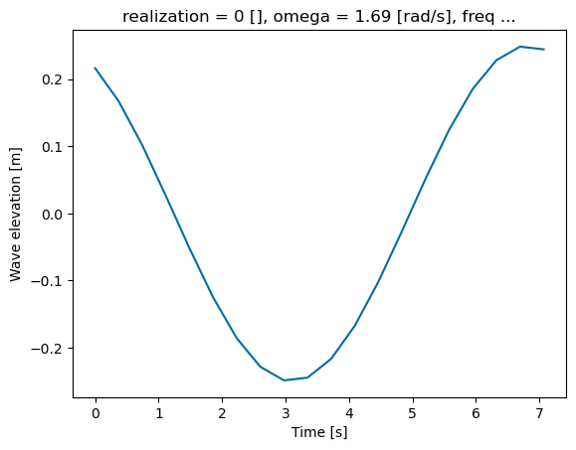
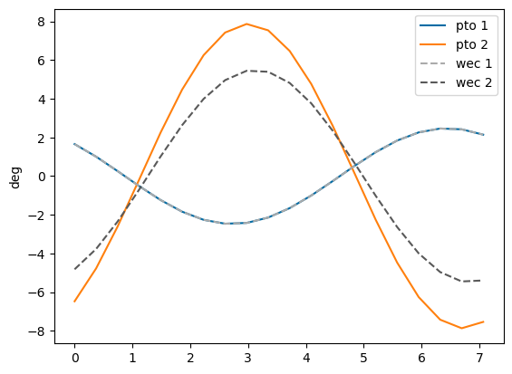
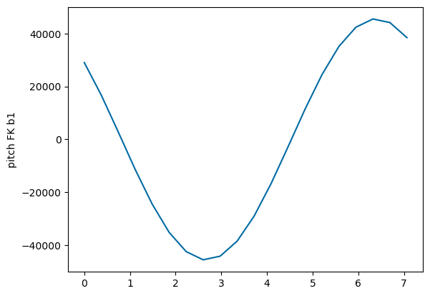
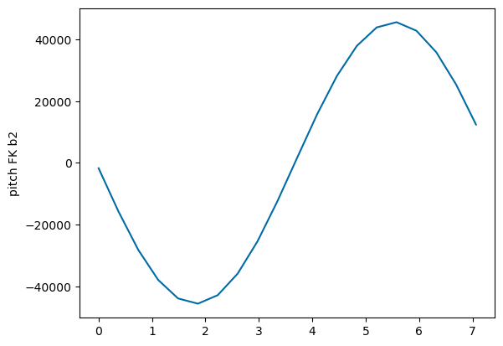
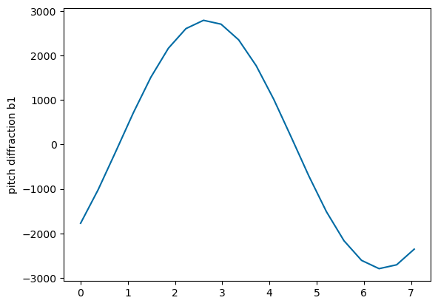
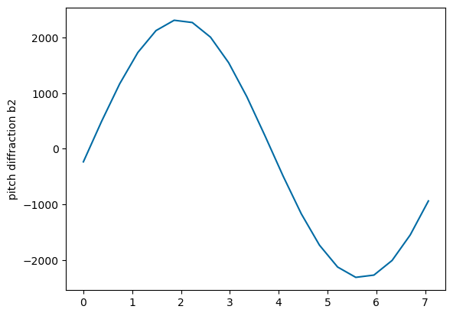
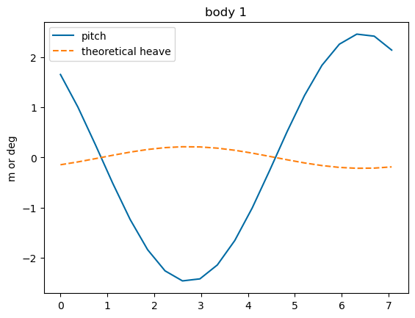
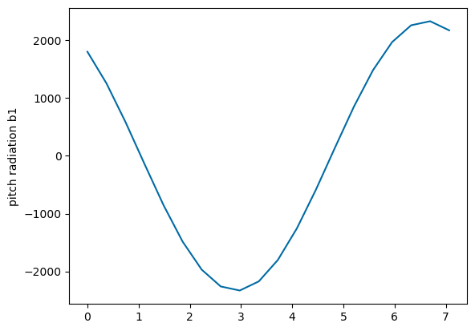
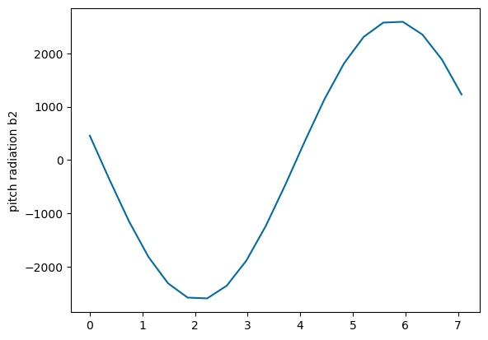
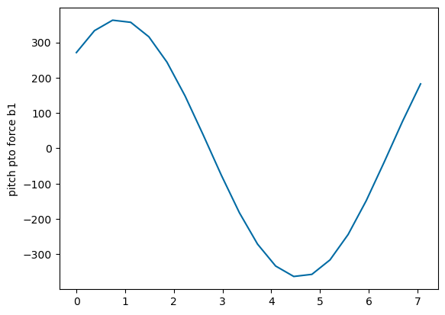
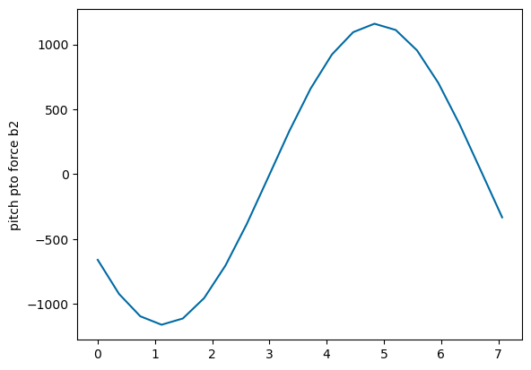
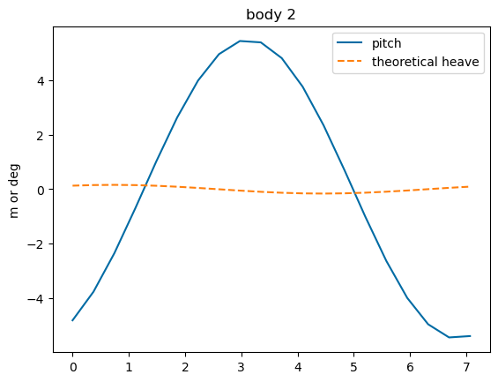
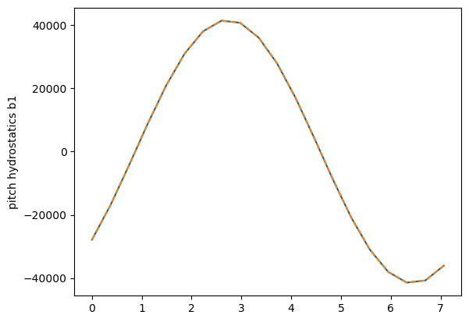
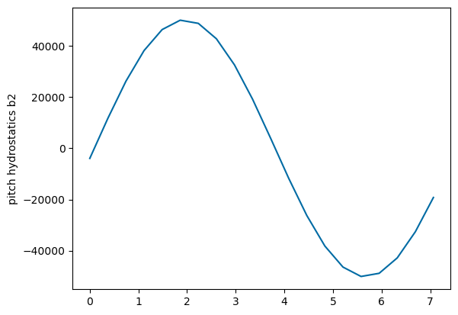
Compare 2 body forces
Do forces make sense?
Negative pitch FK occurs with positive heave displacement
PTO force looks good
Radiation seems okay
Hydrostatics are off – seem to be based on wave elevation instead of body disp.
RERAN with switched coupling element check!!!!

Slide 15
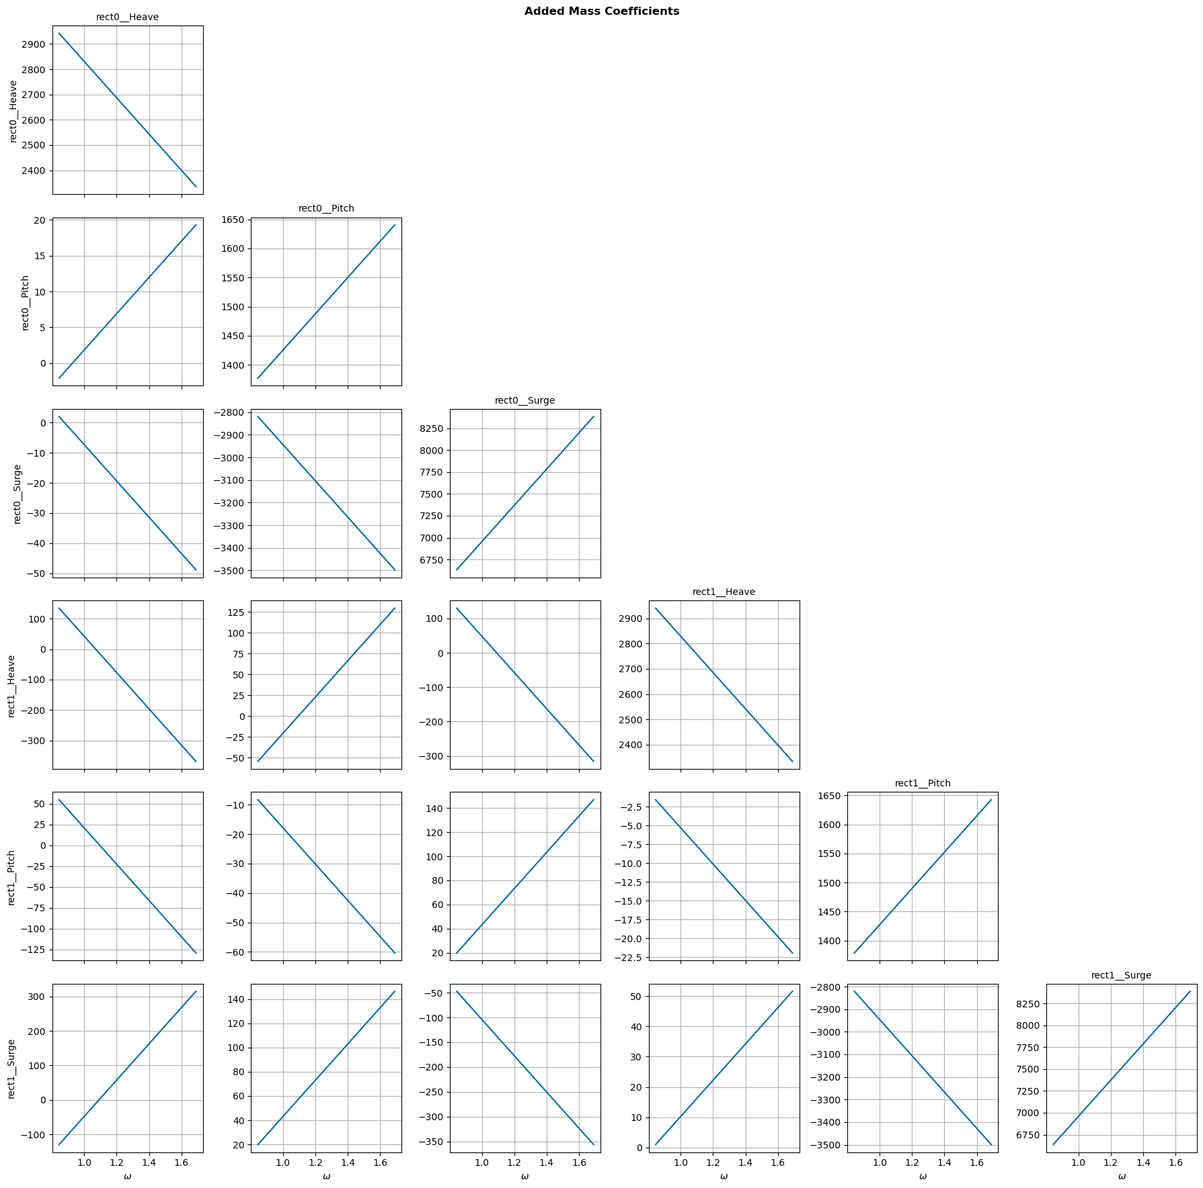
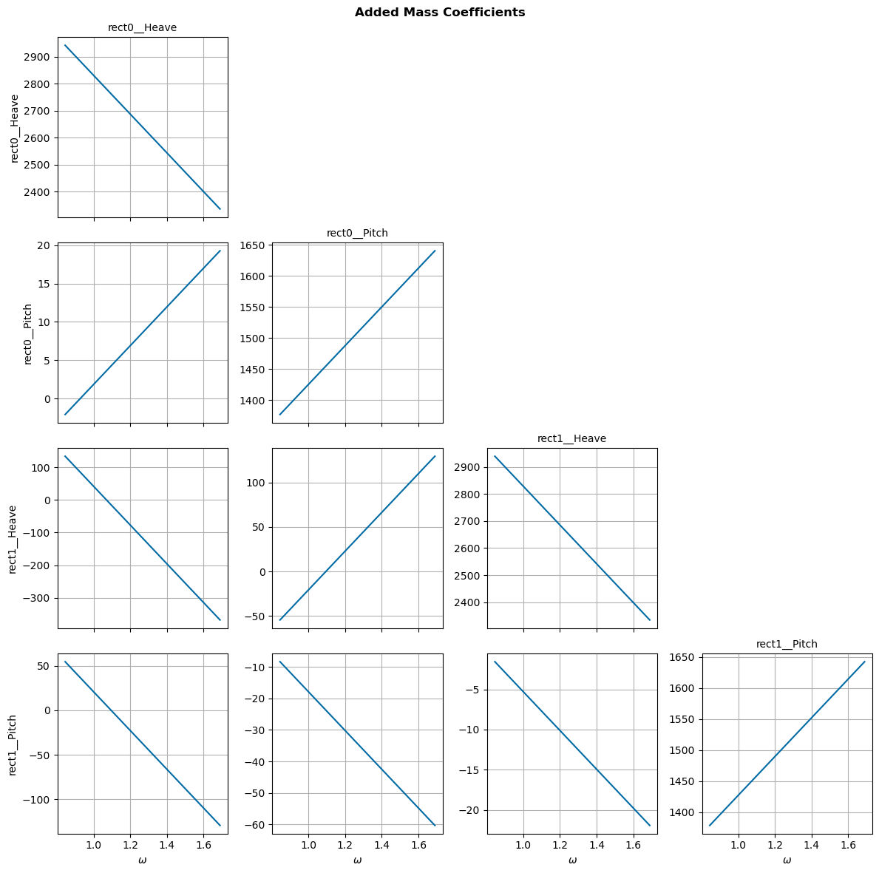
Does adding surge change the existing dofs?
Nope!

Slide 16
Look into how the influenced/radiating dof are applied for each force
When I select influenced dof on rect0 pitch term, I get the coupling term, but it doesn’t seem to be applied this way?
Maybe look at how the x_wec is converted to the position of each body

Slide 17
Why does WEC-Sim apply the same excitation forces to both bodies?
Somehow both have the same excitation force phase…
It seemed to be because they had the same name!

Slide 18
WEC-Sim model?
If I model the system in WEC-Sim, what is the heave force?
Is it equal to the inverse kinematics? Probably not quite due to constraints
Are there constraint forces acting in heave? I think so when not at equilibrium?
PTO has internal mechanics forces only in pitch
But, it has constraint forces in other directions
Constraint on body is a bit bigger than PTO constraint force

Slide 19
Is it incorrect to solve a WEC about a dof other than the cg without coupling terms?
When solving with only pitch, the force from hydrostatic stiffness is K*theta
When solving with pitch and heave, the force from hydrostatic stiffness is K*theta + K_couple*z
When solving BEM about a point other than the CG, Capytaine handles this!

Slide 20
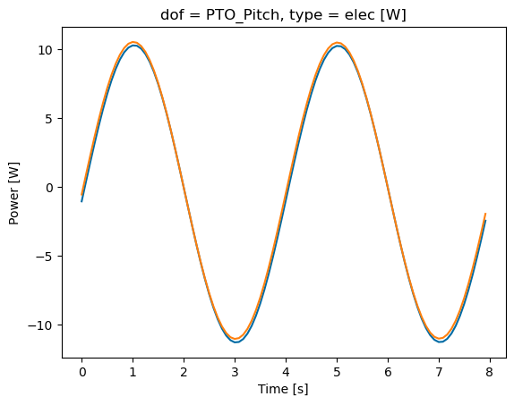
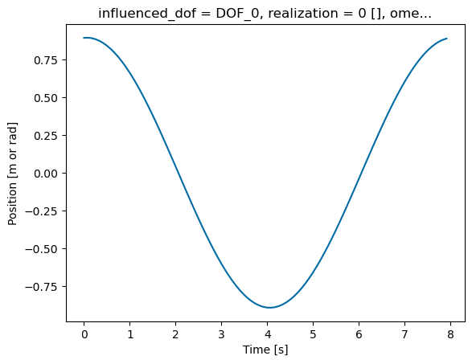
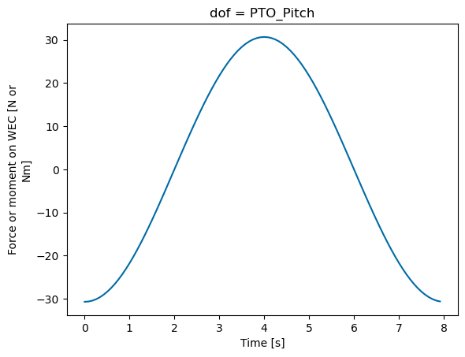
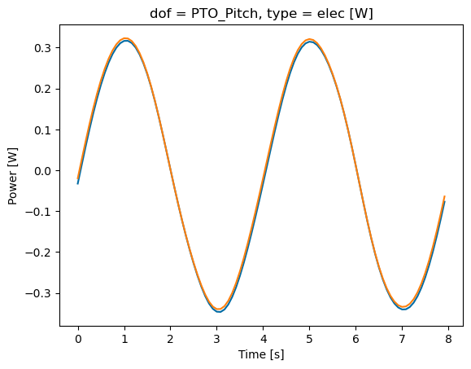
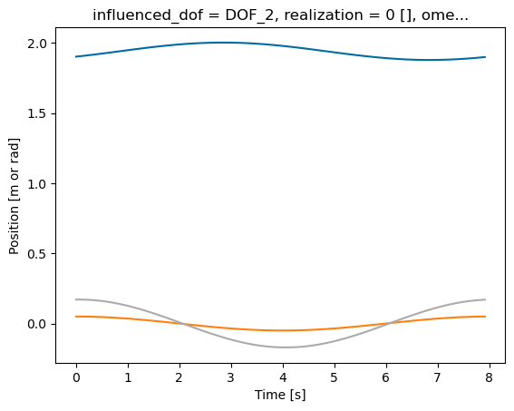
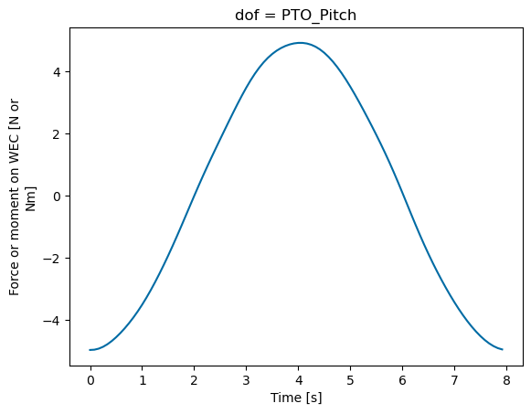
Am I solving the FOSWEC incorrectly? No
I don’t think so because:
No hydrostatic restoring force is present in surge
No horizontal distance between cg and hinge point, so heave doesn’t have coupling terms
But there is a difference…
And it’s a big difference
This is because of lack of constraints on surge/heave!!!!
But I can’t add constraints
I think I need to prescribe/force heave motion for attenuator

Slide 21
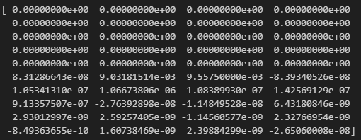
Try prescribing heave position
Can I replace the residual to include only pitch?
Yes, I did this successfully
Now, can I make heave residual just a component based on pitch instead?
Maybe heave can just be an afterthought and pitch is
Forces converted to PTO location, then .
We def need another state variable so force of the waves can depend on both heave and pitch
Try to run and resolve issues

Slide 22
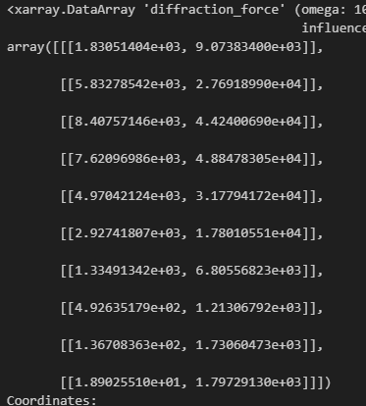
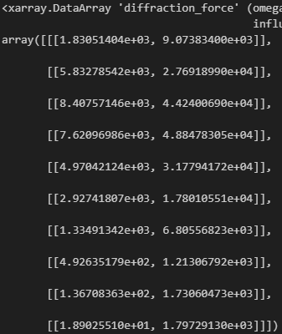


Should converted coefficients match?
Heave matches, and now pitch matches! Just a difference in the center of mass
Pitch results suggest more coupling but its okay

Slide 23
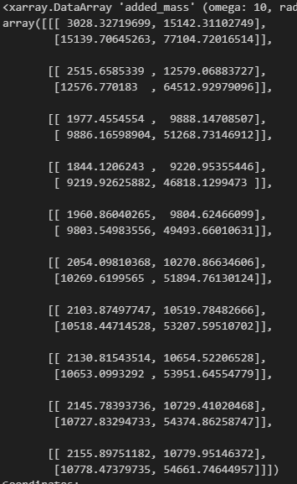
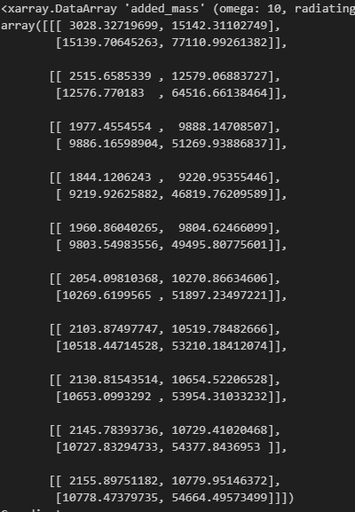
Why doesn’t added mass match?
Added mass matches now
Radiation damping and hydrostatic stiffness also match now

Slide 24
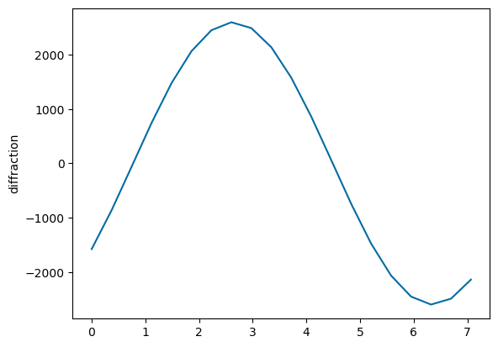
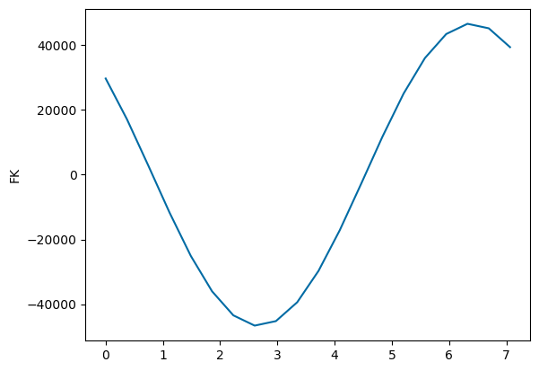






Compare pitch only to consolidated heave/pitch forces
Fixed – negate inertia

Slide 25






Compare results:
Resultant pitch, force, and power are all less than half of pitch only results

Slide 26








Compare types of forces:
Results are the same
Shouldn’t hydrostatics be different for different pitch angles?

Slide 27






Results match each other when I include heave
Why aren’t results the same with and without heave in BEM?

