Slide 1

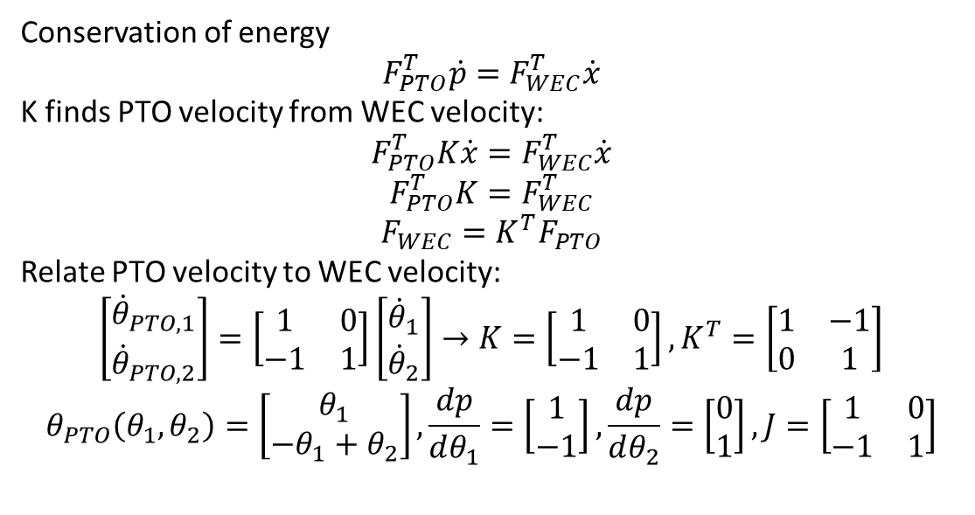





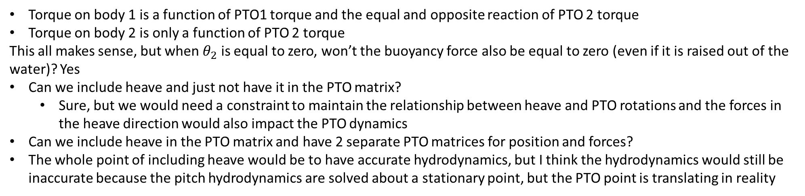

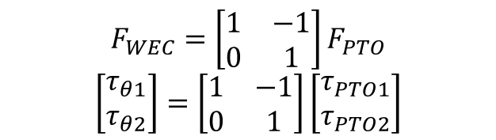
Conservation of energy
$$F_{PTO}^{T}\dot{p}=F_{WEC}^{T}\dot{x}$$
K finds PTO velocity from WEC velocity:
$$F_{PTO}^{T}K\dot{x}=F_{WEC}^{T}\dot{x}$$
$$F_{PTO}^{T}K=F_{WEC}^{T}$$
$$F_{WEC}=K^{T}F_{PTO}$$
Relate PTO velocity to WEC velocity:
$$\left[\begin{matrix}{\dot{θ}}_{PTO,1} \\ {\dot{θ}}_{PTO,2}\end{matrix}\right]=\left[\begin{matrix}1 & 0 \\ −1 & 1\end{matrix}\right]\left[\begin{matrix}{\dot{θ}}_{1} \\ {\dot{θ}}_{2}\end{matrix}\right]→K=\left[\begin{matrix}1 & 0 \\ −1 & 1\end{matrix}\right], K^{T}=\left[\begin{matrix}1 & −1 \\ 0 & 1\end{matrix}\right]$$
$$θ_{PTO}\left(θ_{1},θ_{2}\right)=\left[\begin{matrix}θ_{1} \\ −θ_{1}+θ_{2}\end{matrix}\right],\frac{dp}{dθ_{1}}=\left[\begin{matrix}1 \\ −1\end{matrix}\right],\frac{dp}{dθ_{2}}=\left[\begin{matrix}0 \\ 1\end{matrix}\right], J=\left[\begin{matrix}1 & 0 \\ −1 & 1\end{matrix}\right]$$
$$d$$
$$d$$
$$θ_{PTO,2}$$
$$θ_{PTO,1}$$
$$θ_{2}$$
$$θ_{1}$$
$$F_{WEC}=\left[\begin{matrix}1 & −1 \\ 0 & 1\end{matrix}\right]F_{PTO}$$
$$\left[\begin{matrix}τ_{θ1} \\ τ_{θ2}\end{matrix}\right]=\left[\begin{matrix}1 & −1 \\ 0 & 1\end{matrix}\right]\left[\begin{matrix}τ_{PTO1} \\ τ_{PTO2}\end{matrix}\right]$$
Torque on body 1 is a function of PTO1 torque and the equal and opposite reaction of PTO 2 torque
Torque on body 2 is only a function of PTO 2 torque
This all makes sense, but when $θ_{2}$ is equal to zero, won’t the buoyancy force also be equal to zero (even if it is raised out of the water)? Yes
Can we include heave and just not have it in the PTO matrix?
Sure, but we would need a constraint to maintain the relationship between heave and PTO rotations and the forces in the heave direction would also impact the PTO dynamics
Can we include heave in the PTO matrix and have 2 separate PTO matrices for position and forces?
The whole point of including heave would be to have accurate hydrodynamics, but I think the hydrodynamics would still be inaccurate because the pitch hydrodynamics are solved about a stationary point, but the PTO point is translating in reality

Slide 2
Including heave?
The whole point of including heave would be to have accurate hydrodynamics, but I think the hydrodynamics would still be inaccurate because the pitch hydrodynamics are solved about a stationary point, but the PTO point is translating in reality
Even if we include heave, the pitch hydrostatics are still based on a stationary PTO so are inaccurate.
How would WEC-Sim handle this problem?
Computes BEM about the center of gravity, then uses parallel axis theorem to translate forces to the point of rotation
Think about how to do this in WecOptTool

Slide 3
Hydrostatics
Do the hydrostatics take into account body position or just wave elevation?
In WEC-Sim it just uses wave elevation for linear hydrostatics
WecOptTool uses the transfer function defined as the hydrostatic stiffness from BEM to convert x_wec (wec position) to force in frequency domain
Also just uses the body displacement
But, this won’t be accurate if pitch is about a location that isn’t stationary

Slide 4
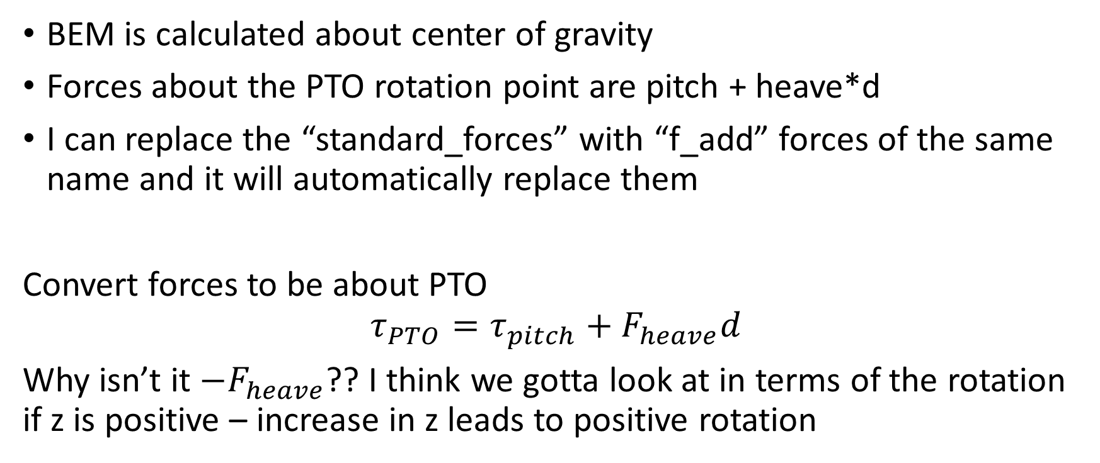
How to apply parallel axis theorem in WecOptTool
BEM is calculated about center of gravity
Forces about the PTO rotation point are pitch + heave*d
I can replace the “standard_forces” with “f_add” forces of the same name and it will automatically replace them
Convert forces to be about PTO
$$τ_{PTO}=τ_{pitch}+F_{heave}d$$
Why isn’t it $−F_{heave}$?? I think we gotta look at in terms of the rotation if z is positive – increase in z leads to positive rotation

Slide 5
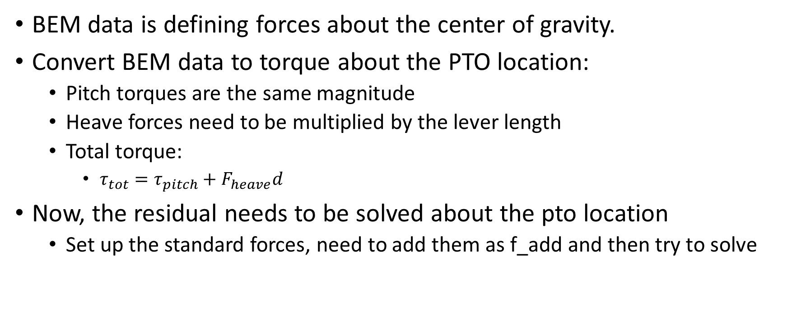
Applying parallel axis theorem
BEM data is defining forces about the center of gravity.
Convert BEM data to torque about the PTO location:
Pitch torques are the same magnitude
Heave forces need to be multiplied by the lever length
Total torque:
$τ_{tot}=τ_{pitch}+F_{heave}d$
Now, the residual needs to be solved about the pto location
Set up the standard forces, need to add them as f_add and then try to solve

Slide 6
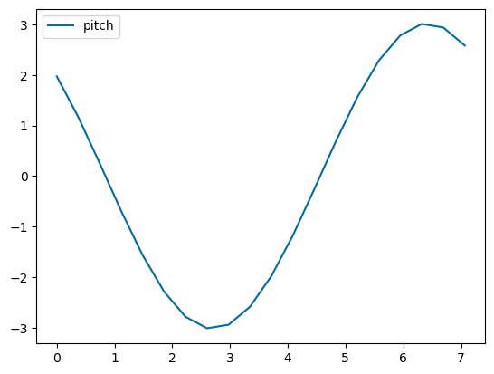
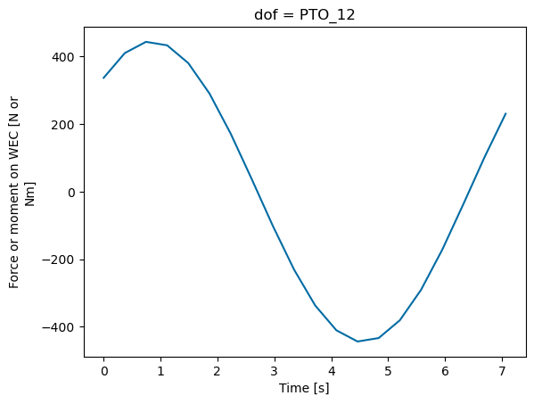
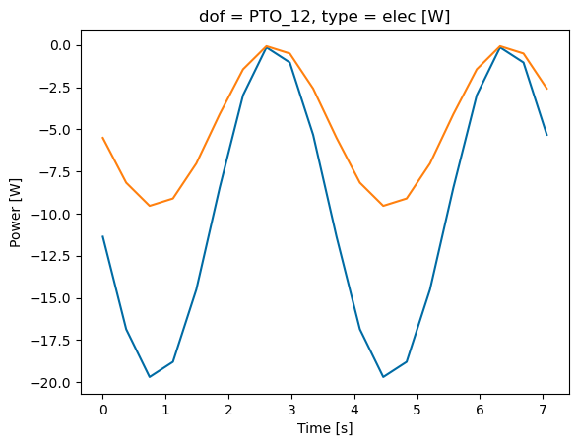
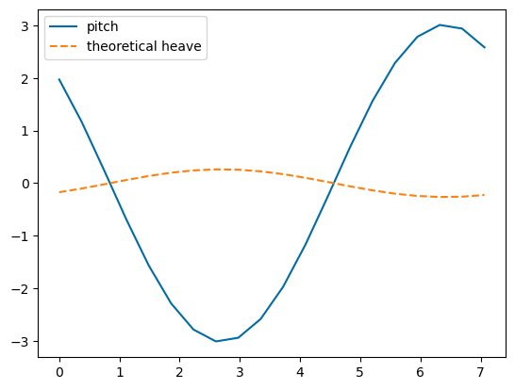


Compare pitch BEM vs. pitch manual
Fixed – inertia needed to be subtracted!

Slide 7
Compare to WEC-Sim
H = 0.5 m, T = 7.4371 s – so its found in WS frequency array
Kp = 1e4 – Matches WEC-Sim!
Why doesn’t 2 dof consolidated match?
Inertia fixed! It matches!
Why does 2 dof not match? Full 2 dof doesn’t make sense because were consolidating heave in pitch dof, then would be adding it back
WEC-Sim CIC case is slightly smaller

Slide 8
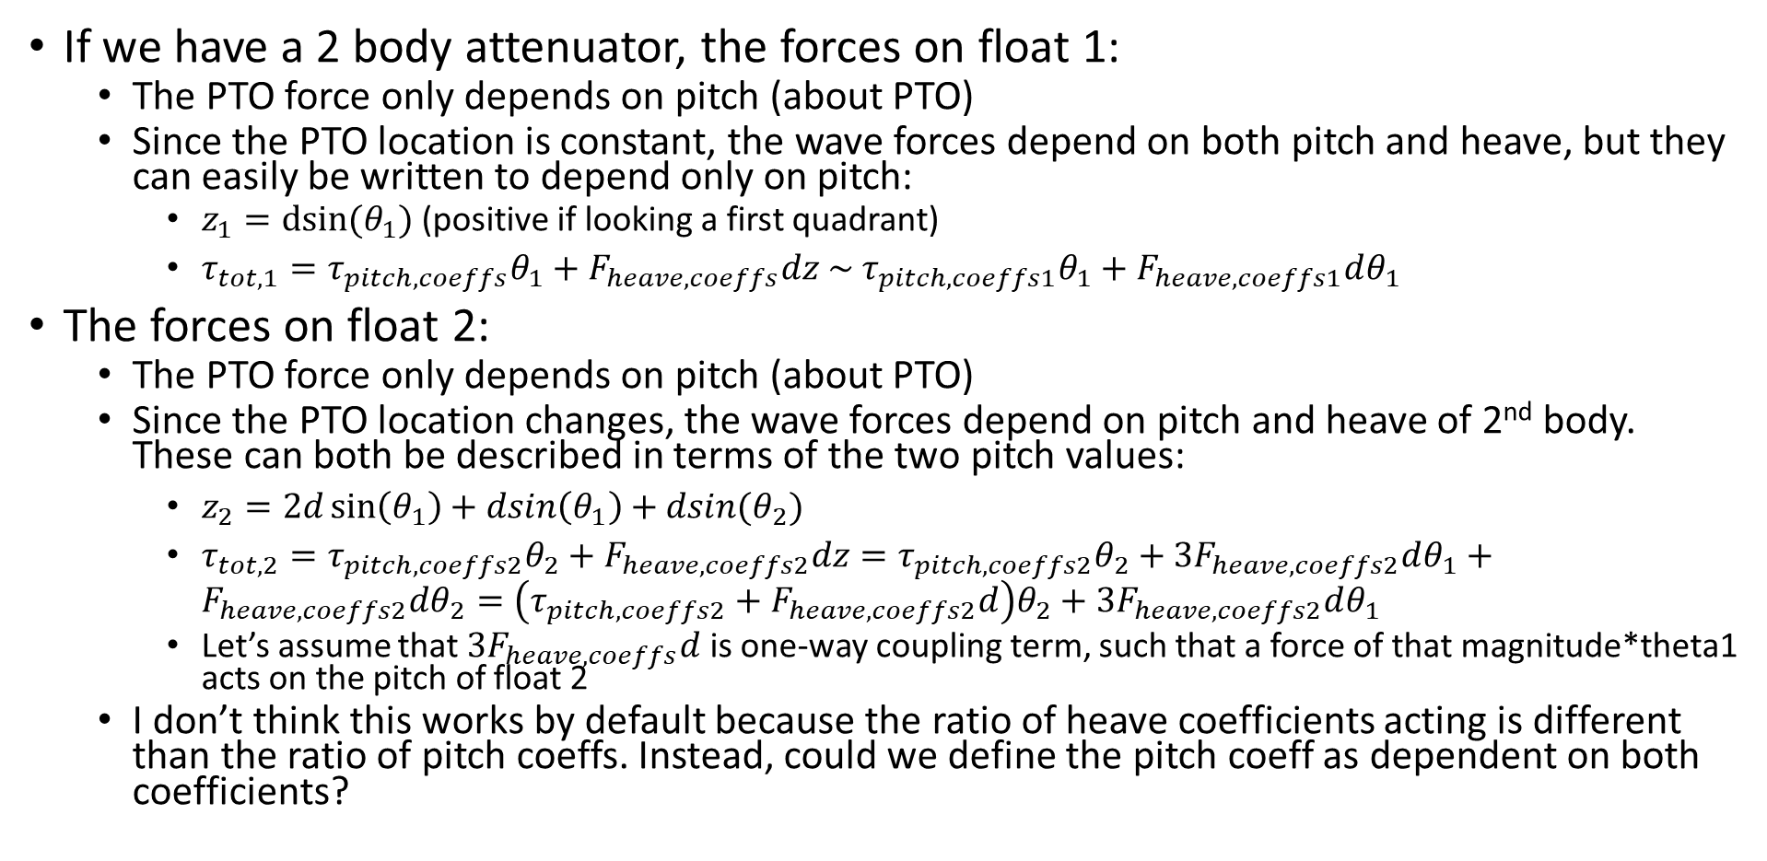
2 body
If we have a 2 body attenuator, the forces on float 1:
The PTO force only depends on pitch (about PTO)
Since the PTO location is constant, the wave forces depend on both pitch and heave, but they can easily be written to depend only on pitch:
$z_{1}=dsin⁡(θ_{1})$ (positive if looking a first quadrant)
$τ_{tot,1}=τ_{pitch,coeffs}θ_{1}+F_{heave,coeffs}dz \sim τ_{pitch,coeffs1}θ_{1}+F_{heave,coeffs1}dθ_{1}$
The forces on float 2:
The PTO force only depends on pitch (about PTO)
Since the PTO location changes, the wave forces depend on pitch and heave of 2nd body. These can both be described in terms of the two pitch values:
$z_{2}=2d\sin\left(θ_{1}\right)+dsin\left(θ_{1}\right)+dsin(θ_{2})$
$τ_{tot,2}=τ_{pitch,coeffs2}θ_{2}+F_{heave,coeffs2}dz=τ_{pitch,coeffs2}θ_{2}+3F_{heave,coeffs2}dθ_{1}+F_{heave,coeffs2}dθ_{2}=\left(τ_{pitch,coeffs2}+F_{heave,coeffs2}d\right)θ_{2}+3F_{heave,coeffs2}dθ_{1}$
Let’s assume that $3F_{heave,coeffs}d$ is one-way coupling term, such that a force of that magnitude*theta1 acts on the pitch of float 2
I don’t think this works by default because the ratio of heave coefficients acting is different than the ratio of pitch coeffs. Instead, could we define the pitch coeff as dependent on both coefficients?

Slide 9
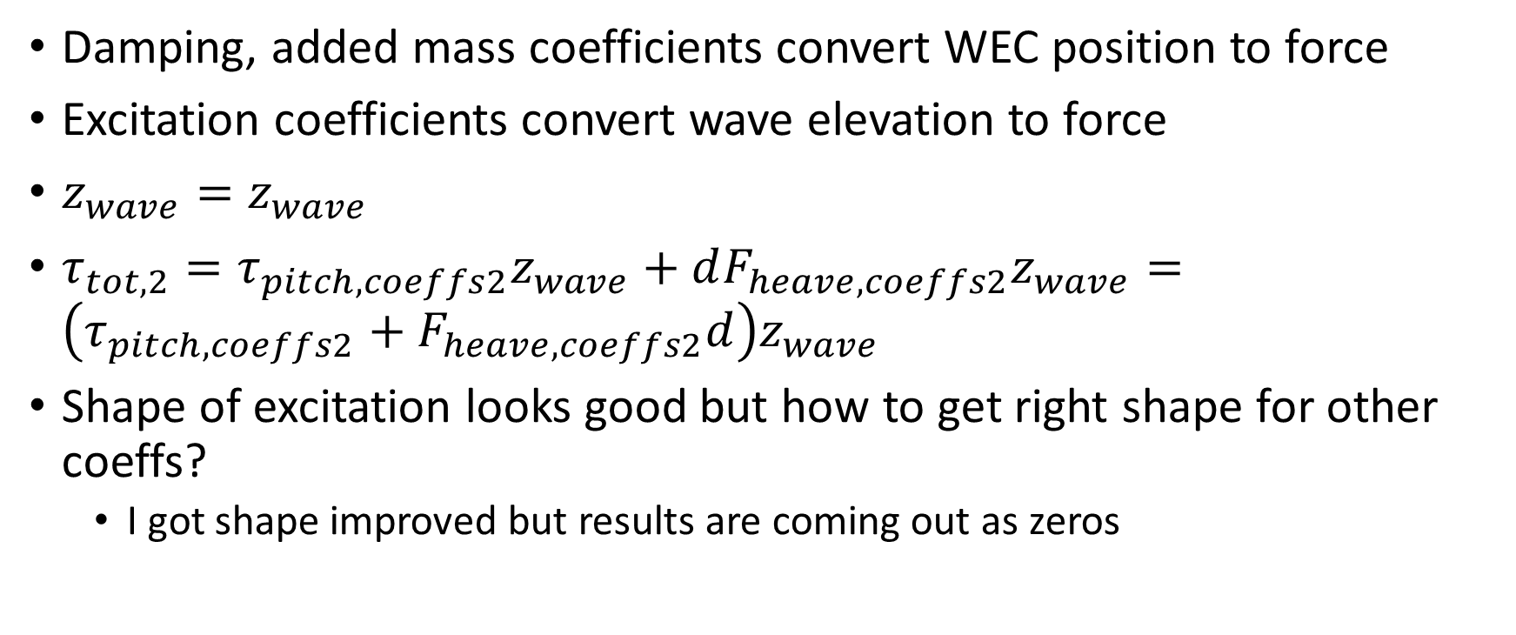
Excitation forces
Damping, added mass coefficients convert WEC position to force
Excitation coefficients convert wave elevation to force
$z_{wave}=z_{wave}$
$τ_{tot,2}=τ_{pitch,coeffs2}z_{wave}+dF_{heave,coeffs2}z_{wave}=\left(τ_{pitch,coeffs2}+F_{heave,coeffs2}d\right)z_{wave}$
Shape of excitation looks good but how to get right shape for other coeffs?
I got shape improved but results are coming out as zeros

Slide 10
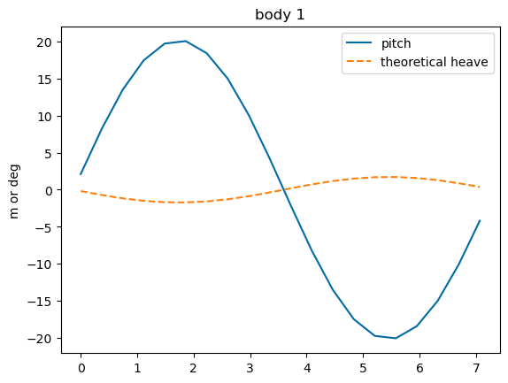
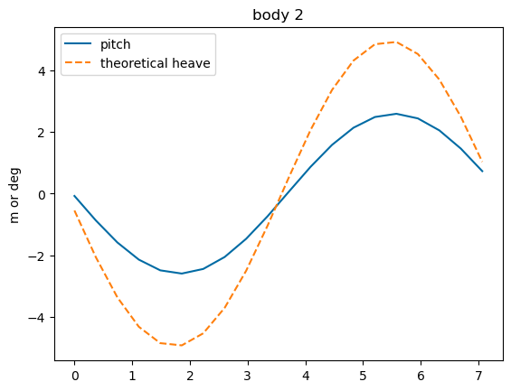
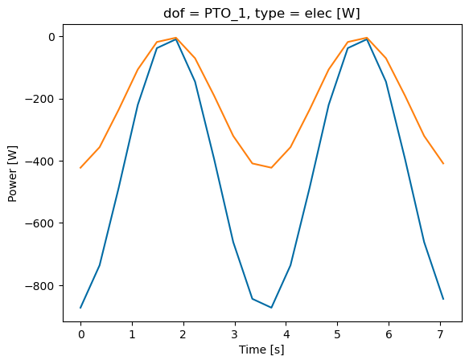
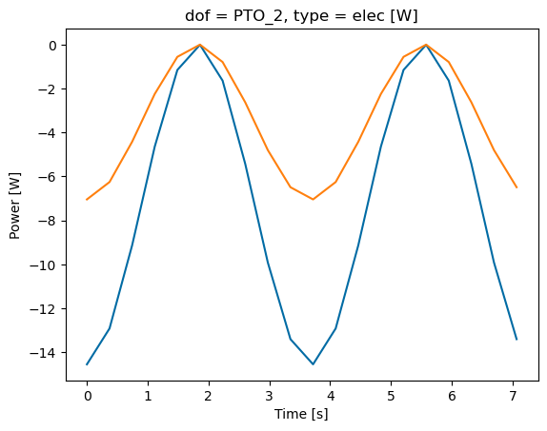
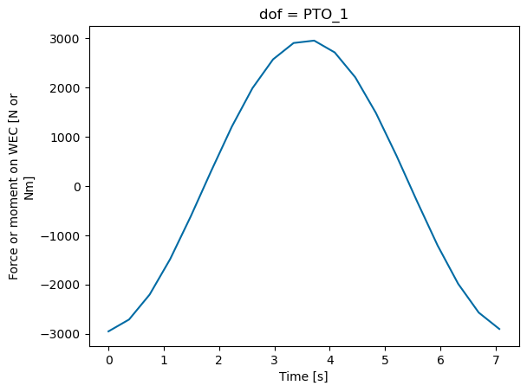
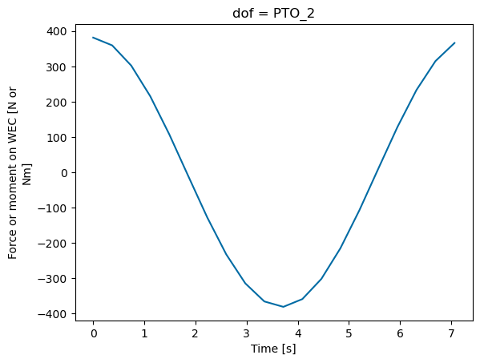
Compare 2 body
WecOptTool results seem pretty large (and small for body 2)
WEC-Sim set up but need to make sure its relative rotation!

Slide 11
WEC-Sim model?
If I model the system in WEC-Sim, what is the heave force?
Is it equal to the inverse kinematics? Probably not quite due to constraints
Are there constraint forces acting in heave? I think so when not at equilibrium?
PTO has internal mechanics forces only in pitch
But, it has constraint forces in other directions
Constraint on body is a bit bigger than PTO constraint force

Slide 12
Is it incorrect to solve a WEC about a dof other than the cg without coupling terms?
When solving with only pitch, the force from hydrostatic stiffness is K*theta
When solving with pitch and heave, the force from hydrostatic stiffness is K*theta + K_couple*z
When solving BEM about a point other than the CG, Capytaine handles this!

Slide 13
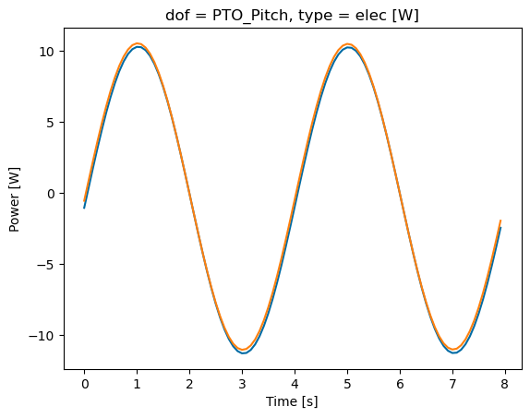
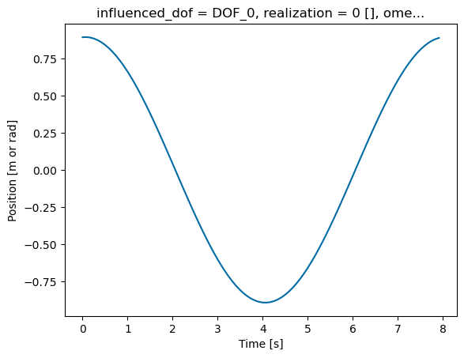
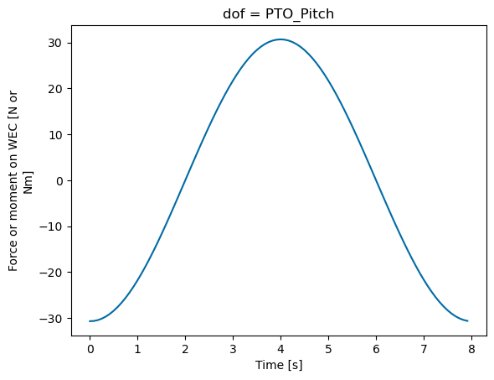
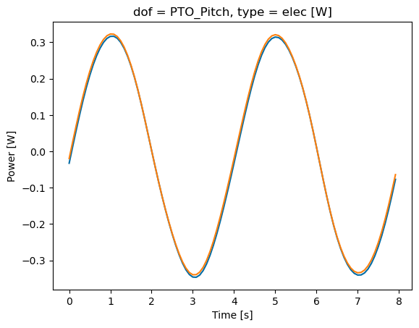
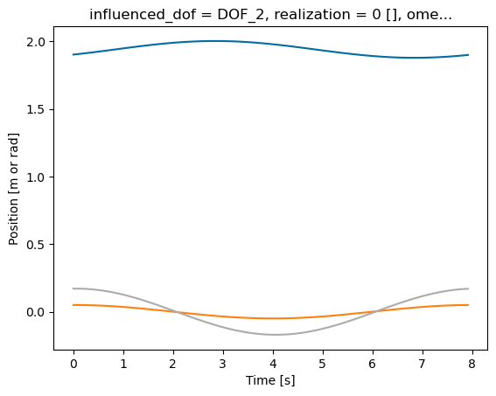
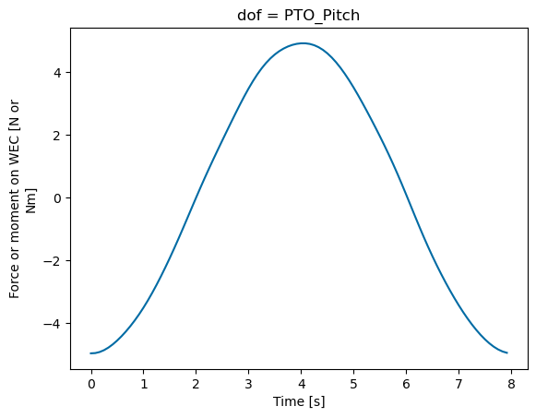
Am I solving the FOSWEC incorrectly? No
I don’t think so because:
No hydrostatic restoring force is present in surge
No horizontal distance between cg and hinge point, so heave doesn’t have coupling terms
But there is a difference…
And it’s a big difference
This is because of lack of constraints on surge/heave!!!!
But I can’t add constraints
I think I need to prescribe/force heave motion for attenuator

Slide 14
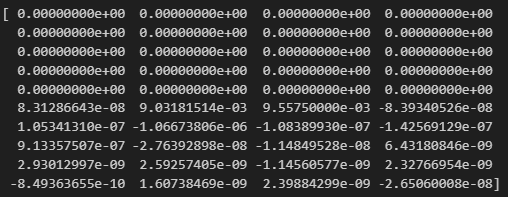
Try prescribing heave position
Can I replace the residual to include only pitch?
Yes, I did this successfully
Now, can I make heave residual just a component based on pitch instead?
Maybe heave can just be an afterthought and pitch is
Forces converted to PTO location, then .
We def need another state variable so force of the waves can depend on both heave and pitch
Try to run and resolve issues

Slide 15
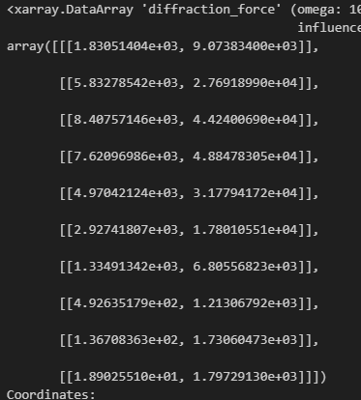
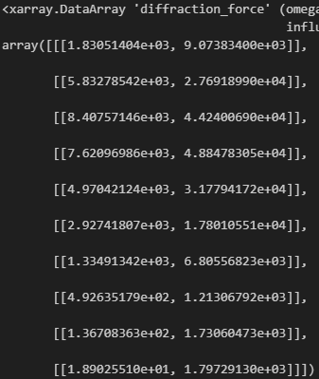


Should converted coefficients match?
Heave matches, and now pitch matches! Just a difference in the center of mass
Pitch results suggest more coupling but its okay

Slide 16
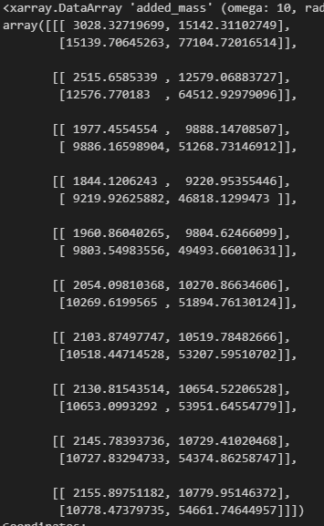
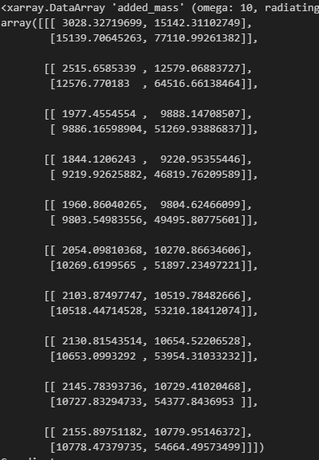
Why doesn’t added mass match?
Added mass matches now
Radiation damping and hydrostatic stiffness also match now

Slide 17
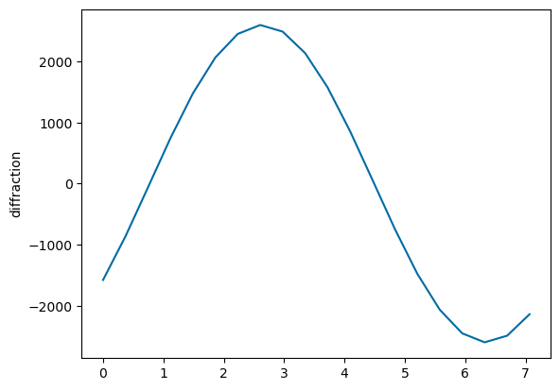
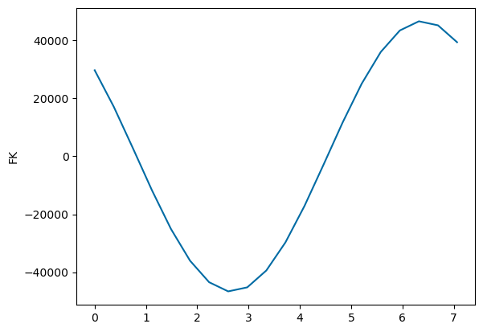
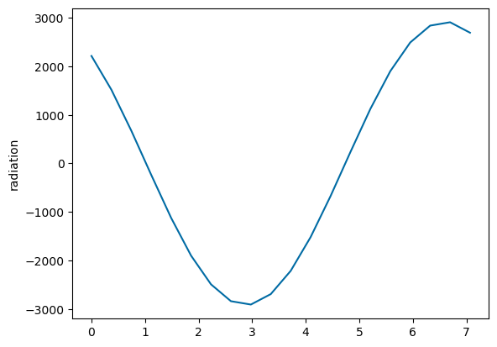
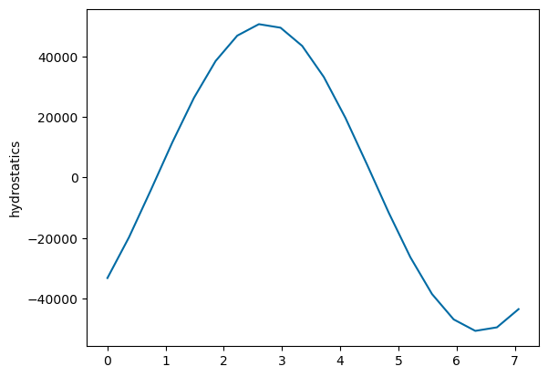
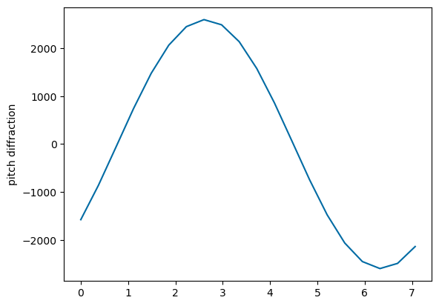
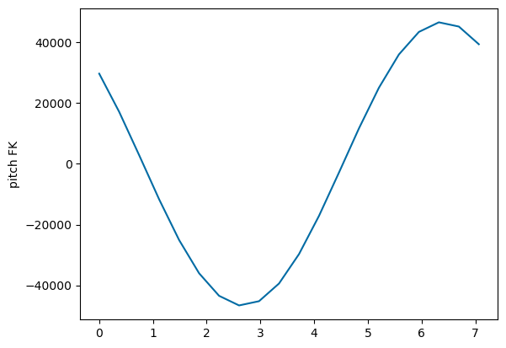
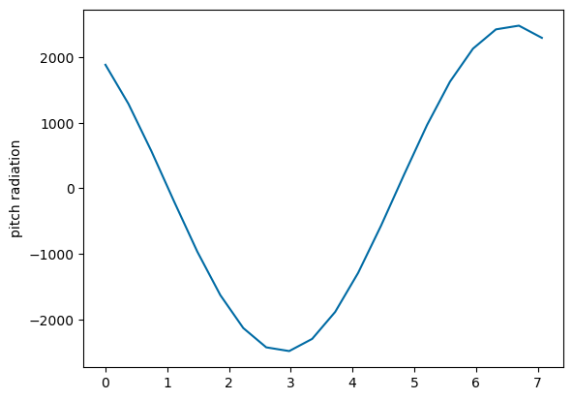
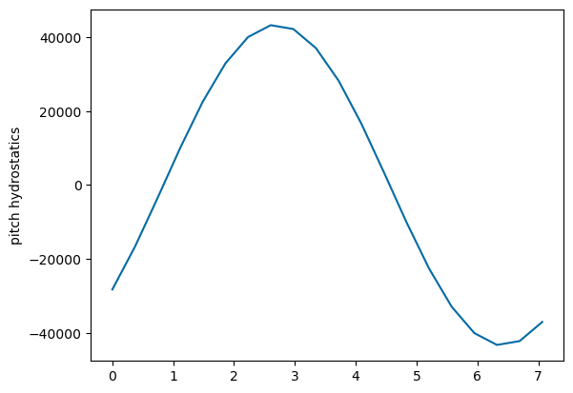
Compare pitch only to consolidated heave/pitch forces
Fixed – negate inertia

Slide 18
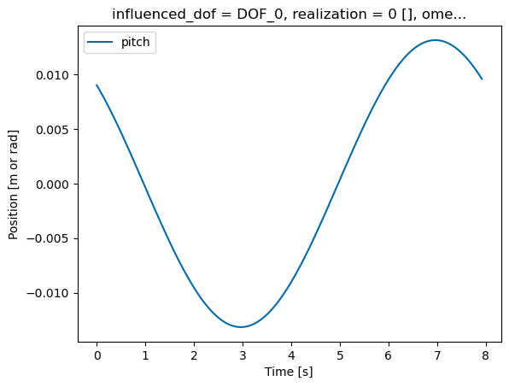
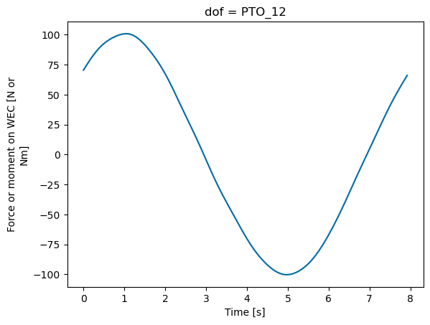
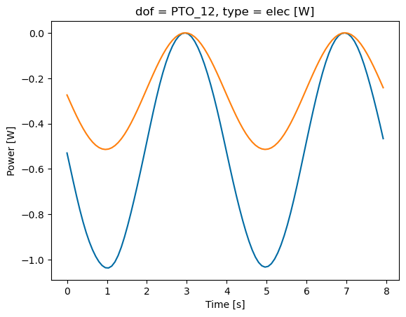
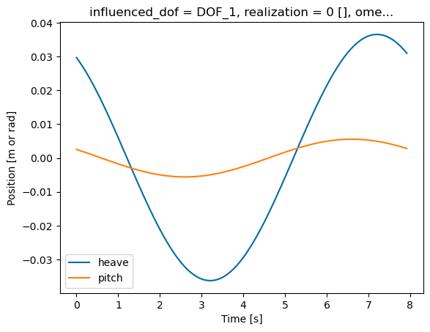
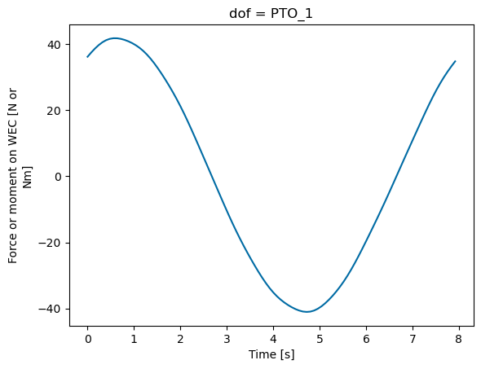
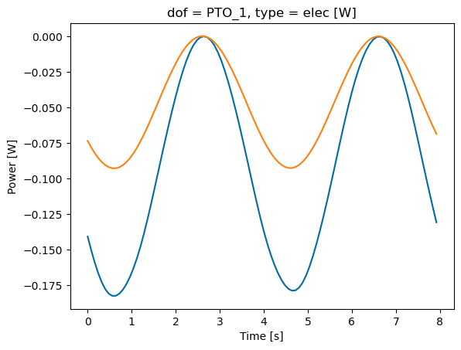
Compare results:
Resultant pitch, force, and power are all less than half of pitch only results

Slide 19
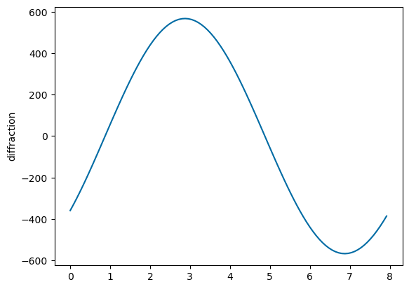
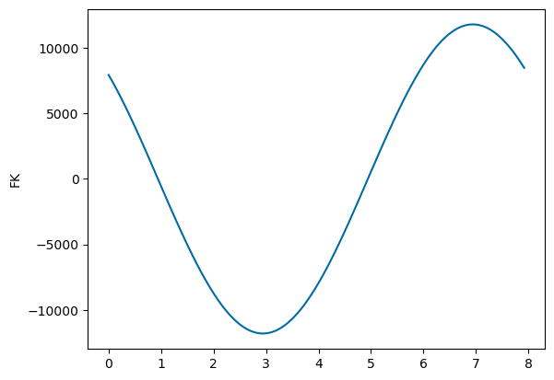
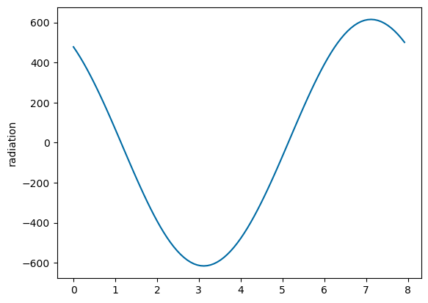
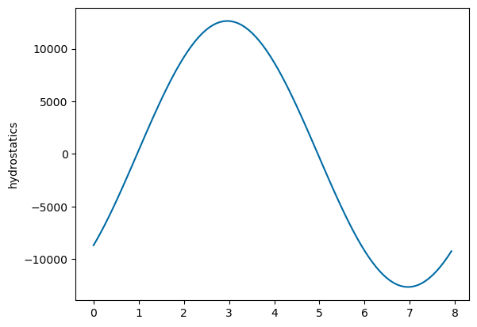
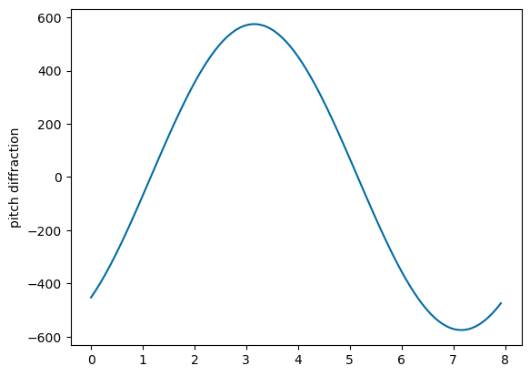
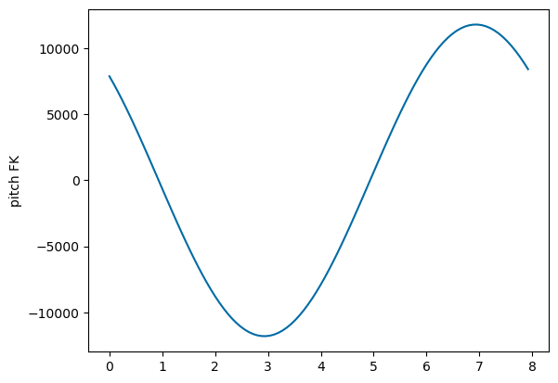
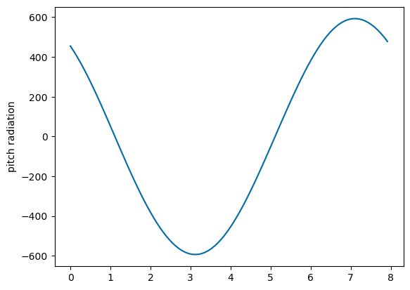
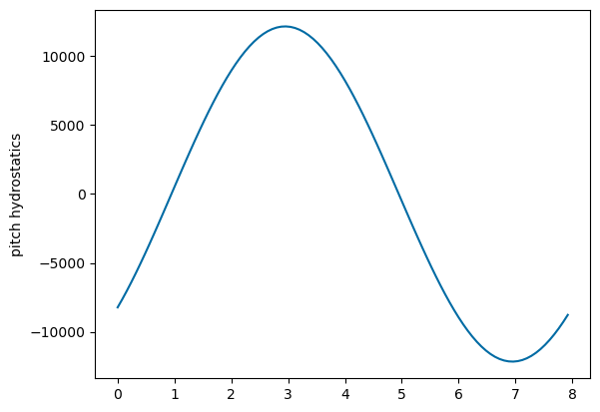
Compare types of forces:
Results are the same
Shouldn’t hydrostatics be different for different pitch angles?

Slide 20






Results match each other when I include heave
Why aren’t results the same with and without heave in BEM?

