Slide 1

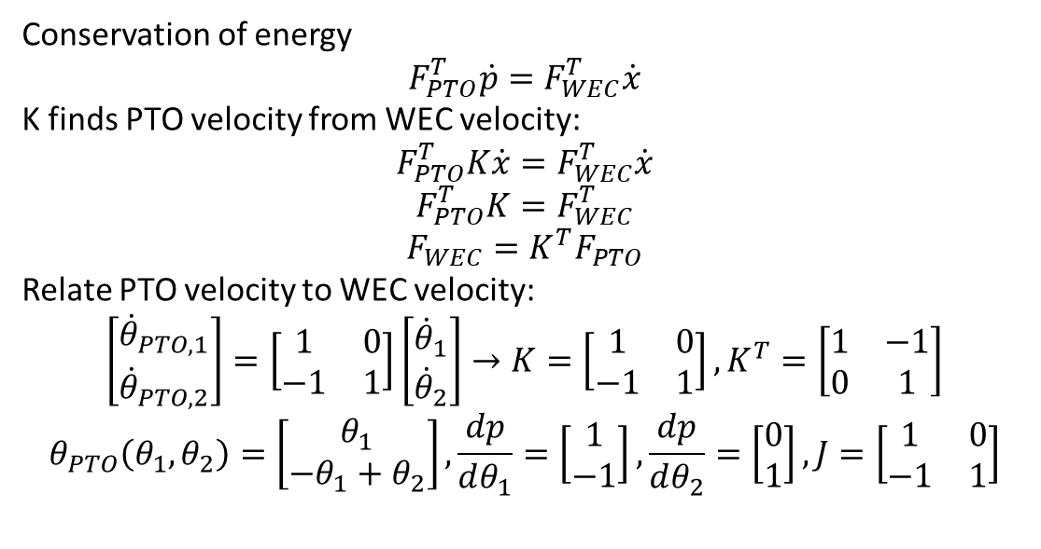





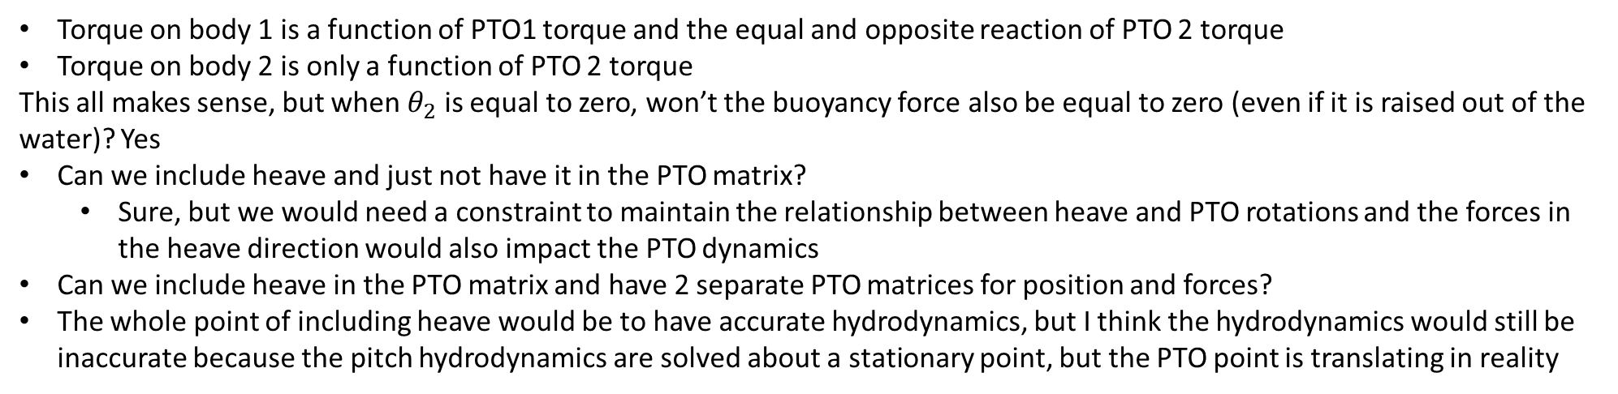

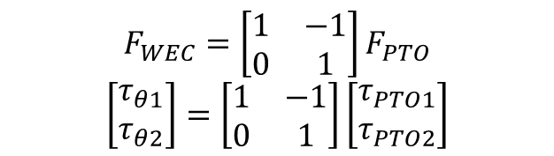
Conservation of energy
$$F_{PTO}^{T}\dot{p}=F_{WEC}^{T}\dot{x}$$
K finds PTO velocity from WEC velocity:
$$F_{PTO}^{T}K\dot{x}=F_{WEC}^{T}\dot{x}$$
$$F_{PTO}^{T}K=F_{WEC}^{T}$$
$$F_{WEC}=K^{T}F_{PTO}$$
Relate PTO velocity to WEC velocity:
$$\left[\begin{matrix}{\dot{θ}}_{PTO,1} \\ {\dot{θ}}_{PTO,2}\end{matrix}\right]=\left[\begin{matrix}1 & 0 \\ −1 & 1\end{matrix}\right]\left[\begin{matrix}{\dot{θ}}_{1} \\ {\dot{θ}}_{2}\end{matrix}\right]→K=\left[\begin{matrix}1 & 0 \\ −1 & 1\end{matrix}\right], K^{T}=\left[\begin{matrix}1 & −1 \\ 0 & 1\end{matrix}\right]$$
$$θ_{PTO}\left(θ_{1},θ_{2}\right)=\left[\begin{matrix}θ_{1} \\ −θ_{1}+θ_{2}\end{matrix}\right],\frac{dp}{dθ_{1}}=\left[\begin{matrix}1 \\ −1\end{matrix}\right],\frac{dp}{dθ_{2}}=\left[\begin{matrix}0 \\ 1\end{matrix}\right], J=\left[\begin{matrix}1 & 0 \\ −1 & 1\end{matrix}\right]$$
$$d$$
$$d$$
$$θ_{PTO,2}$$
$$θ_{PTO,1}$$
$$θ_{2}$$
$$θ_{1}$$
$$F_{WEC}=\left[\begin{matrix}1 & −1 \\ 0 & 1\end{matrix}\right]F_{PTO}$$
$$\left[\begin{matrix}τ_{θ1} \\ τ_{θ2}\end{matrix}\right]=\left[\begin{matrix}1 & −1 \\ 0 & 1\end{matrix}\right]\left[\begin{matrix}τ_{PTO1} \\ τ_{PTO2}\end{matrix}\right]$$
Torque on body 1 is a function of PTO1 torque and the equal and opposite reaction of PTO 2 torque
Torque on body 2 is only a function of PTO 2 torque
This all makes sense, but when $θ_{2}$ is equal to zero, won’t the buoyancy force also be equal to zero (even if it is raised out of the water)? Yes
Can we include heave and just not have it in the PTO matrix?
Sure, but we would need a constraint to maintain the relationship between heave and PTO rotations and the forces in the heave direction would also impact the PTO dynamics
Can we include heave in the PTO matrix and have 2 separate PTO matrices for position and forces?
The whole point of including heave would be to have accurate hydrodynamics, but I think the hydrodynamics would still be inaccurate because the pitch hydrodynamics are solved about a stationary point, but the PTO point is translating in reality

Slide 2
Including heave?
The whole point of including heave would be to have accurate hydrodynamics, but I think the hydrodynamics would still be inaccurate because the pitch hydrodynamics are solved about a stationary point, but the PTO point is translating in reality
Even if we include heave, the pitch hydrostatics are still based on a stationary PTO so are inaccurate.
How would WEC-Sim handle this problem?
Computes BEM about the center of gravity, then uses parallel axis theorem to translate forces to the point of rotation
Think about how to do this in WecOptTool

Slide 3
Hydrostatics
Do the hydrostatics take into account body position or just wave elevation?
In WEC-Sim it just uses wave elevation for linear hydrostatics
WecOptTool uses the transfer function defined as the hydrostatic stiffness from BEM to convert x_wec (wec position) to force in frequency domain
Also just uses the body displacement
But, this won’t be accurate if pitch is about a location that isn’t stationary

Slide 4
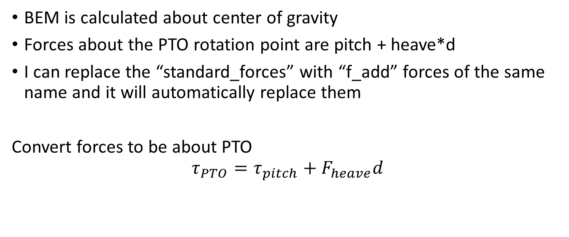
How to apply parallel axis theorem in WecOptTool
BEM is calculated about center of gravity
Forces about the PTO rotation point are pitch + heave*d
I can replace the “standard_forces” with “f_add” forces of the same name and it will automatically replace them
Convert forces to be about PTO
$$τ_{PTO}=τ_{pitch}+F_{heave}d$$

Slide 5
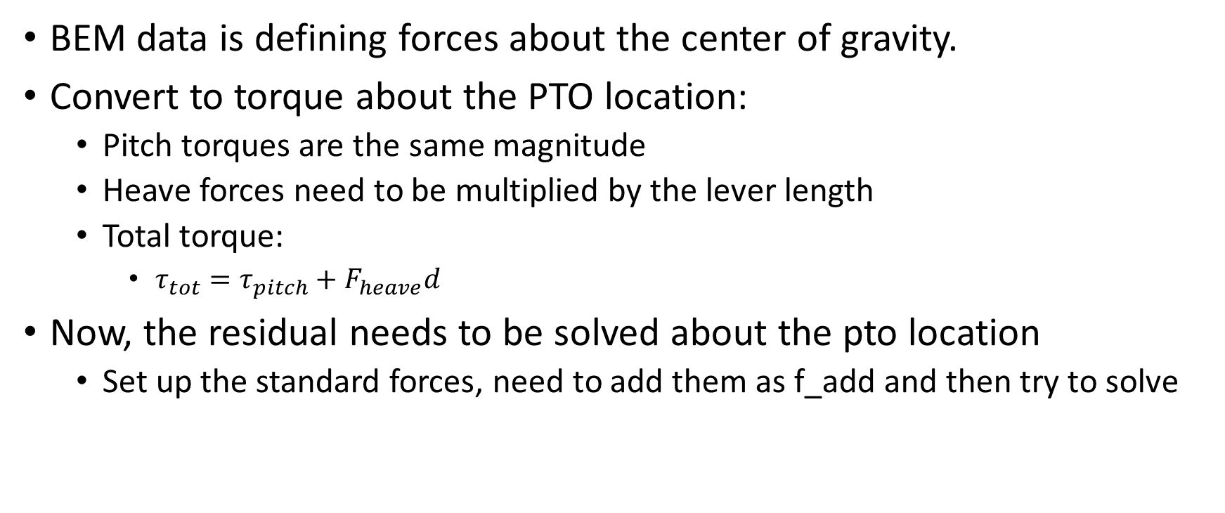
Applying parallel axis theorem
BEM data is defining forces about the center of gravity.
Convert to torque about the PTO location:
Pitch torques are the same magnitude
Heave forces need to be multiplied by the lever length
Total torque:
$τ_{tot}=τ_{pitch}+F_{heave}d$
Now, the residual needs to be solved about the pto location
Set up the standard forces, need to add them as f_add and then try to solve

Slide 6
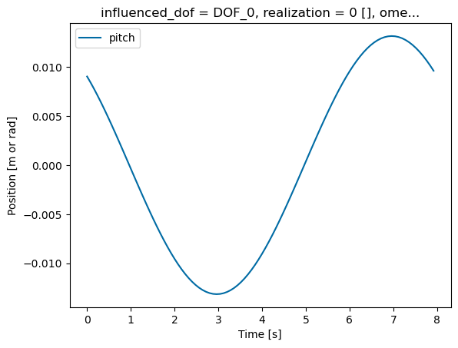
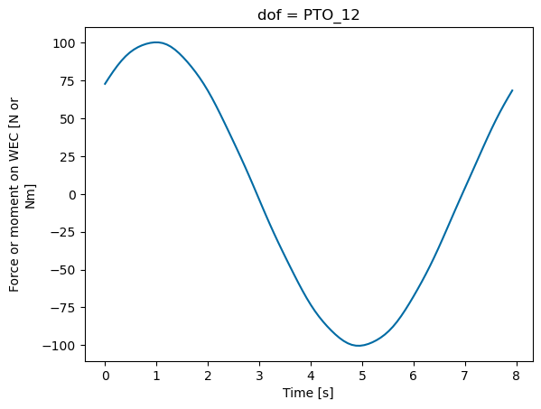
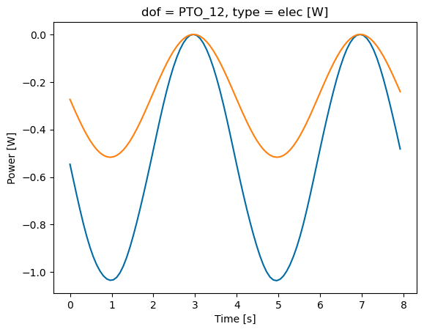
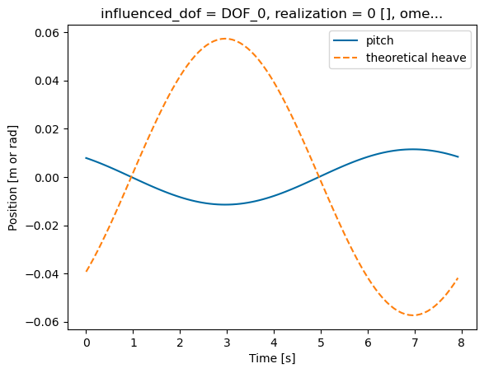
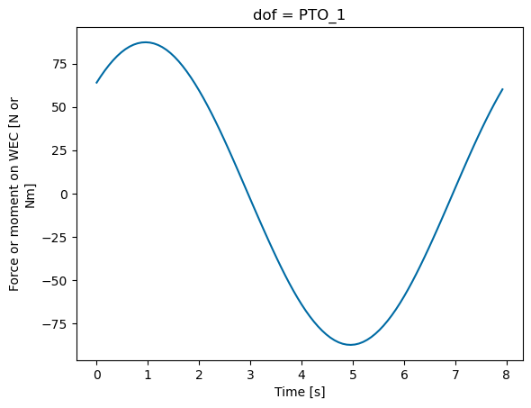
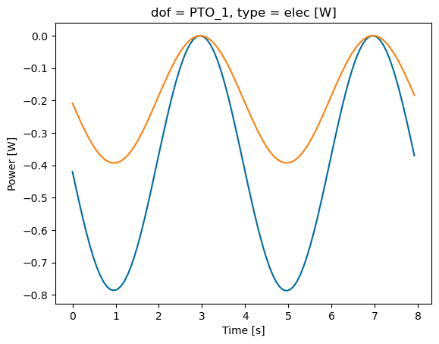
Compare pitch BEM vs. pitch manual
Results are slightly off, but I think its okay?
Confirmed that coefficients match without axis of rotation, so this is the best we’ve got…

Slide 7

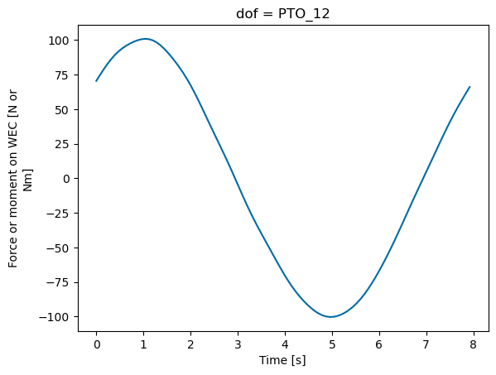
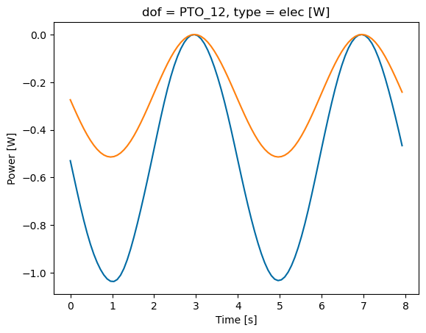
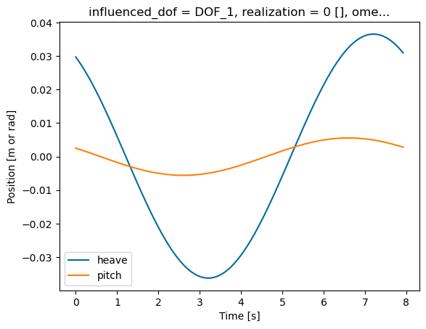
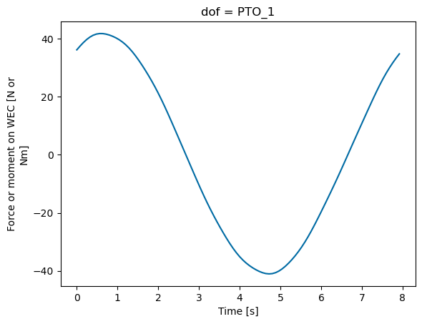
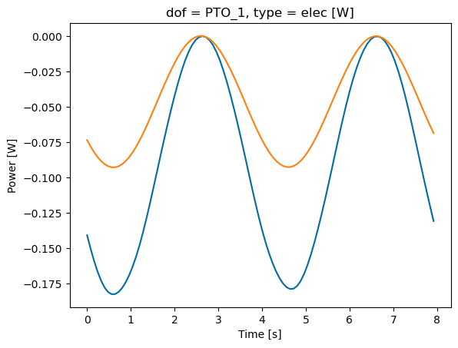
Compare results:
Resultant pitch, force, and power are all less than half of pitch only results

Slide 8
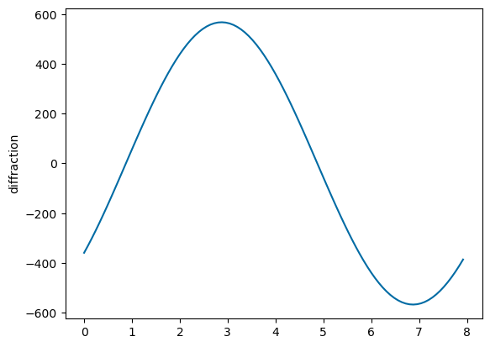
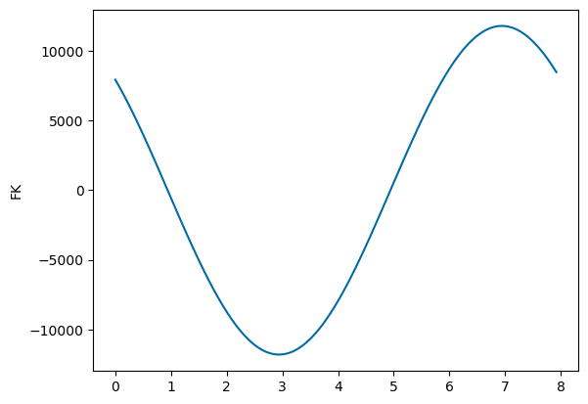
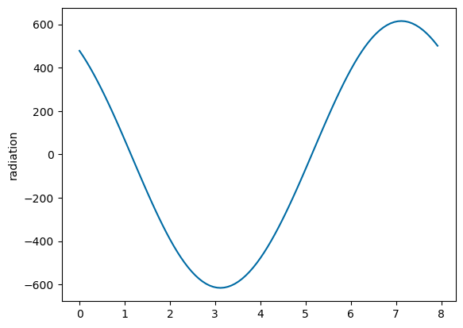
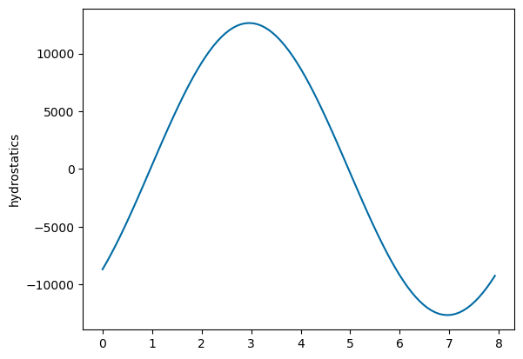
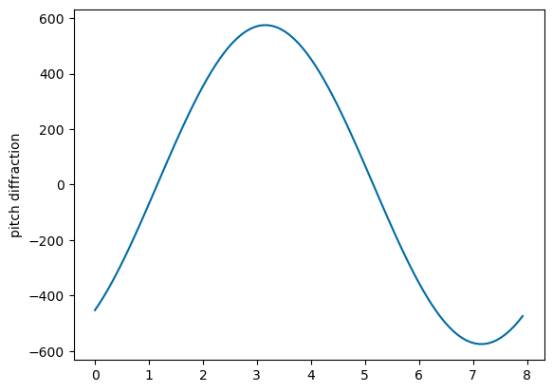
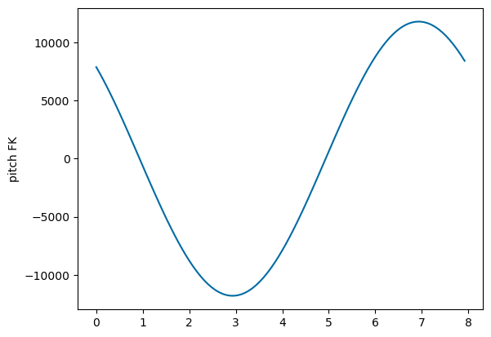
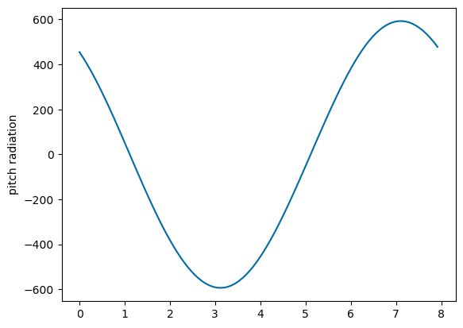
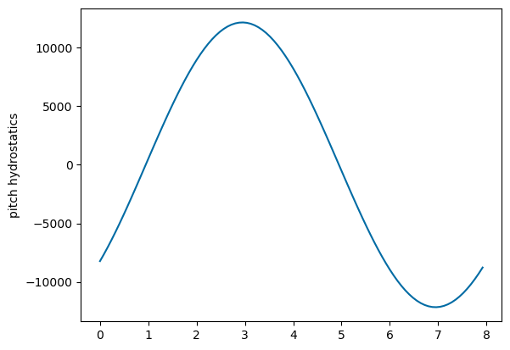
Compare types of forces:
Results are the same
Shouldn’t hydrostatics be different for different pitch angles?

Slide 9
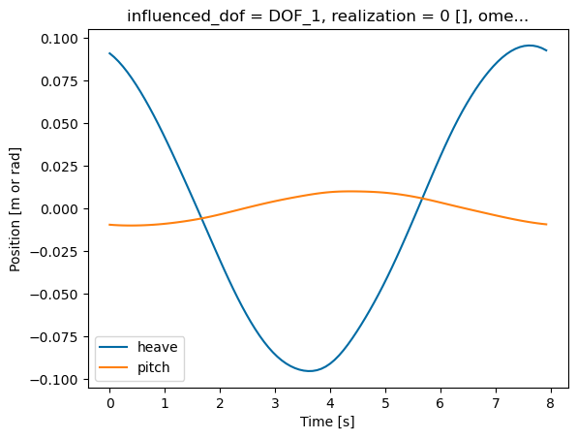
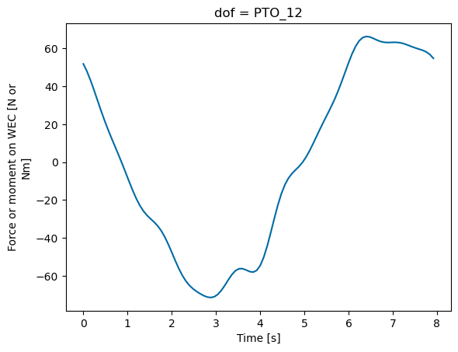
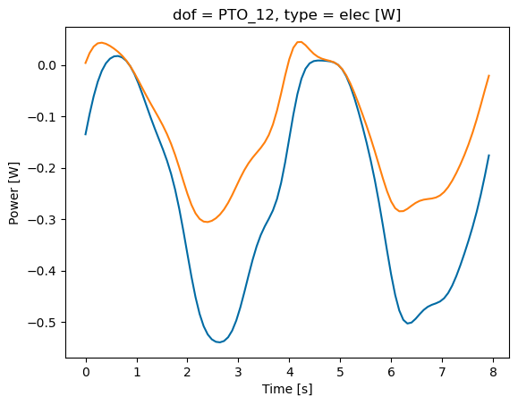
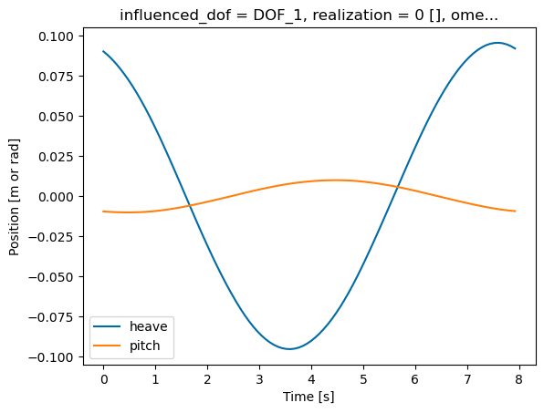
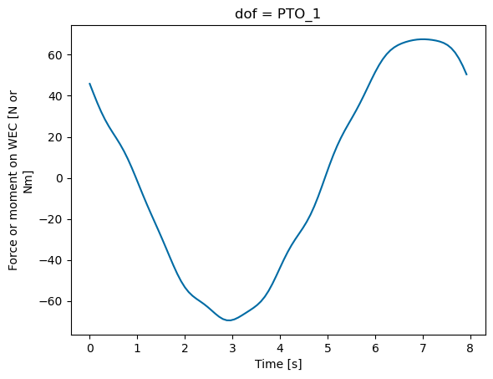
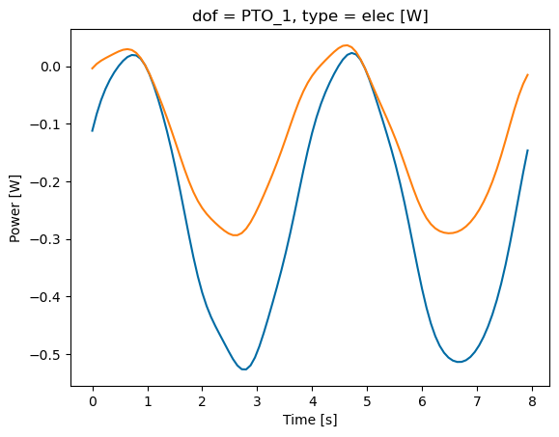
Results match each other when I include heave
Why aren’t results the same with and without heave in BEM?

Slide 10
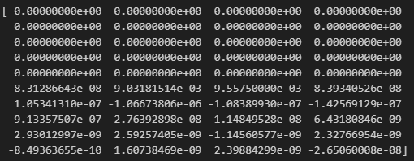
Try prescribing heave position
Can I replace the residual to include only pitch?
Yes, I did this successfully
Now, can I make heave residual just a component based on pitch instead?
Maybe heave can just be an afterthought and pitch is
Forces converted to PTO location, then .
We def need another state variable so force of the waves can depend on both heave and pitch
Try to run and resolve issues

Slide 11
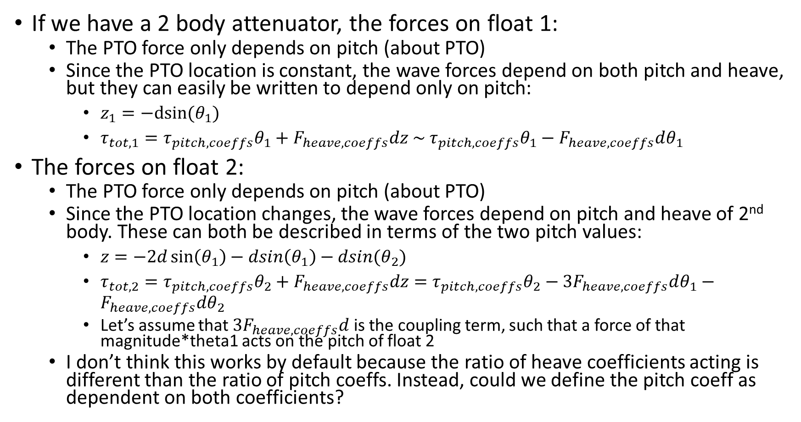
2 body
If we have a 2 body attenuator, the forces on float 1:
The PTO force only depends on pitch (about PTO)
Since the PTO location is constant, the wave forces depend on both pitch and heave, but they can easily be written to depend only on pitch:
$z_{1}=−dsin⁡(θ_{1})$
$τ_{tot,1}=τ_{pitch,coeffs}θ_{1}+F_{heave,coeffs}dz \sim τ_{pitch,coeffs}θ_{1}−F_{heave,coeffs}dθ_{1}$
The forces on float 2:
The PTO force only depends on pitch (about PTO)
Since the PTO location changes, the wave forces depend on pitch and heave of 2nd body. These can both be described in terms of the two pitch values:
$z=−2d\sin\left(θ_{1}\right)−dsin\left(θ_{1}\right)−dsin(θ_{2})$
$τ_{tot,2}=τ_{pitch,coeffs}θ_{2}+F_{heave,coeffs}dz=τ_{pitch,coeffs}θ_{2}−3F_{heave,coeffs}dθ_{1}−F_{heave,coeffs}dθ_{2}$
Let’s assume that $3F_{heave,coeffs}d$ is the coupling term, such that a force of that magnitude*theta1 acts on the pitch of float 2
I don’t think this works by default because the ratio of heave coefficients acting is different than the ratio of pitch coeffs. Instead, could we define the pitch coeff as dependent on both coefficients?

Slide 12
Is it incorrect to solve a WEC about a dof other than the cg without coupling terms?
When solving with only pitch, the force from hydrostatic stiffness is K*theta
When solving with pitch and heave, the force from hydrostatic stiffness is K*theta + K_couple*z
This leads to the same forces acting on the body for less displacement
Is this an incorrect way of solving?

Slide 13
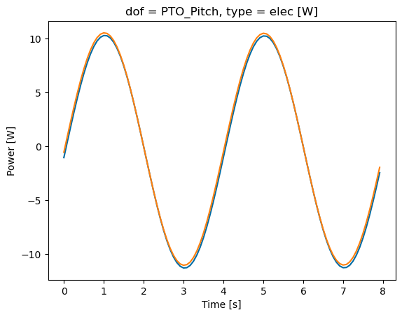
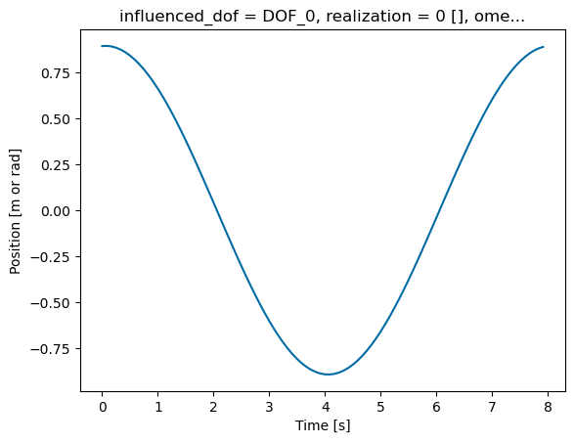
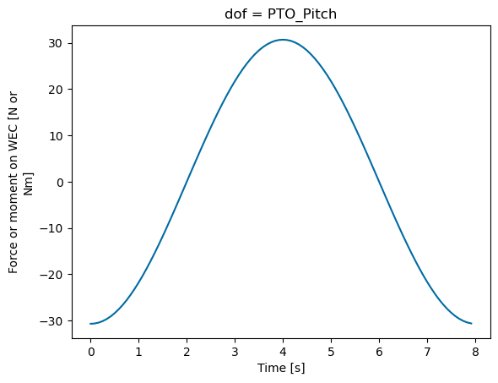
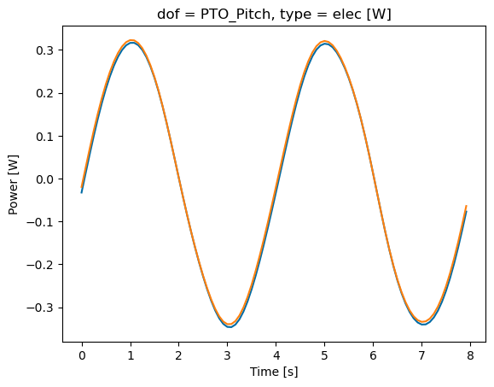
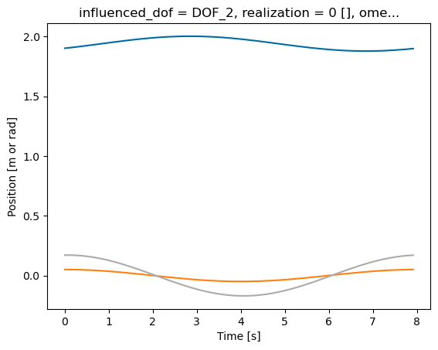
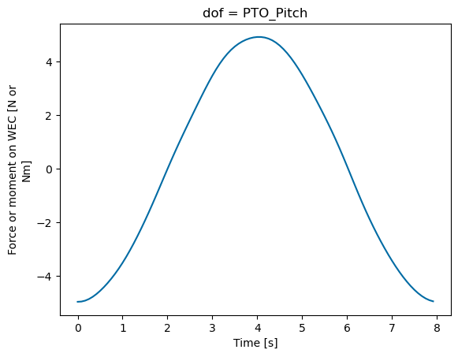
Am I solving the FOSWEC incorrectly?
I don’t think so because:
No hydrostatic restoring force is present in surge
No horizontal distance between cg and hinge point, so heave doesn’t have coupling terms
But there is a difference…
And it’s a big difference
This is likely because of lack of constraints on surge/heave
But I can’t add constraints
I think I need to prescribe/force heave motion for attenuator

Slide 14

Adding inverse kinematics matrix separate from kinematics matrix
$\left[\begin{matrix}F_{z1} \\ τ_{θ1}\end{matrix}\right]=\left[\begin{matrix}\frac{−1}{d} \\ 1\end{matrix}\right]τ_{PTO}$
Rewriting pto class to account for inverse kinematics matrix

Slide 15
Maybe instead I need to prescribe heave motion?
If I model the system in WEC-Sim, what is the heave force?
Is it equal to the inverse kinematics? Probably not quite due to constraints
Are there constraint forces acting in heave? I think so when not at equilibrium?

Slide 16
Set up 2 body case
If we set up a 2 body case, can we just resolve the dynamics about the PTO location?
No, we need to solve BEM at the cg, then when we apply forces, apply them about the pto location

Slide 17
WEC-Sim model?
If I model the system in WEC-Sim, what is the heave force?
Is it equal to the inverse kinematics? Probably not quite due to constraints
Are there constraint forces acting in heave? I think so when not at equilibrium?
PTO has internal mechanics forces only in pitch
But, it has constraint forces in other directions
Constraint on body is a bit bigger than PTO constraint force

Slide 18
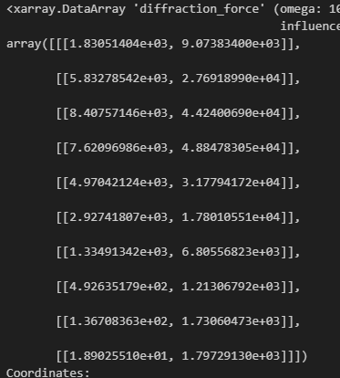
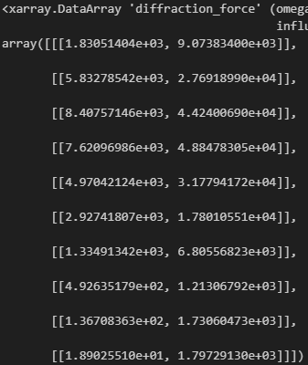


Should converted coefficients match?
Heave matches, and now pitch matches! Just a difference in the center of mass
Pitch results suggest more coupling but its okay

Slide 19
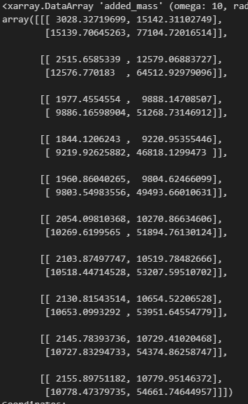
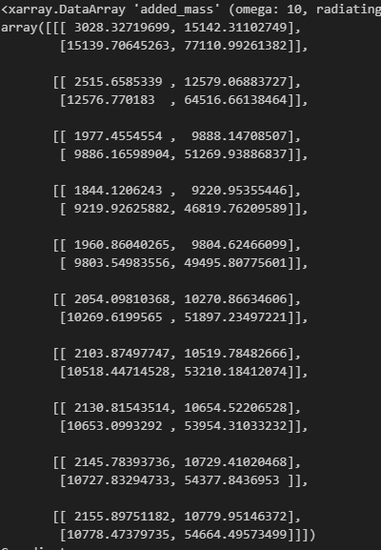
Why doesn’t added mass match?
Added mass matches now
Radiation damping and hydrostatic stiffness also match now

