Slide 1
FOSWEC BEM Dimensions
0.2 m
0.2 m
SWL
0.1 m
0.76 m
0.59 m
0.58 m
CG = [-0.72, 0, -0.42]
CG = [0.72, 0, -0.42]
0.17 m
0.1 m
Platform: CG = [0, 0, -0.8]
0.04 m
0.05 m
0.05 m
0.4 m
DAQ
0.2 m
1.06 m
0.72 m
1.44 m
1.63 m

Slide 2
FOSWEC BEM Dimensions
Property: | Value | Units
Flap mass | 23.1 | kg
Platform mass | 189.8 | kg
Mooring stiffness | [1e5, 0, 1e5, 0, 1e5] | N/m
Mooring damping | [1e4, 0, 1e4, 0, 1e4] | Ns/m
Mooring pretension (heave) | -273.0614 | N
Top view
1.44 m
DAQ
1.06 m
0.6 m
0.72 m
0.05 m
0.05 m

Slide 3
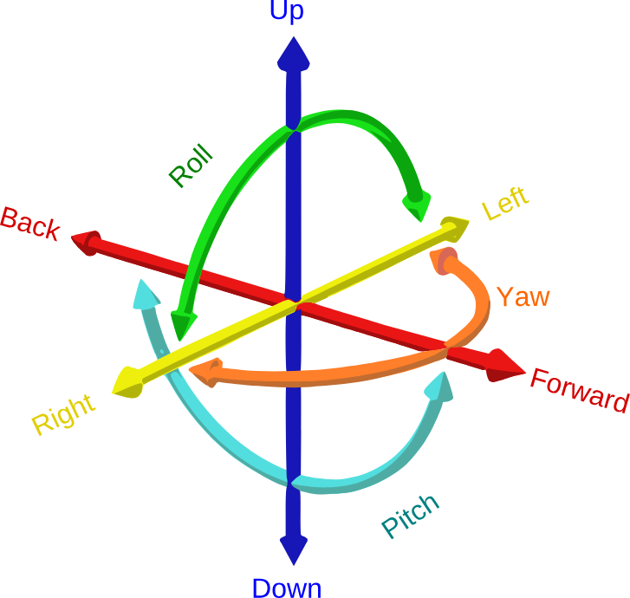
6 dof
6 dof
6 dof
Platform
DAQ

Slide 4
still water line
3 DOF
3 DOF
3 DOF
Platform
DAQ

Slide 5
still water line
1 degree of freedom
1 degree of freedom
3 degrees of freedom
Platform
DAQ

Slide 6


still water line
$$F_{b}$$
cb
cg
$$F_{g}$$

