Slide 1

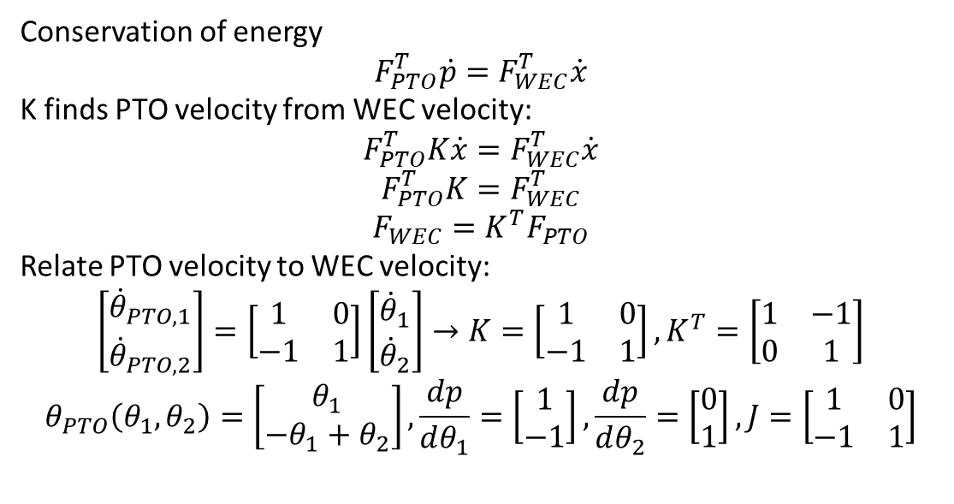





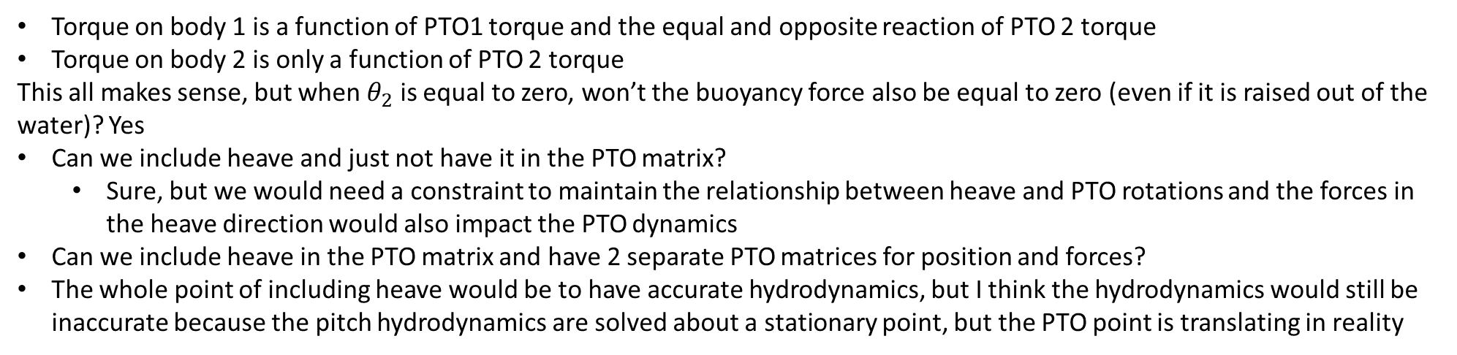

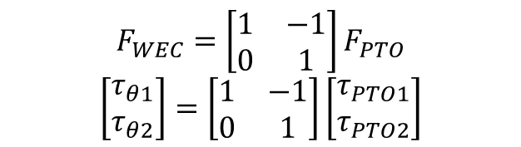
Conservation of energy
$$F_{PTO}^{T}\dot{p}=F_{WEC}^{T}\dot{x}$$
K finds PTO velocity from WEC velocity:
$$F_{PTO}^{T}K\dot{x}=F_{WEC}^{T}\dot{x}$$
$$F_{PTO}^{T}K=F_{WEC}^{T}$$
$$F_{WEC}=K^{T}F_{PTO}$$
Relate PTO velocity to WEC velocity:
$$\left[\begin{matrix}{\dot{θ}}_{PTO,1} \\ {\dot{θ}}_{PTO,2}\end{matrix}\right]=\left[\begin{matrix}1 & 0 \\ −1 & 1\end{matrix}\right]\left[\begin{matrix}{\dot{θ}}_{1} \\ {\dot{θ}}_{2}\end{matrix}\right]→K=\left[\begin{matrix}1 & 0 \\ −1 & 1\end{matrix}\right], K^{T}=\left[\begin{matrix}1 & −1 \\ 0 & 1\end{matrix}\right]$$
$$θ_{PTO}\left(θ_{1},θ_{2}\right)=\left[\begin{matrix}θ_{1} \\ −θ_{1}+θ_{2}\end{matrix}\right],\frac{dp}{dθ_{1}}=\left[\begin{matrix}1 \\ −1\end{matrix}\right],\frac{dp}{dθ_{2}}=\left[\begin{matrix}0 \\ 1\end{matrix}\right], J=\left[\begin{matrix}1 & 0 \\ −1 & 1\end{matrix}\right]$$
$$d$$
$$d$$
$$θ_{PTO,2}$$
$$θ_{PTO,1}$$
$$θ_{2}$$
$$θ_{1}$$
$$F_{WEC}=\left[\begin{matrix}1 & −1 \\ 0 & 1\end{matrix}\right]F_{PTO}$$
$$\left[\begin{matrix}τ_{θ1} \\ τ_{θ2}\end{matrix}\right]=\left[\begin{matrix}1 & −1 \\ 0 & 1\end{matrix}\right]\left[\begin{matrix}τ_{PTO1} \\ τ_{PTO2}\end{matrix}\right]$$
Torque on body 1 is a function of PTO1 torque and the equal and opposite reaction of PTO 2 torque
Torque on body 2 is only a function of PTO 2 torque
This all makes sense, but when $θ_{2}$ is equal to zero, won’t the buoyancy force also be equal to zero (even if it is raised out of the water)? Yes
Can we include heave and just not have it in the PTO matrix?
Sure, but we would need a constraint to maintain the relationship between heave and PTO rotations and the forces in the heave direction would also impact the PTO dynamics
Can we include heave in the PTO matrix and have 2 separate PTO matrices for position and forces?
The whole point of including heave would be to have accurate hydrodynamics, but I think the hydrodynamics would still be inaccurate because the pitch hydrodynamics are solved about a stationary point, but the PTO point is translating in reality

Slide 2
Including heave?
The whole point of including heave would be to have accurate hydrodynamics, but I think the hydrodynamics would still be inaccurate because the pitch hydrodynamics are solved about a stationary point, but the PTO point is translating in reality
Even if we include heave, the pitch hydrostatics are still based on a stationary PTO so are inaccurate.
How would WEC-Sim handle this problem?
Computes BEM about the center of gravity, then uses parallel axis theorem to translate forces to the point of rotation
Think about how to do this in WecOptTool

Slide 3
Hydrostatics
Do the hydrostatics take into account body position or just wave elevation?
In WEC-Sim it just uses wave elevation for linear hydrostatics
WecOptTool uses the transfer function defined as the hydrostatic stiffness from BEM to convert x_wec (wec position) to force in frequency domain
Also just uses the body displacement
But, this won’t be accurate if pitch is about a location that isn’t stationary

Slide 4
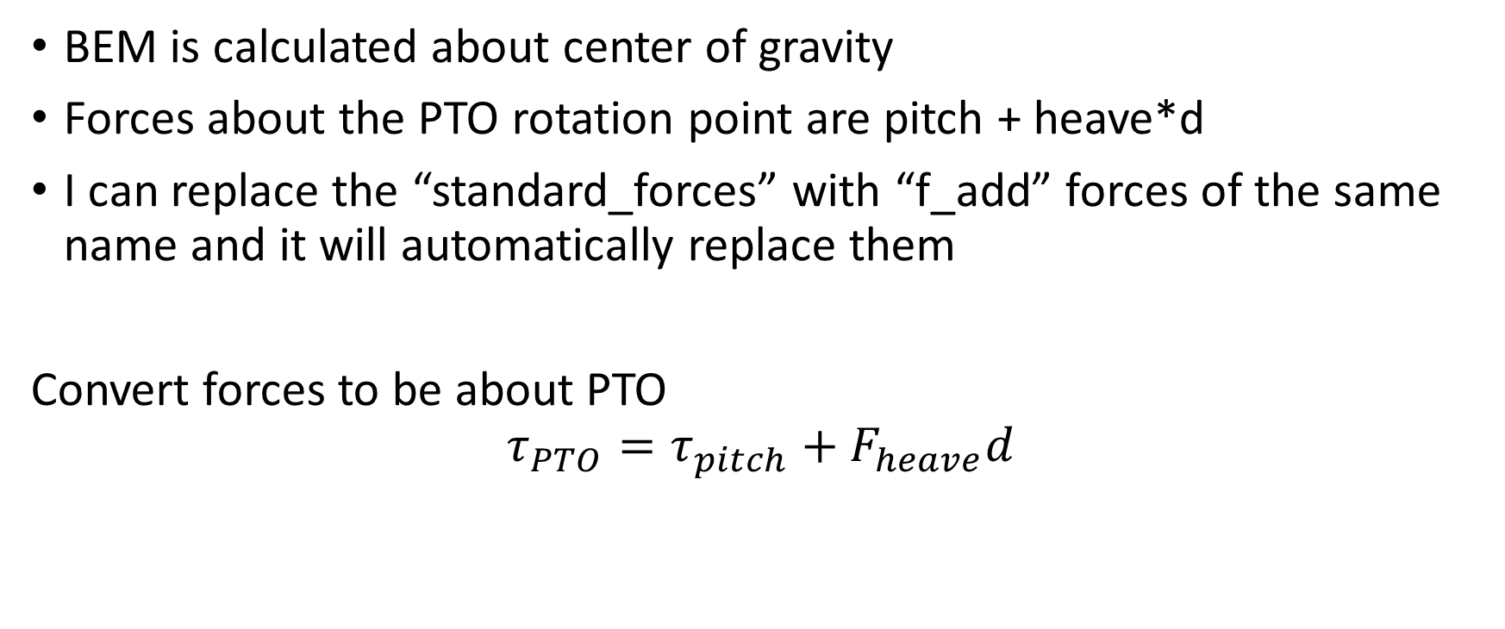
How to apply parallel axis theorem in WecOptTool
BEM is calculated about center of gravity
Forces about the PTO rotation point are pitch + heave*d
I can replace the “standard_forces” with “f_add” forces of the same name and it will automatically replace them
Convert forces to be about PTO
$$τ_{PTO}=τ_{pitch}+F_{heave}d$$

Slide 5
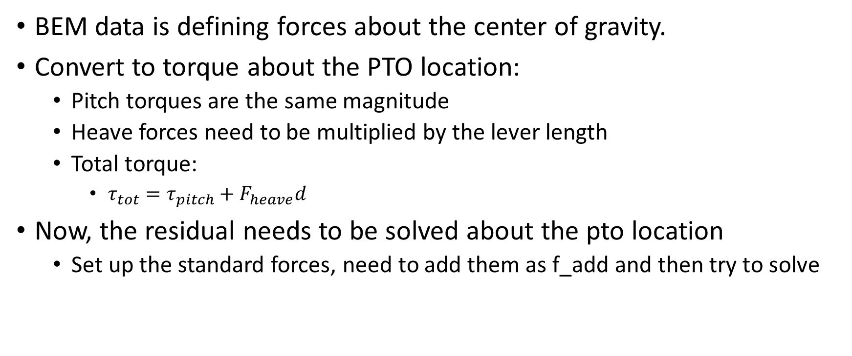
Applying parallel axis theorem
BEM data is defining forces about the center of gravity.
Convert to torque about the PTO location:
Pitch torques are the same magnitude
Heave forces need to be multiplied by the lever length
Total torque:
$τ_{tot}=τ_{pitch}+F_{heave}d$
Now, the residual needs to be solved about the pto location
Set up the standard forces, need to add them as f_add and then try to solve

Slide 6
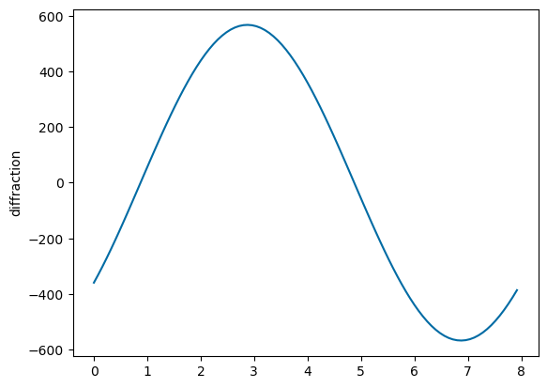
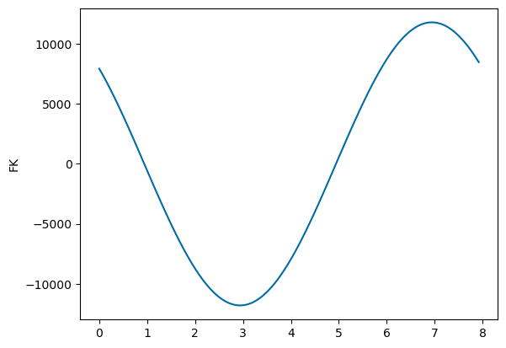
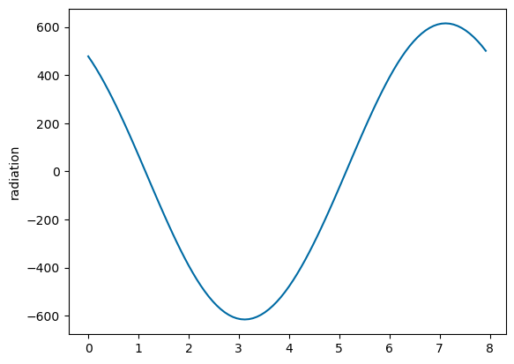
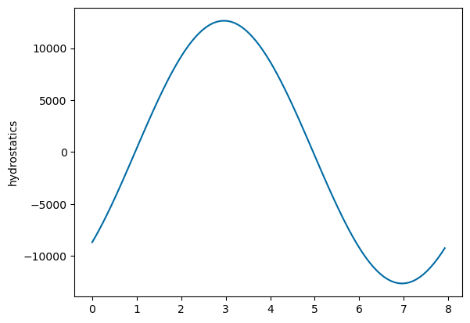
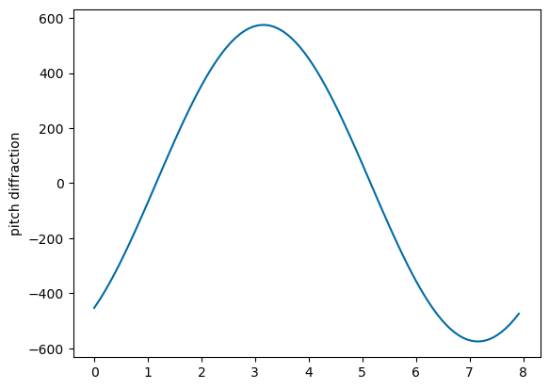
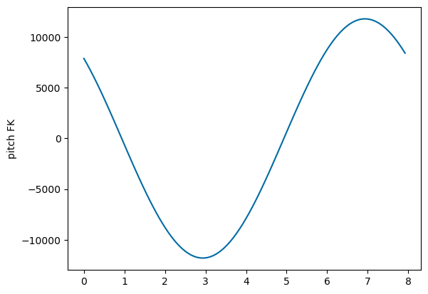
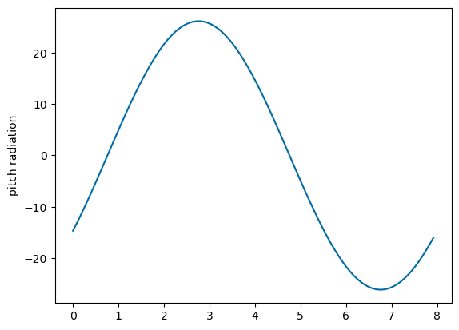
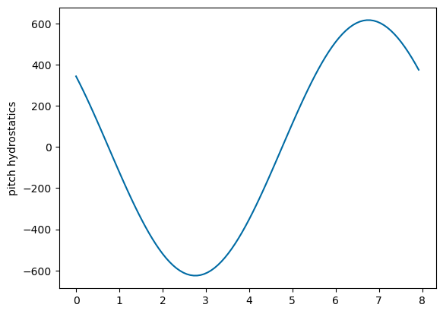
Compare types of forces:
Hydrostatic stiffness is very different – seems like coupling term is in one vs. two terms
Pretty close results! Coupling term might still be an issue!?

