Slide 1

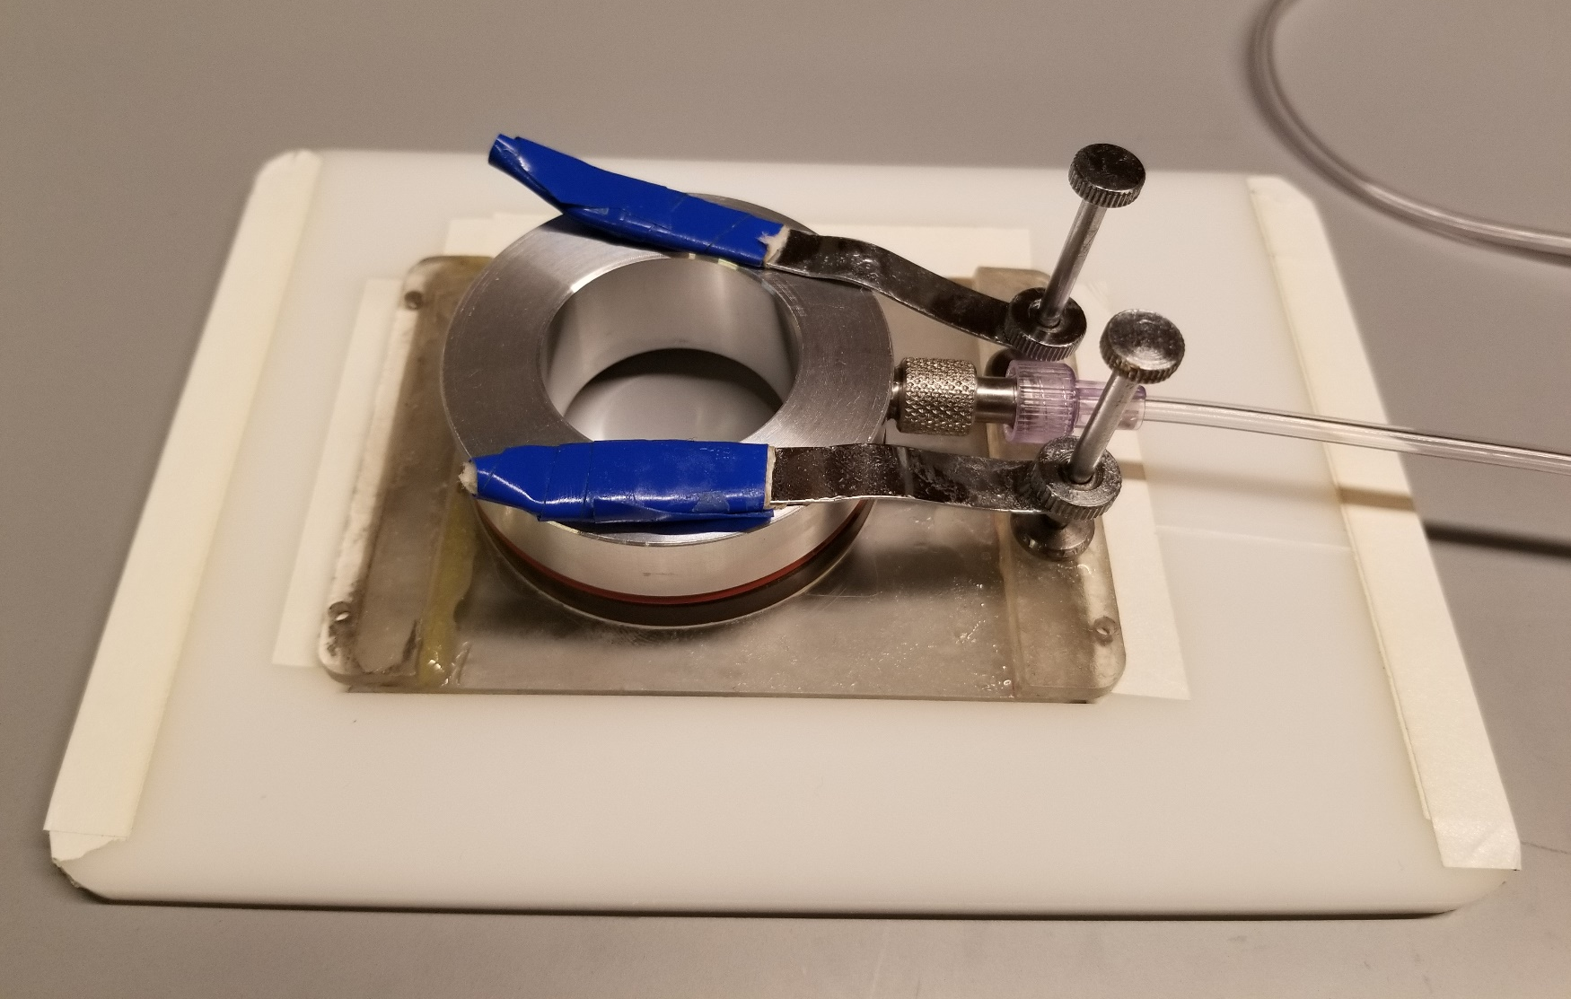
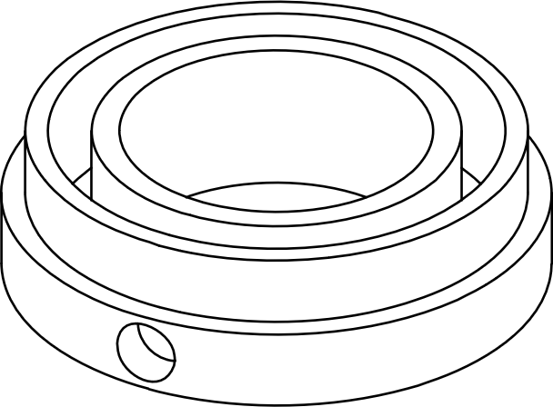
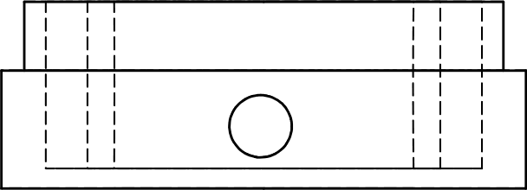
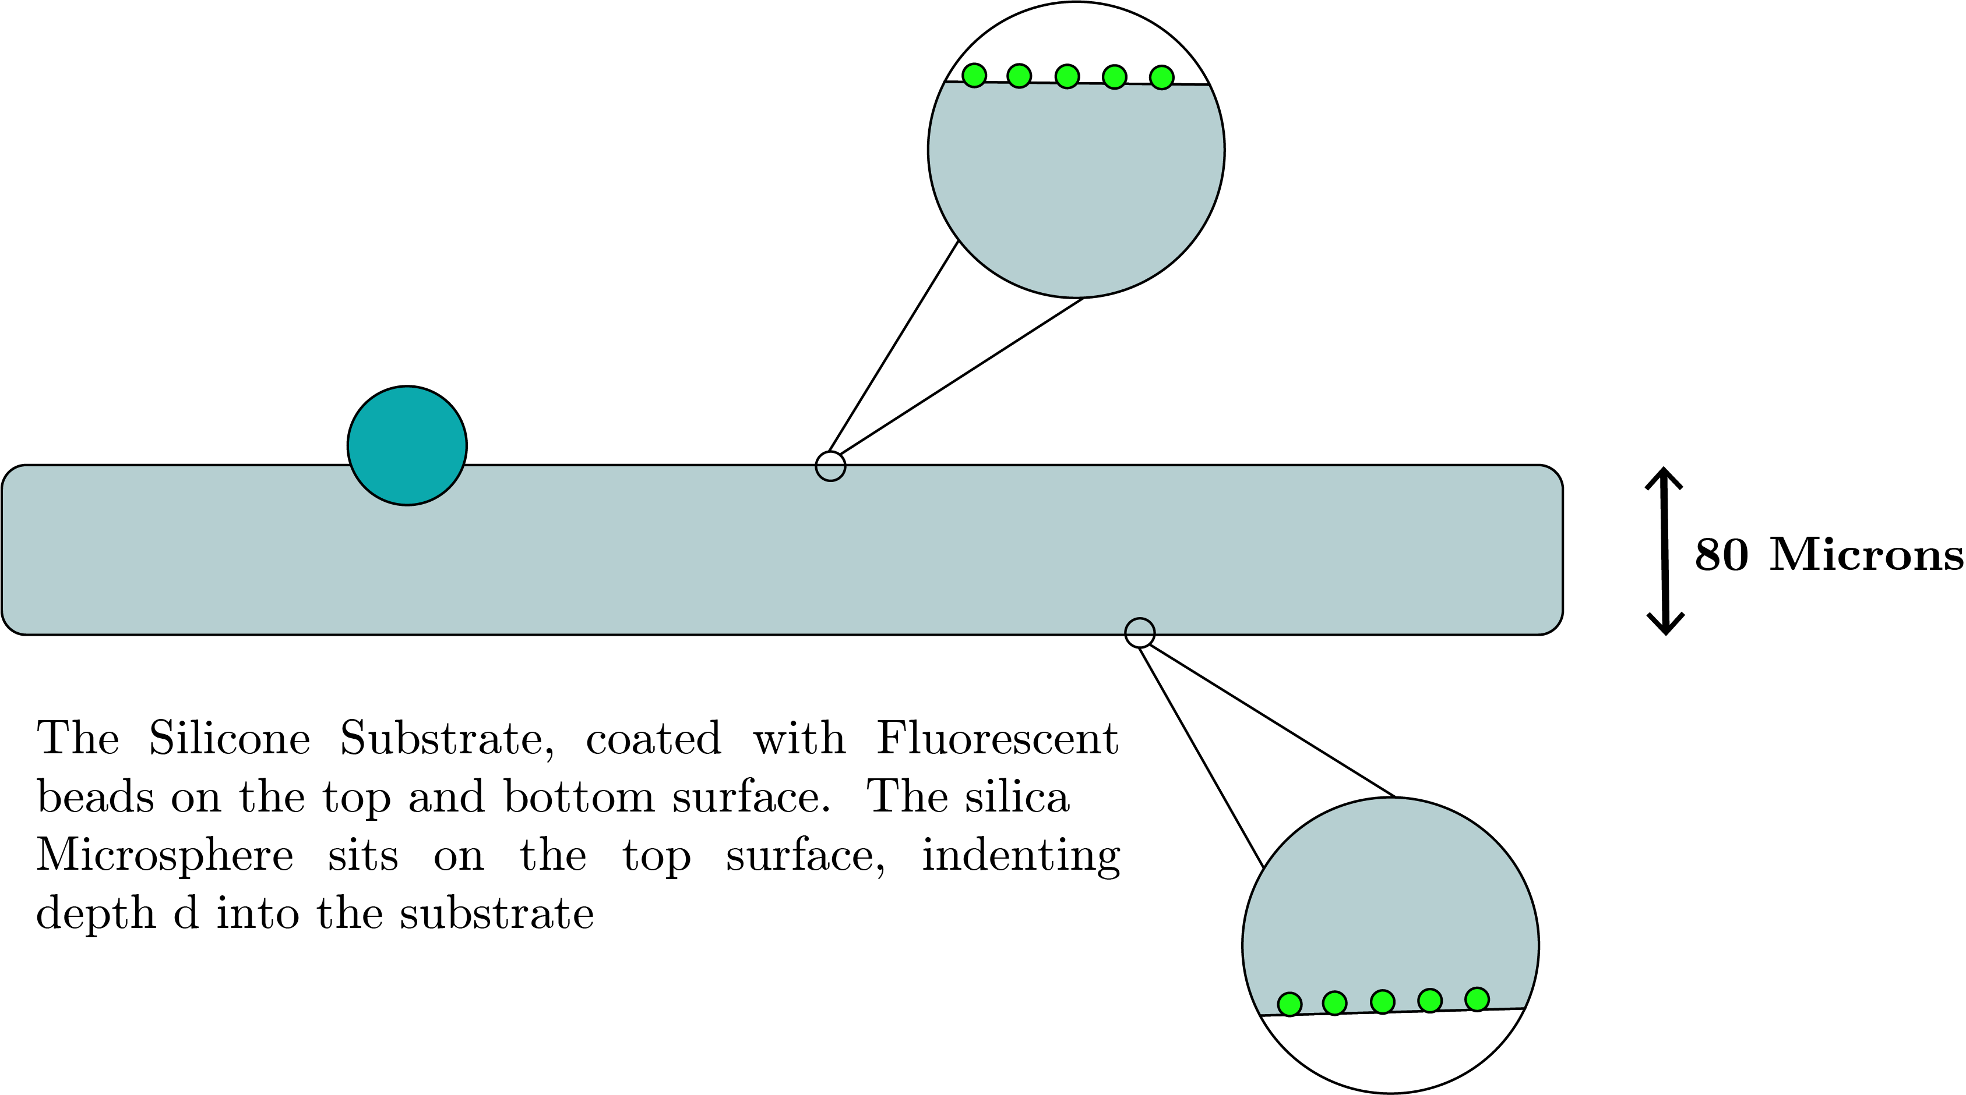
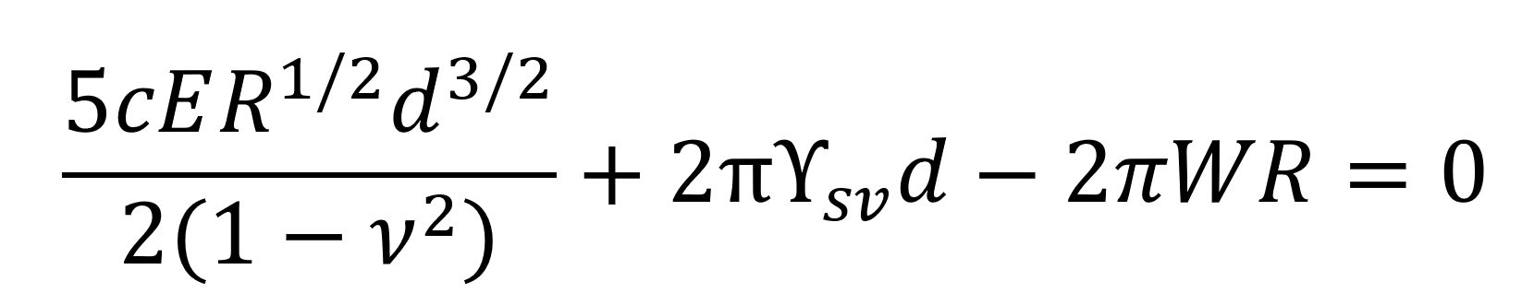
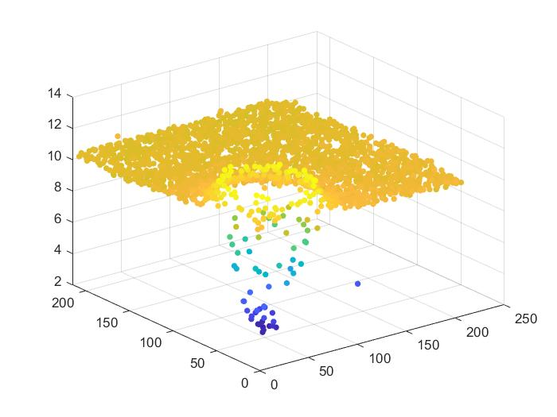
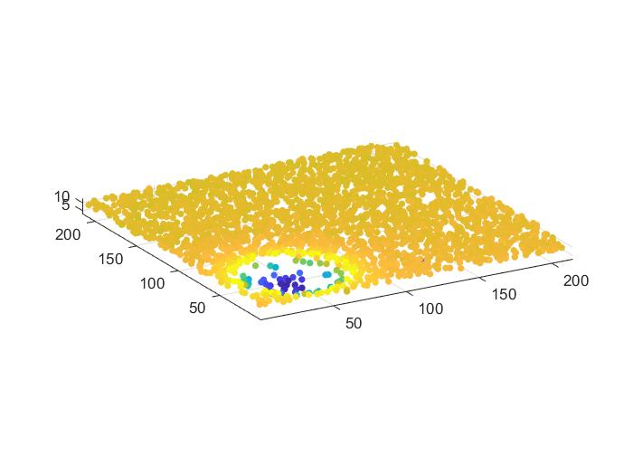
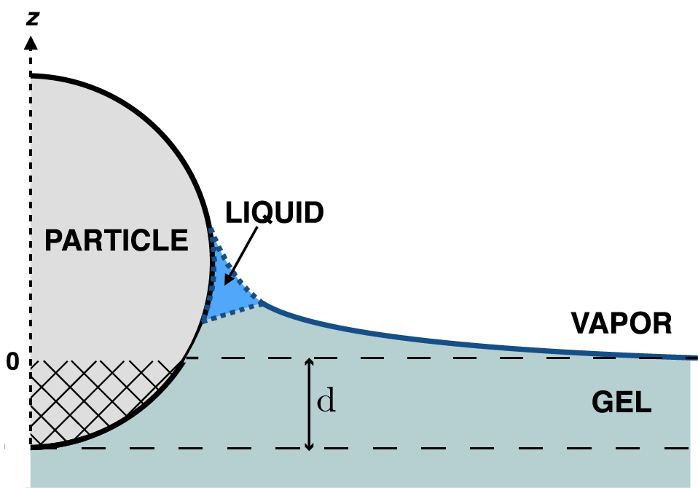
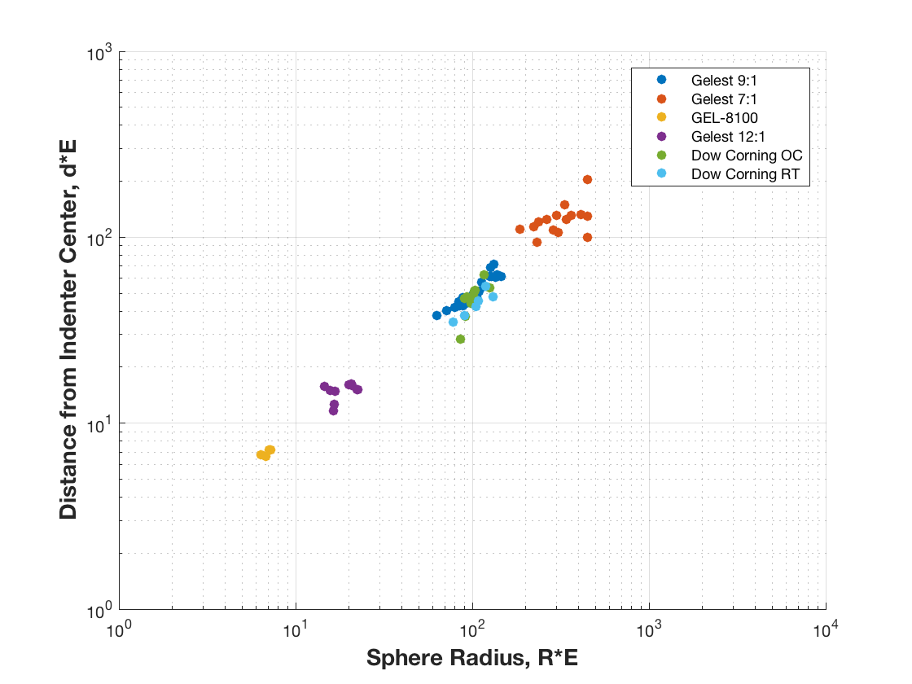
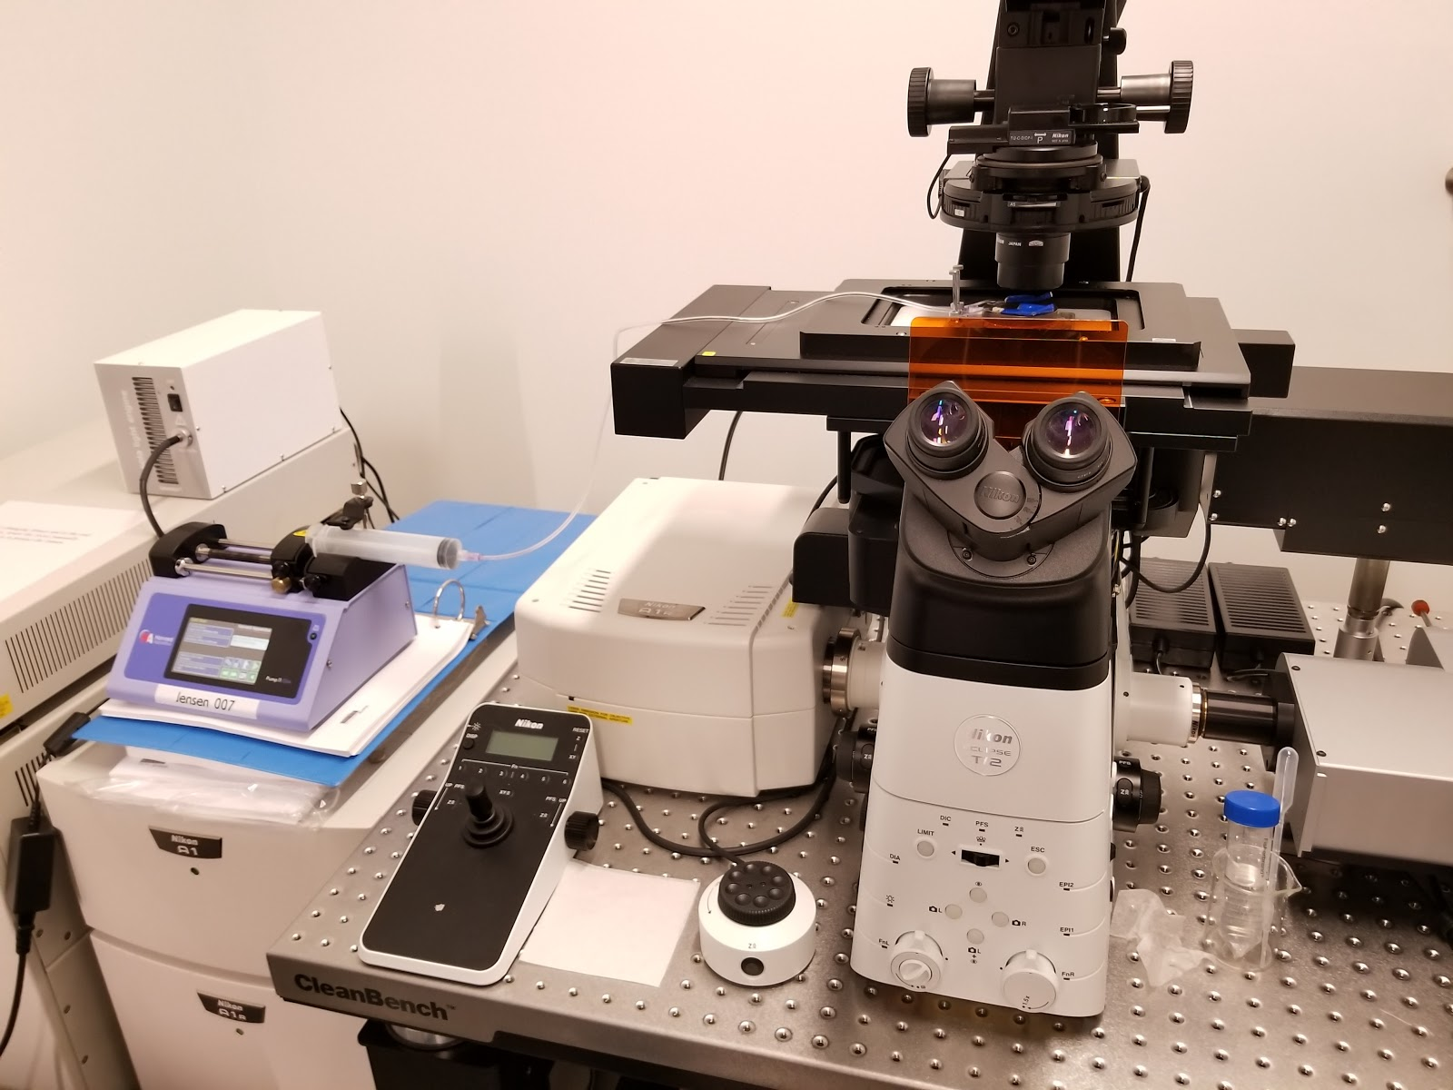

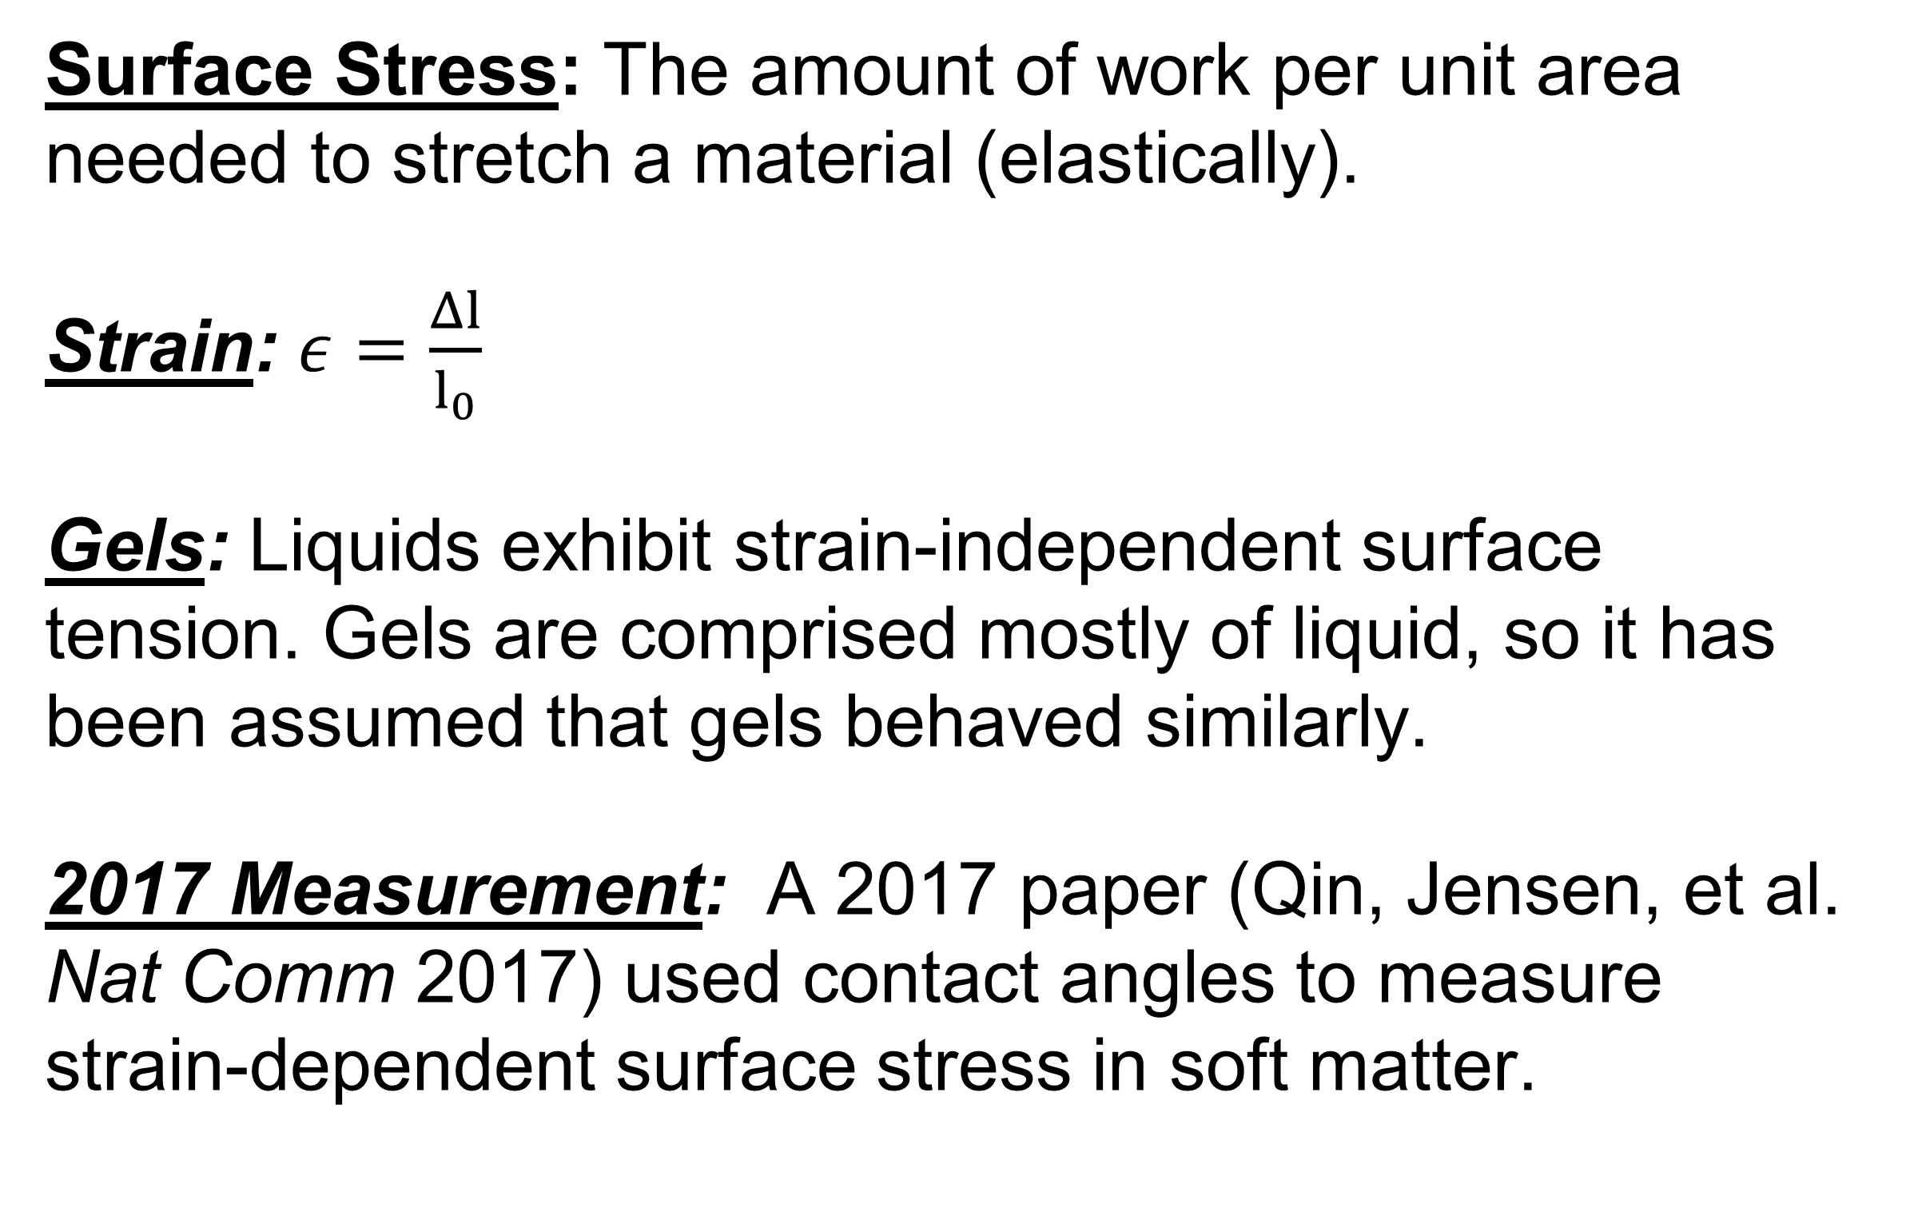
Measuring Strain-dependent Surface Stress in Soft Matter
Jeremy K. Thaller, Joshua Kang, K.E. Jensen
Department of Physics, Williams College
Definitions and Motivations
Homogeneous Equi-biaxial Stretching
Surface Stress: The amount of work per unit area needed to stretch a material (elastically).
Strain: $ε=\frac{Δl}{l_{0}}$
Gels: Liquids exhibit strain-independent surface tension. Gels are comprised mostly of liquid, so it has been assumed that gels behaved similarly.
2017 Measurement: A 2017 paper (Qin, Jensen, et al. Nat Comm 2017) used contact angles to measure strain-dependent surface stress in soft matter.
Homogeneous stretching is achieved using a custom-built stretching apparatus, milled out of aluminum and inset in laser-cut stage insert.
Fluorescent Confocal Microscopy
Silica Microsphere’s diameter ~ 30 microns
Preliminary Results: d vs R at zero strain with D.C. PDMS
The silicone substrate, coated with fluorescent beads on the top and bottom surface. The silica microsphere sits on the top surface, indenting depth d in the substrate.
Fluorescent bead’s diameter ~ 40nm
Indentation depth, d, is measured vs radius, r, of the silica microsphere particle
text
Confocal Microscope with custom stage insert and syringe pump
Conclusions and Outlook
Confirm new stretching apparatus is capable of long-term strain hold.
Collect data and analyze strain dependence of PDMS (Silicone).
Extend strain-dependent surface stress measurements to other materials.
jkt2@williams.edu

