Slide 1
Predicting Transport Integrals with Machine Learning
Jeremy Thaller and Maxim Gorbatschow
05.02.2020

Slide 2
Quick Recap

Slide 3
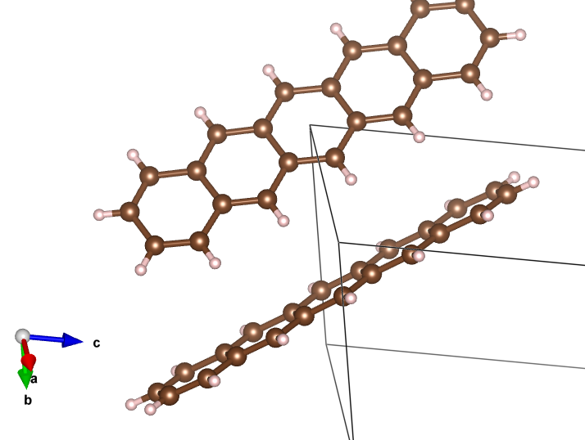
Given Information
Pic file with 900 features and 10,000 examples

Slide 4
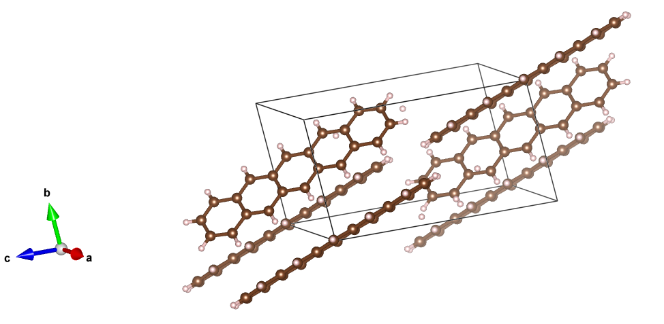
Goal
Predict the Transport integral give 900 distances between two 30-atom monomers

Slide 5
Preprocessing

Slide 6
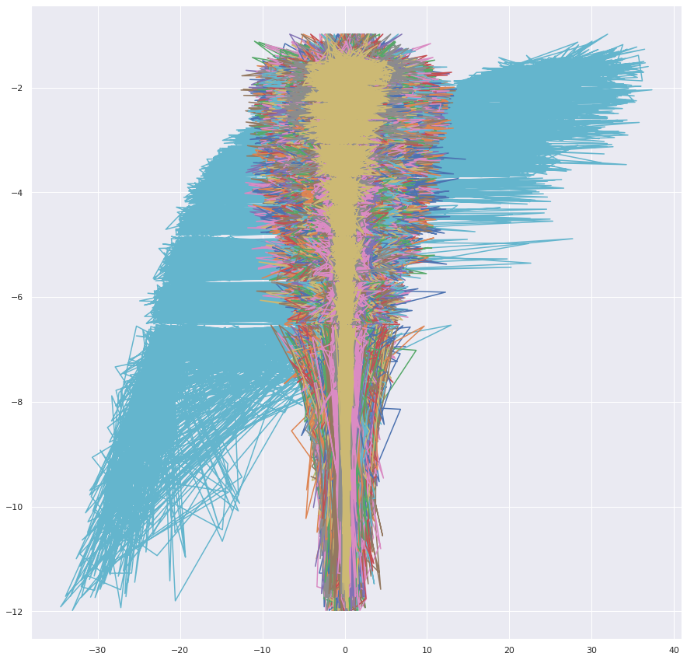
Dealing with 900 features
Principal Component Analysis

Slide 7
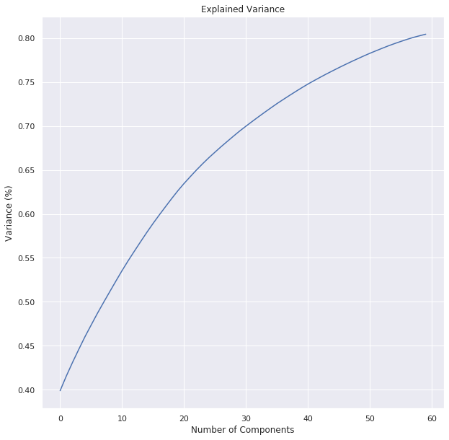
PCA Cont.

Slide 8
Regularization for Model Fitting
Add an extra cost to the loss function to prevent overfitting
L1 vs. L2

Slide 9
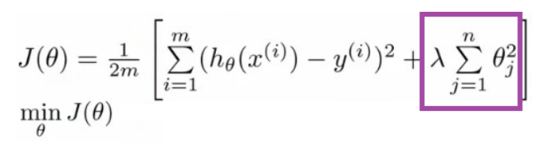
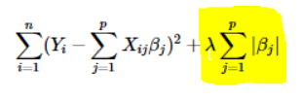
Regularization for Model Fitting
L1: Lasso Regression
Loss function = sum of absolute values of errors
(Least Absolute Shrinkage and Selection Operator)
Tends to push weights to zero
L2: Ridge Regression
Loss function = sum of squared errors
Lasso shrinks the less important features’ coefficients (even removing them altogether), making it better for feature selection with large number of features
Notes:
Ridge is good to prevent overfitting

Slide 10
Regression Models

Slide 11
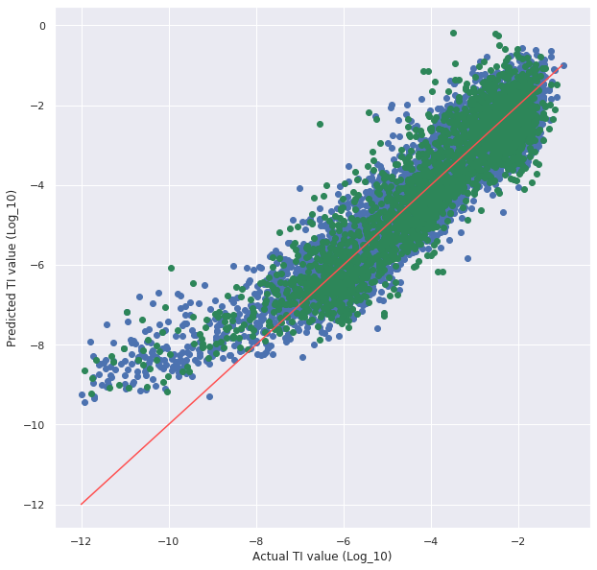
Linear Regression
With PCA applied and k-fold
cross validation:
Mean_squared_error (average):
1.002949261587887
standard_deviation:
1.187689627016626
(RMSE: 1.0014735)
Training Data: Y vs. Y_prediction
Test Data: Y vs. Y_prediction
(Linear with slope 1 => perfect match)

Slide 12
Sanity check: How is PCA doing?
Without PCA
With PCA
RMSE:
0.795003 (no k-fold)
mean_squard_error: 1.002949261587887
standard_deviation: 1.187689627016626
RMSE:
1.129056 (no k-fold)
mean_squard_error: 1.002949261587887
standard_deviation: 1.187689627016626

Slide 13
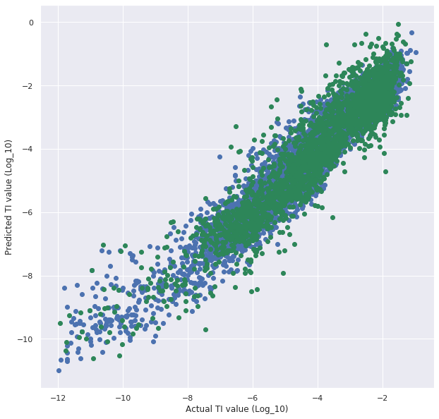
Polynomial Regression
Mean_squared_error (average): 1.774617823490909
standard_deviation: 2.4438984231990983
(RMSE: 1.3321478234381157)
Training Data: Y vs. Y_prediction
Test Data: Y vs. Y_prediction

Slide 14
Polynomial Regression
Mean_squared_error (average):
1.774617823490909
mean_squared_errors: [8.92539671
1.24277882 0.53544367 0.97998094
1.85069762 1.98805718 0.88201865
0.455358 0.37556103 0.51088562]
Training Data: Y vs. Y_prediction
Test Data: Y vs. Y_prediction

Slide 15
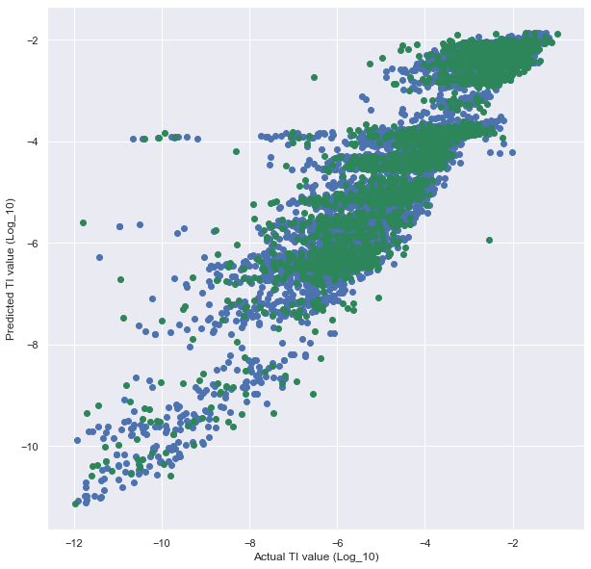
Random Forest Regressor
- best parameters are max_depth of 6 and n_estimators of 1000
- RMSE: 0.699682

Slide 16
Random Forest Regressor
[6.35710053 0.71129973 0.79274011 0.58765779 0.48054221 0.75907597 0.38439998 0.17103299 0.18910843 0.59895555]
mean_squared_error: 1.1031913291487907
standard_deviation: 1.763541449709036
Training Data: Y vs. Y_prediction
Test Data: Y vs. Y_prediction

Slide 17
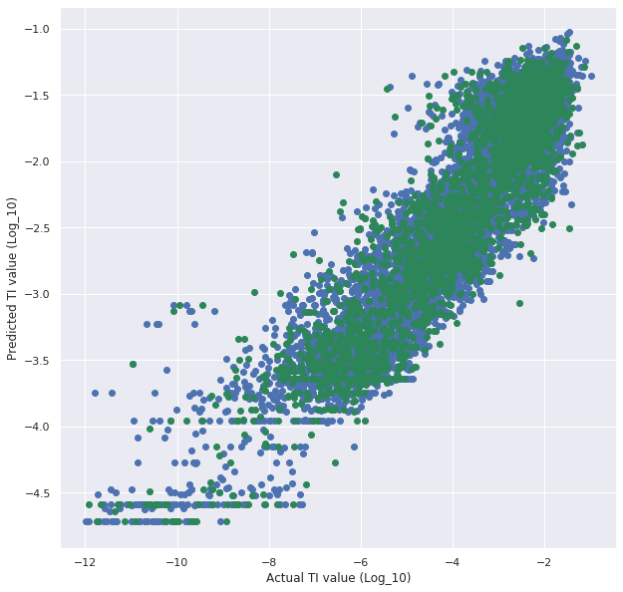
XGBoost
Regressor
RMSE: 1.999990
xgboost = xgb.XGBRegressor(objective ='reg:squarederror', colsample_bytree = 0.3, learning_rate = 0.1, max_depth = 5, alpha = 10, n_estimators =10)
Training Data: Y vs. Y_prediction
Test Data: Y vs. Y_prediction

Slide 18
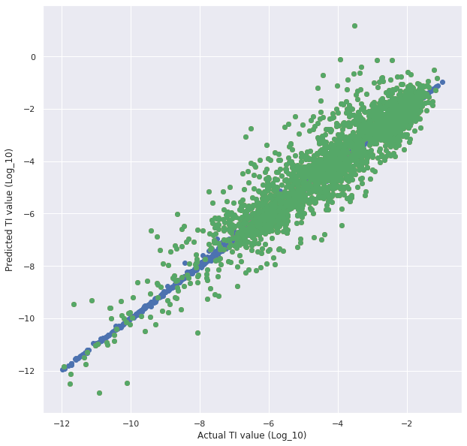
Kernel Ridge
RMSE of 0.799
Training Data: Y vs. Y_prediction
Test Data: Y vs. Y_prediction

Slide 19
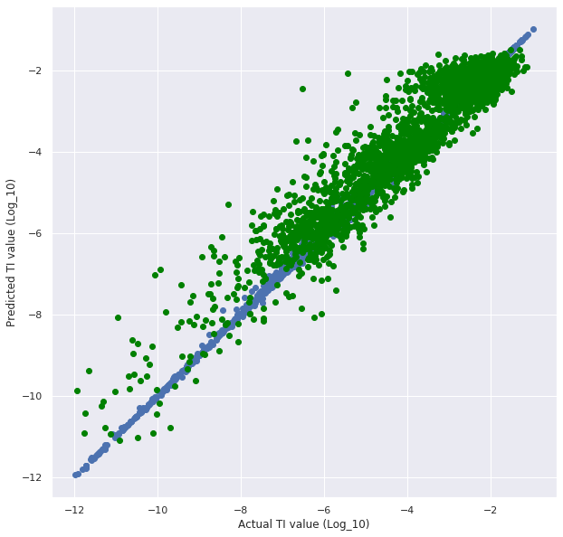
Keras
Neural Network
RMSE: 0.645438
Training Data: Y vs. Y_prediction
Test Data: Y vs. Y_prediction

Slide 20
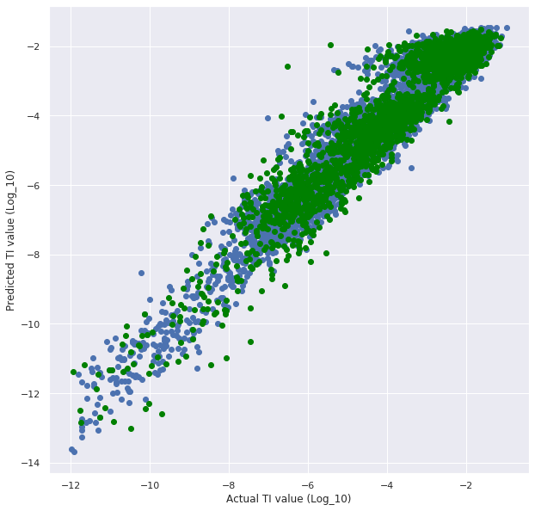
Correcting Keras Overfitting
Loss = mean_absolute_error RMSE: 0.640988
Loss = mean_squared_error RMSE: 0.575086
Notes:
Switching Regularization method didnt work. Mse punishes large errors more.

Slide 21
Final Predictions

Slide 22
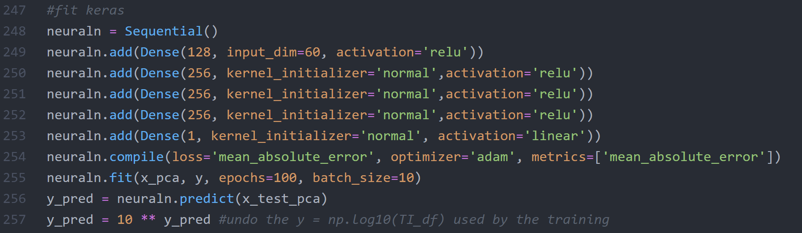
Keras

