Slide 1
NIH Spending Patterns and Effects on Global Health
Justin Harris
The Data Incubator
Capstone Project

Slide 2


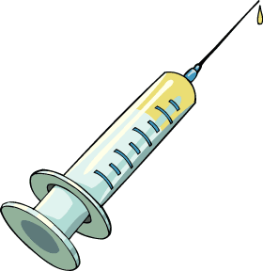



The Question
Billions in public funds are spent annually to improve public health

Slide 3
The Question
Billions in public funds are spent annually to improve public health
Are we spending money where it can do the most good?
Are allocations based on actual data or public opinion?
Do funds spent on disease research correlate to a decreased burden?

Slide 4
The Question
Billions in public funds are spent annually to improve public health
Are we spending money where it can do the most good?
Are allocations based on actual data or public opinion?
Do funds spent on disease research correlate to a decreased burden?
Can we do better?

Slide 5
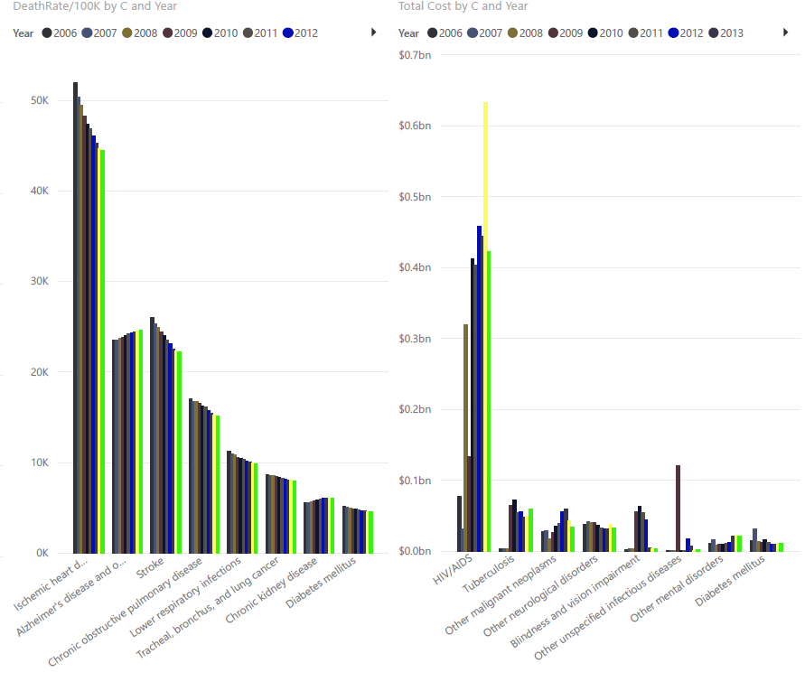
Death and Money
Most money spent on HIV/AIDS research
Heart disease is biggest killer
Note: Based on current data cleaning. Significant improvements necessary before conclusions drawn

Slide 6
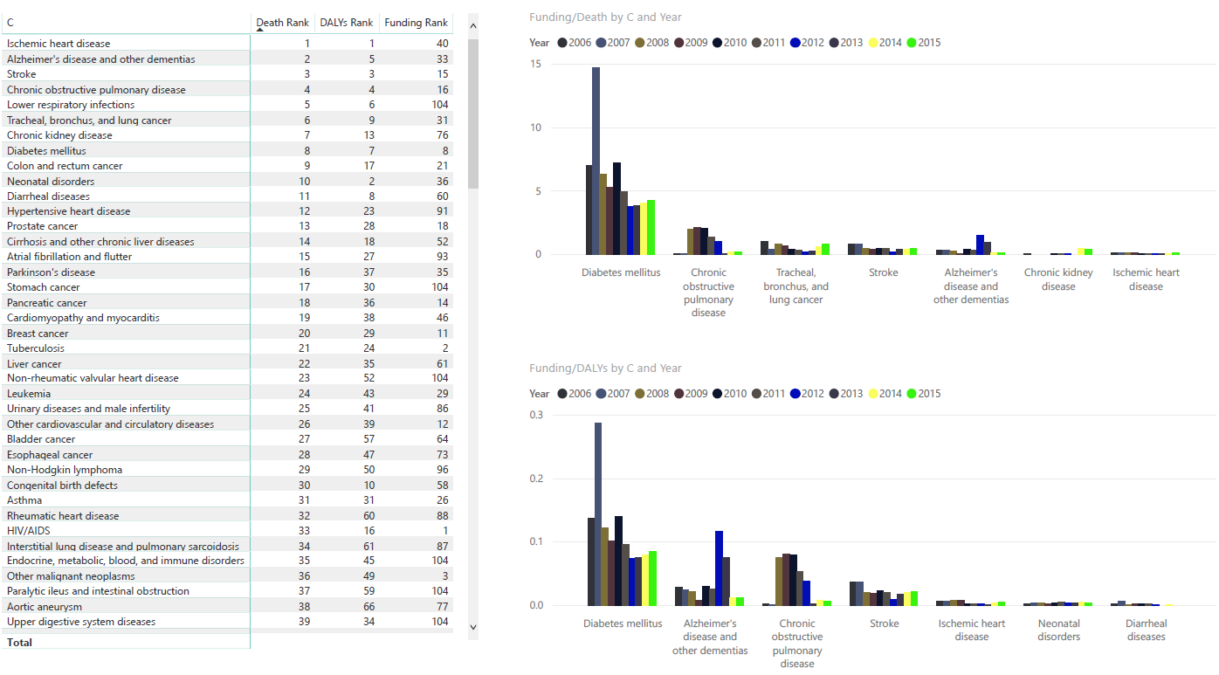
Death and Money
Highest killers are not highly funded
Funding works!
Notes: Replace table with visual
Notes: No hard conclusions, statements based on preliminary results

Slide 7
The Money Trail
Twitter/Facebook as measure of public opinion
Hypothesis: Funded projects closely related to diseases with “hype”
Hypothesis: Total available funds also tied to public fervor
Note: Add visuals on discrepancies between Global Burden and Public Opinion
Note: Add visuals correlating money spent to both
Note: Update with Twitter/Facebook findings and charts

Slide 8
How to Maximize ROI
Build model to minimize Death and DALYs across all causes based on correlations between spending and GBD reduction
Deliverables
Historical model of public opinion and GBD vs. disease funding
Historical model of total NIH funding vs public opinion
Predictive model of funding vs. GBD reduction
Total model of GBD reduction as function of public opinion and project funding distribution

