Slide 1
Identity, Security and XML Web Services
Jorgen Thelin
Chief Scientist
Cape Clear Software Inc.
E-mail: Jorgen.Thelin@CapeClear.com

Slide 2
Abstract
The use of security credentials and concepts of single-sign-on and “identity” play a big part in Web Services as developers start writing enterprise-grade line-of-business applications. An overview is provided of the emerging XML security credential standards such as SAML, along with various “identity” standards such as Passport and Liberty. We examine how “identity aware” Web Service implementations need to be, and the value a Web Services platform can add in reducing complexity in this area, with lessons drawn from experiences using J2EE technology for real-world security scenarios.

Slide 3
Agenda
The Concept of Identity
Web Services and Identity
Interoperable XML Security and Identity
Examples of Security Credentials in SOAP
Single-sign-on
Identity Awareness in Web Services

Slide 4
Cape Clear Software Inc.
Start-up founded in 1999 by several executives from Iona Technologies
Venture capital funding from Greylock and Accel Partners
Offices in:
  Dublin, Ireland
  London, UK
  San Mateo, CA, USA
  Waltham, MA, USA
The company is totally focused on XML Infrastructure, including Web Services
Products:
  Web Services Development tool set
  XML Integration Server supporting Web Services
  FREE WSDL Editor
http://www.CapeClear.com
http://www.CapeScience.com

Slide 5

A Definition of Identity
Definition from Cambridge Dictionaries Online:
  Identity
    [ noun ]
    Who a person is, or the qualities of a person or group which make them different from others
    http://dictionary.cambridge.org/define.asp?key=identity*1+0

Slide 6
What is Identity?
At its most basic, the concept of Identity is about:
  Who you are
  How you prove who you are
  What that allows you to do

Slide 7
Identity – Who are you?
An identity equates to a particular subject or principal
  For example: Joe Bloggs …
  … Who lives at 123 My Street, Your Town
Usually equates to a person, but could also be a group, corporation, or even something like an automated software agent component
Subjects must be distinguishable
  May be another Joe Bloggs living at 125 My Street

Slide 8
Identity – Proof of identity
How do you prove who you are?
In real life, this is usually thru some official documents such as:
  Driving License
  Passport
In computing terms, a user has a set of security credentials such as:
  username + password
  X509 certificates

Slide 9
Identity – Permissions
What does this identity prove about us?
What does this identity allow us to do?
Some real life examples:
  Holding a UK passport proves I am a UK Citizen
  Being a UK Citizen allows me to work in the UK
  Losing my passport does not stop me being a UK Citizen; it just makes it harder to prove that I am.
  A standard driving license shows I am allowed to drive a car
  I am not allowed to drive a Heavy Goods Vehicle unless I hold a HGV Driving License

Slide 10
Identity – Permissions and Credentials
The permissions and entitlements for an identity is ultimately determined by the set of credentials that were presented to assert that identity.
Permissions and credentials are use to make policy enforcement decisions
  Am I allowed to drive a Heavy Goods Vehicle?
  Am I allowed to work in the UK?
  Am I allowed to work in the US?

Slide 11
Web Services and Identity
How does this affect Web Services?
Security and Identity is a fundamental requirement of any real-world deployment of a Web Services application
Ultimately all security policy decisions are based on the caller’s identity
The challenge is to how to represent and prove a caller’s identity in an open and interoperable way.

Slide 12
Web Services and Identity 2
Security and identity considerations for a Web Services application:
  Authentication
    Who is the caller?
    How did they prove their identity?
    Do we trust the source of these credentials?
  Authorization
    What is the caller allowed to do?
  Attributes
    What other facts do we know about the caller?
      For example, e-mail address, department, employee number
    How do we use this attribute information in the application?
      For example, customizing the data returned based on display preferences

Slide 13
End-to-end Security Credentials
CORBA
Firewall
Firewall
Firewall
Firewall
Client
WS
Gateway
WS
Gateway
WS
Broker
EJB
Public Internet
Web
Service
XML security credentials
“The Last Mile”

Slide 14
Interoperable Security Credentials
To achieve interoperable security and identity, web services require the following
Standard ways to:
  Representing security credential data in XML
    Eg. SAML – Security Assertions Markup Language specification
  Obtaining credential data
    Eg. Single-sign-on services such as Microsoft Passport or Liberty Alliance specifications
  Transport credential data in a SOAP message
    Eg. SOAP header fields defined in the WS-Security specification

Slide 15
WS-Security
Owner: Microsoft/IBM/Verisign – Now OASIS WSS-TC
Status: WIP for OASIS standardization process
Purpose:
  Provides a model for many levels of security needed for web services.
  A general-purpose mechanism to associate security-tokens with messages
  Describes how to encode binary security tokens in messages using SOAP Headers
  Includes enhancements to SOAP to provide quality of protection mechanisms
Notes:
  Builds on top of XML Digital Signatures and XML Encryption specifications
  WS-Security Addendum adds
    Facility for timestamp and TTL headers
    Provides greater protection when passing around passwords and security certificates
More Info:
  http://www-106.ibm.com/developerworks/library/ws-secure/
  http://www-106.ibm.com/developerworks/library/ws-secureadd.html
  WS-Security AppNotes - provide guidance to implementers of the WS-Security specification:
  http://www-106.ibm.com/developerworks/webservices/library/ws-secapp/

Slide 16
WS-Security - Types of Security Tokens
The WS-Security specification set defines the following tokens:
  Unsigned security tokens
    Username
  Signed security tokens
    X.509 certificates (binary)
    Kerberos tickets (binary)
  XML security tokens
    Any XML token, such as SAML
    Usually self verifying / signed

Slide 17
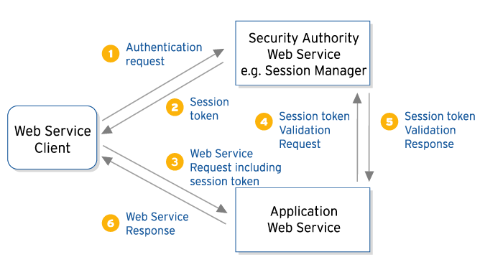
Typical XML Security Dialogue
– Non Self-Validating Credentials
Need to query the security service to validate the credentials

Slide 18
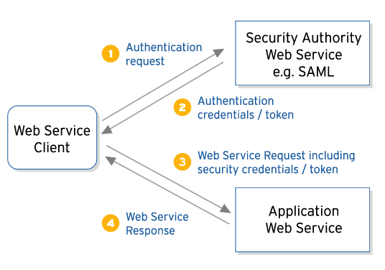
Typical XML Security Dialogue
– Self Validating Credentials
No need to query the security service to validate the credentials.
Usually done by the security authority digitally signing the credentials.

Slide 19
SAML v1.0
SAML – Security Assertions Markup Language
  An XML-based framework for exchanging security information
  A specification published by the OASIS organization
The SAML specification defines:
  How to represent security credentials (“Assertions” in SAML parlance) using XML
  An XML message exchange protocol for querying a SAML Authority service
SAML does not define:
  How to obtain security credentials (“Assertions”) in the first place

Slide 20
SAML Assertion Types
SAML Authentication Assertions
  The results of an authentication action performed on a subject by a SAML authority
SAML Attribute Assertions
  Attribute information about a subject
SAML Authorization Assertions
  Authorization permissions that apply to a subject with respect to a specified resource

Slide 21
A Username Token in WS-Security SOAP Header
<SOAP:Envelope xmlns:SOAP="...">
<SOAP:Header>
<wsse:Security
xmlns:wsse="http://schemas.xmlsoap.org/ws/2002/12/secext">
<wsse:UsernameToken>
<wsse:Username>jthelin</wsse:Username>
<wsse:Password Type="wsse:PasswordDigest">
XYZabc123
</wsse:Password>
<wsse:Nonce>
h52sI9pKV0BVRPUolQC7Cg==
</wsse:Nonce>
</wsse:UsernameToken>
...
</wsse:Security>
</SOAP:Header>
<SOAP:Body Id="MsgBody">
<!–- SOAP Body data -->
</SOAP:Body>
</SOAP:Envelope>

Slide 22
A Binary X509 Certificate in WS-Security SOAP Header
<wsse:Security
xmlns:wsse="http://schemas.xmlsoap.org/ws/2002/12/secext">
<wsse:BinarySecurityToken Id="X509Token"
xmlns:wsse="http://schemas.xmlsoap.org/ws/2002/12/secext"
ValueType="wsse:X509v3"
EncodingType="wsse:Base64Binary"
>
MIIEZzCCA9CgAwIBAgIQEmtJZc0...
</wsse:BinarySecurityToken>
<ds:Signature xmlns:ds="http://www.w3.org/2000/09/xmldsig#">
<ds:SignedInfo> ... </ds:SignedInfo>
<ds:SignatureValue> ... </ds:SignatureValue>
<ds:KeyInfo>
<wsse:SecurityTokenReference>
<wsse: Reference URI=”#X509Token” />
</wsse:SecurityTokenReference>
</ds:KeyInfo>
</ds:Signature>
...
</wsse:Security>

Slide 23
A SAML Assertion in WS-Security SOAP Header
<wsse:Security
xmlns:wsse="http://schemas.xmlsoap.org/ws/2002/12/secext">
<saml:Assertion
xmlns:saml="urn:oasis:names:tc:SAML:1.0:assertion"
MajorVersion="1"
MinorVersion="0"
AssertionID="SecurityToken-mc375268"
Issuer="mycompany"
IssueInstant="2002-07-23T11:32:05.6228146-07:00" >
...
</saml:Assertion>
<ds:Signature xmlns:ds="http://www.w3.org/2000/09/xmldsig#">
<ds:SignedInfo> ... </ds:SignedInfo>
<ds:SignatureValue> ... </ds:SignatureValue>
<ds:KeyInfo>
<wsse:SecurityTokenReference>
<saml:AssertionIDReference>
SecurityToken-mc375268
</saml:AssertionIDReference>
</wsse:SecurityTokenReference>
</ds:KeyInfo>
</ds:Signature>
...
</wsse:Security>

Slide 24
Single-sign-on Services
SSO Services provide:
  a single point of logon and authentication
  a standardized way to obtain suitable credentials to prove the authenticated identity
The main contenders using XML are:
  Liberty Alliance
  Microsoft Passport
  Proprietary security products such as Netegrity SiteMinder are adding direct SAML interfaces
  WS-Trust – new spec for standardized XML interface
Still remains an area needing standardization

Slide 25
Liberty Alliance
The Liberty Alliance Project is a cross-industry group aiming to establish an open standard for federated network identity
http://www.projectliberty.org/
The Liberty specification v1.0 has two main facets:
  Single sign-on
  Identity federation

Slide 26
Microsoft .NET Passport
Microsoft .NET Passport is a suite of Web-based services that makes using the Internet and purchasing online easier and faster for users.
http://www.passport.com/
.NET Passport provides users with
  Single sign-in (SSI)
  Fast purchasing capability at participating sites
Microsoft is upgrading the current Passport facilities to
  Provide an XML interface
  Support federation
  Use Kerberos v5 as the underlying mechanism for securely exchanging credentials

Slide 27
The Need for a Sign-on Standard
– WS-Trust
The need remains for a “sign-on standard” to avoid reliance on proprietary interfaces
WS-Trust
  A proposed specification in the WS-Security family
  Provides a standardized interface for acquiring security tokens
  Still very early in the standardization process, but the most likely candidate for a common interface
  http://msdn.microsoft.com/library/en-us/dnglobspec/html/ws-trust.asp

Slide 28
WS-I Basic Security Profile
From the charter for the new WS-I Basic Security Profile work group:
  The BSP-WG will develop an interoperability profile dealing with transport security, SOAP message security, and other Basic Profile-oriented security considerations of Web Services
Although this will not cover all aspects of the emerging XML Security specifications, it will certainly solidify the base levels.

Slide 29
Identity-awareness in Web Services
Do web services themselves need to be identity-aware?
  Not really, in most cases
  A mature web services platform product such as Cape Clear Server can handle almost all the “boilerplate” work of authentication and enforcement of access control lists

Slide 30
Identity-awareness in Web Services - 2
Most standard authentication and authorization functions are best done in a uniform manner by the platform, rather than being implemented on an application-by-application basis
  Interceptor plugins allow this to be a deployment policy decision rather than an implementation decision

Slide 31
Identity-awareness in Web Services - 3
Web Service application only needs to be Identity-aware if it needs to use attributes asserted for the caller
  For example, reading the delivery address from the user’s MS Passport record

Slide 32
Desired Web Services platform security
The goal will be declarative security functions for web services just like EJB
  So, having declarative statements of security policy for an Web Service application:
    Required transport security attributes
    (for example, “Callers must use encrypted / SSL connections”)
    Required message security attributes
    (for example, “Messages must be digitally signed”)
    Permitted authentication realms / single-sign-on services
    Role-based access control lists applied at the granularity of the operation / method call.
This places control of security to application administrators rather than developers.

Slide 33
Summary
“Identity” is one of the fundamental concepts behind all the security mechanisms in line-of-business Web Services
Having a standard XML-based serialized form of credentials is vital for true end-to-end interoperability
Standardization of specifications for credential exchange and single-sign-on using XML and SOAP are still incomplete, so true interoperability is not yet possible.
WS-I Basic Security Profile is working to guarantee interoperability of transport and message level security for Web Services
Use a mature Web Services runtime platform such as Cape Clear Server to handle most “boilerplate” security tasks such as enforcing authentication and authorization requirements

Slide 34
Resources
Cape Clear Software
  WSDL Editor
  Web Services Development tool set
  XML Integration Server supporting Web Services
  http://www.capeclear.com
CapeScience
  Papers, articles, tutorials, and webcasts for Web Services developers
  http://www.capescience.com
Jorgen Thelin’s Weblog
  Weblog covering enterprise systems development, and especially Web Services
  http://www.TheArchitect.co.uk/weblog/

