Slide 2
Integrating with
Windows Live ID
NDA Only
Jorgen Thelin
Senior Program Manager
Identity Services Team
Microsoft Corporation
http://TheArchitect.co.uk

Slide 3
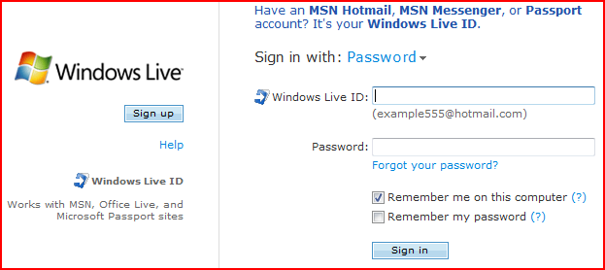

What is Windows Live ID?

Slide 4
What is Windows Live ID?
Windows Live ID is …
… the biggest authentication provider on the planet!
  ~ 430 million Active Accounts @ Feb 2008
  ~ 1.1 billion Authentications per day
  > 99.9% service availability
  Peak traffic is generally 2X normal load
  200 countries, 35 languages
  > 1 million new accounts created per day
  – the majority by spammers ☹

Slide 5
Live ID - Vision and Mission
Windows Live ID is the industry-leading identity platform for all Microsoft online services and its partners, delivering a secure, trusted, and personalized experience to users on all applications and devices.
Windows Live ID will enable user and developer communities through rich, easy-to-use identity, with ever higher security and lower integration cost.
Notes:
Note that its unchanged from last review ☺

Slide 6
What is Windows Live ID? - 2
Windows Live ID is …
  The authentication provider for all Microsoft’s web properties
But also:
  An authentication platform
  A delegation platform
  A federation platform
  A user provisioning platform
  The first line of anti-spam defense
All delivered as Software + Services
  Cloud hosted + client SDK libraries for easier integration
  Two major feature Live ID release cycles per year

Slide 7
Windows Live ID Authentication Overview
Who are you?

Slide 8












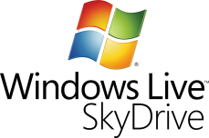












Lots of Live ID Partners
Windows Live
Microsoft Live
External Partners

Slide 9

Live ID - Types of Identities
Principals
  User (WLID)
  Machine (Device ID)
  Machine on behalf of User (linked device)
  App (App ID)
  App on behalf of User (Delegation)
Types of User WLID’s
  Passport Account, Hotmail account
    person @ hotmail.*
    person @ live.*
    person @ msn.*
  EASI (“Email as sign-in") account
    Any valid email account
      person@yahoo.com
      person@myISP.net
  Managed namespaces
    Custom Domains
    Hotmail-hosted email account (@MyDomain.com)
  Federated Accounts
    @EDU Program
    Net-ops Partners
    Enterprises
Microsoft Confidential
9

Slide 10
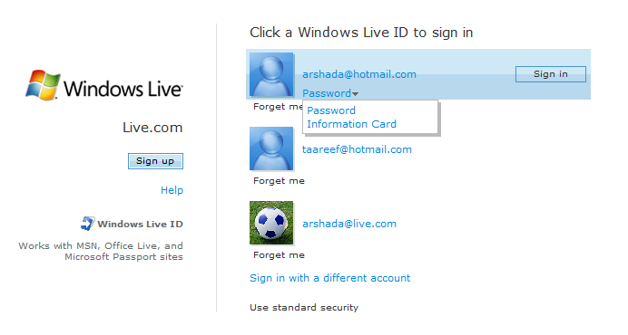

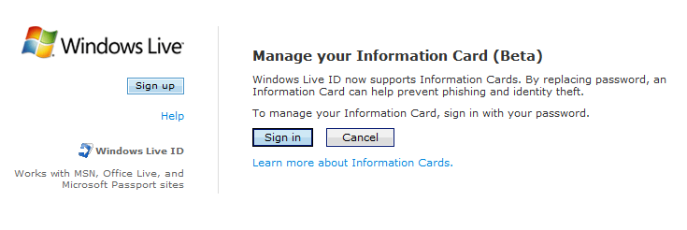
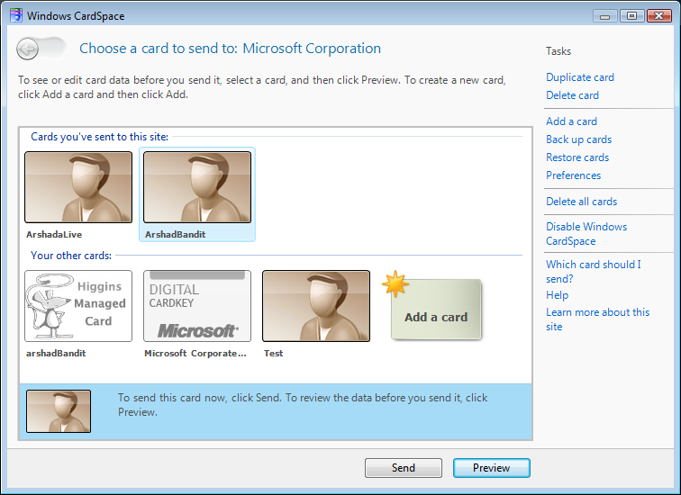
Live ID - CardSpace Support
Live ID supports self-issued info cards
(Beta @ August 2007)
Associate an info card with WLID account
Working on release UX
Managed info cards in the future
https://login.live.com/beta/ManageCards.srf
Notes:
https://login.live.com/beta/ManageCards.srf

Slide 11
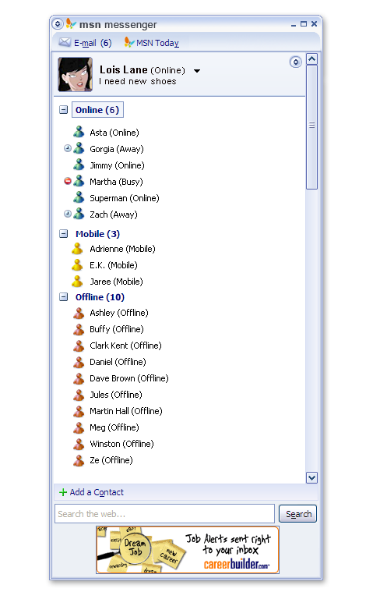
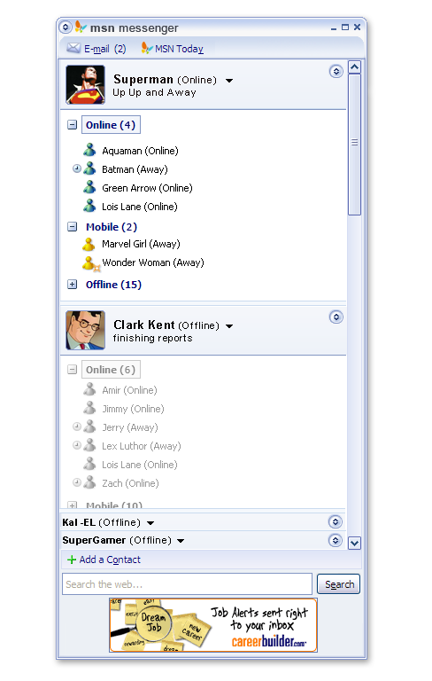
Linked IDs (Personas) Overview
Personas problem: users need to represent themselves differently: family, work, dating, gaming.
Many users maintain multiple Live IDs to manage their personas.
Microsoft previously did not know that multiple IDs belong to the same user.
Solution: Allow users to link together and sign in with multiple identities, with easy switching between personas.
Scenarios:
Live Mail: unified inbox
Windows Live: easy user switching
Windows Live Mesh: mesh of all devices, data, apps,
and contacts
Live Messenger: unified messaging, presence & status
by group
Office Live: coexistence of work and home IDs
Xbox Live: shared points balance across multiple IDs
Syndication: Coexistence of internal and external IDs

Slide 12
Anti-SPAM – User Reputation System
Spam Economics 101
  Value of account =
    Cost to create + Cost to use account
Massive SPAM problem
  Spam account creation in the thousands to millions per day
  Express team firefighting spammers every day
  1 million spam sign ups blocked per day by static IP blocking alone!
Solution: Make SPAM accounts difficult to create
  Real-time IP blocking system using IP reputation system
  Measures to make signup automation harder
  Apply Device ID to make signup secure
Solution: Reduce outbound SPAM and account abuse
  Difficult to use SPAM accounts via User Reputation System
End user experience
  Less spam for everybody
  Legit user will see improved user experience in seeing less prompts

Slide 13
Live ID - Integration SDKs
Live ID Client SDK
  Smart client applications
Live ID Relying Party Suite (RPS – aka Live ID Server SDK)
  Runs on Windows Server OS
  Depth partners
Live ID Web Authentication SDK (WebAuth)
  Open source samples in 6 languages – ASP.NET, Java, Perl, PHP, Ruby, Python
  Breadth partners
Live ID Delegated Authentication SDK (DelAuth)
  Open source samples in 6 languages – ASP.NET, Java, Perl, PHP, Ruby, Python
  Third-party application providers
Windows Live Tools for Visual Studio
  Includes 4 ASP.NET controls to simplify integration with Live ID / Windows Live:
  Contacts, IDLogin, IDLoginView, SilverlightStreamingMedia

Slide 14
Windows Live ID Roadmap
Where are we heading next?

Slide 15
Live ID - Wave 3 Innovations
5.5 (Jan 08)
Delegated Authentication for secure sharing of user data
6.0 (July 08)
Live Connector
6.5 (Within ~12 months)
(Provisional plans – subject to change)
Anti-spam rule-based IP blocking
Exchange B2B collaboration
Anti-SPAM Users reputation
Aliasing
Windows 7 - Device to User mapping
IDCRL 6.0 – Single sign in across Desktop
Scale federation for enterprises
Customize-able sign in and sign up by 3rd party
Service provisioning framework
Reporting system for 3rd party
WebAuth 3rd party SDK
OpenID Provider
Strong password policy
Smart Card support
Active-active failover

Slide 16
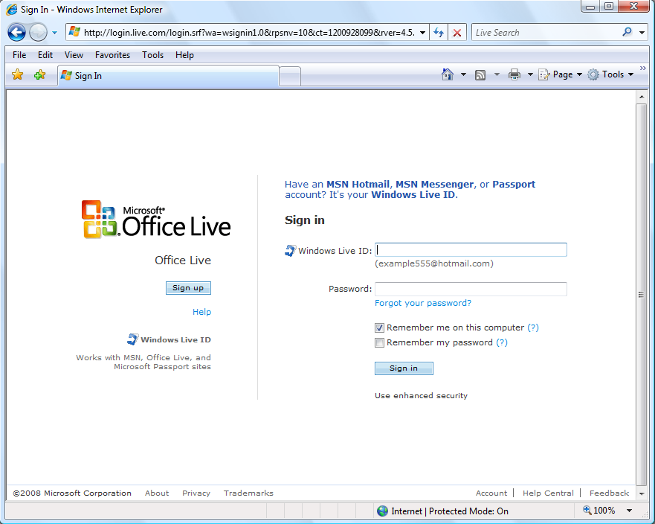
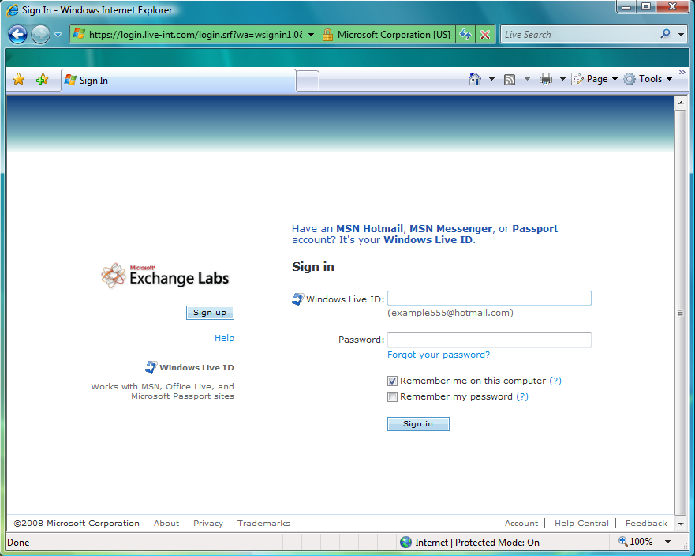
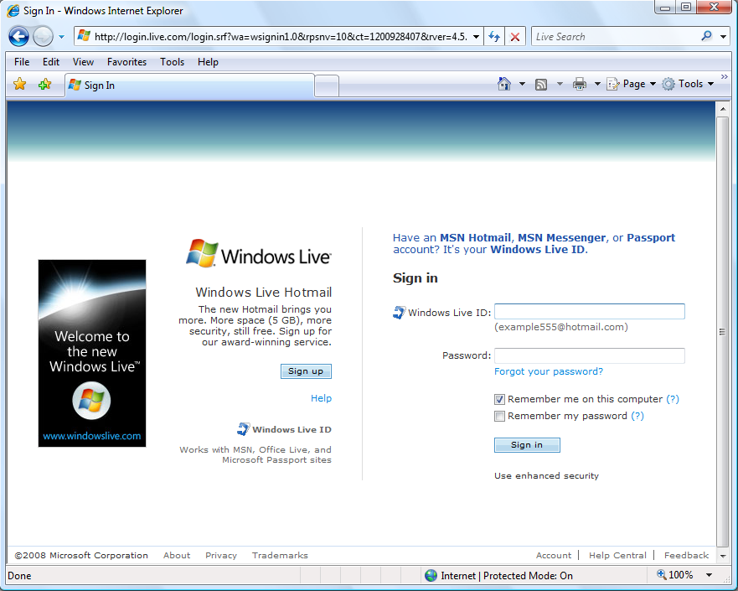
Simple Sign-in Screen Customization
RPS sites can customize the sign-in screen presented to their users

Slide 17
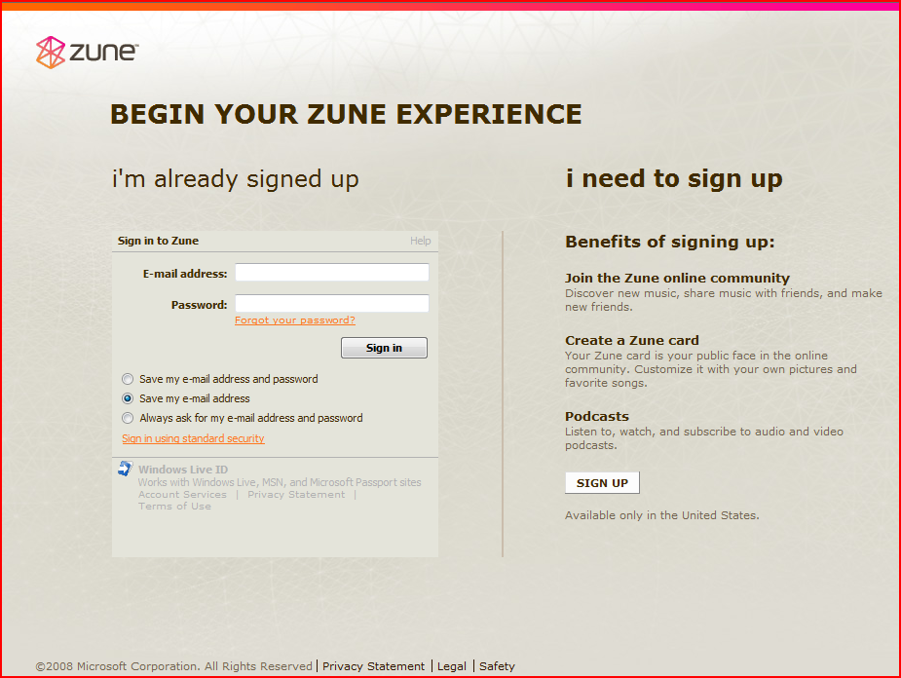
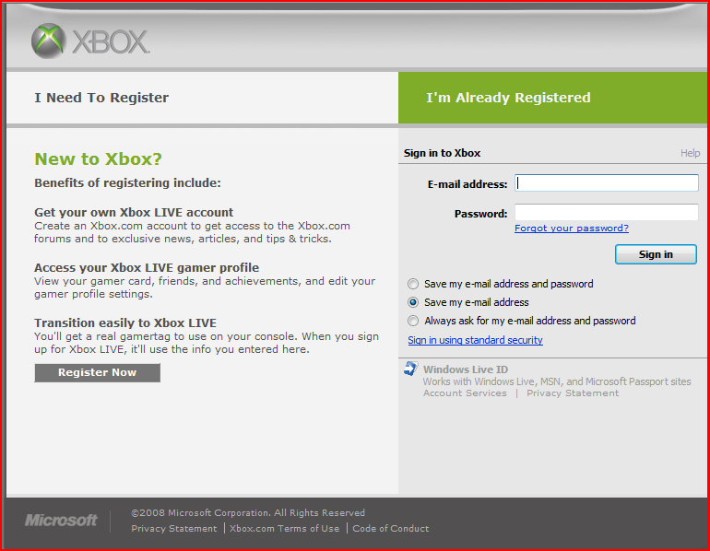
Advanced Sign-in Screen Customization
Flexible RPS sign-in customization options allow creativity

Slide 18
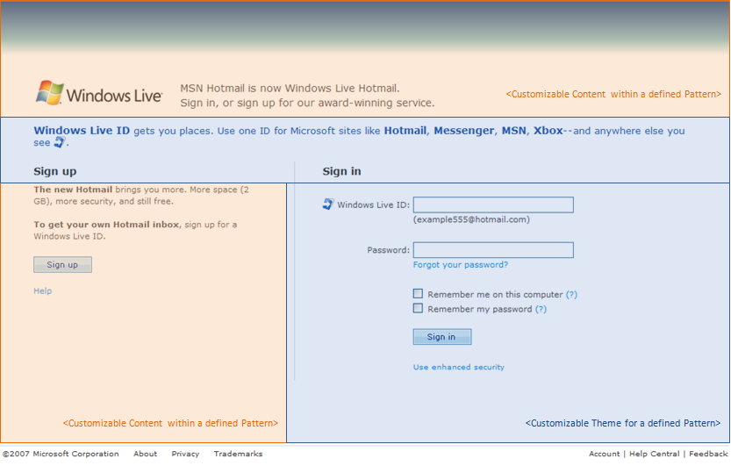
Customizable Sign-in Screen - Future
In future, both RPS and WebAuth sites will have equivalent customization support
Customizable Contents Area – Orange
Contents element that can be customized.
  Partner Logo
  Task integration description statement
  Product description
  Sign up section
Customizable Theme Area – Blue
Contents element cannot be but look and feel can be customized.
  Font color
  Background color
  Button color
  Tile color.
  Live ID value proposition description font color
Proposal

Slide 19
Windows Live ID Federation & Provisioning
Enabling the enterprise…

Slide 20
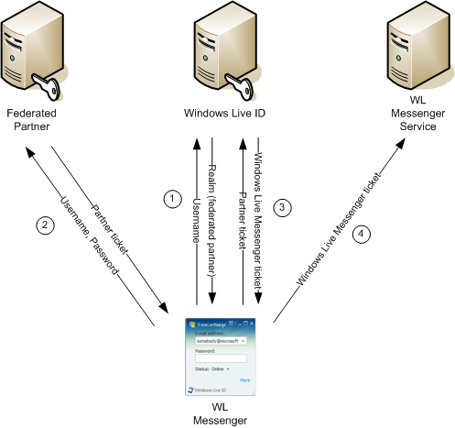
Federated Authentication Flow
Step 1 (Realm Discovery)
Messenger collects username/password from the user. Messenger sends the username (user@partner.com) to WLID. WLID responds w/ the partner login URL.
Step 2 (Partner Login)
Messenger sends username/password to the partner login URL. The partner logs the user in and returns a partner login ticket.
Step 3 (WLID Login)
Messenger sends the partner login ticket to WLID. WLID logs the user in and returns a WL messenger login ticket.
Step 4 (Application Login)
Messenger sends the WL messenger login ticket to the messenger service and the user is logged in.

Slide 21
Federation Overview
Federation allows partners to give their users access to Live Services
  Partner is identity provider – for example your ISP
  Partner can include Live Services in their offerings to customer – for example hosted e-mail
Based on WS-* standards and extended to Service Scenarios:
  Automated trust provisioning – WS-Fed extension
  Batch request optimization to reduce roundtrip – WS-Trust extension
  Forced sign in, sign-in security level (strong password, pin) – SAML extension
Easy partner on-boarding is more than just standard protocols
  Realm discovery to route authentication to the right provider & cache for subsequent visits
  Cleanup namespace - Evict squatters
  Support certificate rollover: store two versions of certs
Shadow account creation makes federation invisible to Microsoft services:
  Create PUID / shadow account on the fly
  UPN in foreign token as the account name and store email name
  E-mail name is member name to Live service, rename on the fly if e-mail name changes
  Backwards compatible with existing services: auth tokens look the same for fed and WLID users
Linking with WLID leverages user’s existing investment in Live for best UX
  Account merge: if account has the same name (EASI) merge and keep the PUID for data access
  Link to a different Live ID
  Divorce: Accruing data for password reset allows Microsoft to keep users when they leave the federated partner
Notes:
Breadth Partners are partners that don’t require any customization
The resource provider is currently under discussion, we have the infrastructure. The discussion is about the business and market needs

Slide 22
Live Connector
Foundation technology for software + service initiative - Goal: “One-click federation with Live”
Easy delivery of Live and Online to AD-Based Enterprises
  Easy to use : Easy to use wizard for configuration
  Secure : Control the users with access to online services
Uses standard WS-Federation protocols
Seamless user access from AD to Live and Online services
  Single sign in with corpnet
  Access Live and Online using corporate account

Slide 23
Service Provisioning Framework
Scenario/Requirement
  CreatePassport() API can also provision services that the user has signup for. (e.g., pre-create inbox so that an welcome email can be sent)
  Service offering changes over time:
    new services can be added;
    an offer can be time bound (eg. free trial for 2 month);
    existing users need to retroactively add new services;
    a user might convert from one offer to another.
  When a user leaves an offer, the system must de-provision
Solution
  Scalable system to 100s of millions of users
  Fully data driven to reconfigure offer and business rules
  Simple on-boarding for net-ops through Windows Live Syndication Central

Slide 24
Summary – Windows Live ID
Windows Live ID is the biggest identity provider on the planet!
… but Live ID platform is much more than just the familiar login box
Various types of users and various authentication models are supported
Increasing focus on enabling federation and enterprise access to online services
Ease-of-use is always the goal and the challenge!

Slide 25
Live ID - Resources & Links
Windows Live ID Developer Center - http://dev.live.com/liveid
    Windows Live ID Articles on MSDN - http://go.microsoft.com/fwlink/?LinkId=111111
    Windows Live ID Documentation on MSDN - http://msdn2.microsoft.com/en-us/library/bb404787.aspx
    Windows Live ID Developer Forum - http://go.microsoft.com/fwlink/?LinkID=78146
    Windows Live ID Team Blog - http://winliveid.spaces.live.com
Windows Live ID Whitepapers
  Introduction to Windows Live ID - http://msdn2.microsoft.com/en-us/library/bb288408.aspx
  Understanding Windows Live Delegated Authentication - http://msdn2.microsoft.com/en-us/library/cc287613.aspx
  Windows Live ID Federation - http://msdn2.microsoft.com/en-us/library/cc287610.aspx
Windows Live ID Documentation and SDKs
  Windows Live ID Web Authentication 1.1 SDK
  Docs http://go.microsoft.com/fwlink/?LinkID=91762
  SDK Samples http://go.microsoft.com/fwlink/?LinkID=91761
  Windows Live ID Delegated Authentication 1.0 SDK
  Docs http://go.microsoft.com/fwlink/?LinkID=107420
  SDK Samples http://go.microsoft.com/fwlink/?LinkId=107419
  Windows Live ID Client 1.0 SDK download - http://go.microsoft.com/fwlink/?LinkId=86974
Windows Live ID Web Authentication app registration page https://msm.live.com/app
Delegated Authentication Resource Providers List - http://go.microsoft.com/fwlink/?LinkID=108535
Windows Live ID Server SDK (aka RPS) – Speak to your Microsoft Account Manager
Windows Live Tools for Visual Studio - http://dev.live.com/tools/
Notes:
Additional Whitepapers on specific topics can be made available

Slide 26

© 2008 Microsoft Corporation. All rights reserved. Microsoft, Windows, Windows Vista and other product names are or may be registered trademarks and/or trademarks in the U.S. and/or other countries.
The information herein is for informational purposes only and represents the current view of Microsoft Corporation as of the date of this presentation. Because Microsoft must respond to changing market conditions, it should not be interpreted to be a commitment on the part of Microsoft, and Microsoft cannot guarantee the accuracy of any information provided after the date of this presentation.
MICROSOFT MAKES NO WARRANTIES, EXPRESS, IMPLIED OR STATUTORY, AS TO THE INFORMATION IN THIS PRESENTATION.

