Slide 1
IDA314 – Live ID, Open ID & OAuth
What is the difference between them?
Jorgen Thelin, Windows Live Identity Services
Notes:
Learn a ton of information about online identity
Learn about Open ID & OAuth
Learn about Live ID
Talking points:
1. Good authentication is secure but unobtrusive
2. Identity without borders
3. Specs are “easy”, secure identity at scale is hard

Slide 2
IDA314 – Live ID, Open ID & OAuth
What is the difference?
Session Abstract
  If you are working in the web identity space you will definitely come across Open ID... but how does it compare & contrast to Windows Live ID?
  Come to this session to see the ultimate compare and contrast between Windows Live ID and Open ID (and OAuth).
  Windows Live ID is Microsoft's identity service for our online services; Open ID and OAuth are standards - where do these overlap?
Session Objectives
  Understanding of Live ID capabilities
  Understanding of Open ID capabilities
  Understanding of OAuth capabilities
  When to use which where and why

Slide 3
Agenda
Online Identity 101
What is Open ID?
What is OAuth?
What is Live ID?
Compare and contrast

Slide 4
Online Identity 101
Digital identity is “a set of claims made by one digital subject about itself or another digital subject” -- Kim Cameron
  User view: Who you are, how you prove it, & what that permits you to do
Why do people care about online identity ?
  Too many accounts
  Too many credentials
  Barriers to collaboration - Re-authenticate to access new resources
  Good authentication is secure but unobtrusive
    But there too many bad authentication experiences in current applications and services
    Bad UX leads to weak security - password fatigue, “Post-it passwords”, etc
What is “federated identity” ?
  “Identity without borders”
  User’s sign in once with their Identity Provider then can seamlessly work with trusted partners
Notes:
Why do people care about Online Identity?
Too many accounts – not always the same username
Too many credentials – SSO != same password on each account!
Re-authenticate to access new resources – work interruption
Barriers to collaboration – how many times have you said “I’m not on CORPNET, could you e-mail me a copy of that Sharepoint doc?”
Good authentication is secure by unobtrusive
But too many bad authentication experiences in current applications and services
The more you notice authentication mechanisms, the worse they are!
61% use the same password everywhere! - http://www.readwriteweb.com/archives/majority_use_same_password.php
What is “Federated Identity”
“Identity without borders”
User’s sign in once with their Identity Provider then can seamlessly work with trusted partners
Seamless flow to shared resources provided by partners
Federation is a trust-based agreement between two organizations with some common purpose, such that both want authentication assertions from one organization to be recognized by the other.
This trust relationship can be unidirectional or bidirectional. Windows Live ID is capable of playing either role.
A federated identity relationship is a standards-based arrangement between organizations in which user claims from one organization are passed to and recognized by another. Users can therefore sign in to (and be authenticated by) their identity provider—the organization that manages their identity account—and then have their authentication information passed to a federated partner as needed without being required to sign in again.

Slide 5

What is Open ID?
In their own words ( http://openid.net/ )
“Open ID is a free and easy way to use a single digital identity across the Internet.”
Notes:
Open ID is a decentralized mechanism for single-sign-on
What problems does it solve?
Too many passwords
Someone else already grabbed my username
My online profile is scattered across dozens of sites
An OpenID is a URI
What can you do with an OpenID URI?
You can claim that you own it
You can prove that claim
Which means that you can use that URI for authentication

Slide 6
What is Open ID?
A Web single-sign-on solution
A personal identifier (OpenID URI)
An authentication protocol
A standards organization
A business model
Notes:
A Web single-sign-on solution
An authentication protocol
Cross-platform, technology neutral, extensible
Includes mechanism for profile data exchange
A standards organization
OpenID was originally developed by an informal community group with unclear IPR policies
OpenID Foundation now owns the OpenID spec
A personal identifier
Your OpenID URI is globally unique
A business model
Outsourcing user authentication and management can be a big money saver for a website!

Slide 7
What Open ID Isn't
Not an Identity Provider – there are many
Not an account, just an identity
  User still need to register with each new site
Not a guarantee of anything except the user’s URI
Not a trust broker – “Identity is not Trust!”
Notes:
Open ID tells you very little about a user
You don’t know their name
You don’t know their e-mail address
You don’t know if they are a person or a spam-bot (or a dog)
Still need to ask users for their information as part of registration process
Open ID augments the regular sign-up process, it doesn’t completely replace it
Still use CAPTCHA to help block spam-bots
Open ID Simple Registration Extension can help user’s fill out the registration form by getting user consent to transfer profile info from the identity provider

Slide 8
Demo – Open ID Authentication

Slide 9


OpenID Protocol Mechanics
Relying party
e.g. yoursite.com
1. Send identifier
1
2. Associate handle
3. Redirect over UA
3
5
2
6
4. Login
end user w/ user agent
4
5. Redirect over UA
6. Check authentication
(optional)
Identity provider
e.g. myopenid.com
+ IP-Delegation + Discovery Functionality in Open ID 2.0
Notes:
OpenID demo – Sign in to WikiTravel using Verisign PIP - http://wikitravel.org/en/Main_Page
1. User enters Open ID URI
2. RP establishes shared secret with IP using Diffie-Hellman key exchange
3. Redirect to Identity Provider via user agent (browser)
4. User signs-in to IP
5. Redirected back to RP via user agent
Note: Open ID does not specify how user authenticated to IP – IP can use a mechanism that suits their users:
Username/password
X.509 client certs
SecureID
InfoCard
smartcard, etc
A provider could also just say “yes” to every request! – Proof-of-concept demo: http://www.jkg.in/openid/

Slide 10















Who's Using OpenID?
Identity Providers
Relying Parties
Provider lists:
  OpenID Directory
Adopter lists:
  OpenID.net, MyOpenID, OpenID Directory, ClickPass
Notes:
Microsoft HealthVault is the first real “high-value” site we’ve noticed using OpenID
Identity Providers:
Some big boys: VeriSign Personal Identity Provider (PIP), TrustBearer, AOL, Yahoo
Various Identity start-ups: MyOpenId, ClickPass, ClaimID, Vidoop, etc
Relying Parties:
Big Boys: Microsoft HealthVault
Lots of start-up websites
Many Blog systems: Blogger, WordPress, Ma.gnolia, Technorati. MovableType, LiveJournal
Social Networks: Plaxo

Slide 11
Considerations for Relying Parties
RPs are placing trust in the Open ID providers they accept (providers can be the weak link)
  Provider security levels are paramount and not standardized
Low-value web sites happy to accept any OpenID provider
High-value web properties are rightly much more selective on which Open ID providers they trust
  HealthVault only accepts VeriSign or TrustBearer
  AOL has white-listed 15 providers
White-listing of providers is becoming the norm, but without standards
Open ID can be a spammers dream (lots of IDs)
Notes:
Relying parties are placing trust in the Open ID providers they accept – can be the weak link and/or a new attack vector
White-listing of providers is becoming the norm
Open ID providers don’t all have the same security and privacy policies.
Open ID is a spammers dream come true! – they can create an unlimited number of identities at ~zero cost
Low value web properties are generally happy to accept any Open ID providers
High-value web properties are rightly much more selective on which Open ID providers they trust
For example, HealthVault only accepts VeriSign or TrustBearer
AOL has white-listed 15 providers

Slide 12
Open ID - User Experience
User experience is generally holding back widespread adoption
Open ID identity is a URI
  Good for Geeks; Bad for Grandmas
Open ID URL raises some privacy concerns because of cross-site account correlation
Little progress on mobile friendly Open ID experience
Open ID protocol can be prone to hacking
Pain if Open ID provider disappears / goes down
– 99.999% availability is HARD WORK!
Notes:
User experience is generally holding back widespread adoption
Open ID URIs are confusing to non-geeks
Many users already have difficulty remembering their e-mail address
Lots of work going into improved sign-in UX through identity selector components, but still not mainstream
Privacy concerns exist about correlation of information across sites through single shared ID (eg Open ID URI)
Little progress on creating a mobile friendly Open ID experience
Open ID protocol can be prone to hacking
Social engineering - Users consider it normal to enter username and passport together, but in Open ID they need to be taught to use separate steps
An un-trusted site can redirect you to a fake version of your trusted identity provider – common problem for most web authentication protocols
Anti-hacking defenses by providers are not uniformly good – provides a new attack vector
Users may be locked out of their accounts if their Open ID provider disappears or suffers a service interruption – providing 99.999% availability is REALLY hard work!

Slide 13
Summary - Open ID
Open ID provides
  Single-sign-on through a standard authentication protocol
  More benefit to new websites (relying parties) than established ones
High-value sites need to be selective about which providers they accept / trust.
  http://openid.spammer.com is bad!
Main challenge remains
  Ease-of-use (for users)
  Trust relationships (for relying parties)
Notes:
Open ID is doing some work around profile data sharing (attribute exchange / simple registration extensions) but experimental and not feature rich
Prediction
OAuth will overtake OpenID as the de-facto open identity protocol.
OAuth provides both identity functionality and data access permission – “It’s all about the data”
Next: The other “O” - OAuth

Slide 14
What is OAuth?
In their own words ( http://oauth.net/ )
“An open protocol to allow secure API authentication in a simple and standard method from desktop and web applications.”
Notes:
Previously talking about authentication – now talking about authorization

Slide 15


What is OAuth?
An application authentication protocol
An application authorization protocol for user consent to data sharing
Attempt at convergence for authentication / authorization protocol for all major use cases (web, mobile, smart client)
Developed by an informal community group
and many others…
Notes:
An application authentication protocol
An application authorization protocol for user consent to data sharing
An attempt to converge on a single application authentication / authorization protocol for all major use cases:
Web applications
Smart-client applications
Mobile application
Developed by an informal community group – including Google, Yahoo, AOL, MySpace, Plaxo, and may others

Slide 16
What OAuth Isn't
Not related to OpenID – except for a shared ‘O’
Not a new concept
(AuthSub, BBAuth, OpenAuth, DelAuth)
Not yet a very clear IPR policy – in progress
Not tied to a specific authentication mechanism
Not a specific UX – different experience per provider
Currently not very scalable or suited to mobile apps (verbose, chatty, lacking lifetime/refresh features)
Notes:
Not related to OpenID – except for a shared ‘O’
Not a specific UI – different providers have different consent screens
Not tied to a specific authentication mechanism
Currently not very scalable or suited to mobile apps
Verbose protocol – long parameter names
Multiple round trips to get an access token
Lacking token lifetime control and refresh features
Not really a new concept:
Google has AuthSub
Yahoo has BBAuth
AOL has OpenAuth
Microsoft has Live ID Delegated Auth (DelAuth)
Not yet a very clear IPR policy – in progress

Slide 17
Demo – OAuth Authorization

Slide 18
OAuth Protocol Mechanics
Consumer
Service Provider
Request Request Token
Grant
Request Token
Obtain Unauthorized Request Token
Person using web browser or manual entry
Direct User to Service Provide
Consumer/Service provider
Obtain User authorization
User authorizes
Request Token
Direct user to consumer
Request Access Token
Grant Access Token
Exchange Request Token for Access Token
Access Protected Resources
Notes:
OAuth demo – TechCrunch accessing MySpace data - http://www.techcrunch.com/myspace/app.php

Slide 19
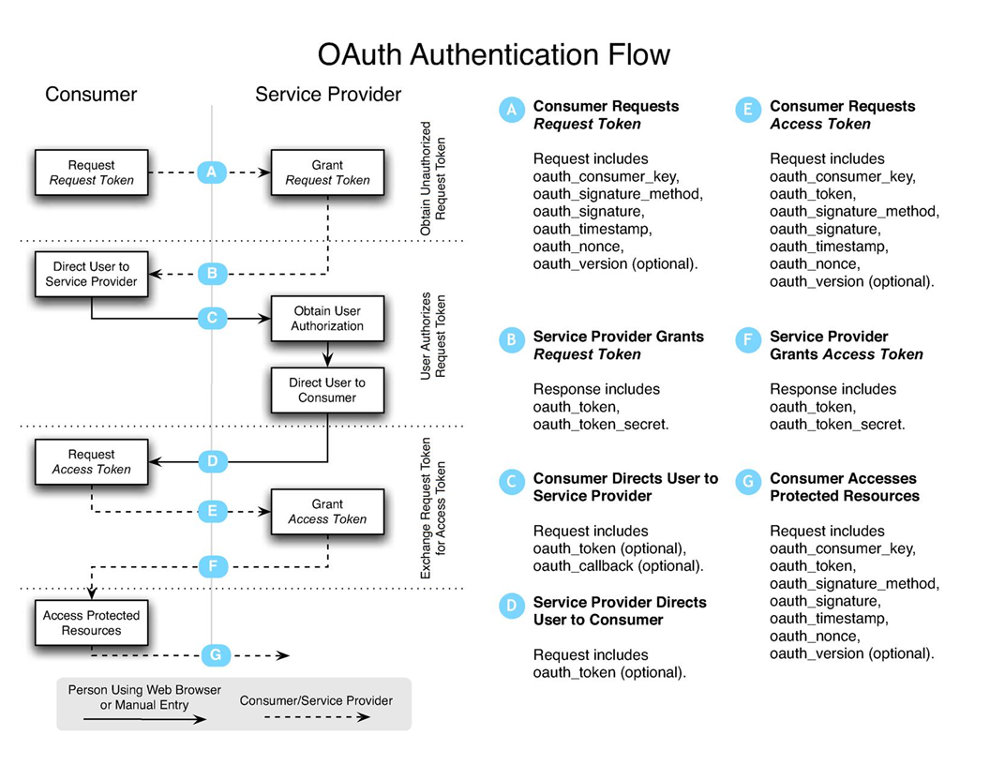
OAuth Protocol Mechanics

Slide 20





Who's Using OAuth?
Various open source client libraries available
Notes:
Google – GData APIs and OpenSocial
MySpace – OpenSocial, Data Availability
Yahoo – Flickr & FireEagle support now, full YOS support in Sept 2008
Various photo sharing sites: SmugMug, PhotoBucket, Flickr
Various tagging / rating sites: Ma.gnolia, GetSatisfaction, Pownce
Various open source client libraries

Slide 21
Summary - OAuth
Enables data portability through a standard authorization protocol
Gaining rapid adoption among service providers (big and small)
Challenges
  Protocol scalability
  IPR / governance ambiguity
Notes:
OAuth provides data portability through a standard authorization protocol
OAuth is gaining rapid adoption among service providers (big and small) – which will drive even more usage
Main challenge remains protocol scalability and IPR / governance ambiguity

Slide 22

What is Live ID?
In their own words ( http://dev.live.com/liveid/ )
“Windows Live ID is the
identity and authentication system
for Microsoft services and its partners”
Notes:
Originally: “Windows Live ID is the identity and authentication system provided by Windows Live.”
Refined version (from Neel/Lynn) - “Windows Live ID is the identity and authentication system for Microsoft services and its partners”

Slide 23
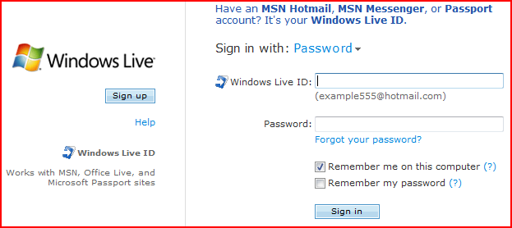

What is Windows Live ID?

Slide 24
What is Windows Live ID?
… the biggest authentication provider on the planet!
  ~ 500 million Active Accounts @ Jun 2008
  200 countries, 35 languages
  ~ 1.2 billion Authentications per day
  Peak traffic is generally 2X normal load
  >~ 99.99% service availability
  > 1 million new accounts created per day
  – a huge number are by spammers ☹
Notes:
Windows Live ID Mission Statement:
Windows Live ID is the industry-leading identity platform for all Microsoft online services and its partners, delivering a secure, trusted, and personalized experience to users on all applications and devices.
Windows Live ID will enable user and developer communities through rich, easy-to-use identity, with ever higher security and lower integration cost.

Slide 25
What is Windows Live ID? (cont)
The authentication provider for all Microsoft’s web properties
But also an identity platform:
  An authentication platform
  A delegation platform
  A federation platform
  A user and service provisioning platform
  The first line of anti-spam defense
All delivered as Software + Services
  Cloud hosted + client SDK libraries
  Two major Live ID feature releases per year
Notes:
Windows Live ID Mission Statement:
Windows Live ID is the industry-leading identity platform for all Microsoft online services and its partners, delivering a secure, trusted, and personalized experience to users on all applications and devices.
Windows Live ID will enable user and developer communities through rich, easy-to-use identity, with ever higher security and lower integration cost.

Slide 26
Live ID - Types of Identities
Principals
User (WLID)
Machine (Device ID)
Machine on behalf of User (linked device)
App (App ID)
App on behalf of User (Delegation)
Types of WLIDs
Passport Account, Hotmail account
EASI (Email as Sign-In) account
Managed namespaces
Federated Accounts
Notes:
Types of User WLID’s
Passport Account, Hotmail account
person @ hotmail.* / live.* / msn.*
EASI (“Email as sign-in") account
Any valid email account
person@yahoo.com
person@myISP.net
Managed namespaces
Custom Domains
Hotmail-hosted email account (@MyDomain.com)
Federated Accounts
@EDU Program
Net-ops Partners
Enterprises

Slide 27
Live ID - High Level Architecture
Consumers
Windows Live ID Service
Browsers
Internet Explorer, Firefox, Safari
Registration
Authentication
Applications
Messenger, Office, Outlook Express,
3rd Party APPS
Windows Live ID interface
(HTTP, SOAP, TCP/IP)
Authorization
Windows Live ID Client SDK
Account Services
Devices
Xbox, MSN TV, phones, pagers
Parental Controls
Trust Provisioning
Services
Web Services
mail.live.com, messenger.live.com
Windows Live ID Server SDK
Federated Identity Authorities
ADFS Servers, Security Token Services speaking WS-Trust
Identity Owners
Personal Domains, ISPs, businesses…

Slide 28
Demo – Live ID Web Authentication

Slide 29
Web Auth Protocol Mechanics
1
Relying party
e.g. yoursite.com
2
7
8
3
end user w/ user agent
4
5
6
Windows Live ID service
Notes:
WebAuth demo – WebAuth SDK sample - http://localhost/webauth/sample/default.aspx
DelAuth demo – DelAuth SDL sample 2 – http://localhost/delauth/sample2/default.aspx
Windows Live Data Interactive SDK - http://dev.live.com/livedata/sdk/

Slide 30
Demo – Live ID Delegated Auth

Slide 31
DelAuth Protocol Mechanics
Application Provider (web site)
Granting consent phase (must be online)
Consent UI (consent.live.com)
Direct user to consent UI
Receive consent token
“Using Consent” Phase (user can be offline)
Send delegation token with API call to resource
Resource Provider (e.g. Windows Live Contacts)
Receive data
Windows Live ID Delegation Service
Send refresh token
end user w/ user agent
Receive new consent token
Notes:
DelAuth demo – Import live contacts to Bebo – http://bebo.com/
DelAuth demo – DelAuth SDL sample 2 – http://localhost/delauth/sample2/default.aspx

Slide 32
Live ID - Integration SDKs
  Smart client applications
  Depth partners web site integration
  Runs on Windows Server OS
  Breadth partners web site integration
  Open source samples in 6 languages – ASP.NET (C# & VB), Java, Perl, PHP, Ruby, Python
Live ID Client SDK
Relying Party Suite (RPS – aka Live ID Server SDK)
Web Authentication SDK (WebAuth)
  Third-party application providers access to Windows Live user’s data
  Open source samples in 6 languages – ASP.NET (C# & VB), Java, Perl, PHP, Ruby, Python
  Includes ASP.NET controls to simplify integration with Live ID / Windows Live:
    Contacts, IDLogin, IDLoginView, SilverlightStreamingMedia
Delegated Authentication SDK (DelAuth)
Windows Live Tools for Visual Studio
Notes:
Live ID Client SDK
Smart client applications
Live ID Relying Party Suite (RPS – aka Live ID Server SDK)
Depth partners web site integration
Runs on Windows Server OS
Live ID Web Authentication SDK (WebAuth)
Breadth partners web site integration
Open source samples in 6 languages – ASP.NET (C# and VB), Java, Perl, PHP, Ruby, Python
Live ID Delegated Authentication SDK (DelAuth)
Third-party application providers access to Windows Live user’s data
Open source samples in 6 languages – ASP.NET (C# and VB), Java, Perl, PHP, Ruby, Python
Windows Live Tools for Visual Studio
Includes ASP.NET controls to simplify integration with Live ID / Windows Live:
Contacts, IDLogin, IDLoginView, SilverlightStreamingMedia

Slide 33
Windows Live ID Federation & Provisioning
Enabling the enterprise…

Slide 34
Why Federate?
Organizations can collaborate without creating or managing lots of new accounts
Partners can include Live Services in their offerings to customer – for example hosted e-mail
Benefits:
  For users – smooth single sign-on (SSO) experience
  For organizations – offer wider range of services to their users at reduced cost
Notes:
Partner can include Live Services in their offerings to customer – for example hosted e-mail
Users benefit - single sign-on (SSO) experience because they enter credentials only once to access resources offered both by their identity provider’s network (for example, account-management services) and by the Windows Live network—sites and services where Windows Live ID provides user authentication.
Organizations benefit by offering services of value to their users, without having to build or manage those services themselves.
A major benefit of federation is the ease with which identities can be created and maintained. Federated Windows Live ID identities are created and updated automatically by means of industry-standard tokens sent from the identity provider to the Windows Live ID service. Thanks to the design of the trust relationship, the identity provider does not need to do any work to set up, maintain, or delete Windows Live ID identities for its users. Windows Live ID automatically creates a mapping between the federated identity and a new Windows Live ID identity when the user first accesses a protected Windows Live service.
Users who discontinue their account with the federated identity provider can no longer sign in with that provider, and so also can no longer access Windows Live services by using their federated identity because no authentication token will be sent to Windows Live ID.

Slide 35



Federated Authentication Flow
Step 1 (Partner Sign-in)
A user sends credentials to the federated partner identity provider. The federated partner’s Security Token Service (STS) generates an IP token and returns it to the user.
User’s IP/STS (Federated Partner)
Windows Live ID IP/STS
Windows Live Service
Step 2 (Windows Live ID Sign-in)
IP token is sent to Windows Live ID.
Windows Live ID STS converts the token from the federated partner to a Windows Live service token.
On the user’s first visit, the Windows Live ID service maps the federated user account to a Windows Live ID unique identifier (PUID) and shadow account.
Windows Live service token
IP/STS token
Windows Live service token
IP/STS token
Personalized content
User name, password
Step 3 (Service Sign-in)
The issued service token is sent to the Windows Live service that the user originally wanted to access.
Client Application

Slide 36
Federation Overview
Federation is a unidirectional or bidirectional trust relationship between organizations
  Authentication assertions from one organization recognized by the other
  Federation involves two parties:
    Identity Provider (IP) authenticates users’ identity accounts
    Resource Provider or Relying Party (RP) permits access to resources in their network
Based on WS-* standards – especially WS-Federation / WS-Trust
Easy partner on-boarding is more than just standard protocols
  Squatters, account merge, trust provisioning, realm discovery UX
Shadow account creation makes federation invisible to Microsoft services
Notes:
Federation is a trust-based agreement between two organizations with some common purpose, such that both want authentication assertions from one organization to be recognized by the other.
Federation involves two parties:
The identity provider authenticates users’ identity accounts so that those users can access resources in third-party networks.
The resource provider permits identities authenticated by an identity provider to access resources in its network.
This trust relationship can be unidirectional or bidirectional. Windows Live ID is capable of playing either role.
Federation allows partners to give their users access to Live Services
Partner is identity provider – for example your ISP
Partner can include Live Services in their offerings to customer – for example hosted e-mail
Based on WS-* standards and extended to Service Scenarios:
Automated trust provisioning – WS-Fed extension
Batch request optimization to reduce roundtrip – WS-Trust extension
Forced sign in, sign-in security level (strong password, pin) – SAML extension
Easy partner on-boarding is more than just standard protocols
Realm discovery to route authentication to the right provider & cache for subsequent visits
Cleanup namespace - Evict squatters
Support certificate rollover: store two versions of certs
Shadow account creation makes federation invisible to Microsoft services:
Create PUID / shadow account on the fly
UPN in foreign token as the account name and store email name
E-mail name is member name to Live service, rename on the fly if e-mail name changes
Backwards compatible with existing services: auth tokens look the same for fed and WLID users
Linking with WLID leverages user’s existing investment in Live for best UX
Account merge: if account has the same name (EASI) merge and keep the PUID for data access
Link to a different Live ID
Divorce: Accruing data for password reset allows Microsoft to keep users when they leave the federated partner

Slide 37
Service Provisioning Framework
Problem
  Incrementally provision specific services for a user (e.g. pre-create an inbox)
Solution
  SPF – Service Provisioning Framework
  Scalable system to 100s of millions of users
  Fully data driven to reconfigure service offering and business rules
  Simple on-boarding for net-ops through Windows Live Syndication Central
Notes:
Scenario/Requirement
CreatePassport() API can also provision services that the user has signup for. (e.g., pre-create inbox so that an welcome email can be sent)
Service offering changes over time:
new services can be added;
an offer can be time bound (eg. free trial for 2 month);
existing users need to retroactively add new services;
a user might convert from one offer to another.
When a user leaves an service offering, the system must de-provision
Solution
Scalable system to 100s of millions of users
Fully data driven to reconfigure offer and business rules
Simple on-boarding for net-ops through Windows Live Syndication Central

Slide 38
Summary – Windows Live ID
The biggest identity provider on the planet!
… but Live ID platform is much more than just the familiar login box
Various types of users and various authentication models are supported
Increasing focus on enabling federation and enterprise access to online services
Ease-of-use is always the goal
..... and the challenge!

Slide 39

Bringing it all together

Slide 40
Not to be compared …
Open ID & OAuth are Standards
  … still evolving and under development
Live ID is a SERVICE (based on standards)
  Identity Provider
  Identity Federation
  Federation Broker
  Delegation
  ... with proven scaling for 500MM users, 1.2BN auths/day
Trust Provisioning
Service Provisioning
Account Management
Parental Controls
Notes:
A good talking point –OpenID (and to some extent OAuth) are driven by communities of enthusiasts. While the enthusiasts drive a lot of noise, they don’t necessarily have a huge stake in the game, nor are they bound to deliver solutions that work at scale in the real world. Most have experiences of supporting a few million users at most.
In contrast, Live ID is driving huge scale solutions in the real world.
It is expected that OpenID and OAuth will need to adapt to the real world considerations before broad adoption (of sites that actually matter) can occur.

Slide 41
But if you must compare ….
Open ID is similar to
  Live ID Relying Party Suite (RPS)
  Live ID Web Authentication (WebAuth)
OAuth is similar to
  Live ID Delegated Auth (DelAuth)

Slide 42
Summary
Good authentication is secure but unobtrusive
Ease-of-use is the goal & the challenge
Live ID Vision: Identity without borders
Specs are “easy”, but scale is hard
Notes:
Good authentication is secure but unobtrusive
The less you notice security steps the better provided they still keep you secure
Ease-of-use is the goal and the challenge – Geeks vs Grandma’s
URI’s are good for Geeks but bad for Grandmas
Specs are “easy”, scale is hard
Live ID Vision is “Identity without borders”
In the end, it’s all about the data!

Slide 43
Resources
External: http://Dev.Live.com/LiveId
Internal: http://LiveId
DL: Windows Live ID Discussion (wliddisc)

Slide 44
Questions?
© 2008 Microsoft Corporation. All rights reserved.
This presentation is for informational purposes only.
Microsoft makes no warranties, express or implied, in this summary.

