Slide 2
Connecting Active Directory To Cloud Services
Session Code: IDA306
Jorgen Thelin
Senior Program Manager
Microsoft Corporation
Notes:
Do you find “could services” scary?
- More work
Less control

Slide 3
Agenda
Connecting Active Directory To Cloud Services
Identity Challenges from Cloud Services
Microsoft Services Connector
Microsoft Federation Gateway
Next Steps

Slide 4

Microsoft Identity Software + Services
One identity model that puts users in control of their identities
Flexibility via Choice
Enhances Productivity
Standards Based
Live Identity Services
Microsoft Federation Gateway
.Net Access
Control
Service
Services
Claims-Based Access
“Geneva” Server
Microsoft Services Connector
Windows CardSpace “Geneva”
“Geneva” Framework
Live Framework
Software
Active Directory
Notes:
SLIDE FOR EVERY MICROSOFT IDENTITY DECK

Slide 5

Identity Challenges
Services Revolution
Different security zones
  Intranet
  Traveling employees
  Partner extranet
  Internet
Multiple islands of identity
  Your organization
  Partners
  Customers
Less
More work for
Sys Admins
Identity can be a barrier
enabler with federation

Slide 6
Federated Ecosystem
Benefits from making federated identity work
Open participation -- based on industry standards
  WS-Federation / SAML
Linking service providers and service consumers
Access to more customers:
  Windows Live ID users
  Other organizations using federated identity
Access to more service / application providers:
  Microsoft cloud applications
  Developers using Azure Services Platform
  Developers using other hosting platforms

Slide 7
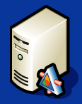

Switching to Cloud Services
Cloud
Enterprise
Apps
ISV App
Windows Live
Microsoft Online
Live Identity Service
Live
Mesh
Microsoft Dynamics CRM Online
Azure Services Platform
Challenge: How to switch to cloud
services without scrapping your existing identity infrastructure?
Typical IT Requests:
Outsource service to cloud-based delivery
Move application to cloud hosting
Use a new cloud-service
Enterprise On-Premises
Active Directory
Exchange
ISV App
SharePoint

Slide 8
Federated Identity Relationships
Point-to-Point
Fabrikam Inc.
Customer
Customer
Customer
Fabrikam Services
Service
Provider
Service Provider
Service Provider
Work, work, work! Work, work, work!

Slide 9
Federated Identity Relationships
Hub and Spoke
Fabrikam Inc.
Customer
Customer
Customer
Federation Hub
Federation Hub
Fabrikam Services
Service
Provider
Service Provider
Service Provider
Businesses federate once to connect to any service
Services providers federate once to connect to any business

Slide 10
Solution: Easy Federated Identity
Microsoft Federation Gateway
Microsoft Services Connection
Hub and spoke model
  → simplified
  trust management
  for enterprises
  & service providers
Production deployment since 2006
Now supports self-service federation provisioning
Connects Active Directory
to Federation Gateway
and Cloud services / applications
Simple 1-time federation setup – auto-provisioning
Flexible and customizable
end -user experience
Free download
Objective: Switch to cloud services without changing
your existing identity infrastructure

Slide 11

Federated Enterprise Software & Service Topology
Cloud
Enterprise
Apps
ISV Apps
Windows Live
Microsoft Online
Live Identity Service
Microsoft Federation Gateway
Live
Mesh
Microsoft Dynamics CRM Online
Azure Services Platform
Microsoft
Services
Connector
Enterprise On-Premises
Browser
Office
Active
Directory
Employee
Apps
Exchange
ISV Apps
SharePoint

Slide 12
Microsoft Services Connector
demo
Installation & Setup
Notes:
Talking Points - Services Connector Setup Demo
Access Control -- Microsoft Services Connector allows IT admins to control who accesses cloud services and what data is shared about those users with the services they access
Simple and Easy -- Setting up Microsoft Services connector takes just 2 steps and about 5 mins of your time – it’s simple and it’s easy.

Slide 13
Microsoft Services Connector
Setup
  Connects Active Directory to Federation Gateway
  and Cloud services / applications
  One-time federation setup – auto-provisioning
    Domain ownership proved with SSL certificate from trusted CA
    Registers enterprise domain, sign-in endpoint, and signing key(s)
  On-going federation management tasks automated
Microsoft
Services
Connector
Microsoft Federation Gateway
Cloud
Enterprise
Applications
Active
Directory
Developer Services
Server Apps

Slide 14
Microsoft Services Connector
demo
Accessing federated resources
from inside corporate network
Notes:
Talking Points - CorpNet Client Demo
Seamless access from CorpNet -- With Microsoft services Connector, once I log in to my corporate network, I have seamless, 1 click access to all the Microsoft services hosted in the cloud. It’s Simple. And it’s easy.

Slide 15
Microsoft Federation Gateway
Accessing Services
  User clicks link -- taken to Microsoft Services Connector for authentication
  Services Connector validates credentials with Active Directory
  Services Connector issues login token and redirects to Federation Gateway
  Federation Gateway validates token and transforms claims
  Federation Gateway issues service token and redirects to service
  User accesses service
Browser
Office
Desktop
Apps
Microsoft
Services
Connector
Microsoft Federation Gateway
Cloud
Enterprise
Applications
Active
Directory
Developer Services
Notes:
Flexible and customizable end-user experience

Slide 16
Microsoft Federation Gateway
Info for enterprises:
  Microsoft Services Connector
    Built on core “Geneva” technology
    Upgrade path to “Geneva” Server
  Works for businesses without AD – BYO (Bring Your Own)
  Protocols: WS-*, SAML later
  Tokens: SAML
Info for relying services:
  Frameworks: .NET, “Geneva”, Live
  Messaging: WS-*, SAML , Live
  Tokens: SAML, Live

Slide 17
Microsoft Services Connector
demo
Accessing federated resources
from outside corporate network
Notes:
Talking Points - Outside CorpNet Client Demo
Inside and Outside CorpNet -- Microsoft Services Connector supports accessing cloud services from computers inside and outside my corporate network
Multiple Credential Types -- Connector supports various forms of authentication in the Extranet – UN/PWD, Certificate, and Information Cards
Web Browser and Smart Client -- Connector supports accessing cloud services using both web browsers and smart client applications like Live Mesh
Simple and Easy Access -- With Microsoft Services Connector, the user experience of accessing a service in the cloud from outside my corporate network is simple and it’s easy.

Slide 18
Deployment Options
Active
Directory
Microsoft
Services
Connector
Services
Connector
Proxy
External
user
Internal
user
Enterprise
DMZ
Range of network infrastructures:
Single server, Server farm, Proxy server
Active Directory: Single domain, Single forest, Multiple forests
Notes:
Proxy server in DMZ
Multi-server options – shared config
Built on core “Geneva” technology
Upgrade path == “Geneva” Server

Slide 19
Benefit: Reduced Federation Costs
Federation Gateway & Services Connector provides:
  Fewer federation relationships to configure
  Protects corporate account security
  No new user accounts needed
  No extra passwords for users to forget!
→ Happier systems administrators! ☺

Slide 20
How You Get It
Microsoft Services Connector
  Community Tech Preview (CTP) available now: http://www.microsoft.com/servicesconnector
  Beta in early 2009
Microsoft Federation Gateway
  Already in Production since 2006
  Whitepaper: http://go.microsoft.com/fwlink/?LinkID=111692
  Easy 2-step on-boarding with Microsoft Services Connector
  BYI on-boarding document: http://go.microsoft.com/fwlink/?LinkID=131673
We want your feedback!
  CTP Feedback Forum: http://connect.microsoft.com/servicesconnector

Slide 21
Summary
Call-to-action
Federated identity makes switching to Cloud services easier:
  Microsoft Federation Gateway for federation of both enterprises and services
  Microsoft Services Connector extends AD into the Cloud - just a 2-step on-boarding process
Try the Microsoft Services Connector CTP now
& sign up for early 2009 Beta release

Slide 22
Q & A
Notes:
SPEAKERS PLEASE NOTE: our standard timing for your availability for Q&A at the Ask-the-Experts pavilion will be the next lunch-break following your session, and variations from this standard will be scheduled based on your availability and for all Friday afternoon sessions.

Slide 24
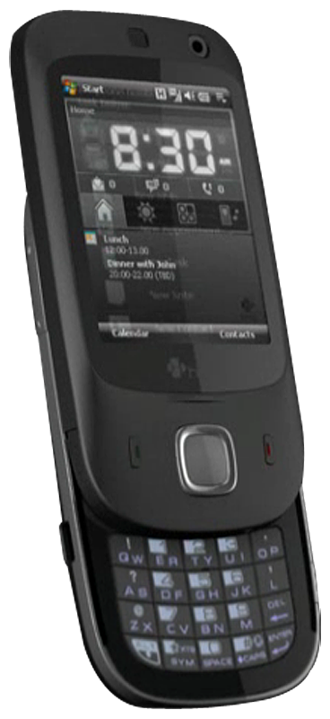
Now extended from
2 to 24 hours after session
for more chance to WIN
Don’t forget to complete
your session feedback forms via the CommNet terminals
or the Registered Delegate Pages for your chance to
win a HTC Touch Dual!
With an amazing line up of international speakers, there are even more chances to win an evaluation prize! So make sure you submit feedback for all the sessions you attend!
http://www.microsoft.com/emea/teched2008/itpro/feedback.aspx

Slide 25

© 2008 Microsoft Corporation. All rights reserved. Microsoft, Windows, Windows Vista and other product names are or may be registered trademarks and/or trademarks in the U.S. and/or other countries.
The information herein is for informational purposes only and represents the current view of Microsoft Corporation as of the date of this presentation. Because Microsoft must respond to changing market conditions, it should not be interpreted to be a commitment on the part of Microsoft, and Microsoft cannot guarantee the accuracy of any information provided after the date of this presentation. MICROSOFT MAKES NO WARRANTIES, EXPRESS, IMPLIED OR STATUTORY, AS TO THE INFORMATION IN THIS PRESENTATION.

