Slide 1
Making Sense of Web Services and Microsoft’s Roadmap
Jorgen Thelin
Connected Systems Division
Microsoft Corporation

Slide 2

Interoperability
Applications working together
  Different platforms
  Different languages
  Different companies
  Different versions

Slide 3
Microsoft’s Commitment to Interoperability
Bill Gates’ Executive E-mail - Building Software That Is Interoperable By Design – 03-Feb-2005
    http://www.microsoft.com/mscorp/execmail/2005/02-03interoperability.asp
  “However, the definition of well-designed [WS-*] protocol architecture is just part of the challenge.
  As part of this collaborative effort, Microsoft and other companies have invested significant resources to ensure that Web services implementations from different companies really are interoperable.
  This has involved industry workshops, extensive testing, revision of specifications in the face of experience, and even setting up an industry body known as WS-I to help ensure interoperability.”
Notes:
The commitment to interoperability goes right to the top at Microsoft.
This deck is the story of how Microsoft is achieving interoperability for the WS-* specs.
Interoperability yields significant benefit to customers.

Slide 4
Microsoft’s Strategy for Interoperability
Open, Interoperable Protocol Framework – WS-*
  Invest in WS-* for Service Orientation
  Ensure all the pieces work together
  Enable WS-* interoperability with industry partners
Easy to use development platform – Indigo
  Adopt WS-* as the underlying wire format
Easy to use development environment – Visual Studio
  Facilitate design and deployment of distributed web services applications
Distributed IT infrastructure
  Systems Management, Connected Devices, Identity Management
User Experience
  Office/InfoPath, InfoCard

Slide 5
Web Services Architecture
Application
App
App
App
Indigo
Contracts
WSE
Other
MSFT
Other
Stack
Data
Contract
Message
Contract
Service
Contract
Policy and
Binding
Service Runtime
Metadata
Behavior
Instance
Behavior
Error
Behavior
Inspection
Facilities
Transaction
Behavior
Throttling
Behavior
Activation
Behavior
Concurrency
Behavior
Cmd/Control
Facilities
Messaging
SOAP Security
Channel
HTTP
Channel
UDP
Channel
Text/XML
Encoder
SOAP Reliability
Channel
TCP
Channel
X-Proc
Channel
Queue
Channel
Binary
Encoder
Activation and Hosting
WAS
Avalon
*.EXE
NT Service
COM+
WS-* Protocols
Infrastructure
and Profiles
Metadata
WS-Federation
WS-Management
Devices
Profile
Network
Assurances
WS-Secure
Conversation
WS-Business
Activity
WS-Metadata
Exchange
WS-Trust
WS-Atomic
Transaction
UDDI
WS-Security
WS-Reliable
Messaging
WS-Coordination
WS-Policy
Messaging
WSDL
SOAP
WS-Addressing
MTOM
XML Schema
Foundation
XML Infoset
XML 1.0
XML
Namespaces
MIME
SOAP / HTTP

Slide 6
What is WS-*?
A protocol framework
  Layered, factored, composable, extensible
Interoperability baked in
  XML, HTTP, URI
Uniform data model – XML Infoset
Metadata-driven
  Self describing and dynamic
Collaborative engineering process
  Quality, time to market, industry support
Notes:
We could have designed this in a few different ways
A key design decision was the framework approach to protocols – XML and SOAP give us a natural way to do this. We publish different parts of the architecture separately, but they MUST be usable together (i.e. compose) – great care is placed here
Uniform data model lets us route on headers and bodies in a symmetrical way – architecture can operate on itself
Interop – WS is layered on top of and borrows from the most successful web protocols
The whole architecture support the dynamism described in the requirements – matching req’s to capabilities

Slide 7
WS-* 101
Endpoints send messages that conform to contracts
  Application messages and/or
  Infrastructure messages and headers enable security, reliability, transactions, ...
Endpoints are described with metadata
  Address on the “network”
    URL or Endpoint Reference
  Binding capabilities and requirements
    Policy
  Contract for structure and behavior
    WSDL and XML Schema

Slide 8
WS-* Architecture
Profiles and
Infrastructure
Metadata
WS-Federation
WS-Management
Devices
Profile
WS-Metadata
Exchange
Assurances
WS-Secure
Conversation
WS-Business
Activity
WS-Discovery
WS-Trust
WS-Atomic
Transaction
UDDI
WS-Security
WS-Reliable
Messaging
WS-Coordination
WS-Policy
Messaging
WS-Transfer
WS-Enumeration
WS-Eventing
WSDL
SOAP
WS-Addressing
MTOM
XML Schema
Foundation
XML Infoset
SOAP / UDP
XML 1.0
XML
Namespaces
MIME
SOAP / HTTP

Slide 9


WS-* Specifications Process
Step 1
Initial
Development
Step 2
Broader
Community Participation
Step 3
Standardization
Step 4
Profiling
Idea
Feedback and Interop Workshops
Specification Published
Revise spec
Standards Org
WS-I
Increasing Industry Participation
Process reconciles conflicting goals
Quality of engineering
Time to market
Breadth of industry support
Notes:
Path: Publish specs, gather feedback through workshops, demonstrate interoperability, build tools and implementations, take to a standards body
Step 1 – Develop
Small number of aligned companies
Work privately on an idea
Step 2 – Broader Participation
More companies participate
Gather Feedback
Prove Interop
Step 3 – Standardization
Spec submitted to standards org (W3C / OASIS / etc)
WG finalizes & ratifies
Step 4 – Profiling
Spec profiled as a basis for broad implementation (e.g. WS-I Basic Profile for SOAP/WSDL/UDDI, WS-I Basic Security Profile for WS-Security)
Call to action: Provide feedback through the WS-* Workshop Process
http://msdn.microsoft.com/webservices/community/workshops/

Slide 10
80+ WS-* Workshop Participants
Actional | Fujitsu | Newisys | Sharp Labs
AMD | Grand Central | Nokia | Siebel
American Megatrends | Hewlett-Packard | Oasis Semiconductor | Software AG
ANL | IBM | Oblix | Sonic Software
Apache Project | iDesign | OPC Foundation | Sun
Axalto | Intel | OpenNetwork | Systinet
BEA | Intermec | Oracle | Tibco
Blue Titan | Iona | OSA Technologies | Toshiba
Boeing | IPO Group | Peerless | Tyco Safety Systems
Brother | Jboss | Ping Identity | Univ of Sydney
Canon | JibxSoap | Printronix | VeriSign
Choreology | KnowNow | QuickTree | Veritas
CommerceOne | Layer 7 Tech | Quovadx | Visa
Computer Associates | Lexmark | Reactivity | Vitria
Content Guard | Lockheed Martin | Ricoh | WRQ
Cornell University | Microsoft | Roxio | webMethods
Dell | Motive | RSA Security | WSO2
Epson | NEC | SAP | Xerox
Exceptional Innovation | NEON | Schneider Electric | Zoran
Feature Software | Netegrity | SeeBeyond | Unaffiliated
Notes:
Total of 80 different companies as of May 2006 have been actively involved in the WS-* Workshop Process.
We’ve had to use a small font because there is a lot of data!

Slide 11
WS-* Spec Status
Step 2 – Workshops & Community Dev
Step 3 – Standardization
Step 4 – Approved Standard
Infrastructure
and Profiles
Metadata
WS-Federation
WS-Management
Devices
Profile
WS-Metadata
Exchange
Assurances
WS-Secure
Conversation
WS-Business
Activity
WS-Discovery
WS-Trust
WS-Atomic
Transaction
UDDI
WS-Security
WS-Reliable
Messaging
WS-Coordination
WS-Policy
Messaging
WS-Transfer
WS-Enumeration
WS-Eventing
WSDL
SOAP
WS-Addressing
MTOM
XML Schema
Foundation
XML Infoset
SOAP / UDP
XML 1.0
XML
Namespaces
MIME
SOAP / HTTP
Notes:
Shows the progress of each spec through the development process towards standardization.
Different WS-* specs are at different stages in the WS-* Workshops process, but all are progressing.

Slide 12
Delivering WS-* - Microsoft
Microsoft is delivering implementations of all WS-* specs
  WSE 2.0 / 3.0
    Interim coverage of evolving security and policy specs
  Indigo
    Full coverage of all SRTP Advanced Web Services specs
      Security
      Reliable Messaging
      Transactions
      Policy
  Windows Server 2003 Release 2
    WS-Management stack for interoperable system management
  Windows Longhorn
    WS-Devices stack for printer and networked device connectivity
Notes:
Key message: Microsoft is delivering on all WS-* specs across the board.
SRTP = Secure, Reliable, Transacted Web services with Policy
WS-Management stack includes implementations of WS-Eventing, WS-Enumeration and WS-Transfer
WS-Devices stack includes implementations of WS-Eventing, WS-Discovery and WS-Devices Profile
Printing in Longhorn uses WS-* protocols end-to-end.
Whidbey
SOAP 1.1/1.2, WSDL 1.1, UDDI v2, BP 1.0
Indigo
+= WS-Addressing, MTOM
+= WS-Policy, WS-MetadataExchange
+= WS-Security, WS-Trust, WS-SecureConversation
+= WS-ReliableMessaging
+= WS-AtomicTransaction, WS-Coordination
+= BSP 1.0

Slide 13




Microsoft WS-* Product Roadmap
Windows
Server
2003
“R2”
Wave
Longhorn
Wave
VS2003 + Web Services
Enhancements (WSE) 2.0
SOAP 1.1
WSDL 1.1
WS-Addressing 2004/03
WS-Security 1.0 (U/P, X509, Kerberos)
WS-Secure Conversation 2004/04
WS-Trust 2004/04
WS-Policy based
VS 2005 + WSE 3.0
SOAP 1.1, 1.2
WSDL 1.1
MTOM
WS-Addressing 2004/08 (or REC)
WS-Security 1.0
(U/P, X509, Kerberos)
WS-Secure Conversation
WS-Trust
WS-Policy based
Limited wire Interop with WSE 2.0
AD Federation Services in R2
Cross-organizational Identity Federation
Web SSO
SQL Server 2005
SOAP 1.1,1.2
WSDL1.1
WS-Security 1.0
Management
WS-Management
Indigo
Wire-level interop with WSE3.0
In addition:
MTOM
SAML Token Profile 1.0
Security Policy
WS-Federation Active Client
- Enables easy to build STS
WS-RM 2005/02, Policy
WS-AT/WS-C 2005/02, Policy
WS-Policy/PolicyAttachment
WS-MEX
Easy to use Digital Identity / InfoCard
Active Directory: Federation
WSD API: Device Profile
Notes:
This slide shows more details of the timescales and protocol versions that Microsoft will be delivering in the near future.

Slide 14
WS-* - Industry Adoption
WS-D
DPWS
Devices
Microsoft | ✓ | ✓
Intel |  | 
Canon |  | 
BEA | A
WebMethods | A
Ricoh |  | 
Epson |  | 
HP |  | 
Xerox |  | 
Fuji-Xerox |  | 
Brother |  | 
Toshiba |  | 
Exceptional Innovation |  | 
Peerless |  | 
Schneider |  | 
Systinet | 
gSOAP | ✓
Lexmark |  | A
WS-RM
WS-SecureConv
Assurances
WS-AT
SOAP / WSDL
WS-Security
WS-Trust
Messaging
MTOM
WS-Fed
Microsoft | ✓ | ✓
IBM | ✓ | ✓
BEA | ✓ | A
Cape Clear | ✓
Systinet | ✓
Blue Titan | ✓
Rogue Wave | 
Sonic | ✓
IONA | ✓ | ✓
JBoss |  | ✓
Choreology |  | ✓
Apache | ✓ | ✓
Tibco | 
Security
Microsoft | ✓ | ✓
IBM | ✓
BEA | ✓
SUN | ✓ | 
Google | ✓
Amazon | ✓
eBay | ✓
Apache | ✓ | ✓
Whitemesa | ✓ | ✓
gSOAP | ✓ | ✓
Ricoh | ✓ | 
Epson | ✓ | 
HP | ✓ | 
Xerox | ✓ | 
Fuji-Xerox | ✓ | 
Intel | ✓ | 
Canon | ✓ | 
Microsoft | ✓ | ✓ | ✓ | 
IBM | ✓ |  | ✓ | ✓
BEA | ✓ |  |  | A
RSA | ✓ |  |  | A
Systinet | ✓ |  | 
Apache | ✓ |  | 
Layer7 | ✓ | A | ✓
DataPower | ✓ |  | ✓
CA | ✓ | A | A
SUN | ✓
SAP | ✓
Tibco | ✓
IONA | ✓
WebMethods | ✓
Nokia | ✓
Cape Clear | ✓
Sonic | ✓
gSOAP | ✓
Ping ID |  | A | ✓ | ✓
Netegrity |  | A | A | 
Verisign |  | A | A | A
OpenNetwork | A | A | A | 
Oracle/Oblix |  |  |  | 
Metadata
MEX
WS-P
Microsoft | ✓ | ✓
IBM | A | 
BEA | A | ✓
SAP | A | 
Sun | A | 
Verisign |  | A
Sonic |  | ✓
Layer 7 |  | 
Apache |  | 
CA | A
WebMethods | A
Systinet |  | ✓
gSOAP |  | ✓
WS-XFer / Enum
Mgmt
WS-M
Microsoft | ✓ | ✓
Intel |  | 
Sun |  | 
Dell |  | 
AMD | A
CA |  | A
Sonic |  | A
gSOAP |  | ✓
Systinet |  | A
WEBM |  | 
NetIQ |  | 
✓ | Released product
 | Public interop
A | Co-Author Only
© 2003-2006 Microsoft Corporation. All rights reserved. The information contained in
this document represents the current view at the time of publication and is subject to change.
Notes:
Many other vendors are also implementing WS-* specs in their products.
A very busy slide, but illustrates the breadth and depth of industry support for WS-* specs.
Data collected from attendance at WS-* Interop Workshops, public demos and/or product datasheets / announcements.

Slide 15
Messaging
SOAP
XML-based message format with simple extension model and support for relays
WS-Addressing
SOAP-based addressing and dispatch
MTOM
Hybrid XML / binary format for SOAP
(a.k.a. “attachments”)

Slide 16
Secure
WS-Security
End-to-end security in the face of relays requires more than transport-level security
WS-Trust
Issuing tokens based on credentials
WS-Secure Conversation
Session-based tokens to reduce per-message crypto costs

Slide 17
Reliable and Transacted
WS-Reliable Messaging
End-to-end delivery assurances in the face of relays requires more than transport protocol
WS-Coordination
SOAP-based multi-party protocols
WS-Atomic Transaction
SOAP-based two-phase commit
WS-Business Activity
SOAP-based workflow and compensation

Slide 18
Metadata
WSDL
Description of service contract
WS-Policy
Parameterized assertions about service capabilities and requirements
WS-Metadata Exchange
SOAP-based inspection of a service’s metadata
UDDI
SOAP-based registry service lookup

Slide 19
Profiles and Infrastructure
Basic Profile 1.0/1.1
Simple SOAP messaging, description, and discovery
Basic Security Profile 1.0
Simple transport and SOAP message security
Devices Profile
SOAP-based discovery, description, control, and eventing of devices
WS-Management
SOAP-based management of computing systems
WS-Federation
SOAP-based identity management

Slide 20
Profile Recipe: Staple, Redline, Glue
SOAP 1.2
WS-Addressing
“Staple”
  Pull relevant specs into scope
“Redline”
  Add constraints on use of those specs
“Glue”
  Define missing bits between specs
  Some will migrate back into specs
WS-Metadata Exchange
WSDL 1.1
WS-Discovery
WS-Eventing
Conformance
Claim
Action
Filter
ThisModel
Metadata
ThisDevice
Metadata
Policy
Assertions
Policy
Assertions

Slide 21
Basic Profile 1.0 / 1.1
Conformance claim
SOAP 1.1
  Faults
  EncodingStyle
HTTP/1.1
  POST
  SOAPAction header
  2xx, 3xx, 4xx, 5xx responses
  Cookies
WSDL 1.1
  1-way / req-resp
  <= 1 child of Body
  Unique input Body
  type vs element
  document/rpc literal
  Faults
  Extensibility
UDDI v2
  tModels
Notes:
[pcotton] The BP material for SOAP 1.1 merely reverse engineers the changes from SOAP 1.2 back “onto” SOAP 1.1.

Slide 22
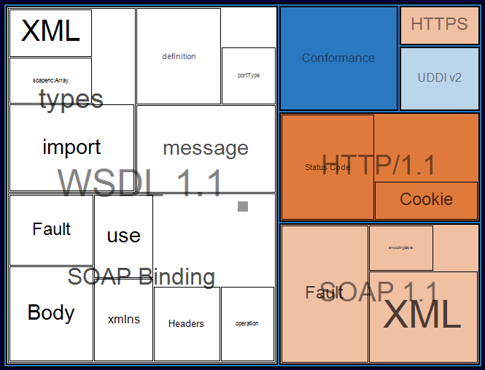
Basic Profile 1.0

Slide 23
Basic Security Profile 1.0
SSL 3.0 / TLS 1.0
  Cipher suites
WS-Security 1.0
  Reference, embed tokens
  Timestamps
Security tokens
  Username Token
    Compute digest
  X509 Token
    Certificate path
  SAML
  REL
XML Signature
  Detached signature
  Key info
  Reference signed content
  Canonicalization
  Digest and sig algs
XML Encryption
  Reference list
  Encrypted key, data
  Encryption algs

Slide 24
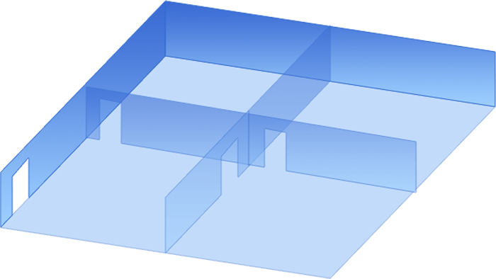






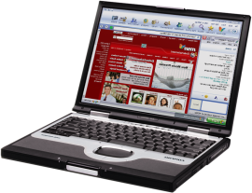
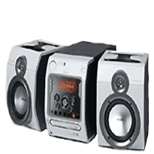







Devices Profile for Web Services

Slide 25
Devices Profile
Protocol
Protocol
Protocol
DMR
Commands
IGD
Commands
Print
Commands
DMR
Events
IGD
Events
Print
Events
DMR
Capabilities
IGD
Capabilities
Print
Capabilities
Metadata
WS-Metadata
Exchange
WS-Discovery
Device
Extensions
WS-Policy
Assurances
WS-Security
TLS
BP 1.1 Sec. 4
Messaging
WS-Eventing
WSDL
SOAP
WS-Addressing
MTOM
XML Schema
Foundation
XML Infoset
SOAP / UDP
XML 1.0
XML
Namespaces
MIME
SOAP / HTTP

Slide 26
WS-Management
Consistent management of multi-vendor systems
  Basic operations across compliant platforms
  Basic operation across OS states
Scale down
  Support low-footprint management controllers
Support operations in DMZ
  Use firewall-friendly transports
Data model neutral
  Map to existing Common Information Model (CIM)
  Support new System Definition Model (SDM)
Inspection of management resources
  Network discovery is out of scope

Slide 27
WS-Management
Management
Extensions
CIM to XML
Assurances
Metadata
TLS
BP 1.1 Sec. 4
Messaging
WS-Transfer
WS-Enumeration
WS-Eventing
WSDL
SOAP
WS-Addressing
MTOM
XML Schema
Foundation
XML Infoset
XML 1.0
XML
Namespaces
MIME
SOAP / HTTP

Slide 28
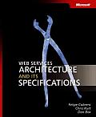
Resources
L. Cabrera, et al,
“Web Services Architecture
and Its Specifications”, Microsoft Press
MSDN Links
  MSDN Web Services Developer Center
    http://msdn.microsoft.com/webservices/
  WS-* Specifications index page
    http://msdn.microsoft.com/webservices/understanding/specs/
  WS-* Workshop Process Overview
    http://msdn.microsoft.com/library/en-us/dnwebsrv/html/wkshopprocess.asp
  WS-* Workshops home page
    http://msdn.microsoft.com/webservices/community/workshops/
  Microsoft Interoperabilty home page
    http://www.microsoft.com/interop

Slide 29

© 2005 Microsoft Corporation. All rights reserved.
This presentation is for informational purposes only. Microsoft makes no warranties, express or implied, in this summary.

