Slide 1
LinuxWorld Conference & Expo
Server Farms
and
XML Web Services
Jorgen Thelin, CapeConnect Chief Architect
PJ Murray, Product Manager
Cape Clear Software
Notes:
Who am I & Who are CapeClear ? Bio:
A Principal Engineer for CapeClear Software. I have had a leading technical role in development of CapeClear's Web Services platform, CapeConnect and Web Services development environment, CapeStudio.
My current role as Web Services consultant includes writing articles on web services, presenting to technical and business audiences and developing web service Proofs of Concept. I presented a session at JavaOne2002 on Composite Web Services.
Cape Clear Software (http://www.capeclear.com/) has one focus: creating Web Services technology that reduces the business costs of software development and integration. CapeConnect is a Web Services based platform for enterprise integration that is simple, fast, and cost-effective to deploy and maintain. CapeStudio is an integrated Web Services development environment, simplifying design, development, integration, and deployment of Web Services applications using XML, WSDL, and UDDI.
Cape Clear's products link packaged business applications, such as ERP and CRM, and diverse technologies, such as Java, J2EE, CORBA, and Microsoft .NET, across intranets and the Internet. Founded in 1999, Cape Clear is a privately held firm with offices in Dublin, London, California, Colorado and Massachusetts.
Any more general or esoteric questions I’ll take at the end or ask me after the session.

Slide 2
Objectives
What aspects must a developer be aware of when a Web Services will be run in clustered environment such as a server farm?
Do Web Services implementations need to be "cluster aware", or can this be handled transparently by the runtime platform?
We revisit the subject of why keeping Web Services implementations as stateless as possible really helps in these circumstances, and the effect of using session-based facilities on scalability.
Notes:
I’ll talk about (1) Server Farms and clustering in general , (2) Web Services, (3) Tying them together we’ll look at architectures for clustering web service implementations.

Slide 3
Basic Definitions
Server Farms are loosely coupled clusters of hardware, networks, and software
Web Services are software components with a well defined XML interface that can be incorporated in a distributed application – Based on Standards
Notes:
5 mins in.
Careful not to restrict my definition to hardware & networks – it’s the software that
Makes the clustering work after all.
I’m assuming a conceptual understanding of clustering or fault tolerance.
Not assuming much knowledge about web services – material will be introductory.

Slide 4
Why cluster?
High Availability
  Transparent backup and failover, redundancy of systems
  Cheaper than tightly coupled multiprocessor system
Parallel processing/Performance
  E.g. Beowulf
Server Integration
  Different servers perform different tasks
    For example, WAS – Web Application Server
Notes:
Clustering has a cost. Why do it ?
HA: Linux initiatives have made this possible & cheap.
8, 16 way servers tend toward becoming expensive.
Parallel processing for problems that are computationally difficult enough to be partitioned. Classical examples are finite element analysis : weather modelling and other fluid dynamics problems like turbulence modelling. Beowulf class parallel computers or clusters.
MIMD (Multiple instruction multiple data). Built entirely from Linux machines – exploiting fast networking that can simulate a multiprocessing architecture. Standardising on MPI (Message passing interface) and PVM (Parallel Virtual Machine) message passing libraries.
Pj: Server Integration : Composite function : as in one web server,
one request processing server and perhaps an authentication server.
Sun’s ONE Server (aka iPlanet).

Slide 5
Why cluster?
Scalability
  More scalable than multiprocessor systems
  Capacity on demand possible
Automated cross-platform system management
Failover and back-up
Load Balancing
  E.g. Linux Virtual Server project
Notes:
These are all similar points – all beneficial side effects of clustering – need different monitoring systems.
Scalability: Can’t afford to throw away the system and start again. Need a incremental solution.
System Management: Administering the cluster as a whole. Eases operations management.
Linux Virtual Server project provides all these – we’ll return to that initiative later.
There are two kinds of downtime — planned and unplanned:
Planned downtime is an deliberate interruption in application availability, scheduled for:
Hardware maintenance
Software upgrades to the operating system, database or application
Database maintenance operations such as backup, recovery, reorganization or archiving
Unplanned downtime is an unexpected failure of an application for any reason, including:
Hardware failures and disasters – 20%
Software issues – 40% (Application failure- “bugs”)
People and process issues – 40% (Operator error, badly trained)

Slide 6
Determining Requirements
Downtime has a cost
  Typically expressed as a cost per hour
  Makes it easy to calculate ROI on clustering projects
  Reduces other costs – disaster recovery
Five 9s
  Currently considered the industry standard for highly-available distributed systems
  Means less than 6 minutes of annual downtime
Notes:
Do we need a cluster ?
Downtime Cost: Companies are running vital aspects of their business on the internet. A couple of examples:
degradation of service or complete downtime of an e-commerce site causes potential customers to seek business elsewhere.
ERP downtime – delayed customer shipments, resulting in lost business, compensatory payments and a reduction in customer satisfaction, potentially affecting future revenue
It’s very easy to calculate the cost based on statistics - lost business per hour:
Brokerage $5.6m - $7.3m
Credit Card Authorization $2.2m - $3.1m
Home Shopping $87k - $140k
Airline Reservations $67k - $112k
Subway Ticket Sales $56k - $82k
Parcel Shipping $24k - $32k
ATM $12k - $17k
(Gartner Group / Dataquest)
6 minutes means very carefully planned servicing and upgrades – ideally we would like no downtime.

Slide 7
What are critical factors?
Size: CPU speed, memory speed, memory size, cache size, disk speed, disk size, network bandwidth?
Too many interdependent factors
Benchmark, find bottleneck, fix it. Repeat.
For Web Services, the bottleneck is usually the network rather than the CPU
Many general guidelines: dual CPU machines scales better – application runs uninterrupted on one CPU while the other CPU handles all network interrupts
Notes:
Critical Factors in System performance.
Web Services bottleneck is the network: because most services (currently) involve reasonably un-complex data and computationally bound operations ?
Typically : SOAP part 10ms, Network 100ms
Dual CPU – <Get Java Virtual Machine performance stats>

Slide 8
Linux Virtual Server Project
The Linux virtual server is a highly scalable and highly available server built on a cluster of real servers.
The architecture of the cluster is transparent to end users, and the users see only a single virtual server.
http://www.linuxvirtualserver.org
Notes:
Let’s look at an example of a successful cluster of servers.
The front-end of the real servers is a load balancer, which schedules requests to the different servers and make parallel services of the cluster to appear as a virtual service on a single IP address. Scalability is achieved by transparently adding or removing a node in the cluster. High availability is provided by detecting node or daemon failures and reconfiguring the system appropriately.
The basic goal of the Linux Virtual Server Project is to:
Produce a high-performance and highly available server for Linux based on
clustering, which provides a good scalability, reliability and serviceability.
LVS has been shipped with some Linux installations at various times. RedHat (piranha management GUI )
Pretty easy to configure – good HOWTOs and other documentation and very good support from the community on the mailing list.

Slide 9
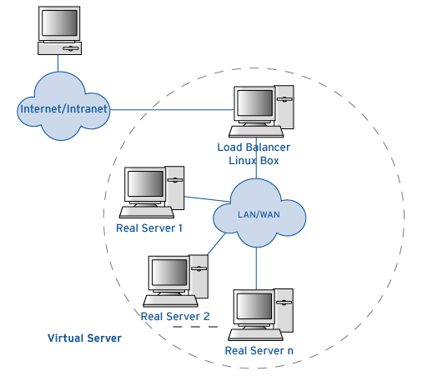
Virtual Server Architecture
Notes:
These works as follows:
We advertise a single IP address and port number for the service.
A Load balancer - Director in LVS parlance - listens on this IP address, and looks for packets that are used to start a TCP connection.
It then routes requests to real servers (RealServers) in the server farm via NAT, IP tunneling, or direct routing, based on a load balancing policy - which is either numbers of connections oriented, client to server oriented or round-robin based, or a combination of these.
We then use a monitoring system (a ‘heartbeat’) to look for servers that are having problems, so that we can pull them out of service either manually or automatically. This is vital since LVS works on the assumption that it manages connections according to a policy, not a monitoring system. In practice this turns out to be an extremely useful double edged sword.
Examples of deployments using LVS: Linux.com (LVS web cluster), SourceForge.com (load balancing HTTP, HTTPS, FTP, SSH, CVS), Real.com
Back to our motivations for clustering (Scalability, HA, serviceability, etc.) – these are provided by the LVS in the following ways:
Scalability is achieved by transparently adding or removing a node in the cluster.
High availability is provided by detecting node or daemon failures and reconfiguring the system appropriately.
(NAT firewalls receive packets for one IP address, translate the headers of the packets, and send the packets to a second IP address)

Slide 10
Load Balancing Algorithms
Basic round robin
Weighted round robin
  Good for servers with different capacity
Least-Connection
  Use least busy server
Weighted Least-Connection
  Percentage share of active connections is ratio to its weights
Notes:
Good explanation of algorithms here as implemented in LVS: http://www.linuxvirtualserver.org/docs/scheduling.html
Round-Robin Scheduling
The round-robin scheduling algorithm sends each incoming request to the next server in it's list. Thus in a three server cluster (servers A, B and C) request 1 would go to server A, request 2 would go to server B, request 3 would go to server C, and request 4 would go to server A, thus completing the cycling or 'round-robin' of servers. It treats all real servers as equals regardless of the number of incoming connections or response time each server is experiencing. Virtual Server provides a few advantages over traditional round-robin DNS. Round-robin DNS resolves a single domain to the different IP addresses, the scheduling granularity is host-based, and the caching of DNS queries hinders the basic algorithm, these factors lead to significant dynamic load imbalances among the real servers. The scheduling granularity of Virtual Server is network connection-based, and it is much superior to round-robin DNS due to the fine scheduling granularity.
Weighted Round-Robin Scheduling
The weighted round-robin scheduling is designed to better handle servers with different processing capacities. Each server can be assigned a weight, an integer value that indicates the processing capacity. The default weight is 1. For example, the real servers, A, B and C, have the weights, 4, 3, 2 respectively, a good scheduling sequence will be AABABCABC in a scheduling period (mod sum(Wi)). In the implementation of the weighted round-robin scheduling, a scheduling sequence will be generated according to the server weights after the rules of Virtual Server are modified. The network connections are directed to the different real servers based on the scheduling sequence in a round-robin manner.
The weighted round-robin scheduling is better than the round-robin scheduling, when the processing capacity of real servers are different. However, it may lead to dynamic load imbalance among the real servers if the load of the requests vary highly. In short, there is the possibility that a majority of requests requiring large responses may be directed to the same real server.
Actually, the round-robin scheduling is a special instance of the weighted round-robin scheduling, in which all the weights are equal.
Least-Connection Scheduling
The least-connection scheduling algorithm directs network connections to the server with the least number of established connections. This is one of the dynamic scheduling algorithms; because it needs to count live connections for each server dynamically. For a Virtual Server that is managing a collection of servers with similar performance, least-connection scheduling is good to smooth distribution when the load of requests vary a lot. Virtual Server will direct requests to the real server with the fewest active connections.
At a first glance it might seem that least-connection scheduling can also perform well even when there are servers of various processing capacities, because the faster server will get more network connections. In fact, it cannot perform very well because of the TCP's TIME_WAIT state. The TCP's TIME_WAIT is usually 2 minutes, during this 2 minutes a busy web site often receives thousands of connections, for example, the server A is twice as powerful as the server B, the server A is processing thousands of requests and keeping them in the TCP's TIME_WAIT state, but server B is crawling to get its thousands of connections finished. So, the least-connection scheduling cannot get load well balanced among servers with various processing capacities.
Weighted Least-Connection Scheduling
The weighted least-connection scheduling is a superset of the least-connection scheduling, in which you can assign a performance weight to each real server. The servers with a higher weight value will receive a larger percentage of live connections at any one time. The Virtual Server Administrator can assign a weight to each real server, and network connections are scheduled to each server in which the percentage of the current number of live connections for each server is a ratio to its weight. The default weight is one.
The weighted least-connections scheduling works as follows:
Supposing there is n real servers, each server i has weight W_{i} (i=1,..,n), and alive connections C_{i} (i=1,..,n), ALL_CONNECTIONS is the sum of C_{i} (i=1,..,n), the next network connection will be directed to the server j, in which
(C_{j}/ALL_CONNECTIONS)/W_{j} = min { (C_{i}/ALL_CONNECTIONS)/W_{i} } (i=1,..,n)
Since the ALL_CONNECTIONS is a constant in this lookup, there is no need to divide C_{i} by ALL_CONNECTIONS, it can be optimized as
C_{j}/W_{j} = min { C_{i}/W_{i} } (i=1,..,n)
The weighted least-connection scheduling algorithm requires additional division than the least-connection. In a hope to minimize the overhead of scheduling when servers have the same processing capacity, both the least-connection scheduling and the weighted least-connection scheduling algorithms are implemented.
Locality-Based Least-Connection Scheduling
The locality-based least-connection scheduling algorithm is for destination IP load balancing. It is usually used in cache cluster. This algorithm usually directs packet destined for an IP address to its server if the server is alive and under load. If the server is overloaded (its active connection numbers is larger than its weight) and there is a server in its half load, then allocate the weighted least-connection server to this IP address.
Locality-Based Least-Connection with Replication scheduling
The locality-based least-connection with replication scheduling algorithm is also for destination IP load balancing. It is usually used in cache cluster. It differs from the LBLC scheduling as follows: the load balancer maintains mappings from a target to a set of server nodes that can serve the target. Requests for a target are assigned to the least-connection node in the target's server set. If all the node in the server set are over loaded, it picks up a least-connection node in the cluster and adds it in the sever set for the target. If the server set has not been modified for the specified time, the most loaded node is removed from the server set, in order to avoid high degree of replication.
Destination Hashing Scheduling
The destination hashing scheduling algorithm assigns network connections to the servers through looking up a statically assigned hash table by their destination IP addresses.
Source Hashing Scheduling
The source hashing scheduling algorithm assigns network connections to the servers through looking up a statically assigned hash table by their source IP addresses.

Slide 11
Web Services Defined (Again)
Self-describing, self-contained modular entities:
  Platform and language independent
  Implementation neutral
  Open standards based
  Loosely coupled
  Programmatically connect business processes
  Typically requiring integration with existing systems
Notes:
15 Minutes in.
What are we trying to achieve with web services – the theory. The next slide is the practise.
Characteristics of Web Services.

Slide 12


Web Services
Web Services are software components:
  Defined in WSDL.
  Remotely accessible via SOAP.
  Registered in a UDDI.
Notes:
How do we achieve this ?
3 Basic Web Service standards – let’s look at each in more detail.

Slide 13
WSDL
WSDL:
  The Web Services Description Language.
  Describes the methods & parameters.
  Like a “users manual” for the Web Service.
  Is based on XML.
Notes:
Like a “users manual” or man page for the WS.
Generated or designed ? Documentation elements become the most important.
Slow change in starting point (existing software components).
A W3C ratified standard. Version 1.1 (1.2 is a Working Draft)
Message part Types (parameters) are defined in an embedded XML Schema.
Specifies the service endpoint. (A web server)

Slide 14
SOAP
SOAP:
  The Simple Object Access Protocol.
  Defines the message contents and processing.
  Like a “transport” for calling Web Services.
  Is based on XML and runs on HTTP(S).
Notes:
In fact the transport in the strictest sense is (usually) HTTP.
Also seeing the emergence of SMTP and JMS as transports – interest in MQ series.
WSDL describes the structure of a SOAP message.
A W3C ratified standard. Version 1.1 (1.2 is a Working Draft)

Slide 15
UDDI
UDDI:
  The Universal Discovery, Description, & Integration.
  Stores Web Services descriptions and endpoints.
  Like a “Yellow Pages” for Web Services.
  Ultimately will require advanced DNS type features
    Round robin endpoint allocation
Notes:
No need to know IP address or location information to use a Web Service.
Standardised by UDDI.org - all the major players are members – currently on version 2.0.
Allows services to be categorised in advanced ways using classifications and ontologies.
Somewhere between a White and Yellow pages. Need to know an organisation
Or service name. Can traverse classifications if implementer has provided one – usually something helpful like ‘Computer Software’.

Slide 16
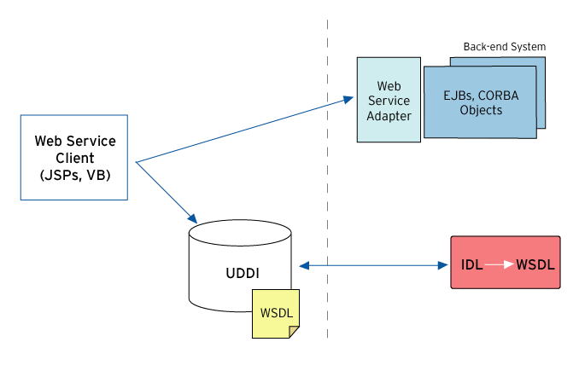
Web Services Example
Notes:
A Simple example of a Web Service architecture and invocation – starting with an existing component.
IDL/EJB interface run through a compiler that produces WSDL.
Store that WSDL into a repository – almost certainly will be a UDDI repository.
Clients builders can pull the WSDL into their favourite Web Service development Tool (.Net, CapeStudio, etc.) and build a client in their preferred language which will produce the SOAP requests.
We’ll need a runtime adapter that receives those SOAP over HTTP requests and based on the WSDL mapping make invocations to the (unmodified) back-end systems.
Cape Clear has products that enable all these tasks. Design/Development time – CapeStudio, runtime CapeConnect.
Popular use is for CORBA-VB connectivity. Used to be possible but awkward – now SOAP has been adopted as a langua franca.

Slide 17
Web Services Standards
Web Services standards look familiar:
  WSDL ↔ Java interfaces, CORBA IDL
  SOAP ↔ Java RMI, CORBA IIOP
  UDDI ↔ JNDI, CosNaming, CosTrader
But they…
  Abstract Java, CORBA and .NET technologies.
  Are being added to many packaged applications.
Notes:
You would be right in thinking that you have seen this before.
Comparing Web service standards to EJB, Java in general or CORBA – quite a lot of overlap. <up to table>
Running SOAP over HTTP is very similar to RMI or IIOP – a request to invoke an object or service – just an encoding in XML instead of a binary format.
So what is the big deal ? Are we getting anything extra from web services above and beyond the tried and trusted distributed object technology ?
2 Key factors : ubiquity – everybody is supporting them: App Servers, Packaged Apps: SAP, PeopleSoft. The set of standards we looked at – MS, IBM and Sun agree on.
Ease of use – opens up distributed computing & integration to a wider audience, because they abstract the more complex middleware.

Slide 18
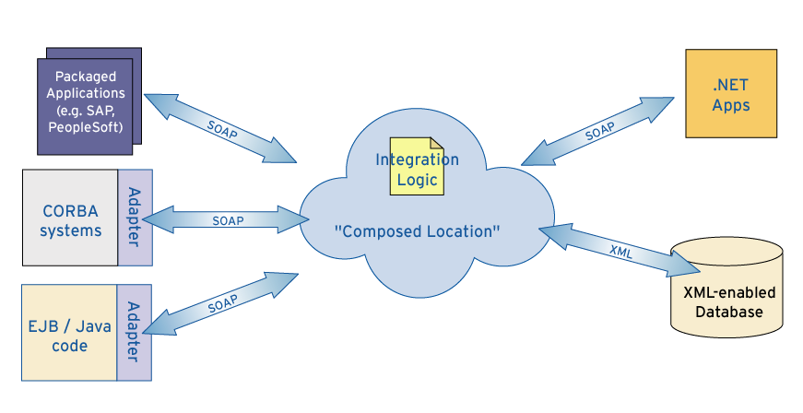
EAI via Web Services
Notes:
Moving on from the simple synchronous RPC example, to a complete business process enabled by using Web Services.
You can put Web Service “facades” on your existing Java, J2EE and CORBA systems with Cape Clear’s technology.
Integrate other SOAP-enabled applications.
Then you can use SOAP to call those components from a different language, platform, etc. using the WSDL interface.
(Point out CapeConnect = Adapter).

Slide 19
Why Clustering and Web Services?
On the back-end (producer)
  Expose - business logic
  Integrate - lightweight EAI – technology integration
On the front-end (consumer)
  “Single Point of Access” for disparate client types
  HTTP-enabled client interfaces
  Inter-application communication interface
  Process inbound XML
Private Directory Systems (UDDI)
Notes:
Pj: Bridging slide.
As we saw from the example on the last slide, companies are operating their business processes with Web Services (not just product catalogues – read only apps). They need to be highly available, scalable, serviceable, etc.
Consumer of web services needs these characteristics to do business with the producer. Customer is not a web browser – could be a trading partner, could be a supplier with a data feed.
Strong separation of producer and consumer of web services, since the producer is going to hide implementation details.

Slide 20
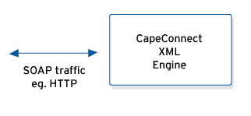
Standalone Web Services Platform
Single instance of CapeConnect server
Single server host
Several points of failure
Notes:
25 mins in.
Let’s look at a series of progressively better solutions to hosting a web services platform – the runtime adaptor piece that maps SOAP requests to service native calls.
It listens for HTTP - From the availability point of view – it’s a web server !
We can learn a lot about fulfilling overall system requirements from web farm techniques.
XML Engine software could fail – through a bug or incorrect configuration, Java runtime could
Fail, OS could fail, server hardware could fail, could be a problem caused by systems management.

Slide 21
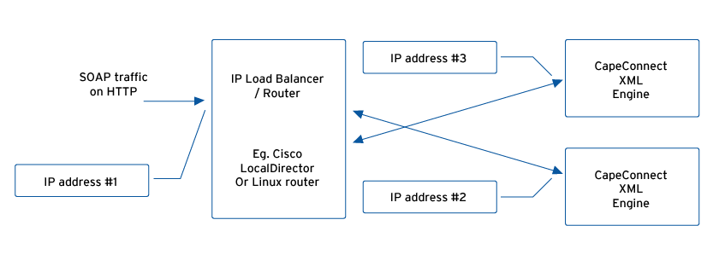
Web Services Platform with clustering IP router
Notes:
Also known as an IP Sprayer. IBM Network Dispatcher is software – part of WebSphere Edge Server.
Although the clients behave as if they are communicating directly with a given Web server, the IP sprayer is actually intercepting all requests and distributing them among all the available Servers in the cluster.
Extremely common for web servers.
This is exactly the configuration at BSkyB.
Cisco LocalDirector – standard corporate configuration – would sometimes favour an Linux solution like an LVS cluster for cost and flexibility.
(PJ: There was a Case Study in progress on BSkyB)
BSkyB’s system manages 1000s subscriptions per day. Not high throughput but each transaction is relatively high value – so very important. $100M / year. 5M Customers.

Slide 22
CapeConnect + IP Router
Multiple CapeConnect server instances
Multiple Linux server hosts
Router provides single endpoint IP address to the outside world
Each server instance runs on a host with its own IP address
Notes:
(Flick back & forth to last slide).

Slide 23
CapeConnect + IP Router
Router provides failover among server hosts
Router can provide load balancing among server hosts
  BUT - requires completely stateless Web Services
Router is the only single point of failure
Notes:
Completely stateless – no session affinity (will talk about this later).
Hardware router like a Cisco Local Director doesn’t understand application concepts like session.
XML Engines cannot be serviced gracefully.
To solve some of these deficiencies with IP-level load balancing we introduce a Web Services Gateway.

Slide 24
A Web Services Gateway
Application level message router
  Receives and forwards SOAP messages across network topology boundaries
  Can be used to bridge between different transport schemes
  For example: HTTP in, JMS out
Usually placed in the DMZ for securely connecting Internet SOAP traffic into a corporate network
Provides a very convenient place to build clustering and failover into the service hosting architecture for Web Services
Also allows load balancing to be used across a cluster of Web Services platforms, thereby avoiding operational hotspots.
Notes:
The Gateway is an application-level router (understands SOAP, not IP) that performs a number of tasks.
The idea is to isolate the CapeConnect Servers from these non-core tasks.

Slide 25
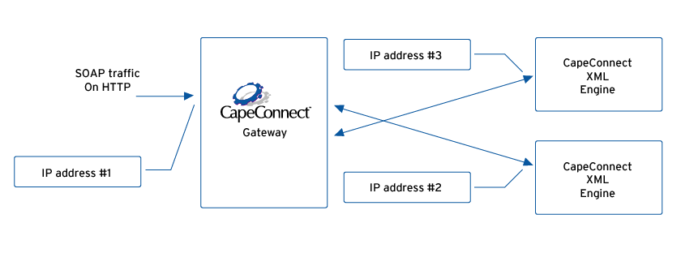
Web Services Platform with Web Services Gateway
Notes:
PJ: which customer was this ?
One customer does HTTP to JMS bridging plus a number of processing engines.
This is the configuration in Robertson Stephens (EJBs, Research Distribution).
4 XML Engines on different boxes.
Our developer site hosts live web services - live.capescience.com
Uses this configuration – puts the Gateway in the DMZ.

Slide 26
CapeConnect + Gateway
Functionally equivalent to using a Clustering IP Router
Allows use of other transport types such as JMS between the Gateway and XML Engines
Some processing (such as security checks) can be handled by the Gateway
Notes:
(Flick back & forth to last slide).
Any of the algorithms we mentioned before can be used: Basic round robin, weighted RR, least-connections, weighted LC.
Can be a good solution if cannot afford a hardware router.
SOAP messages are composed of headers and a body – like IP packets or email messages.
General idea is to allow header parsing (for authentication credentials, for example) but not to parse the complete message (could be expensive – it carries all the data).
An appropriate place for implementations the upcoming web service security standards all based on header processing. For example, SAML assertions, WS-Security based on XML Digital Signatures.).

Slide 27
CapeConnect + Gateway
Gateway can provide “application failover” facilities such as when upgrading a service
If the web services are not stateless, some state data needs to be shared between XML Engine instances – either by the middleware or application itself
Gateway still provides a single point of failure
Notes:
(Flick back & forth to last slide).
Can be dynamically configured to redirect to only one XML Engine Server.
The other server is brought down for an upgrade or a health check if a problem is detected and then brought up again & gateway reconfigured to include the updated server.

Slide 28
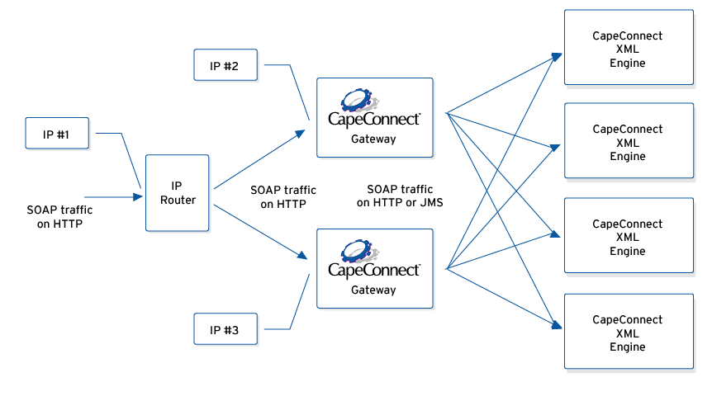
The Ultimate Web Services Cluster
Notes:
The High Availability Scenario.
Lipper (read case study) – 1M transactions/hour on a Solaris box – 16 way with 4 independent XML Engines.

Slide 29
The Ultimate Web Services Cluster
Only single point of failure is the IP router which are generally very reliable
CapeConnect Gateway makes “cluster management” tasks such as service upgrades easier due to the application level failover facilities
Notes:
(Flick back & forth to last slide).
Stats from Cisco– switch with LocalDirector – 7 years MTBF.
Since the Gateway itself is clustered this is not a SPOF and can itself
be serviced.
Key points to bring out:
One of the reasons for clustering is Operations management for example, Making Service Upgrades easy

Slide 30
The Ultimate Web Services Cluster
Any number of CapeConnect XML Engines can be deployed to handle the required service load
Two Gateway instances should be sufficient to handle most scenarios, but more can be added if required
Notes:
(Flick back & forth to last slide).
XML Engines can be added & gateways dynamically reconfigured to redirect to them.

Slide 31
Service Development Considerations
Issues that Web Service developers need to consider for making their applications “cluster friendly”
Notes:
45 Minutes in.
Up to now been talking about architectures that Web Service products like CapeConnect give you. Now what about the developers of the services themselves.
Design choices for service implementations.

Slide 32
The Need for Stateless Services
The stateful-ness of a Web Services implementation is the main determinant of the ease of deployment into a cluster environment
Stateless services deliver the maximum performance as there are no additional “overheads” on each call
Notes:
Most Internet-based scenarios should not require stateful objects or distributed transactions, because both place server resources (for example, database locks) under the control of remote clients. In practice, this means that the services exposed by an XML Web service are:
Stateless. All the information required to perform the service is either passed in with the request message or can be retrieved from a data store based on some information provided with the request.
Atomic. Each service represents a complete unit of work that leaves data stores in a consistent state. For example, if clients need to be able to move money between bank accounts, the service should accept a MoveMoney request message, not just Debit and Credit requests. Integrity of the system is not dependent on further invocations.
Overheads could be things like state reconstruction,

Slide 33
Stateless Service Architectures
If service components are completely stateless:
  a wide range of configuration options can be used to create a completely fault tolerant deployment architecture
  Scalability can be increased by simply adding more processing nodes
  Service processors can easily be moved from node to node for load balancing purposes
Notes:
Reap the rewards of stateless-ness.
All the previous clustering architectures are possible.

Slide 34
Stateful Service Architectures
If service components are stateful:
  Failover has to be explicitly handled by either the service or the server hosting the service
  Load balancing incurs a cost as service instance state needs to be reconstructed on the new node
  Service applications have to be “cluster aware” to ensure any relevant state information is preserved in persisted data after each request
  Preserving state information will add an overhead to all calls, which will ultimately reduce performance (response time and scalability)
Notes:
Outline of the costs of stateful-ness.
Building in Cluster-awareness is costly. Not core-business logic.
Common technique is to build a stateless façade for stateful service and expose that as a web service. This should façade both state and atomicity.

Slide 35
Service Instance configuration
Any configuration information required by the Web Services needs to be available to all nodes the service is deployed onto
To use a single set of config data for all instances, needs to be stored in:
  Config file on a shared file system drive accessible from all nodes
  Database accessible to all nodes
The Web Services will still need to be deployed into each node in the cluster
Notes:
Stateless services are not data-less services – would not be terribly useful in a business context - the state is not preserved intrinsically from Call-to-call.
Need a reconstructable handle to configuration and data – not a stored one. Config or data on NFS drives.
Does stateless-ness preclude any types of web services ?
Not suitable for query/iterator type architectures.

Slide 36
Service Upgrades
One of the hardest part of managing a cluster / server farm is how to perform upgrades on individual applications
Upgrade each processing node in the cluster in turn (see next slide)
Requires “application level” router such as CapeConnect Gateway (IP Routers can’t handle this)
Notes:
For example, Sky wants to upgrade to CapeConnect 4.

Slide 37
How To Handle Service Upgrades
General approach is:
  For each processing node in the cluster:
    Disable an application on one processing node at a time
    CapeConnect Gateway will route requests for that application to other nodes in the cluster
    Redeploy the application on the “offline” node
    Other applications on the ”offline” node can still be active – only the application being upgraded is actually unavailable
    Bring the new application version back on line
    Gateway will start routing requests to that node again
  Proceed with the next node in the cluster until all service instances have been upgraded
Notes:
(Flick back to 25).
CapeConnect Gateway needs this upgrade API: start upgrade on node x.
For example, web service versioning or CapeConnect Server upgrades.
This procedure is not needed for deploying new or updated web services – can be done dynamically.

Slide 38
Sessions
Any use of “sessions” makes service invocations stateful
  Requests need to be routed to the same processor node as the previous requests in this session – “affinity”.
  Or, session state will need to be reconstructed if a request is sent to a different processing node from the last request in this session
Load balancing algorithm needs to be session aware – often referred to as “sticky sessions” or “session affinity”
Notes:
Session state may need to be stored in a shared database or NFS accessible store.

Slide 39
Conclusions
The main aspect Web Services developers need to consider is the stateless-ness of their services
Many deployment options are available for creating Web Services clusters
Stateless services can be scaled more easily simply by adding more processing nodes
Stateless services deliver higher performance
Notes:
55 minutes in.
Deployment options will be dictated by cost considerations and availability requirements.
Higher performance as no state reconstruction.
Learned all those lessons with Web Servers (management) – useful analogy - just relearning old lessons for Web Services.
Now Questions – come and talk to me or come and take a business card and contact me when you get back to the office next week.

