Slide 1

Web Services Discovery
Scaling WS to limited resource devices
Jorgen Thelin
Program Manager
Connected Systems Division
Microsoft Corporation
JThelin@microsoft.com

Slide 2
WS-Discovery - The Big Picture
Services to be discovered
Clients discover services
Discovery Proxy caches found services
Hello/Bye
Service
Client
Probe
ProbeMatch
Hello/Bye
DP
Probe / ProbeMatch

Slide 3
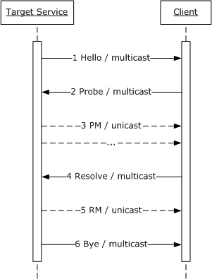
WS-Discovery message exchanges
Target service sends a multicast Hello when it joins a network. Client listens to the multicast Hello.
Likewise, a Target Service may receive multicast a Probe from a Client at any time.
The Target Service sends a unicast Probe Match (PM) to the Client if the Target Service matches a Probe.
Similarly, a Target Service may receive multicast Resolve from a Client at any time.
The Target Service sends a unicast Resolve Match (RM) to the Client if it is the target of a Resolve.
When a Target Service leaves a network, it makes an effort to (6) send a multicast Bye. Clients listen to the multicast Bye.

Slide 4
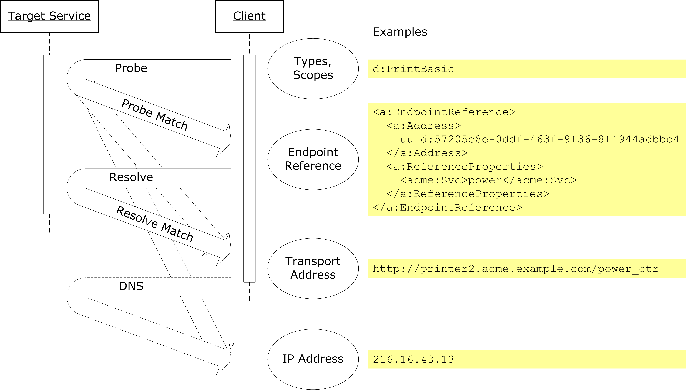
Conceptual Context of Message Exchanges

Slide 5

WS-Discovery Metadata
/s:Envelope/s:Body/*/d:Types
Set of Types implemented by the Target Service (or Discovery Proxy)
/s:Envelope/s:Body/*/d:Scopes
Set of Scopes the Target Service (or Discovery Proxy) is in
MAY be of more than one URI scheme
/s:Envelope/s:Body/*/d:XAddrs
Set of Transport addresses that MAY be used to communicate with the Target Service (or Discovery Proxy)
/s:Envelope/s:Body/*/d:MetadataVersion
Incremented by >= 1 whenever there is a change in the metadata of the Target Service
Metadata includes, but is not limited to, ../d:Types and ../d:Scopes.
MAY be used by the Client and/or Discovery Proxy for cache control of Target Service metadata.

Slide 6


Metadata Matching Rules
Type matching
  If Namespace + Local name are the same
Scope matching based on specified rules:
  rfc2396 – General URI comparison
  uuid – UUID URI comparison
  ldap – LDAP URI comparison
  strcmp0 – Case-sensitive string comparison
Additional matching rules may be specified
  But must be equally supported by Client and Service

Slide 7
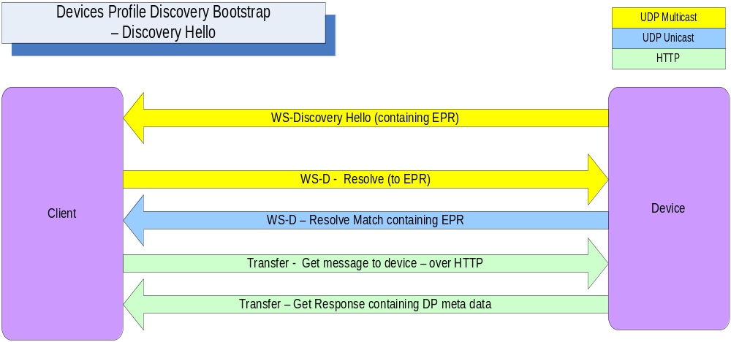
Device Discovery Bootstrap – Based on DPWS

Slide 8
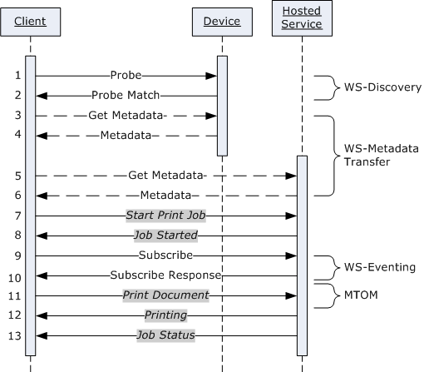
Typical Device/Service Message Exchanges – Based on DPWS

Slide 9
Profile Recipe: Staple, Redline, Glue
- Devices Profile example
SOAP 1.2
WS-Addressing
“Staple”
  Pull relevant specs into scope
“Redline”
  Add constraints on use of those specs
“Glue”
  Define missing bits between specs
  Some will migrate back into specs
WS-Metadata Exchange
WSDL 1.1
WS-Discovery
WS-Eventing
Conformance
Claim
Action
Filter
ThisModel
Metadata
ThisDevice
Metadata
Policy
Assertions
Policy
Assertions

Slide 10
Devices Profile
Protocol
Protocol
Protocol
DMR
Commands
IGD
Commands
Print
Commands
DMR
Events
IGD
Events
Print
Events
DMR
Capabilities
IGD
Capabilities
Print
Capabilities
Metadata
WS-Metadata
Exchange
WS-Discovery
Device
Extensions
WS-Policy
Assurances
WS-Security
TLS
BP 1.1 Sec. 4
Messaging
WS-Eventing
WSDL
SOAP
WS-Addressing
MTOM
XML Schema
Foundation
XML Infoset
SOAP / UDP
XML 1.0
XML
Namespaces
MIME
SOAP / HTTP

Slide 11

Vista WS device support
Printers
  “Plug and Play” experience for network printers
  Security
    Control over who can connect to the printer
    Privacy of data sent to the printer
  Rich printer status
Scanners
  “Plug and Play” experience for network scanners
  enable one-button scanning
  Secure scan delivery

Slide 12
Vista WS device support
PC Discovery
Messenger - People Near Me
BITS - Background Intelligent Transfer Service
Projectors
  Integration with current IT systems
    Remote diagnostics and configuration
    Asset and usage tracking
  Speeds flow of meeting
    Automatic display and audio settings
    Easy to transition between presenters

Slide 13
Web Services On Devices Resources
WS and WSD Sites
  Web Services
    http://msdn.microsoft.com/webservices/default.aspx
    http://msdn.microsoft.com/windowsvista/connected/
  Web Services Feedback Workshops
    http://msdn.microsoft.com/webservices/community/workshops/
  Web Services Basics
    http://msdn.microsoft.com/webservices/understanding/webservicebasics/
  Devices Profile for Web Services
    http://msdn.microsoft.com/ws/2006/02/devprof
  WS-Discovery
    http://msdn.microsoft.com/ws/2005/04/ws-discovery/

Slide 14

Questions?

Slide 15
Backup

Slide 16
WS-Discovery Hello Message Outline
<s:Envelope ... >
<s:Header ... >
<a:Action ... >
http://schemas.xmlsoap.org/ws/2005/04/discovery/Hello
</a:Action>
<a:MessageID ... >xs:anyURI</a:MessageID>
[<a:RelatesTo RelationshipType="d:Suppression" >
xs:anyURI
</a:RelatesTo>]?
<a:To ... >urn:schemas-xmlsoap-org:ws:2005:04:discovery</a:To>
<d:AppSequence ... />
...
</s:Header>
<s:Body ... >
<d:Hello ... >
<a:EndpointReference> ... </a:EndpointReference>
[<d:Types>list of xs:QName</d:Types>]?
[<d:Scopes>list of xs:anyURI</d:Scopes>]?
[<d:XAddrs>list of xs:anyURI</d:XAddrs>]?
<d:MetadataVersion>xs:unsignedInt</d:MetadataVersion>
...
</d:Hello>
</s:Body>
</s:Envelope>

Slide 17
WS-Discovery Bye Message Outline
<s:Envelope ... >
<s:Header ... >
<a:Action ... >
http://schemas.xmlsoap.org/ws/2005/04/discovery/Bye
</a:Action>
<a:MessageID ... >xs:anyURI</a:MessageID>
<a:To ...>urn:schemas-xmlsoap-org:ws:2005:04:discovery</a:To>
<d:AppSequence ... />
...
</s:Header>
<s:Body ... >
<d:Bye ... >
<a:EndpointReference> ... </a:EndpointReference>
...
</d:Bye>
</s:Body>
</s:Envelope>

Slide 18
WS-Discovery Probe Message Outline
<s:Envelope ... >
<s:Header ... >
<a:Action ... >
http://schemas.xmlsoap.org/ws/2005/04/discovery/Probe
</a:Action>
<a:MessageID ... >xs:anyURI</a:MessageID>
[<a:ReplyTo ... >endpoint-reference</a:ReplyTo>]?
<a:To ... >xs:anyURI</a:To>
...
</s:Header>
<s:Body ... >
<d:Probe ... >
[<d:Types>list of xs:QName</d:Types>]?
[<d:Scopes [MatchBy="xs:anyURI"]? ... >
list of xs:anyURI
</d:Scopes>]?
...
</d:Probe>
</s:Body>
</s:Envelope>

Slide 19
WS-Discovery Probe Match Message Outline
<s:Envelope ... >
<s:Header ... >
<a:Action ... >
http://schemas.xmlsoap.org/ws/2005/04/discovery/ProbeMatches
</a:Action>
<a:MessageID ... >xs:anyURI</a:MessageID>
<a:RelatesTo ... >xs:anyURI</a:RelatesTo>
<a:To ... >xs:anyURI</a:To>
<d:AppSequence ... />
...
</s:Header>
<s:Body ... >
<d:ProbeMatches ... >
[<d:ProbeMatch ... >
<a:EndpointReference> ... </a:EndpointReference>
[<d:Types>list of xs:QName</d:Types>]?
[<d:Scopes>list of xs:anyURI</d:Scopes>]?
[<d:XAddrs>list of xs:anyURI</d:XAddrs>]?
<d:MetadataVersion>xs:unsignedInt</d:MetadataVersion>
...
</d:ProbeMatch>]*
...
</d:ProbeMatches>
</s:Body>
</s:Envelope>

Slide 20
WS-Discovery Resolve Message Outline
<s:Envelope ... >
<s:Header ... >
<a:Action ... >
http://schemas.xmlsoap.org/ws/2005/04/discovery/Resolve
</a:Action>
<a:MessageID ... >xs:anyURI</a:MessageID>
[<a:ReplyTo ... >endpoint-reference</a:ReplyTo>]?
<a:To ... >xs:anyURI</a:To>
...
</s:Header>
<s:Body>
<d:Resolve ... >
<a:EndpointReference> ... </a:EndpointReference>
...
</d:Resolve>
</s:Body>
</s:Envelope>

Slide 21
WS-Discovery Resolve Match Message Outline
<s:Envelope ... >
<s:Header ... >
<a:Action ... >
http://schemas.xmlsoap.org/ws/2005/04/discovery/ResolveMatches
</a:Action>
<a:MessageID ... >xs:anyURI</a:MessageID>
<a:RelatesTo ... >xs:anyURI</a:RelatesTo>
<a:To ... >xs:anyURI</a:To>
<d:AppSequence ... />
...
</s:Header>
<s:Body ... >
<d:ResolveMatches ... >
[<d:ResolveMatch ... >
<a:EndpointReference> ... </a:EndpointReference>
[<d:Types>list of xs:QName</d:Types>]?
[<d:Scopes>list of xs:anyURI</d:Scopes>]?
<d:XAddrslist of xs:anyURI</d:XAddrs>
<d:MetadataVersion>xs:unsignedInt</d:MetadataVersion>
...
</d:ResolveMatch>]?
...
</d:ResolveMatches>
</s:Body>
</s:Envelope>

Slide 22


WS-* Specifications Process
Step 1
Initial
Development
Step 2
Broader
Community Participation
Step 3
Standardization
Step 4
Profiling
Idea
Feedback and Interop Workshops
Specification Published
Revise spec
Standards Org
WS-I
Increasing Industry Participation
Process reconciles conflicting goals
Quality of engineering
Time to market
Breadth of industry support
Notes:
Path: Publish specs, gather feedback through workshops, demonstrate interoperability, build tools and implementations, take to a standards body
Step 1 – Develop
Small number of aligned companies
Work privately on an idea
Step 2 – Broader Participation
More companies participate
Gather Feedback
Prove Interop
Step 3 – Standardization
Spec submitted to standards org (W3C / OASIS / etc)
WG finalizes & ratifies
Step 4 – Profiling
Spec profiled as a basis for broad implementation (e.g. WS-I Basic Profile for SOAP/WSDL/UDDI, WS-I Basic Security Profile for WS-Security)
Call to action: Provide feedback through the WS-* Workshop Process
http://msdn.microsoft.com/webservices/community/workshops/

Slide 23
WS-* Spec Status
Step 2 – Workshops & Community Dev
Step 3 – Standardization
Step 4 – Approved Standard
Infrastructure
and Profiles
Metadata
WS-Federation
WS-Management
Devices
Profile
WS-Metadata
Exchange
Assurances
WS-Secure
Conversation
WS-Business
Activity
WS-Discovery
WS-Trust
WS-Atomic
Transaction
UDDI
WS-Security
WS-Reliable
Messaging
WS-Coordination
WS-Policy
Messaging
WS-Transfer
WS-Enumeration
WS-Eventing
WSDL
SOAP
WS-Addressing
MTOM
XML Schema
Foundation
XML Infoset
SOAP / UDP
XML 1.0
XML
Namespaces
MIME
SOAP / HTTP
Notes:
Shows the progress of each spec through the development process towards standardization.
Different WS-* specs are at different stages in the WS-* Workshops process, but all are progressing.

Slide 24
WS-* - Industry Adoption
WS-D
DPWS
Devices
Microsoft | ✓ | ✓
Intel |  | 
Canon |  | 
BEA | A
WebMethods | A
Ricoh |  | 
Epson |  | 
HP |  | 
Xerox |  | 
Fuji-Xerox |  | 
Brother |  | 
Toshiba |  | 
Exceptional Innovation |  | 
Peerless |  | 
Schneider |  | 
Systinet | 
gSOAP | ✓
Lexmark |  | A
WS-RM
WS-SecureConv
Assurances
WS-AT
SOAP / WSDL
WS-Security
WS-Trust
Messaging
MTOM
WS-Fed
Microsoft | ✓ | ✓
IBM | ✓ | ✓
BEA | ✓ | A
Cape Clear | ✓
Systinet | ✓
Blue Titan | ✓
Rogue Wave | 
Sonic | ✓
IONA | ✓ | ✓
JBoss |  | ✓
Choreology |  | ✓
Apache | ✓ | ✓
Tibco | 
Security
Microsoft | ✓ | ✓
IBM | ✓
BEA | ✓
SUN | ✓ | 
Google | ✓
Amazon | ✓
eBay | ✓
Apache | ✓ | ✓
Whitemesa | ✓ | ✓
gSOAP | ✓ | ✓
Ricoh | ✓ | 
Epson | ✓ | 
HP | ✓ | 
Xerox | ✓ | 
Fuji-Xerox | ✓ | 
Intel | ✓ | 
Canon | ✓ | 
Microsoft | ✓ | ✓ | ✓ | 
IBM | ✓ |  | ✓ | ✓
BEA | ✓ |  |  | A
RSA | ✓ |  |  | A
Systinet | ✓ |  | 
Apache | ✓ |  | 
Layer7 | ✓ | A | ✓
DataPower | ✓ |  | ✓
CA | ✓ | A | A
SUN | ✓
SAP | ✓
Tibco | ✓
IONA | ✓
WebMethods | ✓
Nokia | ✓
Cape Clear | ✓
Sonic | ✓
gSOAP | ✓
Ping ID |  | A | ✓ | ✓
Netegrity |  | A | A | 
Verisign |  | A | A | A
OpenNetwork | A | A | A | 
Oracle/Oblix |  |  |  | 
Metadata
MEX
WS-P
Microsoft | ✓ | ✓
IBM | A | 
BEA | A | ✓
SAP | A | 
Sun | A | 
Verisign |  | A
Sonic |  | ✓
Layer 7 |  | 
Apache |  | 
CA | A
WebMethods | A
Systinet |  | ✓
gSOAP |  | ✓
WS-XFer / Enum
Mgmt
WS-M
Microsoft | ✓ | ✓
Intel |  | 
Sun |  | 
Dell |  | 
AMD | A
CA |  | A
Sonic |  | A
gSOAP |  | ✓
Systinet |  | A
WEBM |  | 
NetIQ |  | 
✓ | Released product
 | Public interop
A | Co-Author Only
© 2003-2006 Microsoft Corporation. All rights reserved. The information contained in
this document represents the current view at the time of publication and is subject to change.
Notes:
Many other vendors are also implementing WS-* specs in their products.
A very busy slide, but illustrates the breadth and depth of industry support for WS-* specs.
Data collected from attendance at WS-* Interop Workshops, public demos and/or product datasheets / announcements.

