Slide 1
XML Security Standards
Current and Emerging Specifications attempting to provide standardization of XML security infrastructure
Jorgen Thelin
Chief Scientist
Cape Clear Software Inc.

Slide 2
Specifications and Standards
There are lots of specifications flying around concerning Web Services
Not all specifications are, or will be, “real” standards
The hard part is working out which specifications will “win” and become part of the standard infrastructure
Vendors and Architects need to plot an “intercept trajectory” for emerging standards

Slide 3
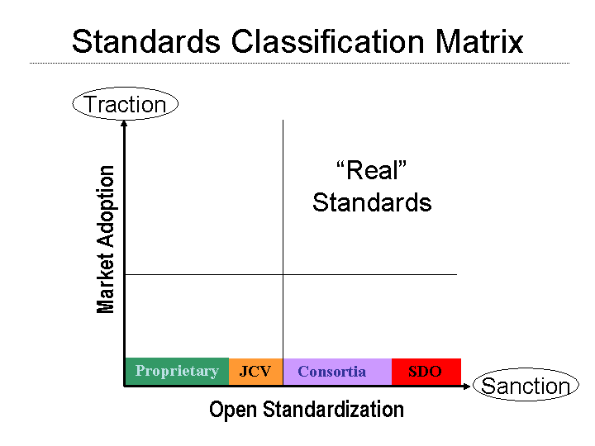
“Real” Standards

Slide 4
When is a Specification not a Standard?
Real standards are:
  Published by a “recognized” standards development organization – eg. W3C, OASIS
  Created through a process that allows public comment and feedback
  Agreed and approved by a committee or group consisting of wide and diverse membership
  Published at a final or definitive status, such as "W3C Recommendation"
  Publicly available for reference - most usually by publication on the Internet.
  Achieving both traction (usage) and sanction (backing)
Everything else is just a specification hoping to become a standard!

Slide 5
Security Standards Overview
There are several specifications for various aspects of XML and Web Services Security
The standardization process is still at a very early stage in the evolution
The front runner specifications are:
  XML Digital Signatures
  XML Encryption
  SAML
  WS-Security
  WS-Trust
  WS-Policy
  WS-Secure Conversation
  WS-Security Policy

Slide 6
XML Digital Signatures
Source: W3C
Status: Final
Purpose:
  Specifies a process for digitally signing data and representing the result in XML
  Define the processing rules and syntax for XML digital signatures
Notes:
  A serialised form in XML is defined for the signature
  The signatures can be applied to information in any form, not just XML-formatted information
  The specification specifically excludes encryption.

Slide 7
XML Encryption
Source: W3C
Status: Final
Purpose:
  Specifies a process for encrypting data and representing the result in XML such that it is only discernable to the intended recipients and opaque to all others
Notes:
  The information that is encrypted can be arbitrary data (including an XML document), an XML element, or XML element content
  The result is an XML Encryption element that contains or identifies the cipher data
  The standard is generally accepted in the industry, although not yet in widespread use

Slide 8
SAML
Source: OASIS
Status: Final
Purpose:
  Uses XML to encode authentication and authorization information in “assertions”
Notes:
  Defines a standardized XML format for credential and security assertion data
  The authentication and authorization information can be moved around systems within or between organizations
  SAML is platform-independent and language-independent
  A key objective of SAML is to allow organizations to exchange date regardless of the security system they use

Slide 9
WS-Security
Owner: Microsoft/IBM/Verisign – Now OASIS WSS-TC
Status: WIP for OASIS standardization process
Purpose:
  Provides a model for many levels of security needed for web services.
  A general-purpose mechanism to associate security-tokens with messages
  Describes how to encode binary security tokens in messages using SOAP Headers
  Includes enhancements to SOAP to provide quality of protection mechanisms
Notes:
  Builds on top of XML Digital Signatures and XML Encryption specifications
  WS-Security Addendum adds
    Facility for timestamp and TTL headers
    Provides greater protection when passing around passwords and security certificates
More Info:
  http://www-106.ibm.com/developerworks/library/ws-secure/
  http://www-106.ibm.com/developerworks/library/ws-secureadd.html
  WS-Security AppNotes - provide guidance to implementers of the WS-Security specification:
  http://www-106.ibm.com/developerworks/webservices/library/ws-secapp/

Slide 10
WS-Security - Security Token Types
The WS-Security specification set defines the following tokens:
  Unsigned security tokens
    Username
  Signed security tokens
    X.509 certificates (binary)
    Kerberos tickets (binary)
  XML security tokens
    Any XML token, such as SAML
    Usually self verifying / signed

Slide 11
WS-Security Profile for XML-based Tokens
Owner: Microsoft/IBM/Verisign – Now OASIS WSS
Status: WIP for OASIS standardization process
Purpose:
  Describes a general framework to enable XML-based security tokens to be used with WS-Security
Notes:
  Two profiles that use this general framework are provided for:
    Security Assertion Markup Language (SAML)
    eXtensible rights Markup Language (XrML).
More Info:
  http://www-106.ibm.com/developerworks/library/ws-sectoken.html

Slide 12
WS-Trust
Owner: Microsoft/IBM/Verisign/RSA
Status: Initial public draft release – Soliciting comments
Purpose:
  Uses the secure messaging mechanisms of WS-Security to define additional primitives and extensions for the issuance, exchange and validation of security tokens.
Notes:
  WS-Trust also enables the issuance and dissemination of credentials within different trust domains.
More Info:
  http://www-106.ibm.com/developerworks/webservices/library/ws-trust/

Slide 13
WS-Policy
Owner: BEA/Microsoft/IBM/SAP
Status: Initial public draft release – Soliciting comments
Purpose:
  WS-Policy Framework
    Defines a general purpose model and corresponding syntax to describe and communicate Web services policies
    Allows Service consumers can discover the information they need to know to be able to access services from a Service Provider
    http://www-106.ibm.com/developerworks/webservices/library/ws-polfram/
  WS-Policy Attachments
    Provides a general-purpose mechanism for associating policy assertions with subjects (services).
    Provides two approaches for making assertions:
      policy assertions defined as part of the definition of the subject
      policy assertions defined independently of and associated through an external binding to the subject
    http://www-106.ibm.com/developerworks/webservices/library/ws-polatt/
  WS-Policy Assertions
    Specifies a set of common message policy assertions that can be specified within a policy
    http://www-106.ibm.com/developerworks/webservices/library/ws-polas/

Slide 14
WS-Secure Conversation
Owner: Microsoft/IBM/Verisign/RSA
Status: Initial public draft release – Soliciting comments
Purpose:
  Defines mechanisms for establishing and sharing security contexts, and deriving keys from security contexts, to enable a secure conversation
Notes:
  Built on top of the WS-Security and WS-Policy models to provide secure communication between services
  WS-Security focuses on the message authentication model but not a security context, and thus is subject to several forms of security attacks which this specification deals with
More Info:
  http://www-106.ibm.com/developerworks/webservices/library/ws-secon/

Slide 15
WS-Security Policy
Owner: Microsoft/IBM/Verisign/RSA
Status: Initial public draft release – Soliciting comments
Purpose:
  Defines a model and syntax to describe and communicate security policy assertions within a larger Policy Framework
  Covers assertions for security tokens, data integrity, confidentiality, visibility, security headers and the age of a message.
More Info:
  http://www-106.ibm.com/developerworks/webservices/library/ws-secpol/

Slide 16
The Extensibility / Composability of XML
XML is designed to be inherently extensible
XML allows composable data structures by supporting nested content
  Extra data can be
Namespaces allow unique identification of data content
Composability does not require any registration with a central authority, just a unique namespace

Slide 17
Combining Standards / Specifications
Due to the extensibility features of XML and SOAP, all XML and Security Specifications can generally be combined independently of each other
For example, add SOAP Headers for:
  WS-Security X509 Token header to assert identity
  WS-Policy header to signify:
    Text encoding requirements
    Supported languages
On occasions, ordering of combinations can be significant
  For example, do you “encrypt” then “digitally sign”, or “digitally sign” then “encrypt”

Slide 18
WS-I Basic Security Profile
From the charter for the new WS-I Basic Security Profile work group:
  The BSP-WG will develop an interoperability profile dealing with transport security, SOAP message security, and other Basic Profile-oriented security considerations of Web Services
Although this will not cover all aspects of the emerging XML Security specifications, it will certainly solidify the base levels.

Slide 19
Conclusion
Only partial agreement on the “real standards” at the moment
  Rival XML security specifications are still emerging
  XML security standards have not yet been widely adopted
New XML security standards are not yet proven (so probably contain “holes”)
WS-I Basic Security Profile will deliver a standardized XML security infrastructure

