Slide 1
A Web Services Security Framework
Jorgen Thelin
Chief Scientist
Cape Clear Software Inc.

Slide 2
4 Main Concerns of a Security Framework
Authentication – identity
  Who is the caller?
  How do we prove they are who they say they are?
Authorization – access control
  What is the caller authorized to do?
  Is the caller permitted by perform the operation it is requesting?
Confidentiality – encryption
  How do we prevent snoopers viewing our messages and data?
Integrity – tamper-proofing
  How do we prevent messages being tampered with between sender and receiver?

Slide 3
Non-Repudiation
This is ultimately the major business requirement for a security framework
  Can a trading partner possibly claim that:
    They didn't send a message
    They sent a different message from the one you received
  Requires framework support for:
    Authentication – we know who sent the message
    Integrity – the message did not change in transit
    Audit record storage – we can prove what happened

Slide 4
Security Challenges
Confidentiality
  Can prying eyes see it?
Authentication
  Are you who you say you are?
Trust
  Have I agreed to work with you?
Non-repudiation
  Can you claim that you didn't send or receive it even if you did?
Integrity
  Was it altered before I got it?
Authorization
  Are you allowed to have it?
Auditing
  Can I prove what happened?

Slide 5
Security Technology to Address Challenges
Confidentiality
  Key-based digital encryption and decryption.
Authentication
  Username/password, key-based digital signing and signature verification, challenge-response, biometrics, smart cards, etc.
Trust
  Key-based digital signing and signature verification.
Non-repudiation
  Key-based digital signing and signature verification, message reliability
Integrity
  Message Digest, itself authenticated with a digital signature.
Authorization
  Application of policy, access control, digital rights management.
Auditing
  Various forms of logging, themselves secured to avoid tampering.

Slide 6
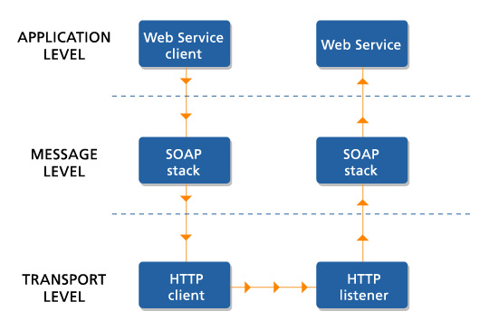
Web Service Interaction Levels

Slide 7
Transport Level Security
Uses existing Web tier technology such as HTTP and SSL
Authentication
  HTTP authentication schemes – Basic or Digest
  SSL client side certificates
Authorization
  URL access control policies in the web tier
  J2EE Servlet declarative security constraints
Confidentiality
  SSL encrypted connections
Integrity
  Point-to-point SSL encryption to avoid data interception

Slide 8
Message level security
Security data built in to the XML message text – usually as additional SOAP header fields
Authentication
  SSO (single sign-on) header tokens
  SAML authentication assertions
Authorization
  SSO session details
  SAML attribute assertions
Confidentiality
  XML Encryption specification
Integrity
  XML Digital Signatures specification

Slide 9
Application level security
A Web Service application handles its own security scheme – for example, UDDI
Authentication
  App specific authentication messages
  App specific credential headers in other messages
  App maintains its own security domain
Authorization
  App performs its own access control checks
Confidentially
  App can apply an encryption scheme to some or all data fields
Integrity
  XML Digital Signature can be used for tamper detection
  App specific integrity data such as MD5 hash can be sent for some or all data fields

Slide 10
Conclusions – Key Issues
A Web Services security framework must support existing security products
Must be an end-to-end framework to avoid any security gaps
New XML security specifications are not yet stabilized or proven
Use existing proven Web tier security infrastructure until XML security specifications and infrastructure is validated
WS-I Basic Security Profile will deliver a standardized XML security infrastructure over time

