Slide 1
Customization Using Interceptors
Using an interceptor-based framework for providing customized client-side and server-side Web Service extension behaviour
Jorgen Thelin
Chief Scientist
Cape Clear Software Inc.

Slide 2
Interceptors
Interceptors are a general purpose concept for customizing and controlling message processing
Interceptors provide a framework for changing the steps involved in processing a message
Interceptors can be used both server-side and client side

Slide 3
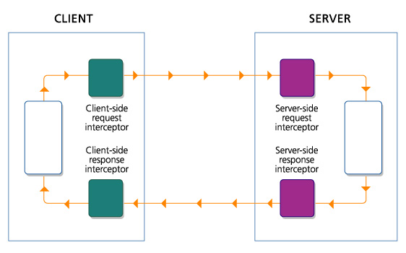
Interceptor Plugin Architecture

Slide 4
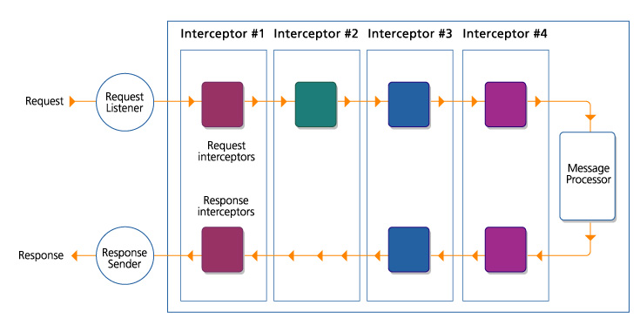
Interceptor Plugins – Server-side
Notes:
Some interceptors may only use the request interception point, some may have use the response interception points, and some may use both request and response interception points.

Slide 5
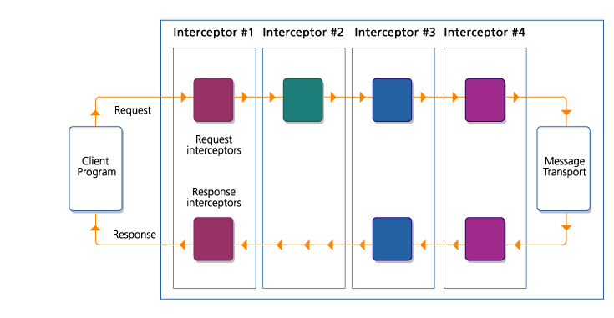
Interceptor Plugins – Client-side
Notes:
This is exactly symmetrical to the server-side case.
The message transport acts as the “pivot point” to handle the message – in this case by forwarding it to a remote server for processing.

Slide 6
Inbound and Outbound Interception Points
Often have similar functionality at “opposite” interceptor points
  Eg. Server-side response interceptor may encrypt data in the reply just like the client-side request interceptor encrypted data in the request message
The request message is:
  Outbound for the client
  Inbound for the server
The response message is:
  Inbound for the client
  Outbound for the server
Client
Server
Encrypt
Decrypt
Client
Program
Message
Transport
Message
Transport
Message
Processor
Decrypt
Encrypt

Slide 7
The “Interceptor-Pair” Concept
Usually require a pair of interceptors to fulfil a task
  One on the client side
    eg. Request interceptor which encrypts the data in a field
  One on the sever side
    eg. Request interceptor which decrypt the field data
The functions of the interceptor pair need to match up
  Eg. Both request interceptors cannot both encrypt or both decrypt
This is often referred to as an input-output interceptor pair
Client
Interceptor pair #1
Server
Encrypt
Decrypt
Client
Program
Message
Transport
Message
Transport
Message
Processor
Decrypt
Encrypt
Interceptor pair #2

Slide 8
JAX-RPC Handlers (aka “SOAP Interceptors”)
JAX-RPC Handlers
  Provide a standardized interface for a “SOAP interceptor” in Java
  Operate on the SOAP object model defined by SAAJ (SOAP with Attachments API for Java)
  Are part of the JAX-RPC extension module which will be in J2SE 1.4 and J2EE 1.4
  Provides a MessageContext object for passing call-related context information between interceptors and callbacks

Slide 9
JAX-RPC handler interface: javax.xml.rpc.handler.Handler
JAX-RPC interface javax.xml.rpc.handler.Handler
  Interception Operations:
    boolean handleRequest( MessageContext context )
      Called with each request message
    boolean handleResponse( MessageContext context )
      Called with each response message
    boolean handleFault( MessageContext context )
      Called with each fault message
  Interrogation Operations:
    QName[] getHeaders()
      The names of the header blocks processed by this Handler
  Lifecycle Operations:
    void init( HandlerInfo config )
      Called at the start of the lifecycle of the Handler instance
    void destroy()
      Called at the end of the lifecycle for the Handler instance.

Slide 10
Microsoft Web Service Extensions (WSE)
Web Services Enhancements 1.0 for Microsoft .NET
WSE is a class library that implements additional Web Services functionality and advanced protocols
  Diagnostics and tracing
  WS-Security
  WS-Routing
  WS-Referral
Provides a SoapContext object for passing call-related context information between interceptors and callbacks

Slide 11
WSE Filter Interfaces
Interface SoapOutputFilter
  Interception Operations:
    void ProcessMessage( SoapEnvelope envelope)
  Lifecycle Operations:
    Standard object constructor
    Standard object destructor
Interface SoapInputFilter
  Interception Operations:
    void ProcessMessage( SoapEnvelope envelope )
  Interrogation Operations:
    bool CanProcessHeader( XmlElement header, SoapContext context )
  Lifecycle Operations:
    Standard object constructor
    Standard object destructor

Slide 12
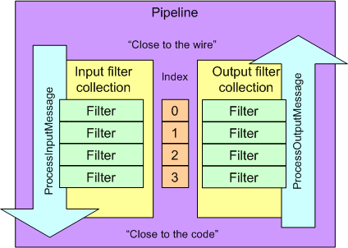
Microsoft Web Service Extensions (WSE) Framework
WSE is based on the architectural model of a pipeline of filters that process inbound and outbound SOAP messages
The pipeline controls execution order
Output filters are called in reverse order
Filters can be integrated with ASP.NET or used in standalone code
Filter ordering in the WSE pipeline
Source: MSDN
More info: http://msdn.microsoft.com/library/en-us/dnwebsrv/html/insidewsepipe.asp

Slide 13
WSE Built-in Filters
Namespace | Input Filter | Output Filter | Purpose
Microsoft .Web.Services .Diagnostics | TraceInputFilter | TraceOutputFilter | Write messages to log files to help with debugging
Microsoft .Web.Services .Security | SecurityInputFilter | SecurityOutputFilter | Authentication, signature and encryption support (WS-Security)
Microsoft .Web.Services .Timestamp | TimestampInputFilter | TimestampOutputFilter | Timestamp support (WS-Security)
Microsoft .Web.Services .Referral | ReferralInputFilter | ReferralOutputFilter | Dynamic updates to routing paths (WS-Referral)
Microsoft .Web.Services .Routing | RoutingInputFilter | RoutingOutputFilter | Message routing (WS-Routing)

Slide 14
Server-side Interceptors
Both JAX-RPC Handlers and .NET WSE Filters fit naturally as server-side interceptors
  Inbound interception points handle requests
  Outbound interception points handle response

Slide 15
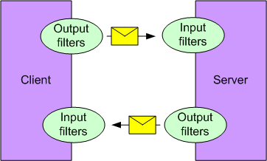
Client-side Interceptors – WSE Filters
.NET WSE Filters fit in naturally as client-side interceptors too
  Output filters handle requests
  Input filters handle responses
Can directly reuse filters written for server-side use
  Eg. Decryption interceptor is always an input filter
The WSE filter model
Source: MSDN

Slide 16
Client-side Interceptors – JAX-RPC Handlers
JAX-RPC Handlers do not fit so cleanly as client-side interceptors:
  handleRequest needs to do different things on the client-side (outbound) and server-side (inbound)
  handleResponse needs to do different things on the client-side (inbound) and server-side (outbound)
Need to write different JAX-RPC Handlers for client and server-side, or use a “configuration flag” to swap behaviour round
Client
Server
Request
Handler
Request
Handler
Client
Program
Message
Transport
Message
Transport
Message
Processor
Response
Handler
Response
Handler

Slide 17
Combining Interceptors in “Chains”
Interceptors are usually independent so can be combined to achieve a desired function
For example, implementing a security policy for a Web Service:
  An interceptor to decrypt a SOAP message which was transmitted using XML Encryption
  An interceptor to recognise and decode SAML authentication assertion carried in the WS-Security header of the SOAP message
  An interceptor to perform a role-based access control check that the caller is a member of the group of people permitted to call this operation

Slide 18
Interceptor Chain – Server-side
Notes:
Some interceptors may only use the request interception point, some may have use the response interception points, and some may use both request and response interception points.

Slide 19
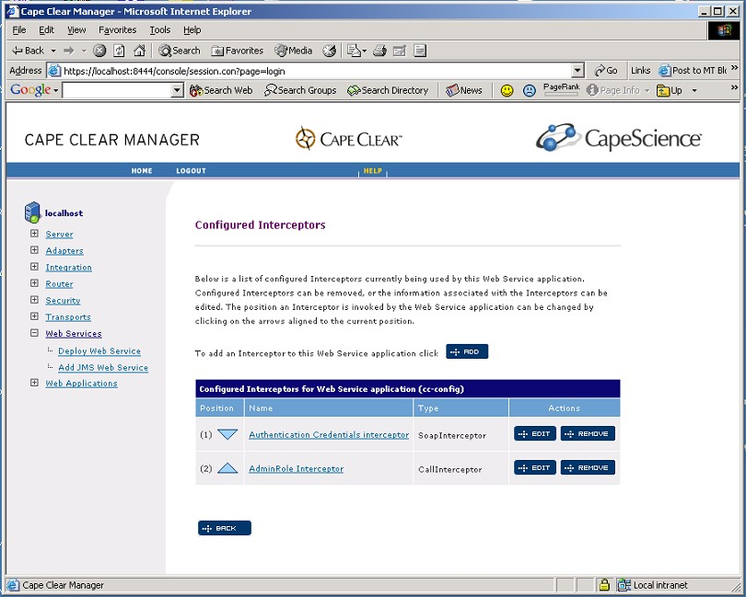
Interceptor Configuration in Cape Clear Server

Slide 20
Aspect-oriented Programming (AOP)
Aspect-oriented Programming (AOP) is a way of implementing separation of concerns (SOC) in software.
AOP make it possible to modularize crosscutting “aspects” or “concerns” of a system.
  For example:
    Logging policies
    Diagnostics
    Transactional contexts
    Security policy checks
Separation of Concerns (SOC) makes software much easier to develop, construct and understand
More info on AOP / AOSD at: http://aosd.net/

Slide 21
Interceptors as AOP
Interceptors are a form of Aspect-oriented Programming (AOP)
  Plug in an interceptor to deal with a specific function such as message validation or logging
  Can change the external visible behaviour by adding an interceptor to modify data before or after processing
  Can change the external visible behaviour by adding an interceptor to “short-circuit” processing
Interceptors provide an ideal way to implement reusable “policy” aspects of a system
  For example: Access-control checks
Interceptors provide an extensibility framework for Web Service protocols and applications
  For example: Adding WS-Security credentials

Slide 22
Example – Custom Authentication Headers
Scenario:
  Client program needs to communicate with a Web Service which requires an session-based authentication dialog
  When calling a “start session” operation, the response message contains a custom header which must be resubmitted with all future requests

Slide 23
Example – Custom Authentication Headers
Implementation:
  A custom client-side interceptor can be written to deal with this specific situation
  Client-side response interceptor:
    Preserve the authentication token found in the SOAP header of the response message
  Client-side request interceptor:
    Add any preserved authentication token into a SOAP header of the next request message

Slide 24
Example Code – Custom Auth Headers
public class SoapCorrelationHeaderInterceptor
implements Handler
{
SOAPHeaderElement correlationHeader; // OK for single-threaded client
String correlationHeaderElementNamespace;
String correlationHeaderElementName;
Name correlationHeaderName;
public void init( HandlerInfo info )
{
Map cfg = info.getHandlerConfig();
correlationHeaderElementNamespace = (String) cfg.get( "header.ns" );
correlationHeaderElementName = (String) cfg.get( "header.name" );
}
public void destroy()
{
}
public QName[] getHeaders()
{
return new QName[] {
new QName( correlationHeaderElementNamespace, correlationHeaderElementName )
};
}
// More below
}

Slide 25
Example Code – Custom Auth Headers
public boolean handleResponse( MessageContext context )
{
try {
// Dig into the response message and extract the contents of the token header
SOAPMessage soapMessage = ((SOAPMessageContext)context).getMessage();
SOAPEnvelope soapEnvelope = soapMessage.getSOAPPart().getEnvelope();
SOAPHeader soapHeaders = soapEnvelope.getHeader();
if (this.correlationHeaderName == null) {
this.correlationHeaderName = soapEnvelope.createName(
correlationHeaderElementName, null,
correlationHeaderElementNamespace );
}
if (soapHeaders != null) {
this.correlationHeader =
extractNamedHeader( correlationHeaderName, soapHeaders );
}
}
catch (SOAPException se) {
throw new JAXRPCExceptionImpl( se );
}
return true; // Continue processing
}

Slide 26
Example Code – Custom Auth Headers
protected SOAPHeaderElement extractNamedHeader(
Name headerName, SOAPHeader soapHeaders )
throws SOAPException
{
Iterator iter =
soapHeaders.getChildElements( headerName );
if (iter.hasNext()) {
SOAPHeaderElement soapHeaderField =
(SOAPHeaderElement) iter.next();
// Remove from SOAP Message element tree
return soapHeaderField.detachNode();
}
else {
return null;
}
}

Slide 27
Example Code – Custom Auth Headers
public boolean handleRequest( MessageContext context )
{
if (this.correlationHeader != null) {
try {
// Dig into the request message and add the contents of the token header
SOAPMessage soapMessage = ((SOAPMessageContext)context).getMessage();
SOAPEnvelope soapEnvelope = soapMessage.getSOAPPart().getEnvelope();
SOAPHeader soapHeaders = soapEnvelope.getHeader();
if (soapHeaders == null) { soapHeaders = soapEnvelope.addHeader(); }
soapHeaders.addChildElement( this.correlationHeader );
}
catch (SOAPException se) {
throw new JAXRPCExceptionImpl( se );
}
}
return true; // Continue processing
}
public boolean handleFault( MessageContext context )
{
return true; // Continue processing
}

Slide 28
Conclusion
Interceptors provide a highly extensible processing architecture
Interceptors allow incremental enhancements to functionality through writing small amounts of code
Interceptors are the way enhanced protocol support is being added to SOAP platforms
Interceptors provide an ideal way to implement custom security logic for Web Services

