Slide 1
Observational Data

Slide 2
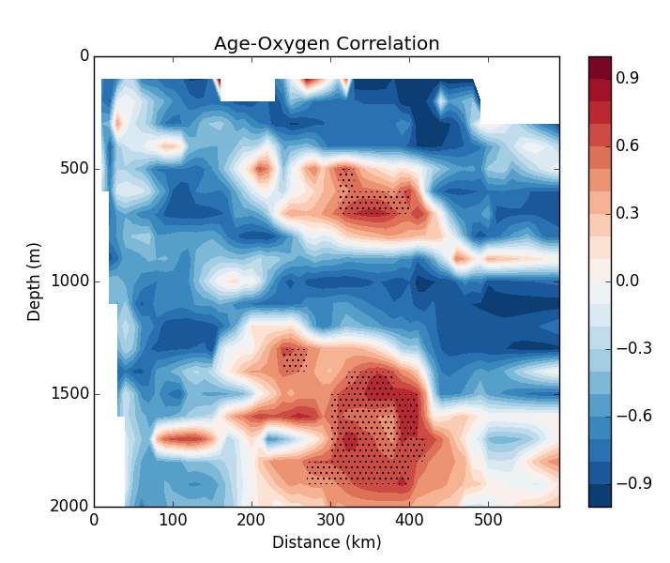
Age and oxygen are typically assumed to be negatively correlated.
Observational analysis shows two regions of positive correlation: One at depth 500m and 300-400km away from coast. The other deeper at 1500-2000m depth.
Most interestingly, the only features that are statically significant are the two positive correlation regions.
Figure 1: Age-oxygen correlation along Line-W. Stippling indicates statically significant correlation at the 95% confidence level.

Slide 3
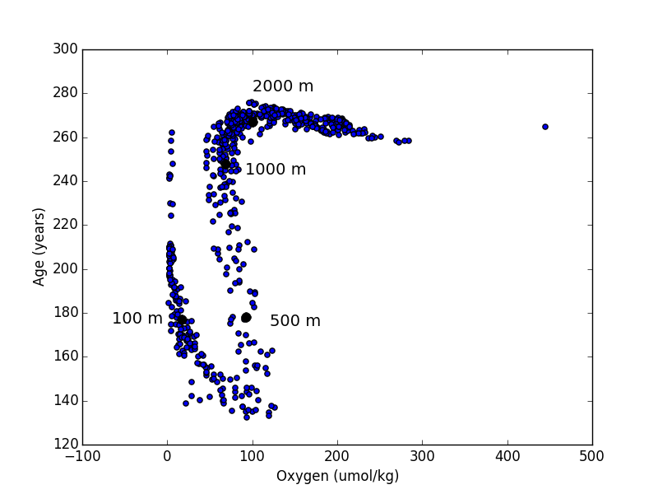
Looking at the age vs oxygen scatter plot for the year 2003, we see a distinctive S-shape curve.
Following from left to right along the curve approximately follows the depth in the water column.
The two positive correlation regions from Figure 1 occur around depths 500 m and 1500 m. These depths correspond to the bottom of the S-curve and top of the S-curve (need a better way to show this).
Figure 2: Age vs oxygen diagram for Line-w data (year 2003). Black dots indicate approximate depth levels.

Slide 4
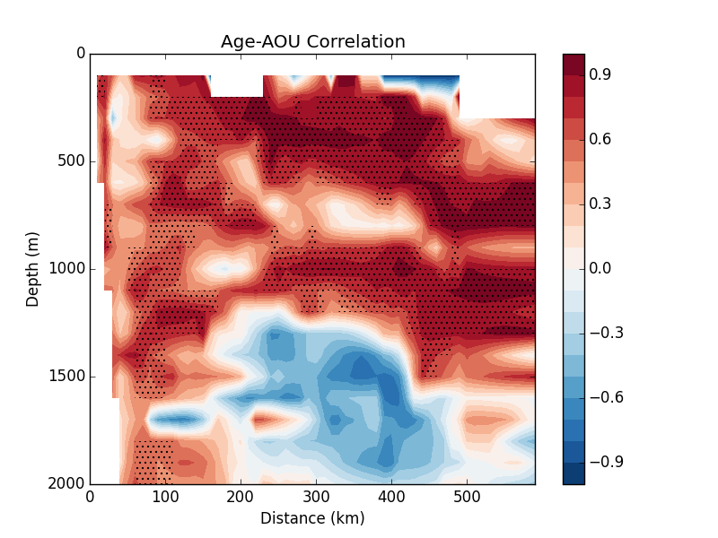
AOU = O₂ _{sat} - O₂
Age and apparent oxygen utilization (AOU) are typically assumed to be positively correlated.
Observational analysis shows one region of negative correlation (1500-2000 m depth).
This is surprisingly different than the Age-O₂ correlation (Figure 1) which has two regions of positive correlation.
Figure 3: Age-AOU correlation along Line-W. Stippling indicates statically significant correlation at the 95% confidence level.

Slide 5
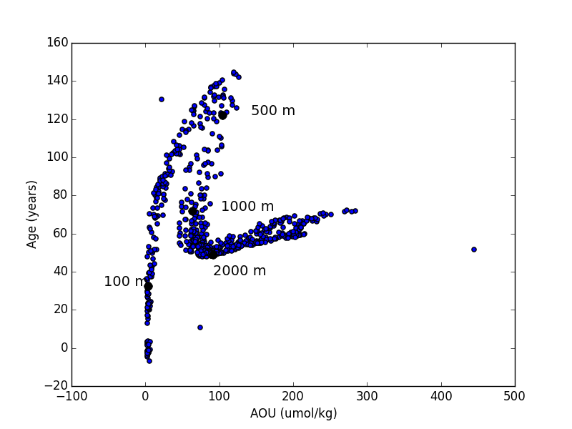
Figure 4: Age vs AOU diagram for Line-W data (year 2003). Black dots indicate approximate depth levels.

Slide 6
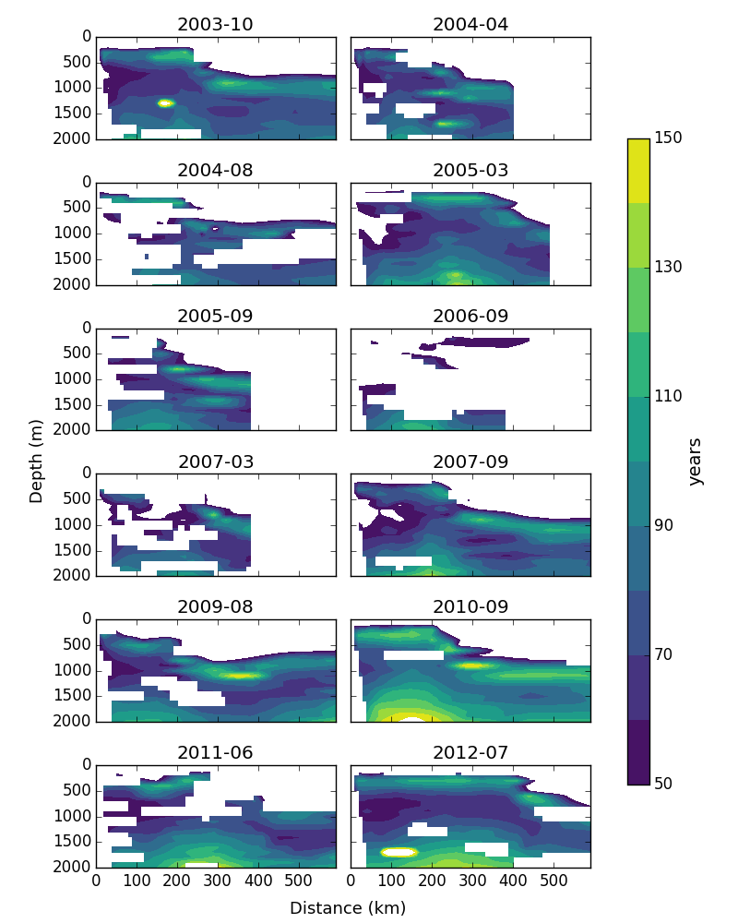
Figure 5: Age observational values for each year with available data. White areas designate missing values.

Slide 7
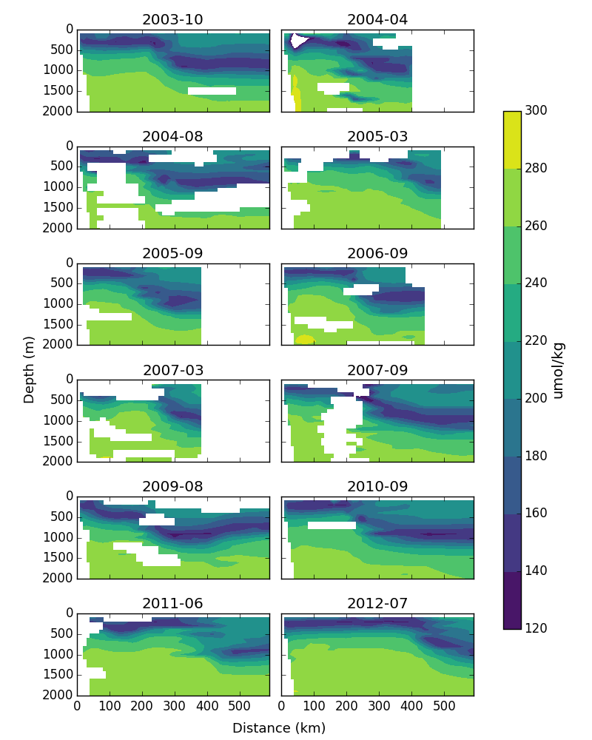
Figure 6: Oxygen observational values for each year with available data. White areas designate missing values.

Slide 8
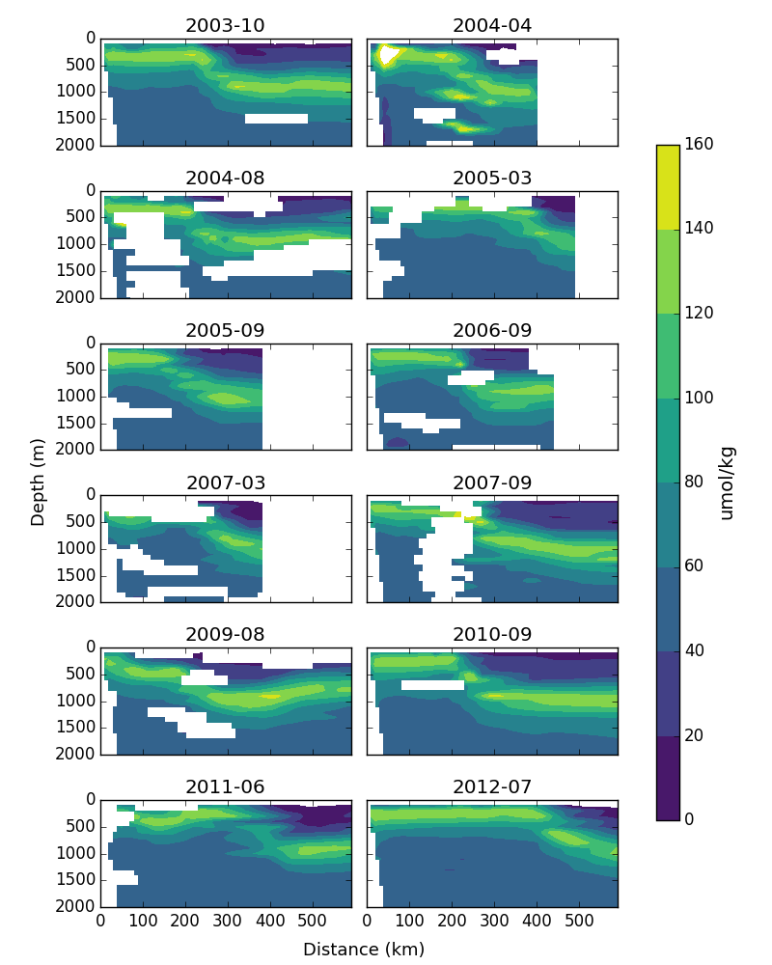
Figure 7: Apparent oxygen utilization observational values for each year with available data. White areas designate missing values.

Slide 9
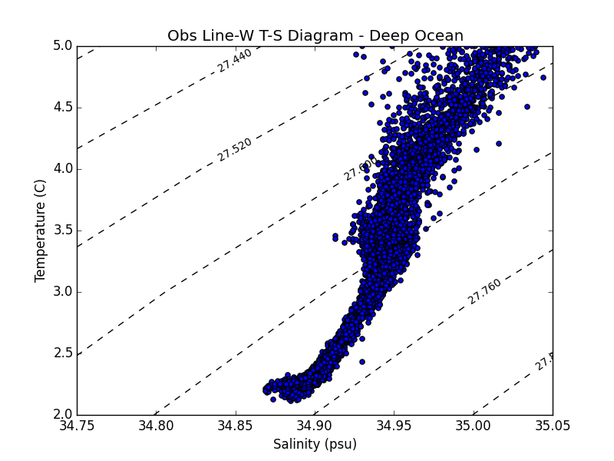
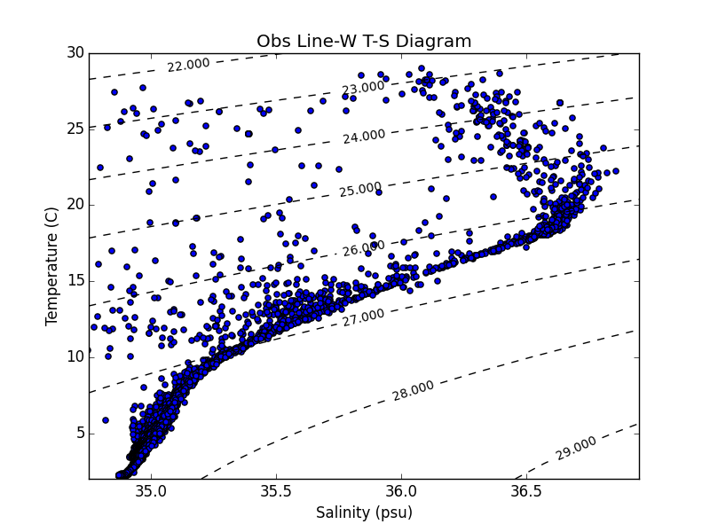
Figure 8: Temperature-salinity diagram for deep Line-W observations (to be compared with de Bras, 2017). Dashed lines indicate density contours.
Figure 9: Temperature-salinity diagram for all Line-W observations. Dashed lines indicate density contours.

Slide 10
ESM2Mc Data

Slide 11
Positive correlation region at depth 500 m and along isopycnal surface 27 is consistent with observational data.
Interestingly, deep positive correlation seen in observations missing in model analysis.
Figure 10: (a) Age-oxygen correlation (b) oxygen climatology and (c) age climatology in ESM2Mc along Line-W.

Slide 12
Lack of negative Age-AOU correlation along isopycnal surface 27 suggests previous signal is solely due to temperature influences on O₂ solubility.
Figure 10: (a) Age-AOU correlation (b) AOU climatology and (c) age climatology in ESM2Mc along Line-W.

Slide 13
Figure 11: (a) Age-PO₄ correlation (b) AOU climatology and (c) age climatology in ESM2Mc along Line-W.

Slide 14
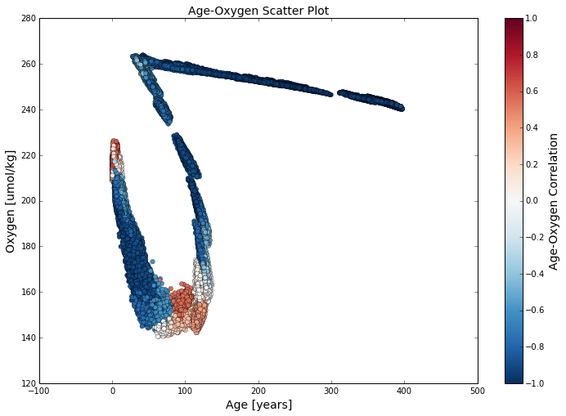

Slide 15
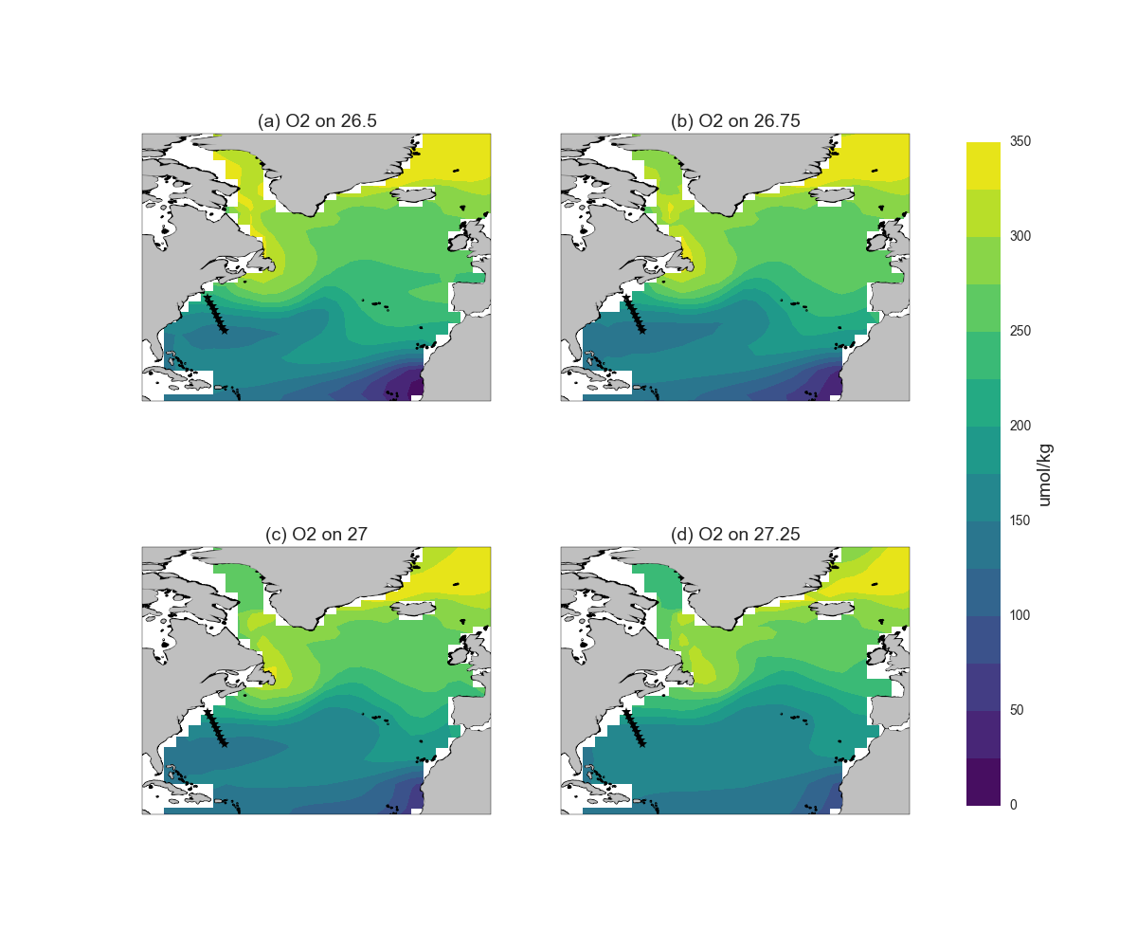

Slide 16
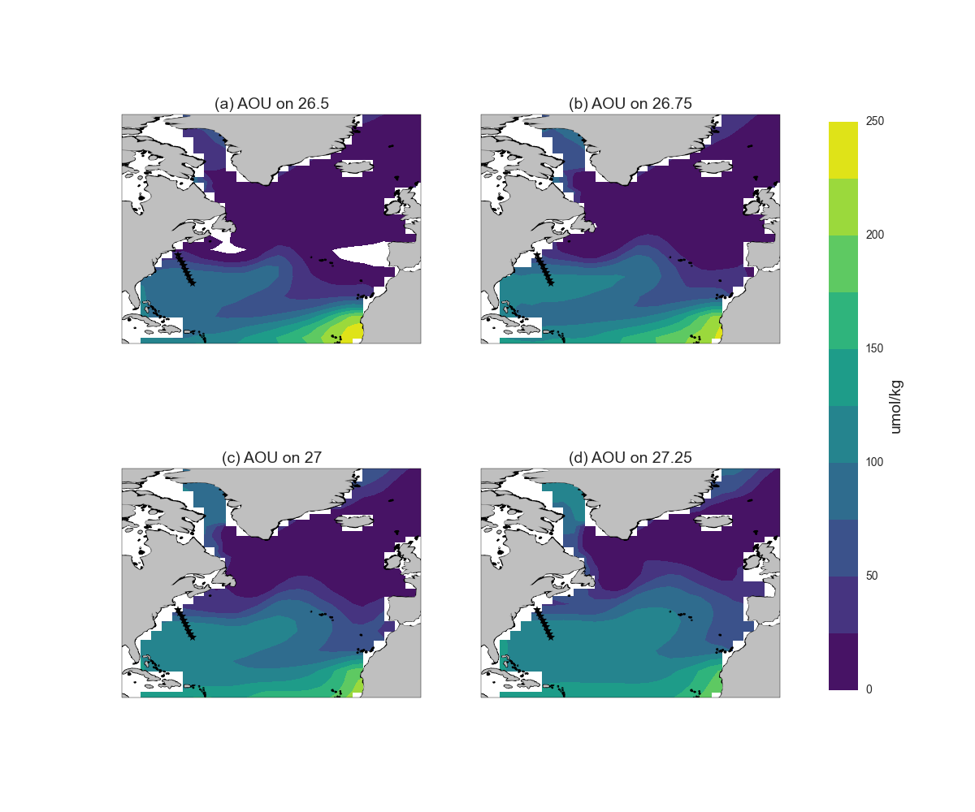

Slide 17
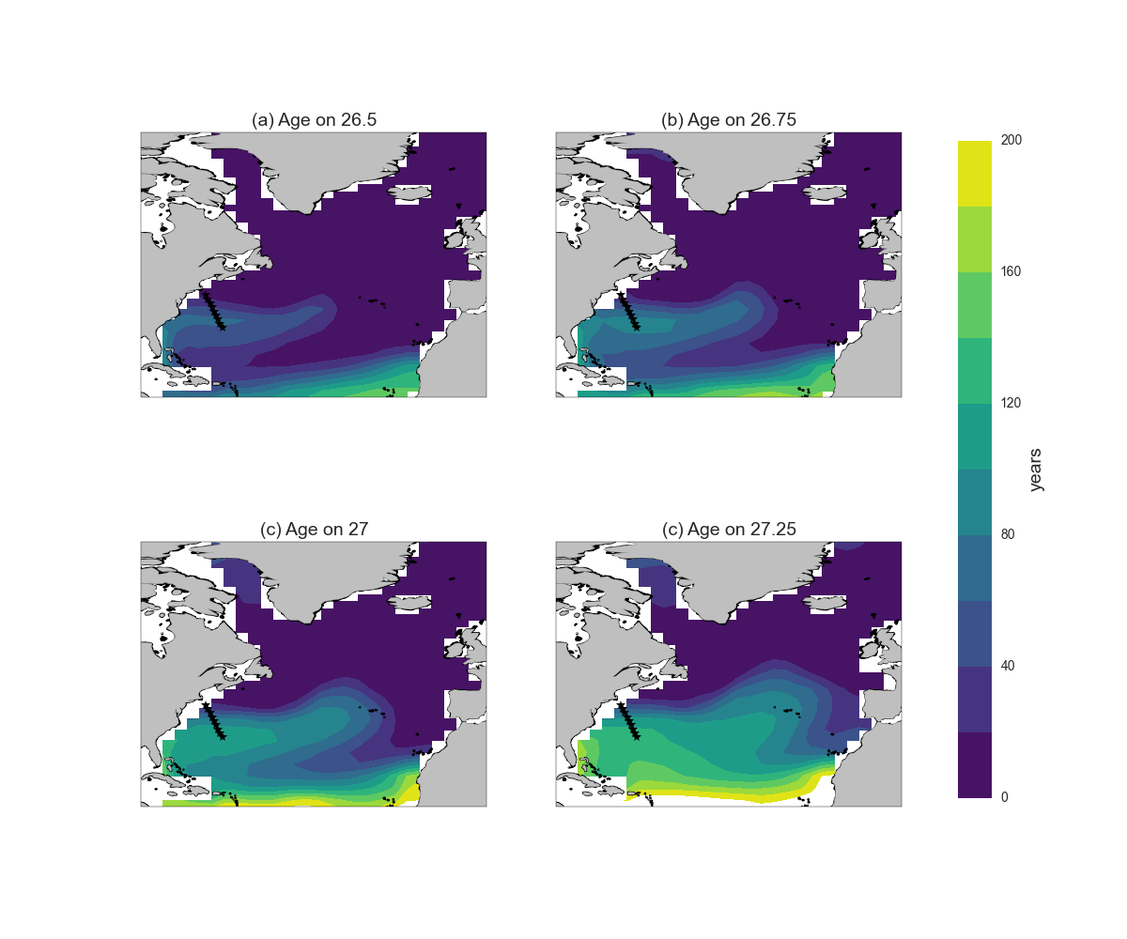

Slide 18
