Slide 1
Introduction
Background:
Understanding the age of water is important. Used to understand how ocean circulation is changing with anthropogenic forcing.
CFCs can be used to infer the age of water, however there are complications. Hard to reconcile ages given by different tracers. As CFCs have been regulated no longer provide information.
CFC measurements are not ubiquitous and we do often do not have as long of an observational record.
Idea to use oxygen measurements as a proxy for age in assessing oceanic ventilation.
Oxygen is consumed as a water mass moves through the ocean, tracer age increases as water moves away from the surface. This should result in a negative relationship between age and oxygen.
Gnanadesikan et al., 2012 show a robust relationship between the simulated change in age and change in oxygen in response to a global warming forcing (Gnanadesikan et al, 2012 – figure 3).
Paper Aim:
Investigate the relationship between age and oxygen in the North Atlantic on Line W.
Can dissolved oxygen be used as a proxy for tracer age?
Do I want to include MOC variability?
Notes:
Line w has temporal variability…
General correspondence between age and oxygen structure (snapshops)
No study that looks at the decadal/interannual variability.

Slide 2
Methods
Observational Data
Observational data information, cruise, ect.
Mean age calculation
Data regridding
Model Simulation
Model information
GFDL ESM2Mc (Galbraith et al., 2011), coarse resolution version of GFDL ESM2M (Dunne at al., 2012).
Description found in Section/Paper XXX.
Quantify important N. Atlantic climatologies? (MOC… ect.)
Regridding to Line W
In order to compare with Line W observations, model was interpolated to Line W.
Variables/quantities
Ideal age, ect.
Figure showing interpolation and climatologies (temperature and salinity)

Slide 3
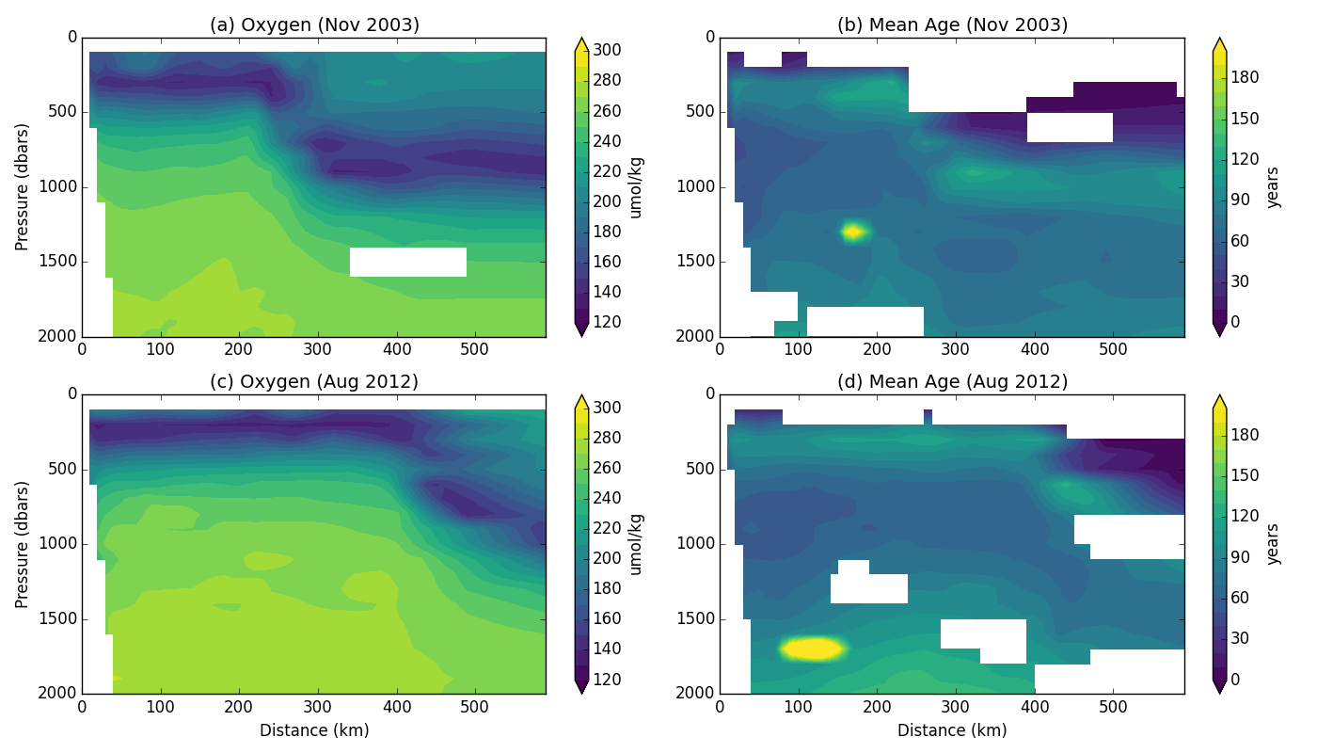
Results – Observations
Need to add neutral density surfaces.
Figure 1: Observations along Line-W for (left) oxygen concentration and (right)
mean age for observation years (top) November 2003 and (bottom) August 2012.
Oxygen and mean age are seemingly negatively correlated along Line W.
Don’t know what to talk about with this figure… change over the 10 year period… differences between oxygen and age.
Notes:
Time series at a few locations… one with negative corr, one with pos corr
Add countours (either neutral density or age/o2) vertical profile is offset

Slide 4
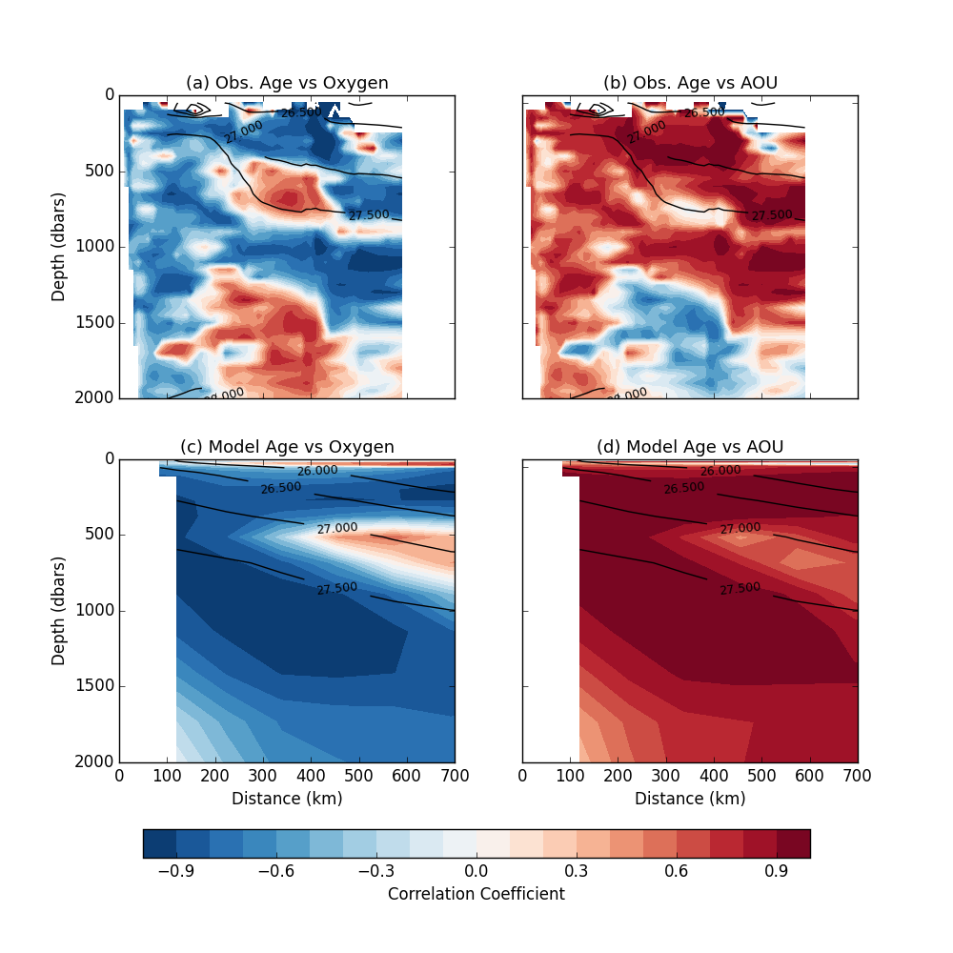
Age-Oxygen Correlation:
Unexpected positive correlation in two regions along Line-W: one at approximate depth 500 m. The other deeper around 1500-2000 m.
Age-AOU Correlation:
Upper region of anomalous correlation disappears (or is reduced).
Lower region of anomalous correlation is consistent with Age-Oxygen correlation.
Figure 2: Pearson correlation coefficients for age versus (left) oxygen and (right) AOU for both (top) Line W observations and (bottom) ESM2Mc model interpolated to Line W. Contour lines indicate neutral density climatology.

Slide 5
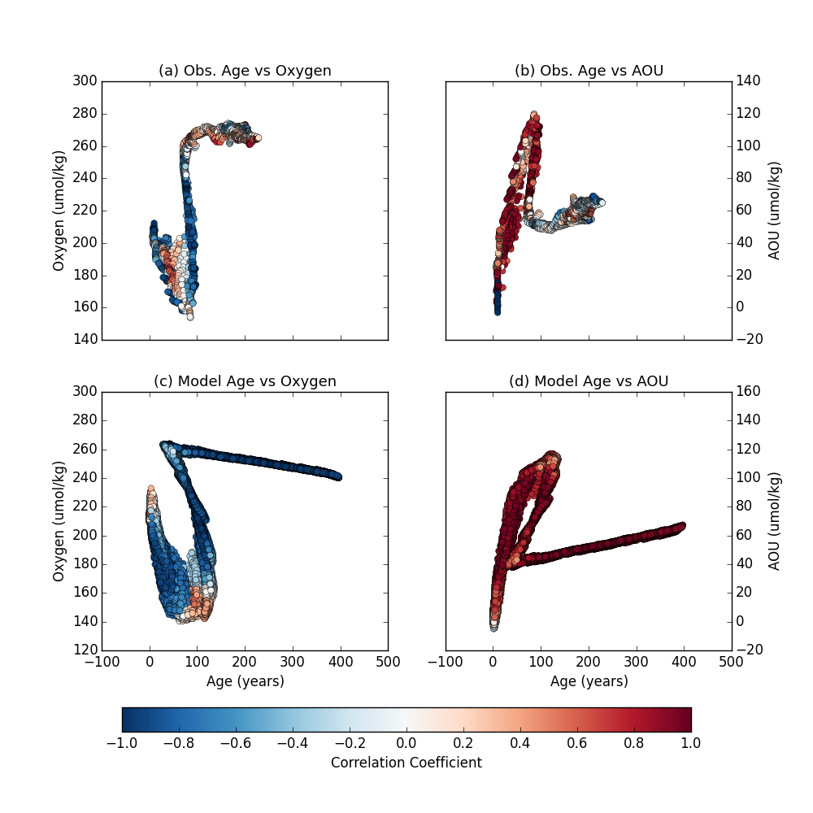
Age-Oxygen/AOU Scatterplot
S-shape in Age-oxygen scatterplot.
Roughly follows depth.
Positive correlations occur at ‘bends’ in S-shape.
Anomalous correlations occur where the age and o2 are offset
Figure 3: Scatter plots for age versus (left) oxygen and (right)
AOU for both (top) Line W observations and (bottom) ESM2Mc model interpolated to Line W. Note scatter plot is colored to represent each points correlation coefficient between the respective variables.

Slide 6
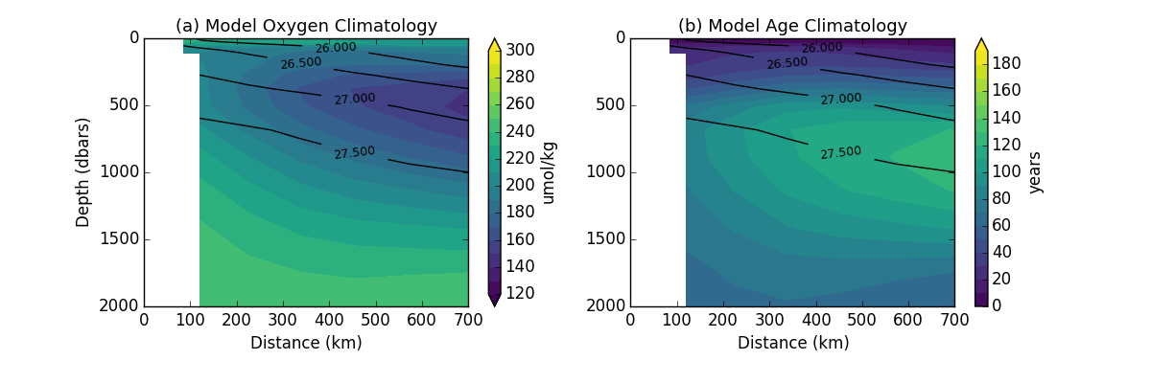
Results - Model
Figure 4: Model climatology for (a) oxygen and (b) ideal age. Black contour lines represent mean neutral density.
Comparison of model Line W climatologies to observational data.
Slight offset between depth of the oxygen minimum (on neutral density surface 27) and depth of the ideal age maximum (on neutral density surface 27.5).
These vertical profiles are likely contributing to the negative correlation between oxygen and age in this region. Why do are the maxima/minima offset?

Slide 7
Model Age-Oxygen Correlation:
Model simulation shows similar upper region of positive correlation.
‘Missing’ deeper region of positive correlation.
Model Age-AOU Correlation:
Model simulation consistent with observations. Anomalous correlation region is diminished when removing temperature influence.
Figure 2: Pearson correlation coefficients for age versus (left) oxygen and (right) AOU for both (top) Line W observations and (bottom) ESM2Mc model interpolated to Line W. Contour lines indicate neutral density climatology.

Slide 8
Model Age-Oxygen/AOU Scatterplot
Similar shape to observational data.
Positive correlation occurs in ‘bend’
Missing the same ‘bend’ in the deeper region.
Figure 3: Scatter plots for age versus (left) oxygen and (right)
AOU for both (top) Line W observations and (bottom) ESM2Mc model interpolated to Line W. Note scatter plot is colored to represent each points correlation coefficient between the respective variables.

Slide 9
Mechanisms causing positive correlation
Upper region of positive correlation:
Hypothesis: isopycnal heave
Oxygen utilization is not spatially uniform…

Slide 10
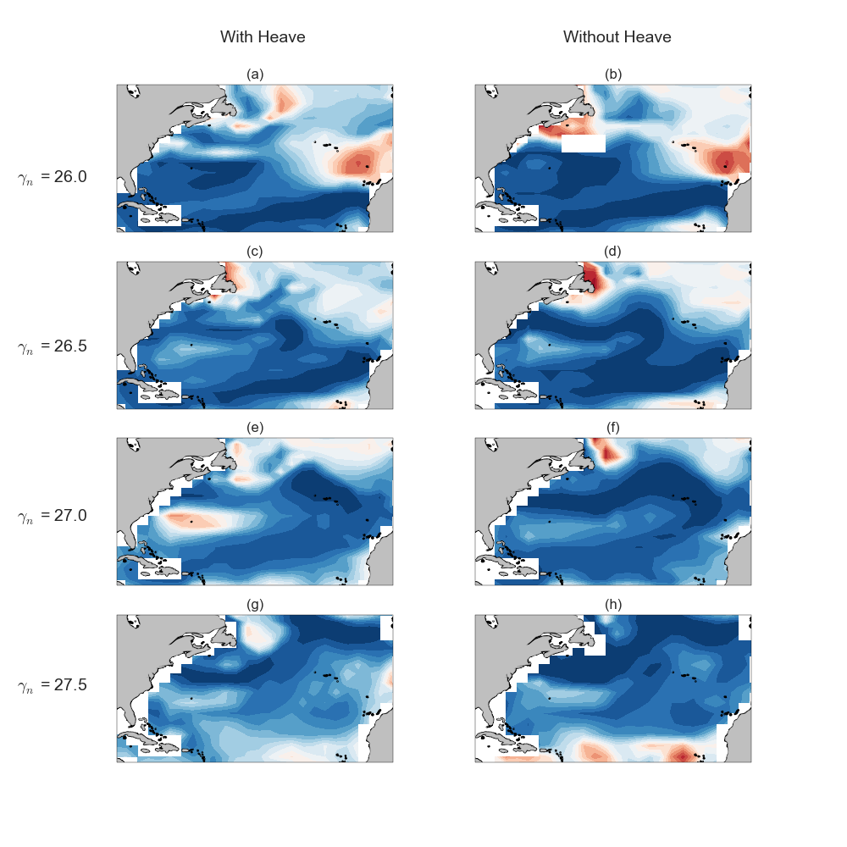

Slide 11
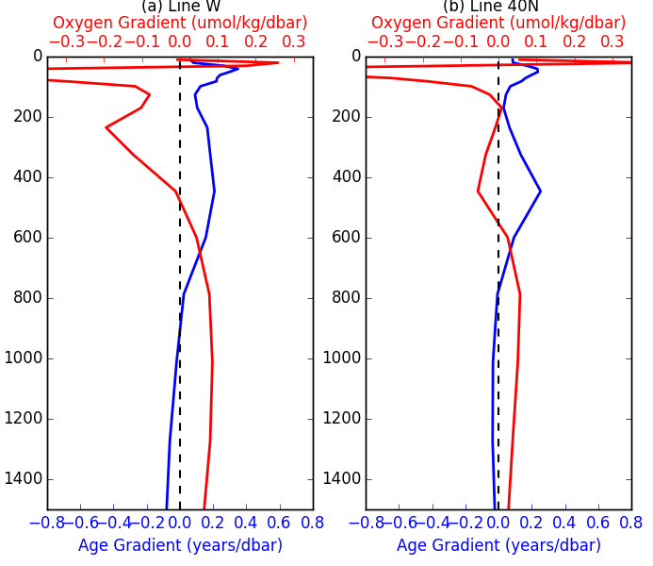
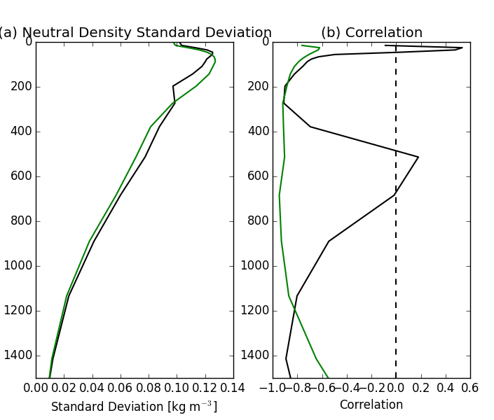

Slide 12
Conclusions
Main Results:
Line W is strange…
Shortcomings:
Implications for future work:
**** Sarmiento 1982 – figures

