Slide 1
Ocean Carbon and Heat Variability in an Earth System Model
Jordan Thomas
The Johns Hopkins University
FESD Meeting June 07, 2016

Slide 2
Ocean Carbon and Heat
Heat and carbon is important in the earth system.
The ocean is the largest reservoir of carbon on short timescales.
Most of the heat and carbon that enter the ocean does so in the Southern Ocean (Frölicher et al, 2015; Sabine et al, 2005).
Reasonable to speculate that the ozone hole could affect the amount and rate of carbon and heat uptake by the ocean.
1

Slide 3
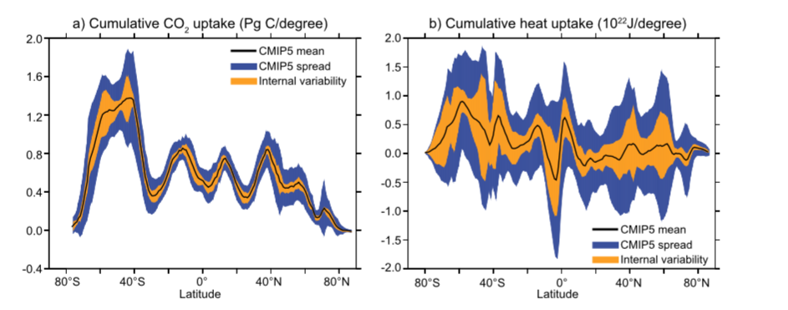
Ocean Carbon and Heat
Frölicher et al., 2015
2
Notes:
----- Meeting Notes (6/6/16 21:59) -----
what kind of simulation?

Slide 4
Ocean Carbon and Heat
Frölicher et al., 2015
High anthropogenic carbon uptake in Southern Ocean.
High anthropogenic heat uptake in Southern Hemisphere.
2
Notes:
----- Meeting Notes (6/6/16 21:59) -----
what kind of simulation?

Slide 5
Ocean Carbon and Heat
Frölicher et al., 2015
High anthropogenic carbon uptake in Southern Ocean.
Decent agreement among models.
High anthropogenic heat uptake in Southern Hemisphere.
Not good agreement among models.
2
Notes:
----- Meeting Notes (6/6/16 21:59) -----
what kind of simulation?

Slide 6
Ocean Carbon and Heat
What is ocean carbon and heat doing in our model?
How does Weddell Sea deep convection change ocean carbon and heat?
3

Slide 7
GFDL ESM2Mc
A coarse-resolution version of GFDL ESM2M (Dunne et al., 2012).
Atmospheric resolution of 3.875º x 3º with 24 vertical levels.
Ocean resolution of 3º x 1.5º with 28 vertical levels.
Complex biogeochemistry model (BLING) and tracers.
Full list of specifications in Galbraith et al. (2011).
3

Slide 8
GFDL ESM2Mc
A coarse-resolution version of GFDL ESM2M (Dunne et al., 2012).
Atmospheric resolution of 3.875º x 3º with 24 vertical levels.
Ocean resolution of 3º x 1.5º with 28 vertical levels.
Complex biogeochemistry model (BLING) and tracers.
Full list of specifications in Galbraith et al. (2011).
Pre-industrial control model simulation to asses natural variability.
3

Slide 9
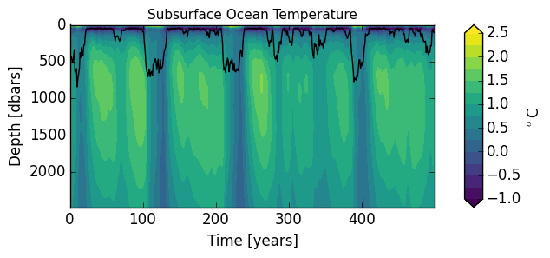
GFDL ESM2Mc
Intense convective variability in the Weddell Sea.
Consistent with:
Bernadello et al., 2015
Martin et al., 2012
4
Notes:
Plot Sea Ice during convection??

Slide 10
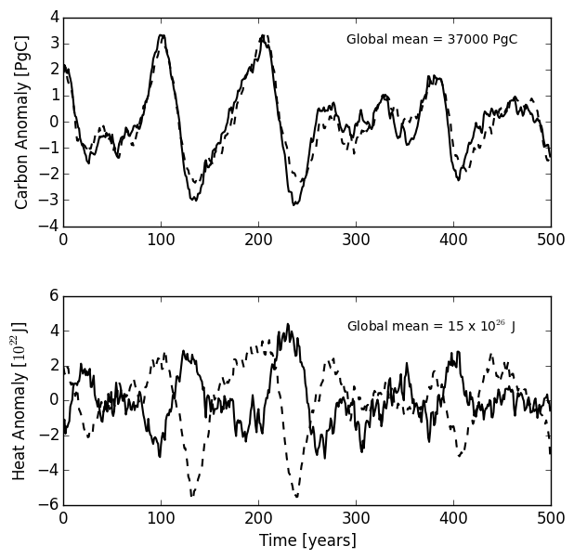
Ocean Carbon Content:
Ocean Heat Content:
Solid = global
Dashed = Southern Ocean
5
Notes:
Need to add mean carbon and heat value and legend.

Slide 11
Ocean Carbon Content:
Ocean Heat Content:
Agreement between Southern Ocean and global signal.
Solid = global
Dashed = Southern Ocean
5
Notes:
Need to add mean carbon and heat value and legend.

Slide 12
Ocean Carbon Content:
Ocean Heat Content:
Agreement between Southern Ocean and global signal.
Global signal is out of phase with Southern Ocean.
Solid = global
Dashed = Southern Ocean
5
Notes:
Need to add mean carbon and heat value and legend.

Slide 13
Ocean Carbon Content:
Ocean Heat Content:
Solid = global
Dashed = Southern Ocean
5
Notes:
Need to add mean carbon and heat value and legend.

Slide 14
Ocean Carbon Content:
Ocean Heat Content:
Solid = global
Dashed = Southern Ocean
5
Notes:
Need to add mean carbon and heat value and legend.

Slide 15
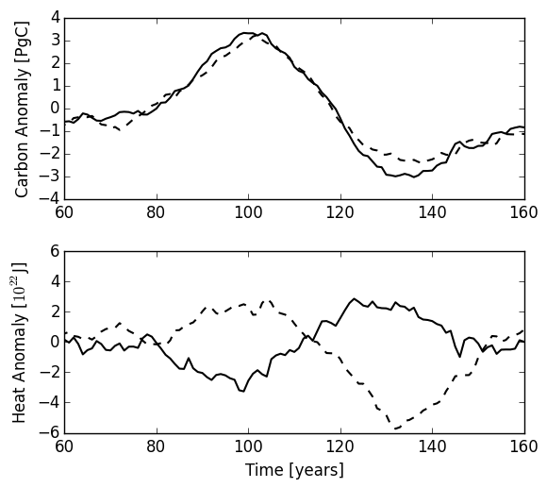
Solid = global
Dashed = Southern Ocean
6

Slide 16
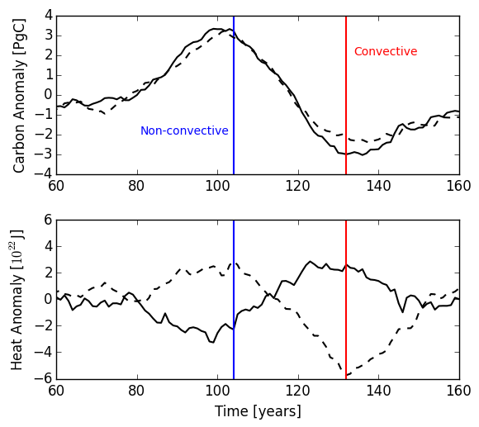
Solid = global
Dashed = Southern Ocean
6

Slide 17
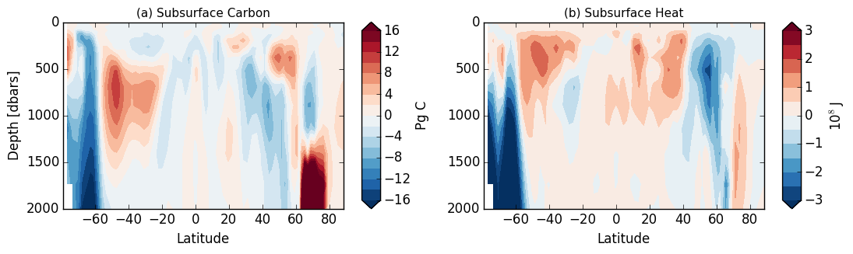
convective – non-convective
7

Slide 18
During Convection:
Southern ocean depletion of carbon and heat
7

Slide 19
During Convection:
Southern ocean depletion of carbon and heat
Mid-latitude increase in carbon and heat – at different depths
7

Slide 20
During Convection:
Southern ocean depletion of carbon and heat
Mid-latitude increase in carbon and heat – at different depths
Large scale surface warming
7

Slide 21
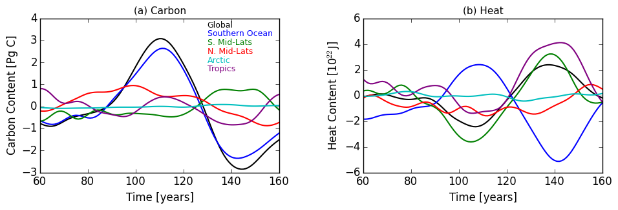
8

Slide 22
Southern Ocean dominates variability over the convective cycle.
8

Slide 23
Southern Ocean dominates variability over the convective cycle.
Southern Ocean out of phase with global heat content.
Tropics and N. mid-latitudes contribute to the heat content increase seen in the global signal.
8

Slide 24
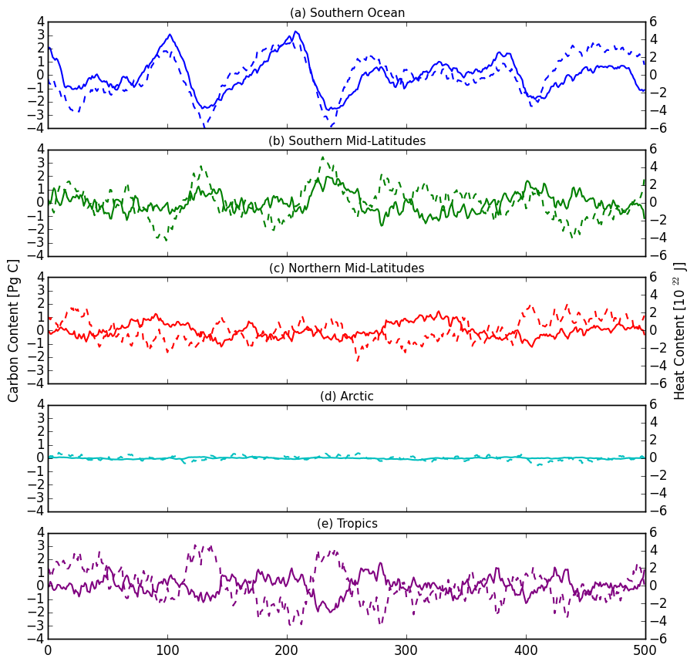
Solid = carbon content
Dashed = heat content
9

Slide 25
Global carbon content is dominated by Southern Ocean variability
Global heat content is out of phase with the Southern Ocean.
Warming in tropics and Southern Hemisphere mid-latitudes.
10

Slide 26
Global carbon content is dominated by Southern Ocean variability
Global heat content is out of phase with the Southern Ocean.
Warming in tropics and Southern Hemisphere mid-latitudes.
Does this relation hold with different convective variability?
What causes tropical and mid-latitude warming during convection?
10

Slide 27
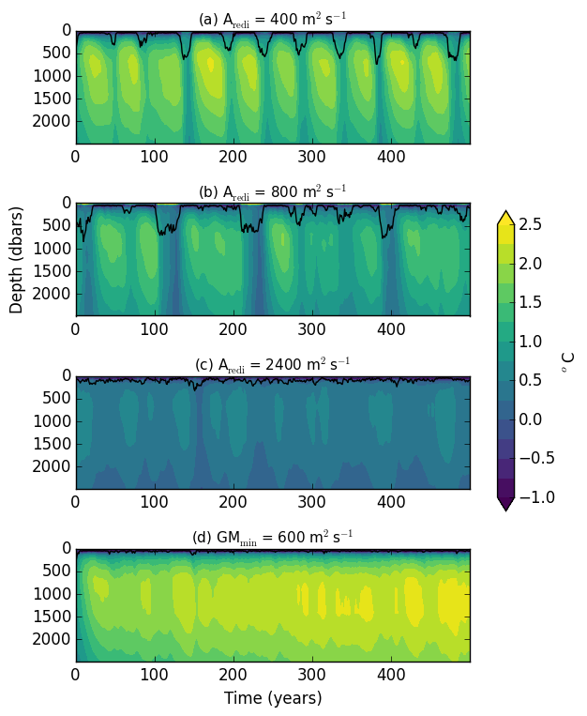
A_{redi} = 400 m²s⁻¹: Low Aredi
very regular, distinct convective events.
A_{redi} = 800 m²s⁻¹: Control
Sporadic strong convective events
A_{redi} = 2400 m²s⁻¹: High Aredi
Constantly convecting
GM_{min} = 600 m²s⁻¹: High GM
No Convection
11

Slide 28
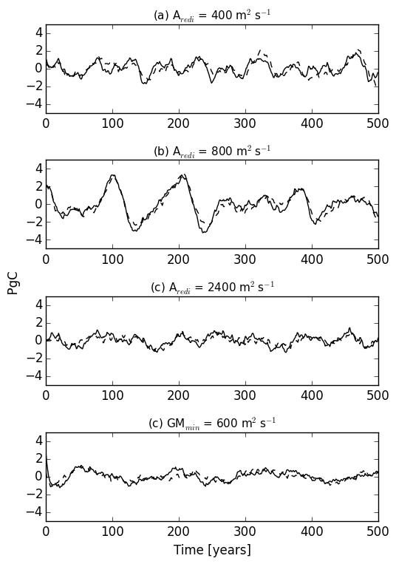
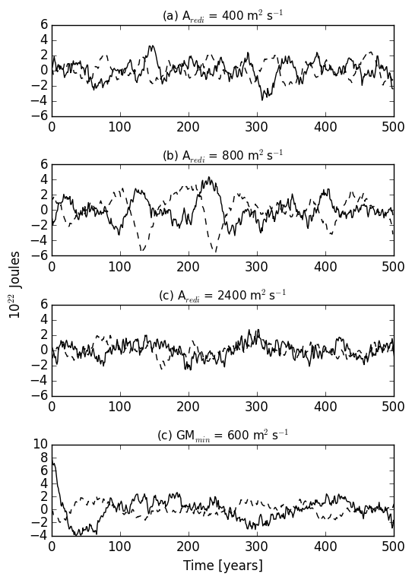
Ocean Carbon Content: Ocean Heat Content:
12

Slide 29
What causes warming in Southern Hemisphere Mid-latitudes and Tropics?
Strong warming at the surface suggests atmospheric feedback.
Possible Hypothesis:
Heat release in Weddell Sea during convection increases sea surface temperature.
Increase in sea surface temperature then increases atmospheric water vapor content, thus causing an increase in greenhouse effect.
Warms the upper layer of ocean surface.
13

Slide 30
Is there an increase in the Greenhouse effect during convection?
G = strength of the Greenhouse Effect
E = Longwave flux emitted by the Earth’s surface
F = Longwave flux leaving the Earth at the top of the atmosphere.
14

Slide 31
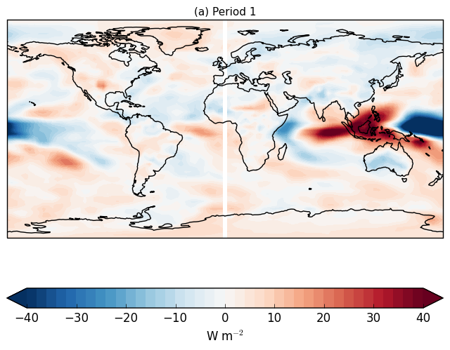
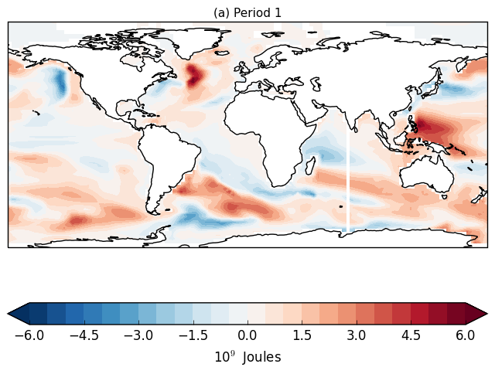
Is there an increase in the Greenhouse effect during convection?
(a) Greenhouse Strength
(b) OHC top 1000m
Same spatial pattern holds for all 3 convective events.
15

Slide 32
Is there an increase in the Greenhouse effect during convection?
Evidence for increase in Greenhouse effect strength during convection – especially over Indonesia.
Doesn’t explain surface water temperature increase in Southern Ocean.
Still need to investigate this hypothesis further.
Water vapor content.
Surface air temperature.
16

Slide 33
Summary
In ESM2Mc, Weddell Sea deep convection dominates the natural variability in heat and carbon content.
These deep convective events result in a decrease in global carbon content, but an increase in global heat content.
Increase in heat content due to increase in tropical surface heat.
This pattern is consistent across model runs with different convective variability.
Still uncertain about cause of tropical variability.
17

Slide 34
Ocean Carbon Content: Ocean Heat Content:
Mean = 3.70 x 10¹⁹ g C
Mean = 15.38 x 10²⁶ J
Mean = 3.69 x 10¹⁹ g C
Mean = 15.36 x 10²⁶ J
Mean = 3.67 x 10¹⁹ g C
Mean = 15.33 x 10²⁶ J
Mean = 3.69 x 10¹⁹ g C
Mean = 15.36 x 10²⁶ J

