Slide 1
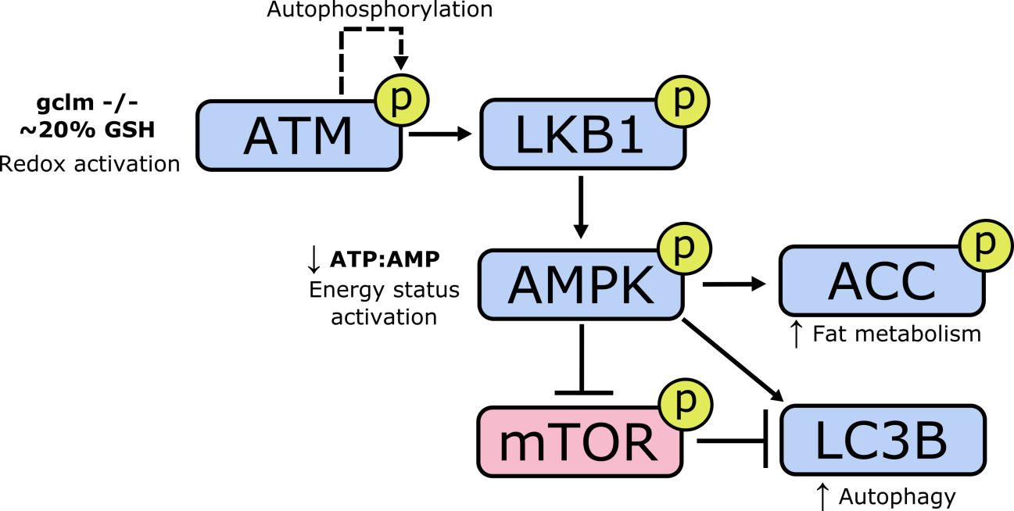
☺ not_a_picture ☺

