Slide 1
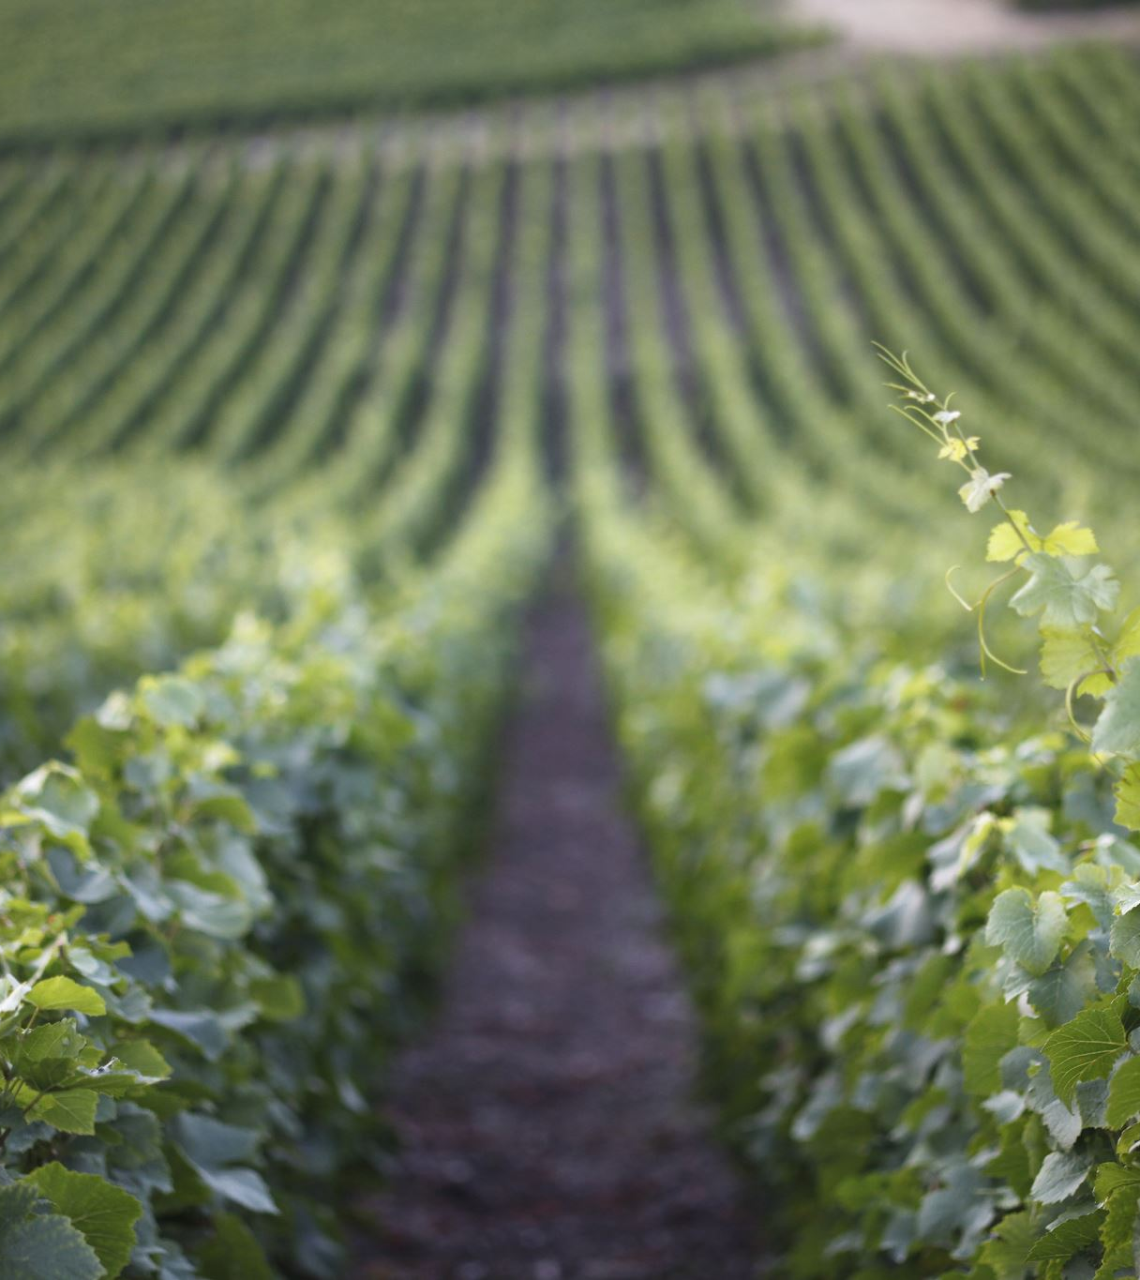

Charlie: Assignment 12.2
Marie Battle, Joshua Hamm, Kody Pope, & Jacob Thompson
12-12-23

Slide 2
Introduction
Jacob Thompson
Database developer. Ensures database aligns with the business rules and the ERD (Entity Relationship Diagram).
I believe that with a database such as the one provided, I feel confident we can help your team ensure that your questions and concerns will be answered. These solutions will help with future endeavors and provide Bacchus with the tools to bring this winery into the future.

Slide 3
Introduction
Marie Battle
ERD Development Lead. Captures the data structure and relationships of the winery's various entities, enabling efficient data management and system integration.
I see great potential in Bacchus Winery. I believe that with the right improvements and marketing strategies, the winery has the opportunity to attract a larger customer base and increase sales. I'm eager to explore new marketing avenues, such as enhancing the winery’s online presence, to reach a wider audience and establish Bacchus Winery as a renowned name in the industry. My passion for Baccus Winery stems from a combination of personal attachment, entrepreneurial drive, passion for wine, and the belief in the winery’s potential for growth and success.

Slide 4
Introduction
Kody Pope
Director of Sales. I help the team gather the intel needed and am responsible for conveying the information to Bacchus Management.
Here at Charlie's Database Management, we help your company stay on track by providing an easy-to-read database. Our solutions will help keep track of whatever your company needs to stay on target. We will provide Bacchus Winery with tools that will help show employee hours, distribution inquiries, and supplier performance. Many clients have enjoyed are quick turnaround by providing a complete ready-to-use database in as little as two weeks.

Slide 5
Introduction
Joshua Hamm
Database developer. Ensures business rules, client needs, and ERD meets standards.
As a developer with Charlie's Database Management, I work in a team environment to ensure productivity, industry standards, and compliance. I work closely with clients, developers, and other team members to make sure project goals align with client needs. With these combined skills and proficiencies, our developer team will work with Bacchus Winery to enhance productivity and revenue.

Slide 6


Case Study
Bacchus Winery is a family-owned business that was inherited by Stan and Davis Bacchus from their father.
Mr. Bacchus
Davis
Stan

Slide 7


Case Study
They are eager to modernize the winery by implementing new business methods to enhance their products and customer service.

Slide 8
Case Study
Despite their desire for change, they decided to retain the existing personnel to minimize disruption during the transition.
Stan and Davis are responsible for inventory management.
They wish to find a more efficient method, potentially through online ordering.
Maria is in charge of distributors and implementing shipment tracking, and she also wants to minimize disruption during the transition.
With the annual business report approaching, Stan and Davis require specific information to assess the state of inventory, distribution, and employee performance.

Slide 9
They need insights into the following areas:
Supplier performance: Are all suppliers delivering on time? Is there a significant gap between expected and actual delivery times? They would like a month-by-month report to identify any problem areas.
Wine distribution: Are all wines selling as expected? Is there a particular wine that is not performing well? They also want to know which distributor carries each wine.
Employee time: Over the last four quarters, how many hours has each employee worked?

Slide 10

Goal
By gathering this information, Stan and Davis aim to make informed decisions about their supply chain, distribution strategy, and employee management to drive overall improvement in their winery operations.

Slide 11
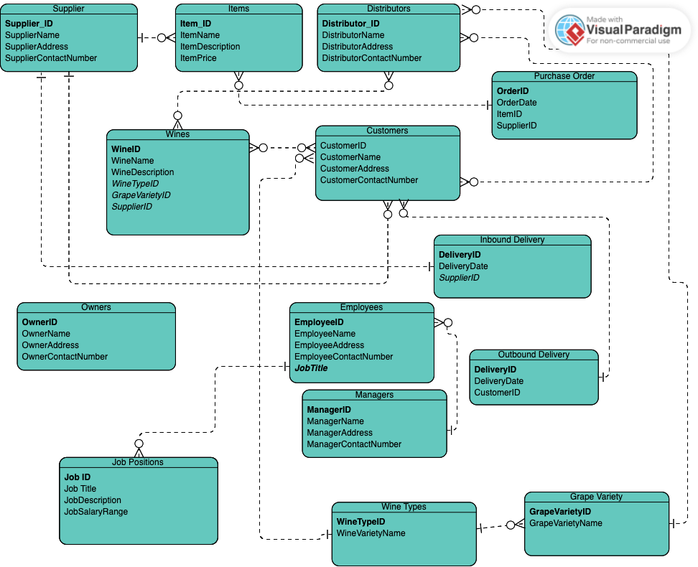
ERD
Link to ERD here.

Slide 12
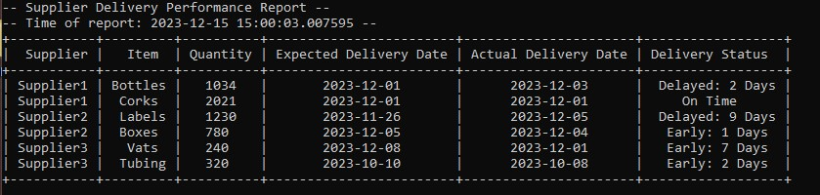
Supplier Delivery Performance Report
This report will provide information on the delivery performance of each supplier.
Included details: expected delivery dates, actual delivery dates, and any delays or gaps between the expected and actual delivery dates.
This report would help Stan and Davis identify any problem areas and assess the efficiency of their suppliers.

Slide 13
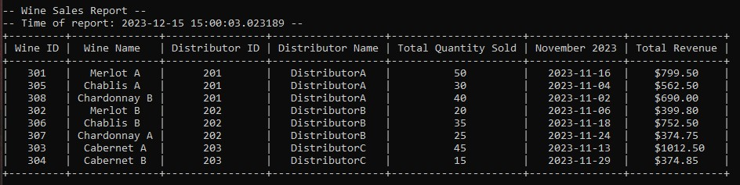
Wine Distribution Sales Report
This report will provide information on the sales performance of each wine variety.
It would include: quantity of each wine sold, revenue generated, and the distributor responsible for selling each wine variety.
This report would help Stan and Davis determine if all wines are selling as expected and identify any underperforming wines or distributors.

Slide 14
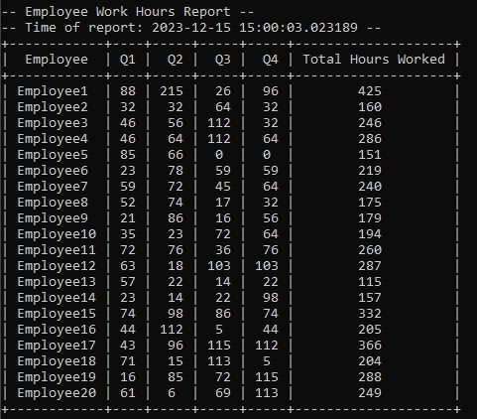
Employee Hours Report
This report will provide information on the number of hours worked by each employee during the last four quarters.
It includes: the employee's name, quarter, and total hours performed.
This report would help Stan and Davis assess the workload and productivity of their employees and identify any imbalances in work distribution, as well as help make informed decisions related to workforce management.

Slide 15
Assumptions
Bacchus Winery is our client, and we are not employees of Bacchus Winery.
Solutions made were based on a real-world time frame of three weeks.
Bacchus Winery is well employed and have many team members.
Bacchus Winery is financially stable and could carry out work as usual while finding new solutions.
Numbers found in the database such as hours and time frames were made up based on real world examples.

