Slide 1
Drone Swarm Algorithms
MIDN 1/C Yair S. Abramoff
Professor Ric Crabbe, Computer Science Department

Slide 2
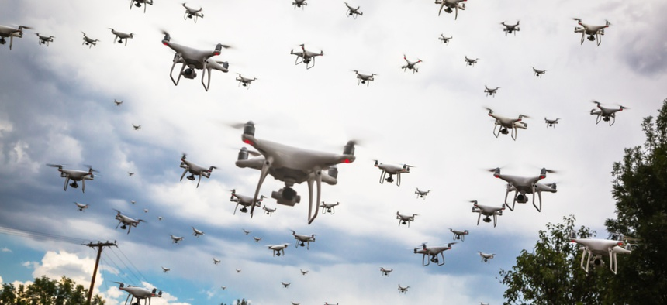
Motivation
Swarm robotics
Land, underwater, surface, aerial robots
Create tactics
Counter-swarms
Fixed-wing drones

Slide 3
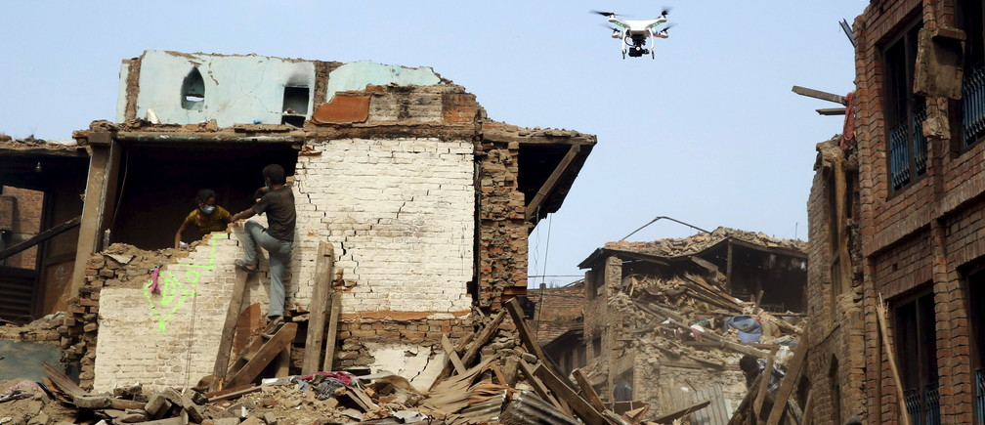
Uses of Drones
Natural Disaster Relief
Surveillance
Pleasure

Slide 4
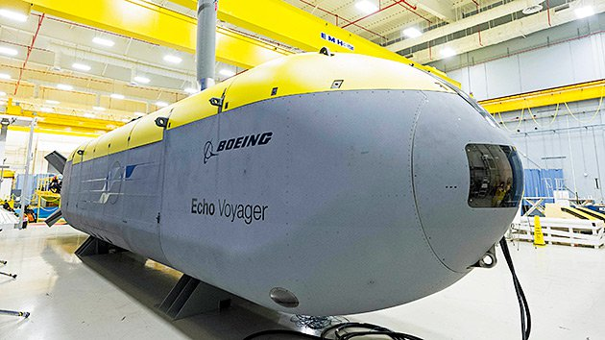
Navy – XLUUV

Slide 5
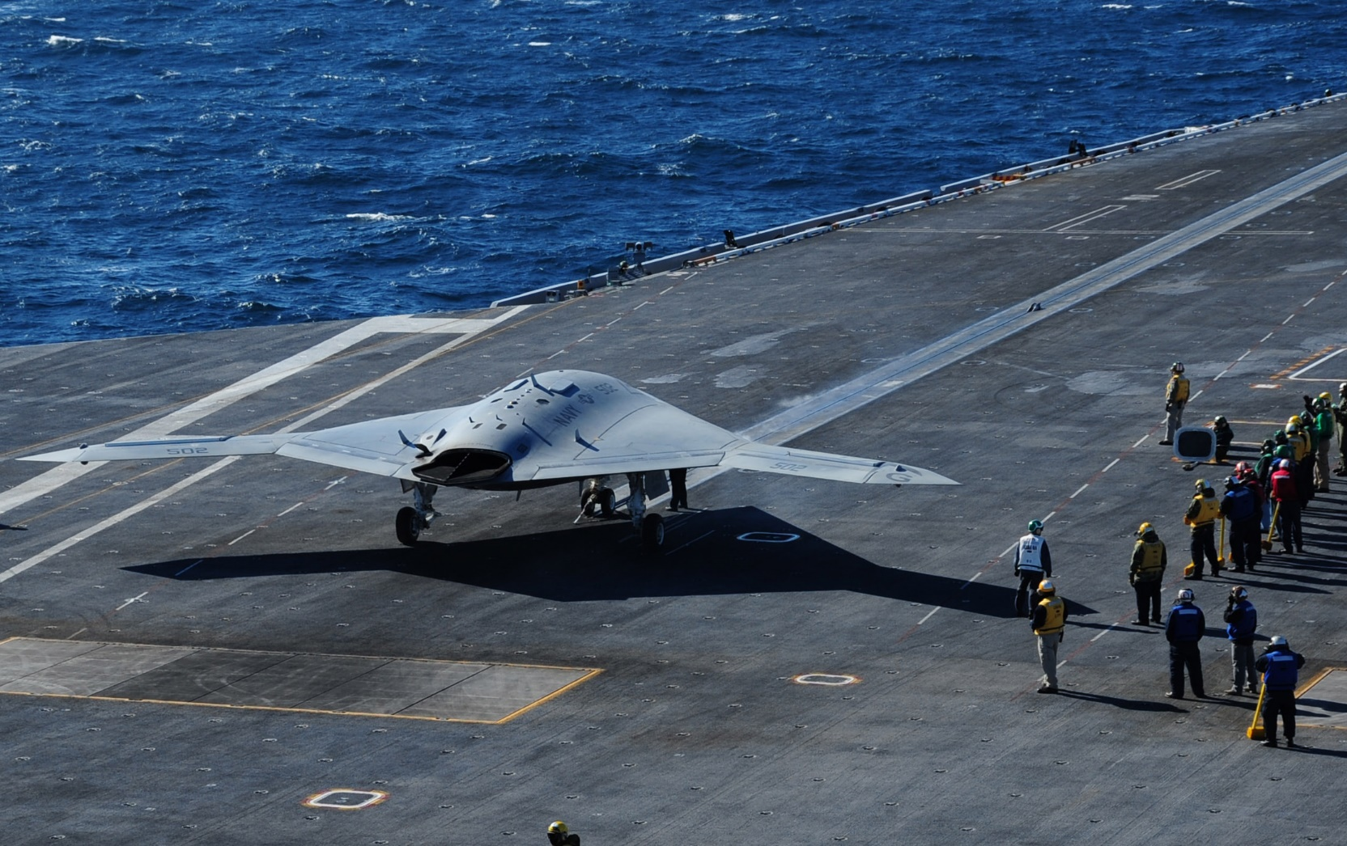
X-47B

Slide 6
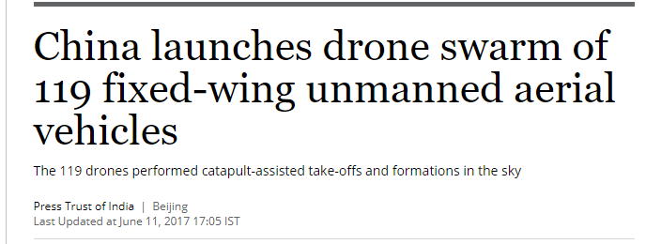
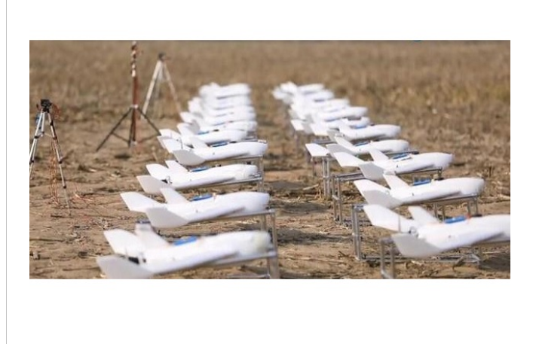

Slide 7
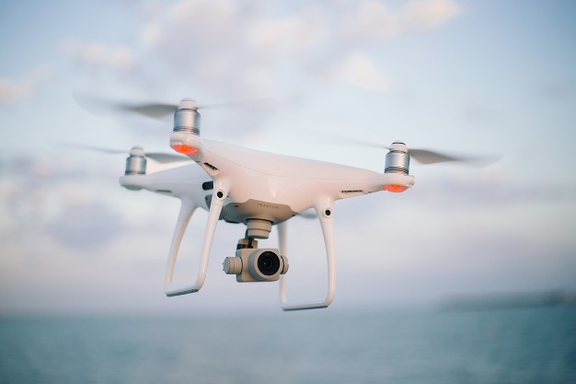
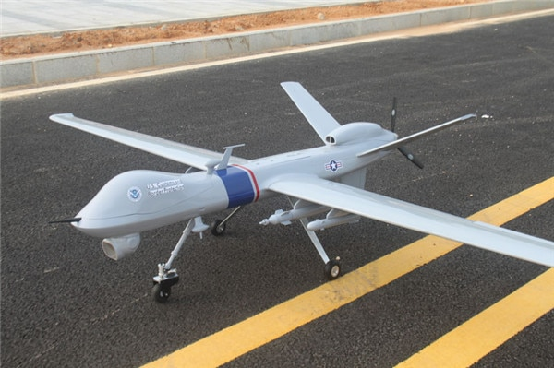
Quadcopter v. Fixed Wing
360 degree movement
Hover capability
Limits in scalability
Limits in rapid changes in flight/movement
Not yet used in swarms

Slide 8
Creating a Simulation
Python
2-D
Physical limitations
Model drone movement, communication
OOP principles, easily transferable to HPC

Slide 9
Process
Physical
Teams
Abstraction
Shooting
Target Selection
Target Approach
Aiming
Formation

Slide 10
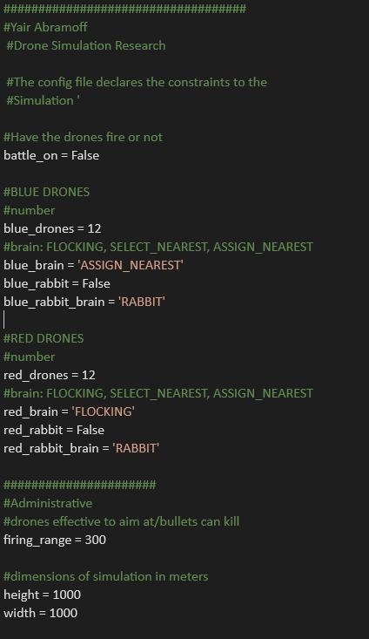
Configuration File

Slide 11
Physical Limitations
Make accurate calculations (1km by 1km field)
Speed of drones (70 m/s), bullets (500 m/s), limited travel
Drones each run Brain algorithm
Drones do not communicate
Out of bounds, collisions, death by fire
Drones do not aim, fire straight
Limitations of fixed wing flight
No cost functions

Slide 12
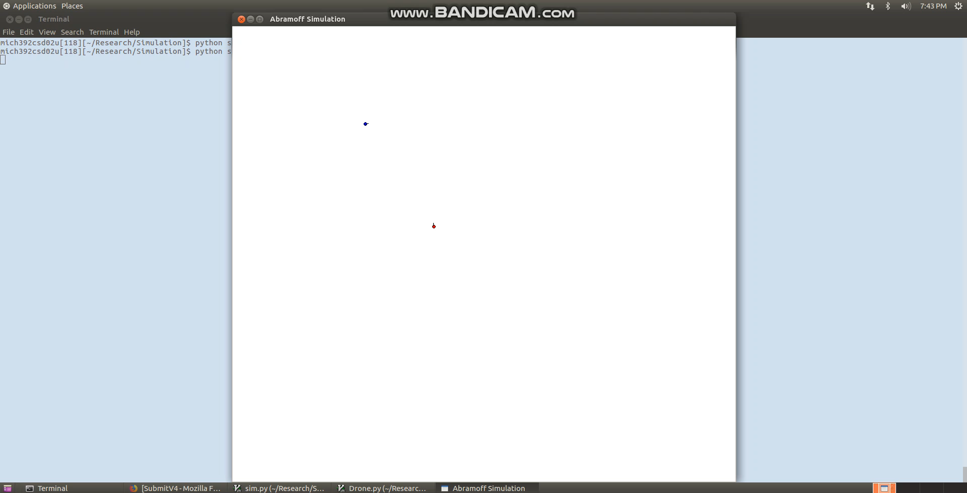
Aiming

Slide 13
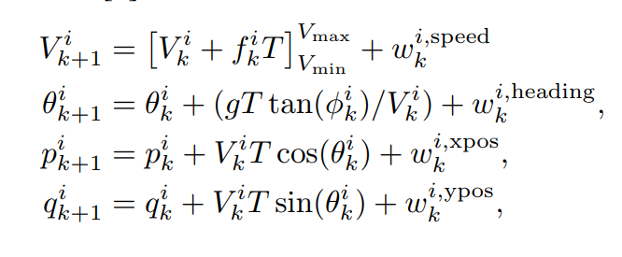
Flight limits
Theta – bank angle
W – velocity
(p,q) position

Slide 14
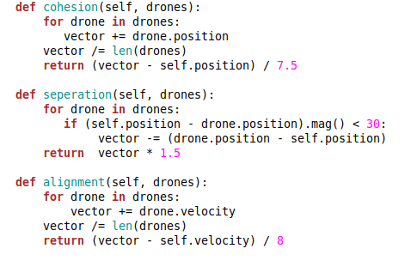
Simple Flocking
Cohesion – fly to the center of the mass of the neighbors
Separation – don’t get too close however (variable)
Alignment – match velocities with nearby drones

Slide 15
FLOCKING VIDEO HERE

Slide 16
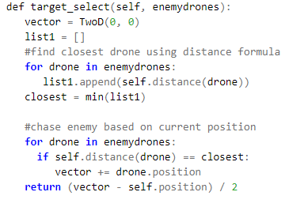
Select Nearest
Find closest drone to self
Chase enemy based on current position
Aim and neutralize

Slide 17
SELECT NEAREST VIDEO HERE

Slide 18
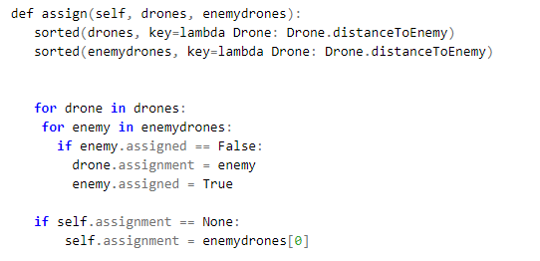
Assign Nearest
Sort enemy drones and friendly drones by distance
Assign each enemy drone to a nearby drone that is closest
If already used, re-run through the loop
Cost function/slow code not factored in
Lambda function used!

Slide 19
ASSIGN NEAREST VIDEO HERE

Slide 20
Counter-Swarm Tactics
A rabbit
Sub swarms
Future thoughts:
Delaying initial charge, using elevation as advantage

Slide 21
RABBIT VIDEO HERE

Slide 22
SUB SWARM VIDEO HERE

Slide 23
Hypothesis
Brain of the Drone would be the most important factors in battle
Swarming will be achievable and effective
Flocking would be least effective
Assign-nearest would be better than select nearest
Rabbit would be able to “distract” assign-nearest
Aiming would significantly help assign-nearest

Slide 24
Challenges/Limitations
2-D Simulation
Gaussian cost function
Accurate physical model
Drones do not communicate
Properly define winners and losers

Slide 25
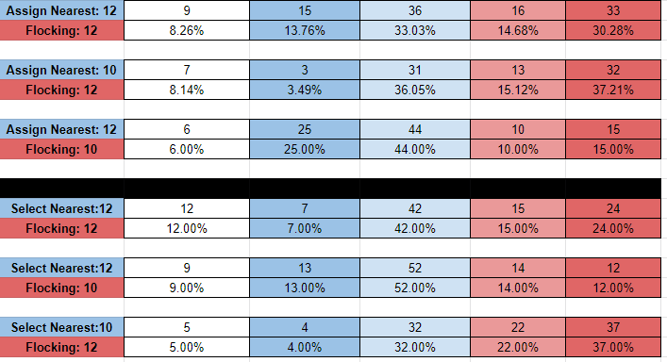
Results-Flocking

Slide 26
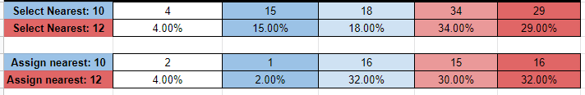
Results- Against oneself

Slide 27
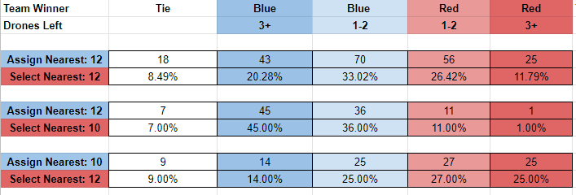
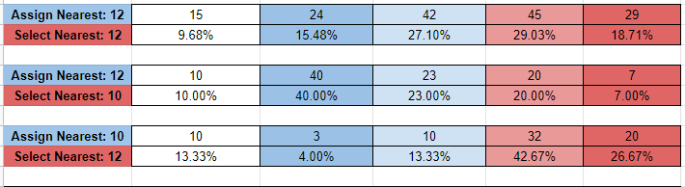
Results- Assign vs Select
Increase in separation

Slide 28
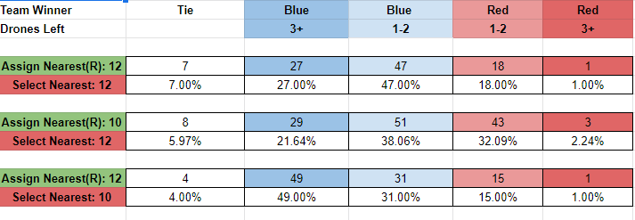
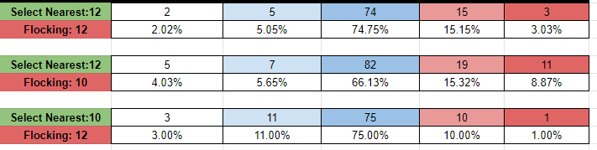
Results-Counter Swarm

Slide 29
Conclusion
Swarming fixed-wing drones is achievable
NUMBERS are the most important factor in determining victory
There is a two-step process in battle: initial contact and chasing
Flocking is the least effective
Select-nearest can be defeated using counter swarm tactics
Select-nearest is effective due to all drones firing at one target
Assign-nearest “wins” the most

Slide 30
Future Work
3 Dimensional Simulation
Testing on real Drone Swarms
Communication between drones
Aiming/different types of weapons
Changing formations
You tell me!

