Slide 1
The Square API: Payment Processing
By Joe Thorkildson and Troy Backes

Slide 2
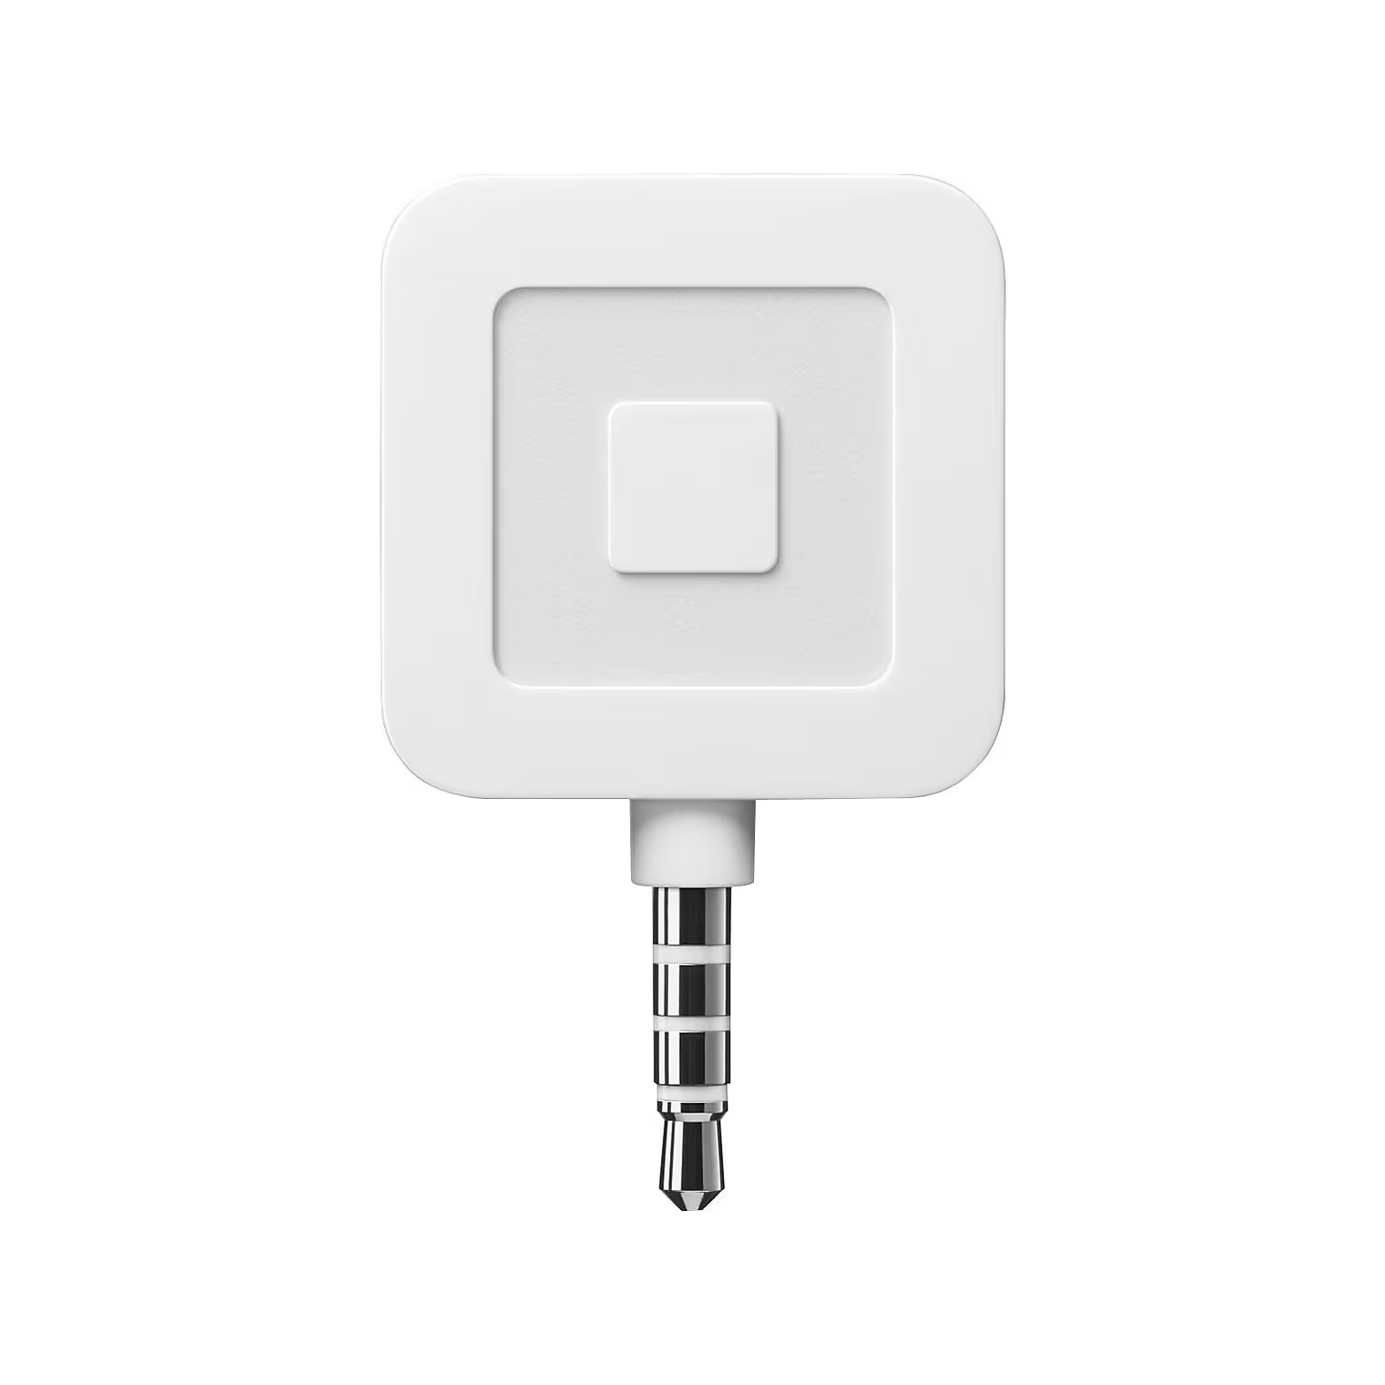
What is Square?
Creates easy-to-use means of payment processing
Point-of-sale(POS) systems (shown to right)
Helps businesses manage inventory, schedule appointments, and accept online payments
Notes:
So what is square? Square is a company that was founded in 2009 with the goal of providing an easy-to-use means of payment processing for all business sizes. They specialize in the production of point of sale (POS) hardware systems,like the one shown here, but they have expanded their services since 2009 into software. Their software helps with business management by managing product inventory, scheduling appointments, and providing an online, API based payment processing system which we are going to be telling you about today.

Slide 3
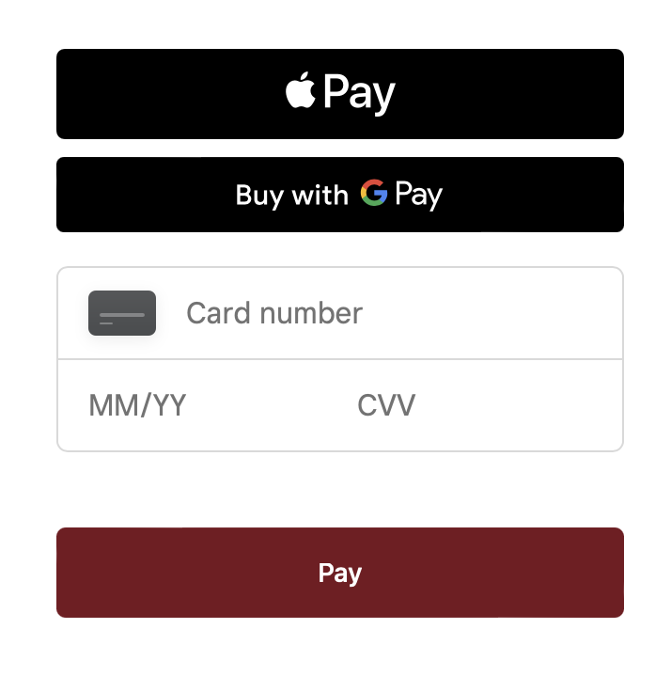
Square API Features
The Square API supports:
Payment processing
E-commerce integration
Inventory management
Analytics
Notes:
The square API is a set of tools and functionalities that allow developers to integrate Square’s payment processing and business management services into their own applications. Now the square API has multiple features with the most prominent being payment processing, but it also supports E-commerce integration, Point-of-sale integration, the aforementioned inventory management features, as well as analytics. !!!POS integration?!!!

Slide 4
Getting Started
Set up an account with Square
Install the react-square-web-payments-sdk and square sdk packages
Has many built-in elements
Notes:
What’s really convenient is most functionality is built in, most of the manual work involves supplying information like your business id and location into already built props.

Slide 5
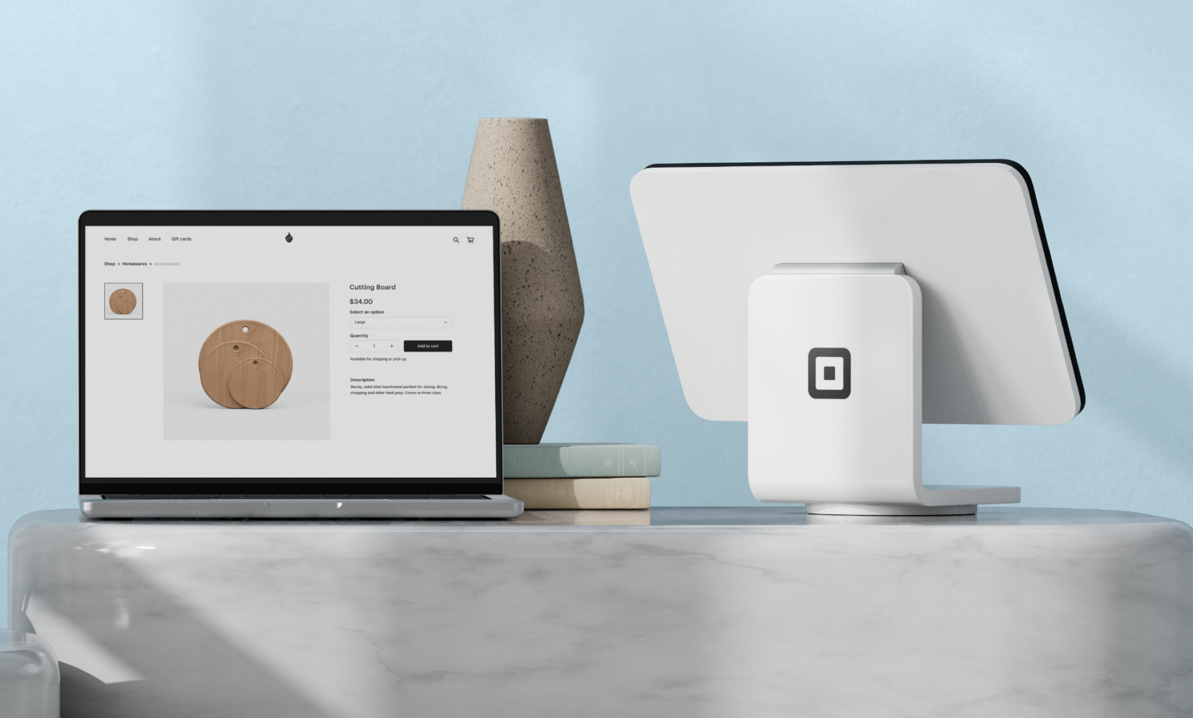
Benefits of Square
Easy to integrate square API into existing applications
Fast transactions
Scales well with business growth
Has built-in security measures
Adding new payment options isn’t very complex usually

Slide 6
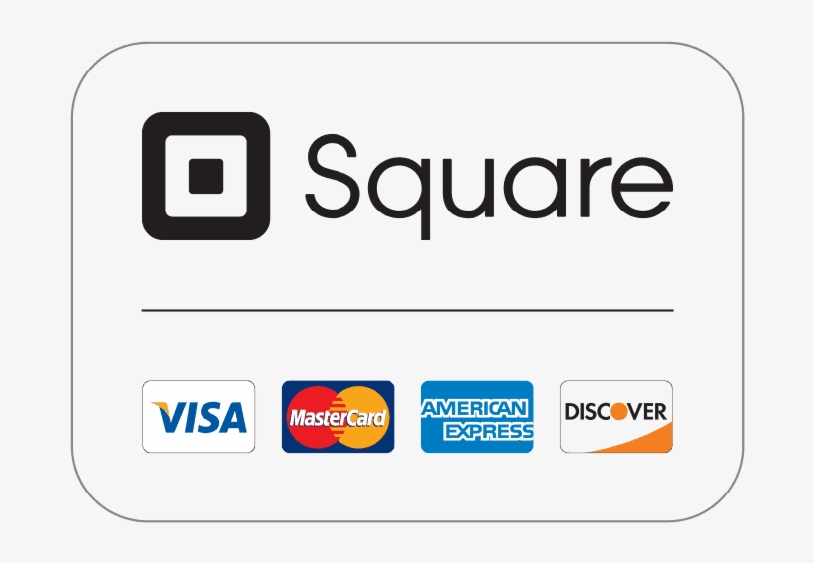
Where to learn about Square API
Square Developer Blog
Square API Documentation
Square’s Homepage

Slide 7
References
https://www.quill.com/square-sku-0047-mobile-35-jack-card-reader/cbs/50573734.html?effort_code=369&sfcp=1&g_acctid=375-313-8373&g_adgroupid=157239979132&g_adid=668222945647&g_adtype=pla&g_campaign=PLA_Prospecting_Retail-Store-Supplies&g_campaignid=20418095514&g_ifcreative=&g_ifproduct=product&g_keyword=&g_keywordid=pla-301560695909&g_merchantid=10009478&g_network=g&g_partition=301560695909&g_productchannel=online&g_productid=50573734&cm_mmc=plaXXgoogleXXPLA_Prospecting_Retail-Store-SuppliesXXpoint-of-sale-(pos)-equipment&gad_source=1&mcode=plaXXgoogleXX&gclid=Cj0KCQiAsburBhCIARIsAExmsu4JX3K74FvIkKcAQ7ws4LNAfjANCfZncovBUhKMaRFCs8D_R50193saAujGEALw_wcB
https://squareup.com/us/en/why-square
https://developer.squareup.com/us/en
https://developer.squareup.com/blog/online-payments-with-square-and-react/

