Slide 1
ENDLESS RUNNER TITLE
Splash Screen
Credits
Settings
Main Menu
Pause Menu
Play
Game Over

Slide 2
Splash Screen
Splash Screen,
Click anywhere to skip
Object Key
Interactive Button
Non-interactive object

Slide 3
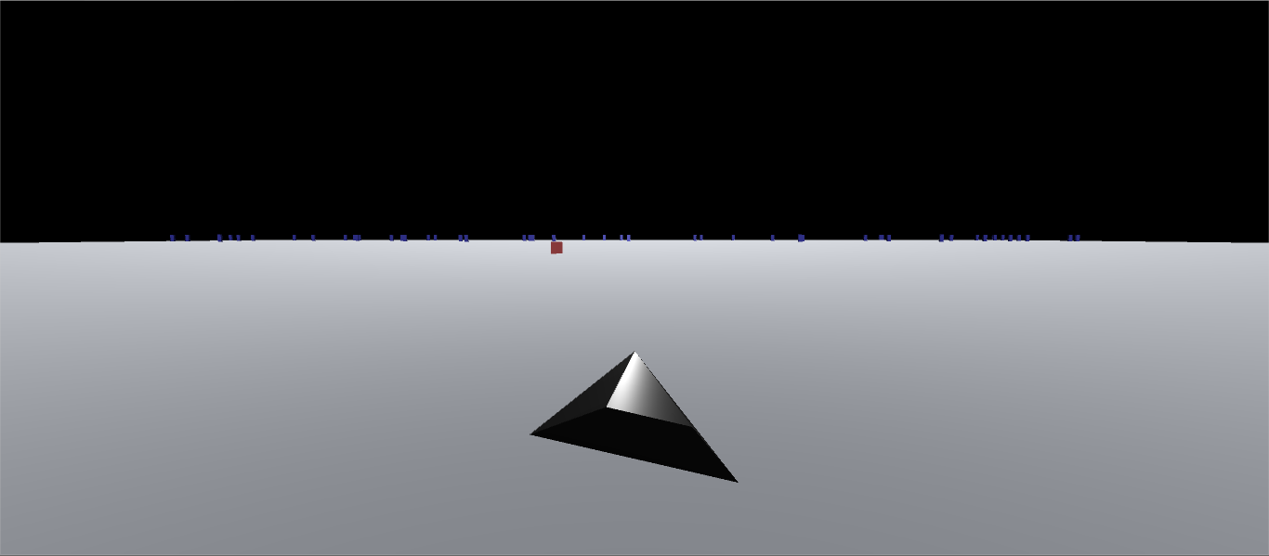
Main Menu mockup
Play
Settings
Credits
Quit
Animated Background
Object Key
Interactive Button
Non-interactive object

Slide 4
Credits
Credits roll,
Click anywhere to go to main menu
Object Key
Interactive Button
Non-interactive object

Slide 5
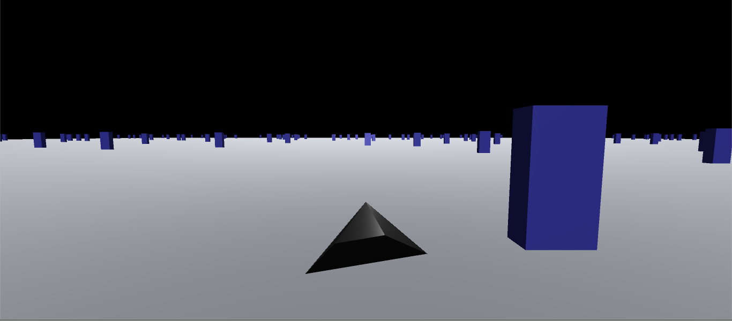
Play
Pause
Score counter
Object Key
Interactive Button
Non-interactive object
(white on black background)

Slide 6
Settings
Return
Controls
Current Setting
BGM
Sound Effects
Object Key
Interactive Button
Non-interactive object
Slider

Slide 7
Pause Menu
Return to Game
Settings
Quit
Game freeze frame in Background
Object Key
Interactive Button
Non-interactive object

Slide 8
Game Over
GAME OVER
Credits
Play Again
Main Menu
Object Key
Interactive Button
Non-interactive object

