Slide 1
Work Orders
Kelsey Dorn
John Huber

Slide 2
Description
Online program
Users can input work orders and view past work orders
Why?

Slide 3
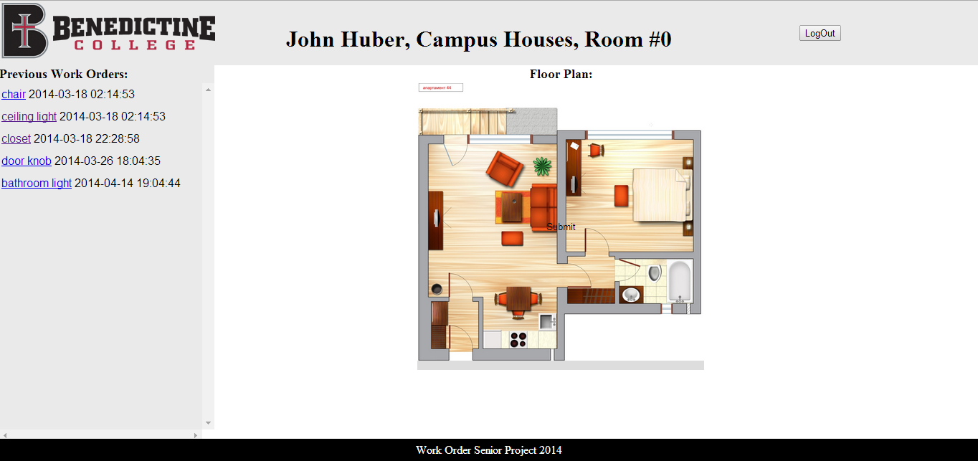
User Interactions - Student/Admin
Admin
Room orders
Floor orders
Student
Room orders

Slide 4
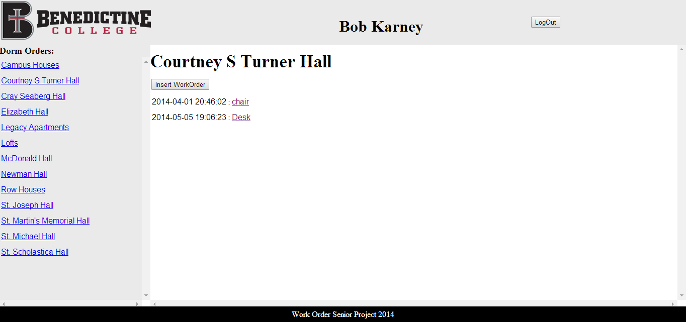
User Interactions - Operations
View orders
Update orders
Insert orders

Slide 5
Implementation
Tools used
MySQL
JavaScript
PHP
HTML

Slide 6
Future Improvements
Get official building plans
Submit orders by email
Clickable objects

Slide 7
Postmortem
What we learned
PHP
Calling data and making it appear
What went right
Creating the database
PHP pages
Calling the data
What went wrong
Graphic intensive

