Slide 1

Auto Insurance Premiums: Contributing Factors
Jared Hubert, Francisco Lara Loza, William Thomer, Levi McLeod, Valerie Grannemann-Barber

Slide 2
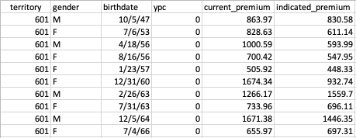
The Data
Our data was collected from an analytics team at TheMarkup.org.
The data set was produced by AllState in 2013. It includes the information of approximately one-hundred thousand auto insurance policy holders over a six-month period.

Slide 3
Factors Considered
Birth date
Gender
Current premium
the policy holder’s regular premium ($)
Indicated premium
the policy holder’s new premium based on AllState's algorithmic loss model ($)

Slide 4

Question 1
Do premiums change based on policy holder’s age?

Slide 5
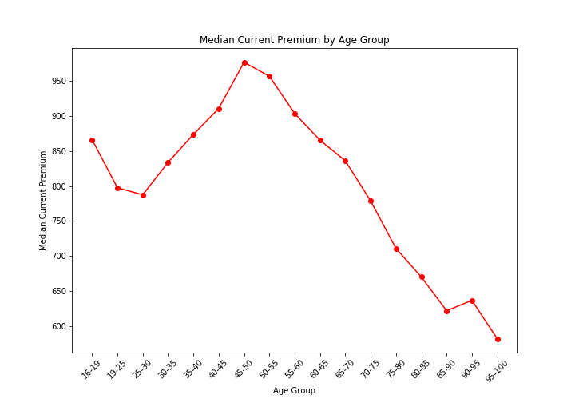
Premium Comparison
Data is arranged by age group, using the median aggregate function to compare each age group’s premium.
Clearly, the 45-50 and 50-55 age groups have the highest median current premium.
The data trends upward after 25-30 and downward after 45-50.
Notes:
We arranged the AllState data by age, then put the policy holders into bins of age range inside our code, which allowed us to compare average rates at a more broad level.

Slide 6
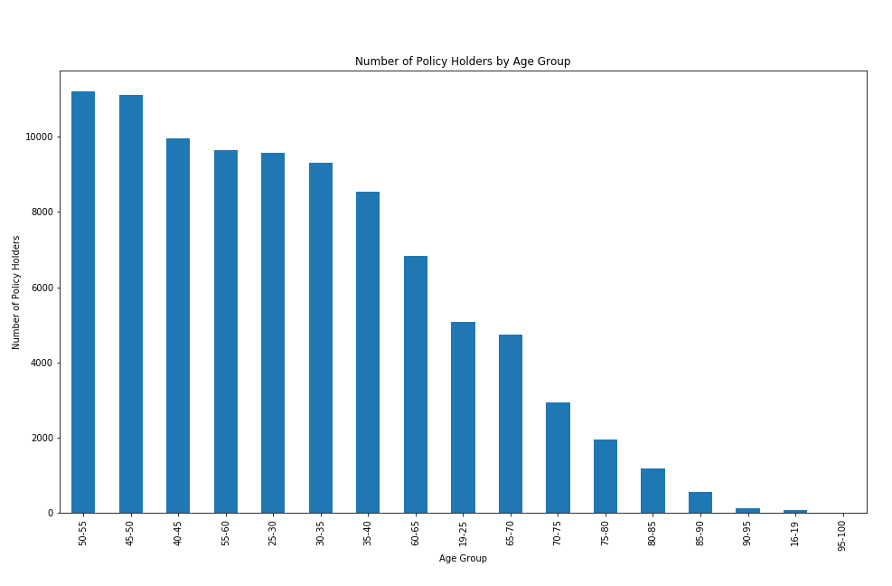
Age Groups
Here we can see the distribution of age data in a bar chart.
The age groups with the highest amount of policy holders are 50-55 and 45-50.

Slide 7
Question 2
Do premiums change based on gender?

Slide 8
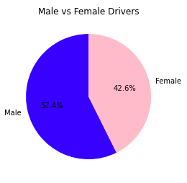
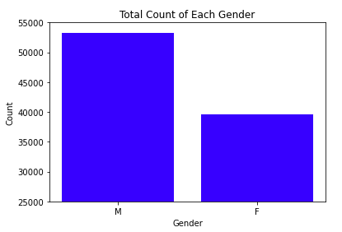
Our analysis indicated the data includes a slightly higher percentage of males than females.

Slide 9
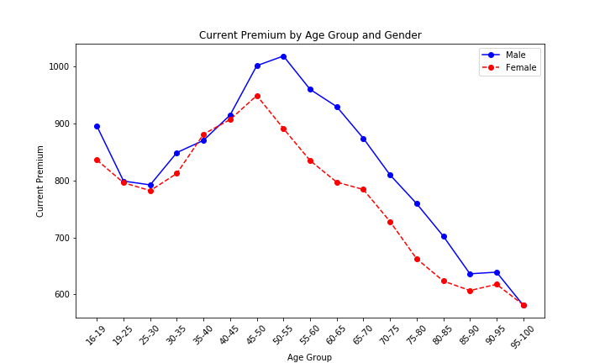
Here we see a representation of the male and female current premium data.
The male data tends to show a higher median current premium per age group.

Slide 10

Question 3
What are the trends in algorithmic loss models of large insurance companies such as AllState?

Slide 11
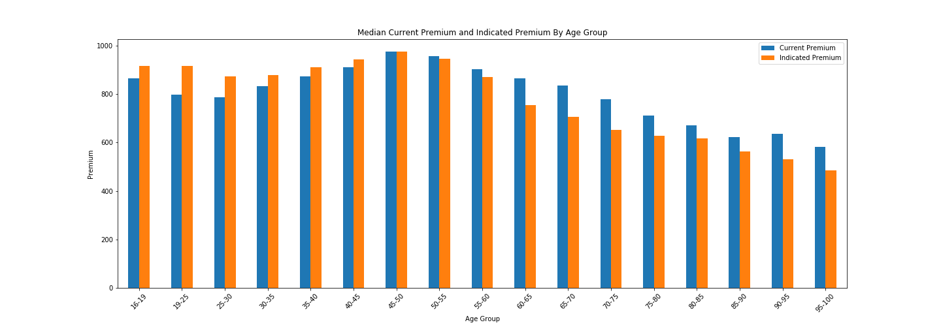
The following graph displays the new premium calculated with the loss model (orange) alongside the original premium (blue).
The indicated premium tends to lower as the age group increases.

Slide 12
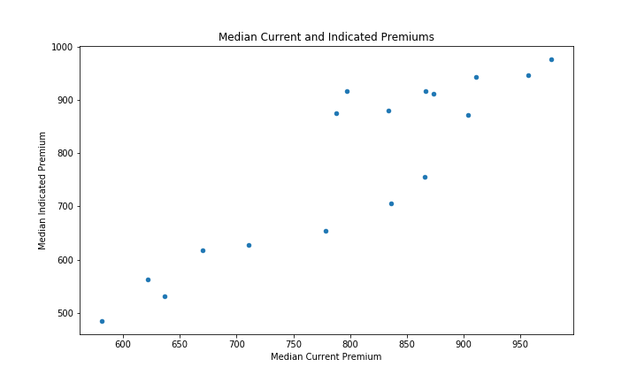
When compared together on a scatter plot, the median current and indicated premiums show a positive correlation.

Slide 13
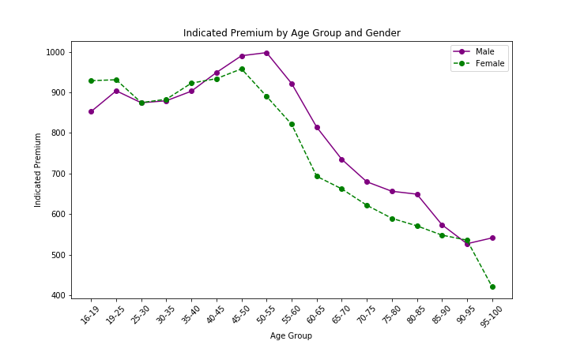
Incorporating gender, the indicated premium is similarly higher in the male data and lower in the female data.

Slide 14

Methodology
Libraries: Pandas, Matplotlib, NumPy, Datetime
Data aggregation with the median
Data binning and grouping
Line graph, bar chart, pie graph, scatter plot, correlation factor

Slide 15

Conclusions
Auto insurance premiums can both vary and trend by age.
Auto insurance premiums can both vary and trend by gender.
Using the new loss model, the indicated premium tended to be lower for older age groups and higher for younger age groups.

Slide 16
Sources
[1]
https://github.com/the-markup/investigation-allstates-algorithm
https://themarkup.org/allstates-algorithm/2020/02/25/show-your-work-car-insurance-suckers-list
[2]

