Slide 1
3D Objects

Slide 2
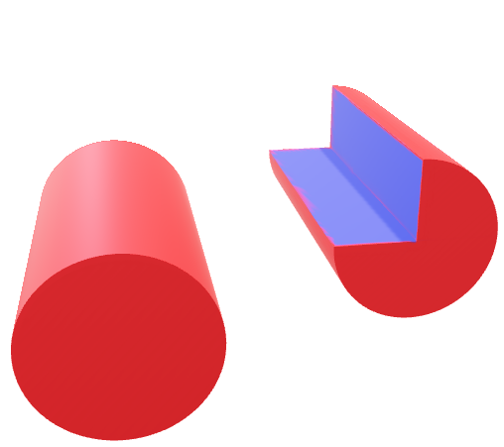

Slide 3
