Slide 1



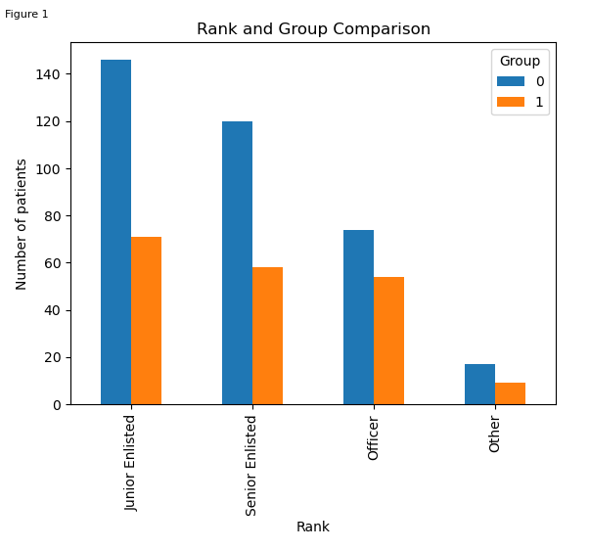
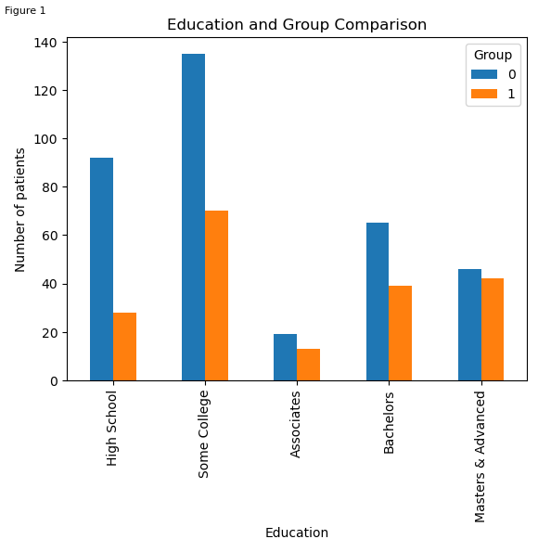
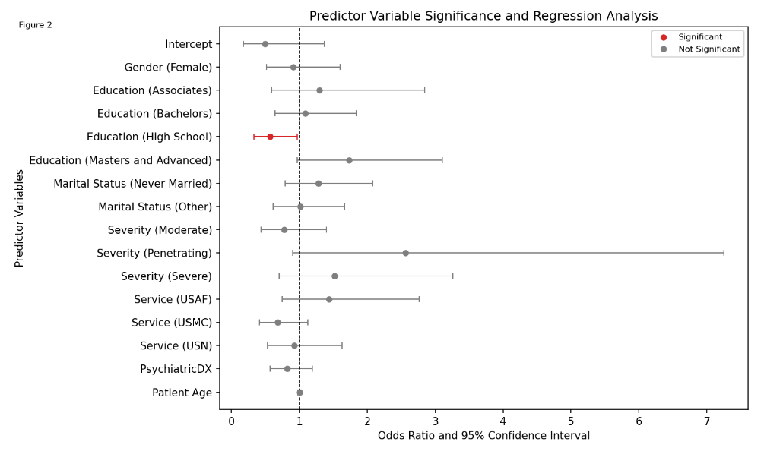
Impact of Education Levels on Patient Compliance: Characteristics of Service Members with Traumatic Brain Injury at a Cognitive Rehabilitation Center
Megan Tsui, MA^{1, 3, 4}, Joshua Thurber³, Peter Hoover, MS ¹, Jose Lara-Ruiz, PhD ¹, Melinda Tung, MS¹⁻⁴, Isabelle Wal, MS ¹⁻⁴, Katherine Sullivan, PhD¹, Wendy Law, PhD^{1,2}, Louis M. French, PsyD^{1,2}
¹National Intrepid Center of Excellence, Walter Reed National Military Medical Center, Bethesda, MD
²Uniformed Services University of the Health Sciences, Bethesda, MD
³Program Executive Office, Defense Health Management Systems (PEO DHMS)
⁴Henry M. Jackson Foundation for the Advancement of Military Medicine, Inc.
INTRODUCTION
RESULTS
Traumatic brain injury (TBI) is a prevalent condition that impacts military populations in deployment and non-deployment settings. Since 2000, over 460,000 service members (SMs) have been diagnosed with a TBI in the DoD¹.
Cognitive symptoms can include disruption in attention, executive function, or memory. One approach to supplementing cognitive rehabilitation is the Brain Fitness Center (BFC) at Walter Reed National Military Medical Center (WRNMMC). The BFC provides computer-based cognitive training, biofeedback, and brain-health classes to active duty, retired, and military dependents reporting cognitive complaints.
Support has been found for the efficacy of computer-based cognitive rehabilitation interventions². However, various factors have been identified as challenges in treatment compliance³.
Prior studies have found that sex, education, marital status, mental health status, and age are all associated with adherence to medical care⁴.
This study aims to understand the characteristics of treatment-compliant patients at the BFC.
Of the 549 SMs who met inclusion criteria, the average age was 33.3 years, were mostly men (91%), married (54.3%), served in the Army (59.7%), and held “some college” as the highest level of education completed (37.3%). Most were diagnoses with a mild TBI, and over half of the participants were diagnosed with one or more psychiatric disorders (55.2%).
There were no statistical differences in demographic variables between the two comparison groups.
Overall, the multivariate logistic regression was significant (p=0.03), which indicates that our model fit our data.
Results of the logistic regression model showed that of the seven predictor variables (TBI severity, sex, marital status, education, service, psychiatric diagnosis (absent or present), and age), only education showed significance.
The odds of complying with care (more than one evaluation) are 0.57 times higher (p=0.039)(As shown in Figure 2) among SMs with high school as their highest level of education compared to SMs with some college completed. In other words, those with fewer years of education were more likely to complete a follow-up evaluation.
METHODS
Figure 1: Demographics for education levels and rank between group 0 (1 evaluation) and 1 (>= 2 evaluations).
Conclusion and Future Directions
This is a retrospective study of electronic health record (EHR) data of active-duty SMs who have been evaluated in the BFC at WRNMMC or Fort Belvoir Community Hospital between 2008 to 2022.
SMs were categorized into two groups:
GROUP 0: those who completed only one evaluation (less compliant group)
GROUP 1: those who completed the typical recommendation of two or more evaluations (more compliant group)
The following patient characteristics were compared between the two compliance groups: TBI severity, sex, marital status, education (shown in Figure 1), service (shown in Figure 1), psychiatric diagnosis (absent or present), and age. The reference groups for our model were: men in the Army, with some college as the highest level of education completed, diagnosed with a psychiatric disorder, and a history of mild TBI.
A multivariate logistic regression was conducted to understand the relationship between the demographic variables and the likelihood of treatment compliance, our results are shown in Figure 2.
Our treatment compliance variable was binary (one evaluation/two or more evaluations).
Treatment compliance is an essential factor in improving PCS symptoms.
This study highlights that, overall, most demographic characteristics do not play a role in patients' treatment compliance. However, the regression model revealed that level of education did predict treatment compliance.
Interestingly, those with less education were more likely to return for follow-up visits. There are a few possible explanations.
One, higher levels of education are a favorable predictive factor in TBI recovery, and it is possible those with less education were reporting more severe symptoms and were more eager to engage in the rehabilitation offerings.
Alternately, those with higher levels of education may have more cognitive reserve and less need for extended intervention.
The other possibility is in a military setting, education is often associated with rank. It is possible that individuals with lower paygrades feel more obligated to comply with clinical recommendations.
These findings suggest different approaches to introducing and implementing treatment processes may be needed to enhance treatment compliance across different educational levels.
References
Traumatic Brain Injury Center of Excellence (TBICoE). (2022). DoD Worldwide Numbers for TBI. Retrieved February 10, 2023, from https://www.health.mil/Military-Health-Topics/Centers-of-Excellence/Traumatic-Brain-Injury-Center-of-Excellence/DOD-TBI-Worldwide-Numbers
Eapen, B. C., Bowles, A. O., Sall, J., Lang, A. E., Hoppes, C. W., Stout, K. C., ... & Cifu, D. X. (2022). The management and rehabilitation of post-acute mild traumatic brain injury. Brain injury, 36(5), 693-702.
Sullivan, K. W., Solomon, N. P., Pramuka, M., Quinn, J. E., Teixeira, K. A., & French, L. M. (2015). Computer-based cognitive rehabilitation research in a military treatment facility: Recruitment, compliance, and lessons learned. Work (Reading, Mass.), 50(1), 131–142. https://doi.org/10.3233/WOR-141986
Kim, Seung Jae MD, MSc; Kwon, Oh Deog MD; Han, Eunice Bormee MD; Lee, Cheol Min MD, PhD; Oh, Seung-Won MD, PhD; Joh, Hee-Kyung MD, PhD; Oh, Bumjo MD, MPH; Kwon, Hyuktae MD, PhD; Cho, BeLong MD, PhD; Choi, Ho Chun MD, MPH,∗. Impact of number of medications and age on adherence to antihypertensive medications: A nationwide population-based study. Medicine 98(49): p e17825, December 2019. | DOI: 10.1097/MD.0000000000017825
Disclaimer
The views expressed in this poster are those of the authors and do not reflect the official policy of the Department of Army/Navy/Air Force, Department of Defense, Henry M. Jackson Foundation, or the U.S. Government.
Figure 2: Logistic regression analysis for group 1 (>= 2 evaluations).
Notes:
REF:
Traumatic Brain Injury Center of Excellence (TBICoE). (2022). DoD Worldwide Numbers for TBI. Retrieved February 10, 2023, from https://www.health.mil/Military-Health-Topics/Centers-of-Excellence/Traumatic-Brain-Injury-Center-of-Excellence/DOD-TBI-Worldwide-Numbers
Sullivan, K. W., Solomon, N. P., Pramuka, M., Quinn, J. E., Teixeira, K. A., & French, L. M. (2015). Computer-based cognitive rehabilitation research in a military treatment facility: Recruitment, compliance, and lessons learned. Work (Reading, Mass.), 50(1), 131–142. https://doi.org/10.3233/WOR-141986
Kim, Seung Jae MD, MSc; Kwon, Oh Deog MD; Han, Eunice Bormee MD; Lee, Cheol Min MD, PhD; Oh, Seung-Won MD, PhD; Joh, Hee-Kyung MD, PhD; Oh, Bumjo MD, MPH; Kwon, Hyuktae MD, PhD; Cho, BeLong MD, PhD; Choi, Ho Chun MD, MPH,∗. Impact of number of medications and age on adherence to antihypertensive medications: A nationwide population-based study. Medicine 98(49): p e17825, December 2019. | DOI: 10.1097/MD.0000000000017825

