Slide 1

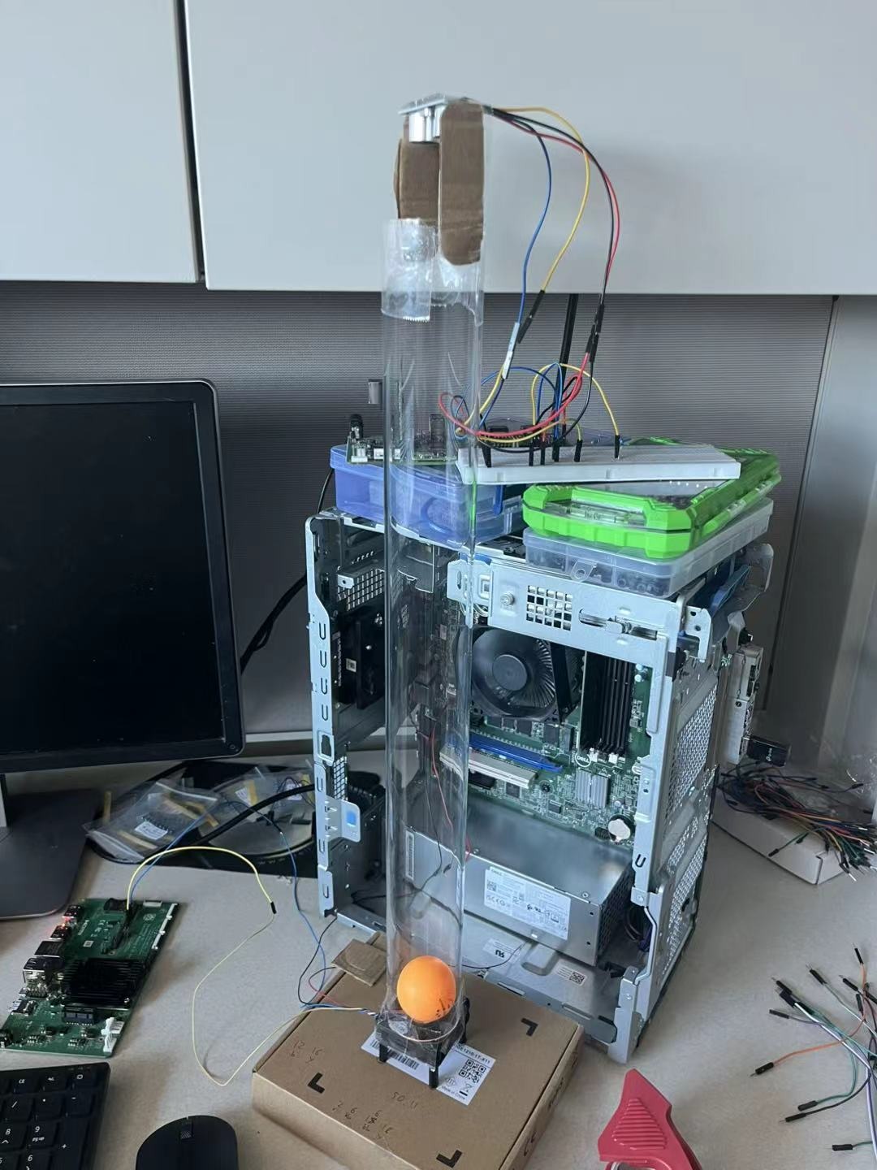
Project 1: Experimental Performance Evaluation of Real-Time Traffic Scheduler in Control System
Objective
Evaluate how real-time traffic scheduling improves control quality
Demonstrate results on a physical ball-floating testbed
Setup
Raspberry Pi + Depth Sensor → Ball position monitoring
Raspberry Pi + PWM Fan → Ball position control
Ball-floating Testbed (pre-built), Pis communicate over Ethernet
Tasks
Implement PID controller to stabilize ball at target position
Introduce network congestion and observe control degradation
Apply real-time traffic schedulers and compare with baseline
e.g., Linux ETF scheduler / KeepON driver
Skills learned
Understand Linux network stack and real-time system
C and Python Programming

