Slide 1



CodeBuddy
Técnicas Interacção Avançadas 2018/19
Group 2
Catarina Fitas 41677
Daniel São Pedro 33704
João Abreu 48858

Slide 2
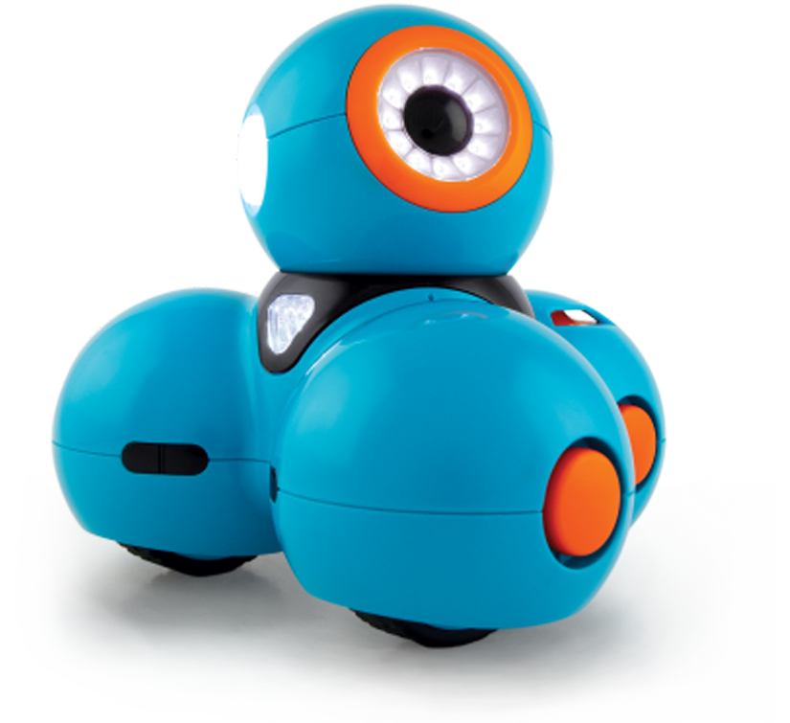
Outline
What we’ll talk about
Brief Introduction
Solution Overview
How It Works
Conclusion

Slide 3
Brief introduction
Solution Overview
How It Works
Conclusion

Slide 4
CodeBuddy
A brief introduction
Learning programming is becoming an important part in children's education

Slide 5
CodeBuddy
A brief introduction
Learning programming is becoming an important part in children's education
It should also be available for visually impaired children

Slide 6
CodeBuddy
A brief introduction
Learning programming is becoming an important part in children's education
It should also be available for visually impaired children
Teachers and educators should explore new ways of teaching programming principles to children

Slide 7
CodeBuddy
A brief introduction
Learning programming is becoming an important part in children's education
It should also be available for visually impaired children
Teachers and educators should explore new ways of teaching programming principles to children
– Open Source
– Configurable
– Extensible
– New Learn Modes
– New Blocks/Actions
– New Robots Supported

Slide 8
Brief introduction
Solution Overview
How It Works
Future Work

Slide 9
CodeBuddy
Solution Overview
Heroku’s Cloud
Client
Speech Modules
Recognition Modules
System GUI

Slide 10
CodeBuddy
Solution Overview
Heroku’s Cloud
Client
Remote Server
Speech Modules
Result Computation
Recognition Modules
Realtime Database
System GUI
Metadata Config

Slide 11
CodeBuddy
Solution Overview
Heroku’s Cloud
Localhost
Client
Remote Server
Local Server
Speech Modules
Result Computation
Result Execution
Recognition Modules
Realtime Database
Interface Adapters
System GUI
Metadata Config
Robot Specific API Scripts

Slide 12
CodeBuddy
Solution Overview
Heroku’s Cloud
Localhost
Devices
Client
Remote Server
Local Server
WebCam
Speech Modules
Result Computation
Result Execution
Blocks w/ TopCodes
Recognition Modules
Realtime Database
Result Execution
Solution+Map Boards
System GUI
Metadata Config
Robot API Scripts
Robots

Slide 13





CodeBuddy
Solution Detail: Client
Client
System GUI
Modules
React
Voice Recognition
Voice Synthesis
Board Recognition
Solution Recognition
Web Components
Context API
Web Speech API
TopCodes API

Slide 14


CodeBuddy
Solution Detail: Remote Server
Remote Server
Result Computation
/api/compute
Realtime Database
/api/save
Metadata Configuration
/api/metadata
Firebase SDK

Slide 15

CodeBuddy
Solution Detail: Local Server
Local Server
Result Execution Interface
/api/execute
Robot Execution Scripts
WonderPy
TIDAL-Lab

Slide 16
Brief introduction
Solution Overview
How It Works
Future Work

Slide 17
CodeBuddy
1. Turn on map recognition and recognize custom board
How It Works
Notes:
…
...
And lastly ...
[PASSAR PARA O PRÓXIMO SLIDE]

Slide 18
CodeBuddy
1. Turn on map recognition and recognize custom board
1.1. System validates board (includes full recognition, start and goal)
How It Works
Notes:
…
...
And lastly ...
[PASSAR PARA O PRÓXIMO SLIDE]

Slide 19
CodeBuddy
1. Turn on map recognition and recognize custom board
1.1. System validates board (includes full recognition, start and goal)
1.2. Board is saved in metadata database
How It Works
Notes:
…
...
And lastly ...
[PASSAR PARA O PRÓXIMO SLIDE]

Slide 20
CodeBuddy
1. Turn on map recognition and recognize custom board
1.1. System validates board (includes full recognition, start and goal)
1.2. Board is saved in metadata database
2. Turn on solution recognition and build it
How It Works
Notes:
…
...
And lastly ...
[PASSAR PARA O PRÓXIMO SLIDE]

Slide 21
CodeBuddy
1. Turn on map recognition and recognize custom board
1.1. System validates board (includes full recognition, start and goal)
1.2. Board is saved in metadata database
2. Turn on solution recognition and build it
2.1. System validates solution (excludes invalid blocks)
How It Works
Notes:
…
...
And lastly ...
[PASSAR PARA O PRÓXIMO SLIDE]

Slide 22
CodeBuddy
1. Turn on map recognition and recognize custom board
2.2. System also converts solution to interface with Group 1
1.1. System validates board (includes full recognition, start and goal)
1.2. Board is saved in metadata database
2. Turn on solution recognition and build it
2.1. System validates solution (excludes invalid blocks)
How It Works
Notes:
…
...
And lastly ...
[PASSAR PARA O PRÓXIMO SLIDE]

Slide 23
CodeBuddy
1. Turn on map recognition and recognize custom board
2.2. System also converts colution to interface with Group 1
1.1. System validates board (includes full recognition, start and goal)
2.3. Saves solution to database
1.2. Board is saved in metadata database
2. Turn on solution recognition and build it
2.1. System validates solution (excludes invalid blocks)
How It Works
Notes:
…
...
And lastly ...
[PASSAR PARA O PRÓXIMO SLIDE]

Slide 24
CodeBuddy
1. Turn on map recognition and recognize custom board
2.2. System also converts colution to interface with Group 1
1.1. System validates board (includes full recognition, start and goal)
2.3.Saves solution to database
1.2. Board is saved in metadata database
3. System auto computes solution for current selected board & game mode
2. Turn on solution recognition and build it
2.1. System validates solution (excludes invalid blocks)
How It Works
Notes:
…
...
And lastly ...
[PASSAR PARA O PRÓXIMO SLIDE]

Slide 25
CodeBuddy
1. Turn on map recognition and recognize custom board
2.2. System also converts colution to interface with Group 1
1.1. System validates board (includes full recognition, start and goal)
2.3.Saves solution to database
1.2. Board is saved in metadata database
3. System auto computes solution for current selected board & game mode
2. Turn on solution recognition and build it
3.1. Adds feedback in form of extra actions
2.1. System validates solution (excludes invalid blocks)
How It Works
Notes:
…
...
And lastly ...
[PASSAR PARA O PRÓXIMO SLIDE]

Slide 26
CodeBuddy
1. Turn on map recognition and recognize custom board
2.2. System also converts colution to interface with Group 1
1.1. System validates board (includes full recognition, start and goal)
2.3.Saves solution to database
1.2. Board is saved in metadata database
3. System auto computes solution for current selected board & game mode
2. Turn on solution recognition and build it
3.1. Adds feedback in form of extra actions
2.1. System validates solution (excludes invalid blocks)
4. Tells local system to execute solution computation (using selected robot)
How It Works
Notes:
…
...
And lastly ...
[PASSAR PARA O PRÓXIMO SLIDE]

Slide 27
CodeBuddy
Voice Commands Supported
Command | Words
Read Commands | /.*(what is|read) (this|the)?( )?(solution|sequence).*/
What is This Block | /.*(what is|what's) (this|that).*/
Compute Commands | /.*(compute|check|verify) (solution|sequence).*/
Execute Computed Commands | /.*(go|start|execute) (solution|sequence) (codi|kodi|buddy|cody|robot).*/
Recognize Commands Board Recognize Map Board | /.*(recognize) (solution|sequence).*/ /.*(recognize) (board|map).*/
Save Map to Database Save Commands to Database | /.*(save|send) (map|board).*/ /.*(save|send) (solution|sequence).*/
Notes:
readSolution: /.*(what is|read) (this|the)?( )?(solution|sequence).*/,
whatIsThis: /.*(what is|what's) (this|that).*/,
computeSequence: /.*(compute|check|verify) (solution|sequence).*/,
recognizeBoard: /.*(recognize) (board|map).*/,
recognizeSolution: /.*(recognize) (solution|sequence).*/,
executeSolution: /.*(go|start|execute) (solution|sequence) (codi|kodi|buddy|cody|robot).*/,
saveMapToDatabase: /.*(save|send) (map|board).*/,
saveSolutionToDatabase: /.*(save|send) (solution|sequence).*/,
thankYou: /.*(thank you)|(thanks).*/,
whoAreYou: /.*(who are you).*/

Slide 28
CodeBuddy
Blocks Types Supported
// BOARD CONFIGURATION 31: { description: "Top Left Boundary" }, 47: { description: "Top Right Boundary" }, 55: { description: "Bottom Left Boundary" }, 59: { description: "Bottom Right Boundary" }, 61: { description: "Wall" }, 79: { description: "Door" }, 87: { description: "Water" }, // GAME MODES 91: { description: "Start" }, 93: { description: "Goal" }, 103: { description: "Points" }, 107: { description: "Path" }, // RESULT FEEDBACK 205: { description: "Success" }, 211: { description: "Failure" }, // DASH ROBOT SPECIFIC 213: { description: "Rotate 360º" }, 217: { description: "Voice Interesting" }, |  | // MOVEMENTS 109: { description: "Move" }, 115: { description: "Swim" }, 117: { description: "Open" }, 121: { description: "Turn Left" }, 143: { description: "Turn Right" }, 151: { description: "Turn Back" }, // ACTIONS 155: { description: "Repeat" }, 157: { description: "Stop" }, 171: { description: "If" }, 173: { description: "Then" }, 179: { description: "Else" }, // NUMBERS 341: { description: "One Time" }, 345: { description: "Two Times" }, 355: { description: "Three Times" }, 357: { description: "Four Times" }, 361: { description: "Five Times" }
Notes:
readSolution: /.*(what is|read) (this|the)?( )?(solution|sequence).*/,
whatIsThis: /.*(what is|what's) (this|that).*/,
computeSequence: /.*(compute|check|verify) (solution|sequence).*/,
recognizeBoard: /.*(recognize) (board|map).*/,
recognizeSolution: /.*(recognize) (solution|sequence).*/,
executeSolution: /.*(go|start|execute) (solution|sequence) (codi|kodi|buddy|cody|robot).*/,
saveMapToDatabase: /.*(save|send) (map|board).*/,
saveSolutionToDatabase: /.*(save|send) (solution|sequence).*/,
thankYou: /.*(thank you)|(thanks).*/,
whoAreYou: /.*(who are you).*/

Slide 29
Brief introduction
Solution Overview
How It Works
Conclusion

Slide 30
CodeBuddy
Conclusion
CodeBuddy’s architecture, extensibility and ease of use makes it an effective tool for visually impaired children to learn programming.

Slide 31
Thank you
Técnicas de Interacção Avançadas 2018/19
Group 2
Catarina Fitas 41677
Daniel São Pedro 33704
João Abreu 48858

