Slide 1




Active Learning in Labs and the Classroom
Jenna G. Tichon, Dept. of Statistics
REG LITZ Teaching Day 2018

Slide 2
STAT 1150: A New Course and a New Opportunity
Science students, mathematically inclined students, research based disciplines
Opportunity to go further than before
Teach big “fundamental” concepts through exploration and activity

Slide 3
Lab Setup
Labs broken in up into groups of 40 students
Alternate once a week between quiz and activity lab
While reinforcing class material, mainly new concepts/activities not duplicated in class
Run by graduate students

Slide 4
Objectives
Each lab based on 2-3 measurable learning objectives
Clear goal on what students should be able to accomplish at the end

Slide 5
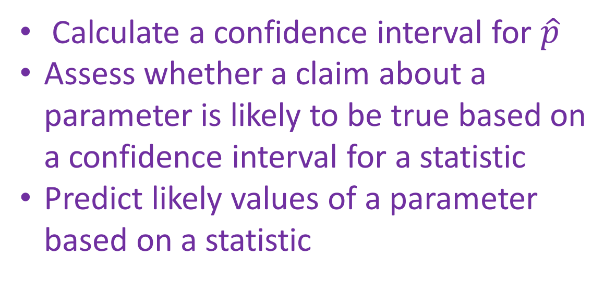
Example Lab:
Calculate a confidence interval for $\hat{p}$
Assess whether a claim about a parameter is likely to be true based on a confidence interval for a statistic
Predict likely values of a parameter based on a statistic

Slide 6
A Real World Starting Point
A bridge-in / “hook” to the lab
Case study, data set, journal article
Practical and interesting that students will have thoughts on regardless of the statistics involved

Slide 7
Example Lab
Marine the cancer-sniffing dog
Experiment performed to see if a dog could detect colorectal cancer
Based on published research paper (as well as many internet articles)

Slide 8
Pre-Assessment
Student divide in groups to an answer an initial set of prompt questions
Questions are about practical understanding
Assess ideas students currently have
Prove to themselves they know something

Slide 9
Example Lab
If Marine was randomly guessing, what should the proportion of correct guesses be?
Marine actually got 30/33 attempts correct. Make a confidence interval for the true proportion of times she can correctly identify a cancer patient.
Do you think it's likely the dog was randomly guessing. Why or why not?

Slide 10
Activities
Exploratory activities led by T.A.’s
Data visualization techniques
Simulation activities
Details of how the case study played out in real life
T.A.’s often “banned” from using technical terms not previously introduced.

Slide 11
Example Lab
Explore through simulation what would happen in lots of repetitions of the experiment if Marine was guessing
Hypothesis “other” values
Validate graphs with some math done in class

Slide 12
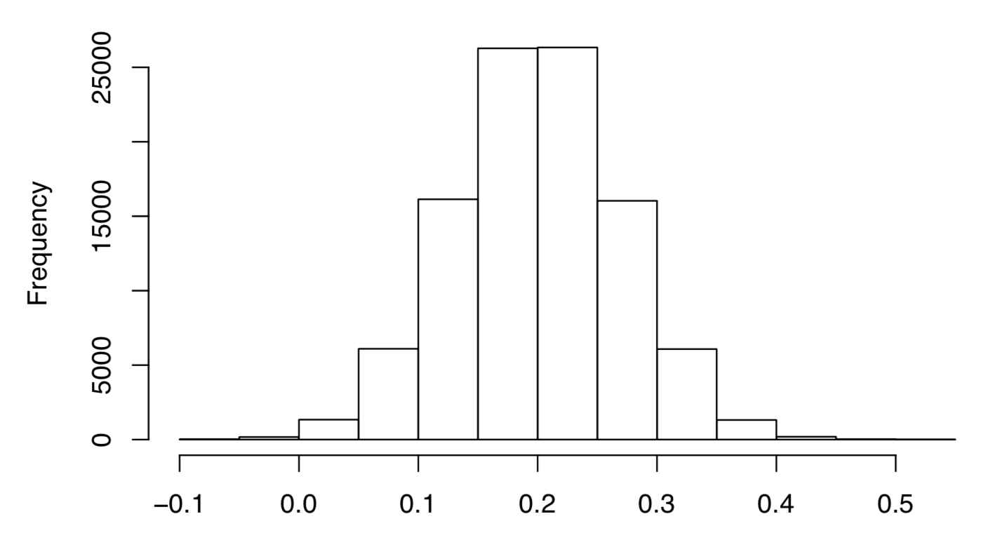

Slide 13
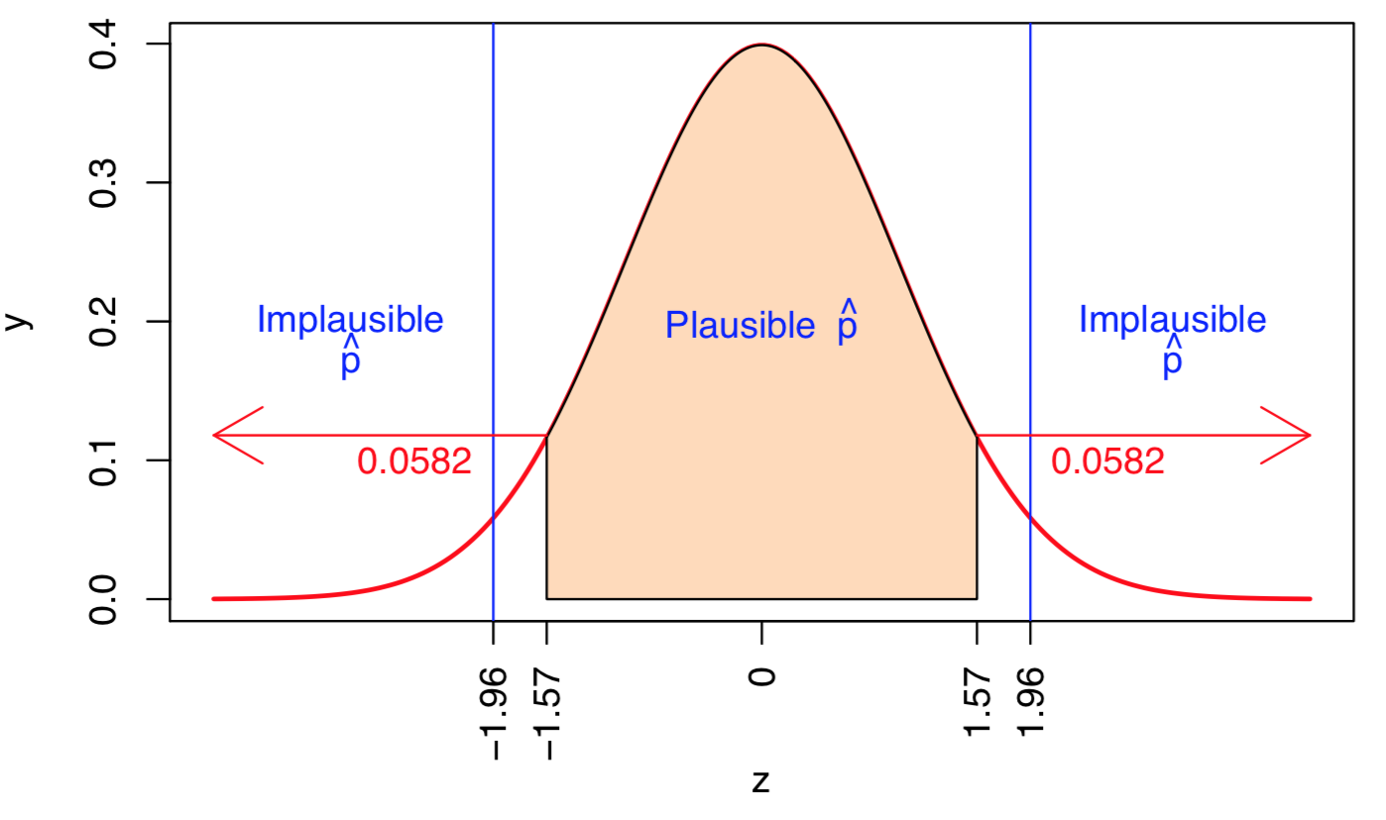

Slide 14
Post Assessment
Final group discussion/activity
Give students the chance to apply the concept to a new situation
Ask critical questions about “practical” implications beyond math taught in the class

Slide 15
Example Lab
What value is our most likely value of p?
Why didn't we conclude p=0.8 if it was plausible?
What else might be happening besides Marine detecting colorectal cancer?
Does this say anything about other dogs?

Slide 16
Summary
Finish every lab off with a summary of key points
Relate back to learning objectives
Make sure forest isn’t lost in the “trees” because the lab is a fun story

Slide 17
Side Benefit: T.A. Mentorship
Real hands on teaching experience and classroom management
Prepares for a future of teaching with data and computers
Empowers them with a true sense of responsibility in the lab for teaching curriculum
Helps take some content out of the classroom

Slide 18
Thank You

