Slide 1
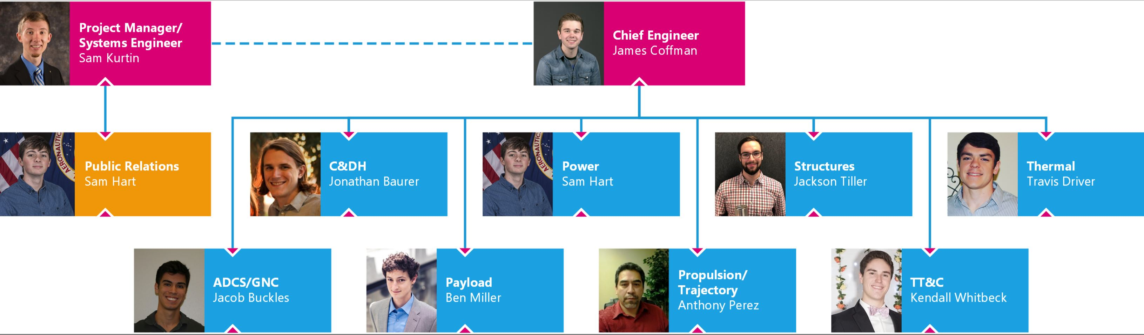

Slide 2
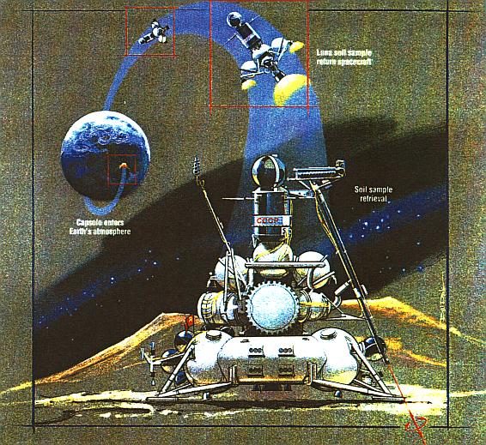

Slide 3
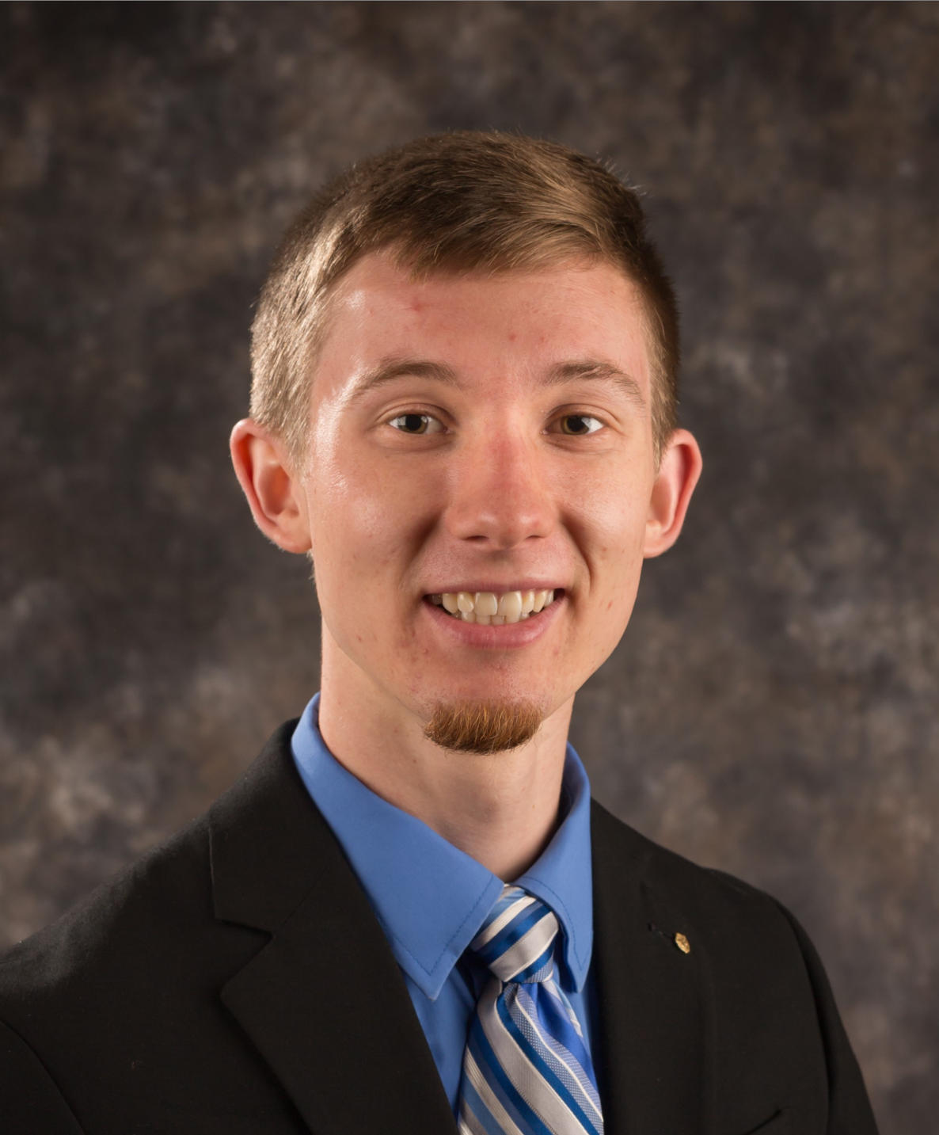
The Team Manager for our project, Sam Kurtin, is responsible for organizing team meetings and delegating responsibilities. Sam has been working to keep track of the team's deliverables and track the completion of assignments such that we hit all of our deadlines. Utilizing all resources for communication such as in-person meetings, group chats, and in document commenting tools, Sam is striving to keep all communication clear, transparent, and quick. The largest challenges that the Team Manager faces is maintaining knowledge continuity throughout the team. In the short term, Sam's initial plans are to submit the Technical and Management Proposal on time and in the long term he looks to empower the team to complete the final report and presentation on time.

Slide 4
