Slide 1
Finding the Best Location to Open a Bar in Queens, NY

Slide 2
Introduction
The borough of Queens in New York City is one of the most diverse and dense boroughs in the east coast
Finding a good location to open a bar in Queens can be a vital step when it comes to be a successful business
By using a good data set and the appropriate algorithms, the task of finding a good location can become less complex and time consuming

Slide 3
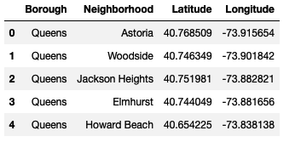
Data Extraction
Queens neighborhood names, latitude, and longitude are extracted from nyu_2451_34572-geojson.json
Venues information are extracted from Foursquare through their API

Slide 4
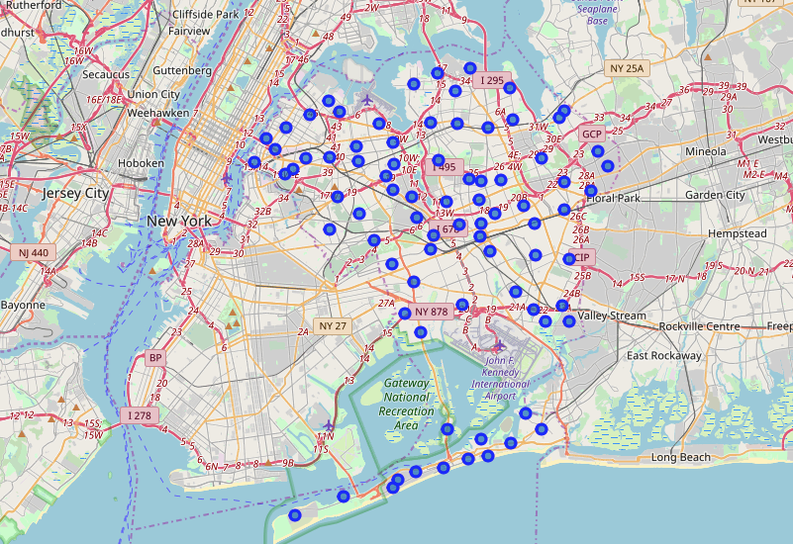
Neighborhoods in Queens, NY

Slide 5
Methodology
By exploring the most popular venues in each neighborhood, we can determine which neighborhoods are more likely to have less bars
After extracting the venues information from Foursquare, a dataframe can be created by grouping venues by category
Finally, a clustering analysis is performed on the dataframe containing the venue categories and neighborhoods
Based on the analysis, we can discard the neighborhoods that have “bar” as a popular venue

Slide 6
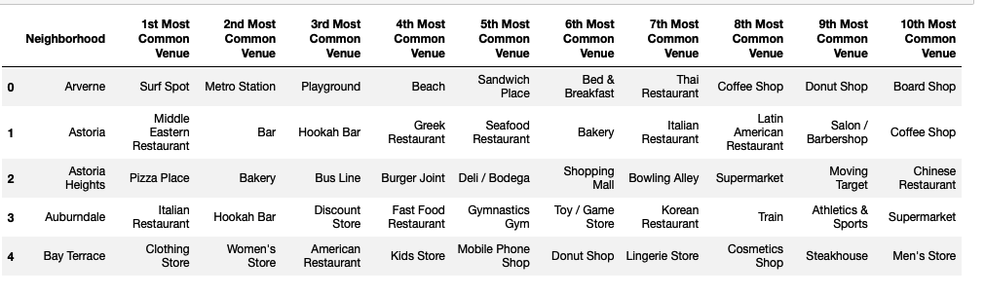
Foursquare Data

Slide 7
Clustering Analysis
The algorithm used is k-means clustering
Number of clusters: 5
Before the analysis, one hot encoding is performed on the Foursquare dataframe and the mean per neighborhood is calculated

Slide 8
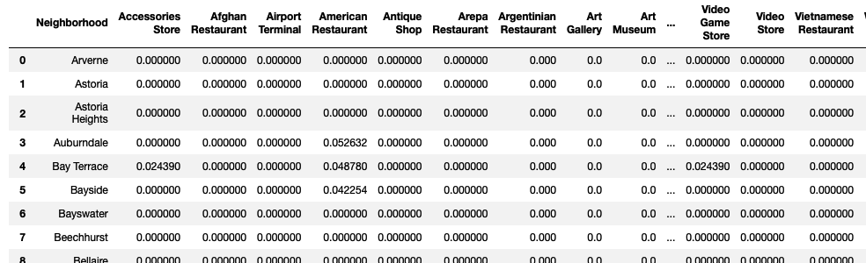
Clustering Data Set

Slide 9
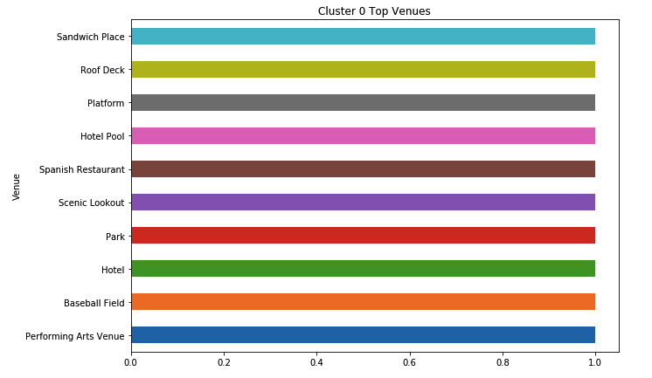
First Cluster

Slide 10
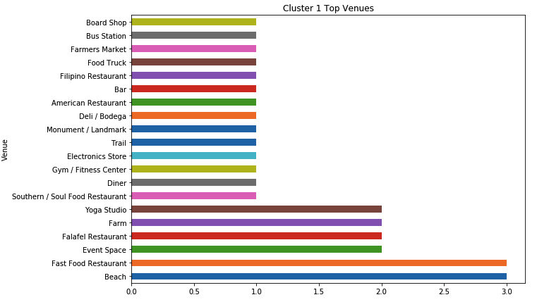
Second Cluster

Slide 11
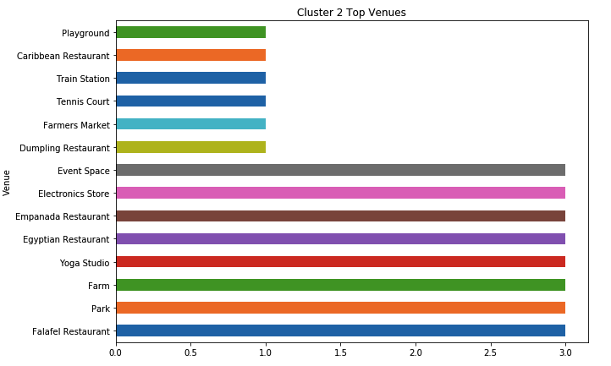
Third Cluster

Slide 12
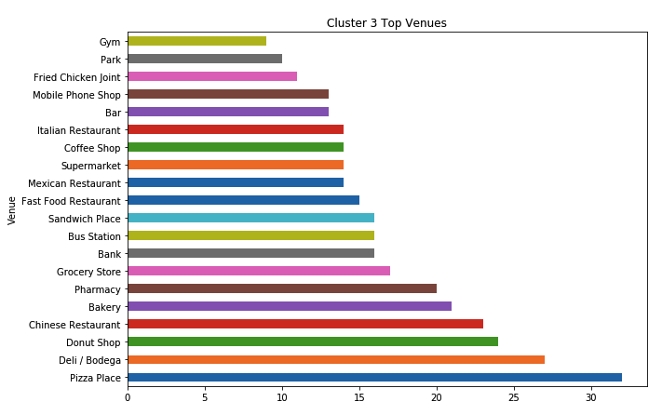
Fourth Cluster

Slide 13
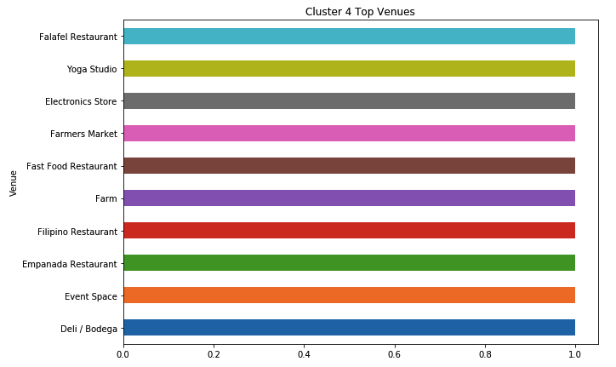
Fifth Cluster

Slide 14
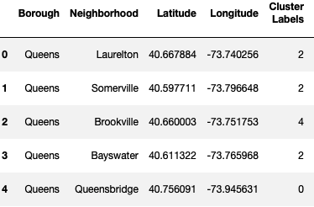
Analysis Results
By looking at each cluster, we can see that clusters 1 and 3 contain “bar” as a top venue
Neighborhoods in cluster 1 and 3 must be discarded
Consequently, the following neighborhoods can be a good location to open a bar:

Slide 15
Observations
Bayswater or Somerville can be a perfect location if the plan is to open a bar in the summer because they are close to the beach.
On the other hand, Laurelton and Brookville are close to the JFK Airport, which can attract travelers
In addition, information containing the average income of the final 5 neighborhoods can help decide which neighborhood is the best to open a bar

Slide 16
Conclusion
A good data set and the right analysis can speed up the process of finding a good place to start a business
Foursquare makes things easier by providing existing business information
By using Python, we can combine information from multiple sources, such as files and APIs, and use different analysis tools or algorithms depending on the needs of the project

