Slide 1
Functions
Jin-Soo Kim (jinsoo.kim@snu.ac.kr)
Systems Software & Architecture Lab.
Seoul National University
Dec 16 – 20, 2019

Slide 2
Python Functions
A function is some reusable code that takes argument(s) as input, does some computation, and then returns a result or results.
Built-in functions
Provided as part of Python
print(), input(), type(), float(), int(), max(), …
User-defined functions
Functions that we define ourselves and then use
A function can be defined using the def reserved word
A function is called (or invoked) by using the function name, parentheses, and arguments in an expression

Slide 3
Function Example
Function name
Argument
big = max([4, 1, 9, 0])
>>> big = max([4, 1, 9, 0])
>>> print(big)
9
>>> tiny = min([4, 1, 9, 0])
>>> print(tiny)
0
Assignment
9
Result

Slide 4
max()
A function is some stored code that we use.
A function takes some input and produces an output.
>>> big = max([4, 1, 9, 0])
>>> print(big)
9
max()
function
[4, 1, 9, 0]
9
(a list)
(an integer)

Slide 5
max()
A function is some stored code that we use.
A function takes some input and produces an output.
>>> big = max([4, 1, 9, 0])
>>> print(big)
9
def max(inp):
blah
blah
for x in inp:
blah
blah
return z
[4, 1, 9, 0]
9
(a list)
(an integer)

Slide 6
Building Our Own Functions
We create a new function using the def keyword followed by optional parameters in parentheses
We indent the body of the function
This defines the function but does not execute the body of the function
def print_lyrics():
print('I bless the day I found you')
print('I want to stay around you')

Slide 7
Defining a Function
x = 5
print('Hello')
def print_lyrics():
print('I bless the day I found you')
print('I want to stay around you')
print('World')
x = x + 2
print(x)
Hello
World
7

Slide 8
Definitions and Uses
Once we have defined a function, we call (or invoke) it as many times as we like
x = 5
print('Hello')
def print_lyrics():
print('I bless the day I found you')
print('I want to stay around you')
print('World')
print_lyrics()
x = x + 2
print(x)
Hello
World
I bless the day I found you
I want to stay around you
7

Slide 9
Arguments
An argument is a value we pass into the function as its input when we call the function
We use arguments so we can direct the function to do different kinds of work when we call it at different times
We put the arguments in parentheses after the name of the function
big = max([4, 1, 9, 0])
Argument

Slide 10
Parameters
>>> def greet(lang):
... if lang == 'kr':
... print('안녕하세요')
... elif lang == 'fr':
... print('Bonjour')
... elif lang == 'es':
... print('Hola')
... else:
... print('Hello')
>>> greet('en')
Hello
>>> greet('es')
Hola
>>> greet('kr')
안녕하세요
>>>
A parameter is a variable which we use in the function definition.
It is a "handle" that allows the code in the function to access the arguments for a particular function invocation.

Slide 11
Return Value
>>> def greet(lang):
... if lang == 'kr':
... return '안녕하세요'
... elif lang == 'fr':
... return 'Bonjour'
... elif lang == 'es':
... return 'Hola'
... else:
... return 'Hello'
>>> print(greet('en'), 'Jack')
Hello Jack
>>> print(greet('es'), 'Sally')
Hola Sally
>>> print(greet('kr'), '홍길동')
안녕하세요 홍길동
>>>
A "fruitful" function is one that produces a result (or return value)
The return statement ends the function execution and "sends back" the result of the function

Slide 12
Arguments, Parameters, and Results
>>> big = max([4, 1, 9, 0])
>>> print(big)
9
Parameter
def max(inp):
blah
blah
for x in inp:
blah
blah
return z
[4, 1, 9, 0]
9
Argument
Result

Slide 13
Multiple Parameters / Arguments
We can define more than one parameter in the function definition
We simply add more arguments when we call the function
We match the number and order of arguments and parameters
def mymax(a, b):
if a > b:
return a
else:
return b
x = mymax(3, 5)
print(x)
5

Slide 14
Default and Keyword Arguments
Default arguments
You can specify default values for arguments that aren't passed
Keyword arguments
Callers can specify which argument in the function to receive a value by using the argument's name in the call
def student(name, id='00000', dept='CSE'):
print(name, id, dept)
student('John')
student('John', '00001')
student(name='John')
student(id='20191', dept='EE', name='Jack')
Notes:
John 00000 CSE
John 00001 CSE
John 00000 CSE
Jack 20191 EE

Slide 15
Passing Arguments
>>> def f(a, b):
... a = 9
... b[0] = 'spam'
>>> x = 5
>>> L = [1, 2]
>>> f(x, L)
>>> print(x)
5
>>> print(L)
['spam', 2]

Slide 16
Passing Arguments
>>> def f(a, b):
... a = 9
... b[0] = 'spam'
>>> x = 5
>>> L = [1, 2]
int
x
5
L
list
int
int
1
2

Slide 17
Passing Arguments
>>> def f(a, b):
... a = 9
... b[0] = 'spam'
>>> x = 5
>>> L = [1, 2]
>>> f(x, L)
int
x
5
L
list
a
b = L
a = x
int
int
b
5
5

Slide 18
Passing Arguments
int
>>> def f(a, b):
... a = 9
... b[0] = 'spam'
>>> x = 5
>>> L = [1, 2]
>>> f(x, L)
9
int
x
5
L
list
a
int
int
b
5
5

Slide 19
Passing Arguments
int
>>> def f(a, b):
... a = 9
... b[0] = 'spam'
>>> x = 5
>>> L = [1, 2]
>>> f(x, L)
9
int
x
5
L
list
a
str
int
b
'spam'
5

Slide 20
Passing Arguments
int
>>> def f(a, b):
... a = 9
... b[0] = 'spam'
>>> x = 5
>>> L = [1, 2]
>>> f(x, L)
>>> print(x)
5
>>> print(L)
['spam', 2]
9
int
x
5
L
list
str
int
'spam'
5

Slide 21
Local vs. Global Variables
Local variables
If a variable is assigned a value anywhere within the function's body, it is assumed to be a local
Visible only to code inside the function def and exists only while the function runs
Global variables
Variables defined outside a function
Variables that are only referenced inside a function are implicitly global
Use global keyword to use a global variable inside a function
There is no need to use the global keyword outside a function

Slide 22
Local vs. Global Variables: Examples (1)
def f():
print(s)
s = 'Spam is delicious'
f()
def f():
s = 'Egg is better'
print(s)
s = 'Spam is delicious'
f()
print(s)
Spam is delicious
Egg is better
Spam is delicious
Notes:
LEFT: s in f(): global
RIGHT: s in f(): local

Slide 23
Local vs. Global Variables: Examples (2)
def f():
print(s)
s = 'Egg! Egg!'
print(s)
s = 'Spam is delicious'
f()
print(s)
def f():
global s
print(s)
s = 'Egg! Egg!'
print(s)
s = 'Spam is delicious'
f()
print(s)
Traceback (most recent call last):
File "local.py", line 7, in <module>
f()
File "local.py", line 2, in f
print(s)
UnboundLocalError: local variable 's' referenced before assignment
Spam is delicious
Egg! Egg!
Egg! Egg!

Slide 24

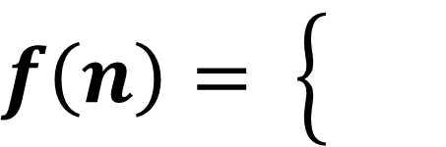



Recursive Function
Functions that call themselves either directly or indirectly
$f\left(n\right)= \left\{\begin{aligned} \\ \end{aligned}\right.$
$$f\left(n−1\right)+f(n−2)$$
$$n≥2$$
$$1$$
$$n=0, n=1$$
def fib(n):
if (n < 2):
return 1
else:
return fib(n-1) + fib(n-2)

Slide 25
To Function or Not to Function…
Organize your code into "paragraphs" – capture a complete thought and "name it"
Don't repeat yourself – make it work once and then reuse it
If something gets too long or complex, break it up into logical chunks and put those chunks in functions
Make a library of common stuff that you do over and over – perhaps share this with your friends…

Slide 27
Lab: Factorial
$n!=n ×\left(n−1\right)×\left(n−2\right)× .. . ×2×1$
def fact(n):
return result

Slide 28
Lab: Factorial
$n!=n ×\left(n−1\right)×\left(n−2\right)× .. . ×2×1$
def fact(n):
result = 1
for i in range(1, n+1):
result *= i
return result

Slide 29
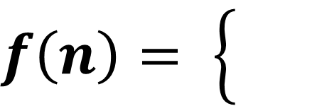

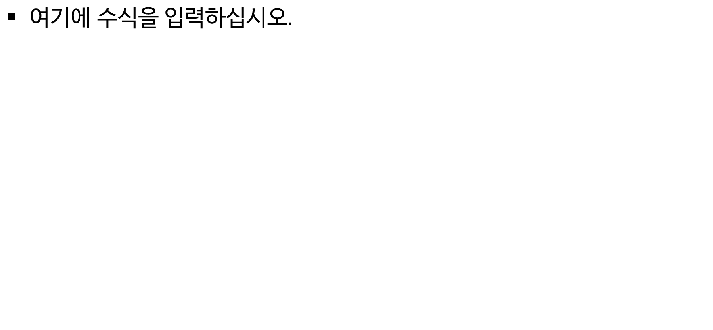



Lab: Fibonacci Numbers
$f\left(n\right)= \left\{\begin{aligned} \\ \end{aligned}\right.$
$$f\left(n−1\right)+f(n−2)$$
$$n≥2$$
$$1$$
$$n=0, n=1$$
def fib(n):
return x;

Slide 30
Lab: Fibonacci Numbers
$f\left(n\right)= \left\{\begin{aligned} \\ \end{aligned}\right.$
$$f\left(n−1\right)+f(n−2)$$
$$n≥2$$
$$1$$
$$n=0, n=1$$
def fib(n):
a, b = 1, 1
for i in range(2, n+1):
a, b = b, a+b
return b

Slide 31
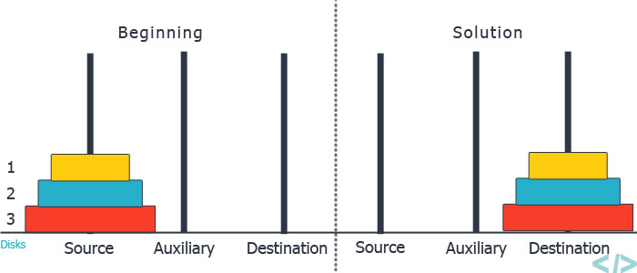
Lab: Tower of Hanoi
def hanoi(n, source, dest, aux):
hanoi(3, 'A', 'C', 'B')
Notes:
def hanoi(n, source, dest, aux):
if n > 0:
hanoi(n-1, source, aux, dest)
print('Move disk', n, 'from', source, 'to', dest)
hanoi(n-1, aux, dest, source)
hanoi(3, 'A', 'C', 'B')

Slide 32
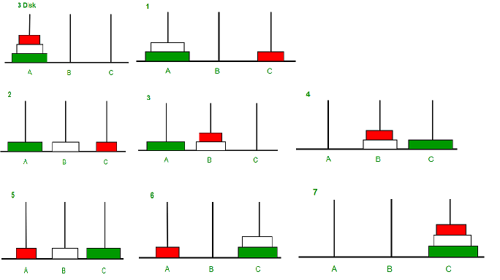
Lab: Tower of Hanoi
Move disk 1 from A to C
Move disk 2 from A to B
Move disk 1 from C to B
Move disk 3 from A to C
Move disk 1 from B to A
Move disk 2 from B to C
Move disk 1 from A to C

