Slide 1
Toward Big Data: A Modern Workflow for Data Management
Jason Kiley
Oklahoma State University

Slide 2
github.com/jtkiley/

Slide 3
Related
AOM Big Data workshop with Tim Hannigan, Hovig Tchalian, and Laura Nelson (on Github).
My AOM Content Analysis PDW presentation (on the UGA Content Analysis website).

Slide 4
Overview
Python: data analysis is not (necessarily) programming.
Reproducibility helps move research forward faster.
Workflow overview and demonstration.

Slide 5
Motivation
Data management is getting more complex and has higher rewards for good practices.
Reproducibility is important for good science, and you as a researcher are a primary beneficiary.
Better workflows allow more focus on higher value added work in research.

Slide 6
What do I really need to know about Python?

Slide 7
Why Python?
Approachability: well-designed modern programming language that handles a lot for you.
Features: many things have been built already, and you simply “glue” them together.
Learning resources: wide popularity in academia and practice means that there are extensive resources.
Scalability: from your computer, to the cloud, to a computing cluster, you can use largely the same tools.

Slide 8
Python Fluency
Software Development
Good-enough Programming
Data preparation
Basics

Slide 9
Basics
Skills | Software: Anaconda, Python interpreter, Jupyter Notebooks Variable types: strings, ints, floats Objects and methods: lists, dictionaries Packages: importing and installing Documentation: official and community
Time | 2-4 hours
Necessity | Largely unavoidable

Slide 10
Data Preparation
Skills | Software: pandas Reading data formats (built-in) Slicing, views, df.loc[ ] Operations on columns and rows Reshaping Merging and querying
Time | 1-2 days and ongoing
Necessity | Needed and high ROI

Slide 11
Good-enough Programming
Skills | Loops Writing functions Reading and writing files (the hard way) Throwing and handling exceptions Using additional packages End point: working, reusable script
Time | 1 week and ongoing; divisible
Necessity | Helpful and good ROI

Slide 12
Software Development
Skills | Classes and inheritance Package development Version control Unit testing and continuous integration Cross-version support Open source contributions
Time | A lot
Necessity | Not at all; good for the field

Slide 13
What resources are available for learning?

Slide 14
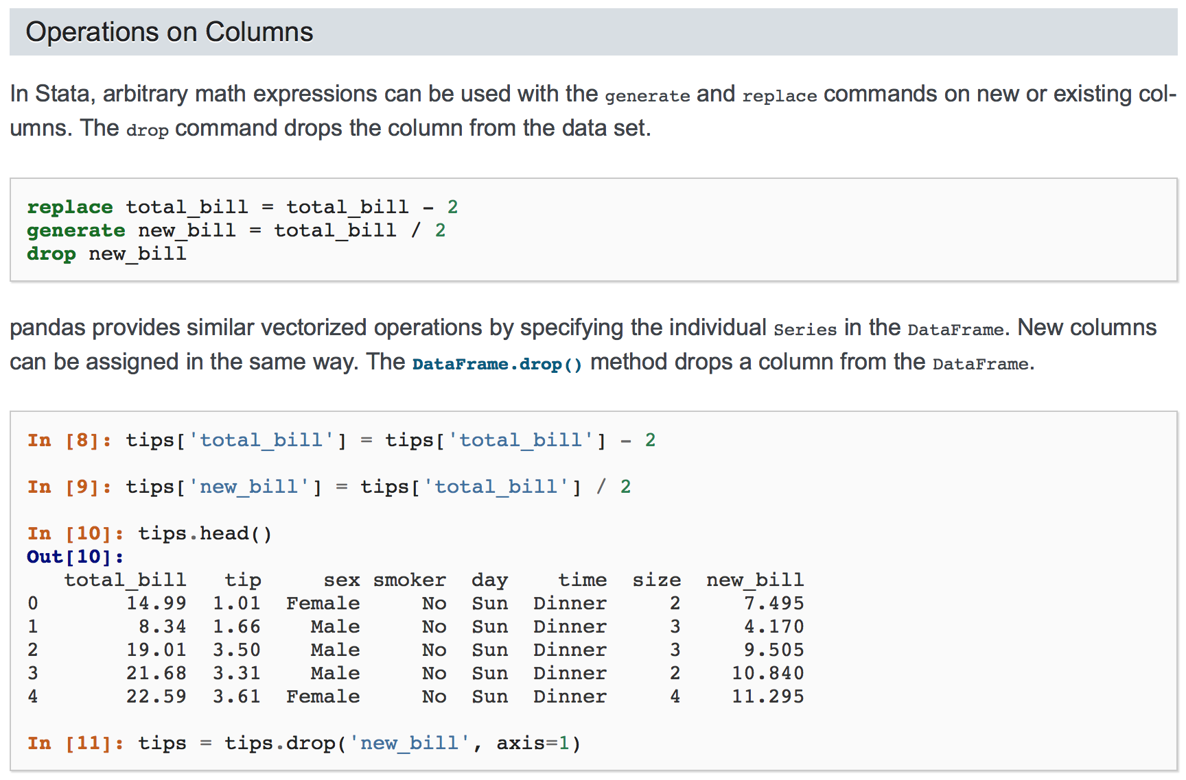
pandas documentation
Comparison with Stata

Slide 15
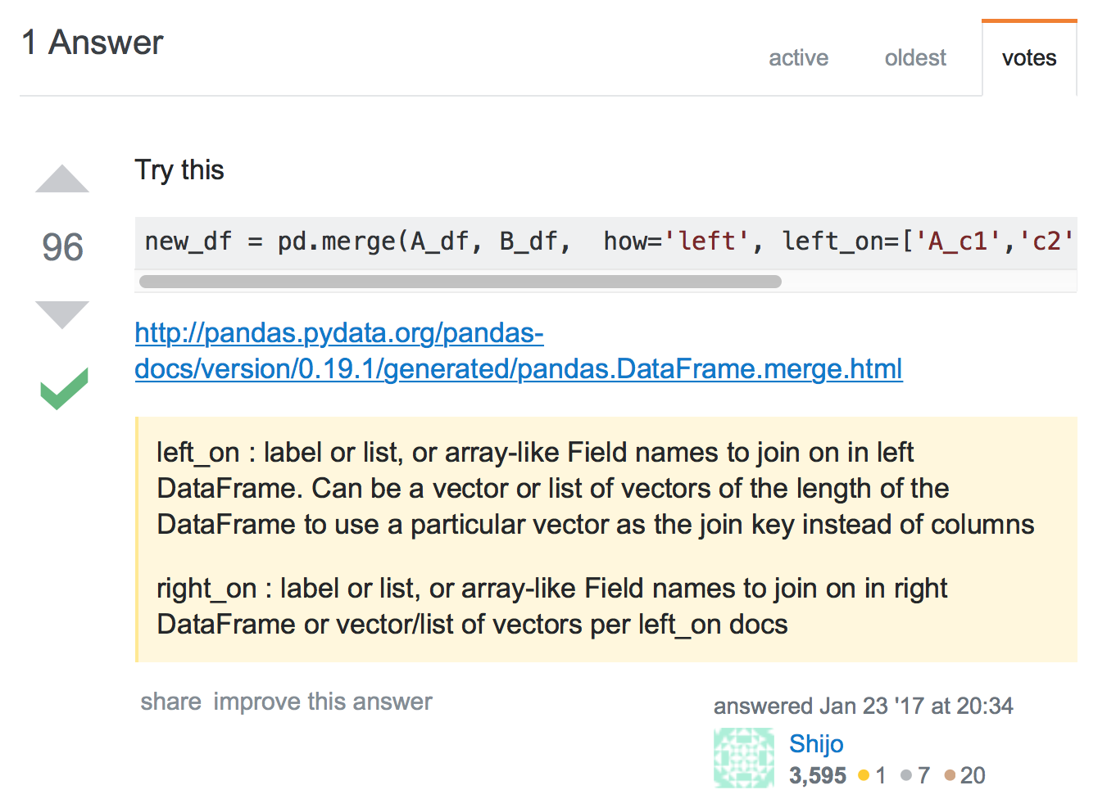
Stack Overflow
Search for what you are trying to do, merging on multiple columns with different names in this case.

Slide 16
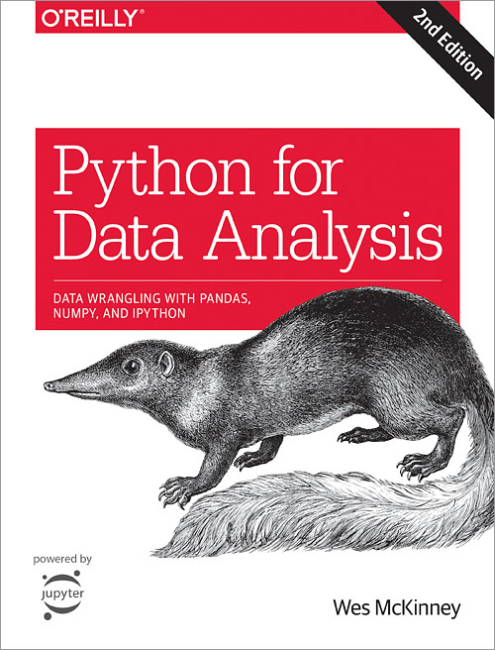
Python for Data Analysis
Wes McKinney
creator of pandas and other open source projects

Slide 17
Other resources
edX: many courses that use or teach Python that are relevant for data work (free).
Data Camp: video courses from basic data preparation up to machine learning ($29/month)

Slide 18
What about R?
R is great overall, especially compared to a lot of commercial stats software.
Compared to Python, it is less general purpose, so some useful packages may not have analogues.
The syntax (from S in the 1970s) is sometimes quite arcane.

Slide 19
How (and why) do I make my work reproducible?

Slide 20
Examples
Inheriting responsibility for a project’s data and methods in the middle.
Reviewers ask for a robustness check that requires a change in the middle of your data preparation.
Supervising a student’s work.

Slide 21
Reproducibility
Overall: Can I or someone else reproduce my data and results?
Documentation: can I show my work?
Efficiency: can I easily make changes in the middle of my data pipeline?
Authoritativeness: can I demonstrate that my documentation accurately reflects my work?

Slide 22
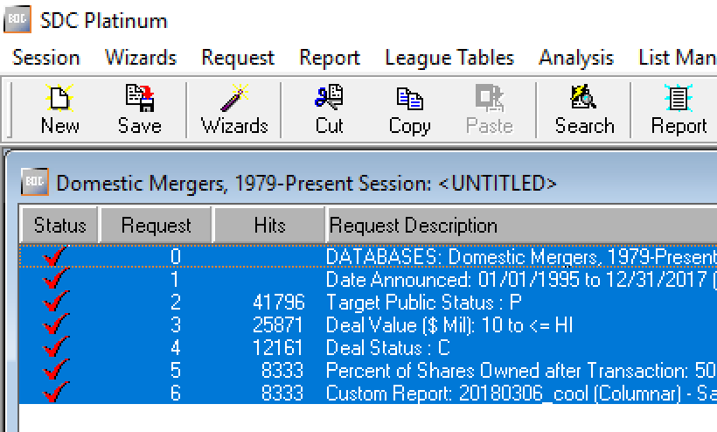
Data sources
Document sources and queries with enough specificity to recreate it.
Not perfect; our databases are not versioned.
Helps mitigate the “one more variable” problem.

Slide 23
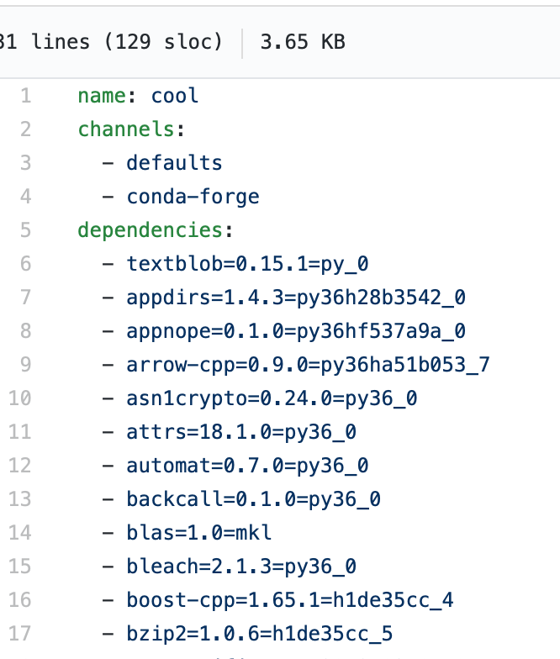
Software
Fix the software versions that you use, so updates do not affect your study.
Conda environments make this fairly easy.
Update as needed, but check your results.

Slide 24
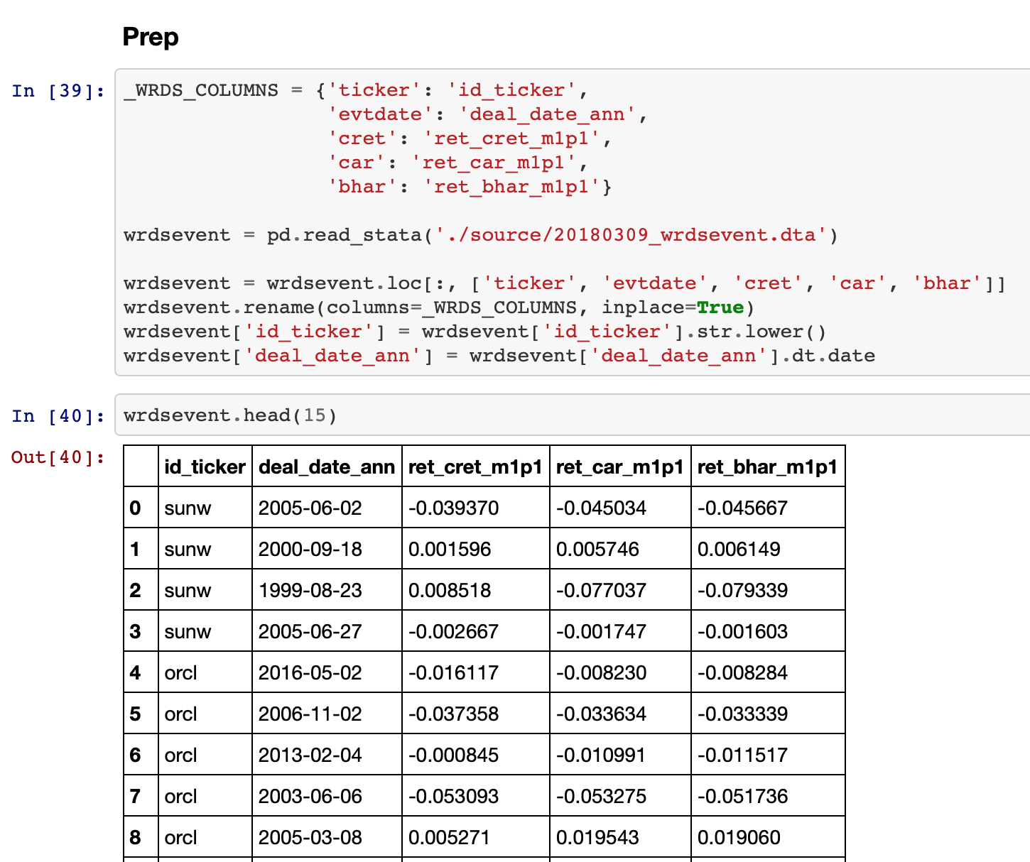
Code that runs
Make all changes to data in code that runs cleanly on the original data.
Running code makes changes very efficient.
Rerunning it proves that it is authoritative.

Slide 25
Is there a crisis?
Probably not (Fanelli, 2018, PNAS, opinion piece).
New data, computational, and methodological opportunities involve greater complexity and a need for more rigor.
We can build on the work of others rather than duplicating so much effort.
In sum, it is more of an opportunity to do better as a field than it is a crisis.

Slide 26
What does a modern workflow look like?

Slide 27
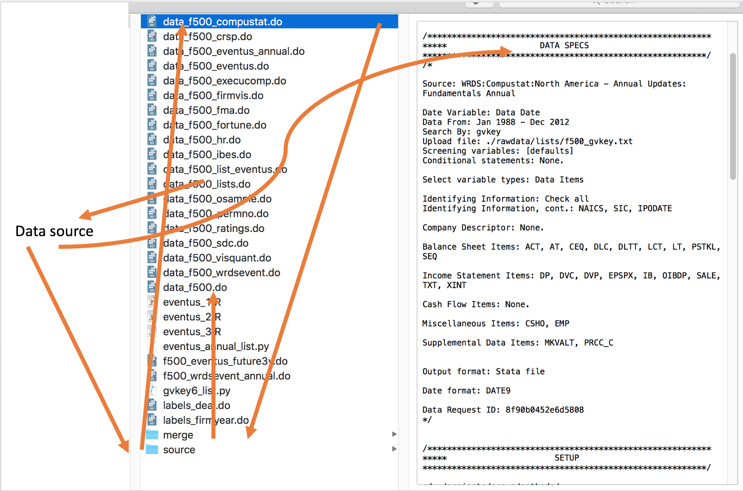

Slide 28
data_0
prep_0
merge_0
data_1
prep_1
merge_1
prep_all
final
data_n
prep_n
merge_n
Documentation

Slide 29
Workflow characteristics
Easy for others to rerun your code and verify your results.
Errors happen: detect and fix them.
Data management is often iterative, and tools workflows should be designed accordingly.
Solve problems well one time and reuse.

Slide 30
Pre-demo questions

Slide 31
Demo

Slide 32
Summary
Using Python for data analysis is not exactly programming, and you already have much of the knowledge you need.
Reproducibility has great benefits for future you.
A modern workflow expands the questions you can reach and increases your efficiency on existing classes of questions.

Slide 33
Key point:
code that runs

Slide 34
Questions

