Slide 1



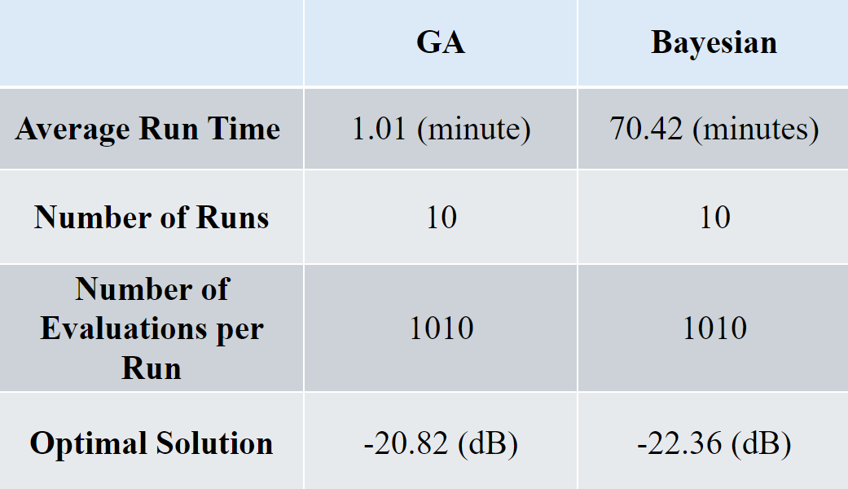
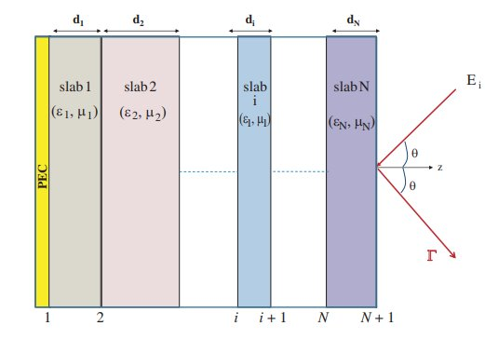


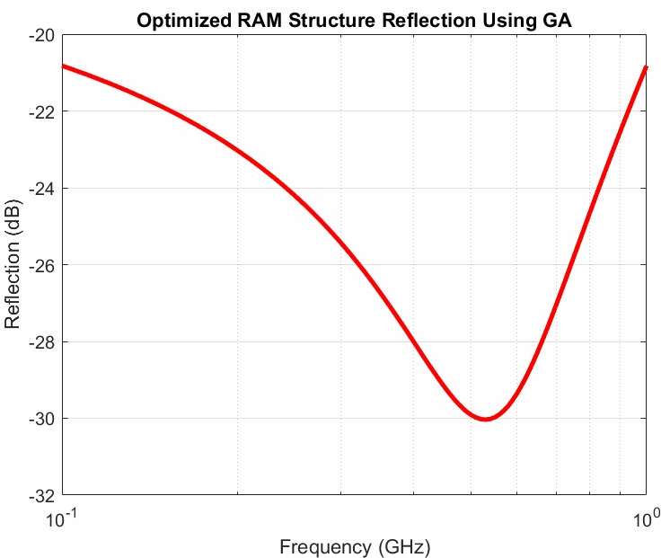
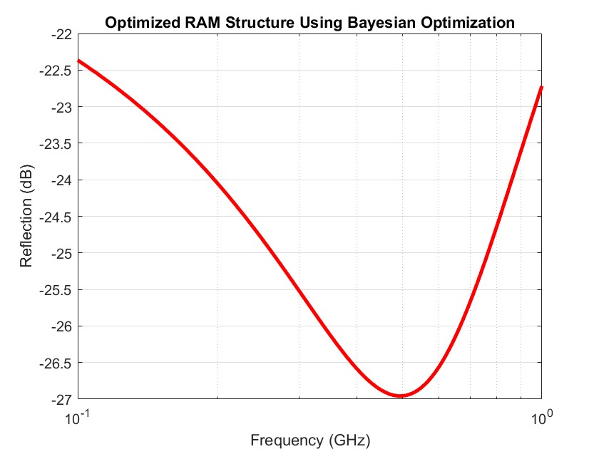
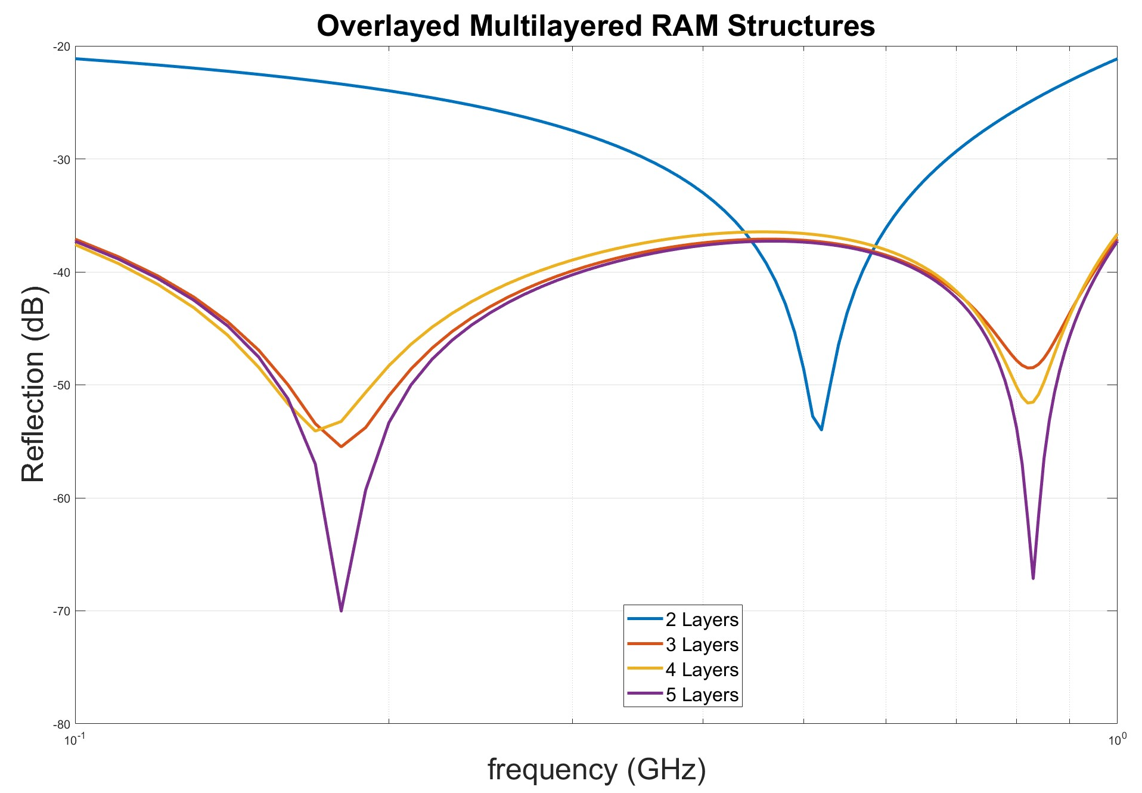
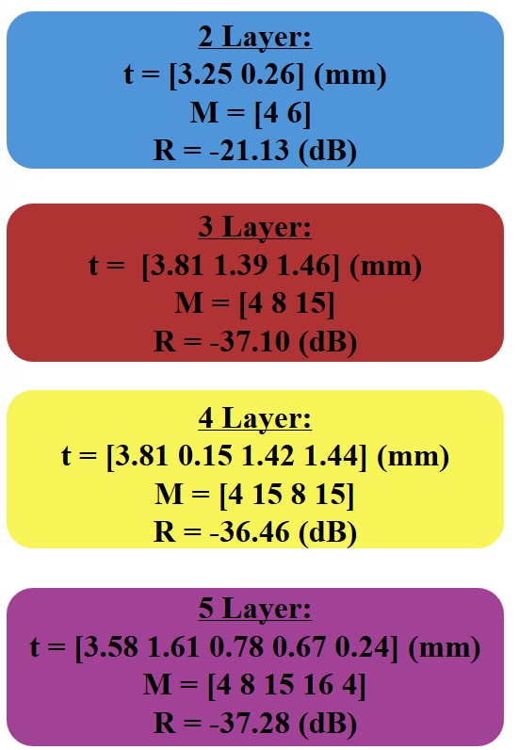
Optimizing Multi-Layer Radiation Absorbing Materials: Advanced Algorithmic Solutions
Project Engineers: Joseph Antonucci, Abegale Jones, Tegan Carr
Project Advisor: Dr. Paul Leu, Dr. Quang Nguyen
Abstract
Design Process
Performance of GA vs. Bayesian Optimization
This project optimizes the design and performance of multilayer radiation-absorbing materials (RAM) using advanced computational algorithms. RAM are crucial for minimizing electromagnetic reflection in stealth technology, electronics, and communication systems. Genetic Algorithms (GA) and Bayesian optimization with MATLAB's Global Optimization Toolbox were used to find the maximum absorption across a broad band frequency range by varying the number of material layers and thicknesses. Results indicate that increasing the number of layers, particularly with 3, 4, and 5-layer structures, significantly improved absorption compared to 2-layer configurations. The optimized structures showed trade-offs in peak reflection and between thickness and reflection, highlighting the potential of both GA and Bayesian optimization for enhancing multilayered RAM performance based on specific design needs.
Using MATLAB’s Global Optimization Toolbox, we developed a double-constrained genetic algorithm to optimize the performance of a multilayered (RAM). This genetic algorithm was designed to handle two critical constraints: limiting the total thickness of the multilayered material to under 7 mm, while achieving a reflection coefficient below -30 dB. To explore the effects of varying the number of layers on the material's performance, we created optimization codes for 2, 3, 4, and 5-layer configurations.
Table 1: GA VS. Bayesian Optimization
Introduction
Table 1 compares the performance of Genetic Algorithm and Bayesian Optimization for optimizing a three layer RAM structure. The Genetic Algorithm is significantly faster, with an average runtime of 1 minute, compared to 70 minutes for Bayesian Optimization. However, Bayesian Optimization achieves a better optimal reflection coefficient of -22.36 dB, indicating improved absorption efficiency over the GA's -20.82 dB. Both optimization techniques were run with 1,010 evaluations and 10 runs to ensure consistency.
RAM are crucial for managing electromagnetic waves, especially those related to radar systems, and have vast applications in industries like military and defense, aerospace, electronics, and telecommunications. RAM help reduce radar cross-section in defense applications and minimize electromagnetic interference in communication systems.
Figure 3: Multilayered RAM Structure [4]
In addition to using genetic algorithms, we also leveraged Bayesian optimization, employing MATLAB's Probability and Statistics Toolbox. By developing a Bayesian optimization code, we compared multiple optimization techniques to identify the most effective approach for enhancing the performance of multilayered RAM.
Figure 1: U.S. Air Force F35 A [1]
Figure 2: Close up of Electronic Device [2]
Optimizing RAM involves enhancing their effectiveness in absorbing, attenuating, or scattering specific electromagnetic radiation across a desired frequency range. To achieve these optimizations, GAs are highly effective tools. GAs are heuristic search techniques inspired by natural selection that excel at solving complex optimization problems involving multiple interacting variables and large search spaces. By leveraging their ability to explore and refine potential solutions, GAs are particularly well-suited for optimizing RAM to achieve better electromagnetic absorption performance [3].
Comparison of Multilayered Structures
Figure 5: GA Optimized Structure
Figure 6: Bayesian Optimized Structure
Figures 5 and 6 illustrate that while the GA provides a quick solution, it results in higher reflection. In contrast, Bayesian Optimization yields a more effective structure with lower reflection, though at the cost of longer runtime. The trade-off here lies between the speed of the GA and the superior solution quality offered by Bayesian Optimization.
Objective
Conclusion
The objective of this project was to optimize the design and performance of multilayered RAM by employing advanced computational algorithms. Specifically, the project aimed to determine the optimal arrangement and thicknesses of multiple layers to achieve maximum absorption efficiency across a broad frequency range. By integrating techniques such as genetic algorithms and Bayesian optimization, the project sought to significantly enhance the material’s effectiveness for stealth technology.
This project highlights the effectiveness of advanced optimization algorithms in designing high-performance multilayered RAM. Structures with 3, 4, and 5 layers improved absorption, with the GA offering better peak absorption and better run times than Bayesian Optimization. The choice of method and layer count depends on design goals, such as peak performance or run time. These approaches enhance RAM for radar signature reduction, shielding, and communication, advancing real-world applications.
Requirements and Specifications
Figure 4: Overlayed Results of Multilayered Structures Using GA
Acknowledgements
Figure 4 shows the reflection results of optimized multilayered RAM structures with configurations of 2, 3, 4, and 5 layers using the GA approach. The graph highlights how the reflection coefficient varies across different frequencies for each configuration, illustrating the effect of increasing the number of layers on the material's absorption capabilities.
Notably, the data indicate that as the number of layers increases, the absorption performance of the RAM material improves significantly. The 2-layer configuration shows the highest reflection (least absorption), while the configurations with 3, 4, and 5 layers achieve markedly lower reflection values, indicating better absorption of electromagnetic waves. The 5-layer structure, in particular, exhibits the lowest reflection coefficient, achieving the highest absorption efficiency among the tested designs.
We extend our deepest gratitude to Dr. David Schmidt, Dr. Paul Leu, Dr. Quang Nguyen, Dr. Jungtaek Kim, and Mr. Mingxuan Li for their invaluable guidance, mentorship, and encouragement throughout this project. Their expertise and support have been instrumental in shaping the success of our work. We are also grateful for their sponsorship that made this research possible.
Make a Template for Army Research Lab to Import Materials
The Material Must be Thin and Easy to Manufacture
Import 16 fictious materials
Create air and PEC layers surrounding material
Maximum of 5 materials thick
Total material thickness < 7 mm
Sources
[1] Wikipedia contributors. (2024, November 29). Lockheed Martin F35 A. Wikipedia.
[2] DeepCoat. (n.d.). How EMI shielding protects cell phones. DeepCoat. Retrieved 2024
[3] Michielssen, E., Sajer, J.-M., Ranjithan, S., & Mittra, R. (1993). Design of lightweight, broad-band microwave absorbers using genetic algorithms. IEEE Transactions on Microwave Theory and Techniques, 41(6), 1024–1031. https://doi.org/10.1109/22.238519
[4] Kilic, O., & Nguyen, Q. M. (2010, January 17). Design of lightweight, broad-band microwave absorbers using Genetic Algorithms | IEEE Journals & Magazine | IEEE Xplore. Application of Artificial Immune System Algorithm to Electromagnetics Problems. https://ieeexplore.ieee.org/document/238519/
Minimize Total Radar Reflection
Efficiently Execute
MATLAB & Python Scripts
Keep reflection of broad-band frequencies under –30 dB
Vectorize FOR Loops
Genetic Algorithm (GA)
Bayesian Optimization

