Slide 1
VendorChain Demo
COMP6452 Blockchain Application Architecture 21T2
July 29, 2021
Daigo Conlan
Justin Pham
Katrina Ding
Sang Hyun Kim

Slide 2
Introduction
We have developed the VendorChain blockchain application to deal with its current challenges.
Problem
Solution
How can we figure out which contracts need extending and which do not?
How can we figure out which contract’s SLA has been breached?
How can we automatically pay for invoices?
The system should be able to check if SLAs are satisfied and terms are not breached.
Approved users should be able to create, read, update or delete contracts.
The system should be able to automatically pay for vendor invoices

Slide 3
System Architecture
VendorChain consists of off-chain and on-chain where blockchain works as a bridge to interact data.
VendorChain Architecture
Off-chain
On-chain
Client Tier
Application Tier
Blockchain Tier
Web-browser
Express
API
Ethereum
React JS
Web3.js
Factory Contract
Node JS
JSON/HTTPS
Instance
Chrome
Oracle
Instance
User
Data Tier
Database
Instance
PostgreSQL

Slide 4
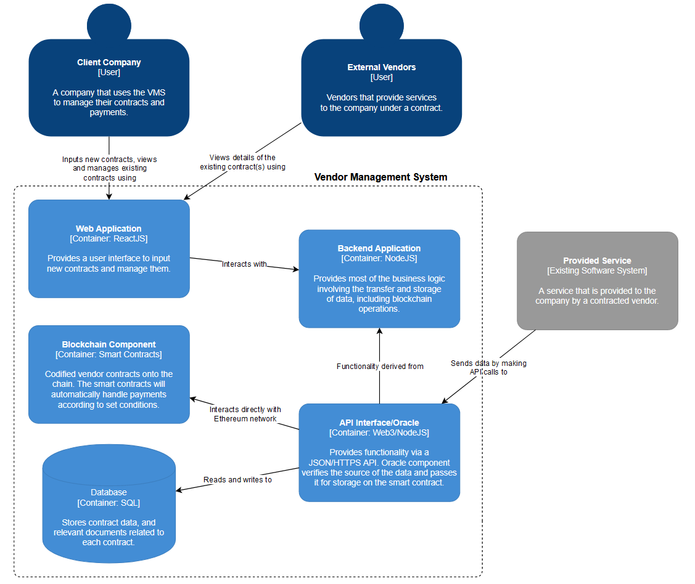
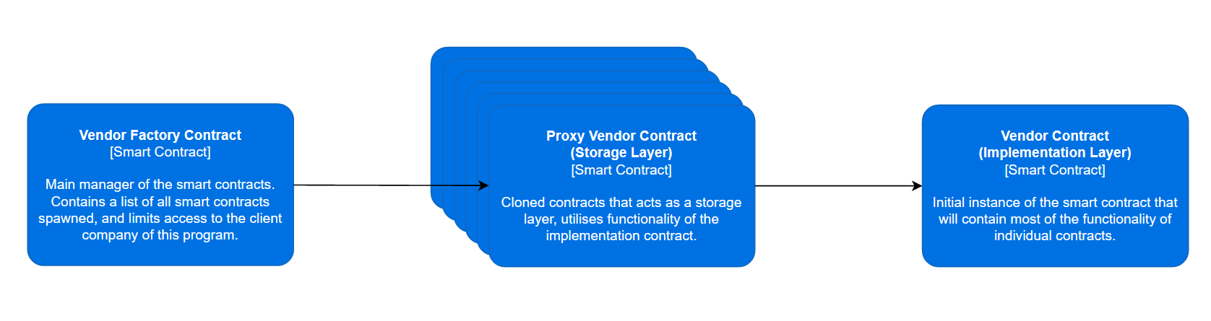
Implementation Details
Software architecture design
Centralised Oracle
Decentralised is an option to avoid single-point-of-failure
Legal and Smart Contract pair
Hashed contract provides integrity
Factory Contract
Spawns new contract using a template
On-chain
Codified vendor contracts
Contract registry
Hashed data
Off-chain
Original contracts
Data/"evidence" of service requirements met
Notes:
1. Cost effective via use of common hardware and resources
2. Updates will only be done once so that they will benefit all of users.
3. Any action affecting the database will affect all shared clients. So it is at the application level that data separation will have to be done and therefore the developer team will prevent data exposure from one customer to another, which will increase the complexity of the application layer. 4. You will be less easily able to customize the offer you offer to your customers. It is still possible to lock some features in the code of the application but again, it may lead to complexity related to development.

Slide 5
DEMO
DEMO

