Slide 1
CRDTs Conflict-free Replicated Data Types
Mohammad Ghasemisharif
John Kristoff Sepideh Roghanchi

Slide 2
Agenda
Background and problem definition
Methods of synchronization
Operation-based consistency
State-based consistency
Algorithms, pseudo-code, and examples
Data types (graph, set, counter)
Real-world usage and limitations

Slide 3
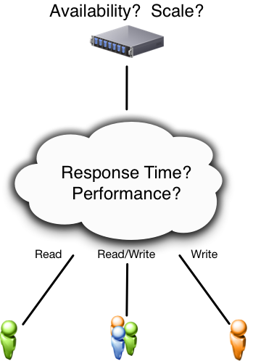
Simple Client/Server

Slide 4
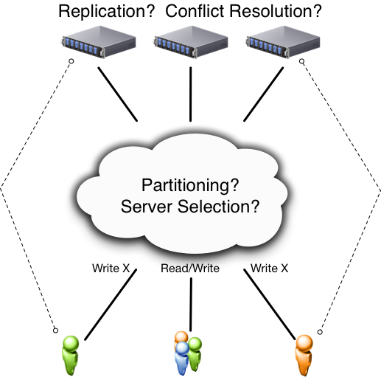
Distributed System

Slide 5
Conflicts and Resolution
Partition A receives update(X_{a})
Partition B receives update(X_{b})
How to merge competing updates?
Timestamp?
Last-writer-wins?
Solution may be imperfect (i.e. a loser)
Some data-types are conflict-free!

Slide 6
Replication
Availability is desirable
Fault-tolerance is desirable
Low latency (high-performance) is desirable
Maintaining consistency can be difficult

Slide 7
Key Concepts to Review
Strong consistency
Eventual consistency
Conflict arbitration
Consensus and rollback
CAP problem (pick 2)
Consistency
Availability
Partition Tolerance

Slide 8
strong consistency
Everyone knows about every update immediately
There is an order for all operations
Everyone sees the same order
Bottlenecks:
Consensus problem
Makes the system sequential
Slow, not scalable
Tolerates < n/2 failures

Slide 9
Unfortunately, the CAP theorem tells us that no system satisfying those three desirable properties together exists:
Availability is often dropped!
Drop strong consistency for a weaker form of consistency:
Eventual consistency

Slide 10
eventual consistency
Update local + propagate
All updates eventually take effect at all replicas, asynchronously and possibly in different orders
Concurrent updates may conflict
Still needs consensus
Conflict -> reconcile
Moved consensus off the critical path (background)
Better performance, more complex
May come at the cost of availability when synchronizing!
Notes:
replicas converge toward the same state in finite time
eventual consistency means that replicas eventually reach the same final value if clients stop submitting updates
<number>

Slide 11
Motivation
provide a data structure distributed over a large network and manipulated by a large base of users around the world
Having multiple replicas of the data structure:
good for fault tolerance and read latency
Problem with updates :
Synchronize -> slow
Don’t synchronize -> conflicts
The provided data structure should follow the CAP properties:
Consistency
Availability
partition-tolerance

Slide 12
Strong eventual consistency
Update local + propagate
A replica of the shared data structure is coherent with other replicas that have observed the same operations
No synchronization (no consensus)
Deterministic outcome for every conflict
Allow any number of failure
→ solves CAP problem

Slide 13
Origin Story
2011 publication by Marc Shapiro, et al.
Strong consistency does not scale
Eventual consistency is better, but…
Concurrent conflict resolution is hard
Therefore, strong eventual consistency

Slide 14
How to do it? Need data types to support it…
CRDT: a simple, theoretically sound approach to eventual consistency
replicas of any CRDT converge to a common state that is equivalent to some correct sequential execution
Properties:
no synchronization
update executes immediately
unaffected by network latency, faults, or disconnection
extremely scalable
fault-tolerant
does not require much mechanism

Slide 15
CRDT
Conflict-free
Replicated
Data Type

Slide 16
Data-type (in CRDTs)
Data structures that ease consistency
Eliminates complexity of consensus
Data or operations must be commutative

Slide 17
Definitions
EC:
Eventual delivery: An update delivered at some correct replica is eventually delivered to all correct replicas: ∀i,j : f ∈ ci ⇒ ♦f ∈ c
Termination: All method executions terminate
Convergence: Correct replicas that have delivered the same updates eventually reach equivalent state: ∀i,j : ci = cj ⇒ ♦ si ≡ sj
SCE
Strong Convergence: Correct replicas that have delivered the same updates have equivalent state: ∀i,j :ci =cj ⇒si ≡sj

Slide 18
Op versus State-based
Operation: add 5, subtract 6
State: send(x_{i}), send(x_{i+1})

Slide 19
Commutative
Data that commutes is a key property
e.g. add A, add B == add B, add A
Not all ops or states are commutative
e.g. multiple 5, subtract 6 != subtract 6, multiply 5

Slide 20
Operation-based replication
Local replica sends operation
Concurrent operations must be commutative

Slide 21
op-based object
Tuple: (S, s⁰, q, t, u, P)
S, s⁰ and q same as state-based object
Replica at process p_{i} has state s_{i} ∈ S
Initial state is s⁰
t = side-effect-free prepare-update
u = effect-update
P = delivery precondition

Slide 22
State-based replication
Local replica (p1)
performs computation
updates local state
Periodically send(p1_state)
Receiver replica(s)
perform merge(p1_state, p2_state)

Slide 23
state-based object
Tuple: (S, s⁰, q, u, m)
Replica at process p_{i} has state s_{i} ∈ S
Initial state is s⁰
q = query
u = update
m = merge

Slide 24
Clients send query to read replica’s state
Read only -> easy
Updates:
State-based
Operation-based
client
S
s1
s2
S2.q(a)
Notes:
<number>

Slide 25
State-based approach
State-based:
Local queries, local updates at source
Send full state every once in a while
On receive, merge
File systems (NFS, Unison, Dynamo)
S
s1.u(a)
s1
s1
s2
s2.m(s1)

Slide 26
all the replicas talk to each other directly on indirectly
if it converges it will satisfy the strong consistency
What is the sufficient condition for it to converge?

Slide 27
Semilattice
Set with partial order and an operation can take any two values and give you an upper bound on them
If the payload forms a semilattice (partial order on values, always can take an upper bound)
If updates are increasing in semilattice
If merge function computes this upper bound
-> replicas converge to LUB of last values

Slide 28
State-based example
S
Plus 5
Plus 4
{s1:9,s2:3}=12
s1
{s1:9}=9
{}=0
{s1:5}=5
s2
Plus 3
{}=0
{s1:5}=5
{s1:5,s2:3}=8
{s1:9,s2:3}=12

Slide 29
Another state-based example
S
Plus 5
Plus 4
s1
{s1:9}=9
{}=0
{s1:5}=5
s2
{}=0
{s1:9}=9
{s1:9}=9
Out of order delivery

Slide 30
Operation-based approach
operation-based:
Only updates are sent (smaller)
Each replica replay the updates
Reconcile non-commutative operations
Collaborative editing, Bayou, PNUTS
Need something stronger!
Make sure that all updates are propagated to all other replicas (downstream replicas)
S
s1.u(a)
s1
a
s2
S2.u(a)

Slide 31
Op-based example
S
Plus 5
Times 2
s1
10
Plus 4
14
0
5
Plus 5
Times 2
s2
Plus 4
0
5
9
18
(5 + 4) × 2 ≠ (5 × 2) +4
Updates should be commutative operations

Slide 32
Compare!
state-based:
Update and merge
Simple data types
Not efficient for large objects
Operation-based:
Update
More complex
More powerful
Small messages
They are equivalent
you can take any state based object and emulate it in an op-based model and if one converges the other converges

Slide 33
G-Counter CRDT
TODO: algorithm and method (see wikipedia page)

Slide 34
PN-Counter CRDT
TODO: algorithm and method (see wikipedia page)

Slide 35
G-Set CRDT
TODO: algorithm and method (see wikipedia page)

Slide 36
2P-Set CRDT
TODO: algorithm and method (see wikipedia page)

Slide 37
LWW-Set CRDT
TODO: algorithm and method (see wikipedia page)

Slide 38
OR-Set CRDT
TODO: algorithm and method (see wikipedia page)

Slide 39
Sequence CRDTs
TODO: algorithm and method (see wikipedia page)

Slide 40
CRDT in Action
SoundCloud
Bet365
Redis
Riak
League of Legions
orbit-db

Slide 41
References
https://pages.lip6.fr/Marc.Shapiro/
https://www.youtube.com/watch?v=ebWVLVhiaiY
https://www.youtube.com/watch?v=vBU70EjwGfw
https://en.wikipedia.org/wiki/Conflict-free_replicated_data_type

