Slide 1
CRDTs Conflict-free Replicated Data Types
Mohammad Ghasemisharif
John Kristoff Sepideh Roghanchi

Slide 2
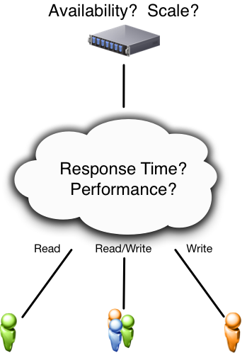
Simple Client/Server

Slide 3
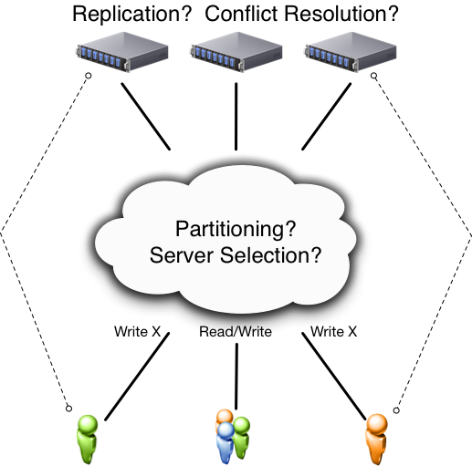
Distributed System

Slide 4
Agenda
Background and problem definition
Methods of synchronization
Operation-based consistency
State-based consistency
Algorithms, pseudo-code, and examples
Data types (graph, set, counter)
Demo

Slide 5
Conflicts and Resolution
Partition A receives update(X_{a})
Partition B receives update(X_{b})
How to merge competing updates?
Timestamp?
Last-writer-wins?
Solution may be imperfect (i.e. a loser)
Some data-types are conflict-free!

Slide 6
Replication
Availability is desirable
Fault-tolerance is desirable
Low latency (high-performance) is desirable
Maintaining consistency can be difficult

Slide 7
Key Concepts to Review
Strong consistency
Eventual consistency
Conflict arbitration
Consensus and rollback
CAP problem (pick 2)
Consistency
Availability
Partition Tolerance

Slide 8
Strong Consistency
Everyone knows about every update immediately
There is an order for all operations
Everyone sees the same order
Bottlenecks:
Consensus problem
Makes the system sequential
Slow, not scalable
Tolerates < n/2 failures

Slide 9
Eventual Consistency
Update local + propagate
All updates eventually take effect at all replicas, asynchronously and possibly in different orders
Concurrent updates may conflict
Still needs consensus
Conflict -> reconcile
Moved consensus off the critical path (background)
Better performance, more complex
May come at the cost of availability when synchronizing!
Notes:
replicas converge toward the same state in finite time
eventual consistency means that replicas eventually reach the same final value if clients stop submitting updates

Slide 10
Strong Eventual Consistency
Update local + propagate
A replica of the shared data structure is coherent with other replicas that have observed the same operations
No synchronization (no consensus)
Deterministic outcome for every conflict
Allow any number of failure

Slide 11
Origin Story
2011 publication by Marc Shapiro, et al.
Strong consistency does not scale
Eventual consistency is better, but…
Concurrent conflict resolution is hard
Therefore, strong eventual consistency

Slide 12
CRDT
Conflict-free
Replicated
Data Type

Slide 13
CRDT Key Ideas
CRDT: a simple, theoretically sound approach to eventual consistency
Replicas of any CRDT converge to a common state that is equivalent to some correct sequential execution
Properties:
No synchronization
Update executes immediately
Unaffected by network latency, faults, or disconnection
Extremely scalable
Fault-tolerant
Does not require much mechanism

Slide 14
Data-type (in CRDTs)
Data structures that ease consistency
Eliminates complexity of consensus
Data or operations must be commutative

Slide 15
Definitions
EC:
Eventual delivery: An update delivered at some correct replica is eventually delivered to all correct replicas: ∀i,j : f ∈ ci ⇒ ♦f ∈ c
Termination: All method executions terminate
Convergence: Correct replicas that have delivered the same updates eventually reach equivalent state: ∀i,j : ci = cj ⇒ ♦ si ≡ sj
SEC
Strong Convergence: Correct replicas that have delivered the same updates have equivalent state: ∀i,j : ci =cj ⇒si ≡sj

Slide 16
System model
Processes interconnected by an asynchronous network
The network can partition and recover
Non-byzantine processes
crash silently
may remain crashed forever
or may recover with its memory intact
Notes:
consider

Slide 17
Query and Update
Clients send query to read replica’s local state
Read only -> easy
Updates are more complicated:
Perform the operation at the source replica
Transmit the update asynchronously to other replicas
client
S
s1
s2
S2.q(a)
Notes:
Clients of an object may read

Slide 18
Replication Types
Two approaches to perform updates:
Operation-based
Operation: add 5, subtract 6
State-based
State: send(x_{i}), send(x_{i}+1)

Slide 19
State-based approach
Local replica (p1)
Local queries
updates local state
Periodically send(p1_state)
Receiver replica(s)
perform merge(p1_state, p2_state)
File systems (NFS, Unison, Dynamo)
S
s1.u(a)
s1
s1
s2
s2.m(s1)

Slide 20
state-based object
Tuple: (S, s⁰, q, u, m)
Replica at process p_{i} has state s_{i} ∈ S
Initial state is s⁰
q = query
u = update
m = merge
Notes:
An object is a tuple

Slide 21
State-based Convergence
all the replicas talk to each other directly on indirectly
if it converges it will satisfy the strong eventual consistency
What is the sufficient condition for it to converge?
Notes:
Eventual delivery
Termination
Convergence

Slide 22
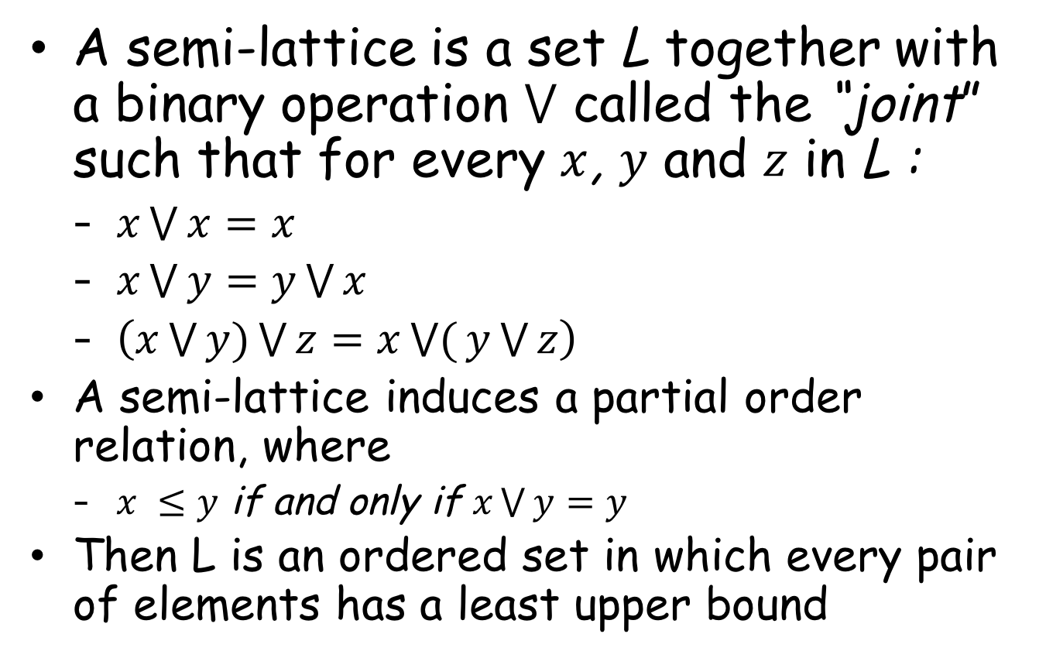
Semi-lattice
A semi-lattice is a set L together with a binary operation $⋁$ called the “joint” such that for every $x$, $y$ and $z$ in L :
$x\bigvee{x=x}$
$x\bigvee{y=y\bigvee{x}}$
$\left(x\bigvee{y)\bigvee{z}=x\bigvee{(}y\bigvee{z}}\right)$
A semi-lattice induces a partial order relation, where
$x ≤y$ if and only if $x\bigvee{y=y}$
Then L is an ordered set in which every pair of elements has a least upper bound
Notes:
idempotent commutative semigroup/associative
least upper bound
is a partial order ≤ equipped with a least upper bound (LUB) ⊔ for all pairs

Slide 23

State-based Convergence
If the payload forms a semilattice
Partial order of values
Always can take upper bound on two values
If updates are increasing in semilattice
Always give a higher value in partial order
If merge function computes this upper bound
CvRDT: Convergent Replicated Data Type
$$⟹$$
replicas converge to LUB of last values
Notes:
(partial order on values, always can take an upper bound)
A type with these properties will be called a

Slide 24
State-based counter example
S
Plus 5
Plus 4
s1
{}=0
{s1:5}=5
{s1:9}=9
{s1:9,s2:3}=12
Plus 3
s2
{}=0
{s1:5}=5
{s1:5,s2:3}=8
{s1:9,s2:3}=12

Slide 25
Another state-based example
Out of order delivery
S
Plus 5
Plus 4
s1
{}=0
{s1:5}=5
{s1:9}=9
{s1:9}
{s1:5}
s2
{}=0
{s1:9}=9
{s1:9}=9

Slide 26
Operation-based approach
Local replica sends operation
Only updates are sent (smaller)
Receiver replicas
replay the updates on their local states
Collaborative editing, Bayou, PNUTS
Need something stronger!
S
s1.u(a)
s1
a
s2
S2.u(a)

Slide 27
op-based object
Tuple: (S, s⁰, q, t, u, P)
S, s⁰ and q same as state-based object
Replica at process p_{i} has state s_{i} ∈ S
Initial state is s⁰
t = side-effect-free prepare-update
u = effect-update
P = delivery precondition
Notes:
prepare-update executes at the source replica
The effect-update method executes at all replicas
one that delivers every message to every recipient exactly once and in an order consistent with happened-before

Slide 28
Op-based Convergence
Data that commutes is a key property
e.g. add A, add B == add B, add A
Not all ops or states are commutative
e.g. multiple 5, subtract 6 != subtract 6, multiply 5
Updates should be commutative operations
CmRDT: Commutative Replicated Data Type

Slide 29
Op-based counter example
S
Plus 5
Times 2
s1
0
10
14
5
Plus 5
Plus 4
Times 2
Plus 4
s2
0
5
9
18
(5 + 4) × 2 ≠ (5 × 2) +4
Reconcile non-commutative operations
Notes:
as opposed

Slide 30
State vs Op-based
state-based:
Update and merge
Simple data types
Not efficient for large objects
Operation-based:
Update
More complex
More powerful
Small messages
They are equivalent
you can take any state based object and emulate it in an op-based model and if one converges the other converges

Slide 31
Sharded CRDT
Combination of independent CRDTs -> CRDT
Independent CRDTs still commute
Static partitions
Sharded CRDT
Static sharding
Each shard is a CRDT

Slide 32
CRDTs
Registers
Last writer wins
Sets
Observed-remove
Map
Set of registers
Counter
Unlimited
non-negative
Sequence
Concurrent editing

Slide 33
Multi-master Counter
State-based
Increment/decrement
Vector of counters C = [int, int, …]
C’ = [int, int, …]
One per replica (master)
value -> ∑C[i] - ∑C’[i]
Increment -> C[replica]++
C’[replica]++
update(s1,s2) -> [… max(s1.C[i],s2.C[i]) …]
[… max(s1.C’[i],s2.C’[i]) …]
Notes:
Incremental feature ensures that we have partial order and all updates are going forward in the partial order

Slide 34
Set
Operations
add(e)
remove(e)
Concurrent add(e) || remove(e)
User’s decision
Last writer wins
add always wins
remove always wins

Slide 35
Observed-Remove Set
State-based
add wins
Optimization:
Using vector clocks
Operation-based
remove(e)
{e2, e1}
s1
add(e)
{e1}
{e1}
{e2}
s2
add(e)
{e2}
{e2}
{e1}
{e1}
s3
{e2}
{e2, e1}
{e2, e1}

Slide 36
Graph
Graph G = (V,E)
addEdge(v,v’) -> if v and v’ in V
removeVertex(v) -> if no edge uses v
Notes:
getting rid of tombstones

Slide 37
JSON
Recent work
Conflict-free replicated JSON data type
JSON
Map
List
{“key1”: Map, “key2”: List, “key3”: value}
Nested CRDTs
Notes:
getting rid of tombstones

Slide 38
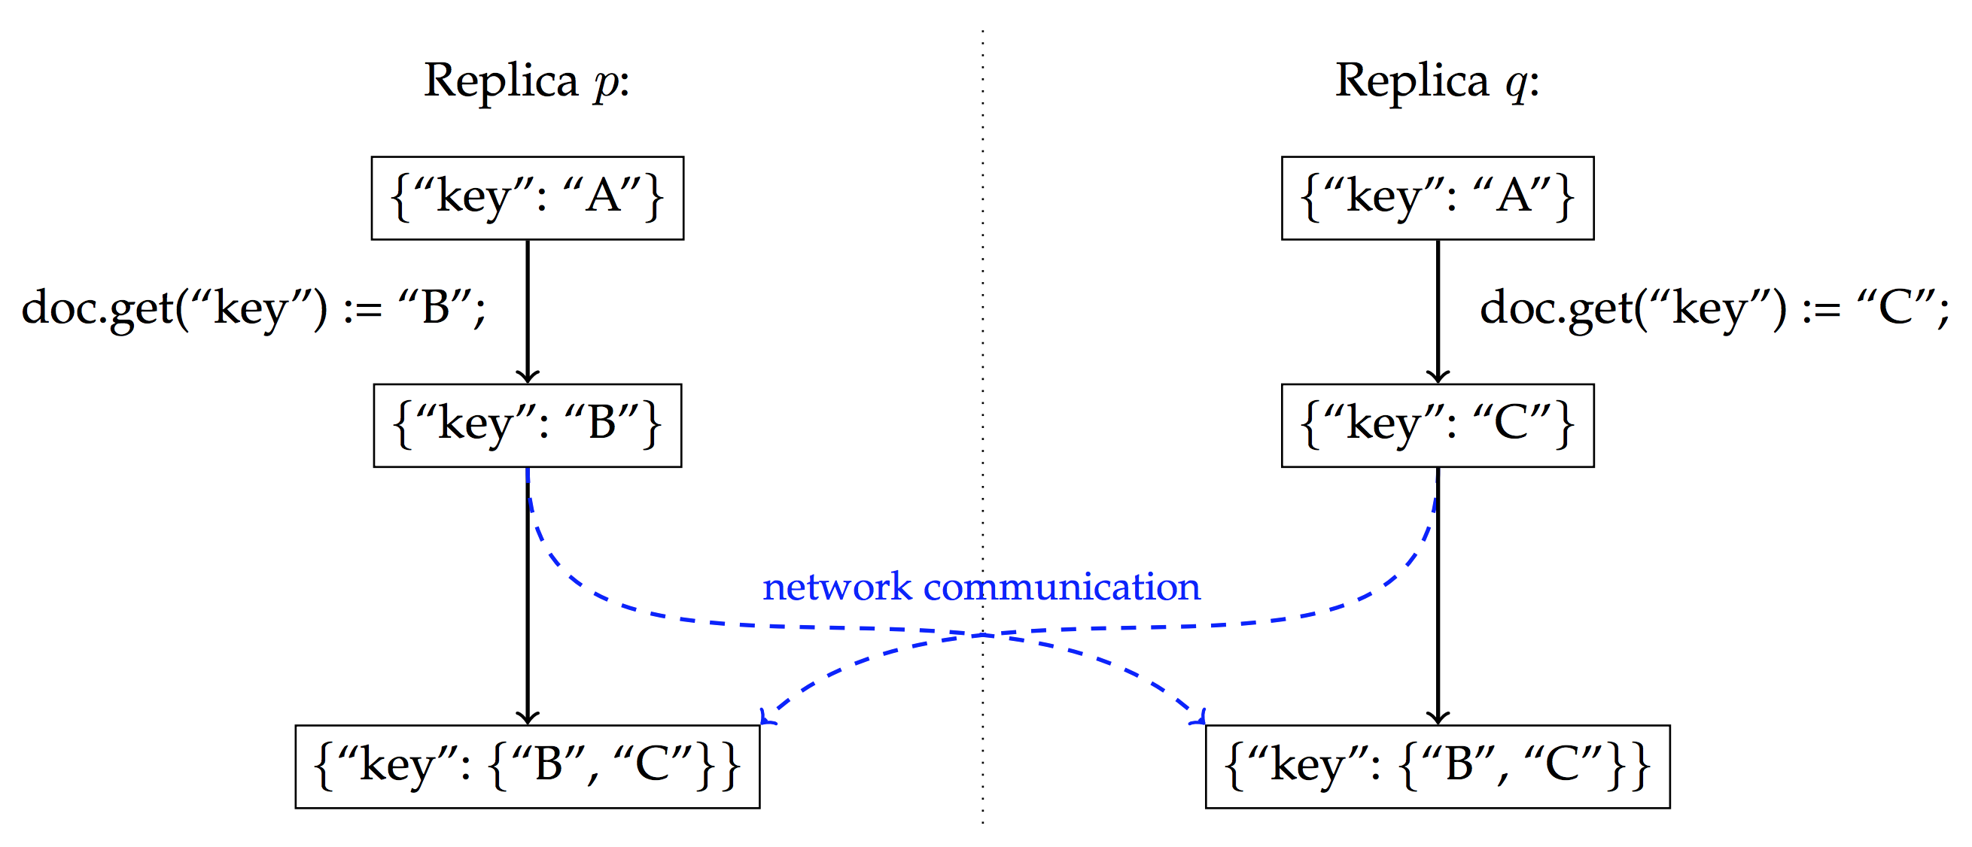
JSON CRDT
multi-value register
M. Kleppmann and A. R. Beresford, “A conflict-free replicated json datatype,” IEEE Transactions on Parallel and Distributed Systems, vol. 28, no. 10, pp. 2733–2746, Oct 2017
Notes:
getting rid of tombstones

Slide 39
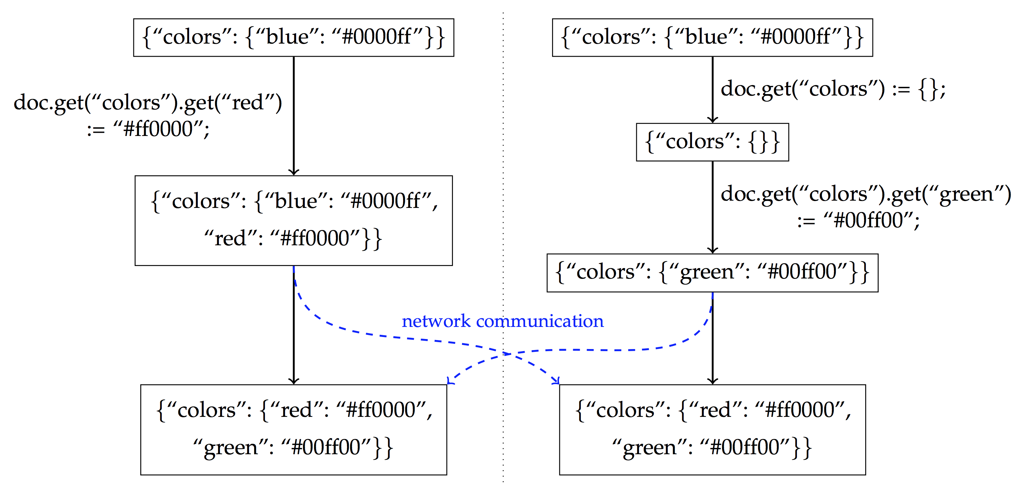
JSON CRDT
M. Kleppmann and A. R. Beresford, “A conflict-free replicated json datatype,” IEEE Transactions on Parallel and Distributed Systems, vol. 28, no. 10, pp. 2733–2746, Oct 2017
Notes:
getting rid of tombstones

Slide 40
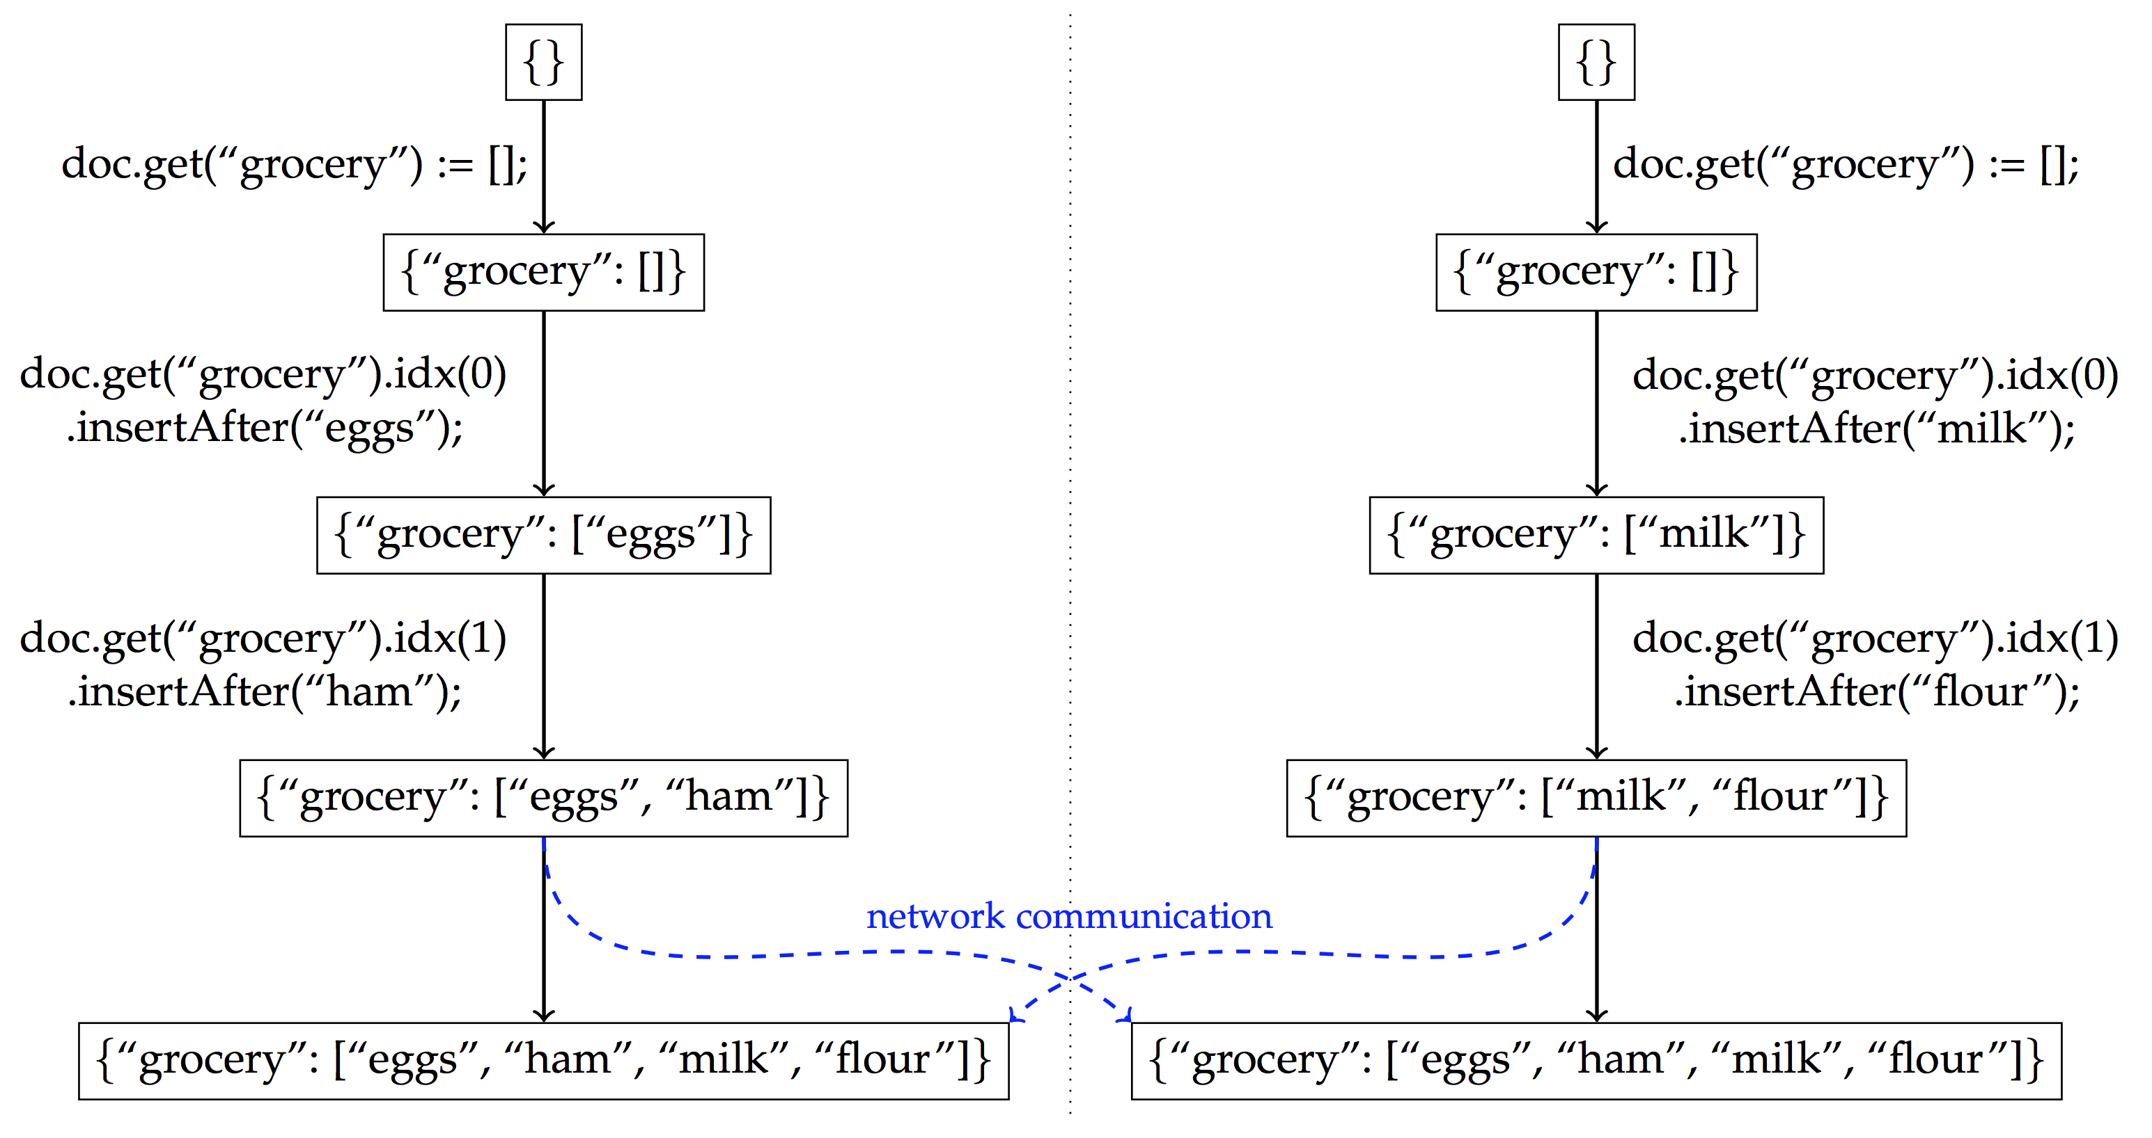
JSON CRDT
M. Kleppmann and A. R. Beresford, “A conflict-free replicated json datatype,” IEEE Transactions on Parallel and Distributed Systems, vol. 28, no. 10, pp. 2733–2746, Oct 2017
Notes:
getting rid of tombstones

Slide 41
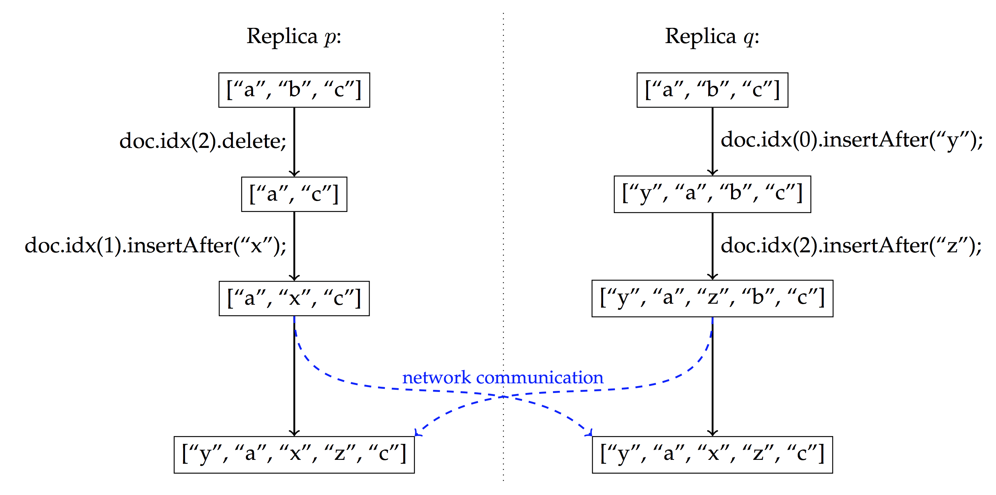
JSON CRDT
M. Kleppmann and A. R. Beresford, “A conflict-free replicated json datatype,” IEEE Transactions on Parallel and Distributed Systems, vol. 28, no. 10, pp. 2733–2746, Oct 2017
Notes:
getting rid of tombstones

Slide 42
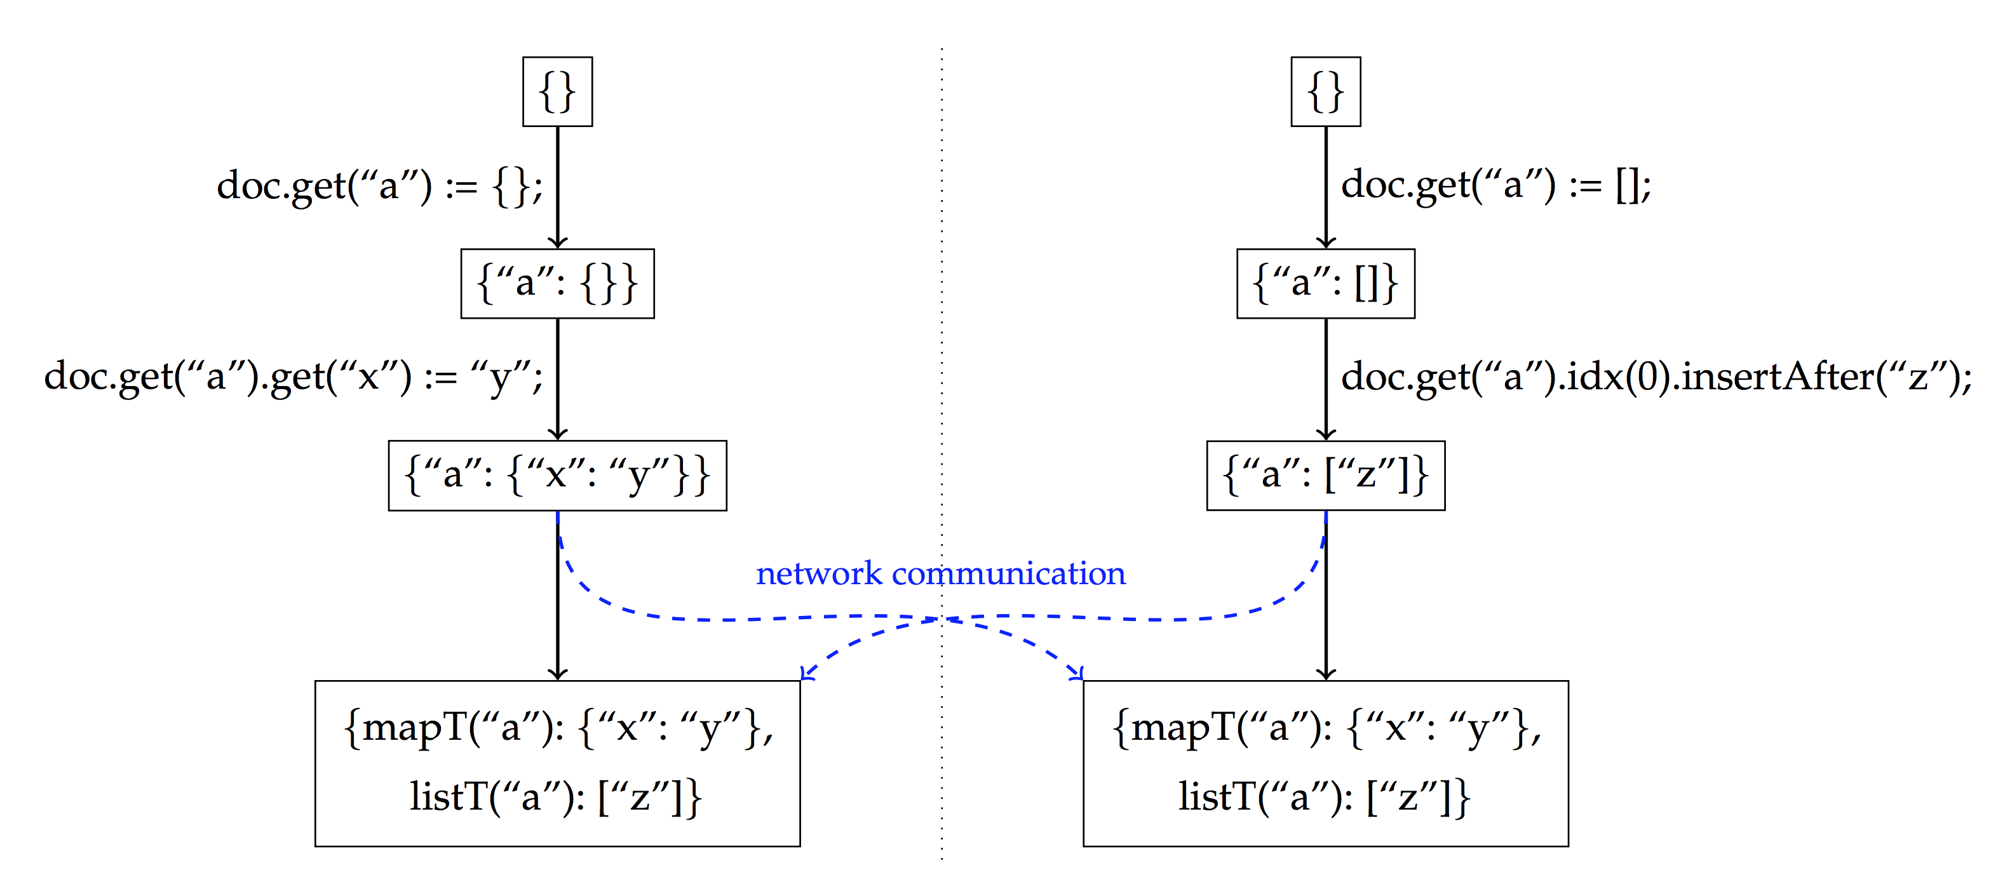
JSON CRDT
M. Kleppmann and A. R. Beresford, “A conflict-free replicated json datatype,” IEEE Transactions on Parallel and Distributed Systems, vol. 28, no. 10, pp. 2733–2746, Oct 2017
Notes:
getting rid of tombstones

Slide 43
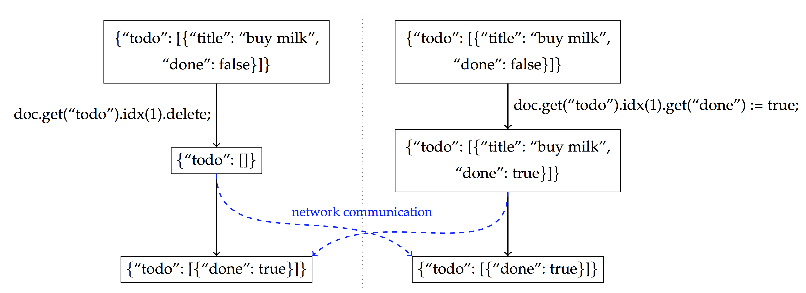
JSON CRDT
M. Kleppmann and A. R. Beresford, “A conflict-free replicated json datatype,” IEEE Transactions on Parallel and Distributed Systems, vol. 28, no. 10, pp. 2733–2746, Oct 2017
Notes:
getting rid of tombstones

Slide 44
Concurrent Editing
Multiple users concurrently editing a document
Google Docs, Wikipedia, Git, SVN
Centralized
Decentralized, peer-to-peer networks
CRDT
Main challenge
Intention preservation
Tombstones
Demo!
Notes:
getting rid of tombstones

Slide 45
CRDT in Action
SoundCloud
Bet365
Redis
Riak
League of Legions
orbit-db
Atom’s Teletype-CRDT

Slide 46
References
https://pages.lip6.fr/Marc.Shapiro/
https://www.youtube.com/watch?v=ebWVLVhiaiY
https://www.youtube.com/watch?v=vBU70EjwGfw
https://en.wikipedia.org/wiki/Conflict-free_replicated_data_type

