Slide 1
powerpoint
images

Slide 2
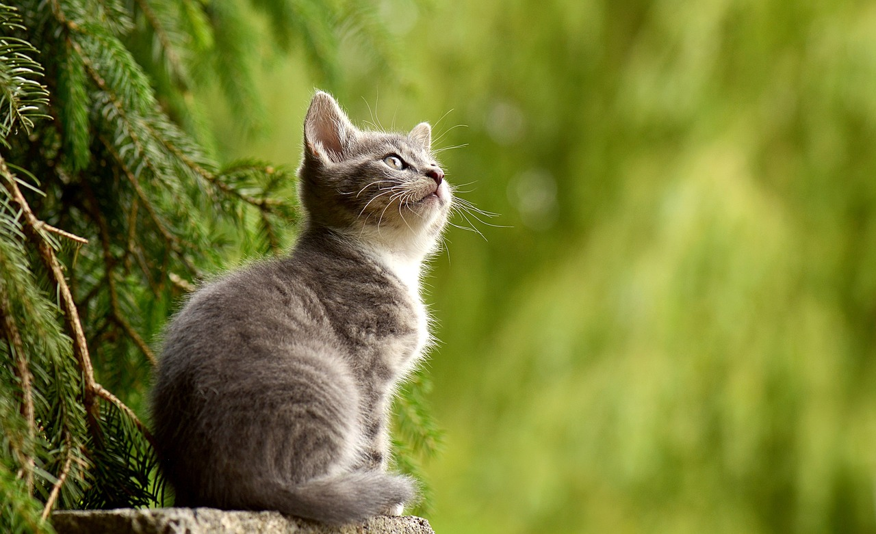
Output (I) - 2 images

Slide 3
Output (II) - 2 images

Slide 4
Output (III) - 1 image
Hello there

Slide 5
Output (IV) - 1 image
Hello there

Slide 6
Output (V) - no image
Hello there Hello there Hello there Hello there Hello there Hello there Hello there Hello there
How ya doin How ya doin How ya doin How ya doin How ya doin How ya doin How ya doin How ya doin

Slide 7
Output (VI) - no image from Quarto.org
contents…
contents…

