Slide 1
R for Authoring!!
PSP Session #3

Slide 2

Problem-Solving Panel (December 21, 2023)
Recap session #2 ↪️
Focal issue: 🤔
pptx figure control
ggpubr::ggarrange
cowplot::plot_grid
gridExtra::
Shared problem-solving

Slide 3
Recap of Session #2:

Slide 4
Desired .pptx Figure locations:

Slide 5
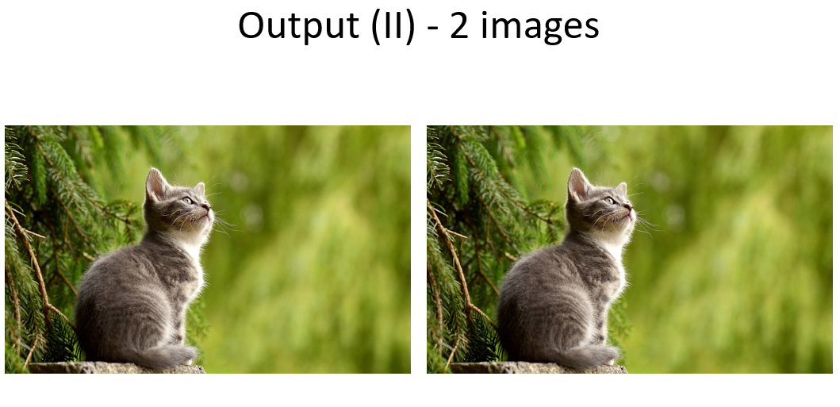
pptx column specification:
Code:
:::: {.columns} ::: {.column width="40%"} ![](https://cdn.pixabay.com/photo/2017/02/20/18/03/cat-2083492_1280.jpg) ::: ::: {.column width="60%"} ![](https://cdn.pixabay.com/photo/2017/02/20/18/03/cat-2083492_1280.jpg) ::: ::::
Output:

Slide 6
Yabut…
column width command nonfunctional, &
built-in capability limited to two columns
Pandoc layout requirements
So Howbout:
gridExtra ❓❓❓
parmf(row) ❓❓❓
play with .pptx “template” ❓❓❓
Multiple images within columns (stacked)

Slide 7
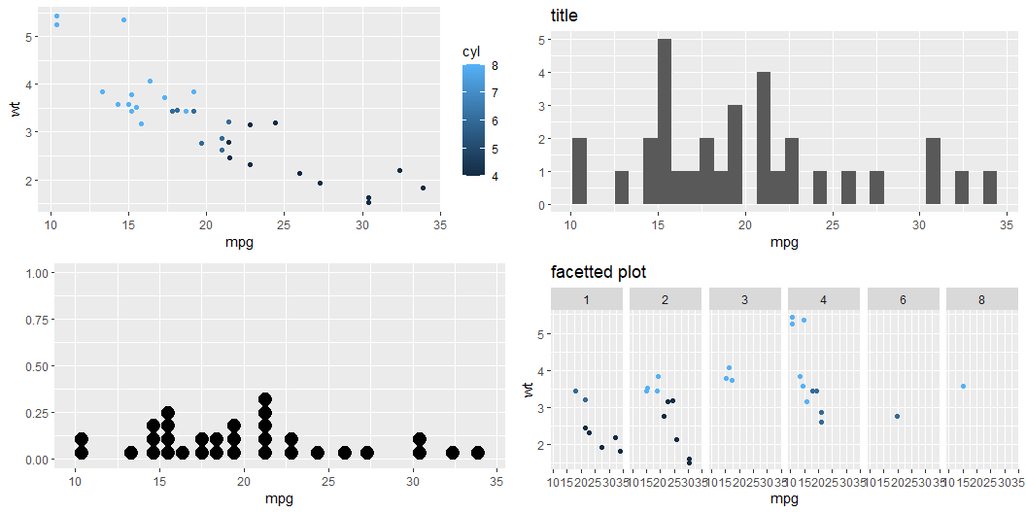
ggpubr:

Slide 8
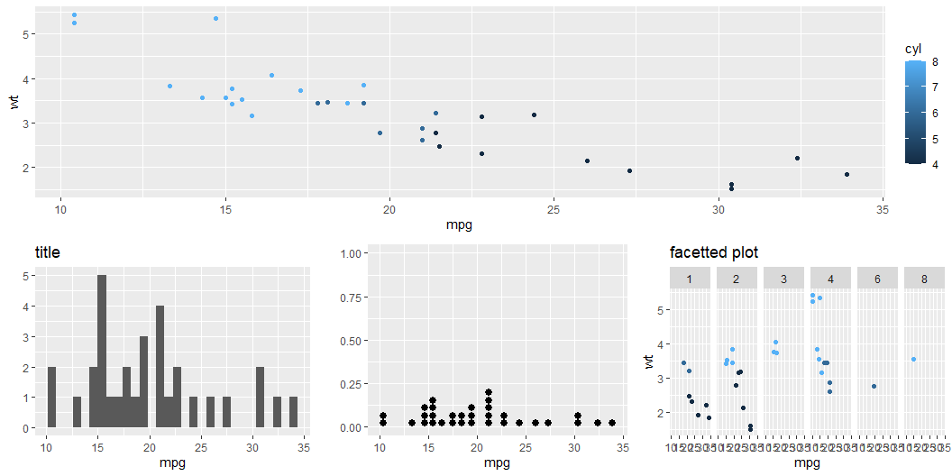
gridExtra:

