Slide 1
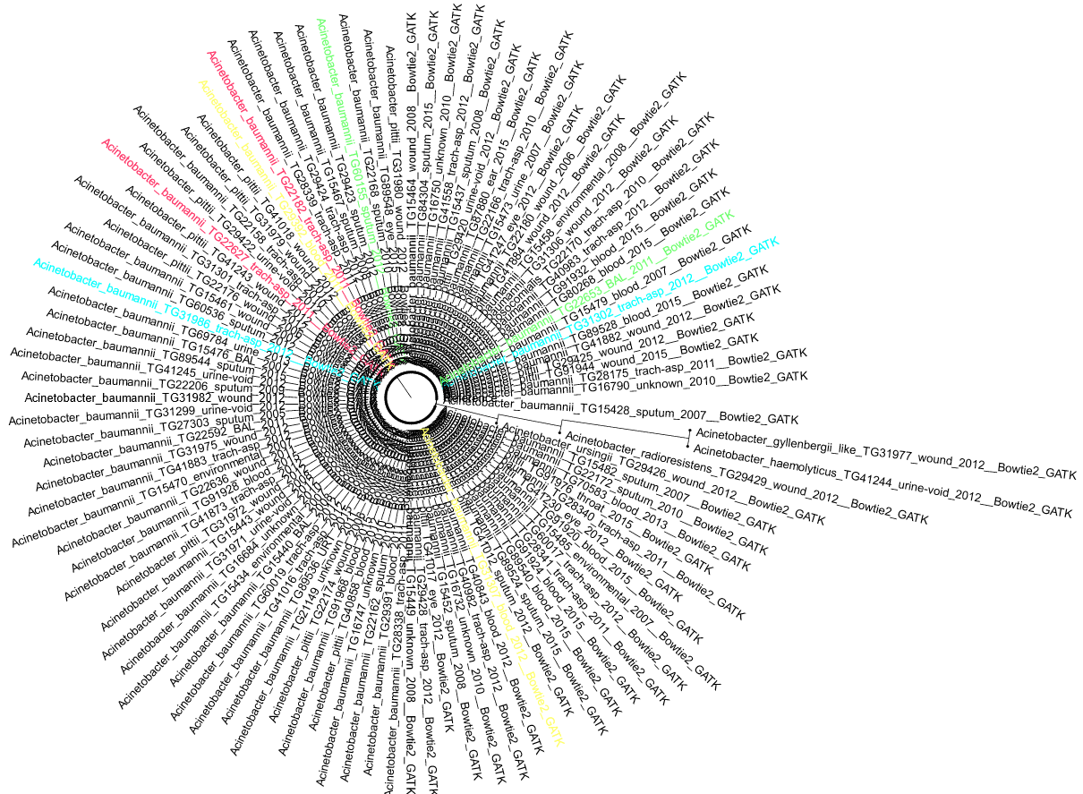
Acinetobacter Transcript analysis
From RNA-seq →Spades alignment →Kallisto to quantify transcripts.

Slide 2
AB Resistance Profiling Methods
Resistance Profiling
MIC of ### isolates with 12 antimicrobials
Paired isolates ID
Isolates differentially susceptible to particular antimicrobials discovered
RNA-seq
Transcriptomics performed to discover differentially expressed RNA causing resistant phenotype
Notes:
Computational Protocol
Short read data aligned to complete genome with BWA-MEM and NASP.
All isolates were treated with cefepime (PM), cefuroxime (XM), gentamicin (GM), ceftazidime (TZ), trimethoprim (TR), azithromycin (AZ), ceftriaxone (TX), aztreonam (AT), erythromycin (EM), piperacillin (PP), levofloxacin (LE), and ciprofloxacin (CI) to generate a resistance profile
6 paired isolates with variable resistance profiles were further investigated.
Each isolate pair used to generate 3 libraries… susceptible in LB, resistant in LB, and resistant in LB + sub MIC.

Slide 3
Comparisons
Untreated Resistant vs. Untreated susceptible.
Untreated Resistant vs. Treated Resistant.
Treated Resistant vs. Untreated susceptible.

Slide 4
File Parsing
File contains Paired Isolate data.
Khead_table = abundance of transcripts for each isolate
S_table = Statistical analysis comparing isolate data.
22182vs22627 folder = raw kallisto data. Has abundance.tsv files for each bioreplicate of each isolate.
Organize data by Paired isolate→ Extract data from 2 or more tsv files and generate a single dataframe.
Khead_table
Calculate mean and standard deviation of bioreplicates for each transcript ID ACS-TG22182aTX-xx-uu-USA-xxxx-077-JB_S3, ACS-TG22182bTX-xx-uu-USA-xxxx-077-JB_S3, ACS-TG22182cTX-xx-uu-USA-xxxx-077-JB_S3
S_table
P-value and Q-value for each transcript id
Export to new dataframe. Calculate difference in mean abundance (22182-22627) for each transcript.

